Slide 1
ClinicalTrials.gov for Librarians
Network of the National Library of Medicine
Erica Lake
July 30, 2025

Slide 2
Agenda
Overview of clinical research and ClinicalTrials.gov
Live demonstration of ClinicalTrials.gov
Class exercise and Q & A

Slide 3
What is a Clinical Study?
A research study involving human volunteers (also called participants) that is intended to add to medical knowledge.

Slide 4
Clinical Trials and Observational Studies

Slide 5
6 Points about Clinical Trials
Informed consent is an ongoing process
Research happens in many ways
Health care continues for participants
Health problems are reported
Researchers collect data
Researchers analyze the data

Slide 6
Public Benefits of Access to Clinical Trials Information
Helps meet ethical obligations
Informs future research
Mitigates information bias
Evaluates research integrity
Prevents duplication of unsafe interventions
Provides access to data
Enhances patient access

Slide 7
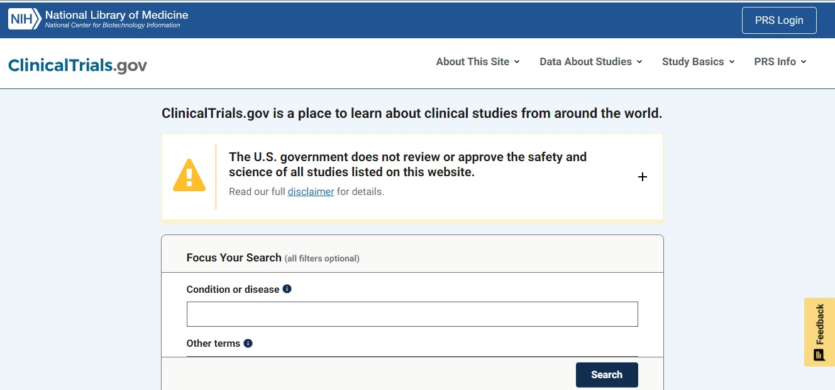
What is ClinicalTrials.gov?

Slide 8
Sponsors and Investigators are Responsible for the Data
ClinicalTrials.gov provides access to study data, but does not own the data.
NIH and NLM do not review or approve the safety and science of the studies listed in the database.

Slide 9
Who Does Clinicaltrials.gov Serve?
EXTERNAL
INTERNAL
Patients and their advocates
Data submitters
Data researchers
Policy and oversight teams
Information specialists, reviewers, librarians, and developers

Slide 10
Which groups will you support?
Patients and Advocates
Data Submitters
Researchers

Slide 11
Patients and Advocates
Centralized place to search for trials
Comprehensive list of ongoing trials
Supporting materials and educational information

Slide 12
Data Submitters
PRS: Protocol Registration and Results System
PRS is the submission database of ClinicalTrials.gov

Slide 13
Researchers
Search for information on current and completed trials
Review study protocols
Research trends
Data analysis

Slide 14
Librarians and ClinicalTrials.gov
Information retrieval
Systematic reviews
Guide patients
Education and training

Slide 15
Librarian’s Advocacy Role
Education
Guidance
Collaboration
Promotion

Slide 16
Problems with Reporting Evidence
Selective publication
Misrepresented data
Underreported data

Slide 17
Milestones for Registration and Result Reporting Requirements
2005: International Committee of Medical Journal Editors (ICMJE) requires trial registration for publication
2007: FDA Amendments Act Section 801 expands information that must be submitted
2017: Final Rule and Other Regulations Applied

Slide 18
Final Rule
Checklist
Scope of trials
Additional data elements
Additional adverse event information
Potential legal consequences

Slide 19
Potential Penalties for Not Submitting
Notice of non-compliance
Civil monetary penalties up to $10,000 per day
Withholding of NIH grant funds

Slide 20
Challenges in Submitting Results
Lack of awareness
Lack of detailed knowledge
You can contact ClinicalTrials.gov via email
register@clinicaltrials.gov

Slide 21
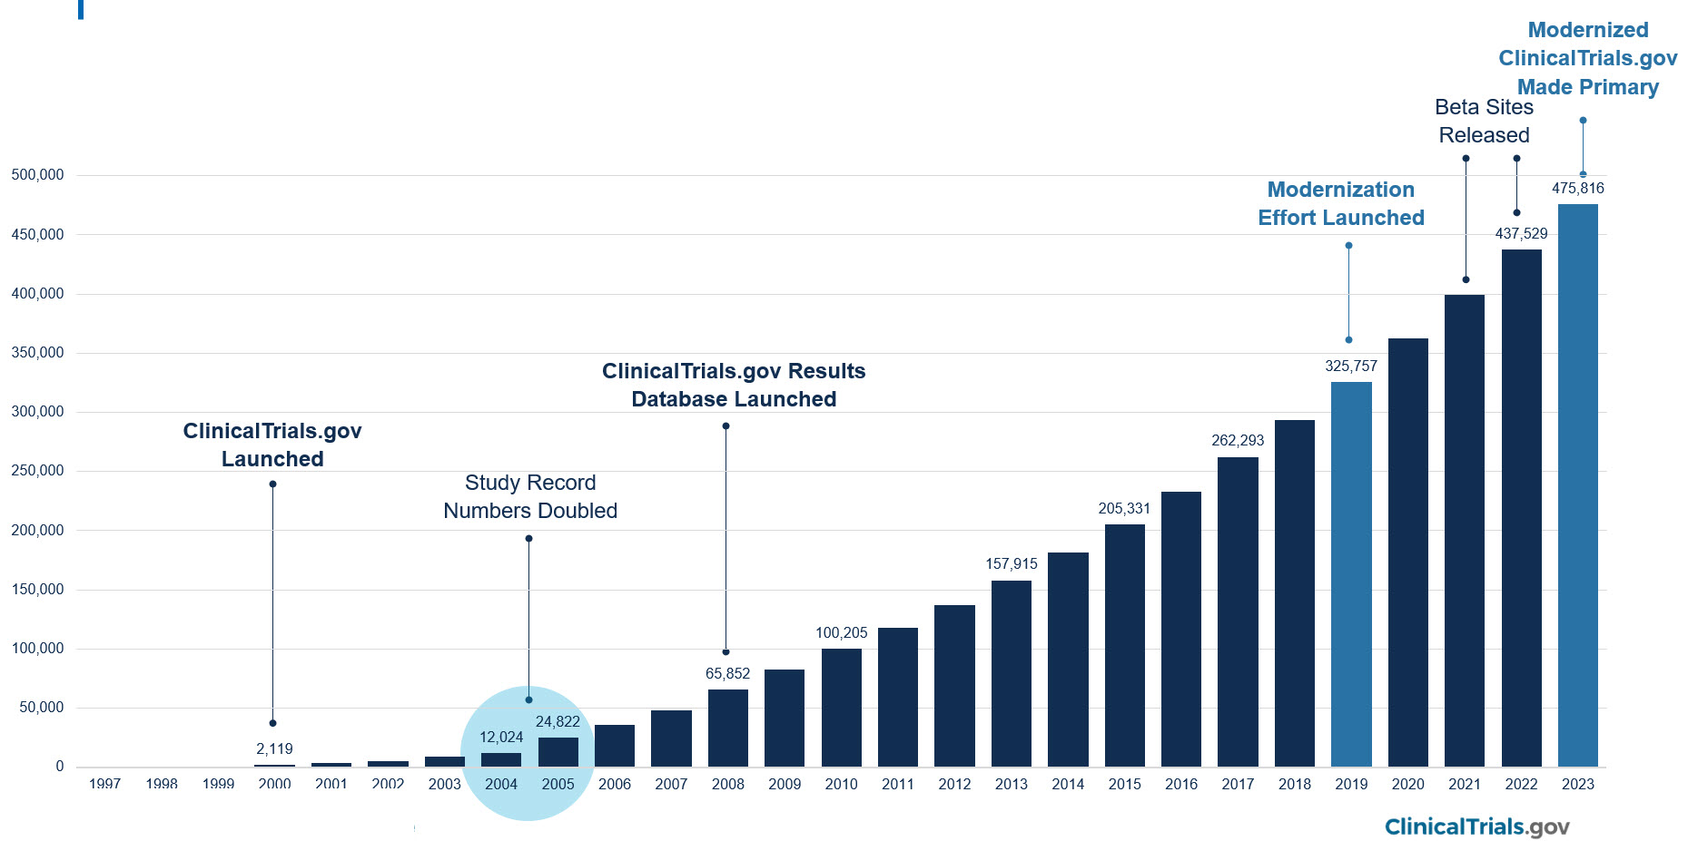
Growth of ClinicalTrials.gov

Slide 22
Live ClinicalTrials.gov Search Demo
Overview of the home page
Performing a Basic Search
Using filters and handy search tips
Research Case Scenario
Notes:
A basic search on Breast Cancer with Vitamin D as the intervention.
We will look at a sample study. I will do a filtered search on location, and you will have a chance to search for actively recruiting studies in your nearest city. Then, I will give you a research case study using virtual reality with burn patients. And we will finish up with finding PubMed citations using the secondary source ID field tag [si]. You won’t want to miss this tip!
Your Turn: Use filters to Find a Trial Actively Recruiting in Your State
Researcher Search: Using Virtual Reality with Burn Patients
Finding PubMed Citations Using [si] Field Tag
You won’t want to miss this last search tip!

Slide 23
Class Exercise: Research Case Scenario
A trauma center is interested in designing a study examining the use of virtual reality (VR) with adult burn patients during wound dressing changes.
The research team recalls hearing about a couple of studies that utilized VR, but don’t know if the studies looked at pain reduction, anxiety, medication, or some combination.
The team wants to know what similar research has been done or is currently being conducted.

Slide 24
Thank You!
Funded by the National Library of Medicine. NLM and NNLM are service marks of the US Department of Health and Human Services.

