Slide 1
Health Programming at Your Library
Jamia Williams, MLS
Consumer Health Program Specialist
Network of the National Library of Medicine
Training Office
jamia.williams@utah.edu
Image by pixabay
This work was supported by the National Library Of Medicine of the National Institutes of Health under Award Number UG4LM013732. The content is solely the responsibility of the authors and does not necessarily represent the official views of the National Institutes of Health.
Notes:
Welcome to Health Programming at Your Library
(Introduce self)

Slide 2
Webinar Information Items
Evaluation at the
end of the session
Up to 30 days to
receive session recording
Feel free to use the chat
Live captioning is
available today
Notes:
All attendees are muted upon entry to the webinar. Please enter any questions and comments you have into the chat box.
During the next 90 minutes, I will ask a few questions. Please use the chat box to share your thoughts and ideas!
A full resource list with links to everything we are covering (and more) is available on the class handout. We will also drop the link into the chat box.
1) Before we start, you might want to locate and open the chat box. It’s closed by default. Look for the chat bubble icon on the bottom of your screen.
2) We’ll provide a link to the evaluation at the end of the session. Completing the evaluation is the first step to claiming MLA CE.
3) We have live captioning available today. You can find it in the Multimedia panel located near the Chat panel. You may need to scroll down in the box and click Continue to start the live caption stream.
4) We’re recording today’s session. It takes up to 30 days to edit and caption the video. We’ll send the link to the recording to all registrants when it’s available.

Slide 3
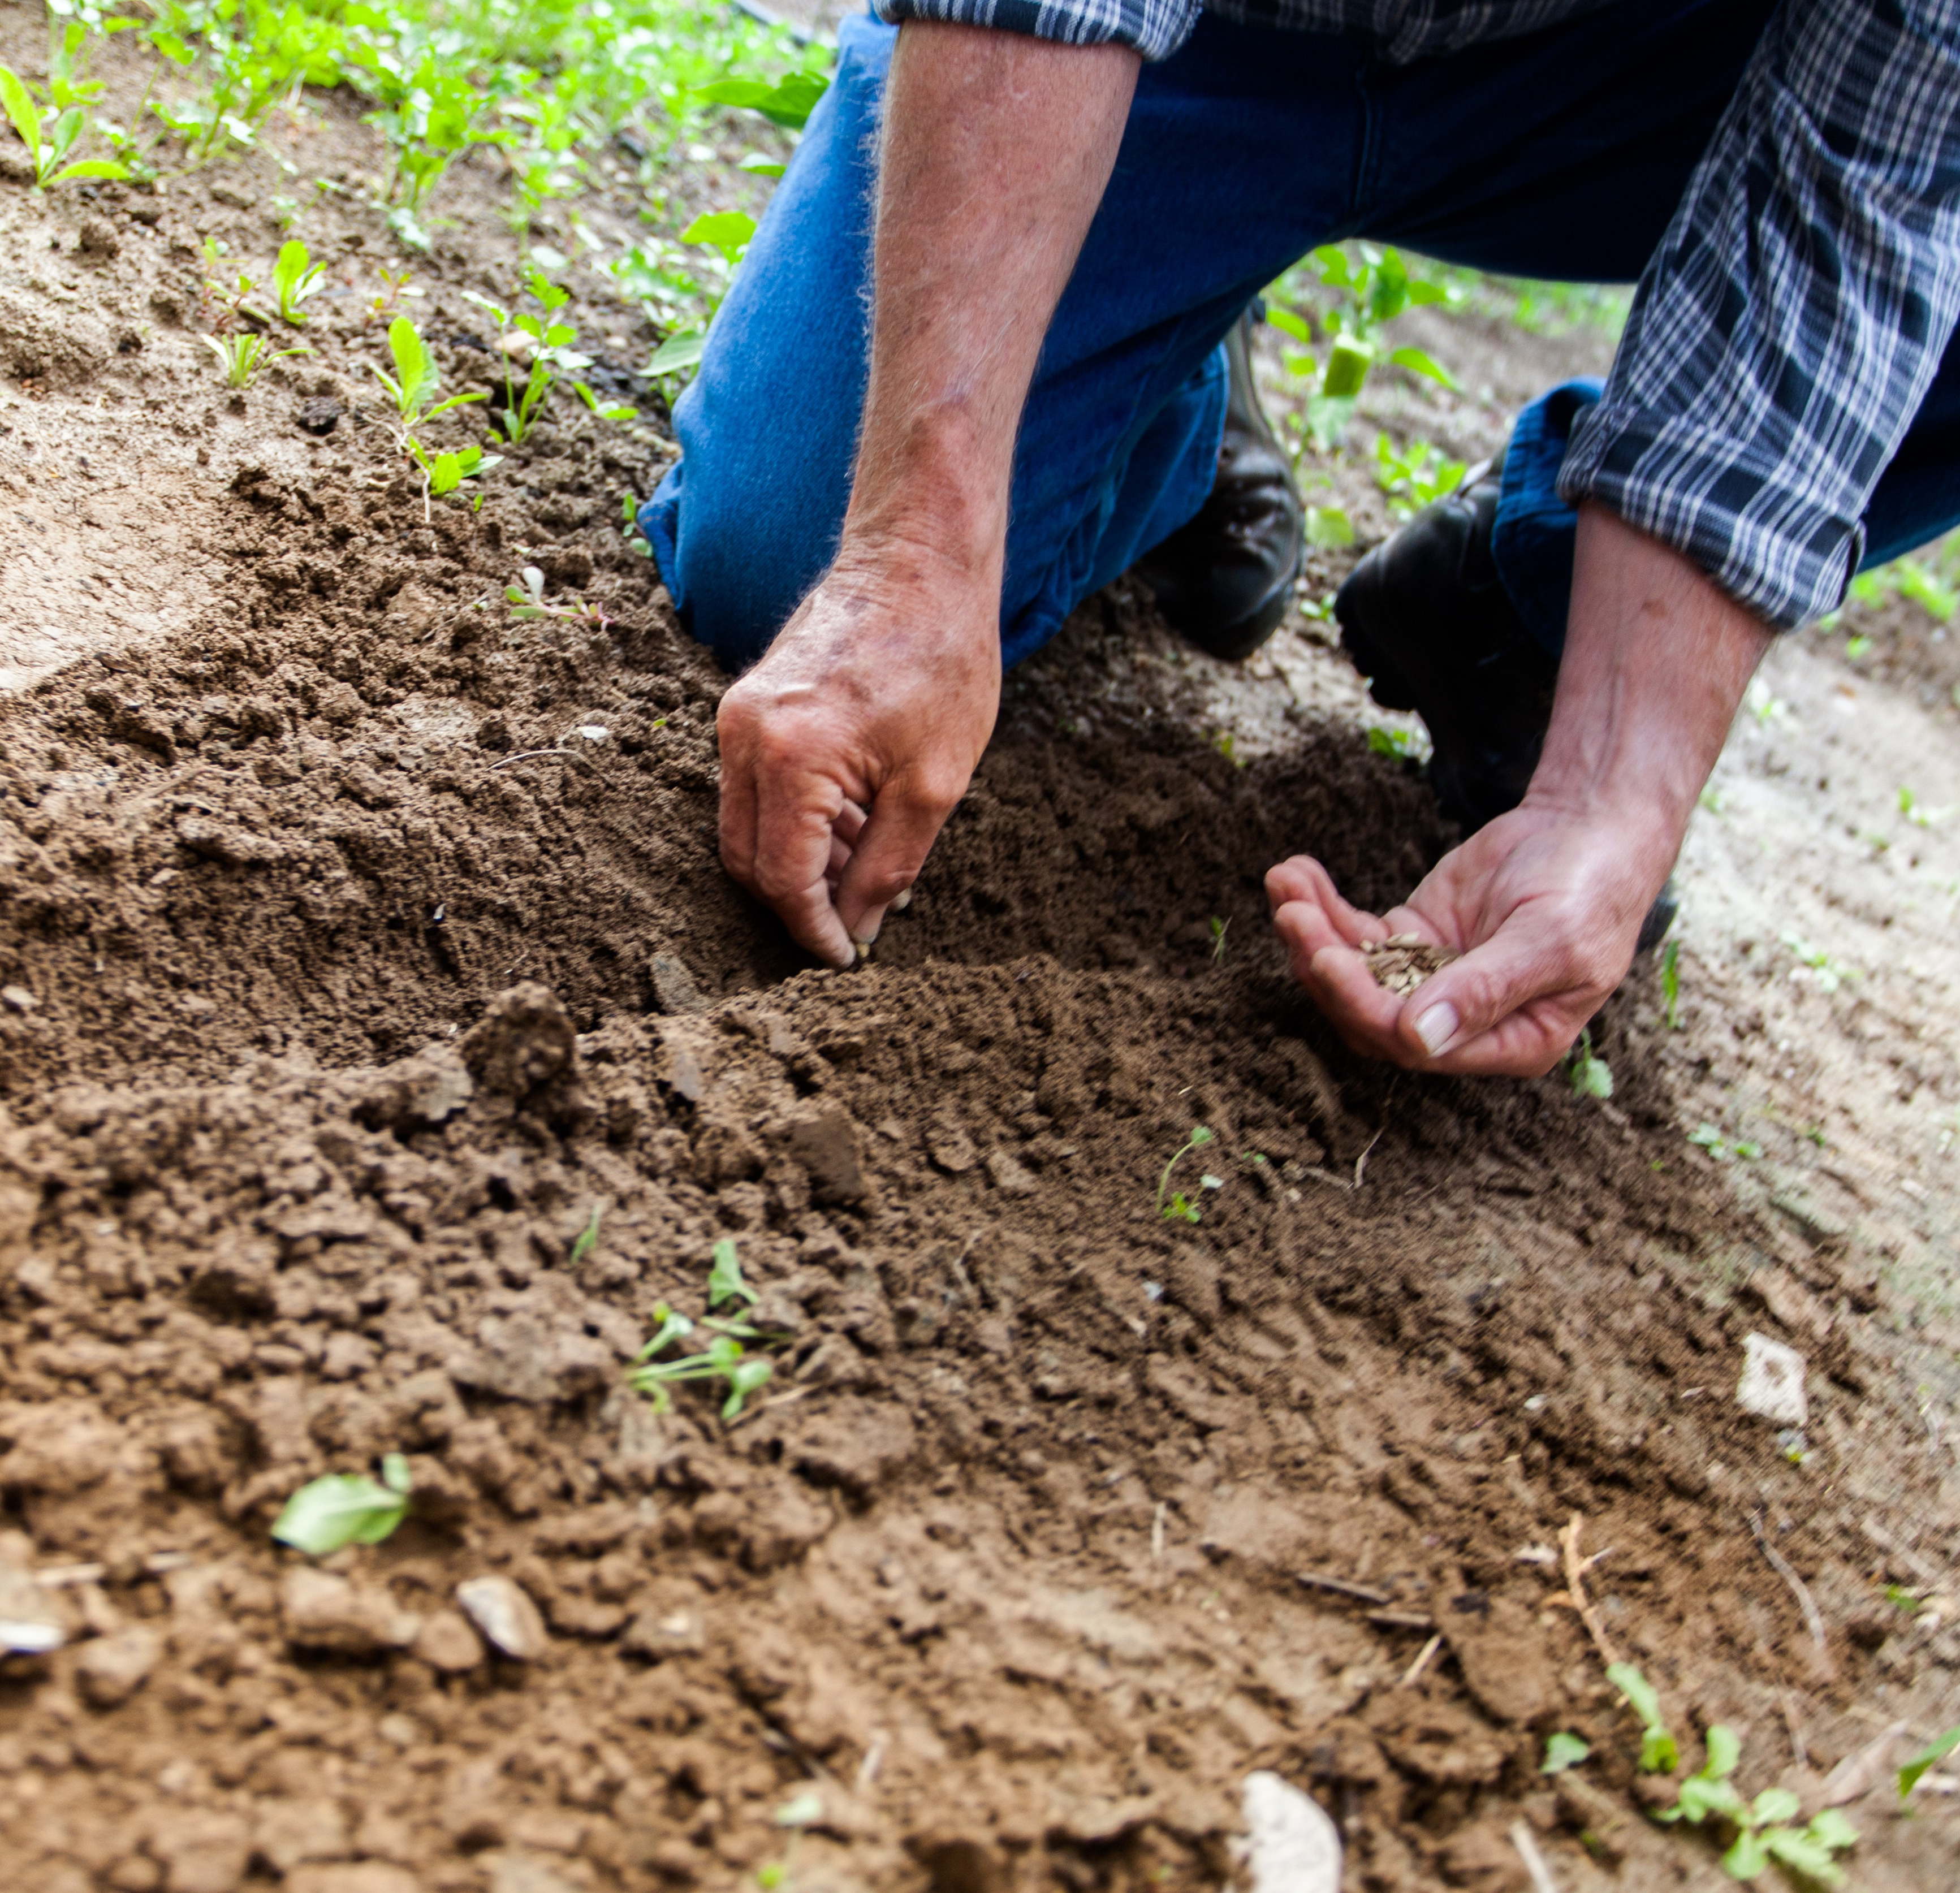
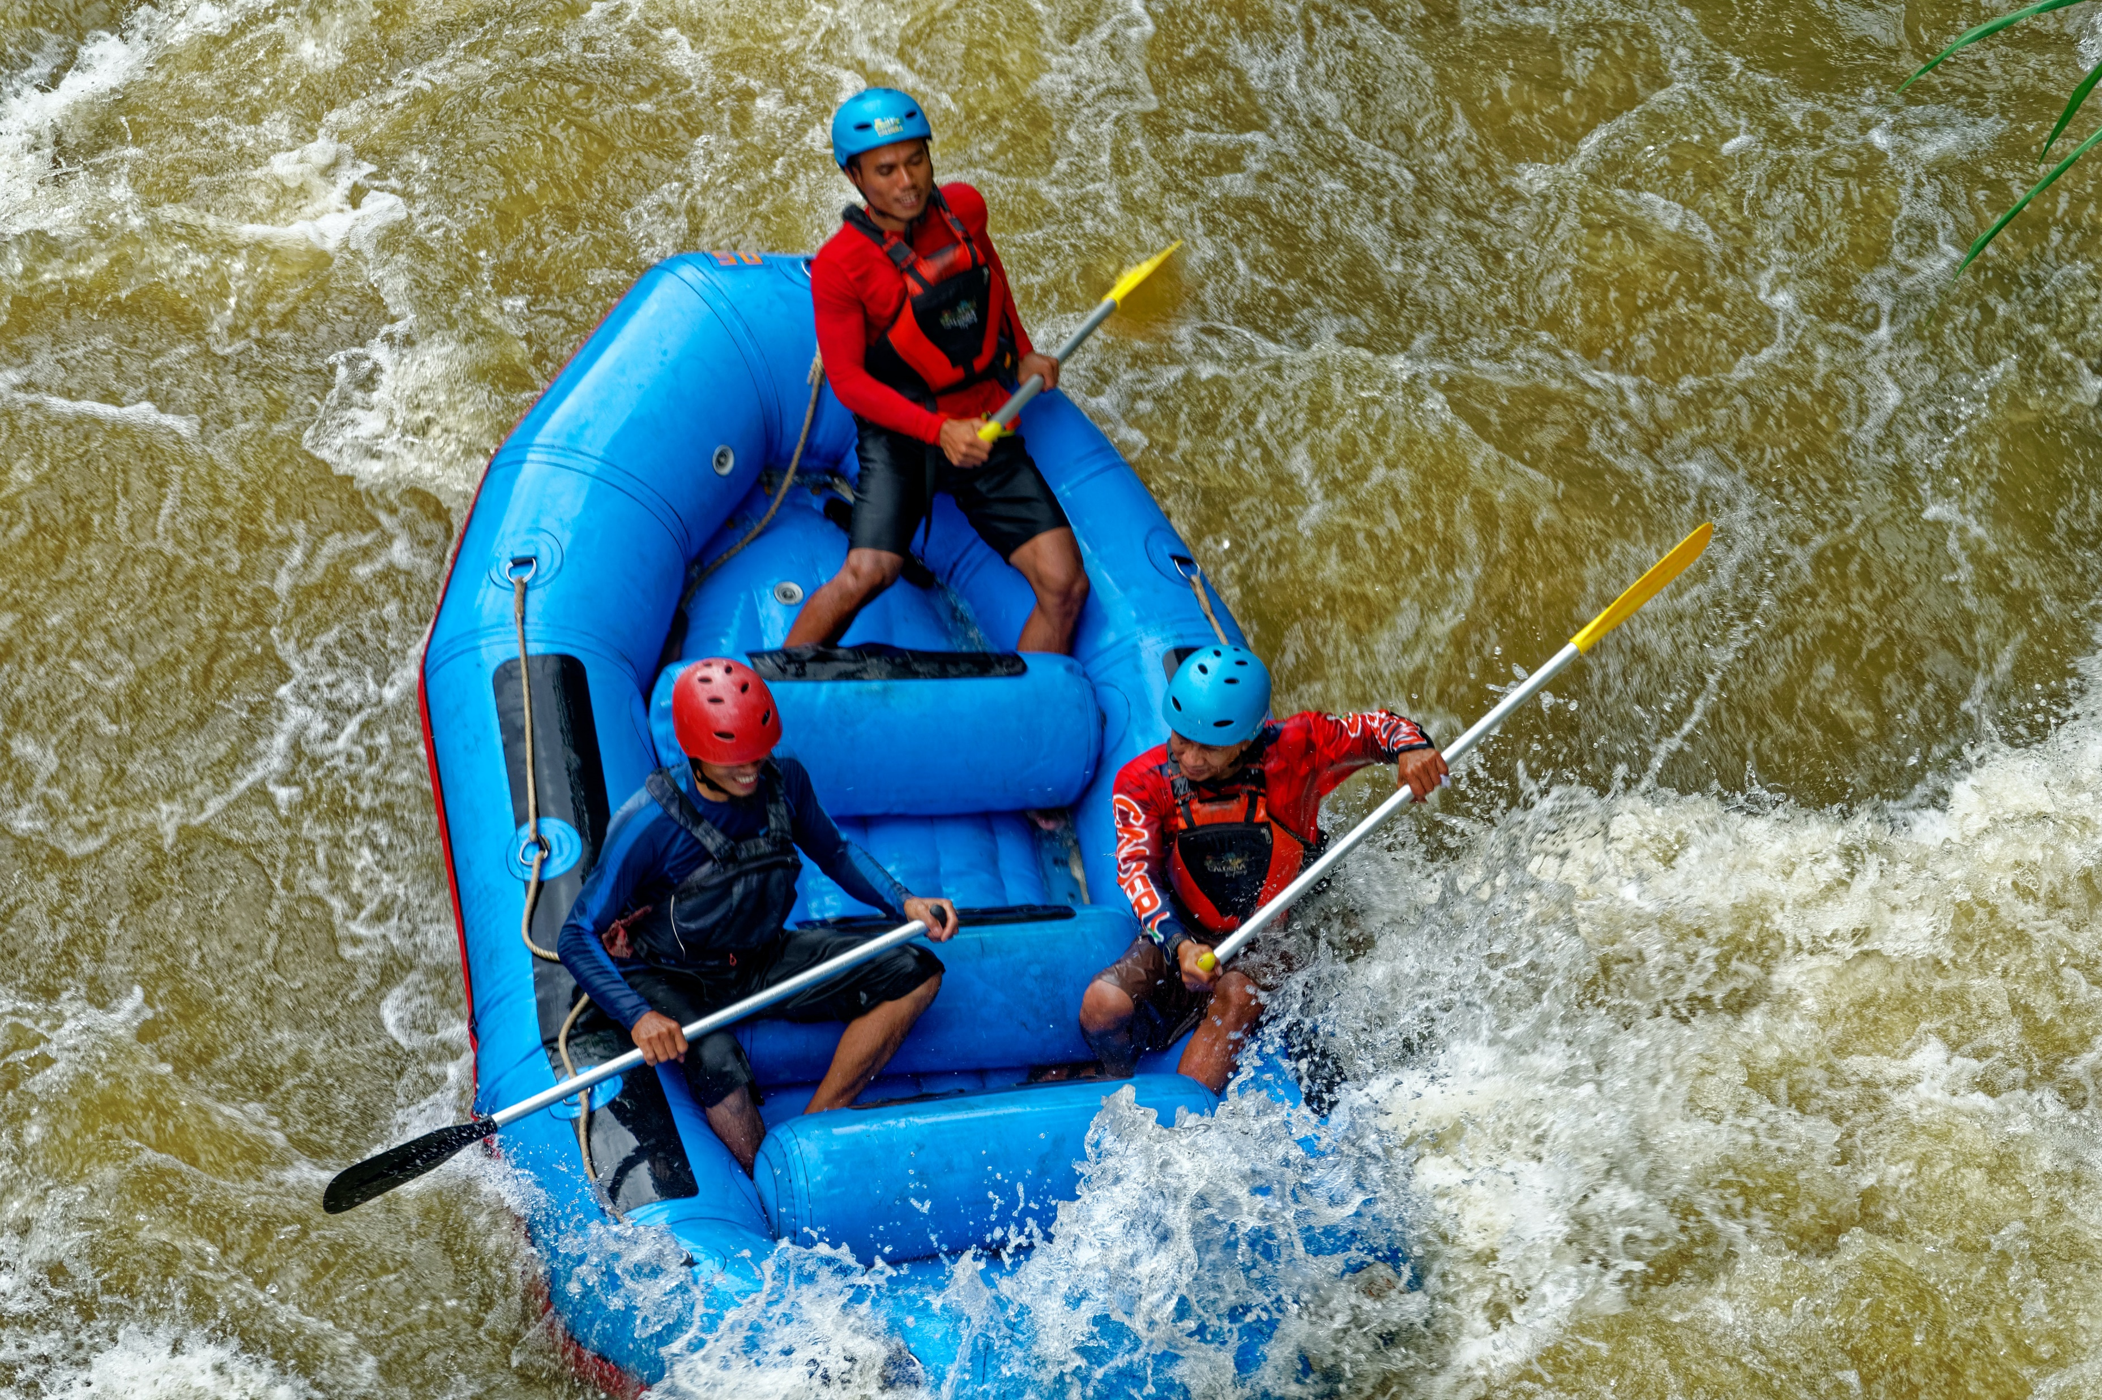
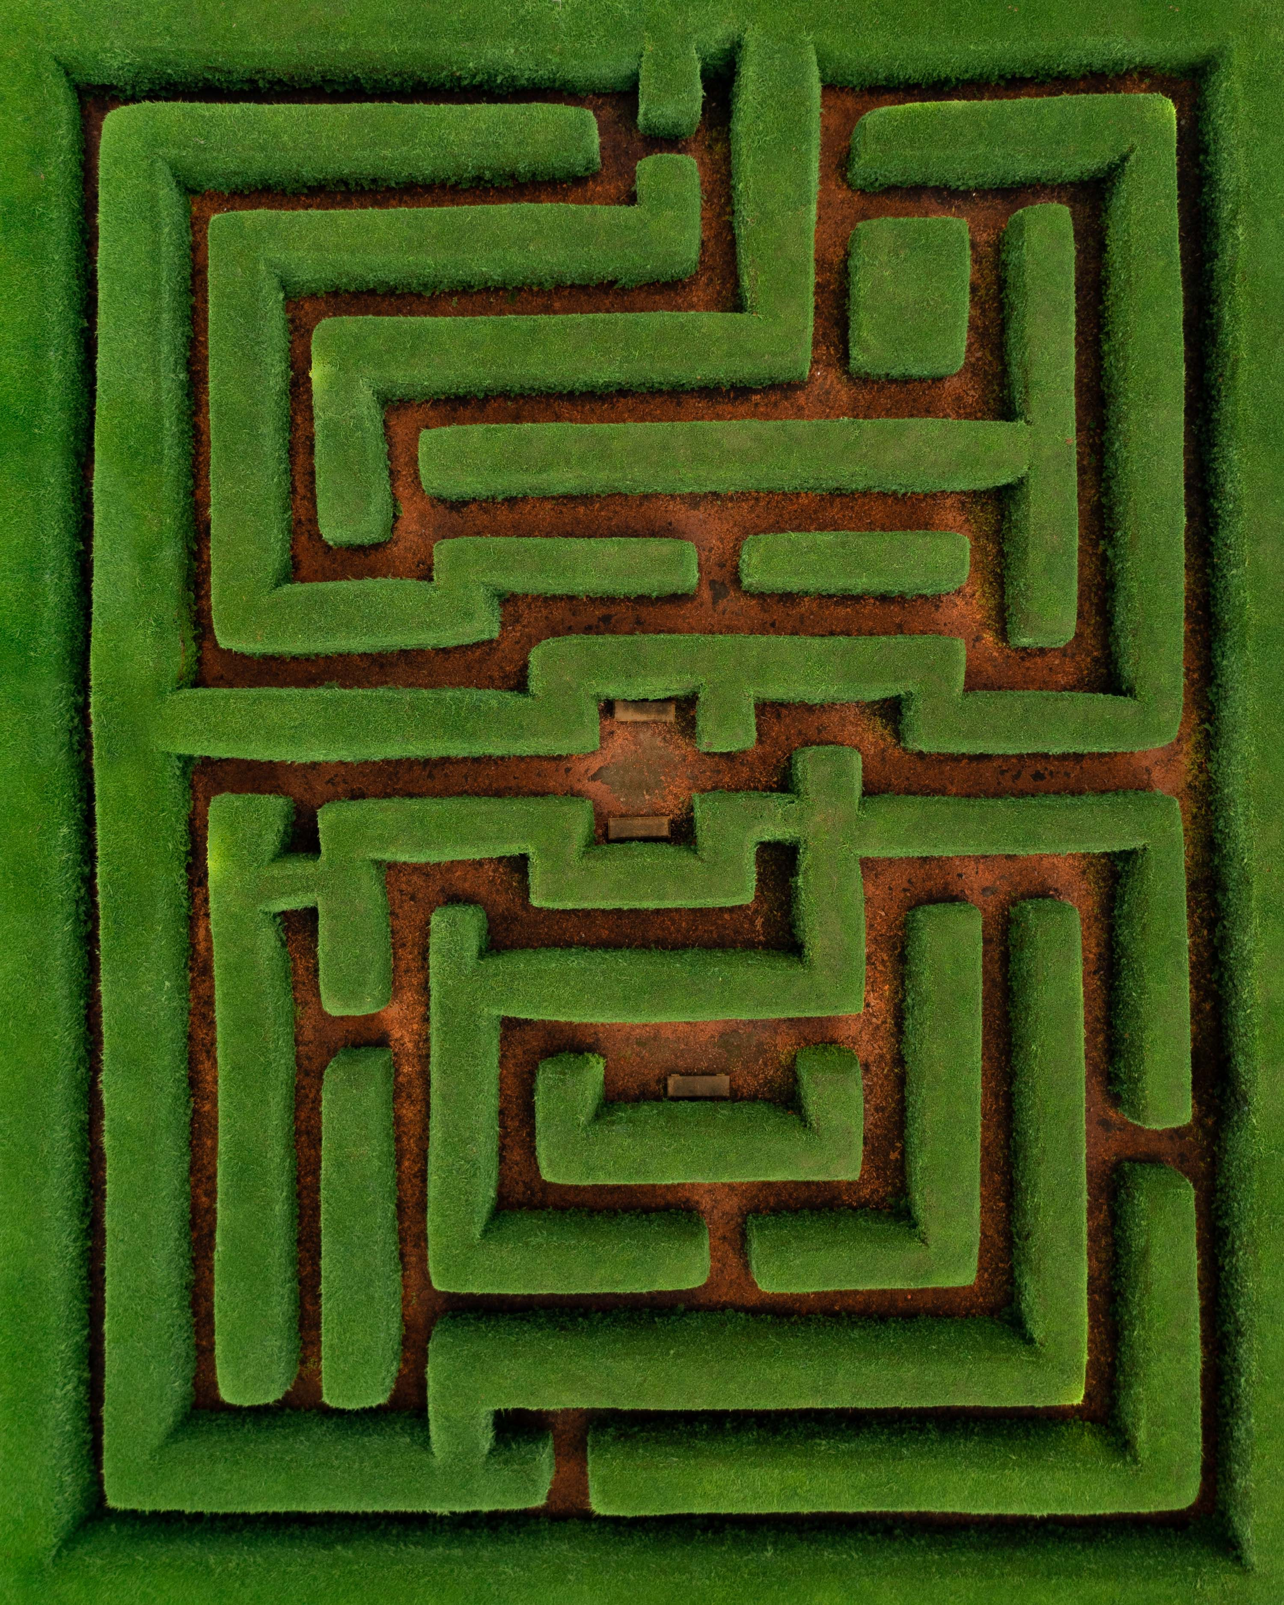
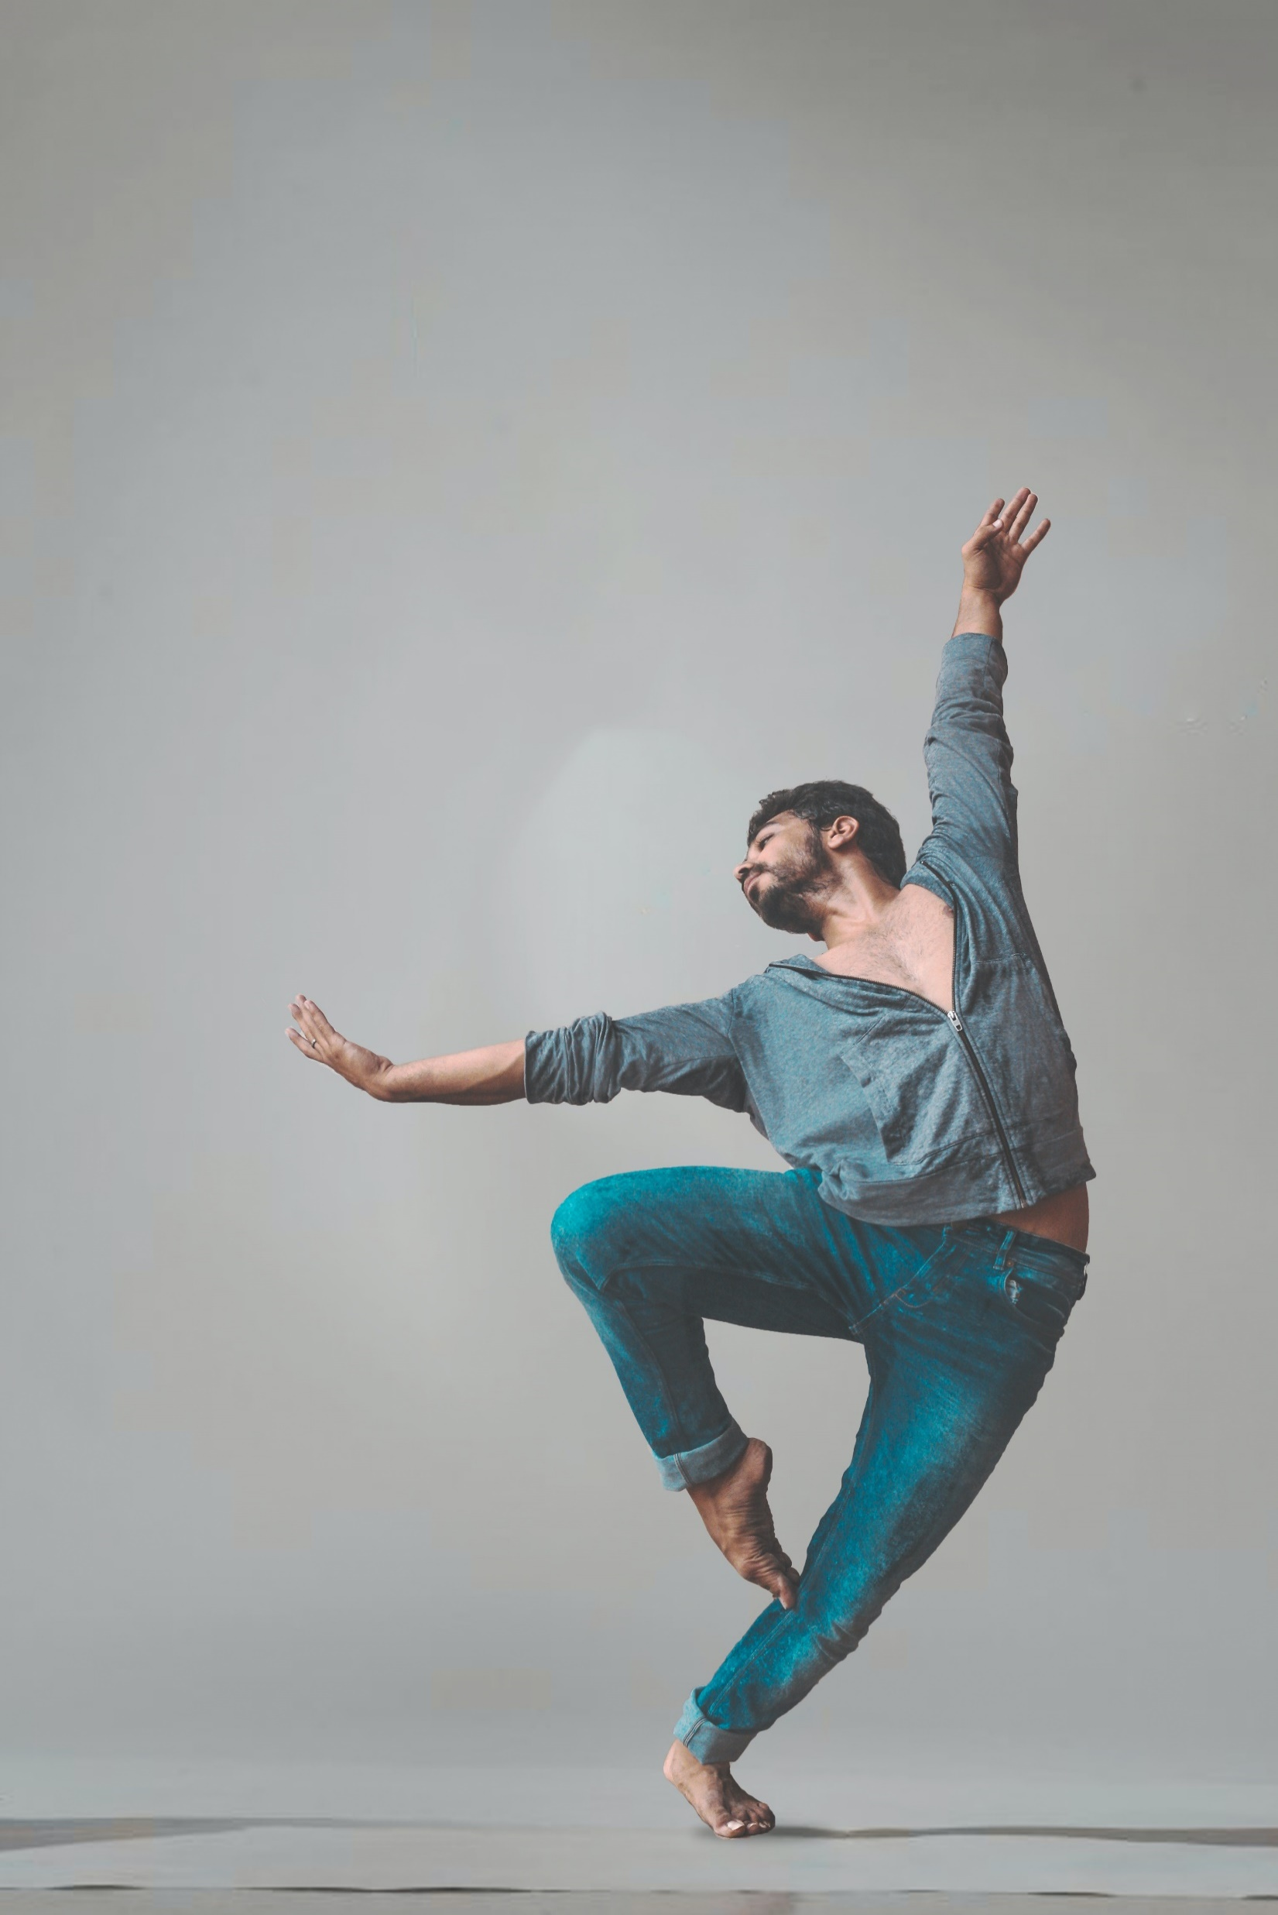
Which picture most closely matches how you feel about health programming?
A
B
C
D
Notes:
When you think about Health Programming for your community, which picture most closely resembles how you feel?
A is hands planting seeds in the dirt
B is a raft in whitewater
C. Is a large hedge maze
D is a ballet dancer
Put your response in the chat, and if you’re up for it, add a little note on why
We all bring different feelings, experiences and expectations about planning and implementing health programming in our communities. We hope to give you some information and resources to support you in this area.

Slide 4
Learning Objectives
Why health outreach programs?
Planning for health programs: ideas and implementation
Partners in programming
Resources and support
Notes:
In this session, we will discuss
The purpose of conducting health outreach programs for libraries.
Create a plan for the development and implementation of health outreach programming in your library – with ideas and examples from big to small.
Identify potential partnerships for health programming and outreach in your library.
Identify resources from the National Library of Medicine(NLM) and other reputable agencies that can be used for support and implementation of health programming in libraries.

Slide 5
Who We Are
National Institutes of Health
Nation’s research agency
27 institutes and offices
NIH
National Library of Medicine
World’s largest biomedical library
NLM
The Network of the National Library of Medicine
Program of the NLM comprised of 7 Regional Libraries (RMLs), 4 offices, and 3 centers.
NNLM
Network of the National Library of Medicine Training Office (NTO)
Supports the training and educational missions of the Network of the National Library of Medicine (NNLM).
NTO
Notes:
Before we get into our class today, a word about who we are!
Though you may be familiar with some of these acronyms, I think this helps set the stage for why I’m here today.
The National Institutes of Health is the nation’s leading medical research agency. Many of you might be familiar with the National Cancer Institute which is one of the many institutes and centers at NIH.
The National Library of Medicine is also an institute at NIH. It is the world’s largest biomedical library which maintains and makes available a vast print collection and produces electronic information resources like MedlinePlus and PubMed.
NNLM is the Network of the National Library of Medicine and is an outreach program of NLM.
The NNLM is made up of 7 geographic regions. I’m from the Network of the National Library of Medicine Training Office (NTO) supports the training and educational missions of the Network of the National Library of Medicine (NNLM).

Slide 6
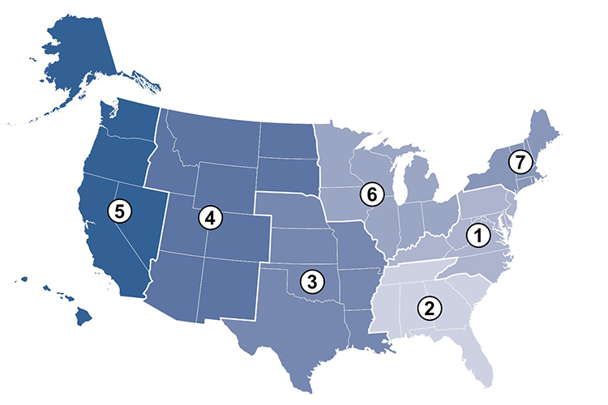
Network of the National Library of Medicine (NNLM)
The mission of NNLM is to advance the progress of medicine and improve the public health by:
Providing all U.S. health professionals with equal access to biomedical information
Improving the public's access to information to enable them to make informed decisions about their health
Notes:
At NNLM, our mission is to provide equal access to biomedical information to health professionals as well as access to quality health information for the general public so they are better able to make informed decisions about their health.
We do this through resources on our website, funding of projects, in person trainings, and webinars – just like this one, and by partnering with great organizations to support health information access in their communities.

Slide 7
What is an example of health outreach or programming that you have seen recently?
Notes:
There are many ways to incorporate health issues into library programming or outreach
One example of outreach is a library partnering with a local non-profit to provide free menstrual products.
Or you might have programming for seniors about how to find reliable health information online.
If you have seen anything lately that caught your eye, tell us about it in the chat.

Slide 8
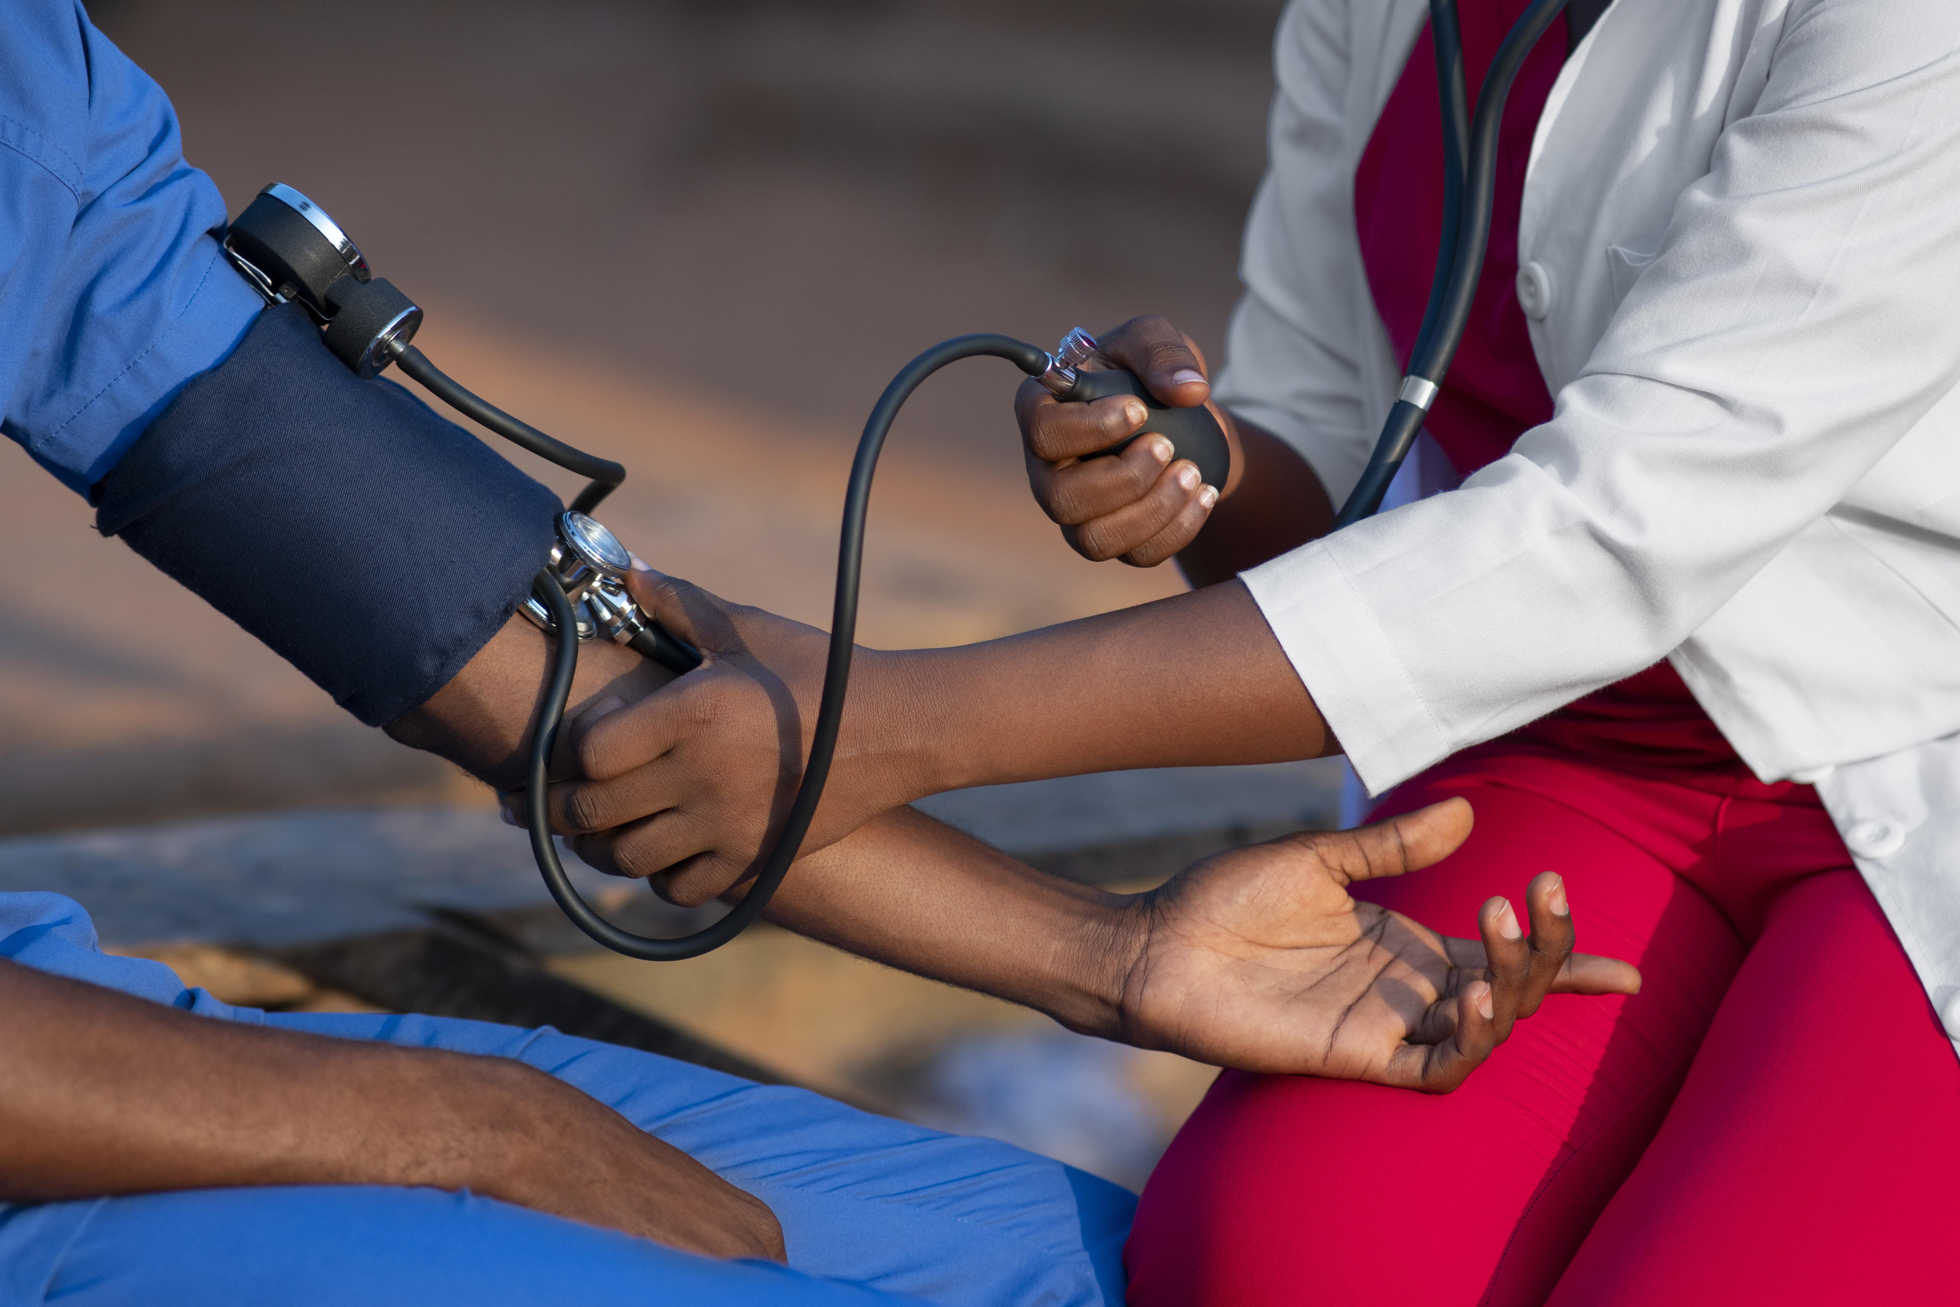
Why might libraries conduct health outreach?
Image by Freepik
Notes:
So why might libraries conduct health outreach?
Some might say that libraries are trusted providers of information and community resources. Libraries have existing partnerships and hopefully local resources that are in tune with the needs of the community.

Slide 9
Health Outreach at Your Organization
Show Value
Enhance Image
Maintain Relevance
Increase Visibility
Stay Current
Adapted from: University of Illinois Current LIS Clips (2003)
Notes:
One reason to offer health outreach in your community is that in today's complex information environment, we have a greater responsibility to communicate the resources and expertise that exist in our communities. Libraries, community centers, and faith-based organizations are often heavily utilized when someone has a question on just about any topic. They are often the “starting points” for information seeking on various topics, including health.
From the library’s perspective, it also strengthens your image and visibility within your community.
It is necessary to market community centers, libraries, and faith-based organizations in a way that community members know what resources are available to them locally. It makes sense that if a library is regularly marketing its services, it will remain current in the types of services and resources that it provides. No one wants to promote outdated information.
Also, by marketing your library, you will help to maintain relevance to your users, increase visibility, and inevitably show your overall value. The same can be said for community and faith based organizations.
If health outreach is new to you and your library/organization, it may be helpful for you to begin by locating information on your community’s health needs.

Slide 10
Health Outreach & Programming Landscape
About Today
In-person to virtual to hybrid to…
Ideas not best practices
Consider your library and community
Consider your capacity
Challenges
Rebounding from the pandemic
Staff capacity
Funding insecurity
Social and political pressures
Notes:
Just a quick note to recognize where we are today in the health outreach and programming landscape
We hope that you will enjoy learning about some resources and projects
Library people are ambitious people!
Find some inspiration and listen to some stories.
But we hope you don’t feel overwhelmed!
Many of you and your colleagues are experiencing challenges:
Rebounding from the pandemic
Staff capacity
Funding insecurity
Social and political pressures
All of these play into what you can and choose to offer in your setting.

Slide 11
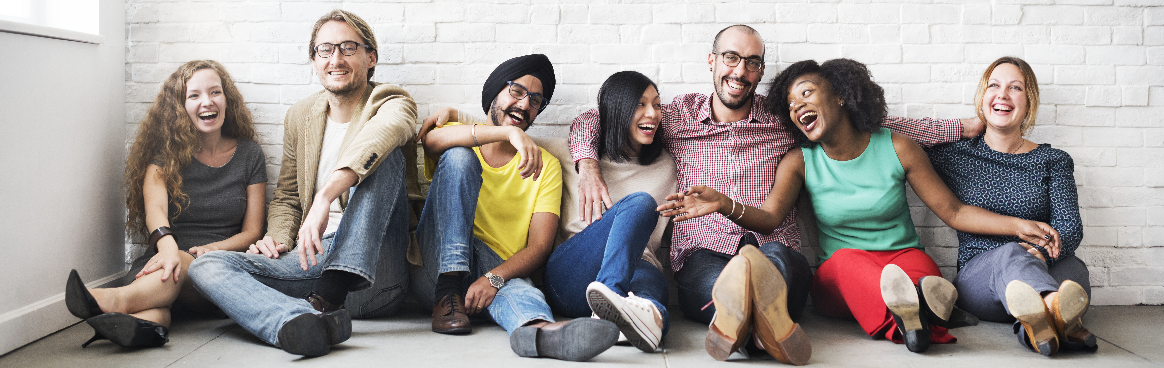
Where to begin?
Know Your Community
Notes:
The first step is to know your community.
This is the first competency of the consumer health information specialization from MLA and based on
Finding Health and Wellness @ the Library: A Consumer Health Toolkit for Library Staff, 2nd Edition. Updated March 2018.
Learning about the demographics, health issues, and challenges of a particular area can help you better meet the needs of your community and Programs that align with the needs of the community are more likely to impact the community. Also, grant funders, like NNLM, require justification for funded program activities.

Slide 12
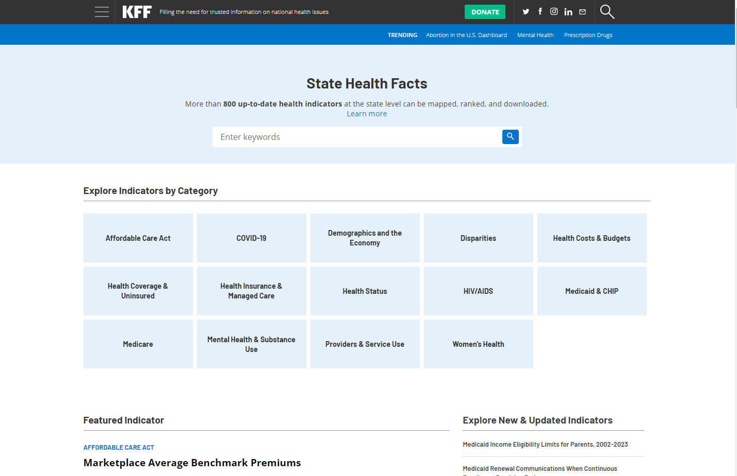
State Health Facts
https://www.kff.org/statedata/
Notes:
I am a firm believer that librarians and community advocates are uniquely in tune with the needs of their communities.
But step one to planning health outreach is knowing where to find quality statistics to back up what you might already feel about your community.
We will give an overview of three resources to learn more about your community. We’ll look briefly at all three, and then I’ll give you some time to explore.
“State Health Facts provides free, up-to-date, and easy-to-use health data for all 50 states, the District of Columbia, counties, territories, and other geographies. Data available on State Health Facts come from a wide variety of public and private sources, including Kaiser Family Foundation reports, public websites, government surveys and reports, and private organizations”.
This resource focuses on providing information at the State Level.
If you are interested in offering a program on diabetes, for example, you can find information on health status indicators for your State on diabetes and information such as the percentage of adults who have been told by a doctor that they have diabetes.

Slide 13
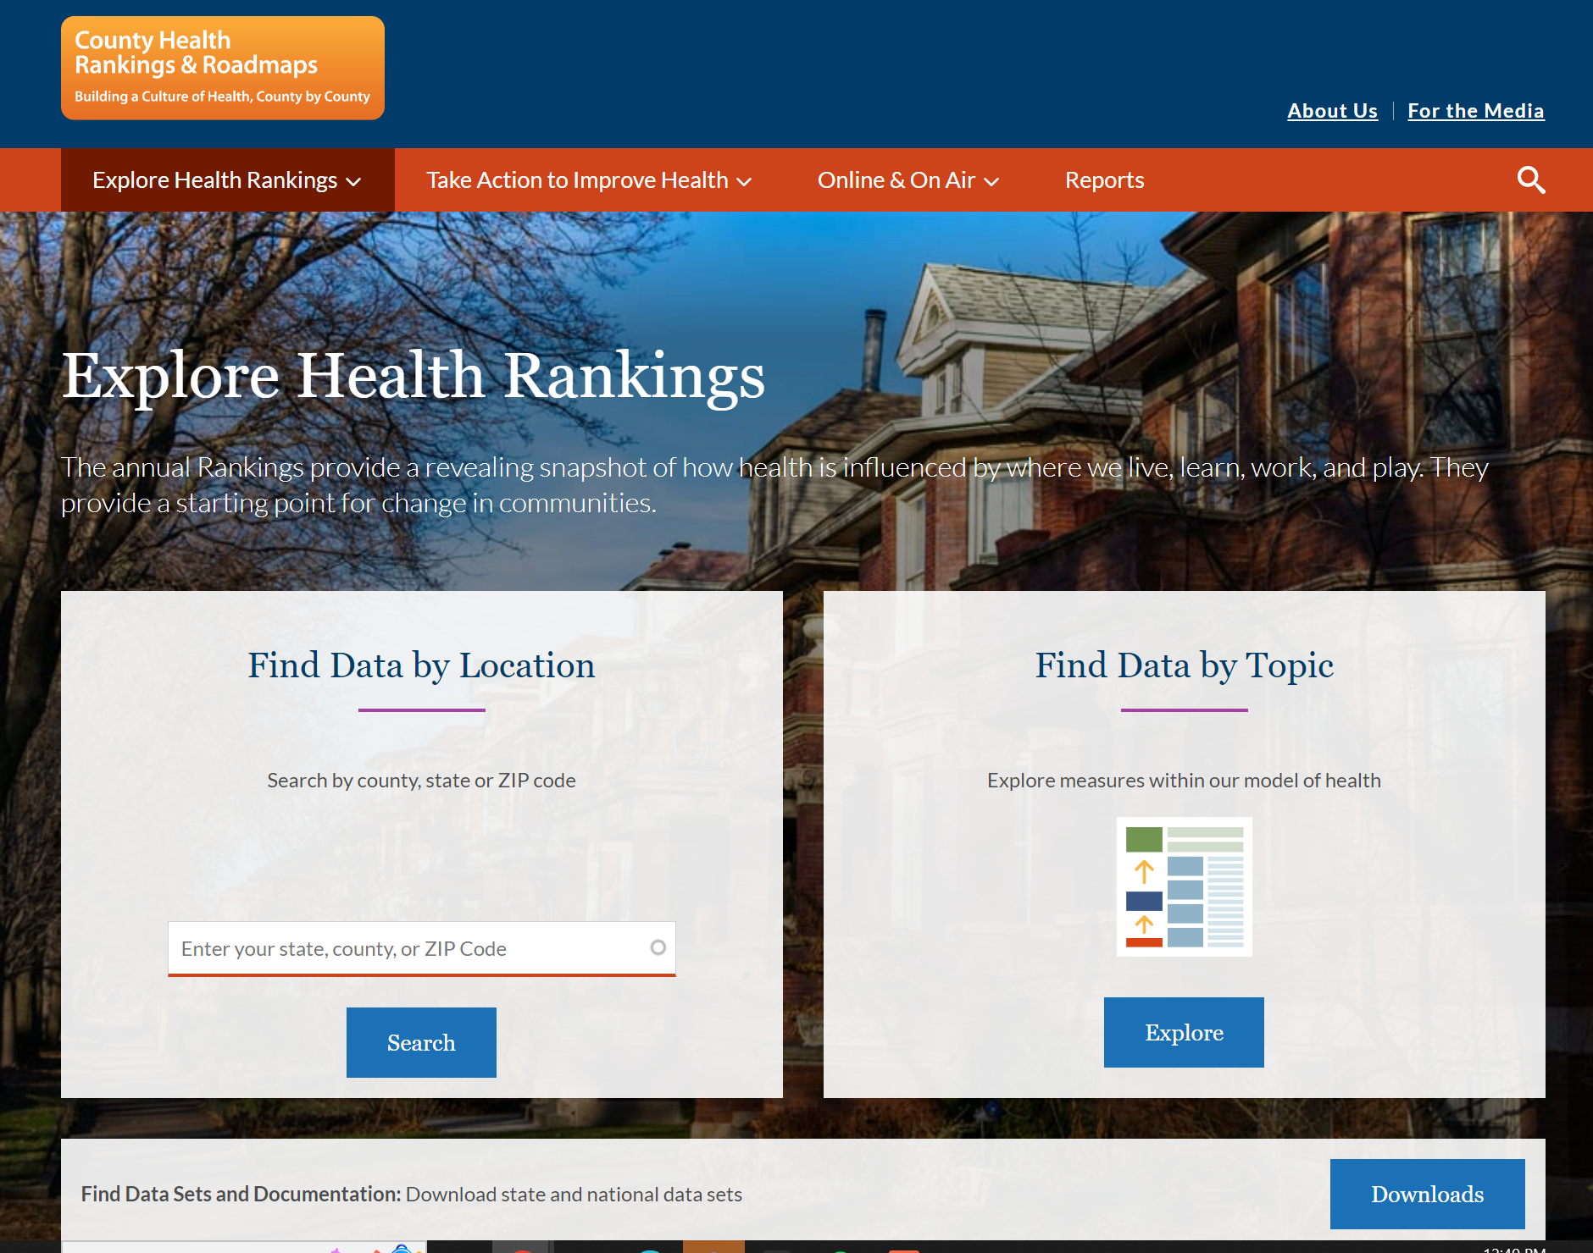
County Health Rankings and Roadmaps
https://www.countyhealthrankings.org/
Notes:
The second resource is the County Health Rankings and Roadmaps , a service from the Robert Wood Johnson Foundation, is another excellent place to start looking for information about health issues in your community. This program provides health data at the county level. Choose your state and county, then scan through the data to get a sense of the information provided.

Slide 14
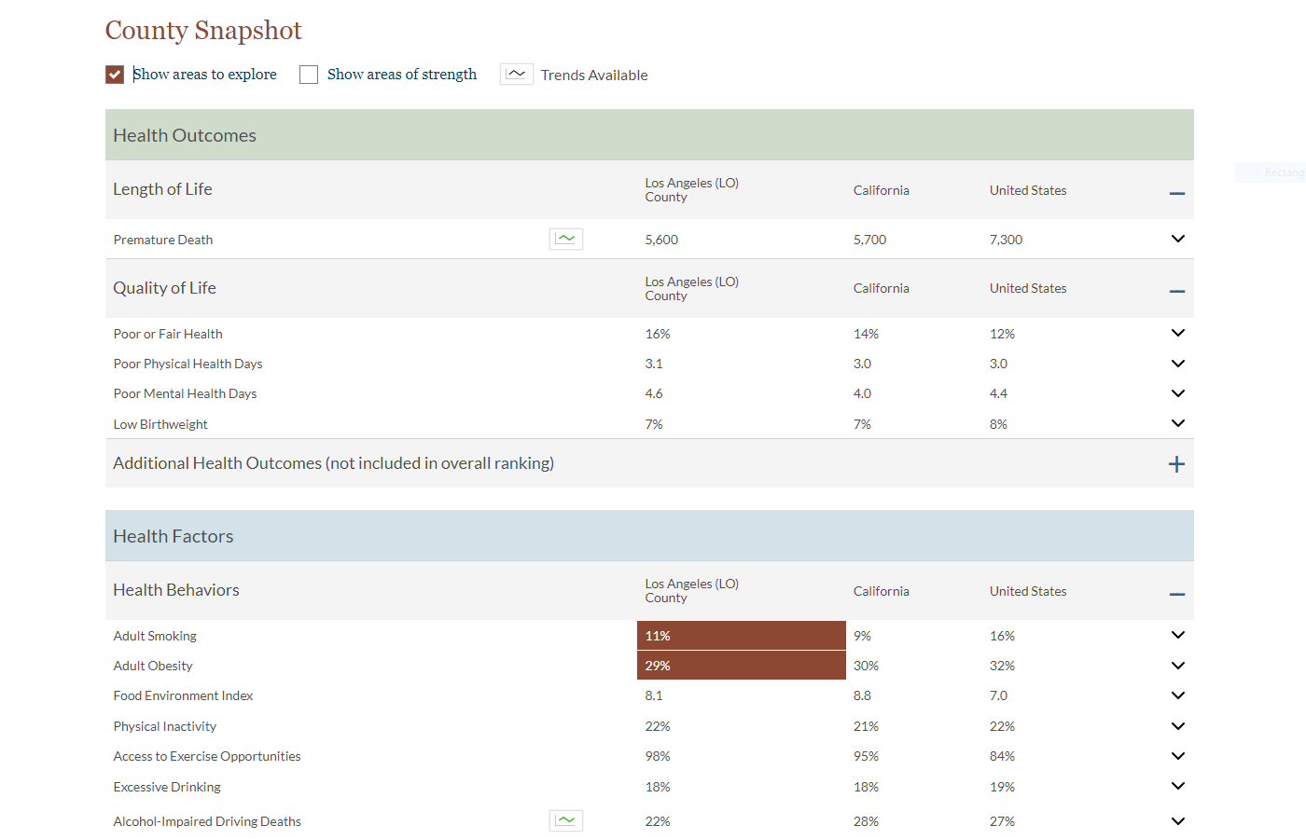
County Health Rankings and Roadmaps - Snapshot
https://www.countyhealthrankings.org/
Notes:
Near the top of the table, there is a check box for "show areas to explore". Clicking the box will highlight any ‘red flag’ areas in the county that are potential challenges to health. Make a note of these and any other areas that stand out to you. You can also find areas of strength
For example, if libraries need to justify the need to purchase materials for a program on a given topic (to library boards/trustees/local municipalities), you can use the county health rankings and roadmaps to locate information on your county and compare to other counties and state that there is an identified need to raise awareness on a given topic.
[THIS SCREENSHOT can be switched out for local area]

Slide 15
City Health Dashboard
https://www.cityhealthdashboard.com/
Notes:
The third and final resource is The City Health Dashboard allows you to see where the nation's 500 largest cities stand on 36 key measures of health and factors affecting health across five areas: Health Behaviors, Social and Economic Factors, Physical Environment, Health Outcomes, and Clinical Care. These categories align with those used in the County Health Rankings & Roadmaps.

Slide 16
City Health Dashboard Sample
Notes:
You can also examine the dashboards by demographic data to see what disparities exist.
This shows unemployment rates by race/ethnicity
Tells you whether a lower or higher value is a better outcome.

Slide 17
Activity 1: Choose Your Own Adventure
State Health Facts
https://www.kff.org/statedata/
County Health Rankings and Roadmaps
https://www.countyhealthrankings.org/
City Health Dashboard
https://www.cityhealthdashboard.com/
Pick a resource
Explore and learn about your area
Share what you used and what you learned or confirmed
Notes:
Pick one of the resources that we just mentioned to explore and learn about your area for a few minutes.
Come back to share what you used, and what you learned or confirmed that might inform health programming you would offer.
I’ll be quiet for about 4 minutes.
Invite folks to share which resource they picked and something they learned or confirmed about their area that might be a start of an idea for programming.

Slide 18
Develop a Plan!
Information
Programming
Training
Target Population
Type of Outreach
Available Resources
Notes:
Once you’ve had a chance to review your community health needs, where do you even begin? Health outreach is similar to any other outreach you may conduct.
You will need to develop a plan. It is often helpful to identify your target population, the type of outreach that you want to do (sharing of resources or a full fledged program) and then determine what resources you already have available to continue with this plan.
Remember, health outreach does not mean that you have to provide a one hour program with a speaker and activities. Think about your library/organization and what a manageable and meaningful outreach activity might look like based on your staff, physical space and other factors.
It might be making information more accessible, it might be offering one time or ongoing programming, or It might be offering some training. There are many other options too.

Slide 19
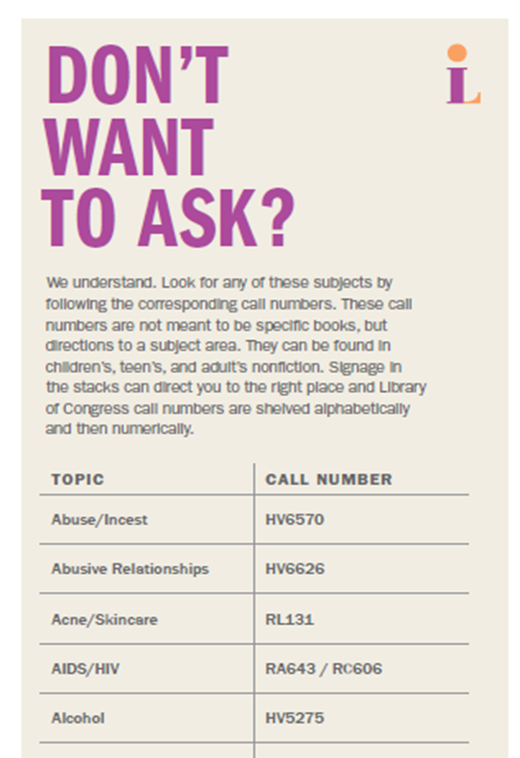
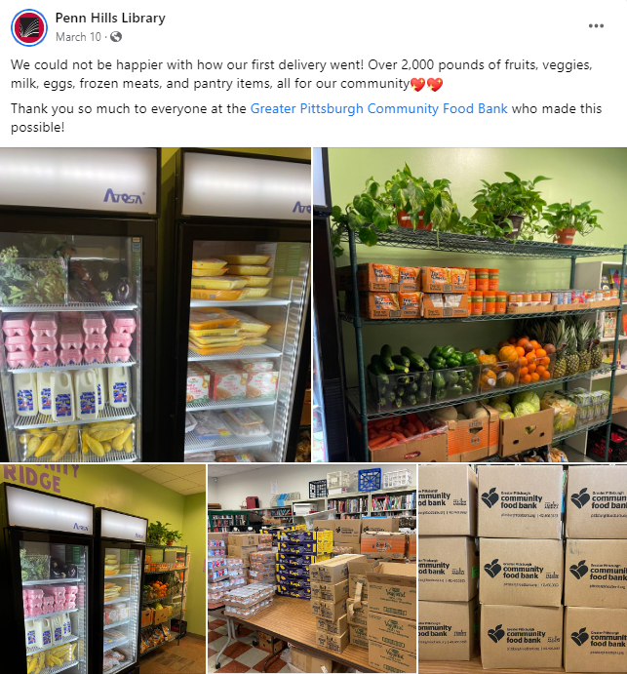
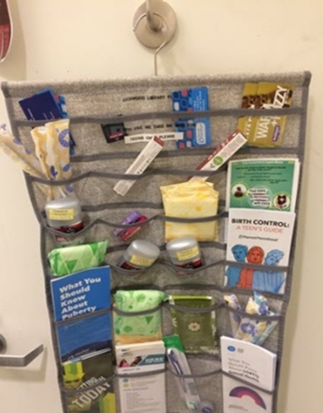
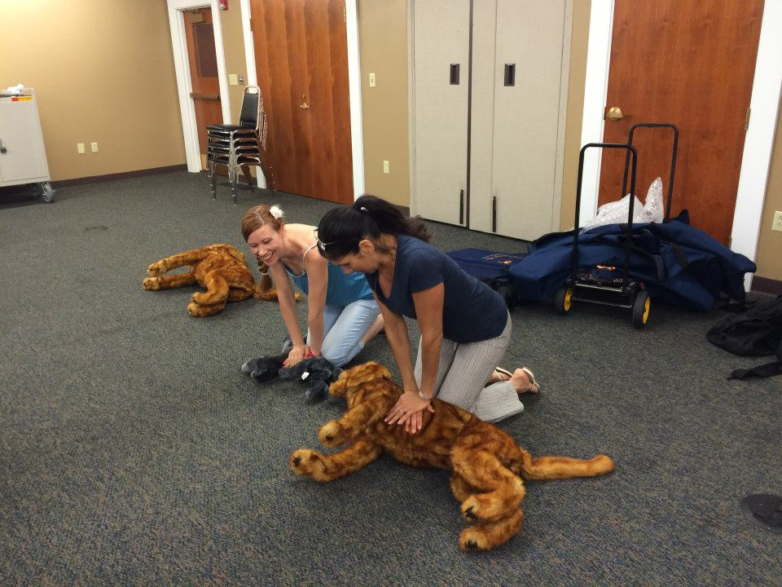
Types of Projects & Programs
Food Access
Movement
Access to Care
Social Work
Technology
Children and Families
Veterinary
Information and Reference Services
Notes:
There are vast variety of programs you can offer to address the health needs of your community
These are a few categories to get you started
Food Access: Pantries, cooking programming, gardening
Movement: Physical activity, walking, yoga, including chair yoga, injury prevention,
Access to Care: Vaccination clinics, diabetes education, smoking cessation, support groups, chronic disease management
Social Work: Embedded social workers
Technology: Telehealth services & digital literacy projects
Children and Families: Sensory story time, music, movement, etc.
Veterinary: Vaccination, pet first aid, pet loss/grief
Promoting Information and Reference Services, Collections: Curated lists of key or sensitive topics
The pictures on this slide share a couple of examples.
Carnegie Library of Pittsburgh offers bookmarks to help teens find materials on sensitive topics without having to ask a library staff member.
Penn Hills Library Food Pantry
Teen Hygiene Health Center at the Rockwood Makerspace (Multnomah County, OR
Central New York Library Resources Council: The Healthy Pet Project included workshops on how to prepare for disasters with your pet.

Slide 20
Getting Started
Considerations
Cautions
Unique to your community
Evidence of need
The next big thing vs. basics
Is your project easy to explain?
Competitions
Know who you’re inviting
Multi-level marketing – MLMs
Registered Dietician vs Nutritionist
Differing opinions and care
Notes:
Considerations:
When making the case to offer health programming, think about unique needs in your community
In addition to your intuition and observations, gather evidence knowing that administration, community leaders, and funders will expect evidence of need
It is easy to always chase big bold projects, but simple ideas and services are a good place to start
A simple question: Is this project, idea, or program easy to explain to others?
Caution:
Avoid Competitions, especially those focused on weight loss
Know who you are inviting
Multi-level marketing sales
If you are not familiar – MLMs are businesses that use a non-salaried workforce to sell products to family and friends while recruiting others to do the same. Some MLMs are illegal pyramid schemes. MLMS that sell supplements, diet plans, or unproven cures may be interested in finding an audience or space in the library.
When working with new partners, authors, and speakers, consider a spectrum of opinions and care.
For example, Registered Dieticians and nutritionists are not the same thing. Anyone may call themselves a nutritionist. A registered or licensed dietician is a recognized medical professional who has passed a national exam. Furthermore, in the world of registered dietitian nutritionists (RDNs), there is a spectrum from weight loss-focused practice to healthy at any weight philosophy. RDN: weigh every day vs. is it okay to weigh you?

Slide 21
Finding Programming Inspiration and Ideas
Let’s Move in Libraries
ALA: Programming Librarian
WebJunction: Health Happens in Libraries
Rural Health Literacy Toolkit
Ready.gov
Jbrary Storytime Resources
NNLM Past Funded Projects
Notes:
Some of you may already have an idea for the type of programming and outreach you want to conduct, but if not, let’s go get some ideas.
Let’s Move in Libraries has program ideas, resources, and examples of library programming focused around movement and active living. Advice for where to begin, accessible programming, and liability.
ALA: Programming Librarian Browse and search library programming ideas, examples – includes a search by budget. An incredible resource.
WebJunction: Health Happens in Libraries: This is less a list of ideas and more dedicated resources for you to develop health programming – including webinars, communication ideas, detailed examples of projects – it is a deep resource and very much worth exploring to make your health programming a lighter lift for you.
Includes resources on things like sustainability, helping your library be autism ready, creating a garden program or community pantry and much more
Rural Health Literacy Toolkit: Program clearinghouse specifically dedicated to rural libraires
Ready.gov: Emergency Preparedness training and programs
Jbrary Storytime Resources food, movement, etc. for storytime with children
NNLM Past Funded Projects – and current funded projects – describe the target population and project

Slide 22
Activity 2: Choose a Resource
Let’s Move in Libraries
ALA: Programming Librarian
WebJunction: Health Happens in Libraries
Rural Health Literacy Toolkit
Ready.gov
Jbrary Storytime Resources
NNLM Past Funded Projects
Select a Programming Resource
Find an interesting or promising idea for your community
Notes:
Now it is time for activity 2!
These are linked in your guide for today. Because not everyone will be interested in the same types of programming, we are going to give you a few minutes to explore 1 or 2 of the resources that are appealing to you. If you don’t already have a project in mind, find an idea that you can use for the remainder of the activities today.
Choose a resource and find an interesting or promising idea for your community.
I will be quiet for four minutes so you can explore, and I invite you to share what you used and found in chat.

Slide 23
Getting Started: Partnerships
Local government/public health
Healthcare providers
Food banks, agriculture nonprofits
Cooperative extensions
Local authors, businesses
Health Non-Profits
Notes:
With an idea in mind, begin to think about who you might be able to partner with to enable or enhance the outreach or programming activity
Partnerships:
One effective way to do health programming is to Partner with a local organization who needs a location or space, and goals that align with yours
Sometimes they reach a bigger population by coming to the library
Types of Partnerships to consider
Local government or public health offices;
Healthcare providers
Food banks, agriculture nonprofits
Cooperative extensions – might do programs on food safety
Local authors, businesses

Slide 24
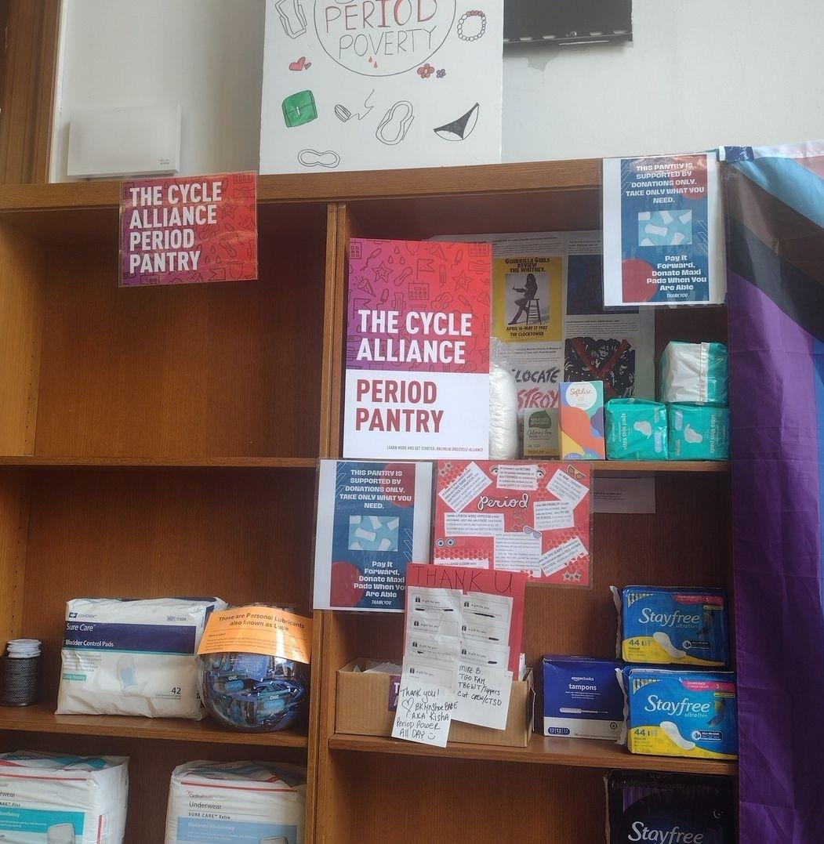
"Period Pantry" at the Brooklyn Public Central Library (Kings County, NY)
Source: https://www.cbsnews.com/newyork/news/central-library-provides-free-menstrual-products/
Notes:
Think outside the box when it comes to meeting health needs. There are many ways to reach an audience.
Here’s one example: At Brooklyn public central library, the young adult librarian, Rakisha Kearns-White, noticed a need in her community – many young people experiencing period poverty.
According to Period.org, in 2021, 23% of young people in America struggled to afford period products and 16% of students had to choose between buying pads and buying food. Statistics show that students of color, lower-income students, and those living in rural places are most impacted by a lack of access to feminine hygiene products.
The library partnered with a non-profit called The Cycle Alliance to start up a period pantry. This resource provides products and is surrounded with educational materials and information about reproductive health.
https://www.cbsnews.com/newyork/news/central-library-provides-free-menstrual-products/

Slide 25
Virtual Health at the Pottsboro Public Library
https://youtu.be/pV32iJ4WL-g
Notes:
Here’s another example where a community need was identified, and a library developed a project, found partners and funding to meet those needs.
If the video doesn’t play: When COVID-19 struck, one rural library in Texas made a bold move to help their community. They reached out to NNLM about funding opportunities for a virtual health room in Pottsboro, Texas. This had NEVER been done before, having an established room in a library dedicated to tele-health appointments. On this episode of the NNLM Discovery podcast, Region Three Executive Director Brian Leaf shares his story with host Yamila El-Khayat about how he and Jessica Rangel, Executive VP of Health Systems University of North Texas Health Science Center in Fort Worth, helped Pottsboro County Librarian Dianne Connery use an NNLM grant to establish a nationwide model to harness the power of telemedicine to overcome the lack of access to healthcare in much of rural America.
What do you think about this video? What did you like or find interesting about the video? Please share that in the chat

Slide 26
Planning for Health Programming Implementation Tips
Notes:
After you can get your community health statistics and you have brainstormed some ideas. Planning for health programming is essential, so here are some implementation tips I would like to share with you.

Slide 27
7 Key Questions
Who?
Will you reach?
Can assist you?
What?
Type of activity?
Resources to include?
When?
Are staff available?
Are target population available?
Can partner?
Is your organization the one to offer this?
Where?
Do you have the space?
Senior center or school?
Accessible to participants?
Why?
Will it benefit your target population?
How?
Will you market the program?
will you conduct the activity?
Will you tell if it was successful?
How much?
Time?
Money?
Pair with health observance month or local event?
Notes:
In order to think through the development of your activity, there are 7 key questions you can ask yourself. These questions are all multifaceted but will help you recognize what pieces you have in place and where you will need to fill in the gaps.
Who? Think about who your target population will be? Who in your organization can assist? Who in your community might be an expert or might know an expert? Who are potential partners for this outreach event?
What? What type of outreach activity do you wish to provide? Will you provide information or will you offer a program with a speaker? What resources are available from the National Library of Medicine or other agencies that you can use? What are the community health needs and what evidence of this do you have?
When? When will you offer your program? When should you schedule so that your target population and staff are available?
Where? Where will the program be held? Do you have the space? Could this be outreach to a senior center or school? Is it accessible to the participants?
Why? Why do you want to offer this outreach activity? Why will this benefit your library/organization’s chosen target population?
How? How will you market the program? Are there specific locations where your target population frequents? How will you locate speakers if you are unaware of any?
How much? This question involves looking at how much time you and other staff will have to invest in the activity and also how much money will it cost?
Ok, that is a lot!! I’m going to share one more planning tool, and then we’ll give you some time to work on your own.

Slide 28
Logic Model
a visual representation of a program that illustrates how planned activities are linked to program results
NNLM Logic Model: https://www.nnlm.gov/sites/default/files/2021-08/Logic%20Model.pdf
Notes:
If you need buy in from funders or other stakeholders, one way to explain your program or activity is through the use of a logic model.
A logic model is a visual representation of a program that illustrates how planned
activities are linked to program results. A well-constructed logic model can make it easier to
plan outreach programs by helping you determine the resources and activities you need to
achieve desired results.
As complicated as logic models may sound, they can be easy to use and very helpful from program idea to evaluation.
At the very top is the goal of your activity or program
Think of the inputs as the resources that will be used to support the activity or program you wish to conduct.
The activities are the main things the project will do/provide.
Outcomes are the how many and what sort of observable/tangible results will be achieved? The short term focuses on what will occur as a direct result of the activity (such as changes in knowledge, skills or attitudes).
The assumptions are the beliefs about the environment and community.
External factors include the positive and negative influences, the culture, economics, politics and demographics of the community. Both assumptions and external factors should be confirmed before implementing the program.
Link: https://www.nnlm.gov/sites/default/files/2021-08/Logic%20Model.pdf

Slide 29
Completed Logic Model
Notes:
This template shows the types of things you might include in each area.
For example, your inputs include time, money, equipment
Your outputs might be that people have increased knowledge about evaluating health websites, and that they then help their family members separate reliable information from questionable information.

Slide 30
Storytime Logic Model
Notes:
Logic models don’t have to be daunting.
This is a simplified example for children’s storytime from the library research service.
You can think of them as a bit like if… then statements. If we do/have the things on the inputs side, then we predict the outcomes side will happen
For this type of logic model, you can start with the goal and long-term outcomes and work your way back.
If this way of planning appeals to you, there are many resources on developing logic models.

Slide 31
Activity 3: Your Turn
Choose either the 7 questions or logic model from your class guide and begin filling in the key pieces to implement your idea.
Notes:
Activity 3: Your Turn
Choose either the 7 questions or logic model from your class worksheet and begin filling in the key pieces to implement your idea.
I will be quiet for about 4 minutes so you can start completing your worksheet. Please let me know if you have any questions so we can address them.

Slide 32
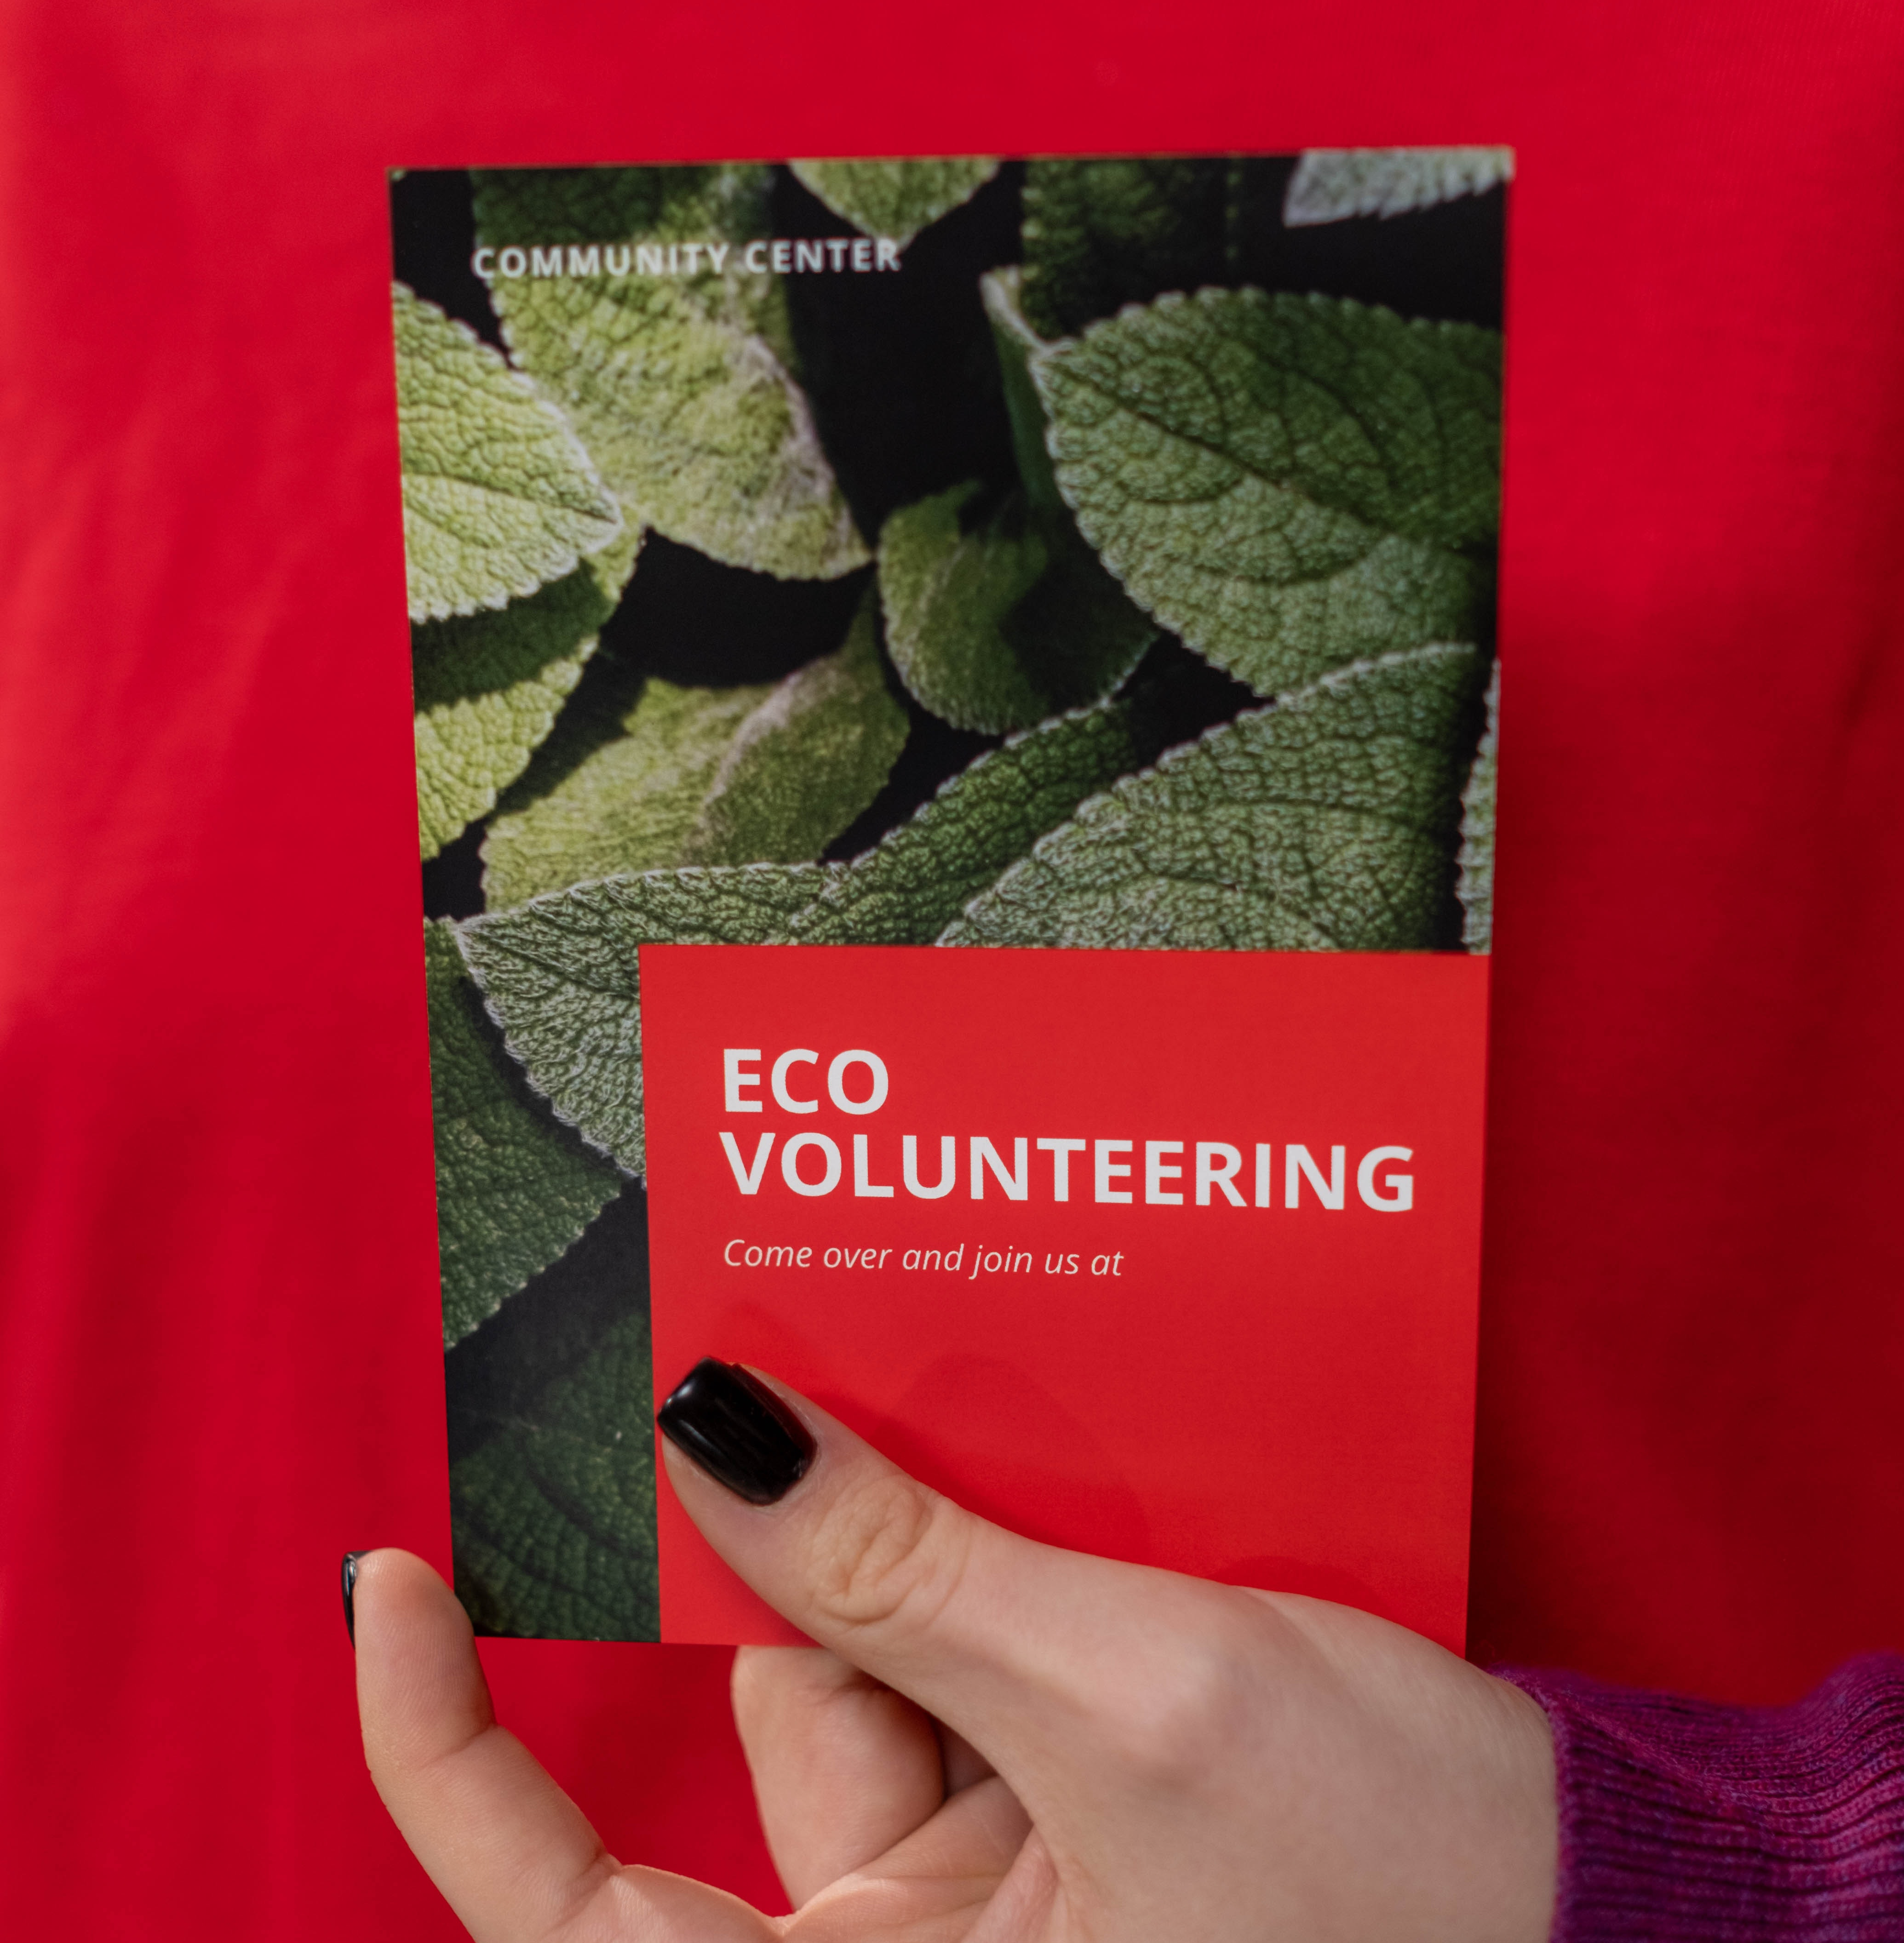
What marketing ideas have you already used or have seen that you might like to use?
Notes:
Alright, now that your program or activity is coming into focus, how will you get it to the folks you want to reach?
Drop into the chat your response to this question. What marketing ideas have you already use or have seen that you might like to use?

Slide 33
Marketing Ideas
Public Library Association's Marketing Strategies Page
Notes:
Once you have determined your target population and type of activity, it is never to early to think about how you will market/promote the health outreach activity.
What agencies in the community does your target population frequent? What areas of your organization are your target population most likely to be in?
It can sometimes be a process of trial and error to determine what marketing strategies work best for your particular community. Some ideas include the traditional use of fliers, newspaper ads or signage on bulletin boards and in windows of local businesses. Additionally, information can be listed on web site calendars, press releases on news feeds and the use of social media sites.
Remember marketing doesn’t mean you have to be restricted to the walls of your library. Place bookmarks in local health clinics,, have fliers about upcoming lecture series or database searching classes in grocery stores, hair and nail salons, childcare centers, and community and faith based organizations in your neighborhoods.
In a library setting it might even be useful to place additional signs about an upcoming health outreach event right in the stacks where the health materials are. This way you may catch a casual browser.
Don’t forget the power of word of mouth and personal invitation. When I worked in libraries, I would make an effort to personally invite patrons to upcoming programs. And sometimes they even show up!
A great resource is the Public Library Association's Marketing Strategies Page on http://www.ala.org/pla/resources/tools/public-relations-marketing/marketing-strategies

Slide 34
Libraries Transform
Notes:
The Libraries Transform initiative was launched in 2015 focused on increasing the public awareness of libraries and the critical role they play in transforming lives and communities through education. It provided a collection of free resources, including graphics, key messages and ideas, that could be used for marketing, advocacy, outreach, and fundraising. More than 15,000 libraries and library advocates joined the campaign.
The project has been retired, but Some assets from the initiative are still available on the I Love Libraries website.
NNLM also partnered with ALA for the Libraries Transform Health Literacy Toolkit: https://ilovelibraries.org/librariestransform/health-literacy-toolkit/
The toolkit provides key messages, program ideas, and downloadable marketing materials, including bookmark templates and social media graphics, for libraries to use as they promote health literacy in October and throughout the year.
The wide-ranging array of health literacy topics covered include nutrition, aging, and chronic illness.
There are numerous resources available in the toolkit that will speak to the different types of health and other outreach that you do in your library or community agency.

Slide 35
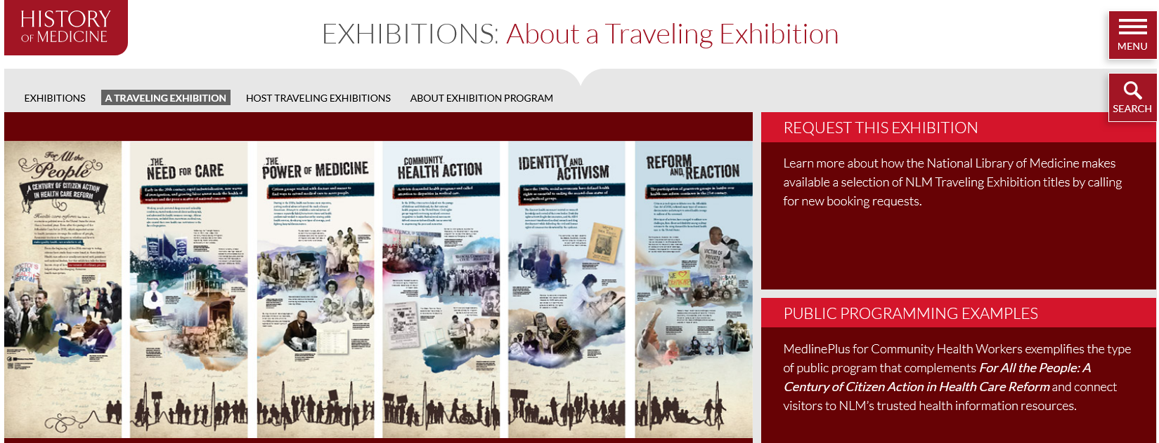
NLM Exhibition Program
https://www.nlm.nih.gov/hmd/get-involved/hostexhibitions.html
Notes:
Creating programs from scratch can be a lot of work.
Next up I’ll share with you some resources from NLM and NNLM that can help you put together health related programming with a little head start.
The National Library of Medicine produces traveling exhibitions, which are made available free of charge to public, university, and medical libraries, as well as cultural centers across the country.
Raise your virtual hand if you have hosted or seen one of these on display.
The traveling exhibition is comprised of banners, usually about 6 of them which contain information about their particular topic but the main information is online. The banners provide an opportunity for programs or to highlight your services.
NLM also has resources for how to create programming around the exhibit that you host.
The exhibit you see here is called For All the People: A Century of Citizen Action in Health Care Reform and is also available in Spanish
There are also online exhibitions enhanced by multidisciplinary educational and career resources for educators and students in grades K - 12 and in colleges and universities. This includes extensive lesson plans for multiple disciplines, from history to science.
Though there is a shipping fee, contact your NNLM Regional Medical Library to inquire about funding sources.
The NLM Exhibition Program link will be placed in the chat
www.nlm.nih.gov/hmd/about/exhibition/index.html

Slide 36
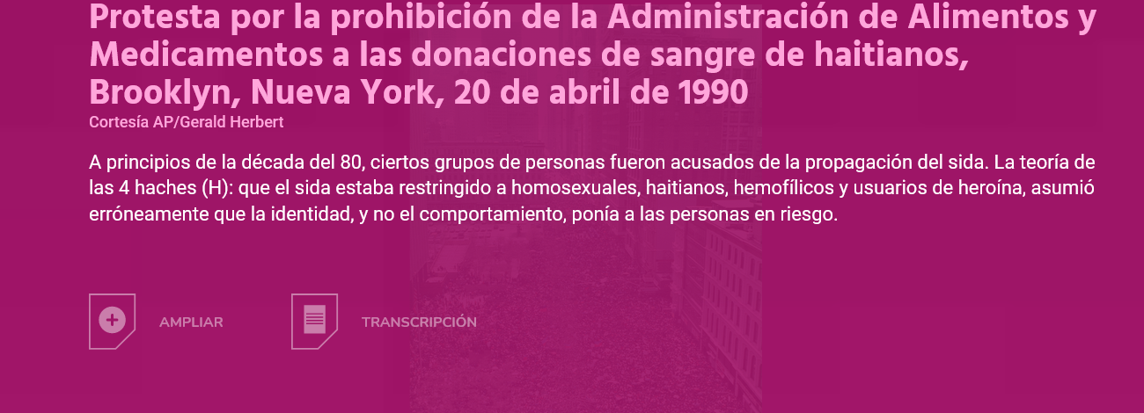
NLM Exhibition Program
Notes:
Some of the exhibits focus on health professions, others on historical and current health issues.
This screenshot is from the online exhibit for Surviving and Thriving: AIDS, Politics, and Culture/Sobrevivir y Prosperar: Sida, Política y Cultura
Online resources for marketing your exhibit as well as programming for your community or partners
Learn more about hosting an exhibit and see the full list. The link will be placed in the chat box.
https://www.nlm.nih.gov/hmd/get-involved/hostexhibitions.html

Slide 37
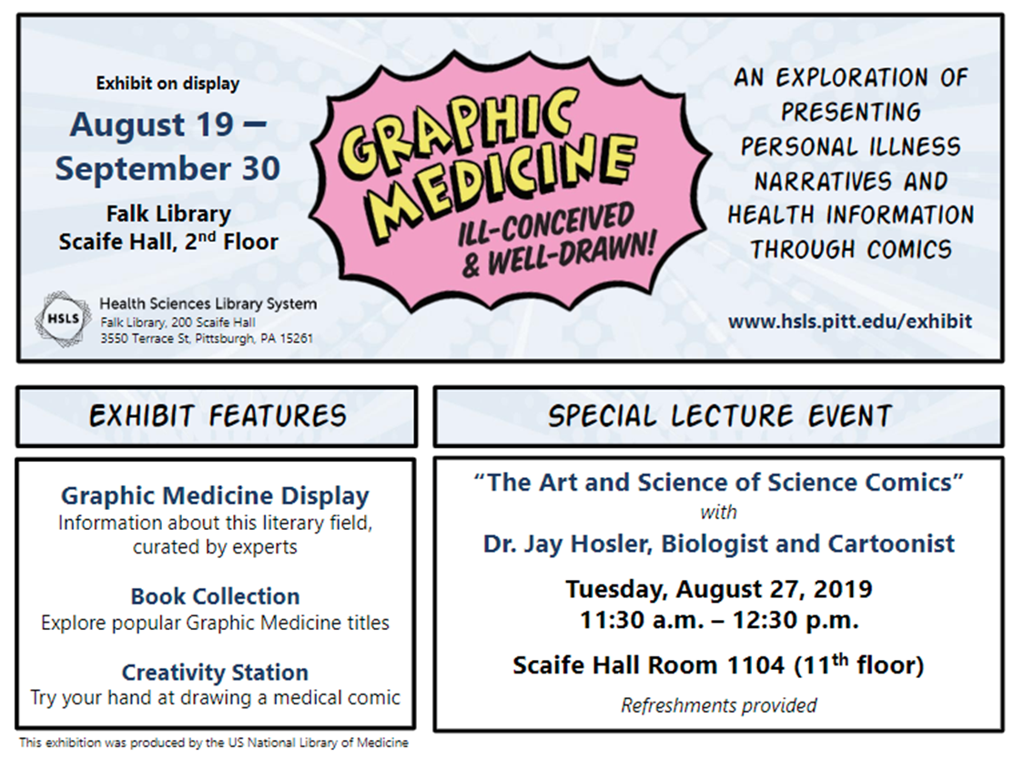
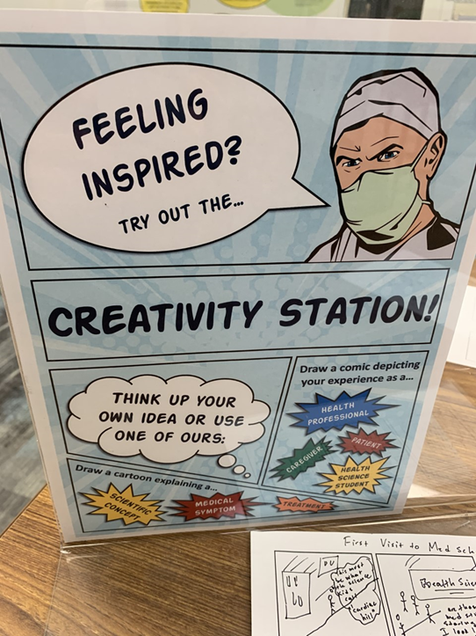
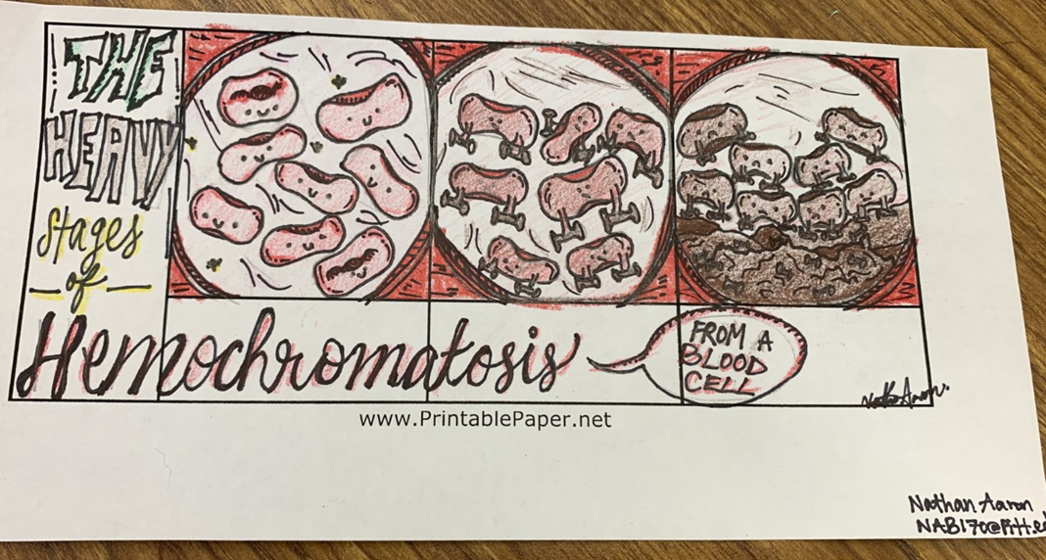
NLM Exhibition Example
Host a Traveling Exhibition
Notes:
This is an example from the traveling exhibit Graphic Medicine: Ill-Conceived & Well-Drawn!
It is about the use of comics and graphic novels as a form of communication about health. It features El Deafo and several other graphic novels focused around health narratives.
University of Pittsburgh Health Sciences Library – As part of the exhibit, they featured books and a drawing competition, And invited a biologist and cartoonist to give a lunch and learn presentation.

Slide 38
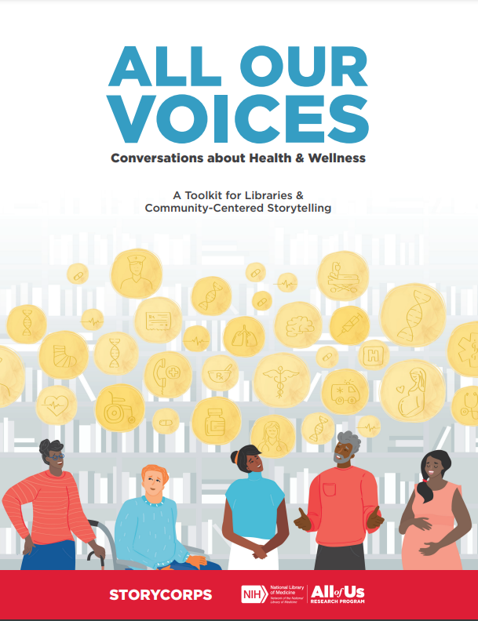
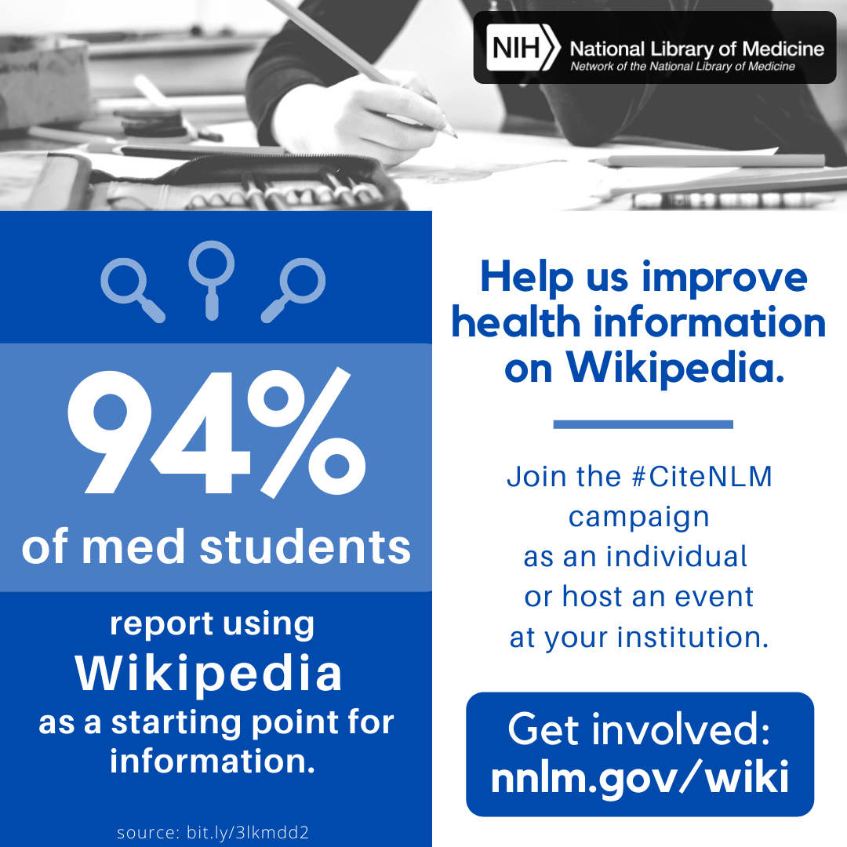
Activities with NNLM Partners!
StoryCorps: All Our Voices Toolkit
Citizen Science Month
#CiteNLM Wikipedia Edit-a-thon
Notes:
NNLM Partners with a variety of organizations to offer projects, programs, and resources for libraries.
StoryCorps
Citizen Science Month
#CiteNLM Wikipedia Edit-a-thons
***
Raise your virtual hand if you have ever heard StoryCorp.
Since 2003, StoryCorps has given over 600,000 people of all backgrounds and beliefs the chance to record interviews about their lives and preserve them in the Library of Congress.
All Our Voices: Conversations about Health and Wellness is a Toolkit for Libraries & Community-Centered Storytelling
The Toolkit includes programming tools, promotional materials, and more to support listening, sharing, and recording stories at the library.
All Our Voices: https://allofus.nnlm.gov/storycorps
***
Citizen Science and Crowdsourcing is an NIH Priority area for NLM
Simply put, Citizen Science (or community science) is participation by the public to aid in real scientific research and discovery.
NNLM develops resources with and conducts programming with SciStarter – an organization focused on advancing engagement from the public in research. SciStarter maintains a directory of project that members of the public may contribute to – bird and insect counts, light pollution, animal behavior surveys, gamified research on Alzheimer's disease, and so many more.
Since 2016, SciStarter has organized Citizen Science Month with NNLM and many other partners. Each April, librarians, scientists, facilitators, citizen science project leaders and many others host events and programs that engage people from all walks of life in real science that matters to them.
#CiteNLM Wikipedia Edit-a-thons
Wikipedia is the starting point (and sometimes the ending point) for information for a lot of people, on all kinds of topics, including health.
Wikipedia’s health topics pages are visited a staggering 7 billion times a year, making it possibly the world’s most popular health information resource. The objective of #CiteNLM is to improve the credibility and content of medical and health-related articles on Wikipedia by adding citations and information from National Library of Medicine (NLM) sources.
Twice per year, NNLM staff virtually host #CiteNLM Wikipedia Edit-a-thons in an effort to make Wikipedia a better health and medical information resource!
You can participate or host your own event – even virtually.
These types of events can build community, teach digital and health literacy and evaluation skills, and work to amplify stories.

Slide 39
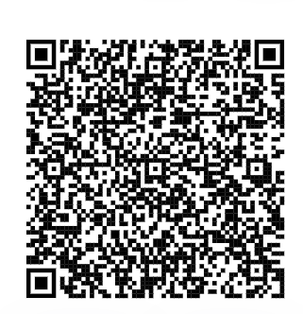
NNLM Reading Club
Ready-to-use toolkit for hosting health-topic book discussions
Books, discussion guides, and health resources
Over 30 topics and 130 titles
Participate with us!
Explore the NNLM Reading Club
Provide Feedback (URL or scan QR code)
Notes:
Many of your libraries include materials that focus on or are related to health. Providing health information through various formats is one way of providing health outreach.
The NNLM Reading Club is a curated list of health-themed books from a variety of genres to facilitate conversations on health and wellness topics. By reading different health topics in a safe setting, people can learn about health information, reducing the stigma surrounding some diseases and health conditions.
Included with each book is a discussion guide and free health information from the National Library of Medicine and other trustworthy resources.
We also want to hear from you. We encourage you to visit the Reading Club webpages to discover books, download discussion guides, and get the health conversation going with your communities.
As the information experts for your community, please advise us on books and health topics or tell us how you have adopted an NNLM Reading Club book for a community read. We want to know your story.
…...
NNLM has developed an online health literacy toolkit to help busy library staff host a popular and familiar library program – the reading club.
The NNLM Reading Club is a curated list of health-themed books to facilitate conversations on health and wellness topics. By reading different health topics in a safe setting, people can learn about health information, reducing the stigma surrounding some diseases and health conditions.
Book suggestions include fiction, memoirs, graphic novels, young adults, and even poetry and short stories. Also, each book includes a discussion guide to download, making it easy to host a discussion. Also included is free health information from NLM and other trustworthy resources. Visit the NNLM Reading Club webpage to discover over 30 health topics and 130 books.
We also want to hear from you. As the information experts for your community, please advise us on books and health topics or tell us how you have adopted an NNLM Reading Club book for a community read. We want to know your story.

Slide 40
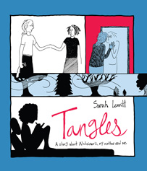
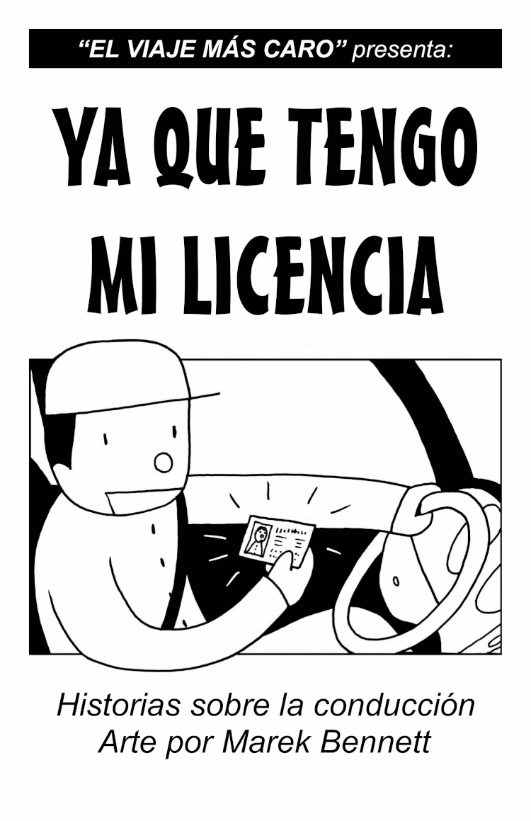
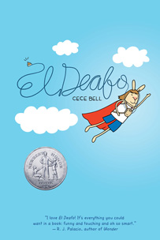
Graphic Medicine 2
“Graphic medicine is the use of comics to tell personal stories of illness and health.”
Learn more:
GraphicMedicine.org
Graphic Medicine: Ill-Conceived and Well-Drawn! (NLM Traveling Exhibit)
Book discussion guides, Region 7 Graphic Medicine Initiative
Interested in Graphic Medicine in your region?
Contact your RML
Notes:
If you already host a book club, consider exploring graphic medicine.
Graphic medicine combines visual storytelling and medicine, creating a unique opportunity for readers to experience and learn about healthcare experiences through comics.
You probably already have a graphic novel section, and considering ones that include a health focus can be a way to approach a complex health topic that makes it less daunting, and for many, comics can help improve retention of information.
Those of you from Region 7, including New England states and New York, can get kits and become part of a Community of Interest. The rest of you still have access to selected graphic medicine book discussion guides.
You can host the National Library of Medicine's Graphic Medicine exhibit, plan programs and exhibits around it, and use the online exhibit for resources. The link to the guide will be placed in the chat.
GraphicMedicine.org is also a great website with lots of resources to check out.
https://www.nnlm.gov/guides/region-7-graphic-medicine-0

Slide 41
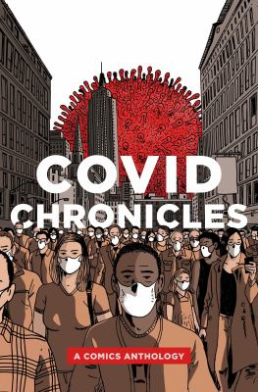
Graphic Medicine
Graphic medicine combines visual storytelling and medicine
Topics such as addiction, epilepsy, grief, mental health, cancer, and more
Full booklists, discussion guides
Pictured: COVID Chronicles edited by Kendra Boileau and Rich Johnson
Notes:
Graphic medicine combines visual storytelling and medicine, creating a unique opportunity for readers to experience and learn about healthcare experiences through comics.
You probably already have a graphic novel section, and considering ones that include a health focus can be a way to approach a complex health topic that makes it less daunting, and for many, comics can help improve retention of information.
You can host the National Library of Medicine's Graphic Medicine exhibit, plan programs and exhibits around it, and use the online exhibit for resources. The link to the guide will be placed in the chat.
GraphicMedicine.org is also a great website with lots of resources to check out.
https://www.nnlm.gov/guides/region-7-graphic-medicine-0
Topics such as COVID-19, addiction, epilepsy, grief, mental health, cancer, and others can be discussed by using graphic medicine.
The book Covid Chronicles is listed here.
Graphic Medicine Initiative
(nnlm.gov/ner/graphic-medicine)
More reading
(graphicmedicine.org)

Slide 42
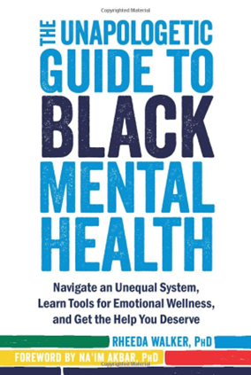
Diverse Voices in Health & Medicine Collections
5 Downloadable Toolkits for Adults, Children, Teens, Adult Zines, and Graphic Medicine
Features more than 1,900 titles
Explore the Diverse Voices Collection
Notes:
IN 2021, NNLM Region 5 funded 27 Collection Equity Outreach Awards to member organizations in the region that used the grants to purchase materials that supported the collection equity goals submitted in their applications.
Each funded organization submitted a bibliography of purchased materials, and these bibliographies were then used to compile the content for several Collection Development Toolkits.
Region 5 staff then compiled and organized the materials by subject, resulting in over 1900 unique resources from multiple genres and formats, which were separated into five collections and are free to download as searchable pdf files.
We hope this toolkit will continue to help to build collections that reflect voices of the communities served, enhance collection equity, and support health literacy by illuminating health issues facing underserved and under-represented populations.
The link to the Diverse Voices in Health and Medicine Collections will be in the chat.
https://www.nnlm.gov/reading-club/diverse-voices-collection

Slide 43
How did it go?
Notes:
Hopefully, these marketing examples sparked some ideas for you in carrying out future programming plans. I want to check in on you to see how activity three went.
Did you select the logic model or the seven key questions? How did it go?

Slide 44
Partner with NNLM
Membership – Funding – Training
Notes:
Now we'll talk a little bit about how to partner with NNLM to design and implement health programs and resources in your library.

Slide 45
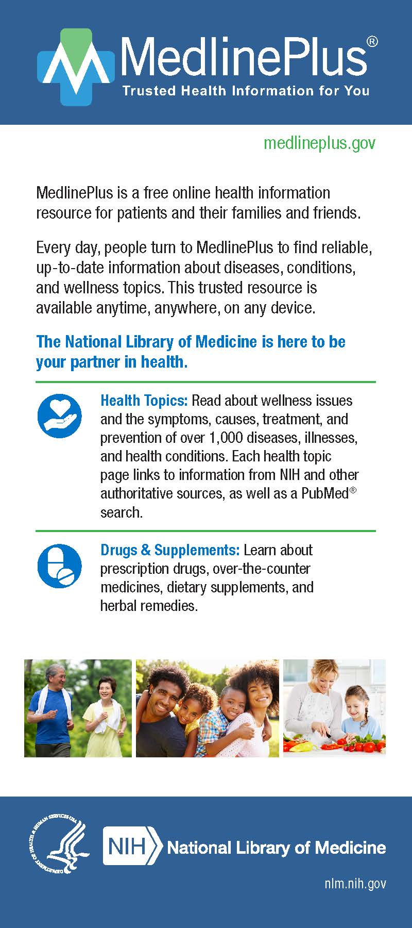
NNLM Guides & Resources
Order Free Informational Materials
NNLM Proposal Writing Toolkit for funding)
NLM Product Guides: Resources from the National Library of Medicine
Notes:
NNLM has a variety of resources to help design and implement health programs and resources in your library.
Browse NNLM’s curated collections that feature tools and programs, and informational materials from NLM, NIH, and other trusted sources of health information, research data, outreach toolkits, training opportunities, and much more.
The Public Libraries Resource Guide is focused on health information needs in libraries including programming and collections information.
Additional guides and toolkits include but are not limited to black maternal health, emergency and disaster preparedness, and grant proposal writing.
Downloadable print materials, also available for order.

Slide 46
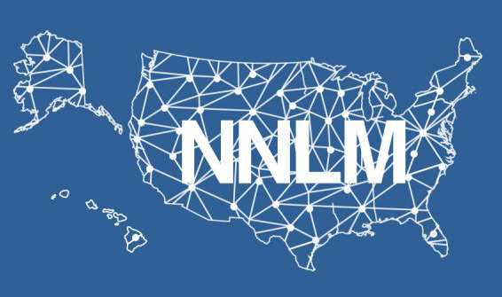
About NNLM
NIH/NLM Initiatives & Priorities
Confronting Health Misinformation
Bridging the Digital Divide
Environmental Determinants of Health
Traveling Exhibitions
Citizen Science and Crowdsourcing
Data Science
Student Engagement
Substance Use Disorders
Notes:
Our network has regional medical libraries, offices, and centers throughout the nation to have regional and specialized support. Much of our work is driven by strategic initiatives and priorities. Currently, we are focused on the topic areas listed on the screen, and these topics evolve as new health information priorities and needs arise in our communities.

Slide 47
NNLM All of Us Program Center
Partnership with NIH All of Us Research Program
All of Us aims to invite at least one million people to share health data to improve health research and care for all
Connecting All of Us and public libraries as partners
Notes:
The NNLM also partners with other NIH initiatives to advocate for libraries as critical community partners when it comes to health and medicine. The NNLM All of Us Program Center, is an example of this. The NNLM partners with the NIH All of Us Research Program, which is creating the largest and most diverse health database of its kind by inviting at least one million people to participate in the program to better understand why people get sick or stay healthy. All of Us also prioritizes privacy and building trust with their intended communities through community-driven engagement, and the goal is to partner with public libraries to promote health literacy and connect communities with All of Us, particularly those underrepresented in biomedical research.

Slide 48
What is All of Us?
Available on YouTube with Captions
Notes:
What is All of Us?
Here is a short animation about All of Us.. YouTube Link with captions: https://youtu.be/ti50nS7B5vI
To Learn more about the All of us Research Program visit www.joinallofus.org/nlm
1 Min 55 sec

Slide 49
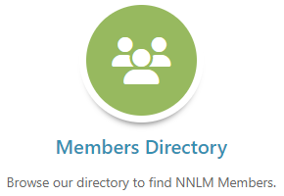
NNLM Membership – always free
Over 8,500 Member Organizations – libraries, schools, community organizations, and more
Full access to NNLM offerings and support
NNLM Membership Directory
Check out other NNLM Members in your community
Become a Member
Notes:
The easiest way to partner with us is to become an organizational member. Any organization that supports health info resources and services to their community can become an NNLM member. Being a member and accessing our offerings is always free.
NNLM organizational members have access to free educational and printed materials, funding opportunities, and more.
--
Member organizations are eligible for benefits and services, including: NNLM funding, access to training, partnership opportunities, free educational and printed materials, NLM Traveling Exhibitions, and institutional recognition as a Network Member.
Additionally, your organization will be listed in the NNLM Membership Directory – an opportunity for partnerships.

Slide 50
NNLM Funding Opportunities
Various opportunities, timelines,
and amounts by region
Example Award Types:
Outreach
Technology
Professional Development
Data Science
All of Us Research Program Engagement
Example of previous funding opportunity
Explore Available Funding
Notes:
The projects we highlighted earlier all received some form of funding support from the NNLM, which again, you can also access as an NNLM organizational member. Each region offers funding for various amounts, timelines, and topics.
If you'd like feedback on an idea, you can always reach out to your regional medical library for a consultation.

Slide 51
Tools for NNLM Funding
NNLM Proposal Writing Toolkit
Tips and resources to use while developing and submitting your NNLM funding application
General proposal writing resources included
How to Apply for NNLM Funding
Annual webinar
Recording available on YouTube
Notes:
Because of our extensive funding opportunities, we also provide plenty of resources and support to those new to applying for an NNLM award, or just new to the grant writing process in general.
We have a Proposal Writing Toolkit with lots of guidance, examples, and resources for granting writing. We also offer a yearly webinar about how to apply for NNLM funding, regardless of region. Our annual session was in September and the recording is available on the NTO YouTube channel. So check it out!

Slide 52
NNLM Training and Classes
Environmental Health and Justice: a brief primer
Health Literacy On Demand
MedlinePlus Tutorial for Librarians and Health Educators
Assessing Health Education Materials
Providing Mental Health Resources at Your Library
Consumer Health Collection Management
Providing Multilingual Health Information
Notes:
Throughout the year, we also offer free trainings in a variety of formats, including on-demand and recorded webinar sessions so that you can take them at your own convenience.
The classes are always free. And often, we are available for in-person trainings for staff at your organizations.
These are some of the classes that may help you learn more to meet the health information needs of your community. And if your organization isn’t yet a member, sign up today to be listed in our member directory.
https://nnlm.gov/training

Slide 53
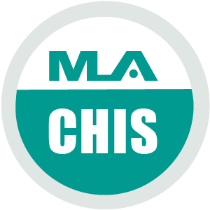
Consumer Health Information Specialization (CHIS)
Learn more about CHIS
Notes:
The Consumer Health Information Specialization is a professional development program through the Medical Library Association, that can help you gain skills in areas such as understanding your community (like we’ve done today), finding and evaluating health information resources, and improving health literacy.
Taking a class like you are today will earn credits toward your consumer health information specialization or CHIS.
One thing that stops a lot of library staff from providing health information outreach, is feeling like they don’t know the resources.

Slide 54
CHIS Classes
12 CE credits across 5 competencies
Free training classes through NNLM
Sponsored application fee
Good for 3 years
Select Courses
Beyond an Apple a Day: Consumer Health
Health Misinformation Webinar series
Introduction to Health Reference: Ethics and Best Practices
Consumer Health Collection Management
NNLM Book Discussion
Providing Mental Health Resources at Your Library
Notes:
Taking certain courses can also help you qualify to receive CHIS.
There is an application fee through MLA for specialization, but NNLM can often reimburse you for the cost of the CHIS application fee.
Getting this specialization on your own or with a group at your library can be a way to boost health information offerings. Something your library can promote as another service to your community.
---
The CHIS is good for 3 years, and then you can renew.
Some of our most popular trainings focus on topics like consumer health resources, health misinformation, health reference, collection development, and mental health.

Slide 55
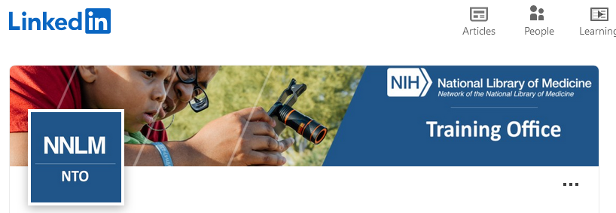
Connect with NIH,NLM, & NNLM
Connect with us!
Add NLM resources and news feed information to your organization’s web and social media sites!
Help combat health misinformation!
Notes:
Community advocates, nurses, teachers, and librarians are trusted among the public – within their families, social circles, and work.
There is a wealth of inaccurate and downright predatory health information online. NLM maintains many social media pages to share our resources and combat dangerous health misinformation.
There are many ways to connect with NIH, NLM, and NNLM. Choose the one that's right for you—using LinkedIn, Facebook, Pinterest or Blogs.

Slide 56
What idea are you most excited to use?
Notes:
I want to conclude with a reflection activity by asking you what idea are you most excited to use.
If you want to share, please do so. I would love to hear from you!

Slide 57
Resource List
Health Equity and Access
All of Us Research Program
Centers for Disease Control and Prevention(CDC) Health Equity Resources
American Public Health Association(APHA) Health Equity
Substance Abuse and Mental Health Services Administration(SAMHSA) Behavioral Health Equity Resources
World Health Organization(WHO) Health Equity
Medline Plus: Health Information in Multiple Languages
Cultural Humility
CDC Cultural Humility and Community Engagement
U.S. Department of Health & Human Services(HHS) Think Cultural Health
NNLM Training Video: "Integrating Cultural Humility into Practice" by Twanna Hodge
TEDXMemphis: "Reimagining the Public Library to Connect the Community" by Shamichael Hallman
Notes:
Last slide! If you have explored the resource list, you will see additional resources about health equity and cultural humility
Before coming to the NNLM training office, I was a health sciences librarian, so these resources will be informative and helpful. Before we can genuinely help and support our communities, we must understand their barriers and be aware that health access looks different for everyone. Also, many people who are different from us are entering our libraries, and cultural humility is a crucial way to engage with people meaningfully and kindly.

Slide 58
Questions and Thank You!
Please complete the short evaluation upon exit!
Jamia Williams, MLS Consumer Health Program Specialist National Network of Libraries of Medicine Training Office (NTO) jamia.williams@utah.edu
Notes:
If you are new to health programming, start small. Integrate reminders throughout your library for students and staff to take breaks or invite a music major to play for an hour in your library.
Thanks for attending today! I hope you picked up some valuable resources for your work and life. If you see me out and about, most likely at a conference, please say hello!
Please complete our class evaluation to help us improve so you can claim credits toward your CHIS.
If you want to stay on the call, I can answer any of your questions.

