Slide 1
CONSUMER HEALTH COLLECTION MANAGEMENT

Slide 2
Instructor Introduction
Carolyn Martin, MLS, AHIP
Consumer Health Coordinator
Network of the National Library of Medicine, Pacific Northwest Region (NNLM PNR)
Previously a medical librarian at hospital systems in Indianapolis
Notes:
Instructor name and photo

Slide 3
Course Overview
Self-paced
One hour-long recorded video session
1.5 – 2 hours of assignments on your own each week
Assignments = reading, exploring, planning for your library and submit in Moodle
4 CE credit hours

Slide 4
At the end of this course, you will be able to…
Assess the quality of your library’s current health information materials
Identify quality health information resources
Select authoritative health information resources
Explain and provide justification of the library’s health information collection

Slide 5
Session Agenda
An Introduction to Health Collection Management
Review Your Collection Policy and Procedure
Know Your Community
Evaluate Your Collection
Adding Resources
This Photo by Unknown Author is licensed under CC BY-SA-NC

Slide 6
Activity: Tell us…
What is your confidence level in your library’s present Health Collection Management Process?
1
Extremely underconfident
2
Not very confident
3
Neutral
4
Somewhat confident
5
Very confident
Notes:
Ice Breaker Activity Slide

Slide 7
INTRODUCTION TO HEALTH COLLECTION MANAGEMENT

Slide 8
What is in your library’s Health Collection?
Physical Collection
Reference Resources
Circulating Materials
DVDs
Things
Electronic Collection
Free web-based resources
Paid databases

Slide 9
Collection Management
Collection Management
Selection Policies and Procedures
Community Needs
Library Goals and Objectives
Public Demand
Existing Collection
Changes in the Environment

Slide 10
Health Collection Management Process
Review policy + procedures
Know your community
Evaluate your collection
Adding Resources

Slide 11
REVIEW COLLECTION POLICY AND PROCEDURES

Slide 12
Collection Development Policy
“The Collection Development Policy is designed to support the Library’s mission statement and serves as a guide for the selection, acquisition, maintenance, and retention of materials by establishing roles, responsibilities, and a process for addressing Library user concerns.”
Collection Development Policy. New Orleans Public Library. Revised August 2, 2016.

Slide 13
Review your Library’s Collection Procedures
Library collection procedures:
Tactical rather than strategic
Influenced by budget and acquisition priorities
A collection procedure should include:
Selection and de-selection (weeding) criteria
Role of physical and electronic resources
Guidance for special subjects, such as Health
Review your policy
Know your community
Evaluate your collection
Adding Resources

Slide 14
KNOW YOUR COMMUNITY

Slide 15
Community needs Public Demands
Community Needs
Public Demands
What are the community’s health concerns and interests?
What are environmental or prevalent health issues?
Who in the community does not visit the library, and how might their needs and interests be different?
What do patrons request?
Which health subjects are most checked out?
What health-related reference questions are most commonly asked?
Review your policy
Know your community
Evaluate your collection
Adding Resources

Slide 16
Know your community’s needs
What do you already know about the community’s unique needs for health information and services?
What needs would you like to understand better?
Review your policy
Know your community
Evaluate your collection
Adding Resources

Slide 17
Researching Community Needs
Health statistics for your community
County Health Rankings & Roadmaps
Rural Health Data Explorer
City Health Dashboard
Contact local healthcare service providers about health issues in your community (and start building a relationship)
Contact local government agencies, nonprofits, news sources, senior centers, etc.
Talk to patrons about health needs
Community outreach to those not coming to the library - go to them

Slide 18
Identify community needs that are beyond print and online
Circulation of things
Bicycles
Wheelchairs
Pedometers
Exercise equipment
Seeds
http://archive.wppl.org/info/checkout-bikes.html
Review your policy
Know your community
Evaluate your collection
Adding Resources
https://www.kclibrary.org/library-locations/irene-h-ruiz-biblioteca-de-las-americas/seedlibrary

Slide 19
EVALUATE YOUR COLLECTION

Slide 20
Evaluate your collection for…
Authority – science-based
Currency – fact and appearance
Appropriate to your community – language, age
Accessible – individually or via multiple formats
This Photo by Unknown Author is licensed under CC BY-SA

Slide 21
Weed health material ruthlessly
Closely evaluate any print material that is more than 2 years old.
Outdated materials must be promptly discarded.
Evaluate works on diet and exercise in the same way as all health material.
Do not regift weeded health material.
Do not hold on to an outdated print material just because it was expensive.
Review your policy
Know your community
Evaluate your collection
Adding Resources

Slide 22
KNOWLEDGE CHECK 1

Slide 23
Dermadoctor - Trust or Trash?
Trust
Trash
Maybe

Slide 24
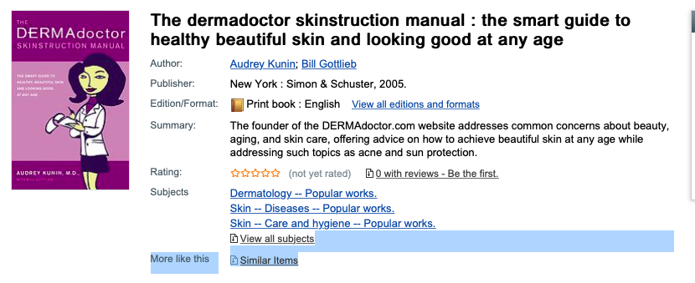
Dermadoctor - TRASH!
Reasons
Out of date
Author is selling skin-care products (see mentioned website)

Slide 25
ADDING RESOURCES

Slide 26
The core of the health collection should be online.
Constantly updated databases
Reflects current medical practices
Free
Does not take up space
Review your policy
Know your community
Evaluate your collection
Adding Resources

Slide 27
An Authoritative Set of Online Resources
Public Library Online Health Collection Resources List
All free resources
Relies on evidence-based science and current medical practice
Updated very frequently
Still needs regular evaluation
Image by Bruno /Germany from Pixabay
Notes:
Pixabay: Stethescope - Image by Bruno /Germany from Pixabay

Slide 28
MedlinePlus

Slide 29
Healthy Community Tools > Databases
Notes:
https://publiclibrary.health/databases

Slide 30
Additional Resources
Consider adding:
Web-sites specific to locality or community needs
Small selection of print materials
Things
Review your policy
Know your community
Evaluate your collection
Adding Resources
Notes:
Image?

Slide 31
Community needs and local resources
Topics of interest such as specific medical conditions
e.g. The Parkinson’s Foundation
Local health information and organizations
e.g. Trenton Health Team
Review your policy
Know your community
Evaluate your collection
Adding Resources

Slide 32
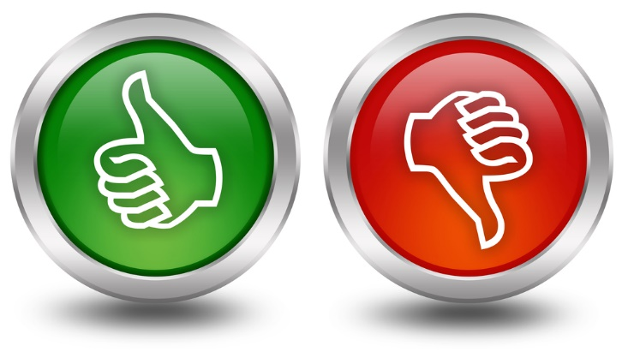
Evaluate Websites
Review websites regularly for:
Authority, objectivity, currency
Coverage, presentation, ease of access
Fit between intended audience and your users
Review your policy
Know your community
Evaluate your collection
Adding Resources
This Photo by Unknown Author is licensed under CC BY-SA

Slide 33
KNOWLEDGE CHECK 2

Slide 34
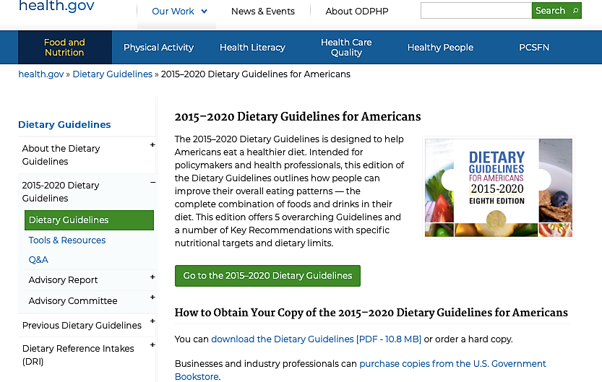
Health.gov - Trust or Trash?
Trust
Trash
Maybe

Slide 35
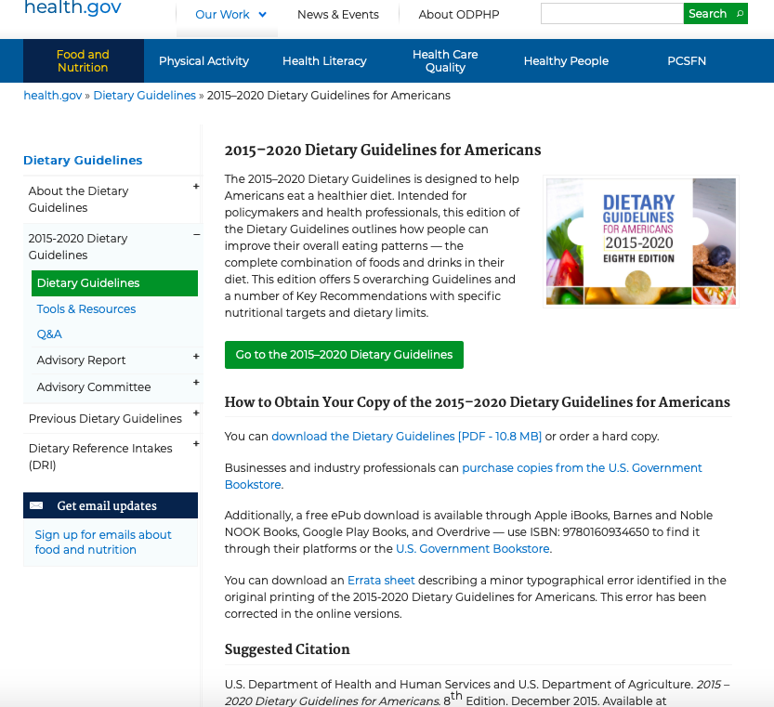
Health.gov - TRUST!
Reasons
“.gov” = government site = reliable source
Specific article dated 2015 - 2020

Slide 36
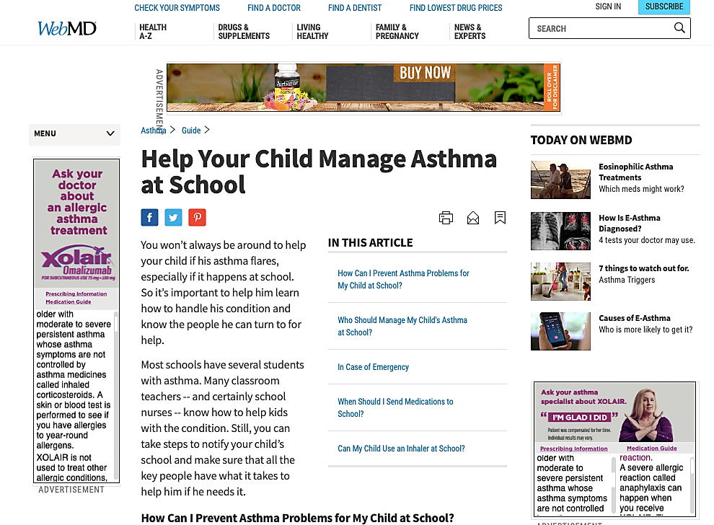
WebMD - Trust or Trash?
Keep
Toss
Maybe

Slide 37
WebMD - TRASH!
Reasons:
Targeted advertising – Asthma treatment
Inexpert web users have difficulty differentiating ad content from subject material.
When was this last updated?
Who is the authority?

Slide 38
ADDING PRINT RESOURCES

Slide 39
Print materials you may want to add
Latest Gray’s Anatomy edition
Current state health code
Cookbooks currently listed as high value by the American Heart Association
In the youth collection:
Current, well-reviewed books about the body and puberty
Chronic diseases of childhood
Nothing more than 5 years old
American Heart Association. (2019). The New American Heart Association cookbook.
Review your policy
Know your community
Evaluate your collection
Adding Resources

Slide 40
ADDING A CIRCULATING COLLECTION OF THINGS

Slide 41
Some Examples
Community Needs | Solution | Things that can be offered
Obesity / Heart Disease | Encourage physical exercise | Fitness equipment
Mobility for Seniors | Assistive equipment | Wheelchairs
Grow Own Food | Encourage education about gardening | Seeds

Slide 42
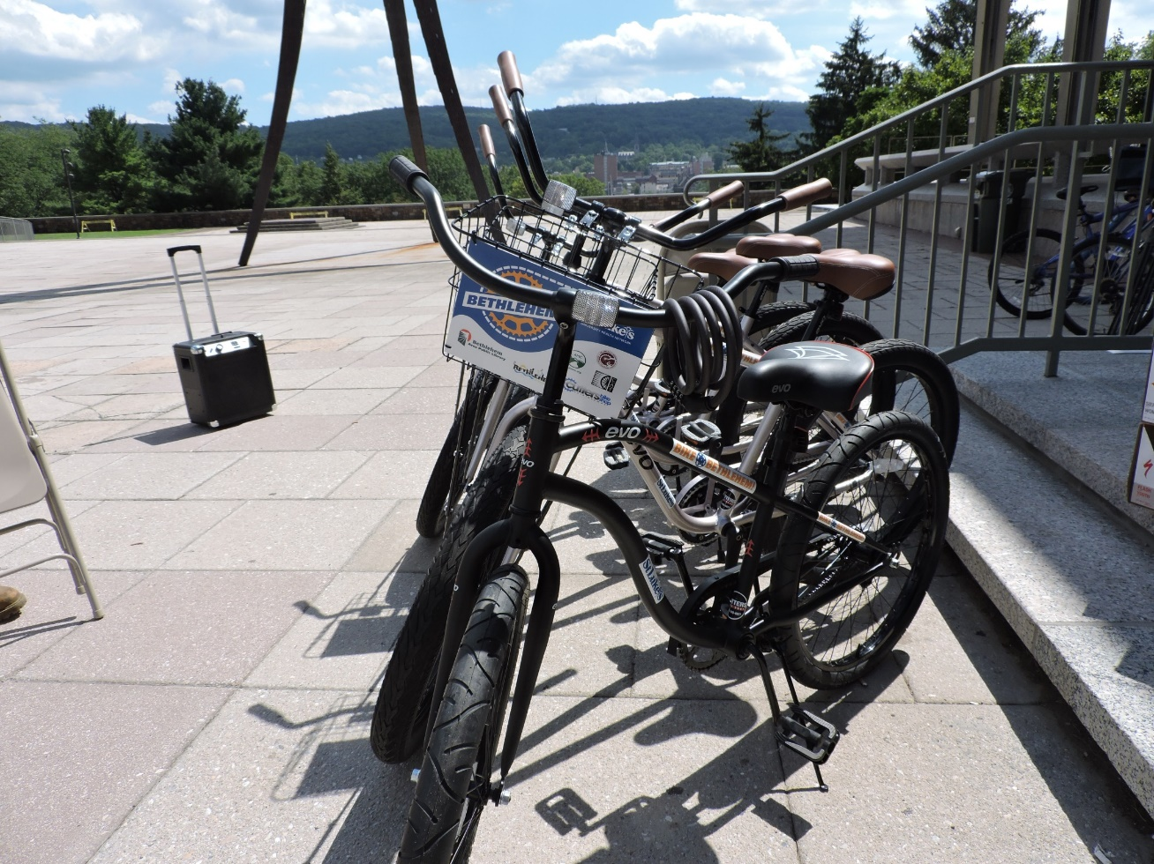
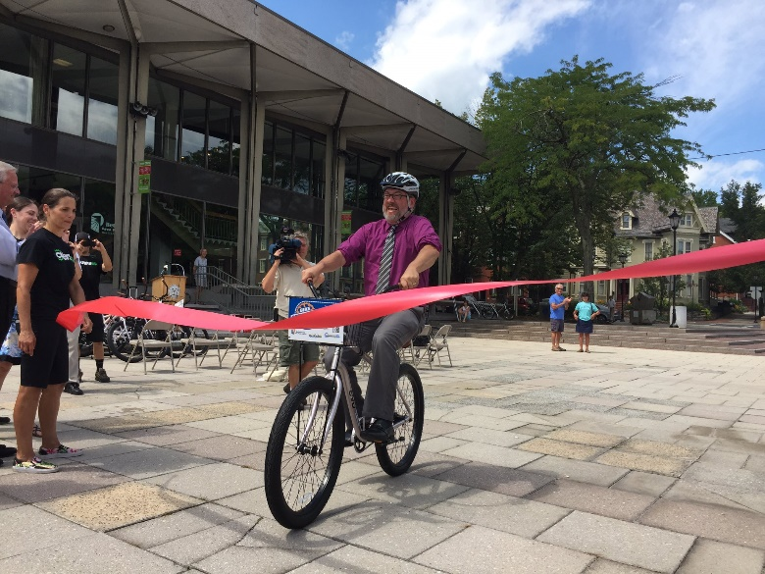
Lending Bikes
Bethlehem Area Public Library
Josh Berk, Director
https://www.bapl.org/bike-bethlehem-is-back/
Photos courtesy of Josh Berk

Slide 43
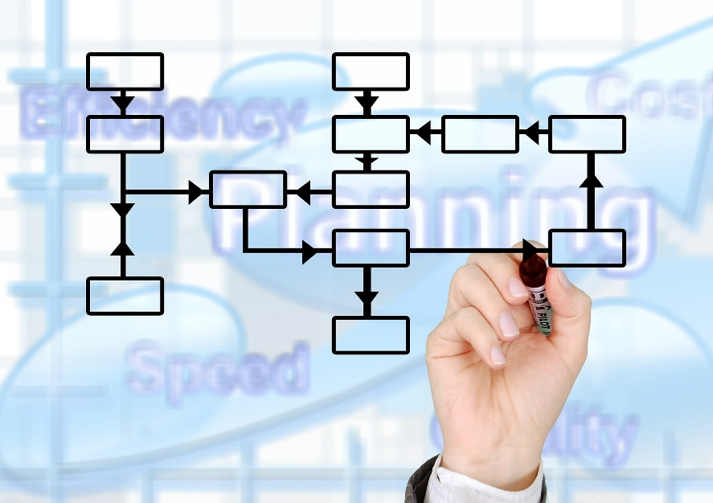
Process of offering “things”
Understand your community needs
Know your budget constraints
Seek external funding
Create a plan (more like a program than a collection)
Market your offering
Measure your success
Image by Gerd Altman on Pixabay

Slide 44
Factors defining success in lending things
Rate of borrowing
Patron feedback
Public demand for more
Measure of Success

Slide 45
Your Health Collection
“Regardless of format, an optimal library collection is one that is reviewed on a consistent basis for accuracy, currency, usage, diversity, and subject area gaps.”
Collection Maintenance and Weeding. ALA. http://ww.ala.org/tools/challengesupport/selectionpolicytoolkit/weeding
Notes:
Concluding slide…

Slide 46
Assignment 1
Do these and submit following directions in Moodle for Assignment 1
Find your collection policy and procedures. Post a link to your policy and/or describe collection management procedures for health and medical resources.
What do you know about your community health needs?
Use the research tools we covered to discover the top health issues facing your community.
Describe an outreach activity you can do to discover additional health information needs. Who will you talk to? How will you reach out to them?

Slide 47
Assignment 2
Do these and submit following directions in Moodle for Assignment 2
Review your current health reference collection. Report on what you find, and how much should be kept vs. weeded based on the criteria from this course.
Are there any print resources you would like to add? What and why?
Review the Public Library Online Health Collections Resource List.
What would you add to address community health needs you have discovered?
What local resources will you add?
Are there any “things” you would like to explore lending in your library?

Slide 48
Questions or Comments?
Contact Carolyn via email, martinc4@uw.edu

