Slide 1
NIH Data Management and Sharing Series Session 3: Practitioner Perspectives on Education
Ariel Deardorff, Data Services Librarian
University of California, San Francisco Library
Nina Exner, Research Data Librarian
Virginia Commonwealth University Libraries
Notes:
Ariel starts us off

Slide 2
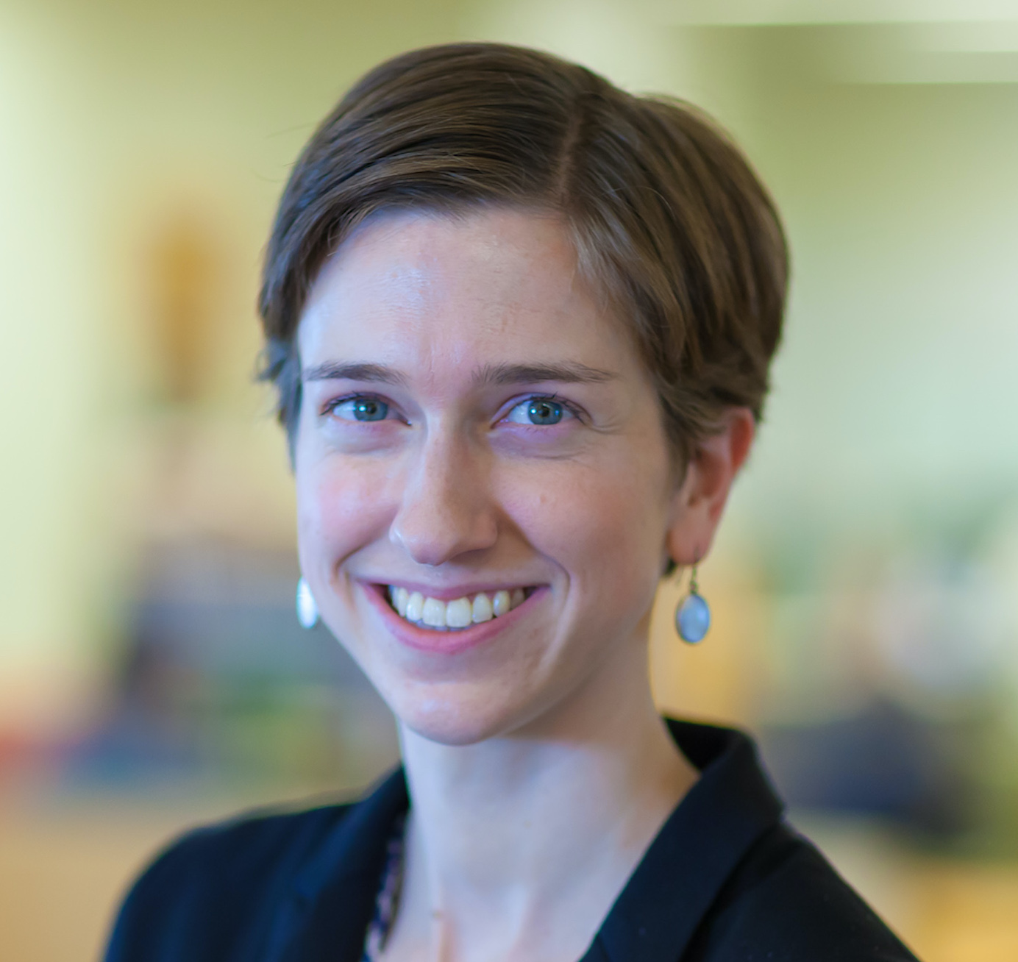
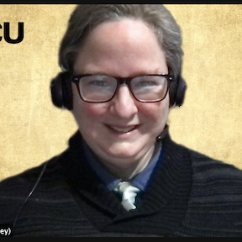
About Us
Ariel Deardorff, MLIS Data Services Librarian
University of California, San Francisco Library
ariel.deardorff@ucsf.edu
Nina Exner, PhD, MLS Research Data Librarian
Virginia Commonwealth University Libraries
nexner@vcu.edu
Notes:
Introduce ourselves

Slide 3
A process, not an answer
Identify audience(s)
Tailor
Roll out!
Adjust for next time
Who do you want to reach and what do they need? Almost as if you were building design personas, think about their interaction with the Policy; their needs; and learning styles
Look at the ways different content might fit the audience. There is a lot to know - probably too much to cover! What are the priorities?
Teach or share the content. Can’t find all the audiences you want? Partner and collaborate!
Interpretation of the policy, resources available, and faculty panic levels will change over time. Adjust as you learn too.
1
2
3
4
Notes:
Ariel takes slides 3-11
Help you think through how to do this work at your campus/institution
Identify your audience/personas

Slide 4
Identify Your Audience

Slide 5
Who will be impacted by this plan?
Leaders in the Office of Research
Administrative Staff
Postdocs, lab managers, research staff
Faculty
Graduate students
Other groups where you work?
Notes:
Some of the audiences/personas that we identified

Slide 6
Audience: Leaders in Office of Research
About: Not so much an instructional audience as an outreach and advocacy target
Their need: Be prepared before compliance trouble hits
Library instructional goal: Help them determine whether systems, policies, procedures, etc need changing
And that the libraries are there to consult if so!

Slide 7
Audience: Administrative staff
About: Staff in the grants office, privacy office, IP office, etc
Their need: Anticipate pain points in grant administration and compliance process
Library instructional goal: Share DMS Policy impacts at different stages in grant administration timeline. If necessary, start culture change around data sharing
pre-award, post-award, participant protection, etc

Slide 8
Audience: Postdocs, lab managers, research staff
About: These are the people that will likely be writing and carrying out the plans.
Their need: Understand what a good plan looks like, get their lab up to speed with requirements
Library instructional goal: Get it on their radar! And connect with relevant resources and answers

Slide 9
Audience: Faculty
Their need: How to get this done with as little hassle as possible
Library instructional goal:
It’s less hassle to integrate it into your grant writing workflow now than to argue and deny it
Normalize data sharing, advocate for a broader culture change.
Reduce worry and worry-driven resistance

Slide 10
Audience: Graduate student learners
About: Students in the sciences that will need to integrate DMPs into their future workflows
Their need: Figure out what data management and sharing looks like as part of their research
Library instructional goal: Use DMS Policy as a way to illustrate best practices in data management and sharing.

Slide 11
2. Tailor Your Education
Notes:
Nina takes slides 12-24

Slide 12
Tailor: Leaders in the Office of Research
Format: Short presentations, meetings, or email briefs
Content: High-level details of the policy (what/when/impact) and offers of help
Note: this is a great chance to connect with these leaders if you haven’t already!

Slide 13
Example: Leaders in Office of Research
Nina’s email to Assoc. VP of Research:
“Have you heard about the NIH data sharing thing? I know they’ve talked about it at meetings like the FDP and the NIH’s virtual Seminar. But those have been long and kind of abstract.
I’d love to talk about some key issues I see, and hear how I can help with your key concerns.”

Slide 14
Tailor: Administrative Staff
Format: Tailored presentations, departmental brown bags, and short updates (new FAQ)
Content: Overview of policy, how will it impact their procedures, where the library can be a resource

Slide 15
Example: Admin Staff
Ariel presented in Nov 2021 to a UCSF IT Governance Committee about how this new policy fit into the landscape of federal data management policies. This led to a conversation about the need for a coordinated campus rollout for the new NIH policy.
Notes:
Terminology - data safety and monitoring plan versus data management plan
Mention Office of Sponsored research taking on rollout with the Library as partners

Slide 16
Tailor: Postdocs, lab managers, research staff
Format: Webinars, workshops, and guidance
Content: What does a good plan look like, how to choose a repository, where to get help
Procedural “how to” with tools and resources
Such as but not limited to LibGuides (https://guides.library.vcu.edu/nihdmsp)
Introduce them to DMPtool.org

Slide 17
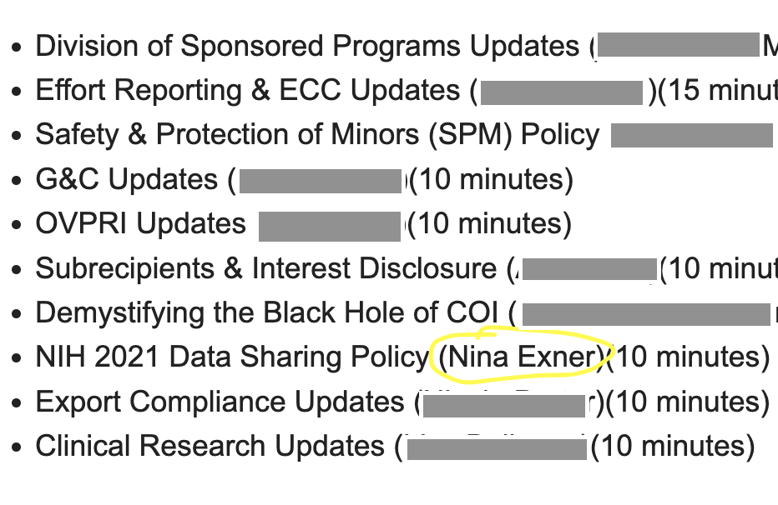
Example: Research Admin Staff
Nina presented to the “Research Administrators Back To School” semi-annual meeting of research administrators.
Nina’s focus was basic awareness and “Contact me for a custom talk to your unit!”

Slide 18
Tailor: Faculty
Format: Integrate into departmental meetings/grand rounds
Content: What does a good plan look like, sample budgets, how will it be evaluated

Slide 19
Example: Faculty
Ariel co-taught a mini workshop on data sharing and the new NIH requirements for a group of faculty at the UCSF BIXBY Center for Global Reproductive Health. The focus was on what to do in different parts of the research lifecycle.

Slide 20
Example: Faculty (2)
Nina offers talks and “mini talks,” to research brown bags and similar faculty or faculty/doc/postdoc research discussions.
Mini-talks cover niche topics, like repositories or the relationship of DMS Policy to security and privacy.
Example slides

Slide 21
Tailor: Graduate Students
Format: Asynchronous tutorials, bite-sized content in other sessions, framing for longer workshops
Content: Policy as a framework for introducing data management best practices

Slide 22
Example: Graduate Students
Module outline
Introduction and overview
The Data Management and Sharing Plan
Data Type
Related Tools, Software and/or Code
Standards
Data Preservation, Access, Timelines
Access, Distribution, or Reuse Considerations
Oversight of Data Management and Sharing
Repositories
Allowable costs
Principles, long-term concepts, and the data sharing “culture change”
Nina is creating a set of lessons that can be viewed alone, or as modules with assessments in Canvas (VCU’s learning management system).
She’s also offering to add a short overview of the DMS Plan into existing classes.

Slide 23
Example: Graduate Students (2)
Ariel is working on a 7 week course for biomedical graduate students at UCSF that will use the DMS Policy as a framework for introducing data management and sharing best practices throughout the research lifecycle. This will also satisfy NIH Responsible Conduct of Research (RCR) requirements.
Notes:
Write a data management plan for their research that incorporates best practices for data organization, storage, sharing, and security.
Design and implement an organization system for their data, methods and code.
Publish their data, code, scholarly articles, and/or methods in an open repository

Slide 24
3. Roll Out Your Education
Notes:
Ariel takes 25-27

Slide 25
Identify your Educational Partners
Who can you work with to increase your reach and impact?
Liaison Librarians
Other Data Librarians
ex: UC librarians working on template language
Research and Admin staff

Slide 26
Make a plan!
Identify your audience (personas) + their info needs
Make a timeline for your outreach/presentations
Identify educational partners
Start presenting!
Track your outreach and impact

Slide 27
4. Adjust For Next Time
Notes:
Nina takes 28 - End (aim for 5 minutes)

Slide 28
Learning as you Go
Policy guidance from NIH is still being released- you will need to keep tabs on emerging guidance and adjust on the fly
Track the questions that you get - what is confusing to people?
Integrate this into your guidance/documentation
Some groups might need several mini presentations
Be prepared to circle back as things change

Slide 29
THANKS!
What questions do you have?
ariel.deardorff@ucsf.edu
nexner@vcu.edu

Slide 30
CREDITS
Fundamental Resources
Special thanks to all the people who made and released these awesome resources for free:
Presentation template by SlidesCarnival
Icons from Noun Project
Introductory links, if you’re just getting started on the forthcoming DSM Policy:
The policy https://grants.nih.gov/grants/guide/notice-files/NOT-OD-21-013.html
An official overview https://www.youtube.com/watch?v=ZcD641ptWIY

