Slide 1
Culture and Health
Central to Healthcare Interactions…

Slide 2
Discussion points from last module
What are ways you have seen implicit bias affect health care?

Slide 3
Objectives
By the end of the program participants will:
Discuss how culture is central to physical healthcare interactions.
Notes:
(Note: Read the material from the slide)

Slide 4
Culture and Health
“A set of practices and behaviors defined by customs, habits, language, and geography that groups of individuals share”²
Culture is important to health care because cultural factors shape health-related beliefs, behaviors, and values³
Notes:
All of us at some point have most likely learned about culture and how it influences health. As a refresher, you can see a definition here that describes culture as, “a set of practices and behaviors defined by customs habits, language, and geography that groups of individuals share”². Culture is important to healthcare because it shapes things like our health-related beliefs, behaviors, and values³. When you hear the word culture, what comes to mind? (Take a few responses, spend less than a minute, there are no wrong answers.)

Slide 5
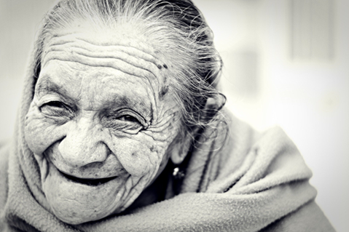
Important points about culture
Cultures can merge and change^{2,3}
Cultural values may be expressed more or less in different circumstances²
Culture is linked to conditions that surround a person, such as the economy and politics³
Culture is not only a persons’ race or ethnicity^{2,3}
Notes:
When we talk about culture however, it is important to remember that culture may not be the same throughout someone's life- a culture can merge and change over time^{2,3}. In addition, someone may express an aspect of their culture more or less based on the circumstance they are in². Our culture is linked to conditions that surround us, such as the economy or the political climate³. If you are thinking of culture as only linked to someone’s race or ethnicity, then these first three points might be surprising. However, culture is not only someone’s race or ethnicity^{2,3}. In fact, culture often differs between individuals of the same racial or ethnic group because these people differ in age, gender, socioeconomic status, religion, or even personality³.

Slide 6
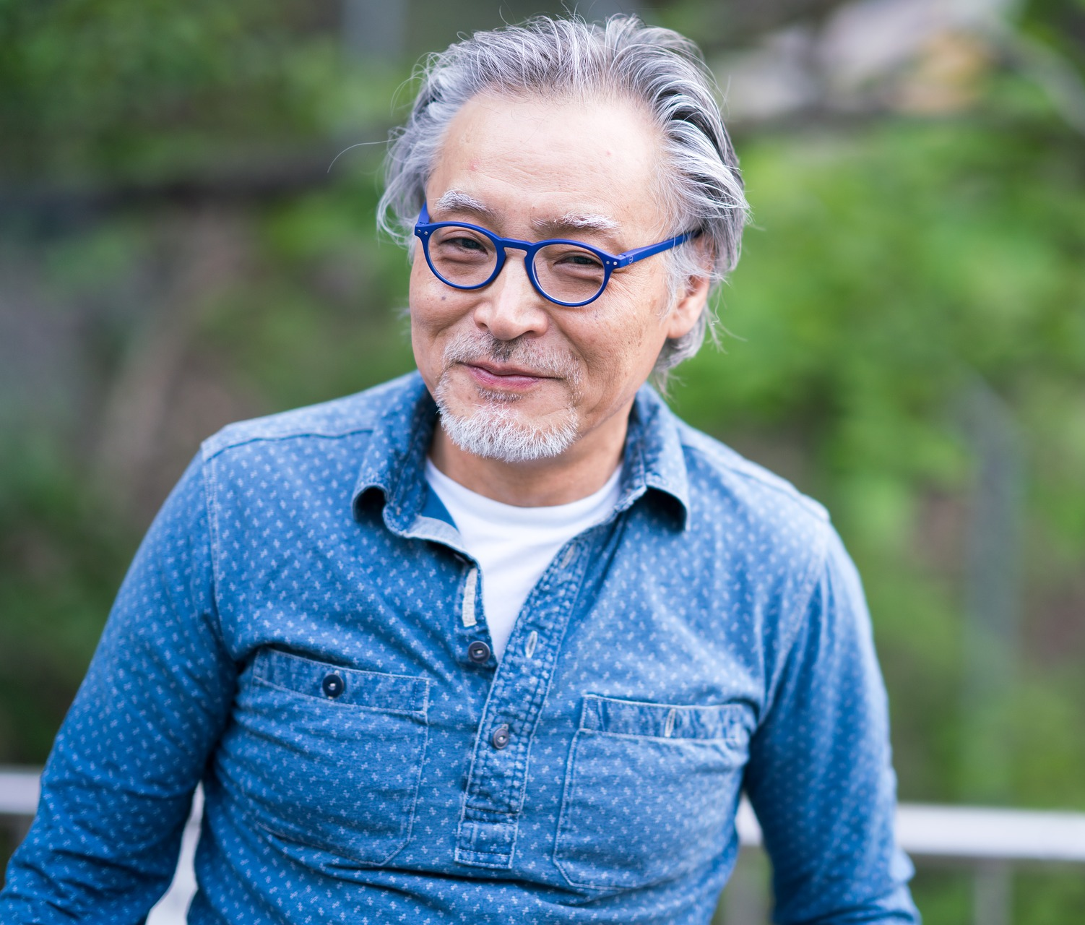
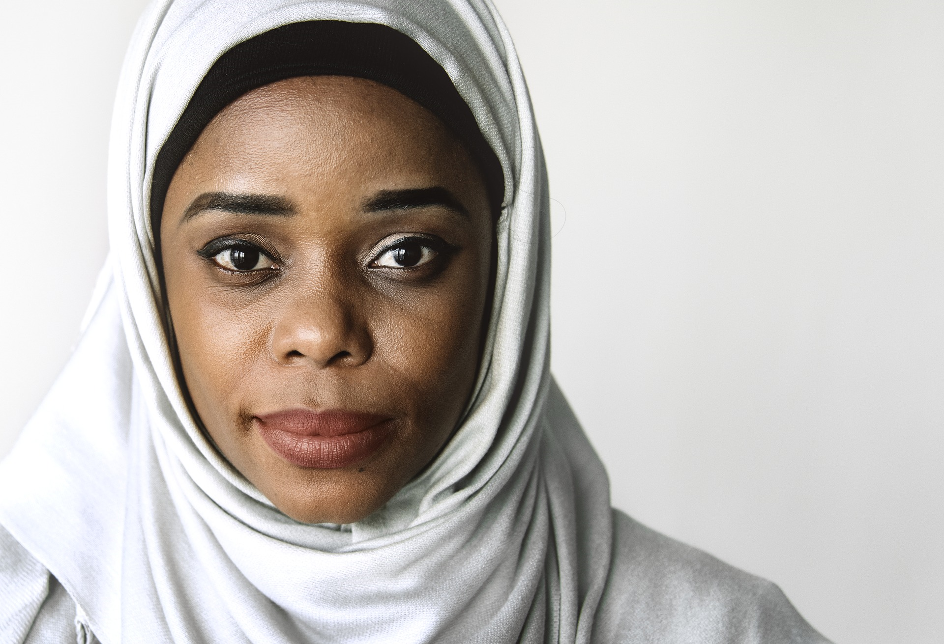
What Makes up Culture?
Age
Education
Ethnicity
Gender
Immigration status
Language spoken
Life experiences
Occupation
Physical ability
Race
Religion
Sexuality
Socioeconomic status
Notes:
You can see here a number of things that contribute to a person’s culture. It is likely that one person will find their identity in more than one of these. In addition, different people will feel more strongly connected with some of these factors than others.

Slide 7
Profession & Culture
“The cross-cultural reality is that even a patient who matches [their] doctor on age, gender, race, and native language will differ on other cultural dimensions. These could be family status, national origin, sexual orientation, and profession”⁴
Notes:
You may have noticed that one bullet point on the previous slide was occupation. This might be something that we would initially overlook as part of someone’s culture, but is important for us to consider as health care providers. You can see the quote here that says, “The cross cultural reality is that even a patient who matches [their] doctor on age, gender, race, and native language will differ on other cultural dimensions. These could be family status, national origin, sexual orientation, and profession”⁴. As we think about how we relate to patients, it can be helpful to consider how our culture differs based on occupation. A family physician named Robert Like said, “every clinical encounter is a cross cultural encounter”⁴. This is why using cultural humility to examine our own cultures, biases, and what we bring to an encounter with a patient is important. Being a healthcare professional means that we have the privilege of professional training, but it is important that we remember this and remain committed to ensuring understanding of healthcare information that we communicate to them⁴. This can be done considering some of the concepts discussed in the health literacy modules. [NOTE TO FACILITATOR: If you are completing these modules in an order other than suggested in the facilitation guide, you may need to adjust this note.]

Slide 8
Explanatory Models Approach
What do you call this problem?
What do you believe is the cause of this problem?
What course do you expect it to take? How serious is it?
What do you think this problem does inside your body?
How does it affect your body and your mind?
What do your fear most about this condition?
What do you most fear about the treatment?³
Notes:
Arthur Kleinman is an anthropologist who introduced this explanatory models approach³. This model is taught in some American medical schools to understand how someone’s culture affects their view of illness³. The authors do caution that this is intended to start a conversation and help someone see their expert knowledge alongside a patient’s understanding of their health or illness³ or recognize that their patient has a different perspective on illness². This model is not intended to “measure” someone’s beliefs or to be used at the end of a conversation².

Slide 9
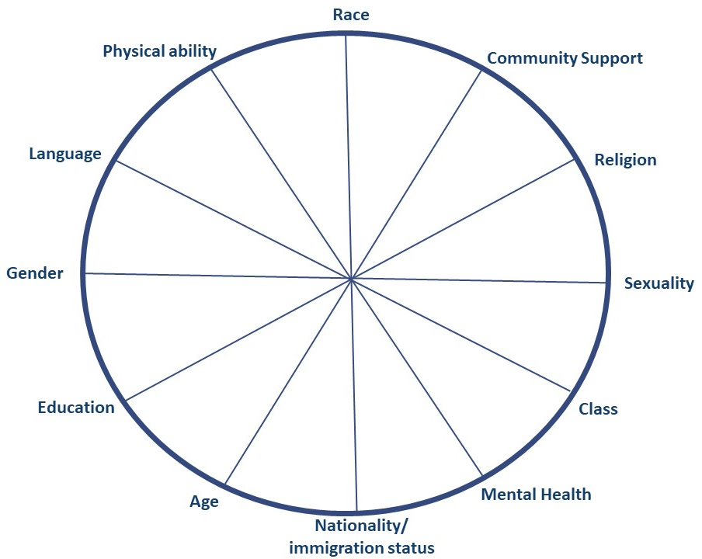
Power & Privilege Wheel
Fig 1. Sunny Kim and Nicole Andrews, 2017
Notes:
This is a tool that can be helpful for us to reflect on our own identities and how privileged we are or are not on different “spokes” of this wheel. Look at this for a moment and think about the categories that are here. Some of these are the same as the earlier list of what makes up culture and some are different. There are a lot of things that make up who we are, so you could consider adding a spoke to this wheel if something that is important to you is missing⁵. Imagine putting a marker on the spokes that are closer to the center of the wheel if you are more privileged by that aspect of your identity⁵. You could also think about the center of the wheel being inclusion and the outside of the wheel being exclusion⁵. There really no “answers” when you are considering this, but as we move forward in future cultural humility discussions, it is important that we have considered our own identity and what that means to us and others around us.

Slide 10
Take home message
Consider:
What aspects of culture are you most aware of as you go about doing your job?
Why are these aspects of culture important?
Developed resources reported in this presentation are supported by the National Library of Medicine (NLM), National Institutes of Health (NIH) under cooperative agreement number UG4LM012342 with the University of Pittsburgh, Health Sciences Library System. The content is solely the responsibility of the authors and does not necessarily represent the official views of the National Institutes of Health.
Notes:
Ask participants to consider how aspects of culture impact their work and how the work is impacted. These differences could include language, religion, immigration status, gender identity.

Slide 11
References
MacKenzie, L., Hatala, A (2019). Addressing culture within healthcare settings: the limits of cultural competence and the power of humility. Canadian Medical Education Journal, 10(1), e124-e127.
Napier, D., Ancarno, C., Butler, B., Calabrese, J., Chater, A., Chaterjee, H… Guesnet, F. (2014). Culture and Health. The Lancet, 384, 1607-1639.
Kleinman, A. & Benson, P. (2006). Anthropology in the Clinic: The Problem of Cultural Competency and How to Fix It. Plos Med 3(10): e294.
White, A. & Stubblefield-Tave, B. (2017). Some Advice for Physicians and Other Clinicians Treating Minorities, Women, and other Patients at Risk of Receiving Health Care Disparities. Journal of Racial and Ethnic Health Disparities, 4, 472-479.
Kim, S. and Andrews, N. Privilege and Identity Wheel. 2017. URL to source

