Slide 1
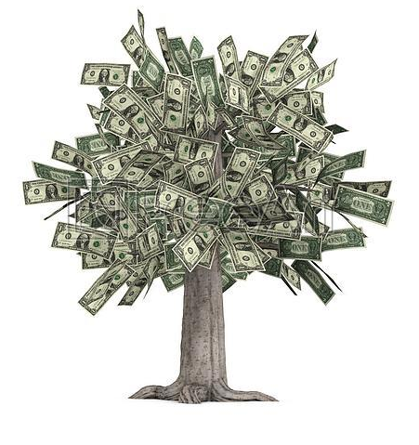
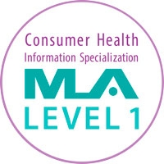
Join NNLM Region 1!
Health outreach funding
FREE online classes – CHIS! DIS! CHES! DSS!
FREE book kits for the NNLM Reading Club
NLM Traveling Exhibits for your space
FREE downloads of educational materials
Networking, partnerships and keeping up on professional news
Learn more: https://nnlm.gov/membership
Join: https://nnlm.gov/membership/join
Notes:
Health Outreach Funding – We fund one year projects that run from May 1st to April 30th each year with awards that range from a couple thousand dollars to support your attendance at a professional conference or to host a health fair to several thousand for a larger community outreach project.
FREE online classes – Just for interest, or earn your MLA Consumer Health Information Specialist (CHIS), Certified Health Educator Specialist (CHES) Data Services Specialist (DSS), Disaster Information Specialist (DIS) credential
FREE Book Kits for the NNLM Reading Club – Ready to use book titles and supporting materials make health outreach fun!
NLM Traveling Exhibits for your space – Harry Potter & potions, Beer & DNA, Women in Medicine, HIV/AIDS, History of Civil War Medicine and so many more…
Networking, partnerships and keeping up on professional news – we’re a fantastic group!

