Slide 1
NIH Data Management and Sharing Policy
Effective January 25, 2023

Slide 2
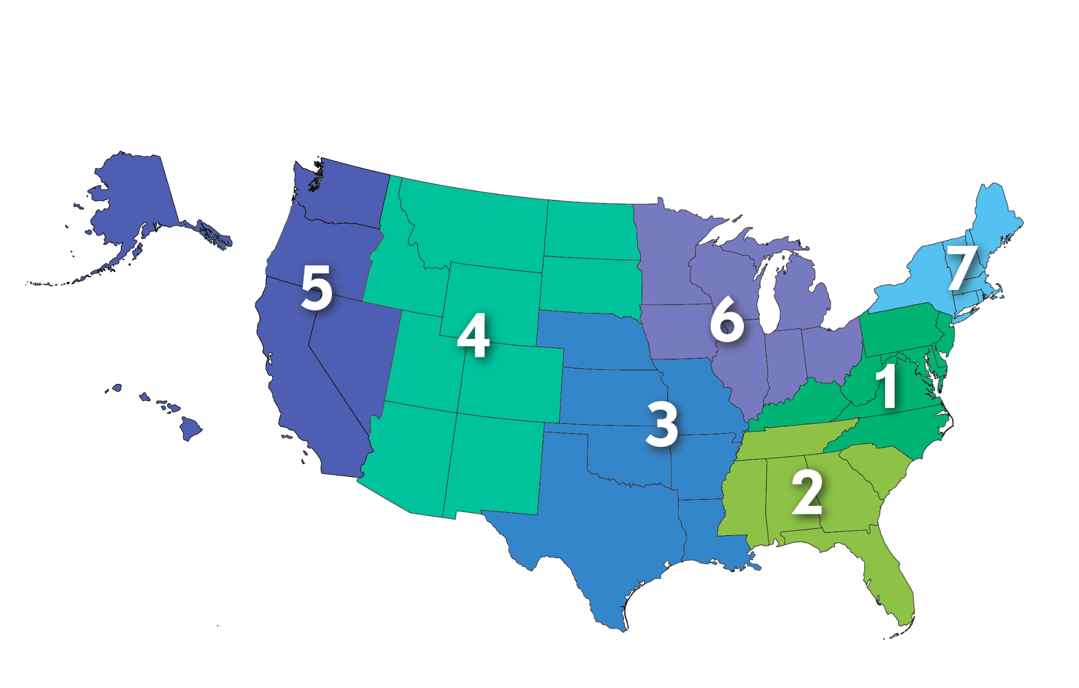
About the NNLM
National Institutes of Health
Nation’s research agency
27 institutes and offices
NIH
National Library of Medicine
World’s largest biomedical library
NLM
Network of the National
Library of Medicine
Program of the NLM comprised of 7 Regional Libraries (RMLs) 4 offices, and 4 centers.
NNLM
NCDS
National Center for Data Services
Focus: Developing data capacity in health information professionals

Slide 3
About Us
Beginner Training
opportunities for health information professionals to get plugged in
Development
Resources
opportunities for data services professionals
to get specialized training & support
instructional materials and guiding information available openly

Slide 4
Who We Are
Alisa Surkis
Director
Peace Ossom-Williamson
Associate Director
Justin de la Cruz Program Specialist
Deborah Peters
Administrator
Fred LaPolla
Content Expert
Genevieve Milliken
Content Expert
Nicole Contaxis
Content Expert
Nina Exner
NCDS Ambassador

Slide 5
Today’s Presenters & Breakout Leaders
Lisa Federer
Alisa Surkis
Genevieve Milliken
Nicole Contaxis
Nina Exner
Christine Nieman
Elizabeth Roth
Justin de la Cruz

Slide 6
Learning Objectives
By the end of this Immersion Workshop, you should be able to:
Communicate the NIH DMSP policy in language that researchers, fellow librarians, or leadership at your institution will understand
Provide guidance for researchers on how to approach each section of a DMSP
Provide a general critique of a DMSP written by a researcher

Slide 7
Code of Conduct
We are dedicated to providing a harassment-free experience for everyone, regardless of gender, gender identity and expression, sexual orientation, disability, physical appearance, body size, race, age or religion. We do not tolerate harassment of participants in any form.
ncds@nnlm.gov

Slide 8
Introduction to the NIH Data Management and Sharing Policy
Lisa Federer, PhD, MLIS
Acting Director, Office of Strategic Initiatives
National Library of Medicine

Slide 9
Session overview
Background to the policy
What goes into a DMSP?
Resources for writing a DMSP
Q&A

Slide 10
Background
A brief history of data sharing at NIH

Slide 11
NIH and Data Sharing
NIH’s mission is to seek fundamental knowledge about the nature and behavior of living systems and the application of that knowledge to enhance health, lengthen life, and reduce illness and disability.
Data sharing is essential for expedited translation of research results into knowledge, products and procedures to improve human health.
NIH’s Longstanding Policy: The results and accomplishments of the activities that NIH funds should be made available to the research community and the public at large.

Slide 12
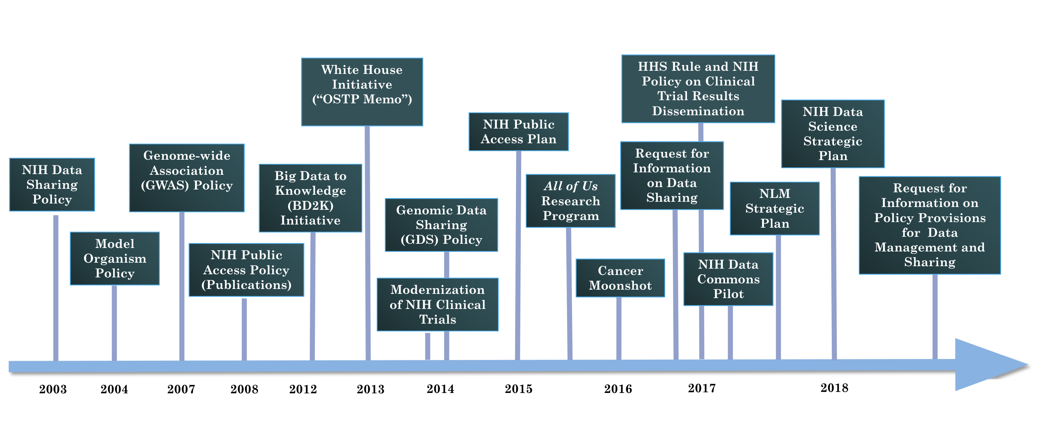
NIH’s Culture of Data Sharing

Slide 13
What’s next?
The NIH Data Management and Sharing Policy (DMSP)

Slide 14
Scope of the policy
All research funded (in whole or part) by NIH that generates scientific data, including:
Extramural grants
Contracts
Intramural research projects
All other NIH funding mechanisms (e.g. Other Transaction Authority)
Does not apply to funding that does not generate data (e.g. training grants and infrastructure development)
https://grants.nih.gov/grants/guide/notice-files/NOT-OD-21-013.html

Slide 15
Policy requirements
Submission of a Data Management and Sharing Plan (DMSP)
Outlines how scientific data and any accompanying metadata will be managed and shared
Identifies any potential restrictions or limitations.
Compliance with the awardee’s plan as approved by the NIH ICO

Slide 16
Elements of a DMSP
Description of the data plus metadata and documentation
Related tools, software, code, etc
Standards for the data/metadata
Data preservation, access, and associated timelines
Access, distribution, and reuse considerations
Oversight of data management and sharing
https://grants.nih.gov/grants/guide/notice-files/NOT-OD-21-014.html

Slide 17
Data description
The type and amount of data that will be collected or used
What data will be shared
What metadata and documentation will be included to facilitate interpretation
Data modality (e.g. imaging, genomic, survey)
Level of aggregation (e.g. individual or aggregated)
Degree of data processing (e.g. raw vs processed data)
Including rationale for data that are not shared (e.g. legal or ethical considerations)
Metadata standards
Study protocols
Codebooks
Data collection instruments

Slide 18
What counts as data for sharing?
Adequate data to validate and replicate study findings
Data resulting from the study but not necessarily supporting a publication
Null findings that do not result in publication

Slide 19
What does not count as data for sharing?
laboratory notebooks
preliminary analyses
completed case report forms
drafts of scientific papers
plans for future research
peer reviews
communications with colleagues
physical objects, such as laboratory specimens

Slide 20
Acceptable reasons to not share
informed consent limitations on sharing
existing consent (e.g., for previously collected biospecimens) prohibits sharing
privacy or safety of research participants would be compromised or place them at greater risk of re-identification or suffering harm
explicit federal, state, local, or Tribal law, regulation, or policy prohibits disclosure
datasets cannot practically be digitized with reasonable efforts

Slide 21
Related tools, software, code
Specialized tools that are needed to access the shared data
Names of specific software tools (e.g. Python, SPSS, etc)
Availability of tools (e.g. open source vs purchase)
Expected lifespan of the tools compared to length of data availability

Slide 22
Standards
Data formats
Data dictionaries
Common Data Elements
Identifiers
Definitions
Indicate when no consensus standard exists

Slide 23
Data preservation, access, and timelines
Name of repository(ies) where data will be shared
Findability and identifiability of data (e.g. unique identifiers)
When data will be shared
No later than time of publication or end of performance period
How long data is anticipated to be available

Slide 24
Access, distribution, and reuse considerations
Informed consent
Privacy and confidentiality protections
Restrictions imposed by federal, Tribal, or state laws, regulations, or policies (e.g. HIPAA)

Slide 25
Oversight of data management and sharing
How compliance with DMSP will be monitored and managed
Who will be responsible for oversight
How often will oversight activities occur

Slide 26
Plan submission, review, and compliance
Compliance
Incorporated into Terms and Conditions
Monitored at regular reporting intervals
Compliance may factor into future funding decisions
Assessment
Peer reviewers may comment on (not score) budget
NIH program staff assess Plans
Plans can be updated
Submission
With application for funding in Budget Justification section

Slide 27
DMSP and the broader policy landscape
DMSP represents the minimum requirements for all NIH
NIH Institutes, Centers, and Offices (ICOs) may provide more specific guidance
Other policies may apply (e.g. Genomic Data Sharing policy)

Slide 28
Resources for writing a DMSP
Tools and additional guidance

Slide 29
Allowable costs
Data curation and development of documentation
Local data management (i.e. during the project, before submitting to a repository)
Preservation and sharing in repositories
https://grants.nih.gov/grants/guide/notice-files/NOT-OD-21-015.html

Slide 30
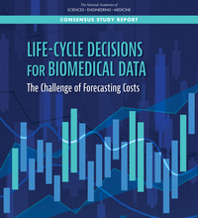
Forecasting Costs for Preserving, Archiving, and Promoting Access to Biomedical Data
Funded by the National Library of Medicine, this study by the National Academies of Sciences, Engineering, and Medicine developed and demonstrated a framework for forecasting long-term costs for preserving, archiving, and accessing various types of biomedical data and estimating potential future benefits to research.
https://www.nationalacademies.org/our-work/forecasting-costs-for-preserving-archiving-and-promoting-access-to-biomedical-data

Slide 31
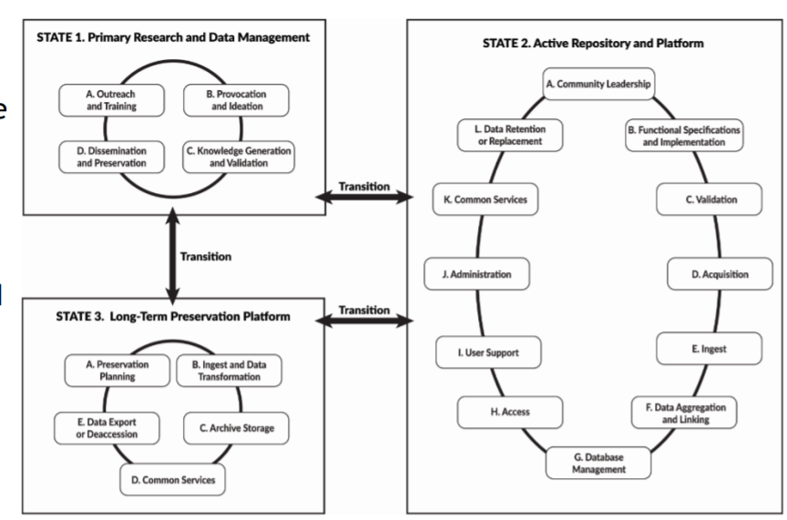
Three data states
State 1: Primary research/data management environment; data are captured and analyzed
State 2: Active repository and platform; data may be acquired, curated, aggregated, accessed, and analyzed
State 3: Long-term preservation platform
https://nap.edu/resource/25639/Slides_NASEM_Biomedical_Data_Costs_Researchers.pdf

Slide 32
Cost Forecasting Framework
Determine the type of data resource environment, its data state(s), and how data might transition between those states during the data life cycle.
Identify the characteristics of the data, the data contributors, and users.
Identify the current and potential value of the data and how the data value might be maintained or increased with time.
Identify the personnel and infrastructure likely necessary in the short and long terms.
Identify the major cost drivers associated with each activity, including how decisions might affect future data use and its cost
Estimate the costs for relevant cost components based on the characteristics of the data and information resource.
https://nap.edu/resource/25639/Slides_NASEM_Biomedical_Data_Costs_Researchers.pdf

Slide 33
Assessing Research Data Costs: A Checklist for Administrators at Research Institutions
Foster implementation of the cost forecasting framework
Improve training and awareness for researchers
Update data policies and procedures
Drive future improvements in the ability to forecast costs
Expand the capacity to make sound data management decisions
https://www.nap.edu/resource/25639/Research_Admin_Checklist_Biomedical_Data.pdf

Slide 34
Selecting a repository: the NIH data sharing landscape
NIH strongly encourages
subject-specific, open access Data Sharing Repositories
as a first choice.
https://www.nlm.nih.gov/NIHbmic/nih_data_sharing_repositories.html
Datasets up to 2 gigabytes
Datasets up to 20 gigabytes
High priority datasets, petabyte-scale
PubMed Central
Generalist Repositories
Cloud Partners
(STRIDES Program)
Stores publication-related supplemental materials and datasets directly associated publications.
Datasets associated with publications or otherwise and links to PubMed.
Store and manage large scale, high priority NIH datasets.

Slide 35
BMIC Repository list
To help researchers locate an appropriate resource for sharing their data, as well as to promote awareness of resources where datasets can be located for reuse, BMIC maintains lists of several types of data sharing resources:
Open NIH-supported domain-specific repositories that house data of a specific type or related to a specific discipline;
Other NIH-supported domain-specific resources, including repositories and knowledgebases, that have limitations on submitting and/or accessing data; and
Generalist repositories that house data regardless of type, format, content, or subject matter.
https://www.nlm.nih.gov/NIHbmic/nih_data_sharing_repositories.html

Slide 36
The NIH Generalist Repository Ecosystem Initiative (GREI)
Solicit applications from generalist repositories working together to:
Expected Outcomes

Slide 37
Objectives
Align with Desirable Characteristics for Data Repositories
Implement browse & search for NIH funded data
Develop consistent metadata models
Conduct limited QA/QC of the NIH funded data
Enable connectivity of digital objects
Use case support including
(x-repository use cases)
Implement open metrics
Develop educational materials
Conduct broad outreach
(workshops)
Commit to
“Co-opetition”
Openly share software & work products developed under the award

Slide 38
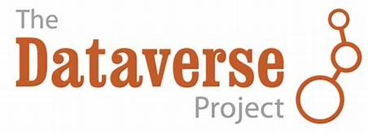
Awardees
Generalist Repository | Website
 | https://dataverse.org
 | https://datadryad.org
 | https://figshare.com
 | https://data.mendeley.com
(Open Science Framework) | https://osf.io
 | https://vivli.org
 | https://zenodo.org/
https://datascience.nih.gov/news/nih-office-of-data-science-strategy-announces-new-initiative-to-improve-data-access

Slide 39
Desirable Characteristics for Data Repositories
Persistent Unique Identifiers
Assigns datasets to a citable PUID to support data discovery and reporting
Long-term sustainability
Long-term plan for managing data; builds on stable technical infrastructure & funding; contingency plans for unforeseen events
Metadata
Ensures datasets are accompanied by metadata sufficient to enable discovery, reuse, and citation
Curation & Quality Assurance
Provides expertise to improve the accuracy and integrity of datasets and metadata
Access
Provides maximally open access, consistent with legal and ethical limits
Free & Easy
Datasets and metadata accessible free of charge and with broadest possible terms of reuse
Reuse
Enables tracking of data reuse
Secure
Documentation of meeting accepted criteria for security to prevent unauthorized access or release of data
Privacy
Documentation of safeguards in compliance with applicable privacy, risk management & continuous monitoring requirements
Common Format
Datasets and metadata can be downloaded, accessed, or exported in a standards-compliant format
Provenance
Maintains a detailed logfile of changes to datasets and metadata to ensure integrity
https://grants.nih.gov/grants/guide/notice-files/NOT-OD-21-016.html

Slide 40
Additional Considerations for Human Data
Fidelity to Consent
Restricts dataset access to appropriate uses consistent with original consent
Restricted Use Compliant
Enforces submitters’ data use restrictions
Privacy
Documentation & implementation of security techniques for human subjects’ data to protect from inappropriate access
Plan for Breach
Has security measures that include data breach response plan
Download Control
Controls and audits access to and download of datasets
Clear Use Guidance
Provides documentation describing restrictions on dataset access and use
Retention Guidelines
Provides documentation on guidelines for data retention
Violations
Has plans for addressing violations of terms-of-use and data mismanagement by the repository
Request Review
Established data access review or oversight group responsible for reviewing data use requests
https://grants.nih.gov/grants/guide/notice-files/NOT-OD-21-016.html

Slide 41
Potential Library Roles

Slide 42
Outreach
Education
Resource Creation
DMS Plan Review
maDMP
FTE and level of data expertise at your library

Slide 43
Outreach (2)
Ensuring researchers and librarians know about the policy change
Can include in-person outreach (e.g., short presentations at faculty meetings) and online outreach (e.g., notices throughout your institution’s web presence)

Slide 44
Outreach (3)
Example provided by Nicole Contaxis at NYU Langone Health:
Worked with the institution’s communication team to include notices about the policy change across the institution’s web presence, in their grant application platform, and in relevant newsletters and listservs

Slide 45
Education
Ensuring researchers and librarians know how to comply with the policy
Will need to address creating a DMSP and some data management best practices
May include asynchronous or synchronous classes/materials

Slide 46
Education (2)
Example provided by Melissa Ratajeski at the University of Pittsburgh:
Training with partners across campus, including with the sessions with their Office of Sponsored Programs and their CTSI Responsible Conduct of Research program

Slide 47
Resource Creation
Create or collect and make findable resources, materials or guidance that can help researchers comply
Resources may include institution-specific guidance on writing a DMSP or materials created by the NIH (e.g., NIH.Sharing.Gov)

Slide 48
Resource Creation (2)
Example provided by Sara Samuel at the University of Michigan at Ann Arbor:
Updating and maintaining the NIH page of their research data guide with current information about the policy, recordings of workshops, and other resources, including materials from the grassroots Working Group on NIH DMSP Guidance

Slide 49
DMS Plan Review
Reviewing, editing, or providing feedback on DMSPs at point of grant submission to provide guidance on data management and sharing best practices
May require significant resources depending on the number of researchers who request this service

Slide 50
DMS Plan Review (2)
No example yet!

Slide 51
maDMP
“Machine-actionable Data Management Plan”
A framework undergoing extensive research in feasibility and implementation
Meant to automate data management and sharing processes by making information in a DMSP ‘machine-readable’

Slide 52
maDMP (2)
Example provided by Levi Dolan at Indiana University:
Reviewed and updating an inhouse, institutional system that has been used to create DMP’s to integrate APIs to tie DMP’s to grant status

Slide 53
Institutional Partners
Successful institutional support of grant applicants and grant recipients will require partnerships across the institution. Key partners include:
The Library
IT
Legal
Grants Office
Science/Research Office
Scientific Cores
IRB

Slide 54
Institutional Partners (2)
Example Task | Partners
Creating guidance for writing DMSP, including institution-specific template/suggested language | IT, Legal, the Library, IRB, Scientific Cores, Science/Research Office
Acting as consultants or contacts for researchers creating DMSPS | IT, Legal, IRB, Scientific Cores, the Library
Development of educational materials and possible educational requirements | Grants office, Science/Research Office, the Library
Deploying technical solutions (e.g., DMPTool) | IT
Development of outreach and communications strategies | IT, Science/Research Office, Grants Office, the Library
Ensuring institutional policies do not contradict the new NIH policy | Grants office, Science/Research Office

Slide 55
RDM Basics

Slide 56
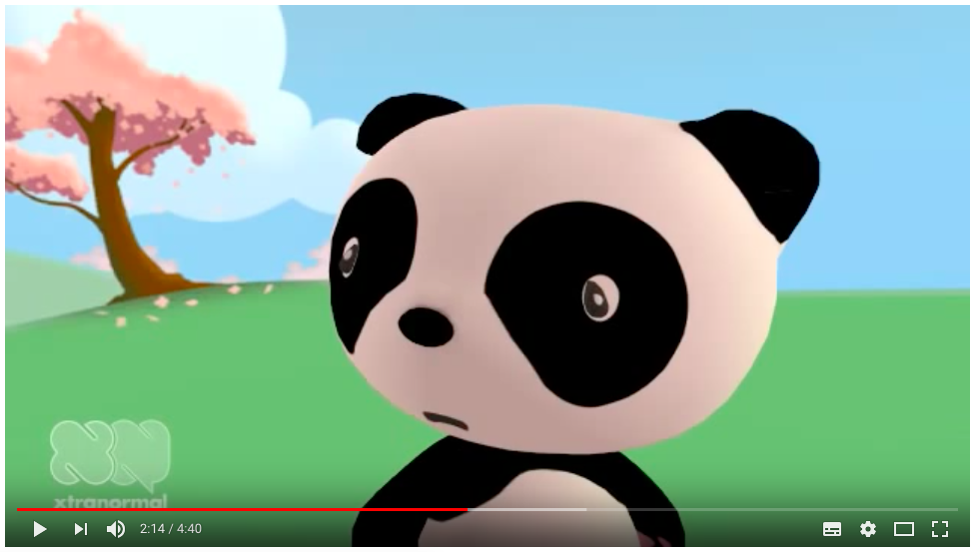
Data Management SNAFU
https://www.youtube.com/watch?v=N2zK3sAtr-4

Slide 57
What did the brown bear do wrong?

Slide 58
What is data management and why is it important?
The rules and guidelines that you and/or your team set to manage the organization, collection, storage, preservation and access of data generated from research.
Managing your data effectively not only helps your research to be sound and replicable, but it can help to anticipate potential problems that can occur during the research process.
Ensure that your research meets the requirements set out by research funders and publishers.

Slide 59
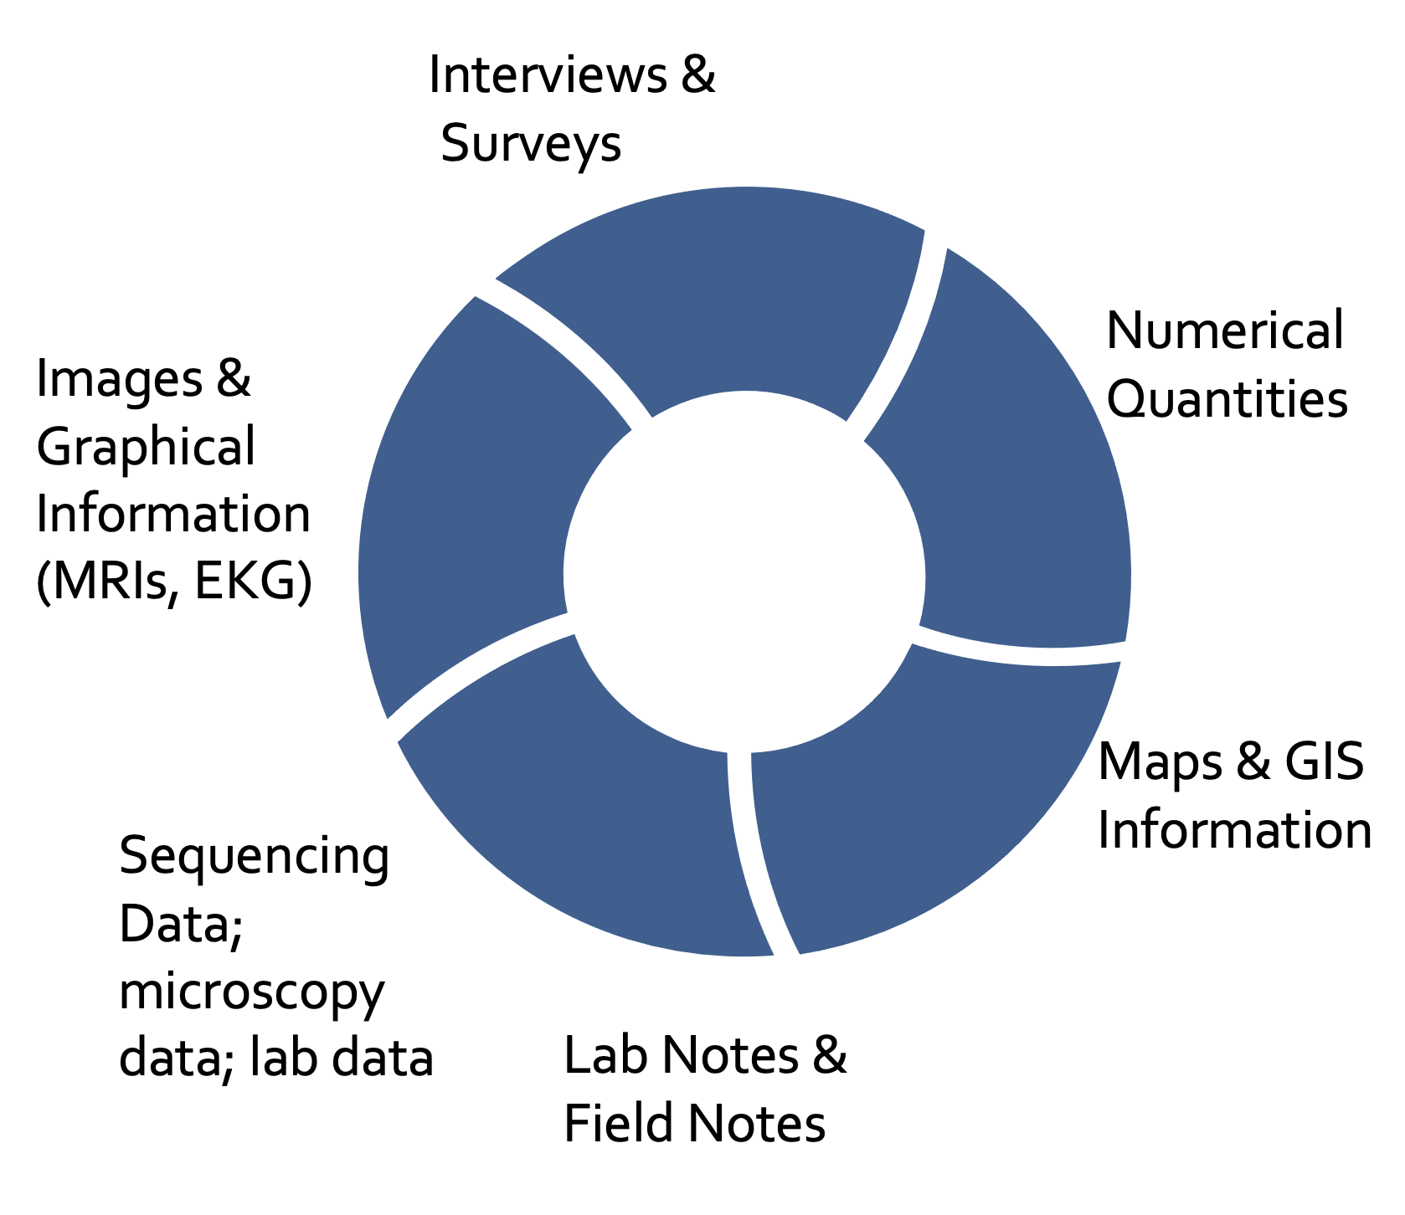
What is data?
“Data” is any kind of raw information that we work with in order to learn something new.

Slide 60
How does NIH define data?
NIH defines Scientific Data as:
data commonly accepted in the scientific community as of sufficient quality to validate and replicate research findings, regardless of whether the data are used to support scholarly publications.
Scientific data includes any data needed to validate and replicate research findings.
Scientific data does not include laboratory notebooks, preliminary analyses, completed case report forms, drafts of scientific papers, plans for future research, peer reviews, communications with colleagues, or physical objects such as laboratory specimens.

Slide 61
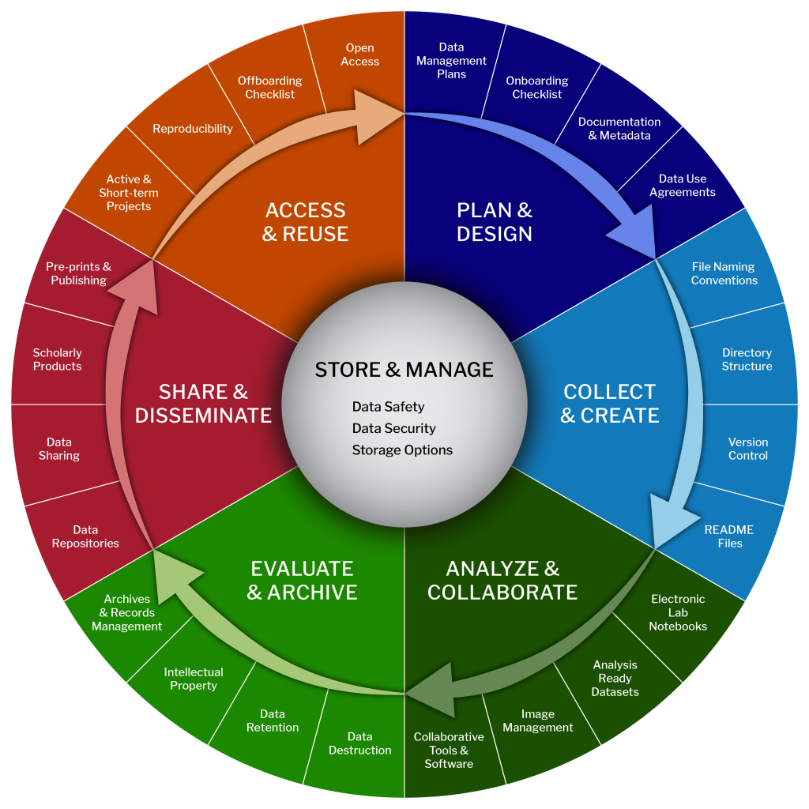
Research Data Lifecycle
Research Data Lifecycle by LMA Research Data Management Group

Slide 62
Elements
of a DMSP
Element 6: Oversight of data management and sharing
Element 1: Data type
Element 5: Access, distribution, or reuse considerations
Element 3.Data standards
Element 4: Data preservation, access, and associated timelines
Element 2. Related tools, software, and/or code

Slide 63
1. Data Type
Be familiar with the data types being produced at your institution
Know basic information about the file types and file sizes
Data Curation Primers & NCDS Data Glossary

Slide 64
2. Software / Code
Understand the connection between software and code and data cleaning, manipulation, access, and analysis
code, scripts, hardware, software, and protocols contribute to greater reproducibility
Librarians Building Momentum for Reproducibility

Slide 65
3. Standards
Interoperability refers to the ways in which data is formatted to allow diverse datasets to be merged or aggregated in meaningful ways.
Metadata Standard
Metadata Schema
Common Data Element
Finding Standards:
https://fairsharing.org/
CDE Repository
BioPortal

Slide 66
4. Preservation & Access
Understanding Types of Repositories:
Open, Discipline Specific
Knowledgebases
Institutional Repositories
Generalist Repositories
DMPTool Guidance of Persistent Identifiers
NIH’s Selecting a Repository

Slide 67
5. Reuse
Considerations
Related Terms to Know:
Data Reuse
Controlled (Data Access Request)
Data Privacy
Data De-identification
Informed Consent
NLM Data Scrubber:
https://lhncbc.nlm.nih.gov/scrubber/

Slide 68
6. Oversight of DMS
The process of Data Stewardship involves data management processes, including effective curation, control, and use of data assets and can include creating and managing metadata, applying standards, managing data quality and integrity, and additional data governance activities related to data curation

Slide 69
Glossaries and Terms
DMPTool General Guidance
Data Terms related to the NIH DMS Plan and Policy
NCDS Data Glossary
Grant Glossary for Librarians

Slide 70
Takeaways
Each Element of a DMSP involves some level of Research Data Management (RDM)
When talking to researchers, incorporate RDM best practices when considering each element of the DMSP
Open science and reproducible practices will help avoid a data snafu (and is aligned with the NIH DMSP Policy!)

Slide 71
Breakout # 1: Assessing Policy Readiness
In the chart provided, briefly list descriptions of tasks that have (1) been completed, (2) are incomplete, or (3) are necessary, but not feasible as it pertains to the policy. Each person will fill out one row and all rows will be discussed as a group. This is a reflective practice to map out capacity for you and your institutions and identify any action items to prepare for the upcoming policy.

Slide 72
Break
Please return at 1:00 PM (Eastern)

Slide 73
The elements of a data management and sharing plan

Slide 74
Element 1 Data type

Slide 75
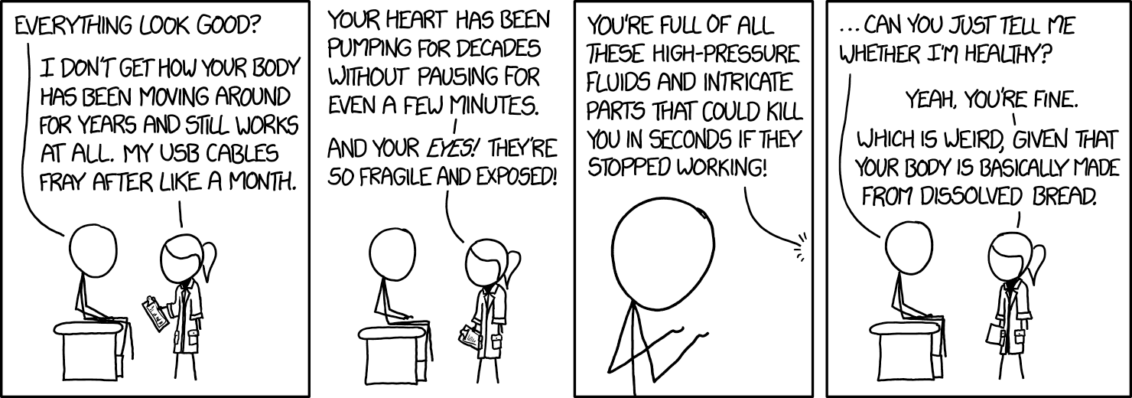
Doctor Visit (from https://xkcd.com/1839/, included to show why PIs’ brains are so full)
© Randall Munroe, licensed CC-BY-NC 2.5

Slide 76
Briefly describe the scientific data to be managed, preserved, and shared, including…
1.A A general summary of the types and estimated amount of scientific data to be generated and/or used in the research. Describe data in general terms that address the type and amount/size of scientific data expected to be collected and used in the project (e.g., 256-channel EEG data and fMRI images from ~50 research participants). Descriptions may indicate the data modality (e.g., imaging, genomic, mobile, survey), level of aggregation (e.g., individual, aggregated, summarized), and/or the degree of data processing that has occurred (i.e., how raw or processed the data will be).
1.B A description of which scientific data from the project will be preserved and shared. NIH does not anticipate that researchers will preserve and share all scientific data generated in a study. Researchers should decide which scientific data to preserve and share based on ethical, legal, and technical factors that may affect the extent to which scientific data are preserved and shared. Provide the rationale for these decisions.
1.C A brief listing of the metadata, other relevant data, and any associated documentation (e.g., study protocols and data collection instruments) that will be made accessible to facilitate interpretation of the scientific data.

Slide 77
What does that mean?
Three subcomponents
1.A.: What data will be generated or collected
1.B.: Which data out of that list will be shared
1.C.: What documentation will you create and share to go with it

Slide 78
What else does it mean besides the subsections?
Items to address
type of data in a very general file/technical sense, like XLSX files or PNG images
amount/size estimates
could be number of files per participant or just weather it’s MB-, GB-, or PB-scale
the data modality, whether it’s imaging, genomic, survey, etc
Optionally this element can give researchers flexibility! Descriptions may indicate…
level of aggregation (e.g., individual, aggregated, summarized) that will have occurred by sharing
the degree of data processing that will have occurred (i.e., how raw or processed the data will be)

Slide 79
Strategic aggregation and processing
This section offers a lot of potential flexibility! Discuss with faculty…
How much cleaning and transformation is practical by closeout sharing?
Are there concerns about sharing that aggregation might address?

Slide 80
Use it, don’t abuse it
Be careful with over-aggregating. They still need to share enough to validate findings!
Potential questions to ask about managing aggregation levels …
Can you still share enough that it’s more validatable and reusable than an article’s methods and results sections alone?
Is there a way to aggregate but still move towards more openness, such as adding more protocol details or including unpublishable (“null” or not-significant) results?
Will the aggregated data have enough documentation that future readers can make accurate comparisons when expanding in new directions inspired by your work?

Slide 81
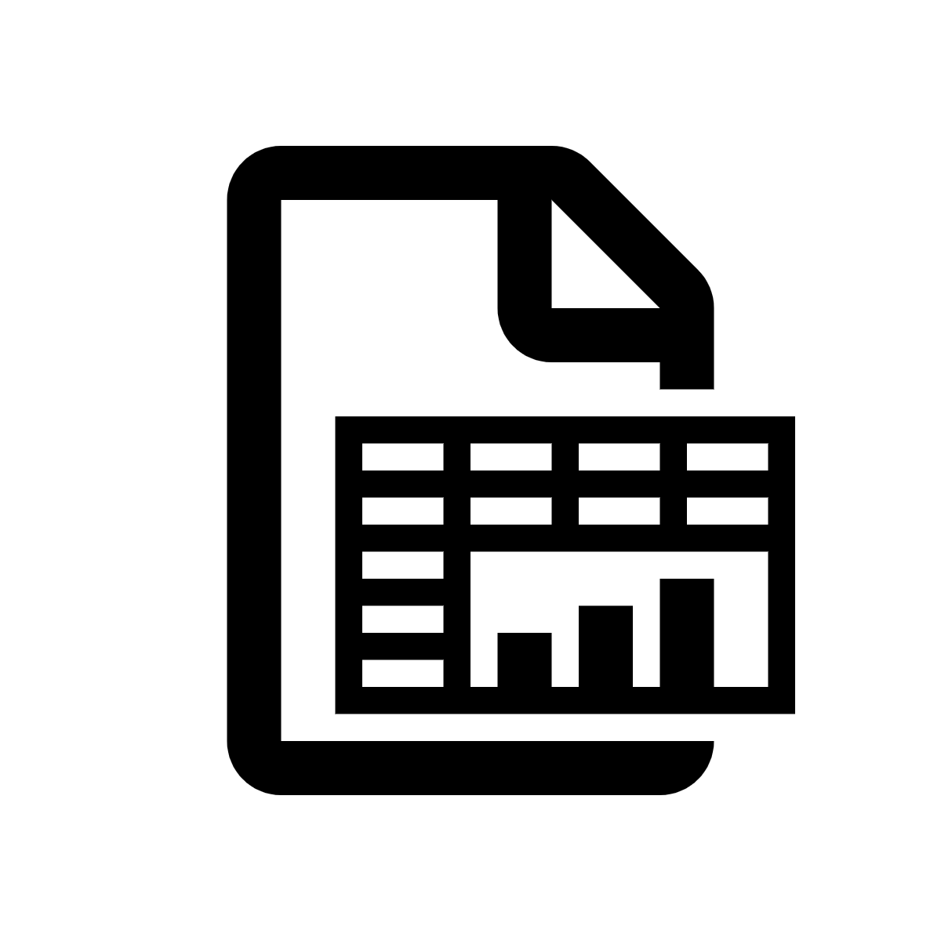
Which data is DMSP data?
Icons from Nounproject
Data during cleaning and transformations
Yes! Data continues to be covered throughout the process of getting it ready for final analysis.
Wet lab stuff
Definitely not!
Also not bedside charts, paper surveys, bench notebooks, biospecimens, etc.
Western blot gel
Usually not, but they could voluntarily address digital images of them.
Quantification
Yes! Once gels or microscopy images get measured, the DMSP applies.
Publication
Probably not.
The article is not covered, but they could choose to include Results tables and graphs.
It’s not data sharing, but articles must still be shared in PMC for the public access policy.

Slide 82
1.A.: Data to be generated
Interview faculty to elicit an answer that is…
Technical. But not too technical!
For example “spreadsheets in excel or CSV format”
Not “surveys including demographics, vitals, and mental health scales”
Also not “RFC 4180 compliant CSV files when text is US_ASCII compatible”
Definitely not reiterating the scientific goals or methodologies
Aiming for estimates, not attempting precise counts

Slide 83
1.B.: Data to be shared
Out of the 1.a list of data to be collected, which types or which subgroups of the data will be shared?
Organize how it makes sense. It could be organized in parallel with 1.A, or in a table where 1.A and 1.B are both addressed.
Or if only subsets will be shared (such as identifiable versus deidentified datasets, or individual versus aggregated versions), the different subsets should be described here.

Slide 84
1.B.: Data to be shared (2)
This part is tightly connected with Element 5.
Element 5 is why won’t you share; this is which parts will you share after you remove what can’t be shared, or else which parts are shared but not in their entirety.
If it’s easier to address both issues in one place, consider adding a “see element 5.1” reference.

Slide 85
1.B.: Data to be shared (3)
An example might be; if 1.A says…
“Survey data and biometrics will be collected in SurveyMonkey and all analysis, summarizing, and storage will be as .xlsx files.”
…then 1.B might say …
“Spreadsheets for sharing will be de-identified by Safe Harbor deidentification. These spreadsheets for sharing will include deidentified responses from all respondents except those identified as having rare conditions will be shared. These deidentified spreadsheets will be shared in .xlsx format, plus CSV exports for future reusability.”

Slide 86
1.C.: Documentation and metadata
What is needed beyond the methods section to help validate and build on the data, particularly the data that will be shared?
Some items you might ask the faculty member about are…:
Metadata automatically produced by instruments and equipment
Study protocols
Data collection instruments and/or forms
Data dictionaries and/or codebooks of the variables
Contextual data, such as date, location, temperature, data collector, etc.
Data transformations, such as variable construction
Data provenance, such as sources of benchmark data that was integrated

Slide 87
Element 2
Related Tools, Software, and/or Code

Slide 88
Element 2:
Indicate whether specialized tools are needed to access or manipulate shared scientific data to support replication or reuse, and name(s) of the needed tool(s) and software. If applicable, specify how needed tools can be accessed.

Slide 89
Related tools, software, and/or code
Tools/software needed to access or manipulate the data
Names of specific software tools (e.g. Python, RStudio, SAS, SPSS, MATLAB, etc.) plus versions and extensions
Availability of tools (e.g. open source vs proprietary)
Expected lifespan of the tools compared to length of data availability

Slide 90
What does "reproducibility" have to do with software?
Questions to Ask:
Can another researcher locate your dataset and your software? Do they know what the software is supposed to do?
Does this other researcher--and the other researcher's computer--have enough information to get the software to run and produce the intended results?
Do they have enough information to get the software to run and produce the intended results without contacting you?
Are there decisions that you've made or specifics about the environment that you have not documented?
Applying FAIR to Software: Introducing the FAIR Principles for research software
Adapted from: https://guides.nyu.edu/software-reproducibility

Slide 91
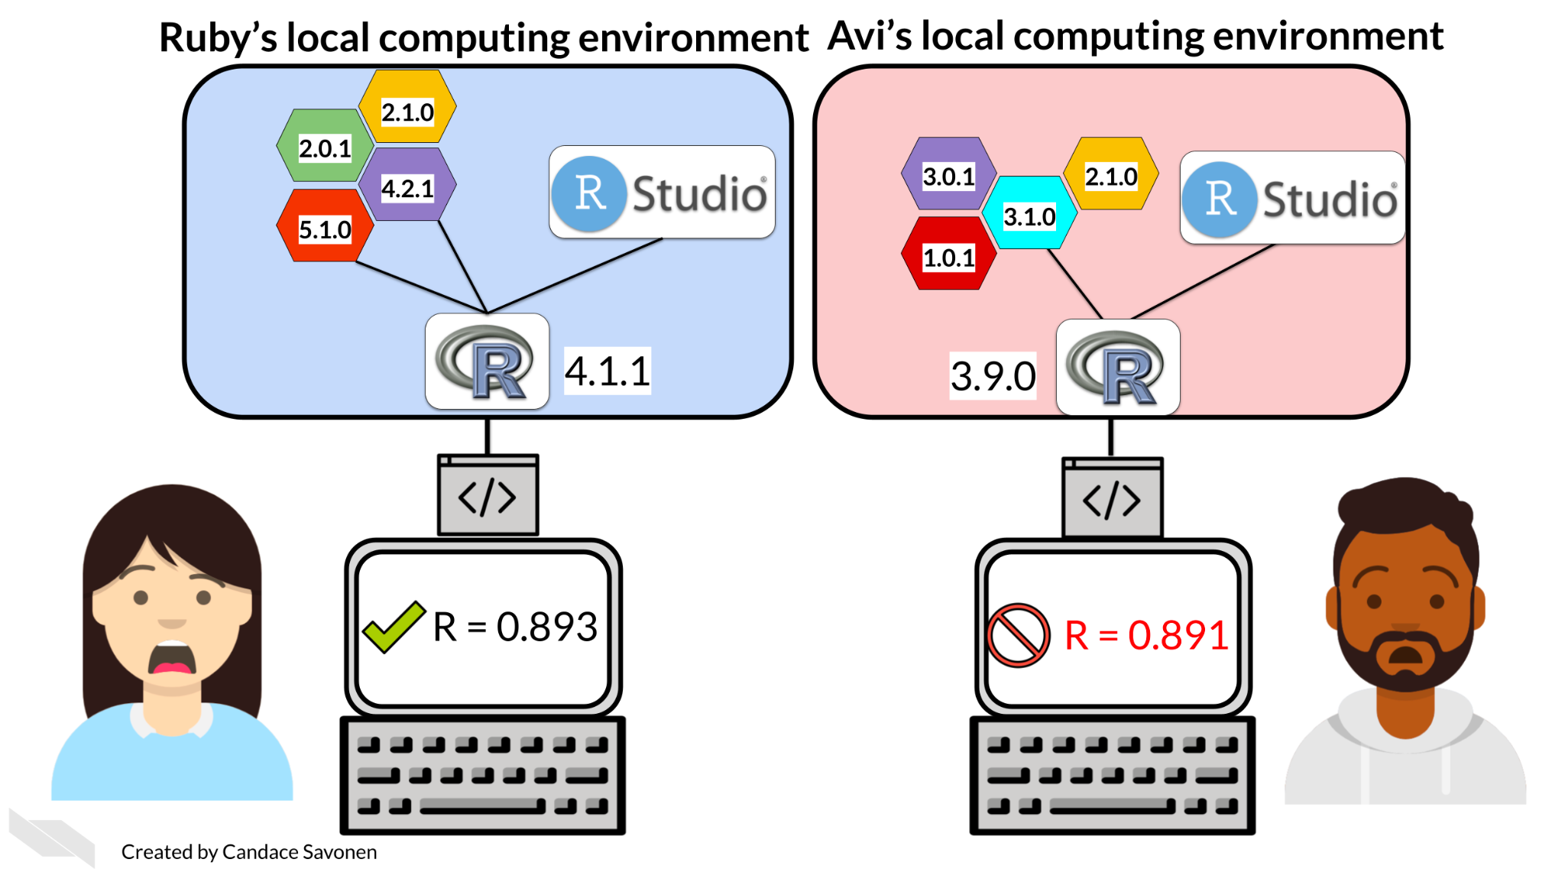
Documenting and Managing Dependencies
For this policy, it is important to document versions and dependencies
List any libraries/packages used
Code is the tip of the iceberg as it is reliant of packages, native environment, and hardware
Adapted from: https://guides.nyu.edu/software-reproducibility

Slide 92
NIMH Sample Answer (Genomics - Mouse)
All code and software that will be written to analyze the data will be deposited on GitHub (https://github.com/labname) for public access and be provided as Supplementary files for any publications. Code will be available no later than when a publication has been submitted.

Slide 93
Git/GitHub
Git is a revision control system, a program to manage your source code history. It is a command-line tool (with available GUIs)
GitHub is a website where you can upload a copy of your Git repository. It allows people to collaborate via Git along with some other features.

Slide 94
Code Licensing
When publishing your data and code, it's crucial that you apply a license.
A license is a document that acts as your official permission for others to do, use, or own something that you are the copyright owner for (like code you've written, or data you've gathered).
Releasing your materials without a license creates ambiguity. No one can use your work if you do not include a license, because the implication is that you have reserved every right (including to copy or modify your code) for yourself.
Choose a license you are comfortable with: https://choosealicense.com/
Adapted from: https://guides.nyu.edu/software-reproducibility

Slide 95
Sample Answer (Clinical / MRI)
The clinical data will be analyzed with custom Python code written using the statsmodels, numpy, and pandas packages, all of which are freely available. 1H fMRS spectra will be analyzed with LCModel 6.3 software using LCMgui, which is freely available from http://s-provencher.com/lcm-test.shtml. fMRI images will be analyzed… using MATLAB. While MATLAB is commercial software, most universities have site licenses available and the SPM8 toolbox is free….
All code will be shared on our lab website …. the main readme.md file for the project will also include instructions and parameter choices for the GUI-based analyses.

Slide 96
NIH Sample Answer (Genomics - Human)
…..Using the Broad Institute’s Genome Analysis Toolkit (GATK), we will apply standard Best Practices workflows for single nucleotide variant (SNV) and Indel discovery from whole genome sequence alignment files (SAM/BAM). These steps should ensure that final association results are representative of “true” genotypes rather than miscalls or confounded genotypes that are unlikely to replicate in independent populations.

Slide 97
Software as Research Output
Cite the software that was used in your research, including all software that was used to generate and analyze data.
“Software should be cited on the same basis as any other research product such as a paper or a book; that is, authors should cite the appropriate set of software products just as they cite the appropriate set of papers." - FORCE11
Software Citation Principles (published 2016)
citation file format (CFF)
CiteAs

Slide 98
Element 3
Standards

Slide 99
Discussion
In the chat, write the effective date for the new NIH Data Management and Sharing Policy.

Slide 100
Standards Example: Writing Dates
Possible ways to write January 25, 2023:
Jan. 25, 2023
Jan 25, 2023
Jan 25, ‘23
1/25/2023
1/25/23
01/25/2023
01/25/23
25/1/2023
25/1/23
25/01/2023
25/01/23
Etc…

Slide 101
Standards Example: Writing Dates (2)
Possible ways to write January 25, 2023:
Jan. 25, 2023
Jan 25, 2023
Jan 25, ‘23
1/25/2023
1/25/23
01/25/2023
01/25/23
25/1/2023
25/1/23
25/01/2023
25/01/23
Etc…
ISO is the International Standards Organization and it has a standard for writing dates.
ISO8601 is a standard for noting dates: 2023-01-25.

Slide 102
What is a standard?
A standard is an established, generally community-agreed-upon, way to collect, organize, or document data.
“Community agreed upon” can mean that the standard is created by an established organization - like the International Standards Organization
“Community agreed upon” can also mean that the standard is created by a group of people through a professional or academic association
Standards help data interoperability and the ability to aggregate data across many studies.
You can find listings of standards on FAIRSharing.org

Slide 103
Caveats about standards
Not all fields or subjects have standards
Many things have multiple, competing standards
There are new standards being created all of the time
Standards can be hyper specific
Bottom line: It is unlikely that you will be providing guidance on which standards to use for data collection specific to a discipline. However, it is helpful to understand the concept and to be prepared to discuss standards for metadata and data description

Slide 104
The NIH’s Field Description
“State what common data standards will be applied to the scientific data and associated metadata to enable interoperability of datasets and resources, and provide the name(s) of the data standards that will be applied and describe how these data standards will be applied to the scientific data generated by the research proposed in the project. If applicable, indicate that no consensus standards exist”

Slide 105
Sample Standards Section
Taken from “FAIR Annotated Dataset of Stroke MRIs, CTs, and Metadata,” created by Andreia Faria, (ORCID: 0000-0002-1673-002X) as part of the DataWorks! Data Management and Sharing Plan Challenge. DMP DOI: 10.48321/D1J31B
“The images will be shared in native subject space and in standard space (Montreal Neurological Institute, MNI), in Nfiti compressed format. The data format and organization follow the Brain Imaging Data Structure, BIDS, guidelines, which will enable navigation and sharing. Additionally, this format is compatible for conversion to newly developed semantic standards. This allows generating computable data objects (CDOs) readily used by the AI community, and facilitate non-expert data analysis. The CDO’s also allow integration with open science efforts, analytical pipelines, APIs, and modules for quality control, harmonization, indexing, and management engines.”

Slide 106
Examples of Standards
Metadata Standards
Common Data Elements
Data Collection Standards
Standards and Repositories

Slide 107
Metadata Standards
Metadata standards are standards!
Examples: DataCite Schema
Standardizes how data is described with metadata to allow for record interoperability
This allows DataCite to make metadata records discoverable across description providers through the DataCite Commons
It also allows DataCite to make the records available via the DataCite Rest API for others to systematically browse, query, and retrieve metadata records

Slide 108
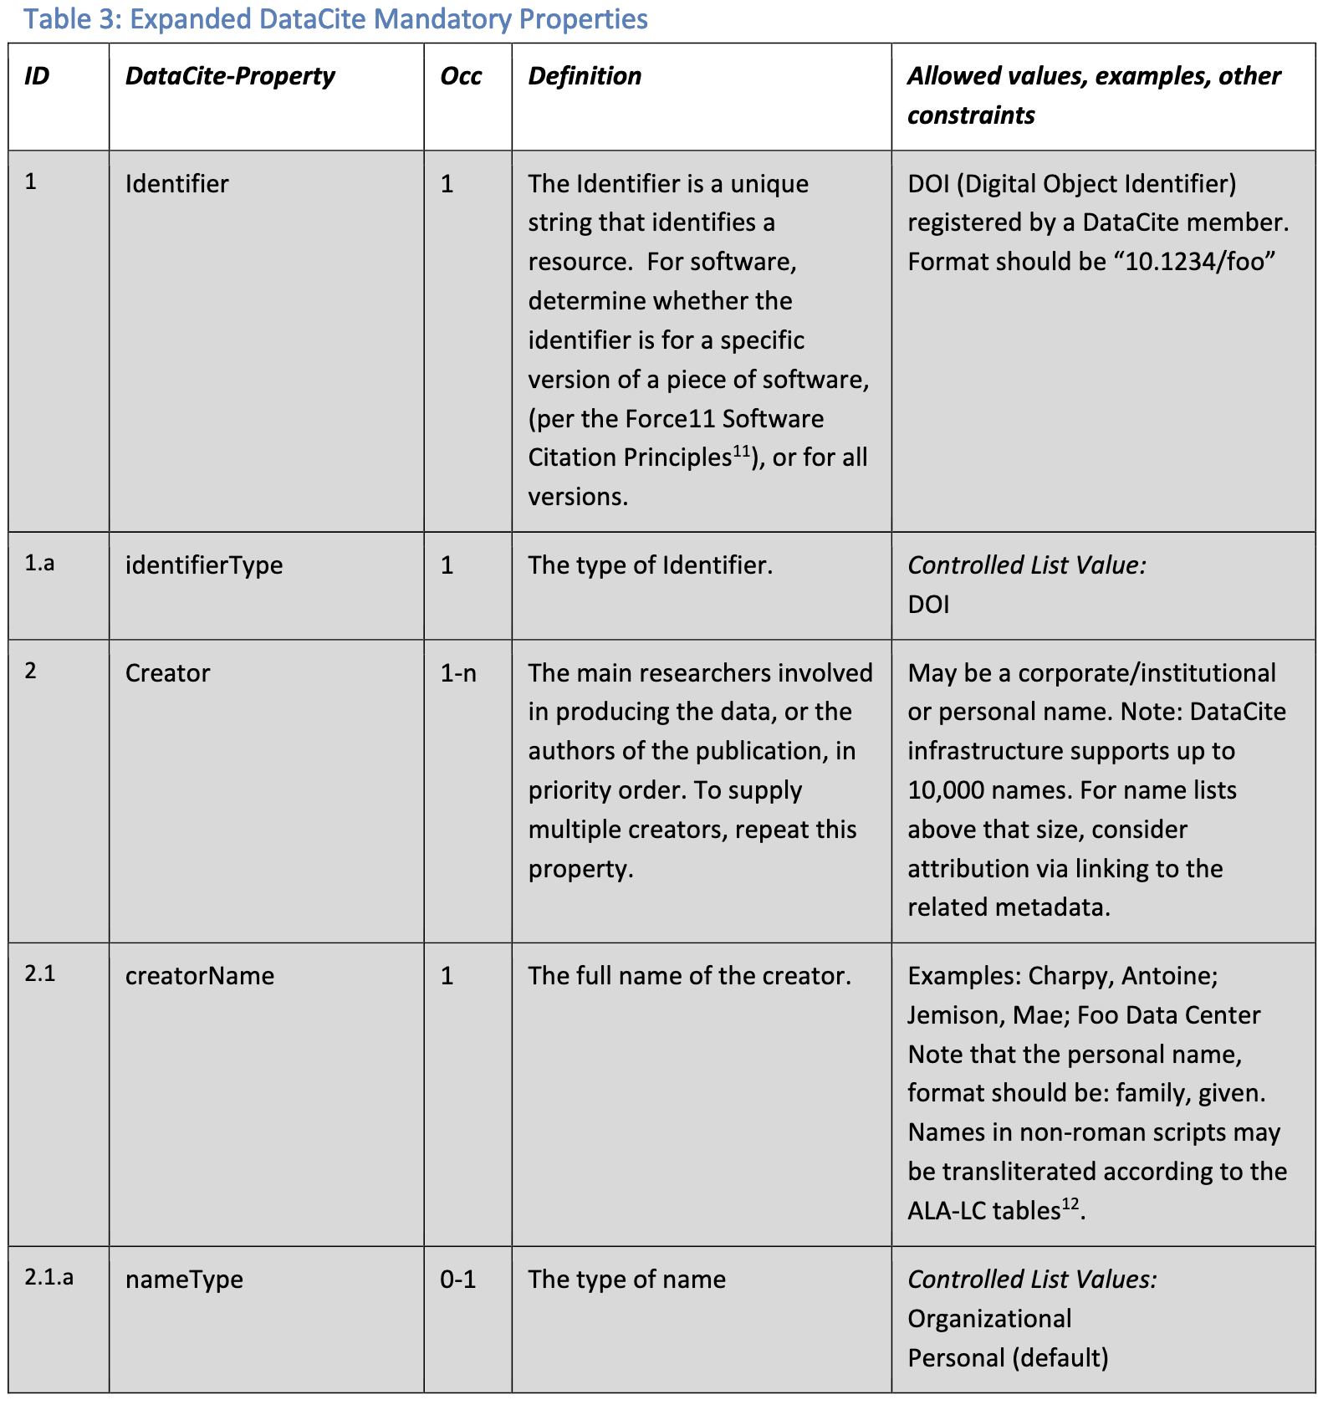
Metadata Standards (2)
Note: The third column, Occurrence (Occ), indicates cardinality/quantity constraints for the properties as
follows:
0-n = optional and repeatable
0-1 = optional, but not repeatable
1-n = required and repeatable
1 = required, but not repeatable

Slide 109
Common Data Elements
Common Data Elements are a precisely defined question, paired with a set of allowable responses
CDE’s are used across different sites, studies, and trials to ensure consistent data collection and the ability to aggregate across sites, studies, and trials
CDE’s are a standard for a field when generally when we talk about ‘standards’ it is a standard for a series of fields
NIH CDE Repository
Tutorial on using the NIH CDE Repository

Slide 110
CDE Example from PROMIS/Neuro-QOL
Question: I had trouble finishing things because I was too tired
Answer:
Never
Almost Never
Sometimes
Often
Almost Always
Data Collection Form created with standardized questions
CDE
CDE
https://cde.nlm.nih.gov/deView?tinyId=mkVLyuZEQ

Slide 111
Field Specific Example: Neurodata Without Borders (NWB)

Slide 112
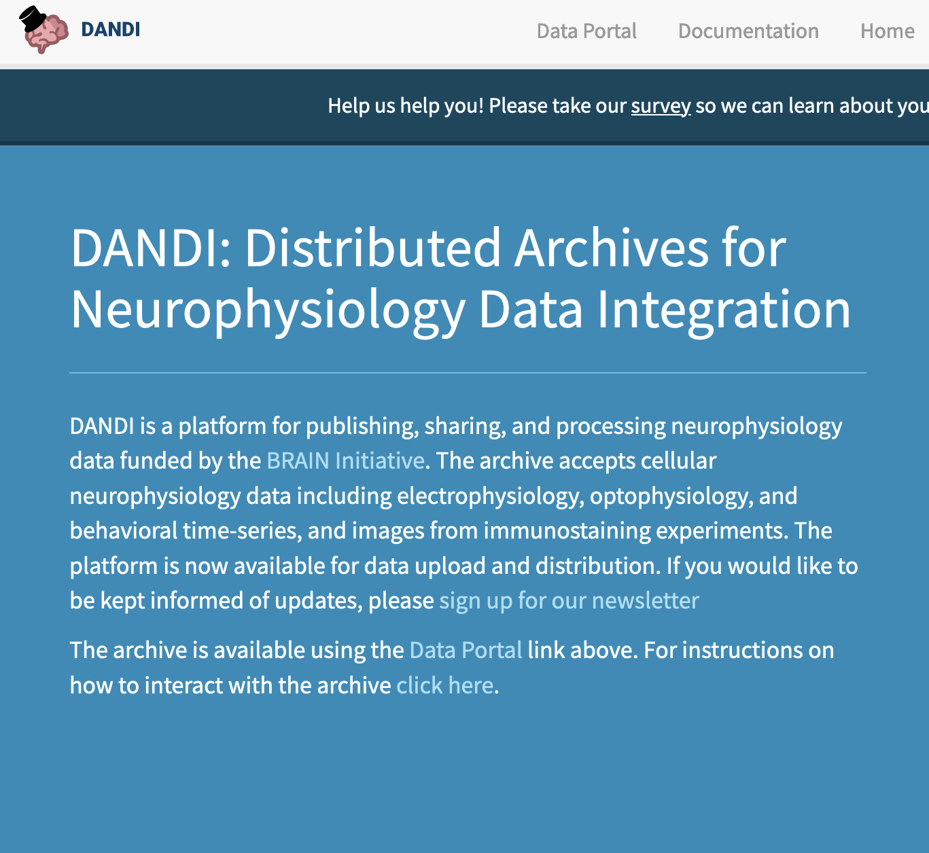
Field Specific Example: Neurodata Without Borders (NWB) & DANDI

Slide 113
Standards and Repositories
Like DANDI, some repositories require use of a standard for data submission
Example: NIMH Data Archive
All submitted data must have a corresponding data structure in the NDA Data Dictionary
In this case, a data structure is a standardized data collection form

Slide 114
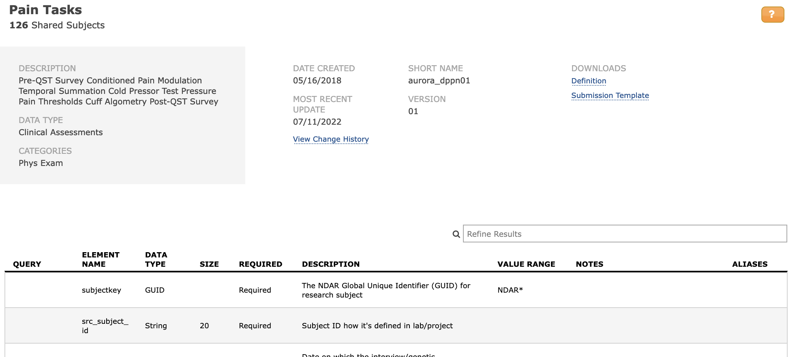
Example Data Structure in the NDA Data Dictionary

Slide 115
Example Data Structure in the NDA Data Dictionary (2)
Example Data Element within this Data Structure
Element Name: dp_cpt_theshtime
Data Type: Integer
Required: Recommended
Description: Pain threshold (First Feel Pain in Secs)
Value Range: 0 - 180
Notes: Time it took for the participant to first feel pain when hand immersed in 6 degree celsius water
Aliases: cp_threshold

Slide 116
Takeaways
Standards are important for data sharing, but they are also complicated and messy
It is unlikely that you will advise on what data collection standards to use, but you may be asked to figure out if a repository requires use of a certain data collection or description standard
It is possible that there will be no consensus on standards in a field. In that case, researchers are encouraged to explain that fact in that DMS Plans

Slide 117
Breakout #2: Data Types in Repositories
Review the following three repositories:
Data Sharing for Demographic Research
Vivli
dbGaP
For each repository, try to figure out:
Data types accepted
Are there standards required to upload data - standards for description and standards for data collection?
Any other limitation on data submission

Slide 118
Break 2
Please return at 3:00 PM (Eastern)

Slide 119
Element 4
Data Preservation, Access, and Associated timelines

Slide 120
Data Storage vs. Data Preservation
Data storage can be… file cabinets, a flashdrive, institutional repositories, cloud servers, a bank vault or safe…
Data preservation is… “a series of managed activities necessary to ensure continued stability and access to data for as long as necessary.”
“All data preservation is data storage, but all data storage is not preservation”

Slide 121
What Does the NIH Want to Know
Where will the data be deposited and shared?
How will the data be findable and identifiable?
When will the data be available? AND How long will the data be available?

Slide 122
Where will the data be deposited and shared?
Free to All Domain-specific Required data standard Mediated upload Permission subject to IRB approval Application required Controlled Access Generalist Required by institute Author approval Accepts multimedia Data Use Agreement
Fee to upload/download Much More!

Slide 123
Repository options
NIH specified repository
Discipline or domain specific repository
Institutional repository
Generalist repository - Incorporating Generalist Repositories into the NIH Data Ecosystem
Repositories for Sharing Scientific Data

Slide 124
NIH-supported Scientific Data Repositories
NIMH Data Archive
Gene Expression Omnibus (GEO)
WormBase (Data on worms!)
National Archive of Computerized Data on Aging (NACDA)
OpenNeuro (Neuroimaging data)

Slide 125
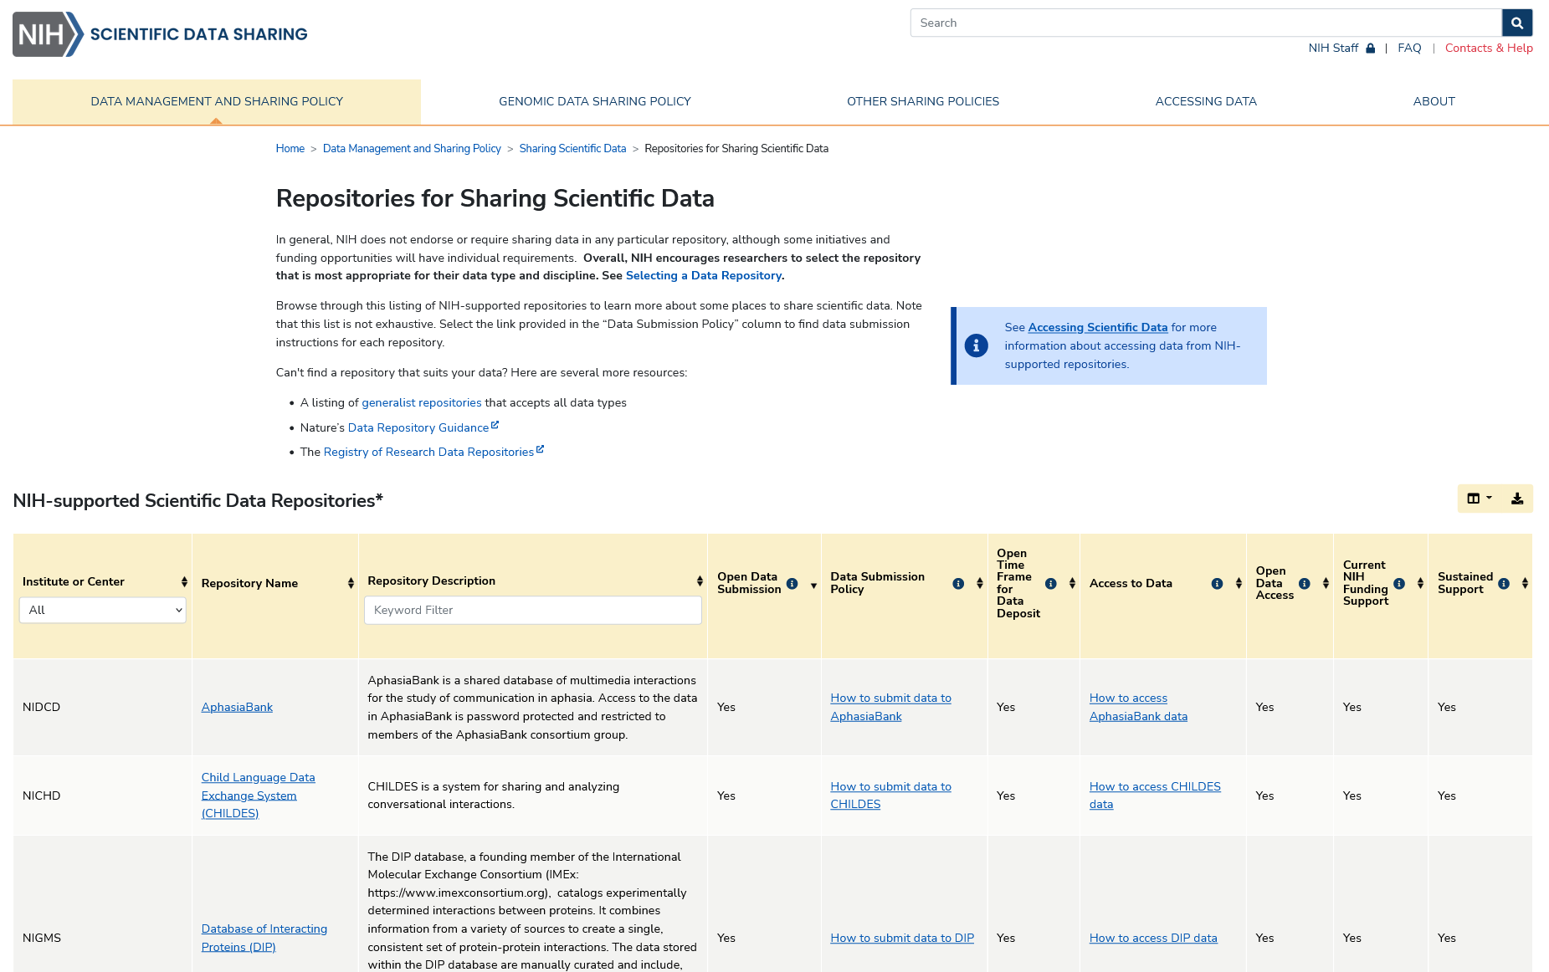
Discipline-Specific Data Repositories
Repositories for Sharing Scientific Data

Slide 126
Generalist Repositories
Dataverse
Dryad
FigShare
Mendeley Data
Open Science Framework
Vivli
Zenodo
GREI Collaborative Webinar Series on Data Sharing in Generalist Repositories

Slide 127
Desirable Characteristics for Repositories
Unique Persistent Identifiers
Long-Term Sustainability
Metadata
Curation and Quality Assurance
Free and Easy Access
Broad and Measured Reuse
Clear Use Guidance
Security and Integrity
Confidentiality
Common Format
Provenance
Retention Policy
Free and Easy Access: The repository should provide broad, free, equitable, and maximally open access to datasets and their metadata.
Clear Use Guidance: The repository should provide accompanying documentation describing terms of dataset access and use.
Retention Policy: The repository should provide documentation on their policies for data retention and associated timelines within the repository.
For more see NOT-OD-21-016 – Supplemental Information to the NIH Policy for Data Management and Sharing: Selecting a Repository for Data Resulting from NIH-Supported Research
Search for data repositories through re3data.org and FAIRsharing.org

Slide 128
How will the data be findable and identifiable?

Slide 129
Unique Persistent Identifiers
From NIH NOT-OD-21-016: The repository should assign unique persistent identifiers for the data, such as a digital object identifier (DOI) or an accession number. This identifier should be citable and support data discovery, reporting, and research assessment.
From NCDS “A Persistent Unique Identifier (PID) is a string of letters and numbers used to distinguish between and locate different objects, people, or concepts.”
Examples
Digital Object Identifier (DOI) for journal articles, datasets, etc.
Open Researcher and Contributor ID (ORCID) for researchers

Slide 130
When will the data be made available?
When will the data be made available?
How long will the data be available?

Slide 131
Sharing Timelines - When
“no later than time of associated publication”
“end of award/support period”
“whichever comes first”!

Slide 132
Data Retention Policies - For How Long
How long the repository will store the data?
1-2 years, 5 years, 10 years, 20+years
Check the repository’s data retention policy
Does the repository support long-term preservation - what is the repository’s sustainability plan?

Slide 133
Element 5
Access, Distribution, or Reuse Considerations

Slide 134
Element 5: Access, distribution, or reuse considerations
Describe any applicable factors affecting subsequent access, distribution, or reuse of scientific data related to:
Informed consent
Privacy and confidentiality protections consistent with applicable federal, Tribal, state, and local laws, regulations, and policies
Whether access to scientific data derived from humans will be controlled
Any restrictions imposed by federal, Tribal, or state laws, regulations, or policies, or existing or anticipated agreements
Any other considerations that may limit the extent of data sharing.

Slide 135
Element 5 Sections
A. Factors affecting subsequent access, distribution, or reuse of scientific data
B. Whether access to scientific data will be controlled
C. Protections for privacy, rights, and confidentiality of human research participants

Slide 136
Section A: Limitations
A. Factors affecting subsequent access, distribution, or reuse of scientific data:
NIH expects that in drafting Plans, researchers maximize the appropriate sharing of scientific data. Describe and justify any applicable factors or data use limitations affecting subsequent access, distribution, or reuse of scientific data related to informed consent, privacy and confidentiality protections, and any other considerations that may limit the extent of data sharing.

Slide 137
Informed Consent
The process by which a volunteer confirms his or her willingness to participate in a research study, such as a clinical trial, after having been informed of all aspects of the study that are relevant to the volunteer’s decision to participate.

Slide 138
Limitations Examples
informed consent will not permit or will limit the scope or extent of sharing and future research use
existing consent (e.g., for previously collected biospecimens) prohibits sharing or limits the scope or extent of sharing and future research use
privacy or safety of research participants would be compromised or place them at greater risk of re-identification or suffering harm, and protective measures such as de-identification and Certificates of Confidentiality would be insufficient
explicit federal, state, local, or Tribal law, regulation, or policy prohibits disclosure (supplement)
restrictions imposed by existing or anticipated agreements (e.g., with third party funders, with partners, with repositories, with Health Insurance Portability and Accountability Act (HIPAA) covered entities that provide Protected Health Information under a data use agreement, through licensing limitations attached to materials needed to conduct the research)
datasets cannot practically be digitized with reasonable efforts
Taken from Frequently Asked Questions

Slide 139
Non-Justifiable Reasons
Examples of reasons that would generally not be justifiable factors limiting scientific data sharing include:
data are considered to be too small
data that researchers anticipate will not be widely used
data are not thought to have a suitable repository

Slide 140
Section B: Controlled Access
B. Whether access to scientific data will be controlled:
State whether access to the scientific data will be controlled (i.e., made available by a data repository only after approval).

Slide 141
Controlled Access
Some data remains sensitive even after other measures such as de-identification have been taken, either because it cannot be sufficiently anonymized or because doing so would make the data lose its scientific utility. In those cases, planning for controlled access may be necessary.
Data De-Identification - the process of removing personally identifiable information
Controlled Access - A data sharing model that requires a request for access to all or part of the dataset, even if de-identified and lacking explicit limitations on subsequent use
Data Access Request (DAR) and Data Use Agreement (DUA) - two ways to facilitate the sharing of data under controlled access and to clarify the terms of use

Slide 142
Section C: Privacy Protections
C. Protections for privacy, rights, and confidentiality of human research participants:
If generating scientific data derived from humans, describe how the privacy, rights, and confidentiality of human research participants will be protected (e.g., through de-identification, Certificates of Confidentiality, and other protective measures).

Slide 143
Privacy Protections
HIPAA Privacy Rule
requires appropriate safeguards to protect the privacy of protected health information
sets limits and conditions on the uses and disclosures that may be made of such information without an individual’s authorization (HHS)
Common Rule (The Federal Policy for the Protection of Human Subjects)
a robust set of protections for human subjects in research
Additional Information on privacy protection in DMSP
Supplemental Information to the NIH Policy for Data Management and Sharing: Protecting Privacy When Sharing Human Research Participant Data

Slide 144
18 Protected Health Information (PHI)
Name
Address (all geographic subdivisions smaller than state, including street address, city county, and zip code)
All elements (except years) of dates related to an individual (including birthdate, admission date, discharge date, date of death, and exact age if over 89)
Telephone numbers
Fax number
Email address
Social Security Number
Medical record number
Health plan beneficiary number
Account number
Certificate or license number
Vehicle identifiers and serial numbers, including license plate numbers
Device identifiers and serial numbers
Web URL
Internet Protocol (IP) Address
Finger or voice print
Photographic image - Photographic images are not limited to images of the face.
Any other characteristic that could uniquely identify the individual

Slide 145
NLM Scrubber
❏ Identifies HIPAA personal identifiers in a dataset
❑ Allows researchers access to medical data and protects patient privacy by deidentifying electronic medical records (EMRs)
❑ Produces HIPAA-compliant datasets for scientific research, publication, and sharing
https://lhncbc.nlm.nih.gov/scrubber/

Slide 146
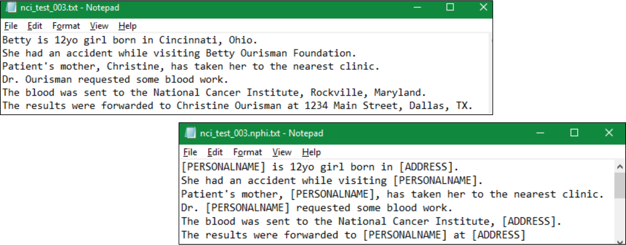
NLM Scrubber Example

Slide 147
Element 6
Oversight of data management and sharing

Slide 148
Element 6:
Describe how compliance with this Plan will be monitored and managed, frequency of oversight, and
by whom at your institution (e.g., titles, roles).
*This element refers to oversight by the funded institution, rather than by NIH. The DMS Policy does not create any expectations about who will be responsible for Plan oversight at the institution.

Slide 149
PIs / Data Managers
“While PIs are ultimately responsible for data management, PIs are increasingly leveraging the skills and expertise of specialized information professionals to fill a dedicated data manager role. The research team’s data manager is responsible for overseeing data as it moves from collection or querying to analysis, storage, and sharing, all while ensuring data integrity and protection of research subject privacy.”
Ten simple rules for maximizing the recommendations of the NIH data management and sharing plan (2021)

Slide 150
Roles & Responsibilities
The Contributor Role Ontology describes a data manager as “a role that encompasses effective and efficient operation and usage of data, including, but not limited to management, handling, or manipulation”
Data Managers, PIs, co-investigators, post-docs, graduate assistants, interns, biostatisticians, and data analyst
Ten simple rules for maximizing the recommendations of the NIH data management and sharing plan (2021)

Slide 151
Roles in Clinical Research Data Management
Data Manager
Database Programmer/Designer
Medical Coder
Clinical Data Coordinator
Quality Control Associate
Data Entry Associate
“The data manager is responsible for supervising the entire CRDM process. The data manager prepares the DMP, approves the CDM procedures and all internal documents related to CDM activities.”
Data management in clinical research: An overview

Slide 152
Assigning Roles and Responsibilities
CHECKING DATA QUALITY
PI
Project Coordinator
Statistician
ANALYZING DATA
Research Assistant
Student
ENTERING DATA

Slide 153
Roles: Documenting Responsibilities
Responsibilities:
Collects data at site
Enters data into database
Training needs:
Protocol training
IRB training
Data entry training
Database training
CITI Training
Responsible conduct of research
Research Assistant

Slide 154
Responsibility Assignment Matrix
A RACI (Responsible, Accountable, Consulted, Informed) chart is a tool that can support ensuring clarity on job roles and responsibilities.
A RACI is a type of responsibility matrix or responsibility assignment matrix that assists in alleviating role confusion.
A RACI matrix is a standard document and best practice used to map out and document the key activities and deliverables for the project and the individuals or groups that have responsibility for their completion, signoff, and awareness.

Slide 155
Allowable Costs for Data Management and Sharing
Costs associated with data curation, preservation, and management are allowable costs and can be factored into the budget justification
Curating data
Developing supporting documentation
Formatting data according to accepted community standards, or for transmission to and storage at a selected repository for long-term preservation and access
De-identifying data
Preparing metadata to foster discoverability, interpretation, and reuse
Local data management considerations
Preserving and sharing data through established repositories, such as data deposit fees.
Budgeting for Data Management and Sharing

Slide 156
Unallowable Costs
Budget requests must NOT include:
Infrastructure costs that are included in institutional overhead (for instance, Facilities and Administrative costs)
Costs associated with the routine conduct of research, including costs associated with collecting or gaining access to research data.
Costs that are double charged or inconsistently charged as both direct and indirect costs
https://sharing.nih.gov/data-management-and-sharing-policy/planning-and-budgeting-for-data-management-and-sharing/budgeting-for-data-management-sharing

Slide 157
Breakout #3: DMP Assignments
Choose one of the six elements of the NIH DMSP
Review the sample NIH Data Sharing Plan provided, and identify all the text in the data sharing plan which would go into the element that you chose
Identify all the information needed for the NIH DMS Policy that is not in the sample data sharing plan.

Slide 158
Break 3
Please return at 4:00 PM (Eastern)

Slide 159
Practice Critique

Slide 160
Talking to researchers

Slide 161
Think reference consultation interview
Like in a reference consultation, the researcher knows the topic in ways that the librarian cannot.
Also like in a consultation, the librarian’s job is to steer the conversation to blend our expertise with the researcher’s expertise; and pull out just the parts that this situation needs.
Instead of listening for potential keywords, try listening for things about measuring things, typing in or cleaning up the numbers, making documentation, and saving different files.

Slide 162
Mock interview
Not rehearsed! Let’s see how this goes
Thank our interviewee:
Dr. Anna Eichinger
Postdoctoral fellow in the Reizis lab
New York University School of Medicine

Slide 163
After the consultation
Draft notes about the Data Type (including 1.1 data generated, 1.2 data to be shared, and 1.3 metadata and documentation)
Add notes on any standards that came up, as well as considerations/limitations to sharing the data for ethical / legal / technical reasons
If the researcher doesn’t mention a preferred archive, look up some possibilities in the BMIC list of data repositories.
Have a recommended generalist option as a backup, such as your institutional data repository or one of the BMIC-reviewed generalist repositories
Time permitting, look up preservation timeline in the archives’ documentation
Write up the remaining questions, such as “Do you need to delay release to the public or ‘embargo’ the data?” to send for followup.

Slide 164
Further resources

Slide 165
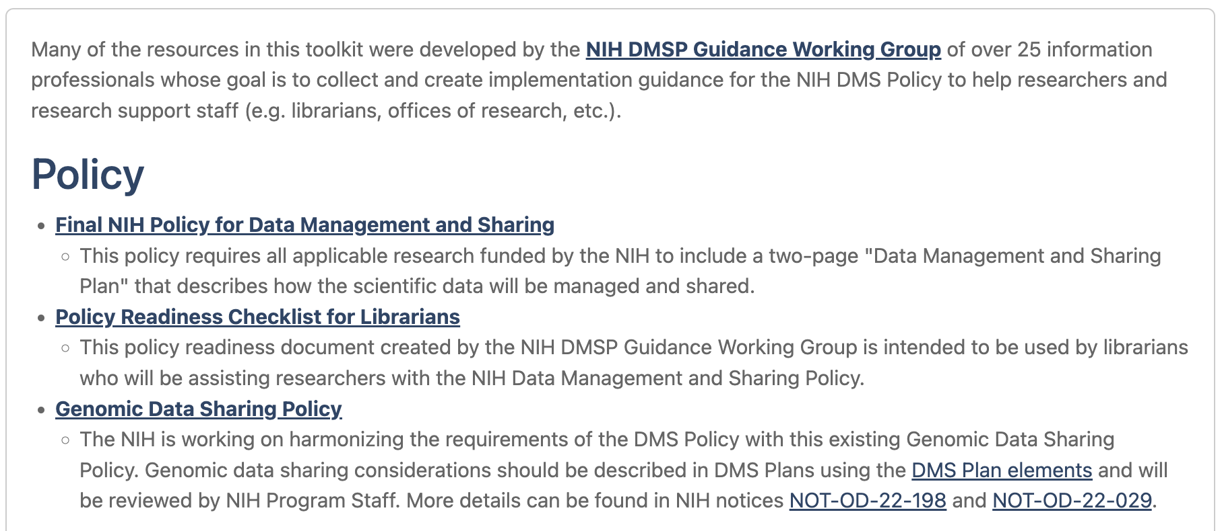
Resource links
NNLM Toolkit for the NIH Data Management and Sharing Policy https://www.nnlm.gov/guides/nnlm-toolkit-nih-data-management-and-sharing-policy

Slide 166
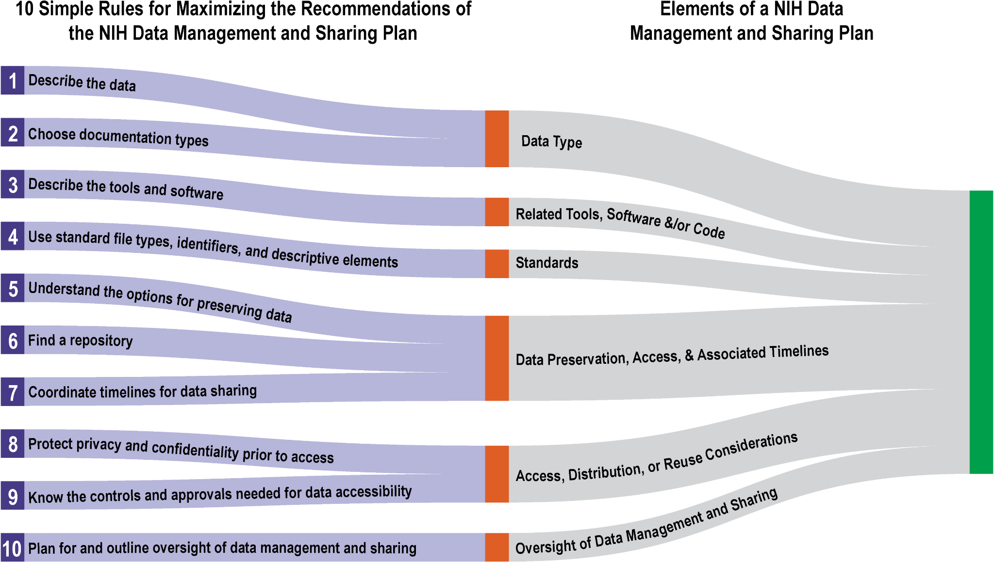
Resource links (2)
Ten simple rules for maximizing the recommendations of the NIH data management and sharing plan
by: Sara Gonzales, Matthew B. Carson, and Kristi Holmes
https://doi.org/10.1371/journal.pcbi.1010397

Slide 167
Resource links (3)
NIH Scientific Data Sharing Website
https://sharing.nih.gov/

Slide 168
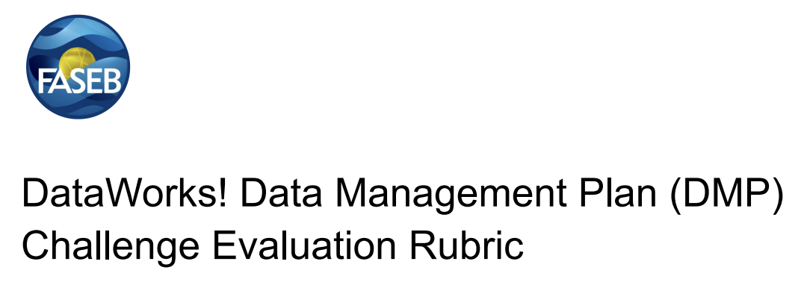
Resource links (4)
DMPTool.org
FASEB Data Management Plan Evaluation Rubric
https://www.faseb.org/getmedia/cb681545-2ed5-4970-b167-e1b47b1f225e/Rubric-for-DataWorks-DMP-Challenge-12-14-21.pdf

Slide 169
Conclusions

Slide 170
General Takeaways
Recognize what’s in the policy and what’s not in the policy.
Consider what you can do, but also be realistic and acknowledge limitations.
Communicate with your leadership and express your needs and limitations.
Seek out existing resources wherever possible.
Connect with others doing this work (at your institution and elsewhere!).

Slide 171
Upcoming Events
https://www.nnlm.gov/about/centers/ncds
Creating Data Management Plans with DMPTool — Dec. 13 and Feb. 15
NIH DMSP Policy Overview — Jan. 10
Data Management Sharing Policy Webinars (On Demand)

