Slide 1
Health Information Resources
Notes:
This is not a comprehensive list of resources as there are lots of them. I primarily will focus on those produced by the National Library of Medicine and National Institutes of Health along with other government resources and some resources produced by associations and organizations.
There isn’t time to demonstrate the usage of these resources. We do have classes that focus on particular populations or topics where more in-depth information is provided. Unfortunately, I don’t have time to provide that but am happy to answer questions either here or you can always email me.
Also, keep in mind, when you or your patrons are seeking answers that most often you will not find the specific answer to the specific question. I worked with healthcare professionals who would ask, “What are the research results of 12 year old boys who take Ritalin for ADHD?” and expect the perfect research article to pop up readily which just isn’t going to happen. People will need to extrapolate what they need from the information or read and apply it broadly. That is why it is so important for patients and healthcare consumers to seek this information but to take it to their health care providers to ask the more specific questions of how this applies to them and their situation.
And of course remembering that we as library staff do not interpret the information.
I would tell my patrons that if they had a question about the information they needed to take that to their doctor but if they had a question about where the information came from, if they wanted something more specific or broader or a different angle that they could ask me.
Remember too, that there such as thing as too much information which I will be doing here the next hour. I usually provide information from 2-3 resources (it’s good to provide information from a variety of resources) and let patrons know they could always ask for more if they wished. It can be overwhelming to see a stack or a list of 10 links.
So, where do your patrons look for information about health?

Slide 2
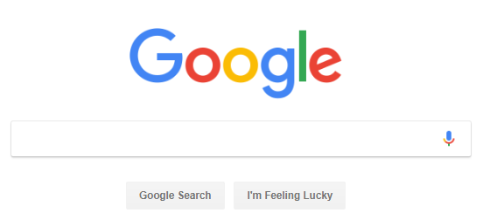
Dr. Google
Is not a licensed health professional!
Notes:
Most likely Dr. Google. While Dr. Google is where most people like to start their search for information it really isn’t the most efficient search tool. And remember Dr. Google is neither a licensed health professional nor a trained librarian.

Slide 3
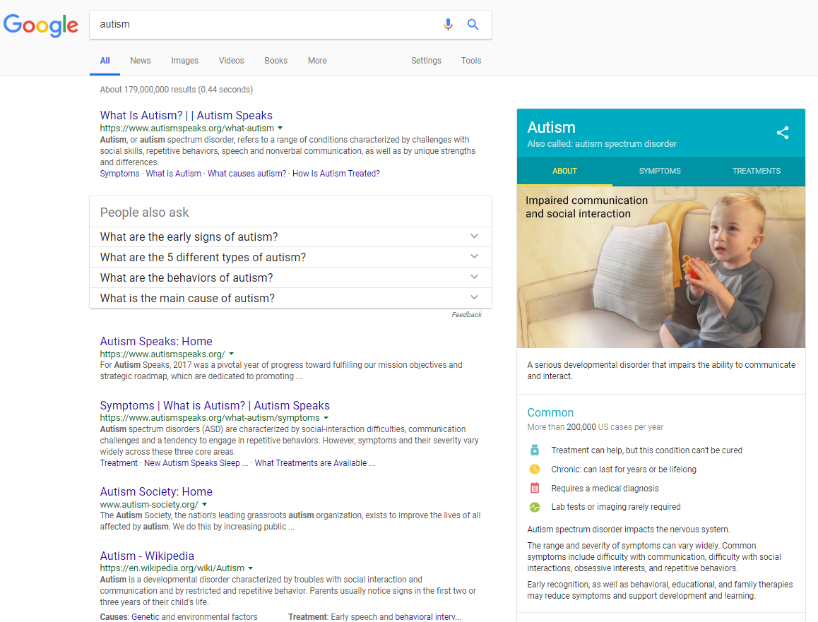
Google results
179,000,000 results
Notes:
Are these really the kind of results you want to sort through?

Slide 4
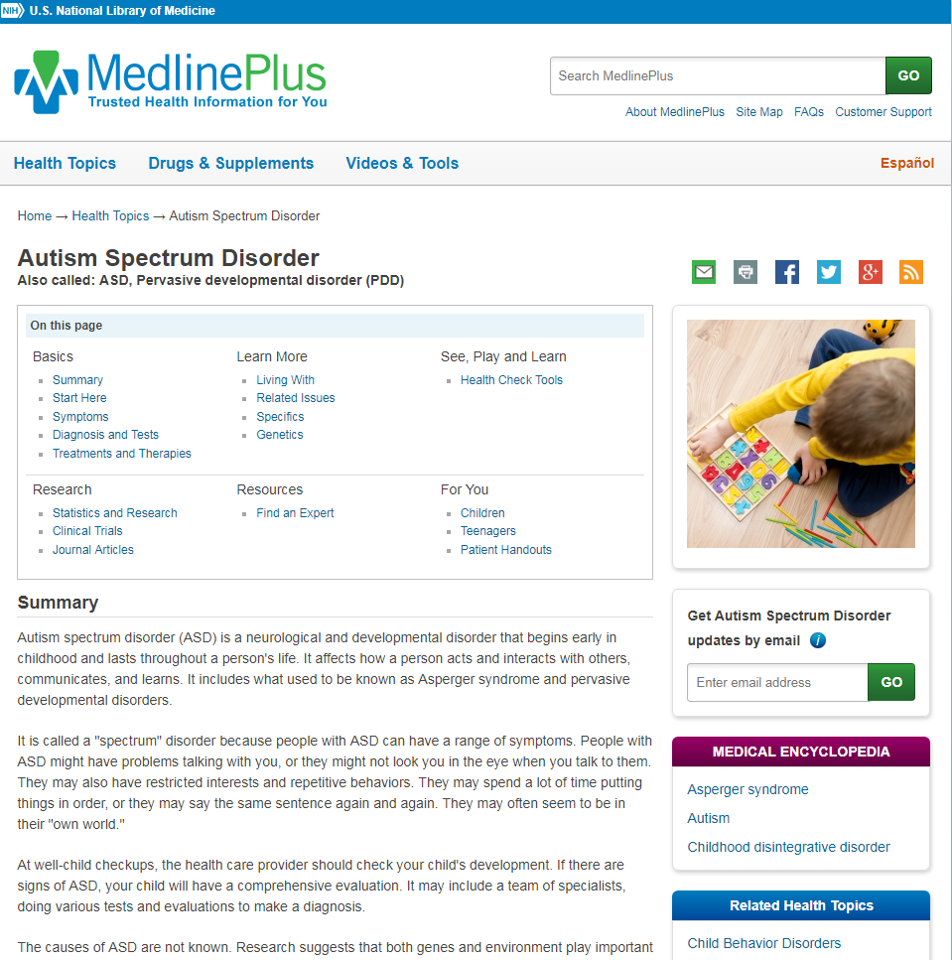
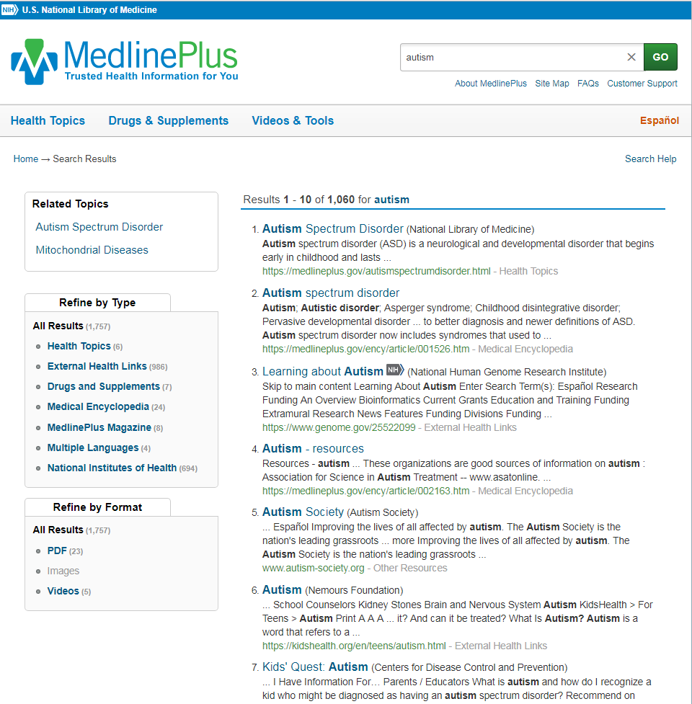
MedlinePlus results
748 results
Autism health topic page
Notes:
Might these look a little less daunting?
On the left you have just under 1,000 results using a Google like search with a large number of results but all within MedlinePlus.
But and even better, the screen shot on the right is a health topic page focused specifically on Autism.

Slide 5
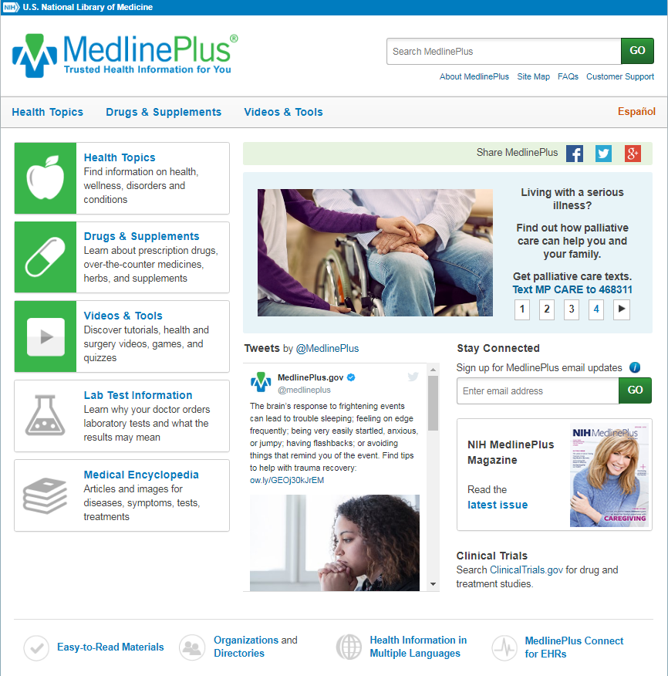
MedlinePlus
Over 1,000 health topics
Links to reliable, authoritative health websites
Regularly reviewed
Strict standards
No endorsements
No advertisements
Notes:
How many of you use MedlinePlus? Let me give an overview for those who may not be as familiar. I encourage you to take some time to explore it on your own. MedlinePlus doesn’t create its own information but gathers it form other websites but these links must pass a strict list of criteria before being included. This way your patrons don’t have to decide whether it is quality information or not as they would when just browsing on the Internet.
Here are information health topics that include diseases but also things like disaster planning and school health.
Drug and supplement information including herbs.
Videos of surgeries, health quizzes, and games are here.
Lab test information is a new feature
and the medical encyclopedia has brief information on a lot of health topics.
MedlinePlus has a FB and Twitter presence.
Clinical trial information.
A magazine that comes out about 4x a year that is online and in print. This can be ordered free of charge in bulk to your library to be used as a giveaway at a program or just to hand out.
Easy to read materials are put together in one place.
A directory of services and organizations.
Information in other languages
And a new feature is the Healthy Recipe of the Week with nutritional information as well prep and cooking time
I call it the Costco of health information

Slide 6
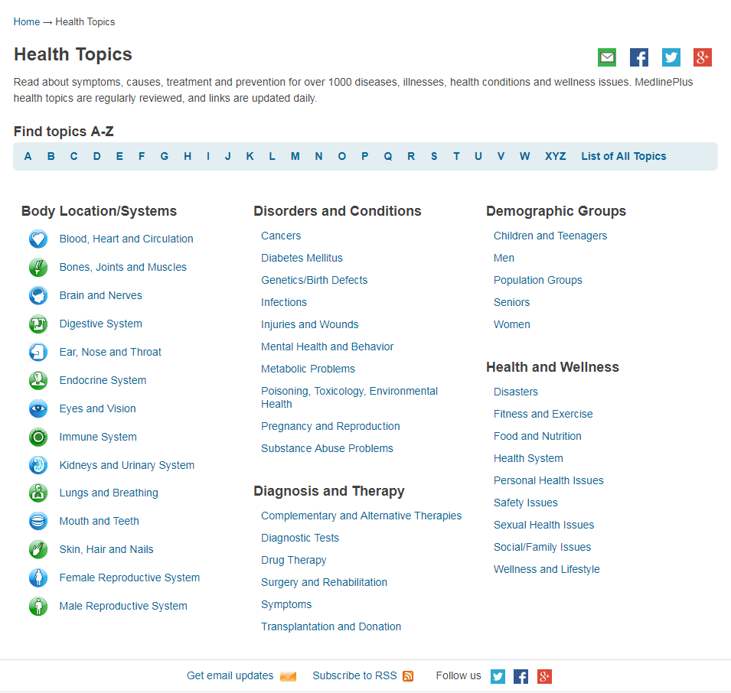
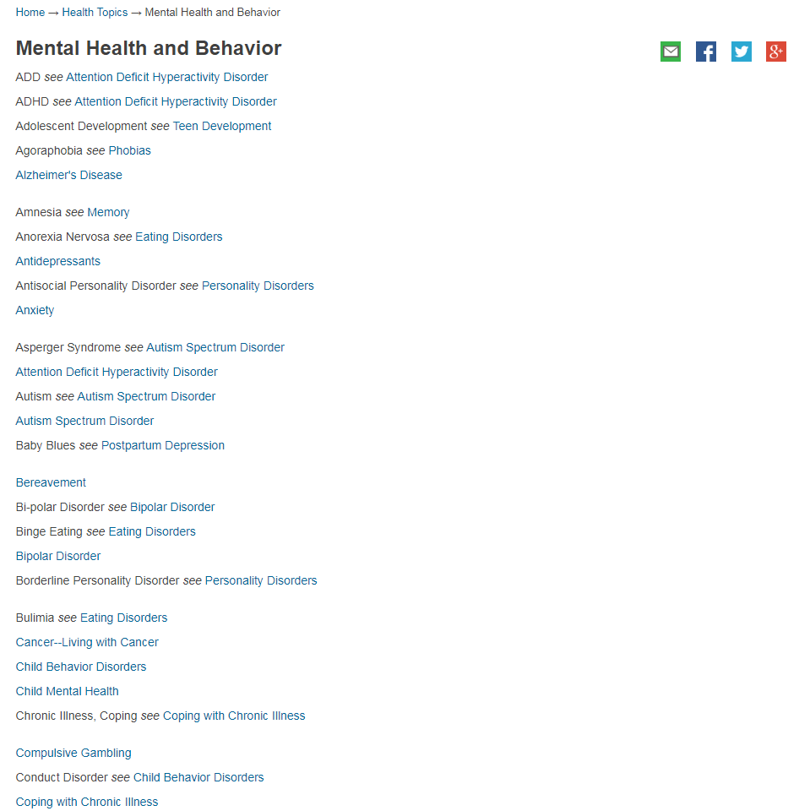
MedlinePlus- health topic search
Notes:
You can search for a health topic a few ways. Besides the search box at the top which is like a google type search you can search by body location/system if you happen to know that but most times people don’t know that.
More commonly you’d search by:
disorders/conditions
Demographics and other categories that you see here
The screen shot on the right is an example of the list of health topics under the category of Mental Health and Behavior

Slide 7
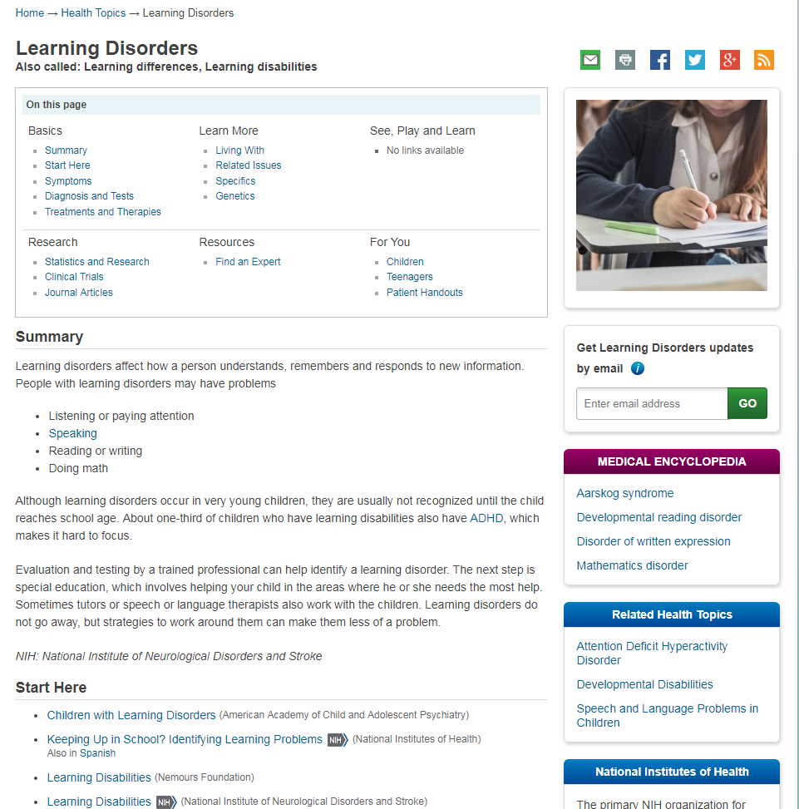
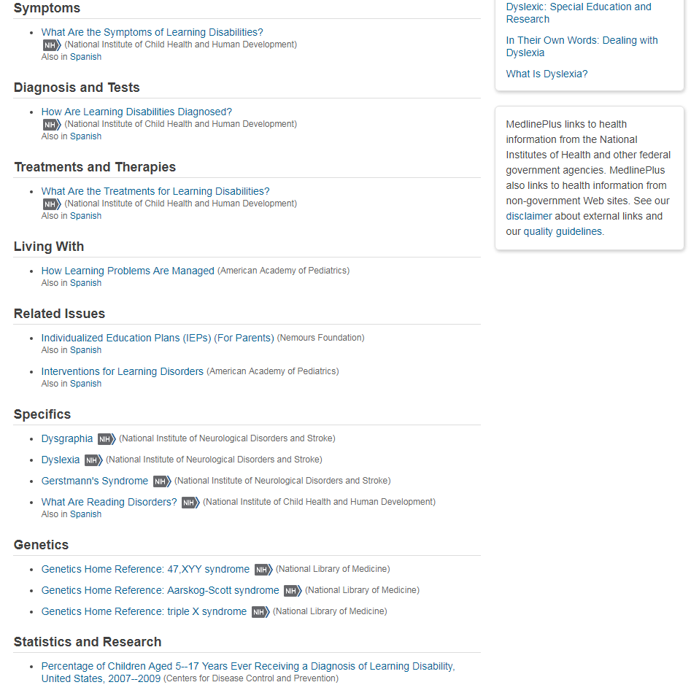
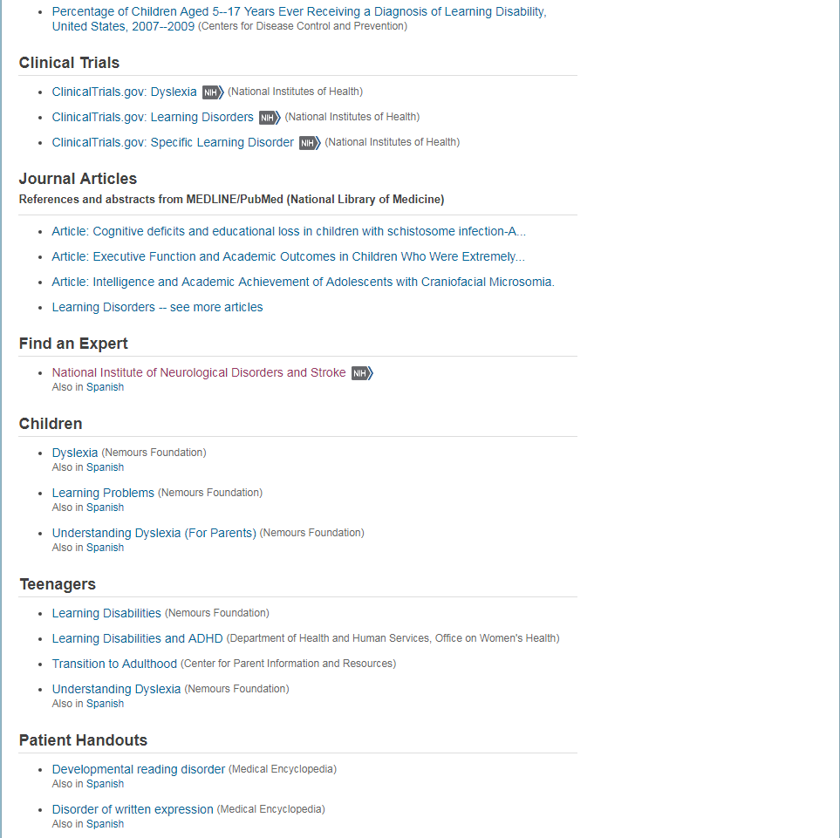
MedlinePlus- health topic page
Notes:
Here is an example of a health topic page in MedlinePlus
Table of contents
Summary
Categories of symptoms, diagnosis, treatment, related issues, genetics, statistics
Notice you can see where the information is coming from
On right side you see medical encyclopedia entries related to this topic, other related health topic pages, information in other languages is typically listed here as well

Slide 8
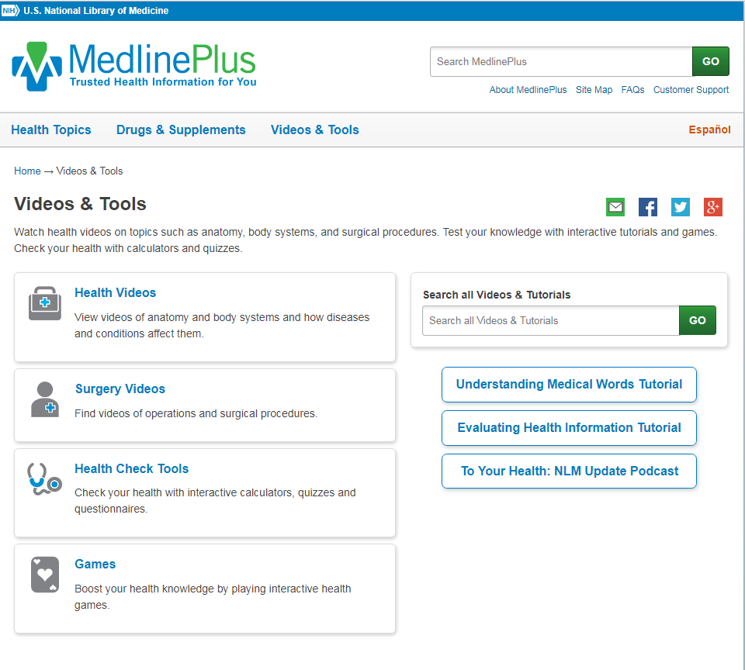
MedlinePlus- videos & tools
Notes:
I’ll go over the drug information in just a bit.
MedlinePlus has some fun and more interactive resources that your patrons may find fun but also informative.

Slide 9
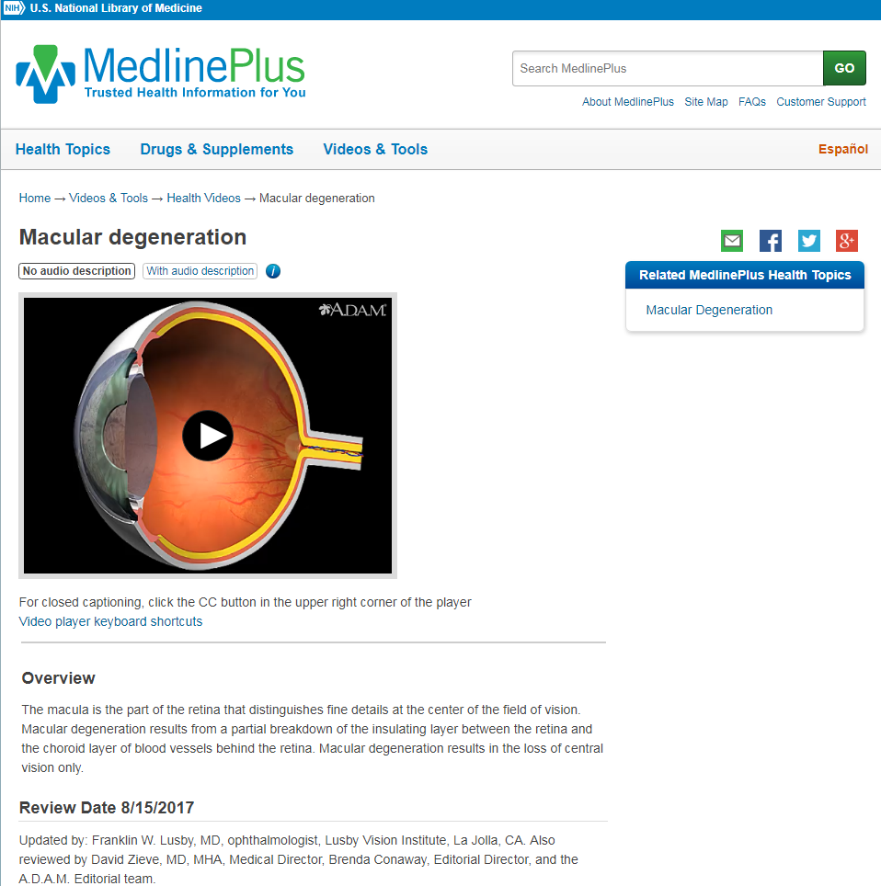
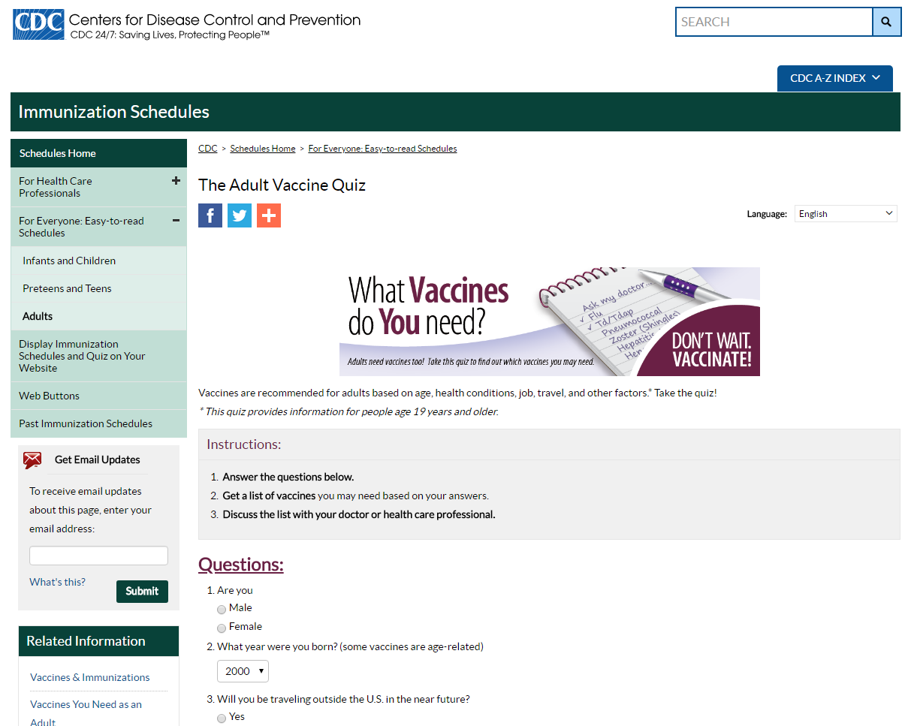
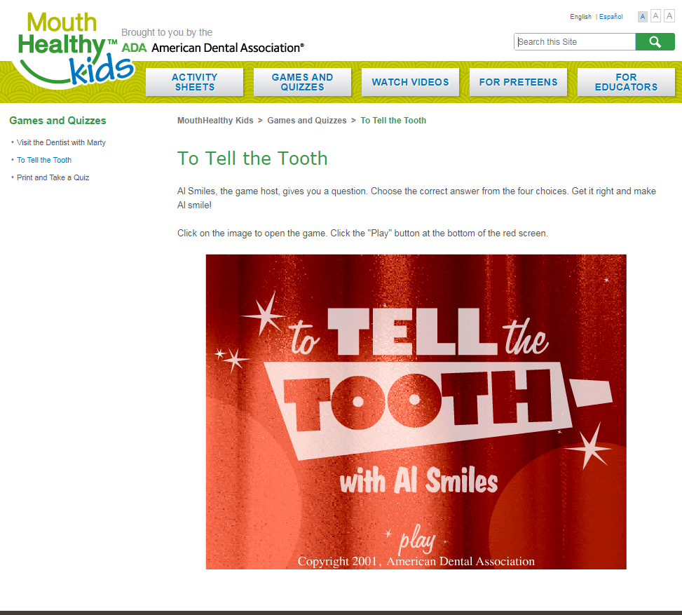
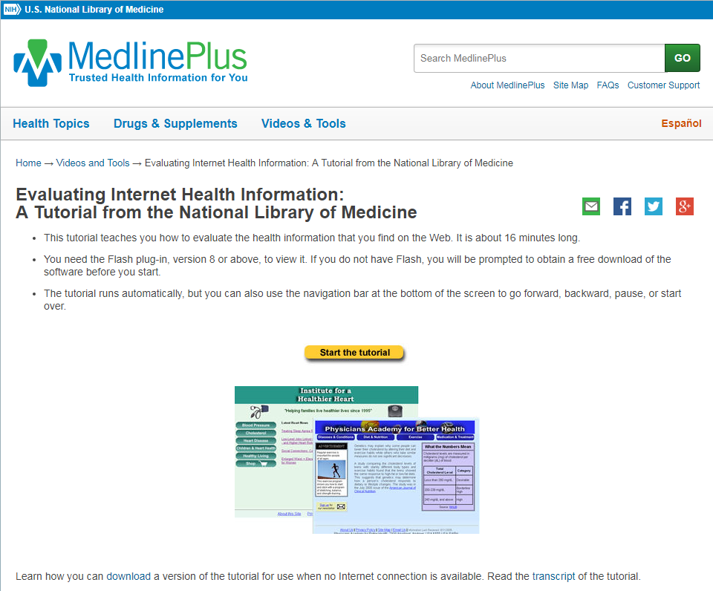
MedlinePlus- videos & tools examples
Notes:
Here is an example of a health video on macular degeneration
A quiz about vaccines
A game called To Tell the Tooth for kids to learn more about their teeth and how to take care of them
And a tutorial about evaluating health information.
These tools can help your patrons become more engaged in their health.

Slide 10
MedlinePlus- responsive design
Notes:
And MedlinePlus is a responsive design so it adapts to the screen and is given priority by Google

Slide 11
National Institutes of Health (NIH)
Notes:
The National Institutes of Health (also known as NIH) may sound like it is just for researchers or health professionals but it also includes health information for the public and educational materials for K-12.
NIH News in Health comes out every month. Individuals can subscribe to it electronically, your libraries can print them out to provide for your patrons, you can use the information for your social media and subject guides.

Slide 12
NIH- 27 institutes and centers
Notes:
The National Institutes of Health is made up of 27 different institutes and centers. You’re probably most familiar with the National Cancer Institutes but the National Library of Medicine is also one of the institutes.
The main webpage of NIH includes information for the public but many of the individual institutes include additional information on each of their individual webpages.
Such as the National Institute of Arthritis and Musculoskeletal and Skin Diseases. Here you can view health topics, information that is in Spanish and other activities and news regarding the work at each institute or center.

Slide 13
Multi-lingual and Multi-cultural
MedlinePlus and other resources
Notes:
English isn’t always the primary language for many in your communities. Finding quality health information in other languages can be a challenge. Here are some resources that may help.

Slide 14
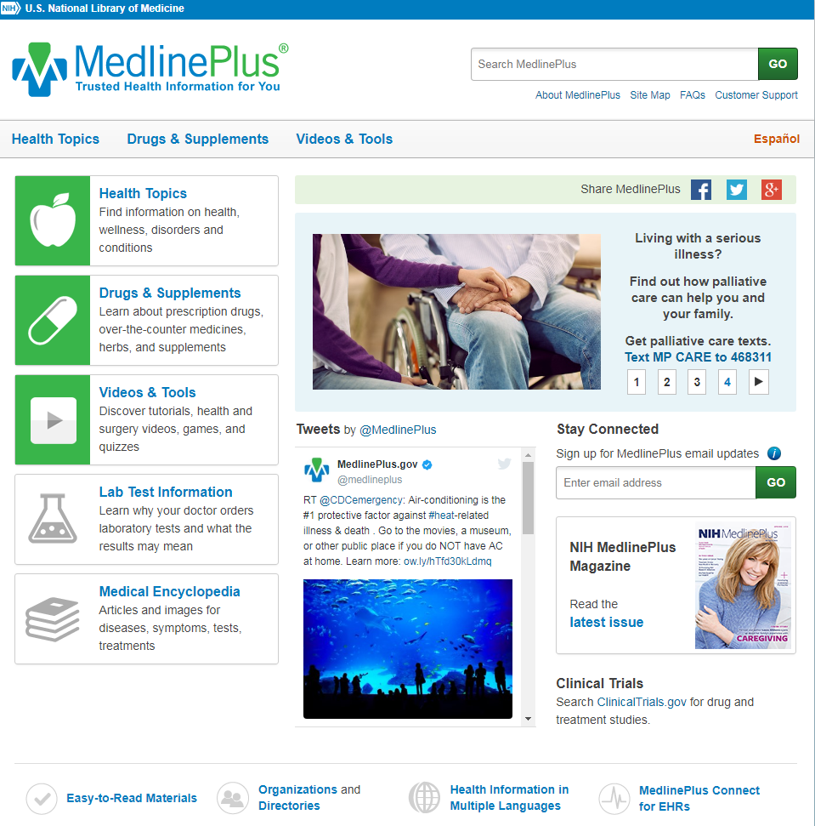
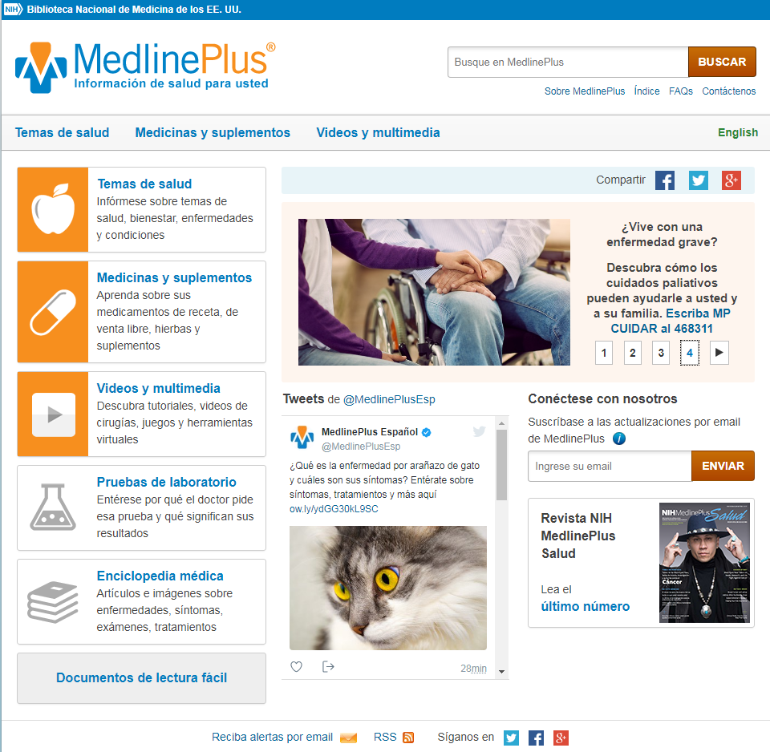
MedlinePlus- English/Spanish
Notes:
And, with just a click, you can access what is available in Spanish in MedlinePlus. It’s not everything that is in English but quite a bit is.
[click]
You can also access information in other languages from here

Slide 15
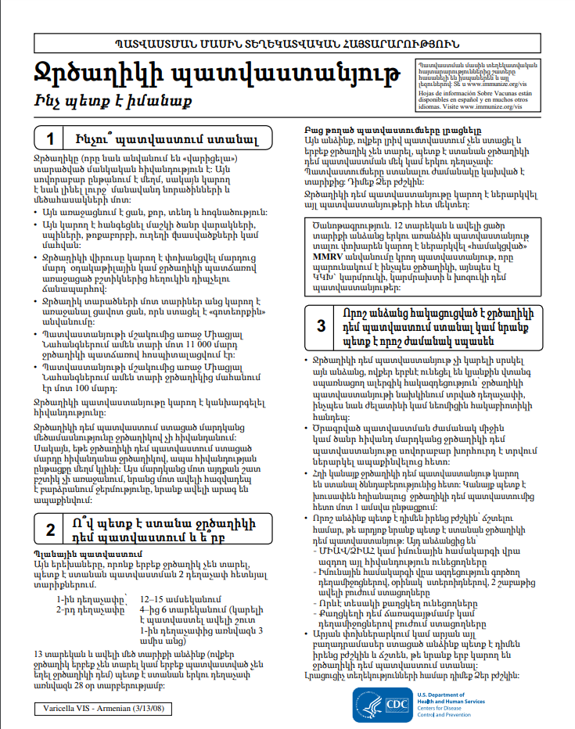
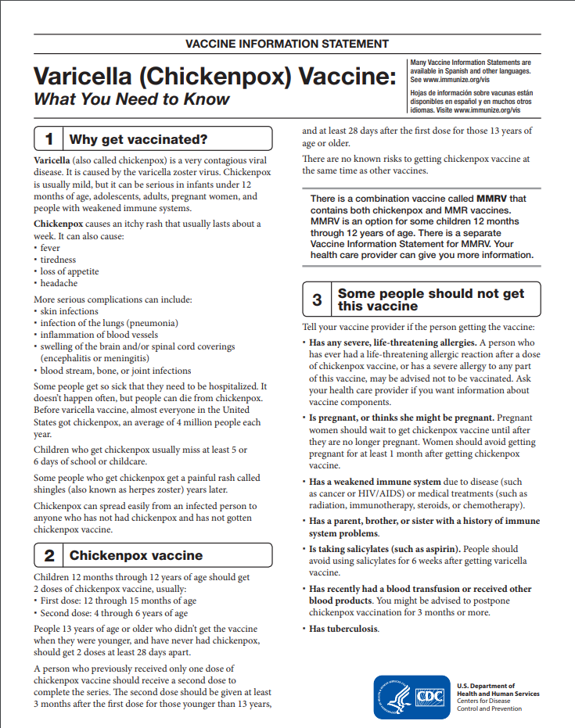
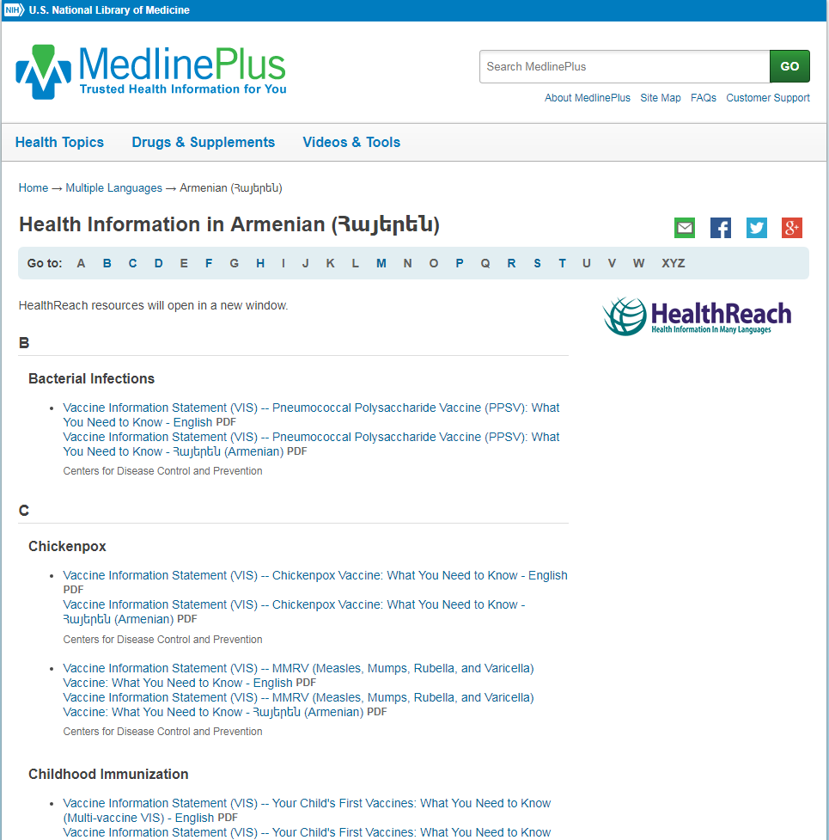
MedlinePlus- multiple languages
Notes:
You can search by language or by health topic.
Here is an example of what health information is available in Armenian
This is the chickenpox vaccine information in Armenian
But you may also want to print out the English version so if they take this to their doctor or the clinic they can hand the English version (if needed) to the clinician so they know what kind of information their patient has.

Slide 16
HealthReach
Notes:
Health Reach is the multi-lingual, multi-cultural health resource from the National Library of Medicine.
HealthReach is a national collaborative partnership where organizations can submit their multi-lingual materials to create this wonderful resource.
These materials are then reviewed before being included into HealthReach and are reviewed annually.
And you can use these resources to provide quality health information to your patrons whose first language isn’t English.

Slide 17
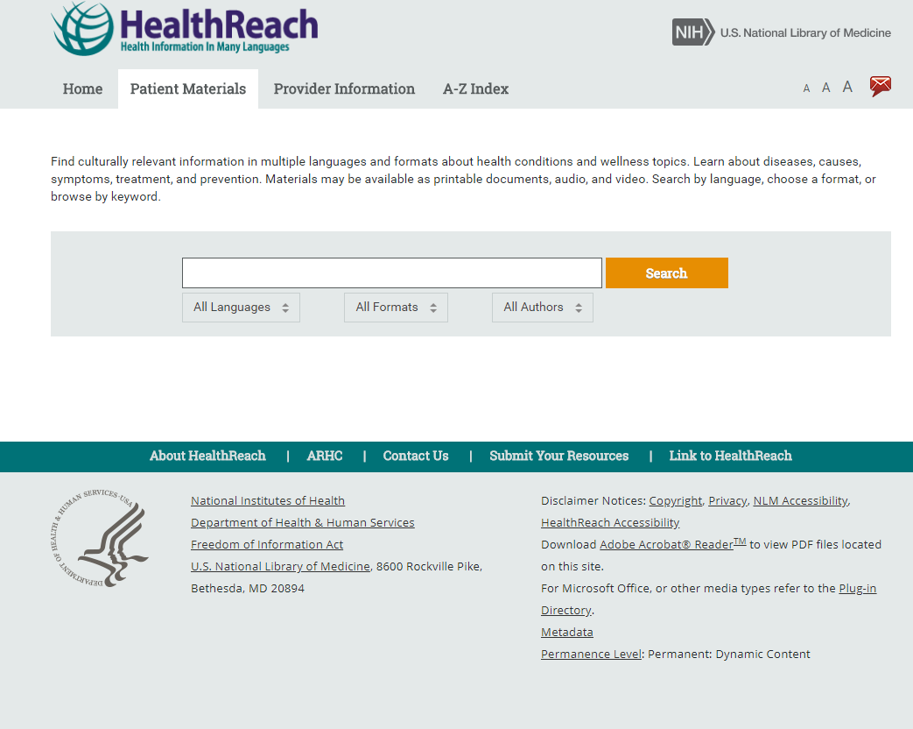
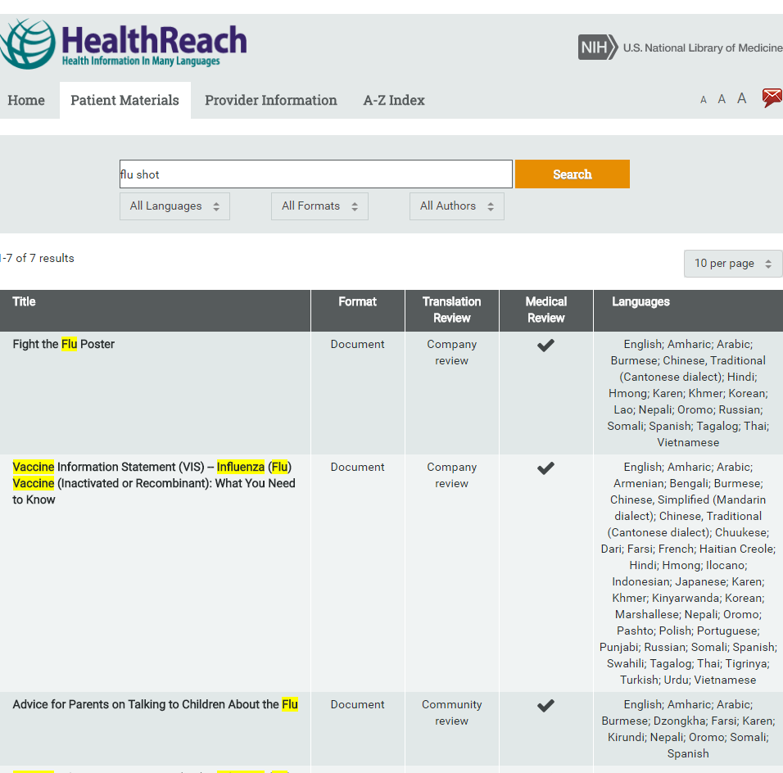
HealthReach- patient materials
Notes:
You can search for health information by language, by format and by author (such as organization) on such topics as the flu.
You can see in the screen shot on the right if the information is in a document or video or some other format, the kind of review and the languages the information is available in.

Slide 18
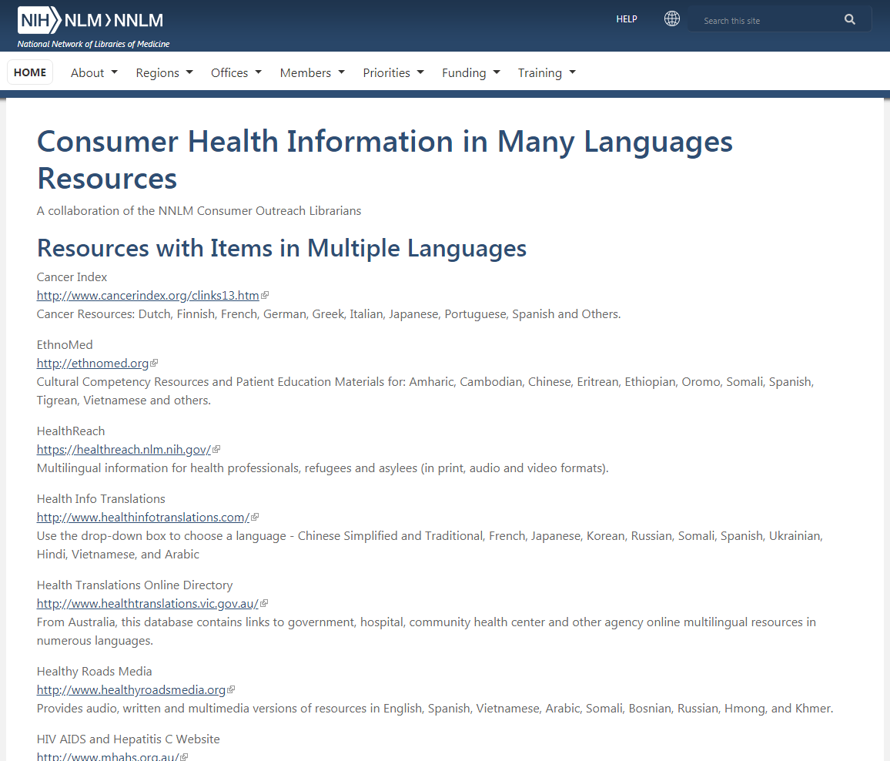
NLM and NNLM resources
Notes:
In addition, the National Library of Medicine’s Specialized Information Services division and the National Network of Libraries of Medicine provide a wealth of information pertaining to health in different languages and about cultural competence.
Links are provided in a number of different categories including Cultural Competency, Health Literacy, Limited English Proficiency, and Refugee Health Portals.
Links to a number of different resources that provide health information in languages.

Slide 19
NIH- Spanish and other languages
Notes:
NIH has created a section of their materials that are in Spanish in one place.
Some information at the NIH institutes also come in other languages such as at the National Institute of Arthritis and Musculoskeletal and Skin Diseases but a few do offer other languages but many offer Spanish.

Slide 20
Multiple – language resources
Notes:
EthnoMed contains information about cultural beliefs, medical issues and other related issues pertinent to the health care of recent immigrants to the US and is primarily for health care professionals (as are many of these resources) but it does contain health information in other languages and it contains information to help you and your staff and even your community become more culturally aware especially in regards to health and culture. This resource has received various funding from us and is out of the University of Washington’s Harborview hospital.
SPIRAL contains health information in Asian languages and is out of Tufts University and also has received funding from NNLM.
Out of Ohio State University is another resource for professionals but a wide range of health information that is culturally appropriate called Health Information Translations
Health Roads Media provides some information in other languages in an audiovisual format that some of these others may not have. This site contains some free health education materials in a number of languages and formats (print, video, audio). They also provide some low-cost materials for hospital or group settings. Materials are developed with attention paid to the issues of literacy, health-literacy, illness, aging, disability and language.
US Committee for Refuges and Immigrants has developed health resources that are cultural and linguistically appropriate through cooperation from a variety of agencies and experts in several different languages. You’ll find Healthy Living Toolkits in various languages which is a multi-page pdf with information about the cold and flu, dental health, and common health conditions.

Slide 21
Drug Information
Including herbal and supplements
Notes:
Almost everyone takes some sort of medication or supplement at some point in their life. As a patient or health consumer it is a good idea to know what you’re taking and why as well as any precautions.

Slide 22
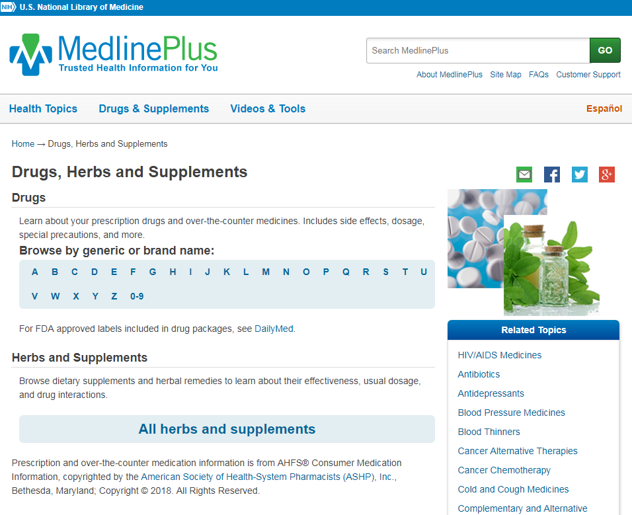
MedlinePlus- Drugs & Supplements
Notes:
MedlinePlus is a great place to start when looking for drug information. The drug information is from the American Society of Health-System Pharmacists which is a much better resource than the PDR (Physicians’ Desk Reference which is what many people think of including physicians). The information is not exactly unbiased as information on drugs included in it is created by pharmaceutical companies who also help produce this resource financially.

Slide 23
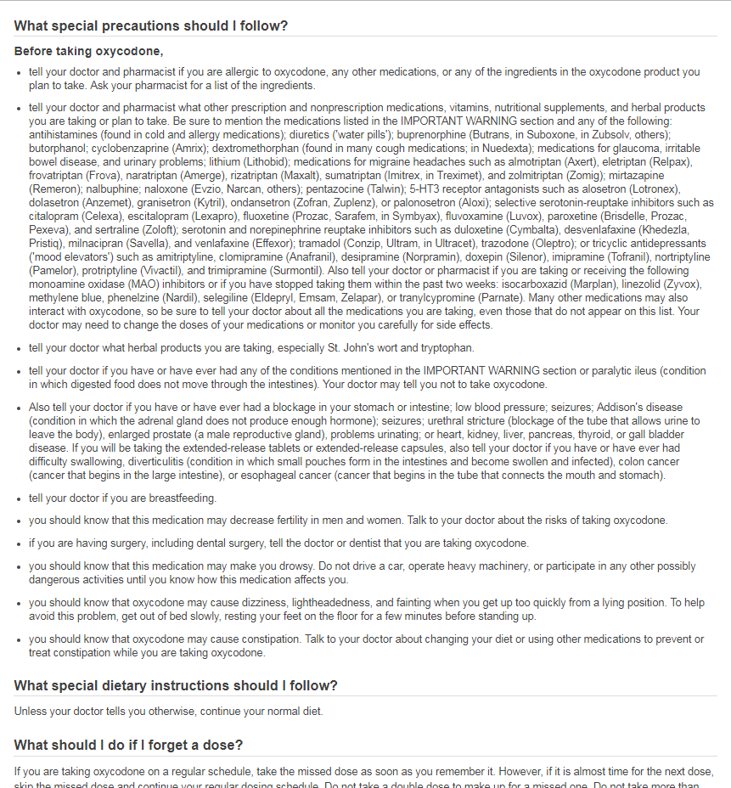
MedlinePlus- drug information
Notes:
Here is an example of drug information in MedlinePlus.
It’s alphabetically listed of both prescription and over the counter drugs
Oxycodone is one of the many opioids that have been in the news lately and you’ll see that the drugs have the same sort of table of contents that the health topics do in MedlinePlus but rather than a list of links the actual information is there
Note that FDA warnings are listed first with a red box around it.

Slide 24
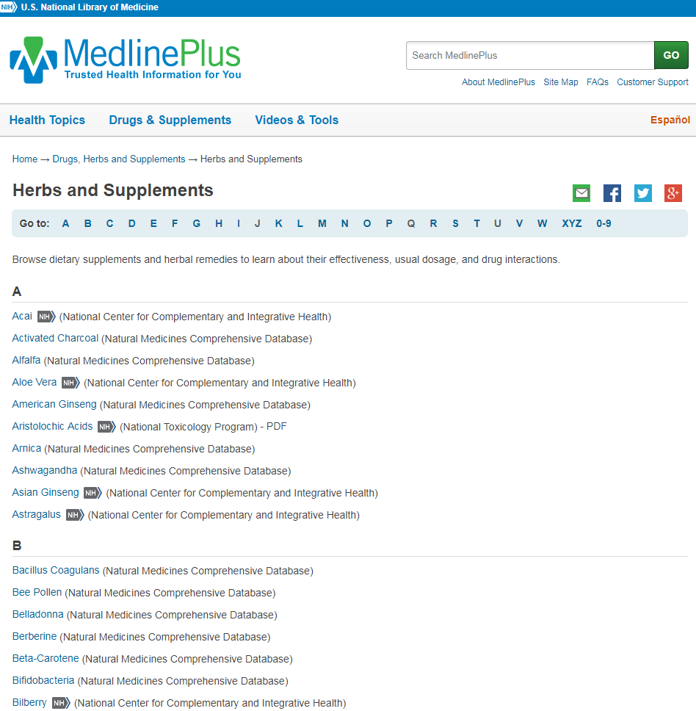
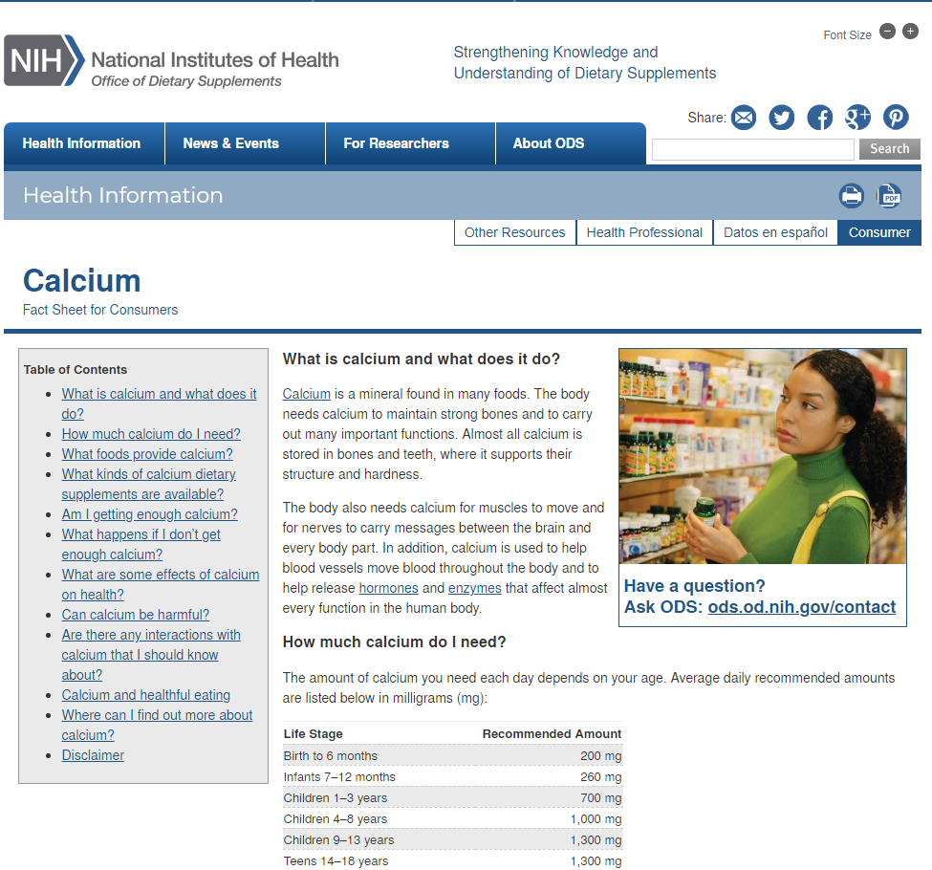
MedlinePlus- herbs and supplements
Notes:
MedlinePlus has information about herbs and supplements.
They’re listed alphabetically
And here it takes you to actual websites with more information on the particular topic.
Information is primarily from the institutes at the National Institutes of Health

Slide 25
Drug Information Portal
Includes over 53,000 substances
Information is from NLM and other U.S. government agencies
Clinical trials to marketplace
More comprehensive than MedlinePlus
For consumers, health professionals and researchers
Notes:
The Drug Information Portal provides more in-depth information than MedlinePlus. It is both for professionals and consumers and because of that I wouldn’t recommend it for your initial search. I still recommend it is best to start with MedlinePlus but sometimes if the information isn’t there or more in-depth information is wanted, then use this resource.

Slide 26
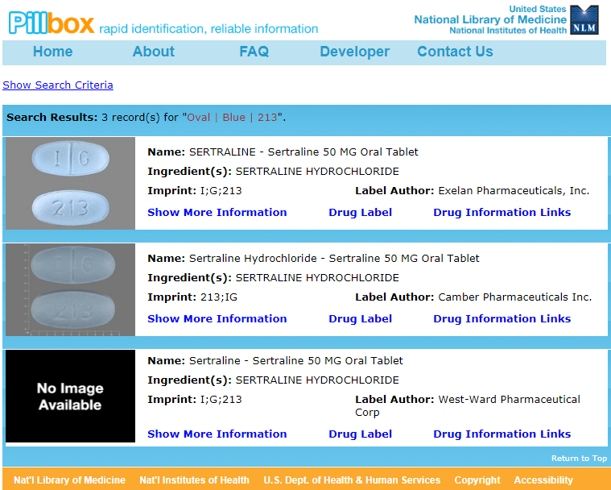
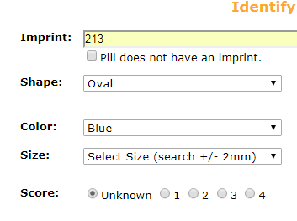
Pillbox- pill identifier
Notes:
Ever find a pill on the floor or someone hand you one? This is the resource to use to identify it using features such as color, shape, size.

Slide 27
National Center for Complementary and Integrative Health
Notes:
NIH’s National Center for Complementary and Integrative Health includes lots of info on various types of complementary or alternative health but there’s also a section called Herbs at a Glance with authoritative information about herbs and botanicals.

Slide 28
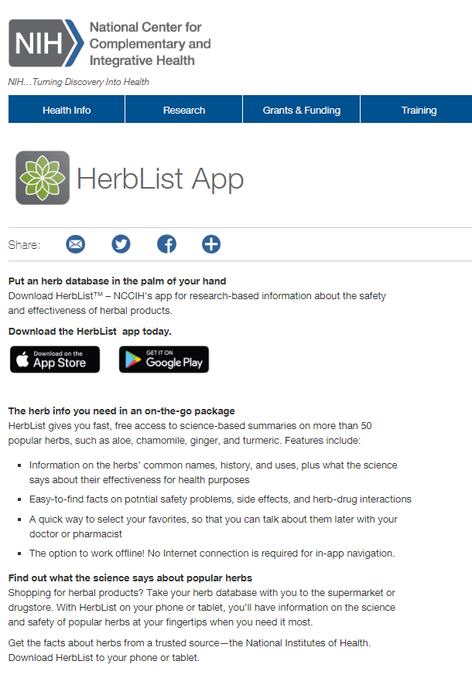
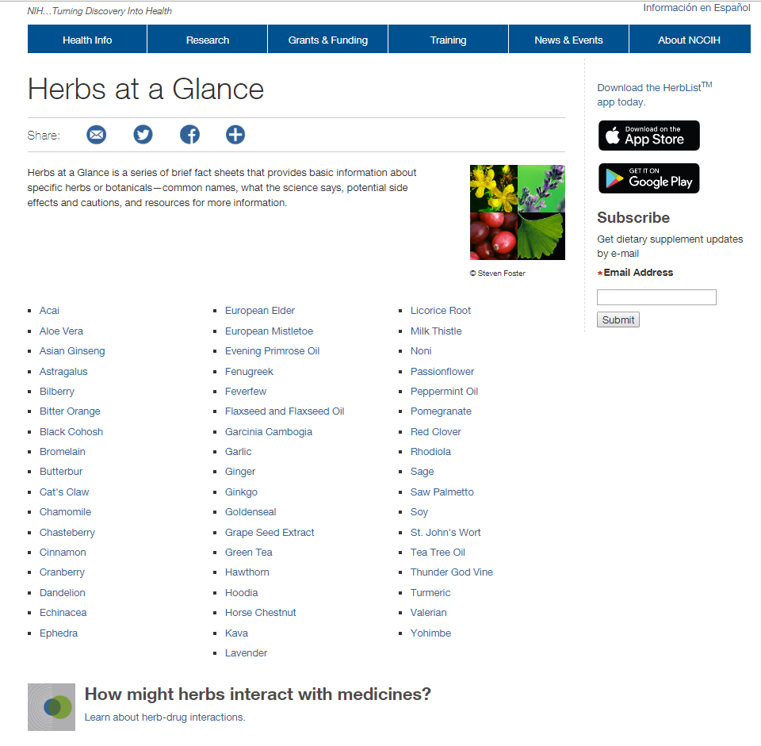
NCCIH- Herbs
Notes:
The National Center for Complementary and Integrative Health has a great resource for herbal information called Herbs at a Glance.
There is also an app with the same information called HerbList so you can have better mobile access.

Slide 29
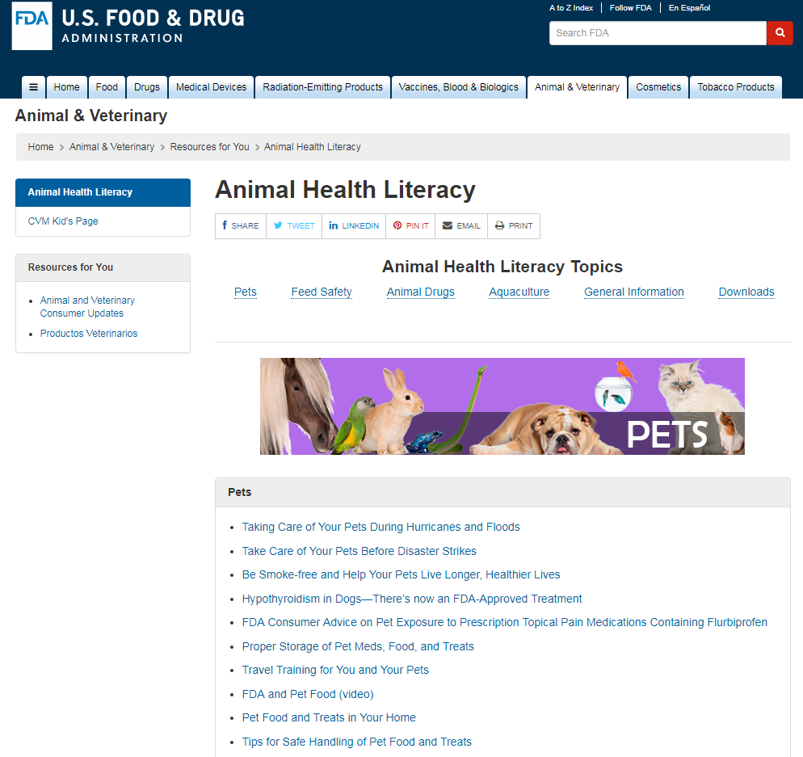
FDA- for consumers
Notes:
The Food and Drug Administration has information for professionals and for consumers. They have a section for patients as well but what your patrons are wanting you’ll probably find more in the consumer section.
The FDA site also has about recalls, alerts, cosmetics and food, and medical devices. There’s a lot here that may surprise you such as this section an animal health so that’s why having this consumer section is good.

Slide 30
NLM- drug information resources
Notes:
For a complete list of National Library of Medicine resources you can go to their main website. Many are for healthcare professionals but anyone can use them and you may find some of your patrons will want more robust resources than just in MedlinePlus.

Slide 31
Specific Populations
American Indian / Alaska Native
Women
Children / Teens
Seniors
Notes:
I thought I’d just mention a resource or two that focus on specific populations. This is by no means comprehensive but just to give you some resources that more specifically address certain demographics.

Slide 32
Medlinelus- Demographic Groups
Notes:
A good place to start is with MedlinePlus. In the Health Topics section there is a list of demographic groups.
Many of the resources I will mention that focus on specific populations also are included in MedlinePlus.

Slide 33
American Indian & Alaska Native (AI/AN)
Notes:
The American Indian and Alaska Native resource was updated about a year ago with a new look and format. It used to be called American Indian Health and has expanded to include Alaska Natives as well. This updated version features Native American art.
The information includes resources on a local, tribal, state, regional and national level from agencies, organizations, and academic institutions.
This resource is advised and assisted by native community members

Slide 34
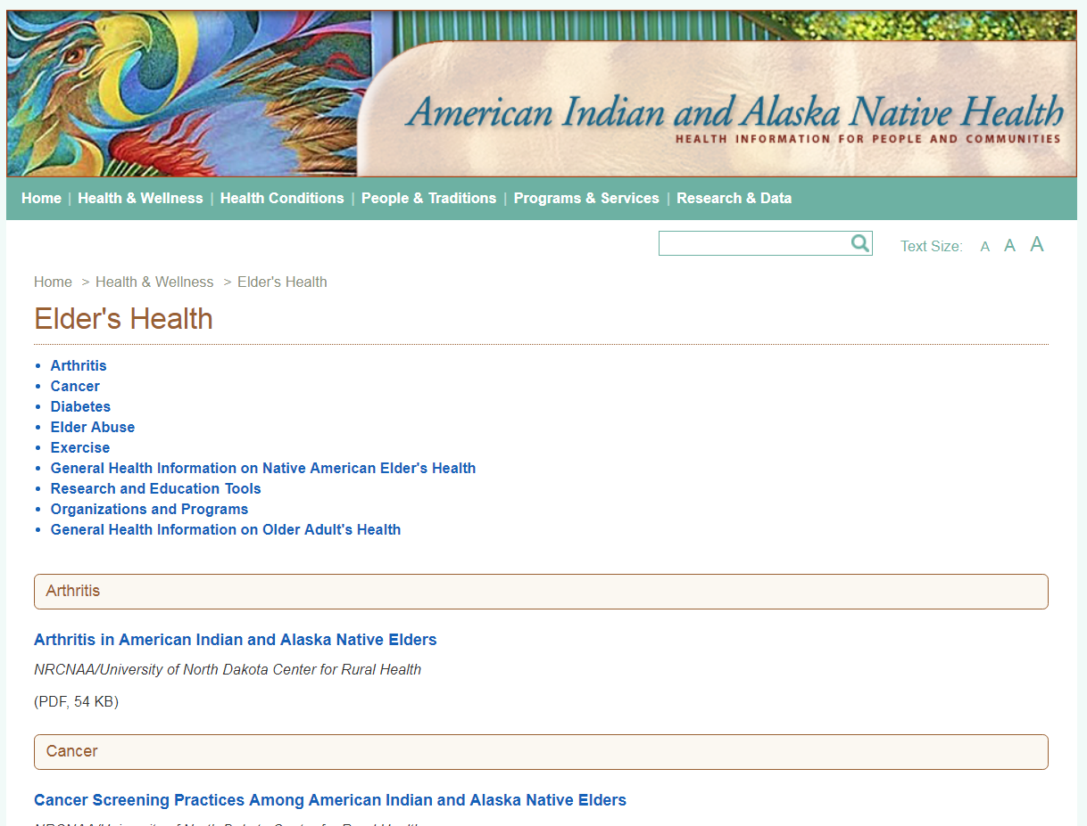
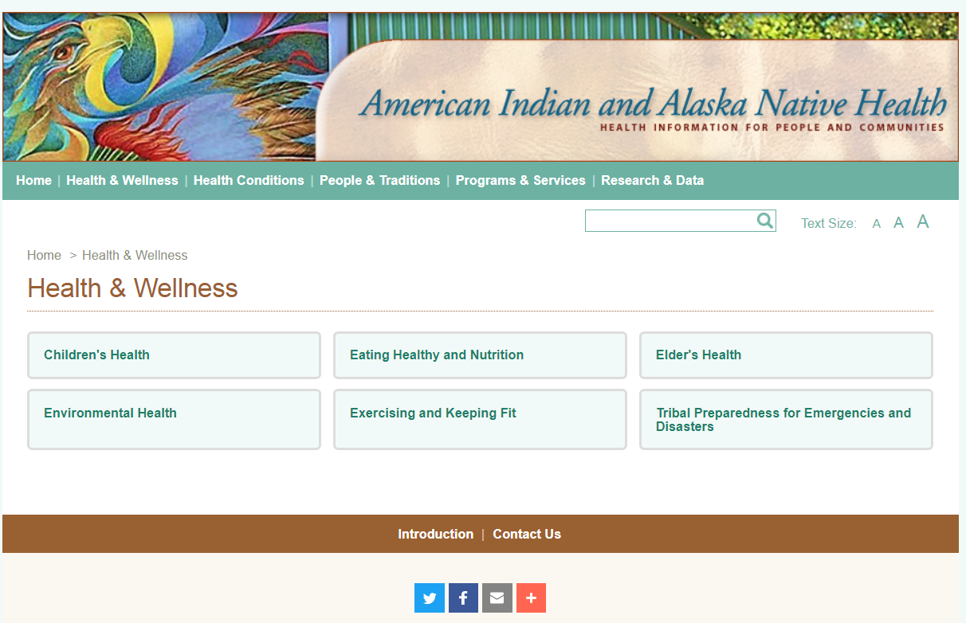
AI/AN- health & wellness
Notes:
Here you can see I the new layout in the Health & Wellness tab and within that the Elder’s Health section which takes you to a page with health topics linking to specific resources that have been evaluated to be included in this National Library of Medicine resource.

Slide 35
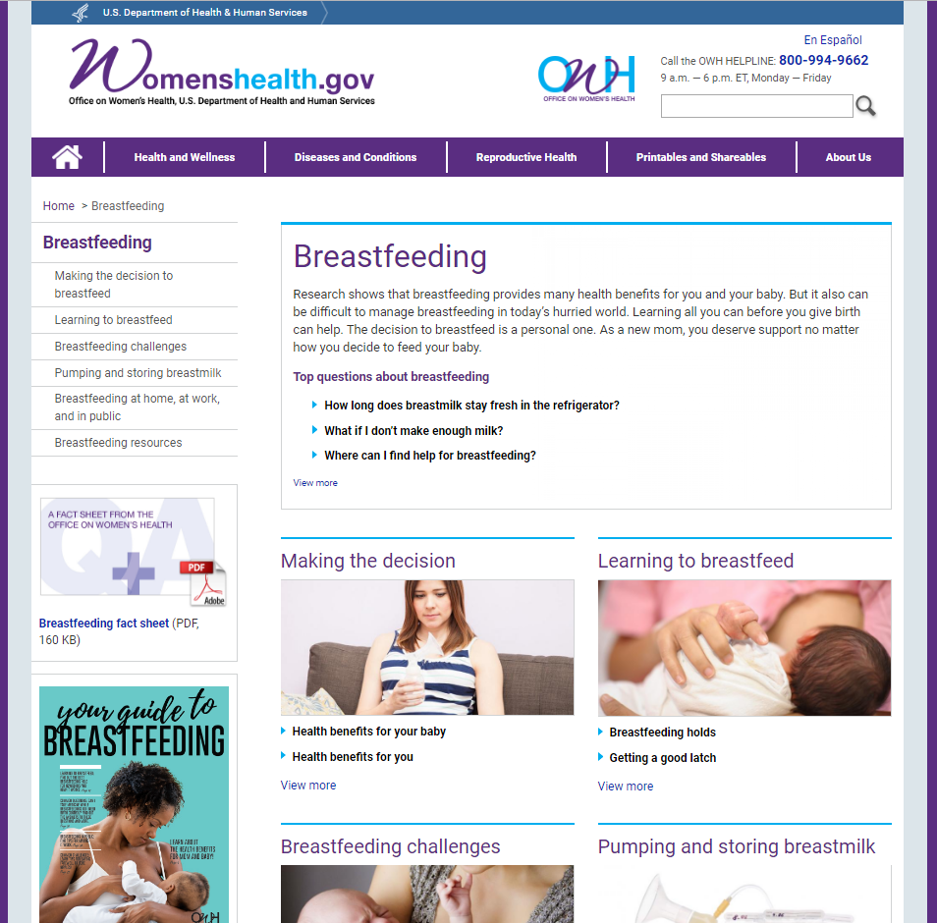
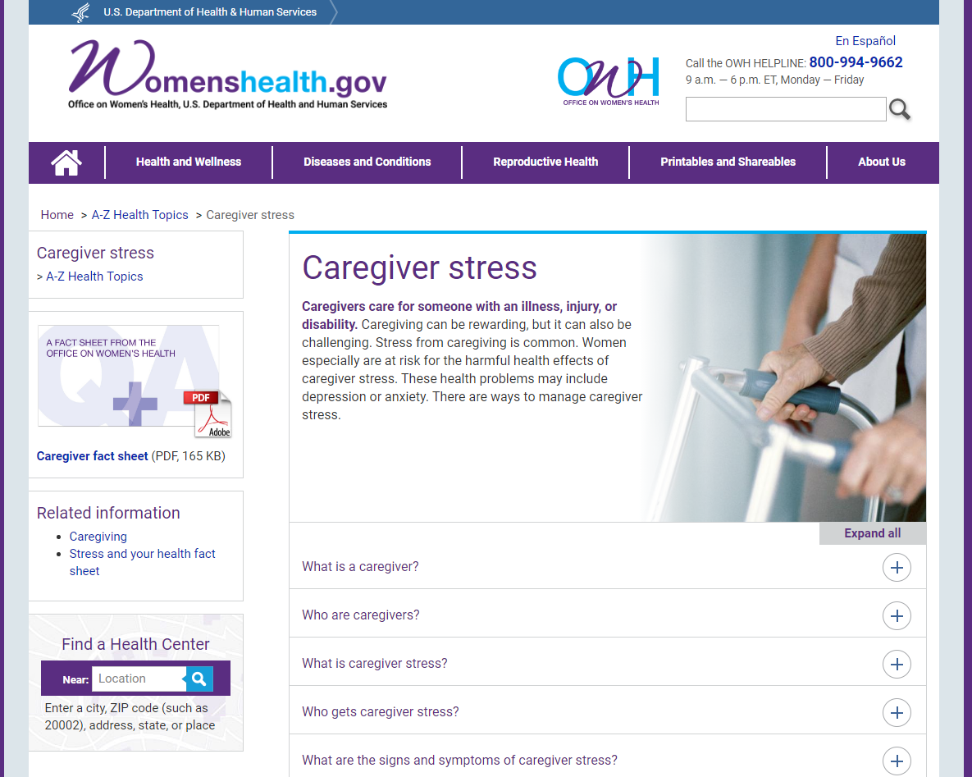
Women’s Health
Notes:
WomensHealth.gov is a great website from the Office on Women’s Health.
This resource is for the general public but also for places that employ women or support women and includes all sorts of topics ranging for young women to older women.
There’s information about supporting nursing moms at work, infographics, webinars, and videos. [click]
Often women are the ones to take on the role of caregiver whether for a parent or a sibling or other relative. This page offers some support for those in that role
You may want to encourage your patrons to sign up for their social media.

Slide 36
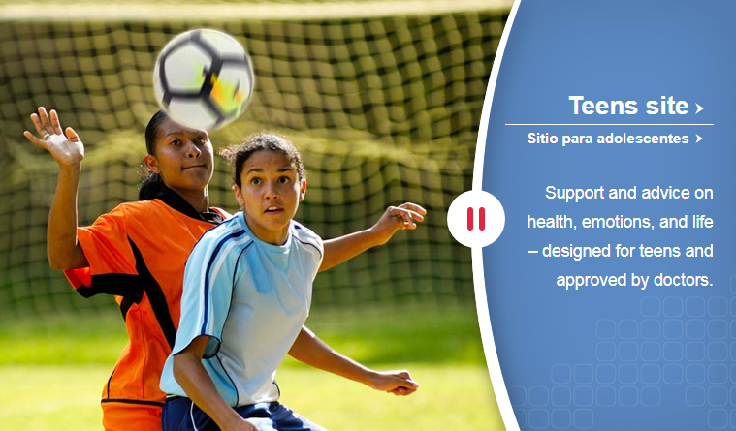
Children and Teens
Notes:
MedlinePlus often links to KidsHealth and it is an excellent resource.
Information is in English and Spanish including audio.
You won’t find advertisements.
The nice thing about this website is that the information is focused on the audience whether you’re a kid, a teen, a parent or an educator.

Slide 37
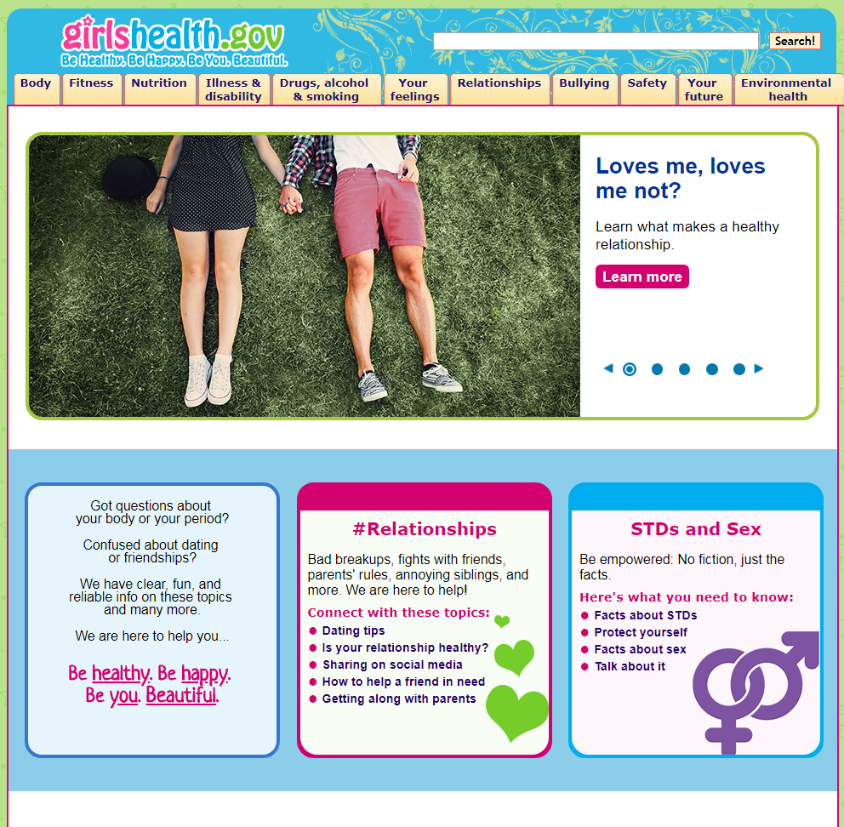
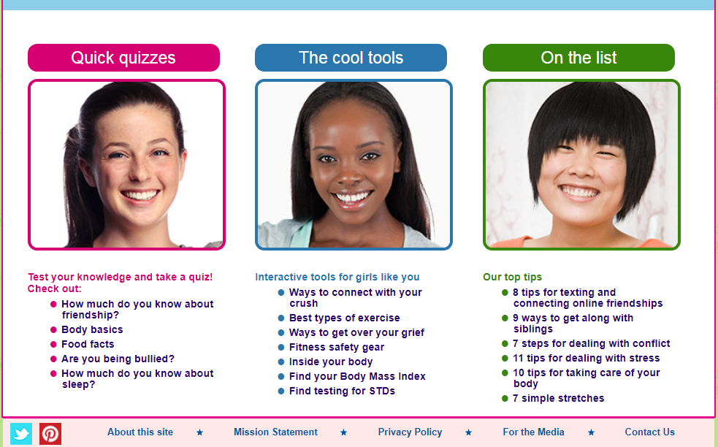
Girls’ Health
Notes:
Girls Health is focused on girls ages 10 – 16 with reliable, useful information on health and well-being.
It covers hundreds of topics, from getting your period to stopping bullies, and from getting fit to preventing sexually transmitted infections. The pages are clear and fun, and they make sure to answer key questions girls ask.
Unfortunately there isn’t one for boys. However…

Slide 38
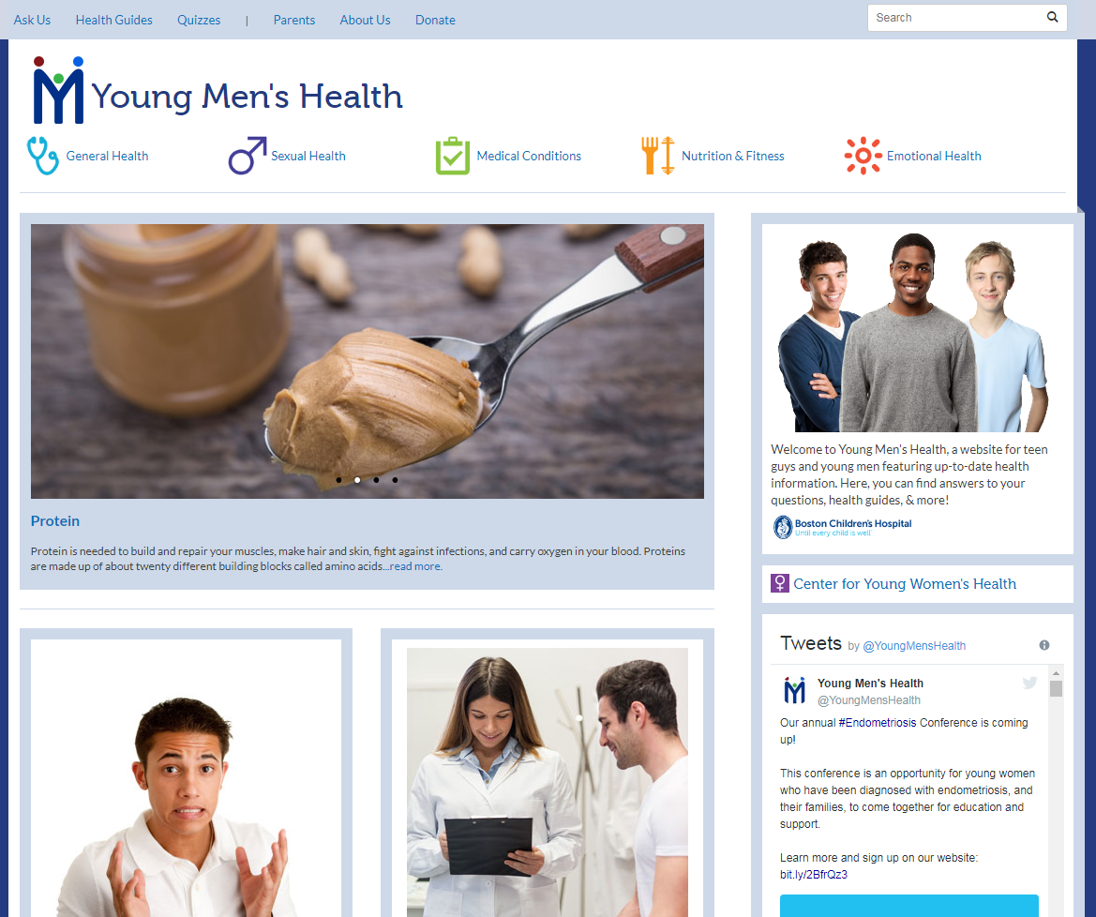
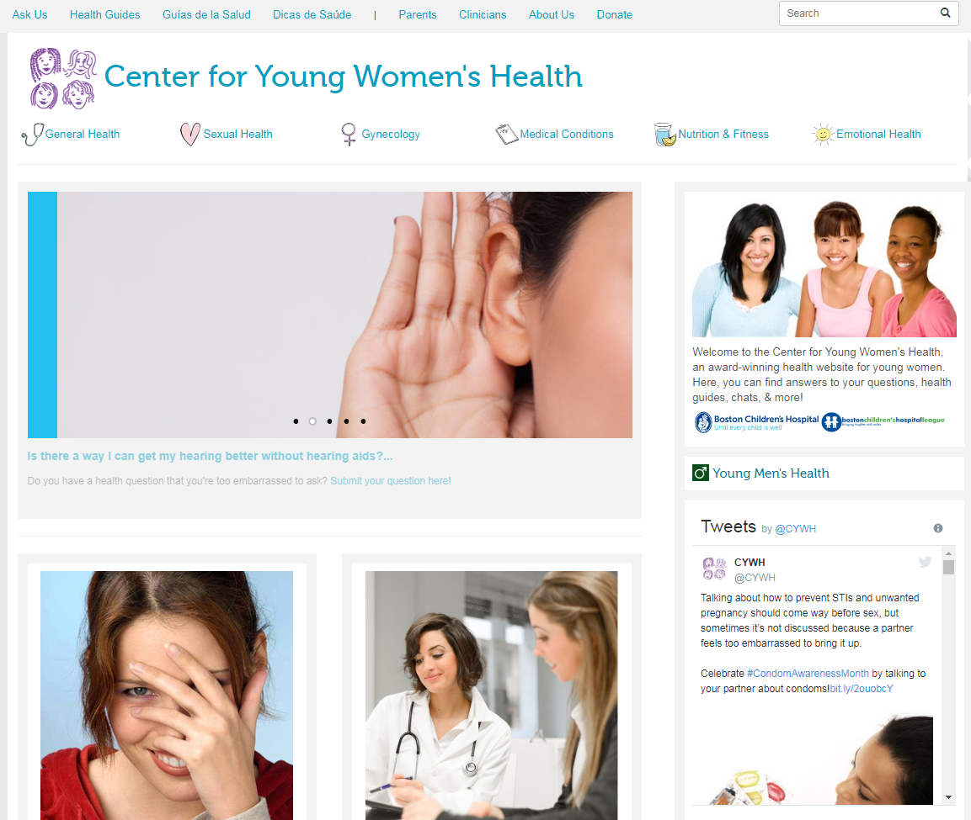
Young men’s and young women’s health
Notes:
Boston Children’s Hospital does provide websites specifically for young men and young women.

Slide 39
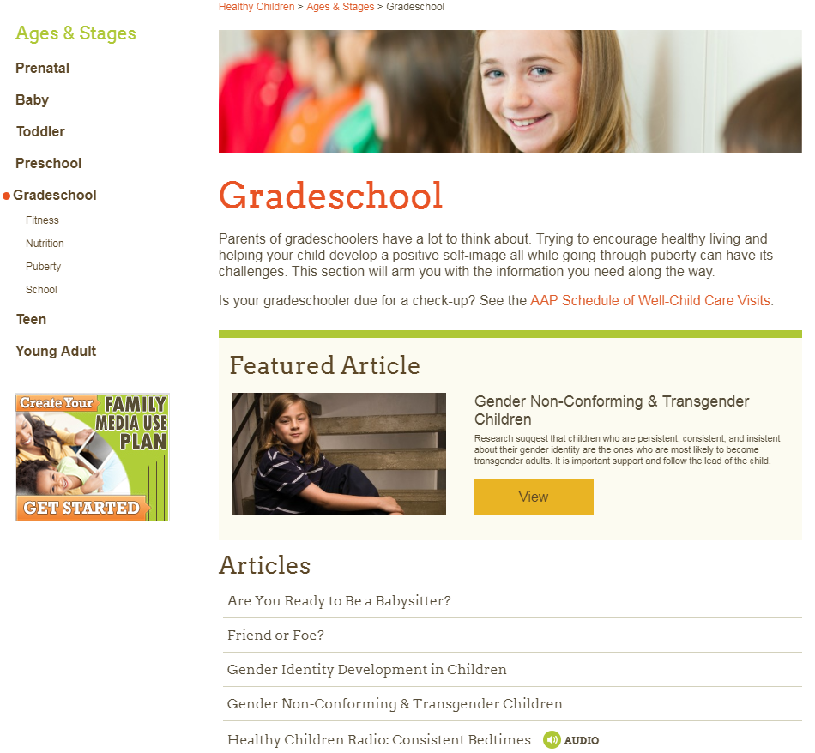
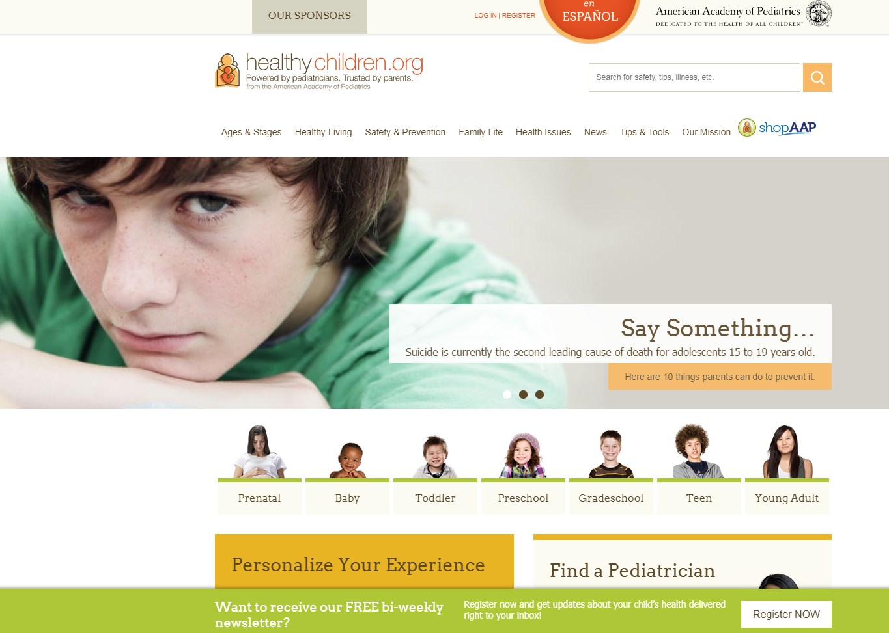
Prenatal to young adult
Notes:
The American Academy of Pediatrics (AAP) has created a resource for the public, especially for parents to help guide them from prenatal to young adulthood.
The AAP is a trusted association in the medical world and should be for parents as well. They shape guidelines regarding children’s health and are a much better resource than some alternative groups such as celebrities who seem to like to tout their expertise in this area however, well intentioned.

Slide 40
Senior health
Notes:
Now for the other end of the life spectrum.
Besides MedlinePlus there is an institute at NIH called the National Institute on Aging.
Lots of great health information here including Alzheimer’s, caregiving, cognitive health, exercise – the Go4Life resource, end of life information and much more. In many public libraries, older adults are frequent visitors.
Take some time to review and think of what your communities would find must useful and focus on a couple of those and use this to create programs that focus on health.

Slide 41
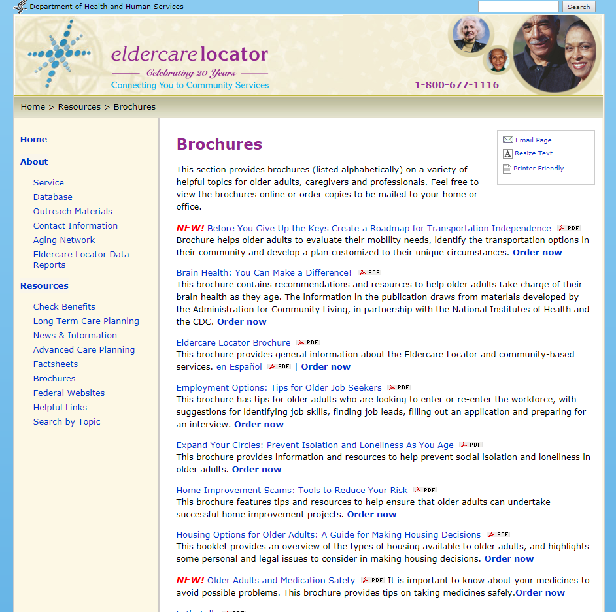
Eldercare Locator- tools and resources
Notes:
Eldercare Locator provides assistance to help you locate services in your area. You can also call using their 800 number especially since rural areas tend to have a higher population of older adults and services and resources tend to be very limited if they exist in these areas so calling may be your best option.
Also, tools such as this brochure about having an elderly parent needing to give up their driving can help prepare you for the best approach and this too could be a program your libraries may consider.

Slide 42
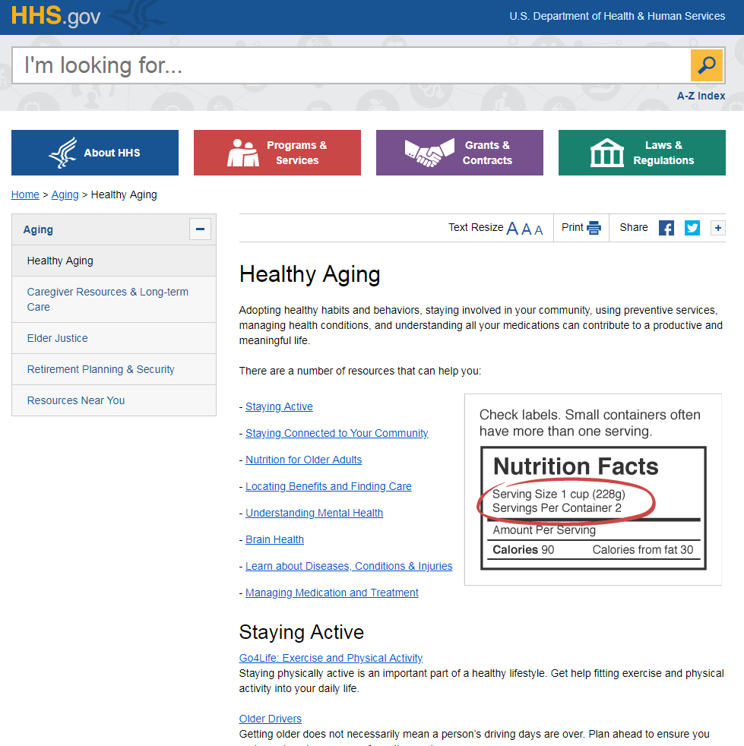
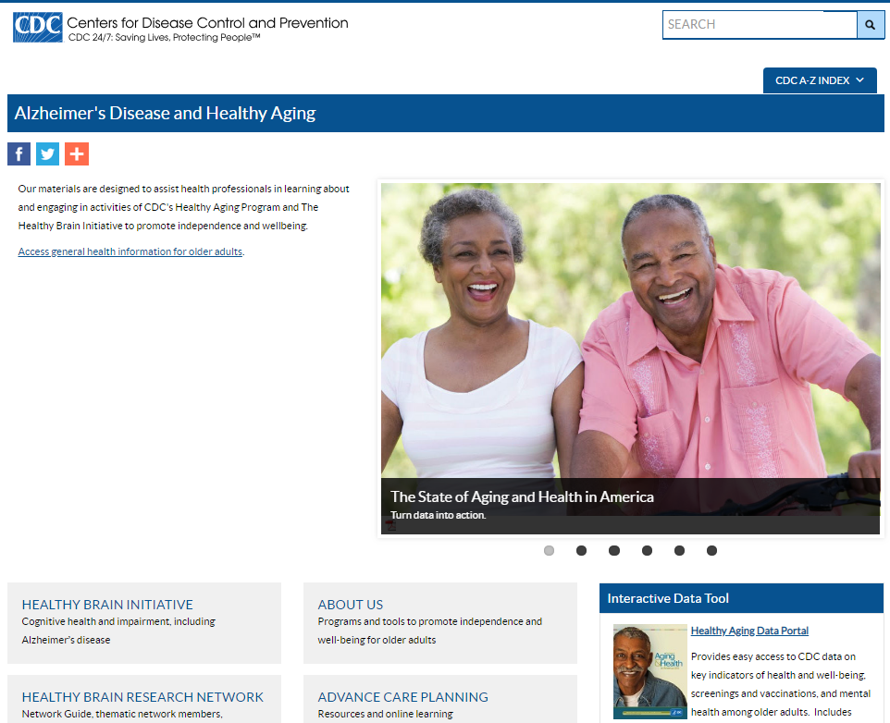
Healthy aging resources
Notes:
The US Department of Health and Human Services has a section for older adults to use and many of the links go to the ones I’ve already mentioned.
The Centers for Disease Control and Prevention also has information about healthy aging. However, this information, though it might be of interest to your patrons is more about statistics, reporting, etc. The information here might prove to be more useful for you when planning programs and services.

Slide 43
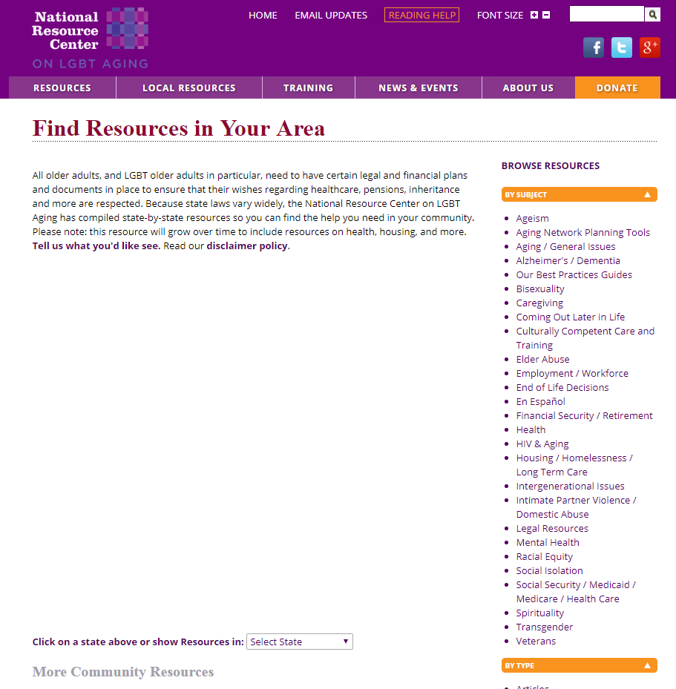
LGBTQ aging
Notes:
This resource is more focused for health care providers but anyone can use it and you’ll find useful items such as finding resources in your area. Many LGBTQ older adults experience discrimination in healthcare especially if they live in more conservative areas or rural areas where options or even awareness isn’t as common. Also, older adults may want more privacy and are not as willing to be public about their orientation.
Offering information about topics that often are stigmatized or ‘frowned upon’ helps to bring awareness and access to information more anonymously.

Slide 44
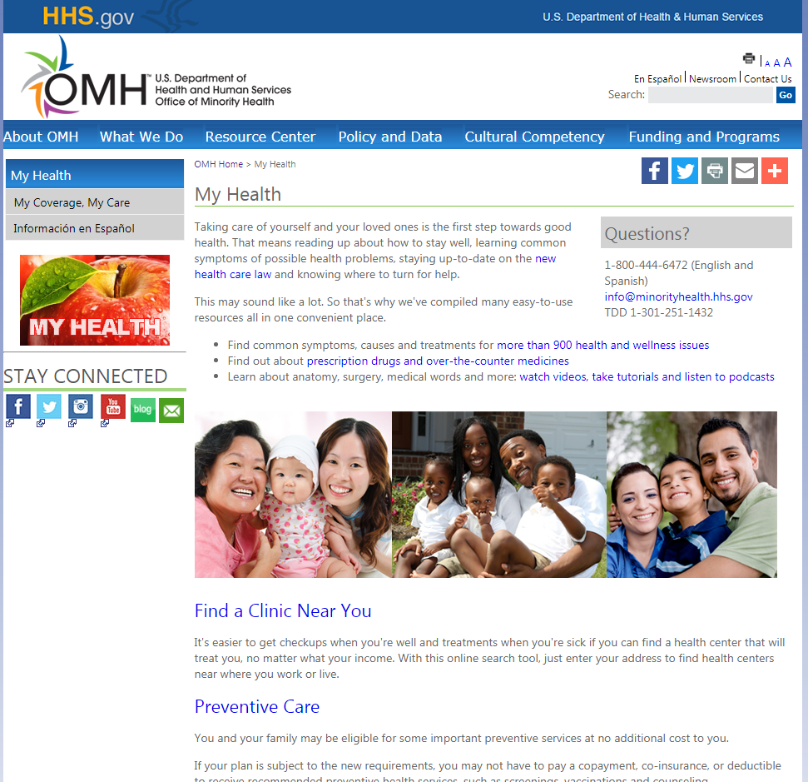
Office of Minority Health
Notes:
The Office of Minority Health includes information for your staff and for your patrons.
National Minority Health Month is in April every year and the Office of Minority Health often has resources to help you provide information for your library to take part in small or larger ways.
I recommend you follow their social media or sign up for their weekly newsletter that has a host of information to increase your library’s cultural competence as well as information for your diverse community.

Slide 45
Specific health conditions
Diet and exercise
Cancer
Mental health
Substance abuse
Notes:
In past sessions of this class, many attendees mentioned their need and interest in specific health topics so I thought I’d address some of that today.
MedlinePlus is where to start for specific health conditions but here are some other resources to consider on a sampling of health conditions.

Slide 46
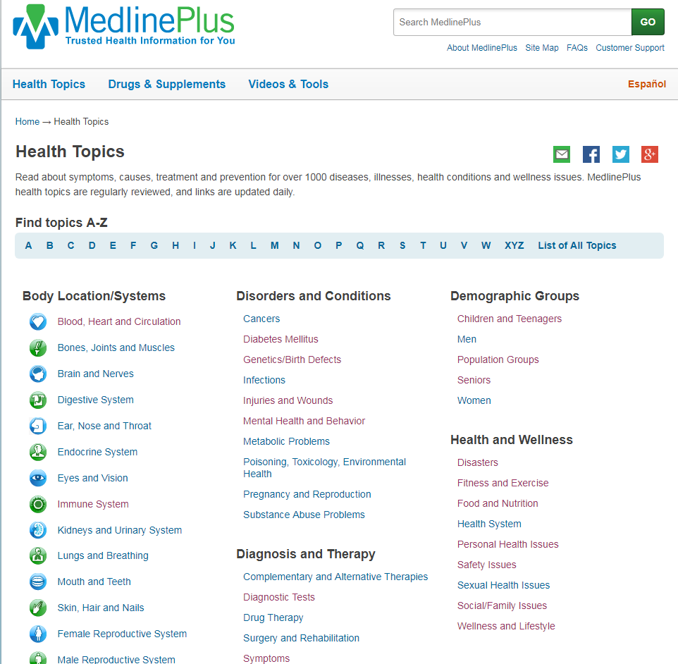
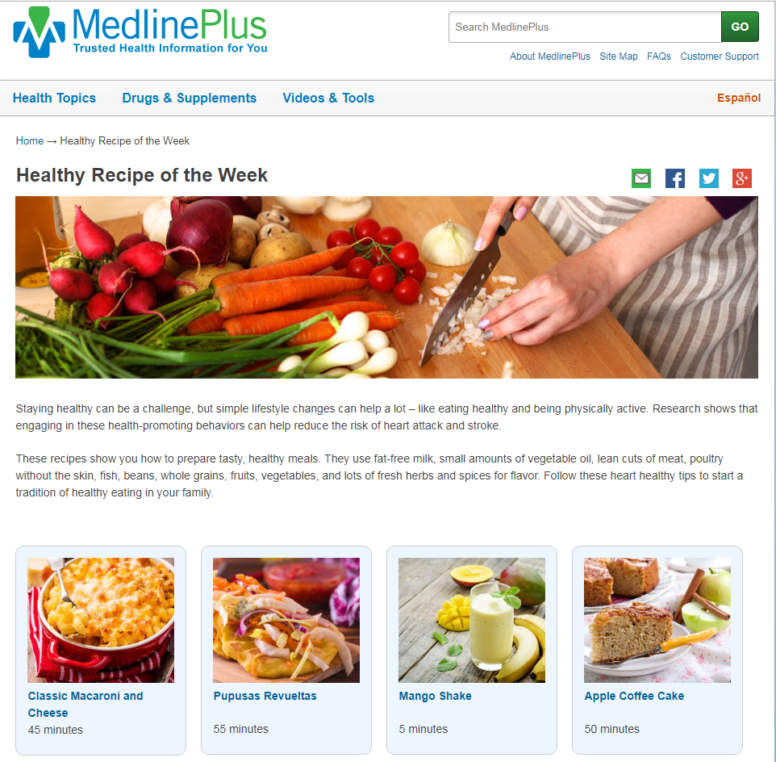
MedlinePlus diet and exercise
Notes:
Exercise and diet are very popular topics especially in public libraries. MedlinePlus has a category on Health and Wellness where even more specific categories are listed such as fitness and exercise and food and nutrition. When you click on those you get a list of health topic pages in alphabetical order.
A new feature in MedlinePlus is Healthy Recipe of the Week which you could encourage your patrons to subscribe or feature on your social media. Each recipe includes preparation time and nutritional information

Slide 47
ChooseMyPlate.gov
Notes:
I know many of you already know about Choose My Plate through the USDA. Unfortunately the font size is very small on this but it does include lots of information for organizations and individuals. Information for school teachers, parents and even kids. It also includes some tips about exercising and even cookbooks such as the State Dinner cookbook of winning recipes from each state submitted by kids with a message by former first lady, Michelle Obama.

Slide 48
EatRight.org
Notes:
The Academy of Nutrition and Dietetics has a web page for the public called EatRight.org. It has information for kids, seniors, men, women and parents. Fitness information is provided as well.

Slide 49
Go4Life
Notes:
I’ve already mentioned the National Institute on Aging but wanted to highlight again their fitness information called Go4Life. The screen shot on the right has easy to read information and a video demonstrating how to properly heel to toe walk as a way to maintain balance.

Slide 50
NIH Body Weight Planner
Notes:
NIH has recently created a tool called Body Weight Planner. It allows individuals to create a personalized calorie and physical activity plan in order to reach a goal weight as well as how to continue to maintain that weight. There is a video to help get started.

Slide 51
HHS.gov
Notes:
The Department of Health and Human Services includes the President’s Council on Sports, Fitness and Nutrition which includes information for organizations but also for individuals interested in maintaining their health both physically and nutritionally. These are resources you can pass on to your patrons.

Slide 52
HealthFinder.gov
Notes:
HealthFinder.gov also provides specific information and what is nice about it is that for those who might feel overwhelmed by MedlinePlus it provides information in smaller more digestible amounts
The green oval points to something you may find useful as a way to integrate health into your library services and programs. A list of health observances is there including toolkits with ideas for social media and your website.

Slide 53
MedlinePlus- Cancers
Notes:
MedlinePlus is a good place to start when providing information to patrons about cancer topics. You’ll find an alphabetical list and then specific cancer topic pages.

Slide 54
National Cancer Institute
Notes:
Many of you are already familiar with the American Cancer Society so I’ll just mention a couple of resources here.
The National Cancer Institute has lots of information for patients and caregivers.

Slide 55
OncoLink
Notes:
Another I think is very good but is not included in MedlinePlus because of its ads is Oncolink out of the University of Pennsylvania. It is a very comprehensive resource and a very good one.

Slide 56
AIDSinfo
Notes:
Though not specifically a cancer resource I wanted to let you know about AIDSinfo.
This National Library of Medicine resource is a good one for the public and for patients. It provides basic information as well as patient information. Many of your students might find this a good resource if looking to do a research paper or project on AIDS
It includes resources for AIDS awareness events to help break the stigma

Slide 57
MedlinePlus- Mental/Behavioral Health
Notes:
MedlinePlus has an extensive list of health topic pages on mental and behavioral health. Don’t forget the medical encyclopedia has basic information which may be all a patron will want.

Slide 58
SAMHSA
Notes:
Mental health is becoming less stigmatized and more people are seeking help. Many of you are already familiar with some common resources such as NAMI but here we have some government and association resources for you to consider using.
SAMHSA Substance Abuse and Mental Health Services Administration provides information for the public and for schools and professionals.
There are links to finding treatment, suicide prevention and special publications you can order or print for free such as this one about how to talk with children about coping after a traumatic event such as a natural disaster or a shooting incidence as we’ve seen so often in the news.

Slide 59
MentalHealth.gov
Notes:
Many of these resources link to each other so you might find similar items on each website.
You might find your patrons finding MentalHealth.gov easier to use than SAMHSA as it contains less information and is a little easier to navigate.

Slide 60
National Institute of Mental Health
Notes:
The National Institute of Mental Health offers free publications that you can order for your library along with their health information.

Slide 61
CDC- mental health
Notes:
The CDC includes statistics and information about mental health. It’s not the primary resource I’d recommend for your patrons but it is a good resource for school projects and awareness including this mental health myth quiz.

Slide 62
MedlinePlus- Substance Abuse Problems
Notes:
Substance abuse is often a top health issue in many communities and methamphetamine has been a problem for several years.

Slide 63
Opioids
Notes:
An abundance of resources are available and for free. Where to look is the issue. Many are aimed at health professionals or those in social services or law enforcement. Finding information specifically for individuals is more difficult. Part of the problem is that opioids includes a number of specific drugs and so that makes it hard to even know if an individual has been prescribed an opioid. These resources may help with that especially this drug fact sheet. The CDC also as information specifically for patients as does MedlinePlus which has added a number of opioid health topic pages recently.
Many of you as well as our past attendees have indicated that this is a huge concern in libraries.
Please note, it is best if you can work with local health professionals, law enforcement, social services and public health in your region or state. This is something that shouldn’t be tackled alone.

Slide 64
Environmental Health & Toxicology – Opioids
Notes:
And the NLM has added information about opioids in their Environmental Health and Toxicology resources. Be aware with this last one it does include an extensive list that is categorized but also includes links to more indepth information and not really for the general public. This is something to recommend to your working professionals such as law enforcement, community agencies and healthcare. Also, students who are doing research papers or projects might find this one useful.

Slide 65
National Institute on Alcohol Abuse and Alcoholism
Notes:
The National Institute on Alcohol Abuse and Alcoholism provides some information for the public such as this guide for individual and family and friends who are looking for ways to address alcohol problems. It is online and downloadable for you to have a copy.

Slide 66
National Institute on Drug Abuse
Notes:
It is not uncommon for some with mental illness to also suffer from substance abuse and addiction.
For drug abuse you can use the National Institute on Drug Abuse website and the NIDA for Teens is a great resource for that age group with games and other interactive tools.

Slide 67
Consumer health apps
Zombies Run
Monster Guard
First Aid
Pet First Aid
Milestone Tracker
Notes:
Apps are a big thing. In 2016 there were an estimated 165,000 health apps on iTunes alone. Very few are used long term and very few deliver what they claim.
The National Library of Medicine has mobile apps and mobile versions of several of their resources.
Some popular and recommended apps include Zombies Run for fitness, Monster Guard for emergency preparedness by the American Red Cross who also has created good first aid apps for humans and for pets.
Also, the CDC has an app to track milestones in a child’s development from ages 2 months to 5 years. It includes an easy to use illustrated check list and tips for encouraging a child’s development and lots of other features. They have other apps as well.

Slide 68
App reviews
Notes:
There are several places to get reviews of medical apps but these two might be your better ones.
iMedicalApps is a good one and has been reviewing medical apps for some time. Yes, they do have advertising but it is one I’d trust over some more commercial websites and it does focus on medical apps. Here is the page for patient apps.
The National Health Service in the UK has a page that says it is being tested. Hopefully it stays around. It too is one I’d trust more than other commercial websites and it does focus on health.
The FDA does not regulate medical health apps because it does not recognize them as medical devices but they did issue guidance for the industry when developing apps but that doesn’t mean those companies are following those tips. https://www.fda.gov/MedicalDevices/DigitalHealth/MobileMedicalApplications/default.htm#e
Use the same criteria you use for evaluating websites and apply it to apps.

Slide 69
There’s An App For That!
Notes:
Emily Hurst suggested those evaluating tips and she gave us a whole session on consumer health apps in a monthly webinar I host in the Pacific Northwest Region. Many of our regions have regularly scheduled webinars that are offered nationally and are often recorded so you can go an watch them later at your convenience. In the PNR region ours is called the PNR Rendezvous and Emily presented on this topic this past December.
Watch the recording and you’ll learn a lot more about these apps than we have time for in today’s session.

Slide 70
Evaluating health apps
Seeking What are you looking for in an app?
Usability Is it easy to use?
Security Is there a privacy policy?
Price What is the cost?
Evaluation What are the reviews?
Creator Who developed the app?
Timeliness When was the app last updated?
Notes:
But, Bobbi here took some of the evaluation tips which that webinar presenter listed and created an easier way to remember them with this acronym, SUSPECT
Seeking – Why are you searching for an app? Does this app do something you want or need? Usability – How is the app designed? Is it easy to use? Do the menus or icons make sense? Security – Do you need to make an account? Does the app share your data with friends? Does the developer share your data or sell it to other third-parties? What is the security policy? Is it easy to find? Is it written in plain language? Price – What is the upfront cost of the app? Are there in-app purchases? Evaluation – Read the reviews for the application, don’t just look at the stars, what are other people saying about the application in their reviews. Creator – Who developed the application? Is the developer reputable? Do they have a website? Timeliness – When was the application developed? When was it last updated?

Slide 71
Learn more…
Webinars and Online (synchronous and asynchronous)
NNLM Resource Picks (NLM resources)
Substance Use Disorder Webinar Series
Will Duct Tape Cure My Warts (complementary/alternative medicine)
On Demand Classes:
EvalBasics (evaluation)
Grants and Proposal Writing
Serving Diverse Communities (cultural competency)
Notes:
The National Library of Medicine has lots of resources as well as many more government resources full of information available to the public that I can’t possibly cover today. To learn more about some of these health topics and resources you can go to our training schedule page to what is being offered and to register. They’re all free including NNLM Resource Picks which we offer every 2 months and we feature a National Library of Medicine resource through staff in those divisions.
Most webinars like this one are recorded so you can listen to them later.
Many of these webinars could qualify for the Consumer Health Information Specialization even though they aren’t marked that way. The Medical Library Association has a form that you can fill out for these types of webinars and classes you feel are consumer health oriented. Unless it really is marginally related I don’t think you’ll have a problem justifying.
Also, the CE for these is usually available 6 months from the live session so even though you didn’t register you can still get CE credit and if you have questions a contact person is listed on the webpages.
We also have some on demand classes such as getting started on evaluations, grant writing, and cultural competency.

Slide 72
Keeping updated
Notes:
Our partnership with PLA has resulted with PLA launching a new website called Healthy Community Tools for Public Libraries to compile training resources, program ideas, and trustworthy health web sites and databases as well as forming a health interest group for continuing discussions and sharing information on consumer health. You do have to be a member of PLA to join the health interest group.
You can sign up for My MedlinePlus Weekly Newsletter and subscribe to our national blog called Bringing Health Information to the Community or more commonly known as BHIC. Several of us contribute to this NNLM blog where we make sure the information is useable for libraries and other member institutions.
Don’t forget that your region may have an email listserv, their own blog, social media, and other useful information on their websites.

