Slide 1
THE Research Data Services LANDSCAPE
How do you start and where does your library fit in?

Slide 2
Learning Objectives
Upon completion, attendees will be able to
describe the common types of research data services offered in health sciences libraries
explain the current trends and challenges in data services
determine next steps for their practice

Slide 3
AGENDA
1. Overview of the different types of data services
2. Benefits of having data services in your library
4. Current trends/landscape
5. Next steps

Slide 4
What is "Research data services"?

Slide 5
Two branches of data services (as of 2022)
Data management and curation
FAIR principles
file naming conventions
metadata
data depositing
digital archives
preservation
data sharing
data discovery
policies and ethics
Data science and data literacy
data cleaning
data visualization
GIS
programming languages
data collection/survey instruments
machine learning
high performance computing
data analysis
statistics
methods and ethics
Notes:
Currently, data services can be seen as two fairly distinct tracks. One is data management and curation, which deals with things like file naming conventions, data organization, metadata, sharing data through repositories, and data discovery. They also are working within and influencing institutional, funder, and publisher policies around data sharing, data storage, and data ownership. The data science and data literacy track deals with skills for analyzing data, including programming languages, data cleaning, and data visualization. They are also working within and influencing institutional policies around permitted software, storage solutions, and computing. It’s important to note that the broader environment around data and research is constantly evolving, and this will of course affect the support services needed, so while the idea of these two distinct tracks makes sense right now, that may change.

Slide 6
How do they interact?
Well documented data
More efficient data cleaning
Data management
FAIR principles
File naming
Metadata
Data depositing
Digital preservation
Data sharing
Data science
Machine Learning
R/Python programming
Text mining
Data cleaning
Data Analysis
Statistics
Reproducibility
More effective data sharing
More reliable data analysis
Well documented code
Notes:
Another area in which many data services librarians have provided support is scientific reproducibility. One aspect of reproducibility is being able to run an experiment with the same methodology as a previous experiment, and get results that are not the same as, but are consistent with, the original experiment. Another aspect is to be able to take the same data, run the same analysis, and get the same results. Reproducibility is an area that encompasses both tracks. For example, good data management will results in well documented data, which will facilitate more efficient data cleaning.

Slide 7
How do they interact?
Well documented data
More efficient data cleaning
Data management
FAIR principles
File naming
Metadata
Data depositing
Digital preservation
Data sharing
Data science
Machine Learning
R/Python programming
Text mining
Data cleaning
Data Analysis
Statistics
Reproducibility
More effective data sharing
More reliable data analysis
Well documented code
But the skill sets are very different!
Notes:
It’s important to note that while these two types of data support have points of interaction, the skill sets for these tracks are very different, and many data librarians will stick to one of these tracks. Those providing introductory data services, particularly as a new service for a library, may offer informational-level services for both tracks, such as a libguide on data sources, data tools, and data management tips.

Slide 8
HOW DOES RDS DIFFER FOR HEALTH SCIENCES LIBRARIES?
For libraries in health sciences institutions, particularly those with clinical areas, there is a greater focus on
privacy and deidentification (PHI)
secure storage and use of HIPAA-compliant tools, like REDCap
supporting researchers working to deposit in biomedical discipline-specific repositories, such as NIH-supported repositories
increased emphasis on data use agreements to protect human subjects and intellectual property
accessing and use of protected data such as EHR data
implications of data ethics for bioethics
Notes:
Once librarians begin to develop deeper knowledge or as data services departments and staff levels grow, roles become more clearly defined and greater levels of services are offered, including consultations and partnerships. Let's look at how these levels are laid out.

Slide 9
Levels of Services
Outreach
Resource Creation
Education
Consultations
Infrastructure
FTE and Level of data expertise in the library
Notes:
Offering data services is not an all or none proposition. There are a range of types of support depending on both how much time can be dedicated to data work in your library and how much expertise the people providing the services have.

Slide 10
Levels of Services
Outreach
OUTREACH: Raising awareness of open science / open data issues and policies that may affect researchers
Notes:
The first step might be taking on outreach to your research community to raise awareness of issues around open science and open data, policies around data sharing, and anything else data-related that may affect them. This is a good way to learn about these issues and to begin to make the connection between the library and data within your institution.

Slide 11
Levels of Services
Resource Creation
RESOURCE CREATION: Compile resources relevant to data support & create research guides to contextualize resources.
Notes:
Creating resources such as research guides requires more time and expertise. It also provides an opportunity for a librarian newly providing data services to do more of a deep dive to understand what resources would most benefit their community. It is an asynchronous activity, so provides time and space to grow more knowledgeable in and comfortable with this area.

Slide 12
Levels of Services
Education
EDUCATION: Develop and/or teach workshops, stand alone classes, and courses for curricular and non-curricular education. May include asynchronous or synchronous classes/materials.
Notes:
Education, whether developing synchronous or asynchronous activities, is another step up in terms of both expertise and time commitment required. This is a point at which specialization in one of the two tracks – data science vs data management – may be warranted. Both are wide-ranging areas which benefit from a deeper focus. While it’s not impossible to pursue both areas, the expectation that someone would do so is, in most cases, unrealistic.

Slide 13
Levels of Services
Consultations
CONSULTATIONS: one-on-one with researchers, labs, departments to advise on and support data management best practices, OR to advise and troubleshoot on data cleaning, analysis, visualization.
Notes:
Data management consultations with researchers, labs, or departments will likely involve questions that are specific to a discipline or data type, going beyond the information that arises in an introductory course. It therefore makes sense to have the basics well in hand before taking on these types of consultations. While there may still be questions you can’t address in the moment, you will at least have the grounding to know how to approach finding an answer. Similarly, consultations on data cleaning, analysis, and visualization may involve questions involving specific data types or more advanced features of tools or programming languages, and would be difficult to manage without having a solid foundation.

Slide 14
Levels of Services
Infrastructure
INFRASTRUCTURE: Develop and/or support policies and technical capabilities, including a data catalog or data repository, high performance computing, lab space, software and virtual computing access.
Notes:
Infrastructure projects are not generally something that can be done by an individual. These typically require a team with deep expertise in data issues – access, discovery, sharing, etc. – and with technical expertise. Projects of this nature can take months, or even years, to develop. For a library to consider taking on a major infrastructure project, their data services work should be fairly mature, as institutional buy-in is a critical aspect to the success of these types of projects.

Slide 15
MANY Potential Services
Plan & Design
DMPs/DMSPs
Metadata Documentation
Use agreements
Collect & Create
File Naming
Version Control
README
Directory Structure
Analyze & Collaborate
Data Cleaning
Lab notes
Software
Access & Reuse
Open Access
Reproducibility
Offboarding
Share & Disseminate
Data Repositories
Data Sharing
Pre-prints
Scholarly Outputs
Evaluate & Archive
Data Retention
Intellectual Property
Archives & Records
Notes:
This is a version of the research lifecycle. There are many variants, but the main takeaway is that there are data services needs throughout the research process, and the levels of service we just went through can be applied to any of these areas. .

Slide 16
Why data services in libraries?

Slide 17
Traditional academic outputs
Journal articles
Books
Book Chapters
Conference papers
Notes:
The growth of data services in libraries is a reflection of the evolution of what is recognized as a “valid” academic output in biomedical research. When this is confined to books, conference papers, and journal articles…

Slide 18
Supporting traditional academic outputs
Expert Searching
Cataloging
Systematic
reviews
Content management
Notes:
Services such as searching, systematic review collaborations, cataloging, and content management are ways that libraries support these academic outputs.

Slide 19
RECOGNIZED academic outputs
Journal articles
Books
Book Chapters
Conference papers
Datasets
Notes:
Datasets have increasingly been accepted as an important type of academic output, and have been accepted as an output that can be included in an NIH biosketch since 2015. Datasets are much more complex than journal articles or books in many respects – they can consist of different data types, different file types including proprietary file types, the size may run to terabytes, petabytes and beyond, and they may lack the necessary metadata to be reused – so the support needed to ensure the preservation, discovery, and reuse of data is correspondingly much more varied.

Slide 20
Supporting DATASETS
Metadata & Documentation
Finding Data
Sharing & Discovery
Reproducibility
Notes:
Some of the ways that datasets can be supported as an academic output is providing training and assistance to ensure that data is collected, analyzed, and documented in ways that ensure that the resulting dataset will be FAIR – findable, accessible, interoperable, and reusable.

Slide 21
RECOGNIZED academic outputs
Journal articles
Books
Book Chapters
Conference papers
Software
Datasets
Notes:
Software has also become more recognized as an important academic contribution. Supporting software as an academic output serves two purposes. First, research reproducibility requires that any software used in data collection, cleaning, analysis or visualization is fully documented. Second, this documentation is needed so that others can use the software, thus increasing its impact.

Slide 22
As academic outputs evolve, so must libraries
https://www.institutefordigitaltransformation.org/impact-of-digital-transformation-on-the-future-of-library-work/
Notes:
The role of libraries should be to support preservation and access to academic outputs, even as their nature evolves, rather than only those outputs accepted at a given point in time.

Slide 23
Current landscape

Slide 24
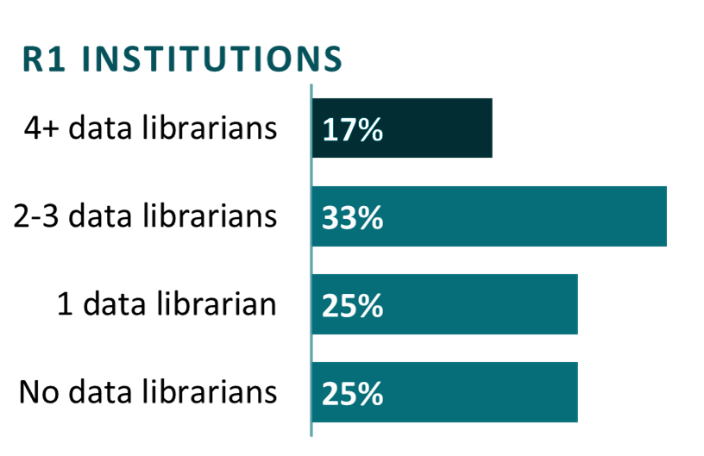
Academic Libraries with Data Services
At R1 universities, he average number of librarians primarily providing data services is just over 2 per institution.
*The average includes institutions with no data librarians.
Notes:
Research Data Services (or RDS) have become a critically important topic for academic libraries. R1 universities, doctoral universities with very high level of research activity a range between 0-10 data librarians, with an average of about 2 data per institution. This information was gathered in 2019 from 131 R1 universities.
https://sr.ithaka.org/blog/counting-data-librarians/
The State of Open Data 2022, found that 72% of researchers would rely on internal institutional resources to make their data more open. Researchers are looking for and relying on those internal support networks, so having a dedicated data sciences librarian, having that on campus resource can be very beneficial.
Goodey, G., Zhou, Y., Jiang, L., Chandramouliswaran, I., Hafez, A. H., Paine, T., Gregurick, S., Day, L., McKellar, K., Grant, R., Cannon, M., Murray, H., & Palma Pena, M. (2022). The State of Open Data. Digital Science, 5. https://doi.org/https://doi.org/10.6084/m9.figshare.21276984.v5

Slide 25
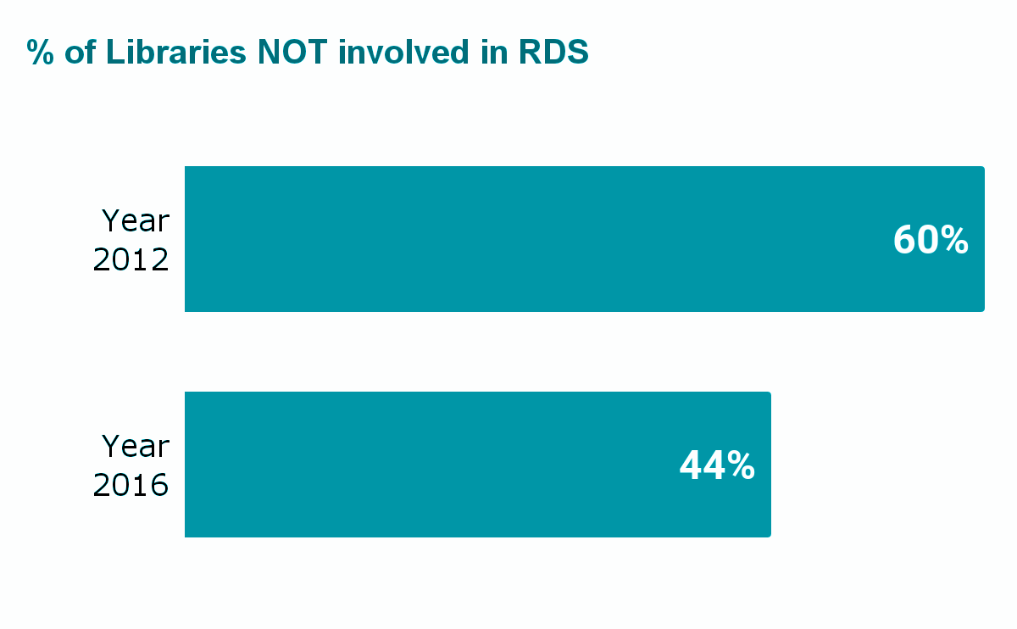
Data Services IS A GROWING NEED
Increase in technical and consultative data services
Preparing metadata
Preparing data
Technical support
Consulting on metadata
Consulting on data management plans
Creating web guides
Data policy development
16% growth in libraries providing RDS in just 4 years.
Notes:
When we look at all institution types from 2 year colleges, bachelor and master programs as well as doctoral colleges, we see that more libraries are getting involved in data services. An ACRL Choice paper in 2019 found that in 2012, 60% of the responding libraries said their “library was not involved in RDS.” By 2016, just 44.1% (82) of the responding libraries were not involved in any RDS. More and more libraries are starting or expanding data services.
Services like consulting on metadata standards, data management plans, offering technical support and participating in data policy development have all increased since 2011.

Slide 26
Analyses of data librarian jobs
Most data librarian jobs are in R1 and R2 level institutions
Job ads frequently mention that candidate will need to build campus relations and library infrastructure around data use (Hagman et al., 2022)
Commonly Listed Job Responsibilities
86% listed general data management
68% listed data repositories
56% listed data curation
Libraries were also looking for traditional LIS skills including instruction (77%), consultation ( 67%), and a public services perspective (38%) (Thielen & Nesser, 2020)
Notes:
Defining data librarianship (Federer, 2018)
Most data librarian jobs are at universities with higher research activity, but those jobs aren’t solely about data or data skills. Like most library jobs, outreach, making inroads, making connections are a big part of the job. You may have the best data resources around, but you still need to make those connections across campus and get buy in from faculty and researchers.
General data management, data repositories and curation are some of the most common responsibilities, but it really depends on your institution and how data services would fit into the library’s mission and work.
Many data librarian positions still looked for traditional LIS skills like instruction and public services. I think this just goes to highlight, that data skills can always be learned. They don’t necessarily need a hard sciences or data intensive background.

Slide 27
Needed Skills
Ranked Most Important
Personal Attributes
oral communication and presentation skills, teamwork and interpersonal skills, written communication
Teaching and Outreach
Building relationships with researchers, consultations, and instruction
Technology Skills
Visualization, coding, statistical software, and web development were all similarly ranked
Notes:
In 2018, Federer surveyed data librarians on what skills they thought were most important in their roles. Soft skills like communication, building relationships, writing, and presenting were among the highest ranked skills. More technical skills such as programming languages, data visualisations, using statistical software were ranked much lower. Technical skills all ranked similarly with about 30-50% of survey respondents saying that technical skills were “very important”. This shows that there’s not one specific technical skill that’s universally needed and that data librarians often have a variety of technical data skills.
The technical skills a data librarian needs will vary by institution. Having the aptitude and willingness to learn is probably more important than knowing a specific software or a specific language. Again much of what a data librarian does, will be outreach and networking with researchers, so people skills and communication skills and will often be just as important.
https://www.ncbi.nlm.nih.gov/pmc/articles/PMC6013124/

Slide 28
The Great U-turn of 2022-
More R, Python, Jupyter Notebooks
RDM Services
NIH DMSP Policy
announced!
RDM! but also still R Python etc.
More Open Access Policies & Support
Open Access!
RDM, FAIR, R, Python and more!
Notes:
While data services initially focused on management and curation, technical skills in coding data literacy, cleaning, and visualisation become more in demand. The release and implementation of the NIH DSMP prompted a need for more research data management support. Researchers wanted more help with data management, but coding and technical skills are still in demand. In August 2022, The Nelson Memo addressed free, immediate public access to federally funded research. This puts emphasis on open access and FAIR data principles. There continues to be a push for open data practices, so that needs to be incorporated into research data support. There’s all kinds of data so there’s a need for all kinds of data librarians and data services.
https://www.whitehouse.gov/wp-content/uploads/2022/08/08-2022-OSTP-Public-Access-Memo.pdf
https://sharing.nih.gov/data-management-and-sharing-policy

Slide 29
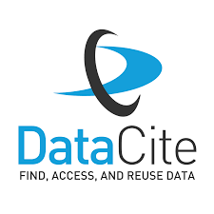
Continuing on the path to Open Data
Funder mandates
Publisher support
International efforts
Notes:
More funders are starting to require that data be shared openly. Many publishers such as PLOS and Nature ask researchers to share their data, with many others moving more to support open data practices. Efforts across Europe, Latin America, and China are also moving to towards more open data practices, so this change is taking place globally. The State of Open Data 2022 notes that “NIH continues to invest in a robust data ecosystem, one where its policies and activities keep pace with evolving scientific technologies, opportunities, and stakeholder expectations” The NIH continues to partner with organizations like DataCite, Federation of American Societies for Experimental Biology, and Data Curation Network to support FAIR and open data. The new NIH DMSP is just one of many steps moving towards more open data practices.
That is to say that open data, open science isn’t going anywhere. The need for skilled librarians that can speak to these topics and support open data at their institutes will continue to increase in the coming years.
https://digitalscience.figshare.com/articles/report/The_State_of_Open_Data_2022/21276984/5

Slide 30
Next Steps
Notes:
Next, we will talk about next steps for librarians interested in going into data services and next steps for library leaders looking to recruit data librarians. First, we will talk about the different specialties data librarians can pursue.

Slide 31
What might a DATA MANAGEMENT Librarian do?
Advise on data organization
Curate data to be shared
Develop metadata to maximize discovery
Teach research data management
Assist in writing or reviewing Data Management Plans
Assist in identifying appropriate repositories for data sharing
Teach and/or consult on use of data collection software
Notes:
tie it back to the two categories in slide 6

Slide 32
What might a DATA SCIENCE Librarian do?
Coding (e.g., R, Python)
Use of data collection tools (e.g., REDCap, Qualtrics)
Data cleaning (e.g., coding, OpenRefine)
Data analytics tools (e.g., SPSS, NVIVO, and MATLAB)
Data visualization (e.g., coding, Tableau)
How to perform statistics within a particular programming environment
Notes:
Data science and data literacy librarians teach and offer consultations in use of data, including coding, surveys, and data cleaning.
Not likely to teach
Statistical analysis (e.g., which test to run) and research design (like advising on validity, power, generalizability)
Machine learning techniques
Anything that requires domain specific knowledge
As you can see, this list alone is quite a hefty set of responsibilities for one person since most data librarians do not have expertise across all of these systems, and many of these tools update and change almost constantly. Therefore, it is best to have an idea of what is in greatest use and demand within an institution in order to support those. For example, one institution may have researchers much more frequently using R, QuestionPro, Tableau with a smaller but significant percentage using STATA and PowerBI. It would be best to hire or develop expertise in those areas. Whereas, for another institution, where researchers are heavily using both R and Python as well as REDCap, the data librarian's skills will need to be focused on those tools.
GIS tends to be its own concentration, where some librarians have GIS services as their central or sole responsibility.

Slide 33
What else Do Data Librarians Do?
Finding data
Accessing data
Teach rigor and reproducibility

Slide 34
TIPS for developing a homegrown data librarian
Training and Support
Value different backgrounds
Data cannot just be an add-on to their responsibilities
Give time for growth into the role and provide clear goals to accomplish
Notes:
Identify someone with an interest
Provide ample professional development support
Provide support in making inroads across the institution
Consider the value of differing backgrounds
text mining - humanities/computer science
GIS - social sciences/humanities/urban planning
use of library subscriptions to data - business analytics
use of large open data sources - computer science and engineering
Data cannot just be an add-on to their responsibilities
Give time for growth into the role and provide clear goals to accomplish

Slide 35
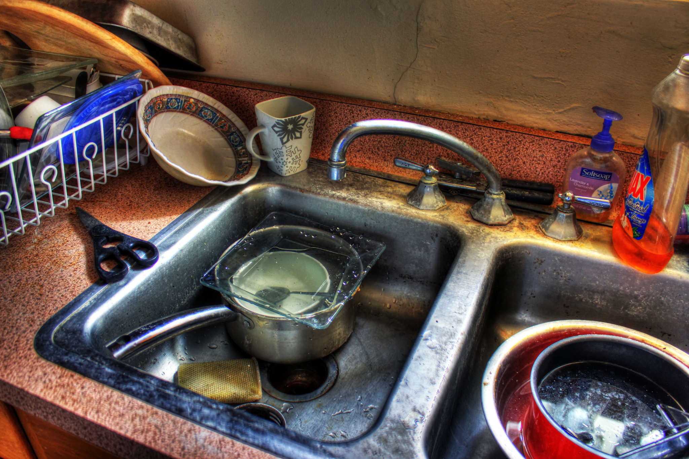
WATCH OUT FOR THE BIGGEST PITFALL
Do not write a kitchen sink job description.
Notes:
Do you want a data librarian, do you want an impact or assessment librarian? What is it you actually want/need? Also what specific foci make sense.

Slide 36
KITCHEN SINK EXAMPLE
DATA SERVICES LIBRARIAN Department: Reference Rate of Pay: competitive
Shelley University seeks a motivated and experienced individual to provide research data management and data literacy support, training, and partnerships to faculty, students, and researchers in the 5 campuses across the metropolitan area. The Data Services Librarian will partner with researchers to evaluate data planning needs and assess options for sharing data and will be leading research data management and curation services, and the scope of responsibilities for this position includes developing and implementing policies, procedures, and best practices for research data acquisition, creation, analysis, visualization, management, curation, and preservation, particularly in regard to meeting requirements for National Institute of Health data management and sharing plans. The individual will be a part of the reference team in the Health Sciences Library. This is a renewable faculty appointment reporting to the Head of Reference. Roles include: Assisting researchers with creating data management and sharing plans meeting NIH requirements; and promoting new metrics for research evaluation. Promote research data services to campuses. Teaching data literacy & management awareness and skills among faculty, researchers, and students Assessing research impact and altmetrics for researchers. Researching the impact of the libraries' services as well as collection circulation and evaluation data. Staffing the service desk 12 hours per week. Serving as a subject liaison to the following programs: Pharmacy, Biology, Biomedical Informatics, Dental Hygiene, Healthcare Administration, and Medical and Molecular Biology. Minimum Qualifications: Master’s degree in Library and Information Science, or equivalent, from an ALA-accredited institution; Knowledge of the research data lifecycle and data management and sharing best practices. Familiarity with appropriate data repositories and public data sets in a variety of disciplines. Strong project management skills and ability to motivate others. Evidence of the ability to do research, publication, and service consonant with tenure and promotion standards Preferred Qualifications: 2 or more years of experience with using a variety of data analysis, visualization, and mapping tools; Experience with conducting quantitative or qualitative research and data analysis; Familiarity with data curation and preservation practices; Experience with data services across the research lifecycle, including creating, processing, analyzing, preserving, accessing, and reusing research data; Experience using quantitative or qualitative research and data tools such as R or Python, PowerBI or Tableau, Nvivo, Javascript, SQL, HTML, SAS, SPSS, or STATA.
Characteristics of a "kitchen sink" post:
multiple responsibilities spanning both data services tracks as well as other responsibilities
large list of required technical skills and software
no salary listed or salary not commensurate with responsibilities
unclear how the position within the library or position in an ill-fitting department
Notes:
Responsibilities include assessment, evaluation, research impact, data management, data curation, and data literacy!

Slide 37
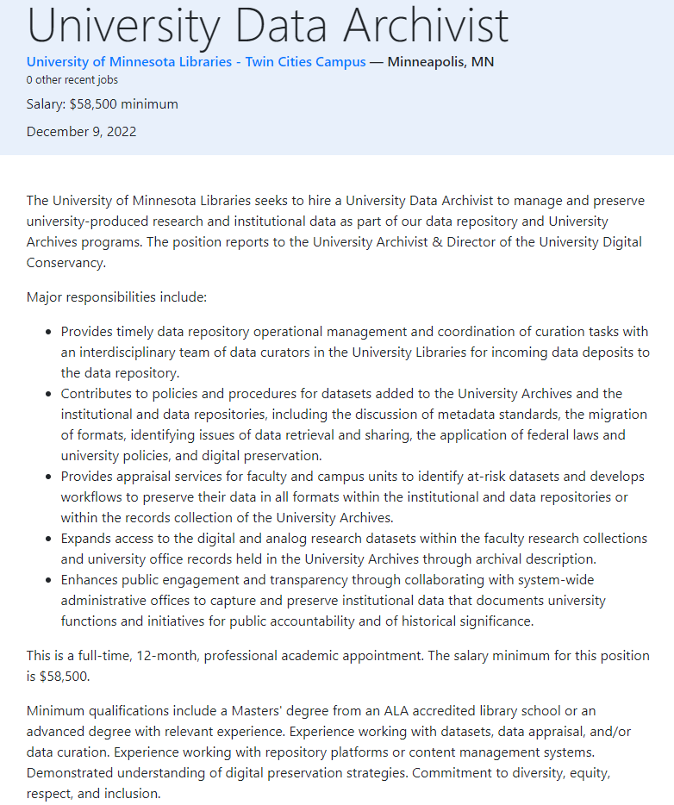
Good job - Example 1
Characteristics of a quality job description:
clearly outlined scope
reporting line is included
required experience is relevant
salary is posted

Slide 38
Good job - Example 2
GEOSPATIAL LIBRARIAN/SPECIALIST (ASSISTANT OR ASSOCIATE) Department: Research Engagement Department Website Link: https://new.library.arizona.edu/about/organization Rate of Pay: $63,000 - $76,000
The University of Arizona Libraries’ Data Cooperative provides data science and visualization services, geospatial services, and digital scholarship services for the University. The incumbent will develop a robust program supporting geographic information systems (GIS) and geospatial data services … The Geospatial Specialist / Librarian will: stay abreast of trends and tools available in the evolving geospatial data ecosystem; provide technical support and training in the use of tools and workflows to support GIS applications; work with library colleagues and researchers to identify appropriate tools, platforms, and resources for geospatial projects; collaborate with other members of the Data Cooperative and Research Engagement to develop outreach strategies and partnerships; work with members of the Libraries’ Technical Services and Support (TeSS) department … Knowledge, Skills, and Abilities … Proficiency in one or more geospatial software suites, such as QGIS, GRASS, or the ESRI suite Knowledge of at least one scripting language (including but not limited to bash, javascript, python, and/or R) Minimum Qualifications Advanced degree in a geospatial, geographic information systems, geography, natural resources, or related field or masters degree in library and information science Demonstrated experience with evolving landscape of geospatial technologies and resources, such as GIS and remote sensing Preferred Qualifications Professional experience working in an academic research library Carpentries Instructor Certification Demonstrated experience in training audiences with diversity of experiences and backgrounds Experience applying geospatial analytical or visualization approaches to a range of user needs and expertise Experience with multiple kinds of geospatial data formats (geoJSON, Shapefile, Spatialite) and relevant metadata standards (e.g. CSDGM, Aardvark) Experience with aerial and satellite imagery data Experience with scripting languages such as JavaScript, Python, or R Experience using PostGIS (geospatial database extender for PostgreSQL software) Experience working in a bash/terminal environment Demonstrated experience in pursuing independent and collaborative scholarship, such as peer-reviewed research, creative works, or open software projects
Characteristics of a quality job description:
clearly outlined scope
departmental information establishes what has been done and where this position fits in
required technical qualifications align with the position
salary is posted

Slide 39
Tips for hiring a data librarian
Tip #1
Consider the collaborators in the institution and in the library.
Notes:
Your data services librarian/team will never be able to meet all the needs of the institution. Think about what makes sense in relation to the services already provided across campus (and in the library) as well as the skills you'll need for someone in that role.

Slide 40
Tips for hiring a data librarian
Tip #2
Consider the market for people with data science skills.
Notes:
anecdotally we are seeing more and more of these positions and getting reports of small pools of applicants, so….
pay, benefits, and other ways of attracting good candidates (work from home, etc.)
make you budget for continuing education (time and financial support), especially for home-grown data librarians

Slide 41
Tips for hiring a data librarian
Tip #3
Make space and build opportunities.
Notes:
make a way for them to be successful
make connections with institutional leaders, work toward improving barriers, such as policies going against data sharing, tenure requirements, etc.

Slide 42
Tips for hiring a data librarian
Tip #4
Be flexible.
Notes:
Skills are transferable. If they have the basic building blocks, they can grow (i.e., going from knowing R to teaching python)
You may try certain services that are not well-received and need to move into another service that is more needed for your institution

Slide 43
Tips for hiring a data librarian
Tip #5
Integrate them into the existing ecosystem.
Notes:
Data librarians are successful working in an integrated environment (liaisons/specialists, etc.)
img src = https://ceo.umich.edu/wp-content/uploads/2020/06/IMG_9307-1920x960.jpg

Slide 44
Where to start

Slide 45
Specialization through MLA Data Services Competencies
Applies principles of data literacy
Establishes and advances data services
Supports research data best practices across the data lifecycle
Applies knowledge of research methods, research ethics and rigor, and open science practices
Provides training and consultation for data-related topics
Notes:
https://www.ncbi.nlm.nih.gov/pmc/articles/PMC7069817/

Slide 46
NNLM Data OFferings
Courses:
Fundamentals of Health Sciences Research Data Management
Fundamentals of Health Data Science
Additional Webinars:
Creating Data Management Plans with DMPTool
Overview of the NIH Data Management and Sharing Policy
On Demand Modules:
Notes:
**INSTRUCTOR: Please update this slide with current and upcoming offerings**

Slide 47
CHALLENGES IN Starting data services
limitations to the role
authority
shoot the messenger problems
on-the-job learning
associating the library with data
Notes:
There are limitations to the role (reproducibility, data literacy, etc.)
scalability
skills that each person has
Authority
Shoot the messenger problems
All or much of this is on-the-job learning for many librarians
Getting people to associate the library with data is an ongoing task

