Slide 1
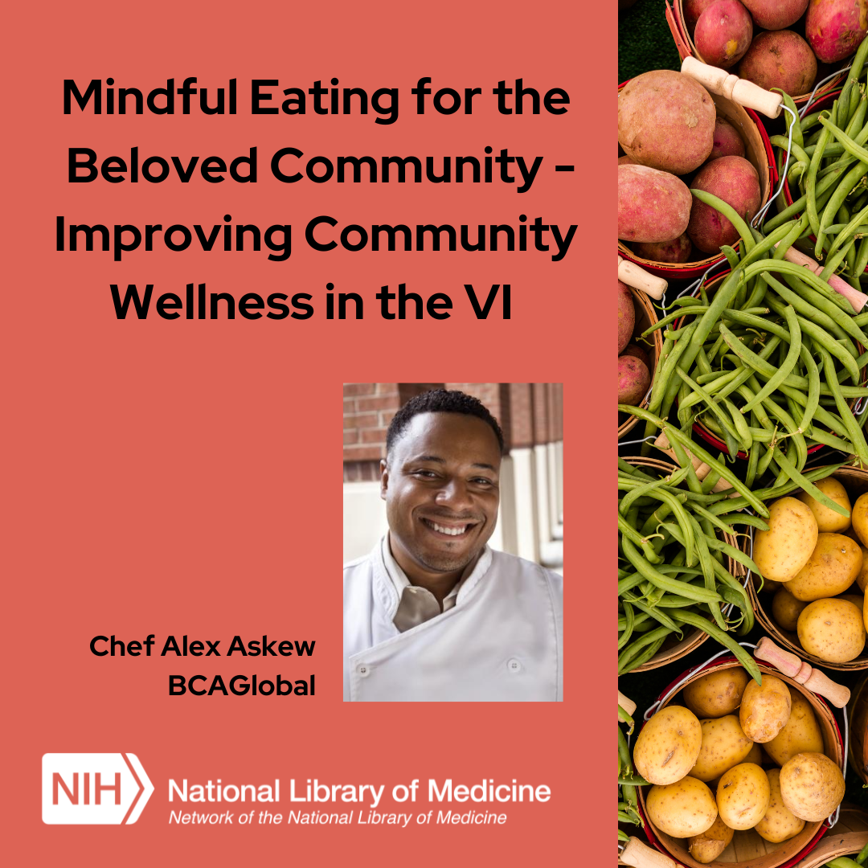
Mindful Eating for the Beloved Community – Improving Community Wellness in the VI

Slide 2
Land Acknowledgements
Land acknowledgements are an honest and historically accurate way to recognize native communities of this land. Presenting land acknowledgments recognizes histories that have been systematically erased.
The native peoples of this region include the Etiwan, Kiawah, Santee, Edisto, Nachez-Kusso, and Wassamassaw people.
The Region 2 RML recognizes the native communities of the land on which we live, work and, play in Charleston, SC.

Slide 3
Community Agreements
Take care of yourself
No one knows everything / Together we know a lot
Make Space / Take Space
One mic / One voice
Understand the difference between impact and intent
Respect confidentiality
Be curious and respectful
Adapted from GLSEN Guidelines from Respectful GSA Spaces
https://www.glsen.org/activity/guidelines-respectful-gsa-spaces

Slide 4
Objectives
Explore food inequity and how to be culturally sensitive when designing an intervention.
Identify barriers to food and health literacy.
Learn strategies for community engagement in health literacy.

Slide 5
Panel Discussion
Introductions
Notes:
It is my pleasure to introduce Chef Alex Askew.
At 14 Chef Alex Askew received his first job offer as a personal chef and at 21 attended the Culinary Institute of America where he co-founded the first on campus group for students of color (BCS) and graduated in 1989. In 1993 Alex Co-founded the BCAGlobal which dedicates itself to Education, Awareness, and Exposure for young minority students seeking careers within the culinary and hospitality industry. The newest core program, “Mindful Eating for the Beloved Community” has gathered National attention for bringing Food, Race, and Social Justice to the forefront while focusing on training chefs of color as Health Equity Ambassadors to produce healthy and whole communities.

Slide 6
Question 1
Why was this program
important or valuable to
you as a participant?

Slide 7
Question 2
What were the key learning
outcomes for you?

Slide 8
Question 3
How do you feel with what
you learned you can influence
your community to have better
wellness outcomes?

Slide 9
Question 4
How were the food exercises
helpful in learning about
Mindful Eating for the
Beloved Community?

Slide 10
Question 5
How committed are you
to sharing what you learned
with others in the community?

Slide 11
Q & A

Slide 12
Let's Connect
Find us on Facebook, LinkedIn, and Twitter @nnlmregion2
E-mail: Region2@nnlm.gov
Notes:
Follow us on social media:
https://www.facebook.com/nnlmregion2
https://twitter.com/nnlmregion2
https://www.linkedin.com/company/nnlmregion2/
Email us at Region2@nnlm.gov

