Slide 1
Transgender
Learn and improve care for all…

Slide 2
Discussion points from last module
What role does gender play in sexual orientation identity?
Notes:
NOTE TO FACILITATOR: If you are completing these modules in an order other than suggested in the facilitation guide, you may need to adjust these discussion points.

Slide 3
Objectives
By the end of the program, participants will:
Understand the difference between gender identity and gender expression
Understand what it means to identify as transgender
Recall terms that are appropriate and inappropriate to use when interacting with people who are transgender

Slide 4
What do you think?
What is the difference between gender identity and gender expression?
Are drag queens transgender?
Notes:
Facilitator: Ask the discussion questions: “What is the difference between gender identity and gender expression?” (more on the next slide) and “Are drag queens transgender?” (The answer is Some are! But many are not. They are not the same thing. Drag is an art form, not an identity.). Give the audience a short amount of time to answer.

Slide 5
First, Some Terms…
Fig 1. Trans Student Educational Resources (2019). Infographics. Retrieved from: URL to Source
Notes:
We’ll get started with our conversation about people who are transgender with some terms. First, gender expression- this is the way a person communicates their gender identity to others by the way their dress, act or refer to themselves. Gender expression is about the entire body – hair, makeup, clothing, the way someone walks, how they talk, mannerisms, etc. Gender identity is not the same thing, this is a person’s internal sense of being a man, a woman, or anything in between. This could be identifying as male, female, masculine, feminine, androgynous, etc. Orientation/attraction is a term to describe sexual and/or romantic attractions to others. Who we love and are attracted to. The last term here, sex, refers to the labels male, female, or intersex given to someone at birth based on their body parts. This is what we are assigned at birth.

Slide 6
It’s Not Just for Trans People
Fig 1. The Gender Bread Person (2013). Breaking through the binary: Gender explained using continuums. Retrieved from: URL to Source
Notes:
Everybody has a gender identity, gender expression, biological sex, and sexual orientation. You can see here that each term from the previous slide. For example, for gender expression in yellow, goes from feminine on one end to masculine on the other with androgynous in the middle. These are all a continuum, where you do not have to pick one end or the other⁴. The same goes for biological sex which goes from male to female with intersex in the middle; gender identity which goes from woman to man, with genderqueer in the middle and sexual orientation which goes from heterosexual to homosexual with bisexual in the middle. These are all independent of one another⁴, meaning that someone could have female biological sex, identify as a woman, express themselves as masculine, and have a sexual identity that is bisexual. [NOTE to FACILITATOR: You can ask the participants to think about where they would fit on each of these spectrums.]

Slide 7
So What is Transgender?
An umbrella term for people whose gender identity and/or expression is different from cultural expectations based on the sex they were assigned at birth.¹
Being transgender just means that they do not identify with the sex they were assigned at birth.
Notes:
Transgender is an umbrella term for people whose gender identity and/or expression is different from cultural expectations based on the sex they were assigned at birth.¹ Being transgender just means that they do not identify with the sex they were assigned at birth.

Slide 8
A few more terms
Gender Dysphoria: Clinically significant distress caused when a person’s assigned birth gender is not the same as the one with which they identify¹
Cisgender: people whose gender identity is congruent with the sex designated to them at birth¹
Notes:
A few more terms related to transgender. Gender dysphoria is a clinically significant distress caused when a person’s assigned birth gender is not the same as the one with which they identify¹. Cisgender is when people whose gender identity is congruent with the sex designated to them at birth¹ or in other words, someone who is not transgender- almost everybody is cisgender.

Slide 9
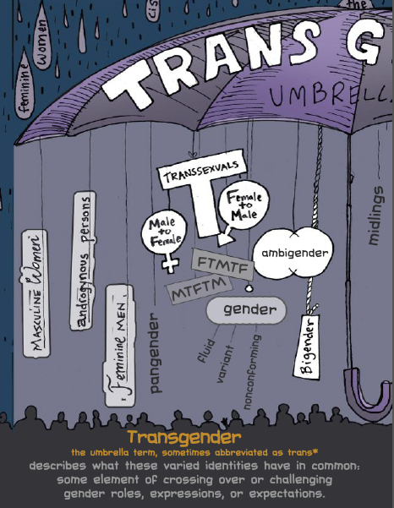
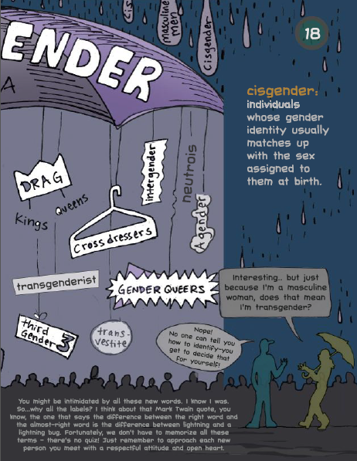
Transgender Umbrella
Fig 1. Reiff, M. & Mays, J. (2013). The Gender Book. Houston: Marshall House Press
Notes:
There are many ways to be transgender. Here are some terms and identities that fall under the transgender umbrella. [NOTE to FACILITATOR: You can ask the participants what words they recognize and what words may be new to them.]

Slide 10
Transitioning
Transitioning: The process by which some people strive to more closely align their internal knowledge of gender with its outward appearance
The process of transitioning (does not have to be in this order):
Social
Medical
Legal
Notes:
Transitioning is the process by which some people strive to more closely align their internal knowledge of gender with its outward appearance. There is more than one way that a person can transition:
Social – telling friends and family, dressing as the appropriate sex, cutting one’s hair, wearing makeup, etc.
Medical – HRT (Hormone Replacement Therapy), surgeries, puberty blockers
Legal – updating legal documents with the appropriate name and/or gender

Slide 11
What about sexual orientation?
Being transgender does not imply any specific sexual orientation. Transgender people can identify as bisexual, lesbian, gay, straight, etc.¹
If a trans woman is exclusively attracted to other people who identify as women, then she is a lesbian
Notes:
If you remember from the first module, sexual orientation & gender identity and expression are interrelated concepts but are not the same or a cause-and-effect relationship. Being transgender does not imply any specific sexual orientation. Transgender people can identify as bisexual, lesbian, gay, straight, etc.¹ If a trans woman is exclusively attracted to other people who identify as women, then she is a lesbian.

Slide 12
Outdated and Inappropriate Terms
Transsexual: an older term that originated in the medical and psychological communities. Still preferred by some people who have permanently changed – or seek to change – their bodies through medical interventions. Many transgender people do not identify as transsexual.²
Transvestite: an outdated term for individuals who dress as a different sex for entertainment or in the privacy of their own homes²
Transgendered
Tranny
Notes:
There are some terms that are either outdated or inappropriate to use:
Transsexual: an older term that originated in the medical and psychological communities. Still preferred by some people who have permanently changed – or seek to change – their bodies through medical interventions. Many transgender people do not identify as transsexual.²
Transvestite: an outdated term for individuals who dress as a different sex for entertainment or in the privacy of their own homes²
Transgendered – adding the ‘ed’ on the end makes this a verb and makes it sound like it’s something that happens to you rather than an identity
Tranny – this is a derogatory term although there may be some people in the trans community who use it as a self-identifier

Slide 13
How to Interact Affirmatively
Do
Don’t
Ask what pronoun they use
Believe them
Only ever call them by the name with which they’ve introduced themselves
Ask about surgeries or body parts
Ask about their sex lives
Ask them their “real” name
Ask to see pictures prior to their transition
Notes:
There are ways to interact in affirming ways with the transgender community.
Do
Ask what pronoun they use
Believe them
Only ever call them by the name they’ve introduced themselves as
Don’t
Ask about surgeries or body parts
Ask about their sex lives
Ask them their “real” name
Ask to see pictures prior to their transition

Slide 14
Take home message
Consider:
The transgender community is as diverse as every other community- how have you seen this demonstrated among your patients?
Remember:
If you’ve met one trans person, you’ve met one trans person
Developed resources reported in this presentation are supported by the National Library of Medicine (NLM), National Institutes of Health (NIH) under cooperative agreement number UG4LM012342 with the University of Pittsburgh, Health Sciences Library System. The content is solely the responsibility of the authors and does not necessarily represent the official views of the National Institutes of Health.
Notes:
Consider:
The transgender community is as diverse as every other community. Trans people come from all races, socioeconomic backgrounds, cultures, nationalities, political parties, etc.
Remember:
If you’ve knowingly met one trans person, you’ve met one trans person.
[NOTE TO FACILITATOR: If you want to complete group discussion immediately following this module content, change the title of this slide to ‘Group Discussion’ and delete the slide with corresponding questions in the next module. If you would like to have discussion take place using your internal LMS system, you can include instructions here for how participants can participate. Then, adjust the slide with the corresponding questions in the next module as needed.]

Slide 15
References
Human Rights Campaign. “LGBTQ Definition for Adults: Welcoming Schools.” Human Rights Campaign, URL to Source
“Glossary of Terms – Transgender.” GLAAD Media Reference Guide – Transgender, GLAAD, URL to Source
“Social Transitioning.” Beyond Gender, The Trevor Project, 2016, URL to Source
The Gender Bread Person (2013). Breaking through the binary: Gender explained using continuums. Retrieved from: URL to Source
Trans Student Educational Resources (2019). Infographics. Retrieved from: URL to Source
Reiff, M. & Mays, J. (2013). The Gender Book. Houston: Marshall House Press

