Slide 1
Motivational Interviewing
Support behavior change

Slide 2
Please complete the pre-test questions
Notes:
[NOTE TO FACILITATOR: if you choose not to have participants complete the knowledge assessment questions, delete this slide.]

Slide 3
Objectives
By the end of the program, participants will:
Discuss the spirit of motivational interviewing
Define ambivalence as it relates to motivational interviewing

Slide 4
Discussion points from last module
How do the concerns, personal circumstances, and contexts of patients and their families play a role in decisions?
Notes:
[NOTE TO FACILITATOR: If you are completing these sections in an order other than suggested in the facilitation guide, you may need to adjust these discussion points.]

Slide 5
Motivational Interviewing
“Motivational Interviewing is a collaborative, person-centered form of guiding to elicit and strengthen the motivation to change.”¹
Notes:
We’ve discussed some useful and important techniques related to communication and health literacy, and motivational interviewing is another communicating technique that goes a step beyond confirming understanding and helps a patient make necessary behavior changes to improve their health. The definition of Motivational Interviewing you see here is an updated one that was provided by the creators of MI in 2009¹. There is a lot that goes into Motivational Interviewing, which is why we will discuss it for several sessions, but this definition offers a lot of insight into MI in just a few words. “Motivational Interviewing is a collaborative and person-centered form of guiding to elicit and strengthen the motivation to change.”¹ Behavior change is difficult for all of us, and oftentimes, the changes we ask patients to make to prevent disease or manage a condition are not things they can do overnight. What this definition of MI is getting at is that motivation to change is intrinsic to our patients², and therefore we need to consider our conversations with patients about behavior change to be a partnership¹.
[NOTE TO FACILITATOR: If you are completing these sections in an order other than suggested in the facilitation guide, you may need to adjust this note.]

Slide 6
Motivational Interviewing & Health Literacy
Title V of the Patient Protection and Affordable Care Act defines health literacy as, “the degree to which an individual has the capacity to obtain, communicate, process, and understand health information and services in order to make appropriate health decisions.”³
Notes:
Why are we discussing Motivational Interviewing in the context of health literacy? If you remember the definition of health literacy from the Affordable Care Act, it includes not only the ability to understand and communicate³, but to use this information to make appropriate health decisions. This is an active piece that someone has to engage in, and sometimes action requires more than understanding. There is also the need for someone to be motivated to change and feel confident that they can act upon the health information they receive.

Slide 7
Motivational Interviewing History
Developed over 30 years ago by a psychologist, primarily for use in the field of substance abuse¹
Widely used and validated in the substance abuse field^{1,6,7,8}
The use of MI has spread to other areas in need of health behavior change, including chronic disease^{1,6,7,8}
“The inclination to confront or persuade patients was replaced by evoking clients’ own reasons to change, which minimized resistance.”⁶
Notes:
Motivational Interviewing has been around for a long time - it was developed over 30 years ago by a psychologist by the name of William R. Miller as a tool for evoking behavior change with clients with substance abuse isses¹. MI has been proven effective and widely used in the substance abuse field, and over the years the use of MI has spread to other health conditions that are unrelated to substance abuse, including chronic diseases,^{1,6,7,8} which is the context we will discuss it in during this module.

Slide 8
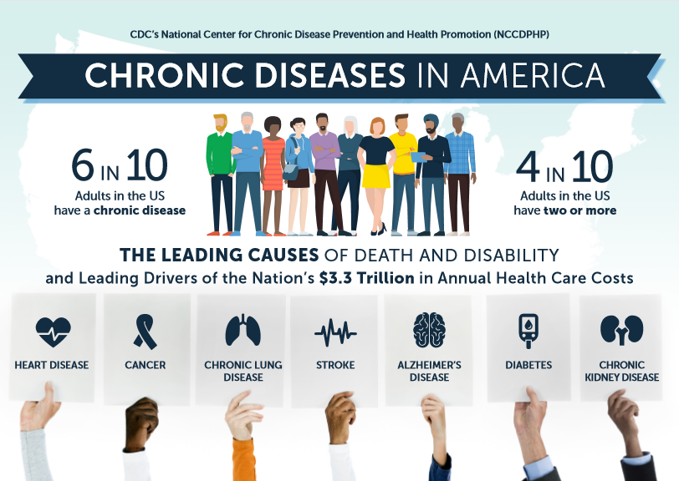
Motivational Interviewing & Chronic Disease
Fig 1. Centers for Disease Control and Prevention (2016). Chronic Diseases in America. Retrieved from: URL to source
Notes:
I mentioned that motivational interviewing has been validated in the substance abuse field^{1,6,7}. There is also a body of evidence around the use of motivational interviewing and chronic disease^{1,6,7}. I’m sure that you are aware that chronic diseases are the leading cause of death and disability in the United States^{1,4,7}. They are also very costly, as you can see reflected in this infographic from the Centers for Disease Control and Prevention⁴.

Slide 9
Motivational Interviewing & Chronic Disease (2)
Fig 1. Centers for Disease Control and Prevention (2016). Chronic Diseases in America. Retrieved from: URL to source
“As chronic ‘lifestyle-related’ diseases steadily become the heaviest burden to modern Western medical systems, effective treatment focused on helping individuals change problematic behaviors are extremely necessary.”⁷
Notes:
The hard part about addressing chronic conditions is that they often need the patient to make some type of lifestyle change - whether this is smoking cessation, reducing alcohol intake or improving diet and exercise. Unlike treatment for other illnesses, healthcare providers don’t necessarily have control over their patient’s behavior choices¹. If you remember when we discussed the research about medication adherence and health literacy, there was a meta analysis that showed a strong correlation between health literacy and adherence in general¹². While this did show a link with medication adherence, the same study found that the average relationship between health literacy and adherence was even higher for adherence to lifestyle, exercise, and diet recommendations¹². The authors assumed that health behavior change may need greater health literacy for a patient to accomplish¹². This is another reason why motivational interviewing can be important as part of a health literacy discussion. Motivational Interviewing is a tool that can positively influence patients’ choices by helping them weigh the pros and cons and identify challenges and successes^{1,6,7}.
[NOTE TO FACILITATOR: If you are completing these sections in an order other than suggested in the facilitation guide, you may need to adjust this note.]

Slide 10
Motivational Interviewing Effectiveness
There are challenges with simply telling patients what to do⁸
There is evidence for the use of motivational Interviewing in medical care settings for indicators/behaviors such as:
Blood pressure
Cholesterol
HIV viral load
Alcohol
Tobacco
Marijuana
BMI
Quality of life
Appointment adherence
Participating in treatment plans^{1,7}
Notes:
Why motivational interviewing? Evidence suggests that patients don’t want to be given advice in a way where they are “being told what to do”.⁸ This style can make the patient focus on their own personal costs of change over the longer-term benefits, while the provider is doing the opposite - focusing on the long-term benefits they see for the patient while minimizing the personal costs⁸. Motivational interviewing is another communication option that has shown promise in medical settings for a number of behaviors, indicators and biometrics that you can see here^{1,7}.

Slide 11
Motivational Interviewing Effectiveness (2)
Overall findings of a 2014 review found MI effective in primary care medical settings^{1,7}
MI interventions studied varied a great deal in method of delivery, but for some behaviors, 1-3 sessions with MI were effective ⁷
Other behaviors needed a larger number (4-11) sessions⁷
Method of delivery did not affect effectiveness⁷
Notes:
In a 2014 systematic review and meta analysis, motivational interviewing was found to be effective in primary care medical settings^{1,7}. This review found a large amount of variation in how motivational interviewing was used and delivered, but that for some behaviors, even 1-3 discussions using this technique were effective in helping patients make changes. For other behaviors there were a larger number of conversations needed, but the positive thing is that the method of delivery did not affect the results, meaning that some of these conversations can take place over the phone⁷.

Slide 12
Ambivalence
Central concept to motivational interviewing^{2,8}
When someone has positive and negative feelings about change⁵ and isn’t sure which choice to make⁹
They want to be healthy, but routines are comfortable and we anticipate disadvantages to change¹¹
MI techniques can help someone work through ambivalence^{2,8}
“I know I should _____ BUT _____.”¹¹
Notes:
I mentioned a moment ago about weighing the pros and the cons of change, and this brings up a central piece of MI - which is ambivalence^{2,8}. Ambivalence is when someone has two feelings about a change, both positive and negative⁵, and they haven’t made a choice about which way to go⁹. It’s likely that a patient wants to be healthy, but they also have a routine that was formed over a long time and this routine is comfortable and it is easy to come up with disadvantages to changing¹¹. Ambivalence is a common change in healthcare conversations because providers can be accustomed to giving a patient advice⁸ and it can be frustrating when they don’t do what was suggested¹¹. The next several sessions of Clinical Conversations will discuss motivational interviewing, which can help patients work through the ambivalence they feel about change ^{2,8}. A primary way to recognize ambivalence is when someone uses the word to show that they want to do something but that they also don’t want to do something¹¹. For example, “I know exercising will make me feel better, but with my work schedule I just don’t have the time.”
[NOTE TO FACILITATOR: If you are completing these modules in an order other than suggested in the facilitation guide, you may need to adjust this note.]

Slide 13
The Spirit of Motivational Interviewing
Four Elements:
Partnership
Acceptance
Compassion
Evocation⁵
“I told myself that I was learning to treat my patients ‘side by side’ instead of ‘head to head’ as I had done previously.”⁵
Notes:
We will get into more concrete techniques as we move forward, but the spirit of MI is considered to be an important piece of the process^{1,2,5}. The spirit of motivational interviewing isn’t necessarily one thing you say or do. This is more about the a provider's attitude or their mindset surrounding the encounter⁵. You can see four elements of motivational interviewing here. Partnership is the idea that the provider isn’t trying to persuade the patient to change¹, but that motivation comes from them and it is up to them to work through their ambivalence¹. Acceptance gets at the concept that we might not agree with a patient’s choice⁵, but the spirit of MI says that we should accept where they are in the change process⁹. Compassion is the idea that we are thinking about the patient’s perspective over our own⁵. Evocation is helping a patient consider their own motivation to change through questioning^{5,9}. In other words, evocation could be that the patient has the best ideas about how and why they should change¹. You can see this impactful quote from one of the authors of the book Interviewing: A Guide for Medical Trainees, who is drawing on their own experience, saying “I told myself that I was learning to treat my patients ‘side by side’ instead of ‘head to head’ as I had done previously.”⁵ This is a nice way to summarize the spirit of MI from a personal perspective.

Slide 14
Cultural Variability
Historically, effectiveness studies of evidence-based practices did not include large numbers of racial and ethnic minorities¹⁰
There is debate about the need for culturally adapted MI and this is an emerging MI topic¹⁰
There are ongoing efforts to develop culturally appropriate methods of MI^{1,10}
Using MI should overlap with cultural competence and cultural humility^{10,9}
Notes:
In closing this introductory conversation about motivational interviewing, its use, and effectiveness, it’s important to also consider how this overlaps with [previous/future] discussions of cultural competence and cultural humility. Historically, studies of the effectiveness of evidence-based practices did not include large numbers of racial and ethnic minorities¹⁰. So, despite motivational interviewing being widely used and validated, there is ongoing debate about the need to culturally adapt MI to serve all populations¹⁰ and there are ongoing efforts to develop more culturally appropriate methods of MI^{1,10}. However, there isn’t one developed standard related at this time. This doesn’t mean that MI shouldn’t be used, but that there should be overlap with the concepts of cultural competence and cultural humility, which [we discussed previously, will be discussed as we move forward].

Slide 15
Take home message
Consider:
What are some times you have noticed ambivalence in a patient?
With which of your patients would you use motivational interviewing?
Developed resources reported in this presentation are supported by the National Library of Medicine (NLM), National Institutes of Health (NIH) under cooperative agreement number UG4LM012342 with the University of Pittsburgh, Health Sciences Library System. The content is solely the responsibility of the authors and does not necessarily represent the official views of the National Institutes of Health.
Notes:
A few things from today’s session to consider are: what are some times you have noticed a patient experiencing ambivalence? And which patients would you consider using motivational interviewing with? For example, someone that you have been talking to about behavior change for some time and can’t seem to quite get where they want to go?
[NOTE TO FACILITATOR: If you want to complete group discussion immediately following this module content, change the title of this slide to ‘Group Discussion’ and delete the slide with corresponding questions in the next module. If you would like to have discussion take place using your internal LMS system, you can include instructions here for how participants can participate. Then, adjust the slide with the corresponding questions in the next module as needed.]

Slide 16
References
Tuccero, Railey, Briggs & Hull (2016). Behavioral Health in Prevention and Chronic Illness Management, Primary Care: Clinics in Office Practice, 43, 191-102. doi: 10.1016/j.pop.2016.01.006
Kelley, C., Sbrocco, G., and Sbrocco, T. (2016). Behavioral Modification for the Management of Obesity, Primary Care, 43(1), 159-175. doi: 10.1016/j.pop2015.10.004
Office of the Legislative Council (2010). Compilation of the Patient Protection and Affordable Care Act. Retrieved from URL to source
Centers for Disease Control and Prevention (2016). Chronic Diseases in America. Retrieved from: URL to source
Gold, M., Kelly, T., Douihy, A. (2015). Motivational Interviewing : A Guide for Medical Trainees. New York: Oxford University Press.
Lundahl, B., Moleni, T., Burke, B., Butters, R., Tollefson, D., Butler, C. & Rollnick, S. (2013). Motivational Interviewing in Medical Care Settings: A Systematic Review and Meta-Analysis of Randomized Controlled Trials, 93, 157-168.
VanBuskirk, K. & Loebach Wetherell, J. (2014). Motivational Interviewing Used in Primary Care A Systematic Review and Meta-analysis, 37(4), 768-780.
Britt, E., Hudson, S. & Blampied, N. (2003). Motivational Interviewing in Health Settings: A Review, 53, 147-155.
Constance, A. & Sauter, C. (2011). Inspiring and Supporting Behavior Change. United States: American Dietetic Association.
Oh, H. & Lee, C. (2016). Culture and Motivational Interviewing, Patient Education and Counseling, 99(11), 1914-1919. doi:10.1016/j.pec.2016.06.010
Rollnick, S., Miller, W. & Butler, C. (2008). Motivational Interviewing in Healthcare. New York: Guilford Press.
Miller, T. (2016). Health Literacy and Adherence to Medical Treatment in Chronic and Acute Illness: A Meta-Analysis, 99(7), 1079-1086.

