Slide 1
Rural Health Pathway
29 January 2021

Slide 2
Introductions
Lisa Zook
Director of Research & Impact
Billi Shaner
Sr. Monitoring, Evaluation, and
Learning Advisor
Becky Romasco-Kelly
Monitoring & Evaluation Specialist
Notes:
Who we are
My name is BRK
Part of InformEd International team
Hired as external consultants to complete the pathway project with NNLM and the National Evaluation Office.
We really appreciate all of those who have assisted us in getting to this point. A few may be on the call who reviewed the pathways, can’t wait to share with you how the pathways have developed over time.

Slide 3
Agenda
Project overview
Review the pathways project goals and objectives
Evaluation Background
What is it?
Evaluation Station
Orientation to 5 Steps to Evaluation
How do I use these steps?
Orientation to the Rural Health pathway
Walk through the pathway and resources on the NEO website
Demonstration/Apply
Demo Rural Health pathway
Question & Answer
Notes:
agenda

Slide 4
Objectives
Walk away with an understanding of the pathways project
Understand how to use the Rural Health Pathway
Learn evaluation considerations for rural health programs
Notes:
objectives

Slide 5
Evaluation pathways Project overview
Notes:
Let’s jump in and talk about the pathway project

Slide 6
Pathways Project overview
Goal: "Enable grant recipients to pursue a particular interest and to develop evaluation plans and evaluation skills specifically tailored to their project"
Create 4 pathways walking through the evaluation process
K-12 Health
LGBTQIA+
Race & Ethnicity
Rural Health
Notes:
The Evaluation Pathways project was initiated to ‘enable grant recipients to pursue a particular interest and to develop evaluation plans and evaluation skills specifically tailored to their project’. 4 populations were identified, each of which had a pathway developed for it.
You may be wondering: why topic specific pathways? When developing the pathways we had the goal of highlighting resources, methods, and approaches that enable one to effectively and sensitively carry out evaluations of common programs funded by NNLM-grants. So, based on this, NNLM selected pathways for K-12 health, rural health, and programs sensitive to race & ethnicity, and LGBTQIA+ populations.
Each pathway covers evaluation that is responsive to the needs of programs in that topic area.

Slide 7
Project Overview: Steps
Step 1
Document Review & Planning
Step 2
Pathway Design
Step 3
Website Integration
Step 4
Step 5
Training & Marketing
5 In-Depth Webinars
December 18
January 8, 15, 22, 29
Finalization & Handover
March 2021
Reviewed by: EWG members, CHAT, HSL members at UW, reviewers at PSR region, and other volunteers.
Notes:
We carried out a document review and planning process
Developed the pathways, and integrating with the website.
At this point, many parties have reviewed the pathways including: EWG members, CHAT, HSL members at UW, reviewers at PSR region, and other volunteers.
We are currently in the training and marketing phase which is meant to socialize the pathways – to ensure that everyone is oriented to the pathways and knows that they are available.

Slide 8
Webinars
https://nnlm.gov/classes/evaluation-pathways-webinar-series
Notes:
Previous webinar recordings can be found under the classes section of the NNLM website- the URL address listed here
I won’t be spending much time on the topics covered in the previous webinars today, so I recommend that you view the previous lessons if you have any questions

Slide 9
Evaluation Background
Notes:
Quick poll of evaluation experience in chat:
0-5 Evaluation experience

Slide 10
What is Evaluation?
Evaluation uses a systematic process to judge quality, combining evidence and values. Good evaluation helps people make better decisions for better outcomes. Different types of evaluation can be done throughout a program or policy cycle, before implementation, during implementation, or after implementation.
-Better Evaluation
Notes:
Most of you answered the poll that…..
What is evaluation? Can mean different things to different people, but it is essentially a “systematic process to judge quality, combining evidence and values”
In the type of evaluation we are discussing today we are using a systematic process to judge the qualities of program funded by nnlm grants. However, many of these evaluation steps are applicable to evaluating programs that aren’t funded by nnlm grants

Slide 11
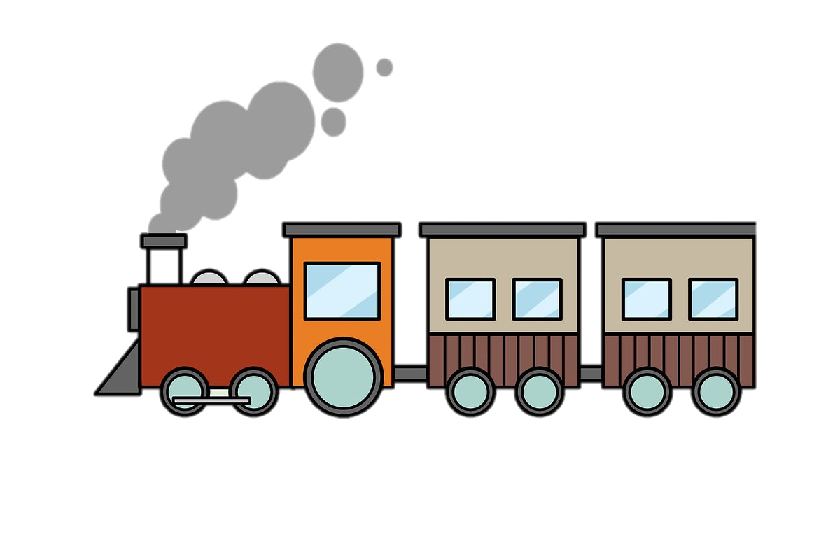
Evaluation Station
Evaluation
Information & Data
Results
Surveys
Interviews
Program documents
Budget/Expense reports
Monitoring data
Previously collected data
Reports
Graphs
Briefs
Presentations
Decisions
Notes:
I like to think of evaluation like a train station. Take in information and data, the evaluation is organized and processes are completed at the station, and out come the evaluation results

Slide 12
Everyone builds their “Station” differently
Everyone builds their “Station” differently
What we cover here are some of the many techniques one can use to evaluate a program
Evaluation techniques used can depend on:
Length of program
Number of program participants
Funding
Resources available
Generalizable results
Creating a toolkit of recommended evaluation practices for small grants
Evaluation

Slide 13
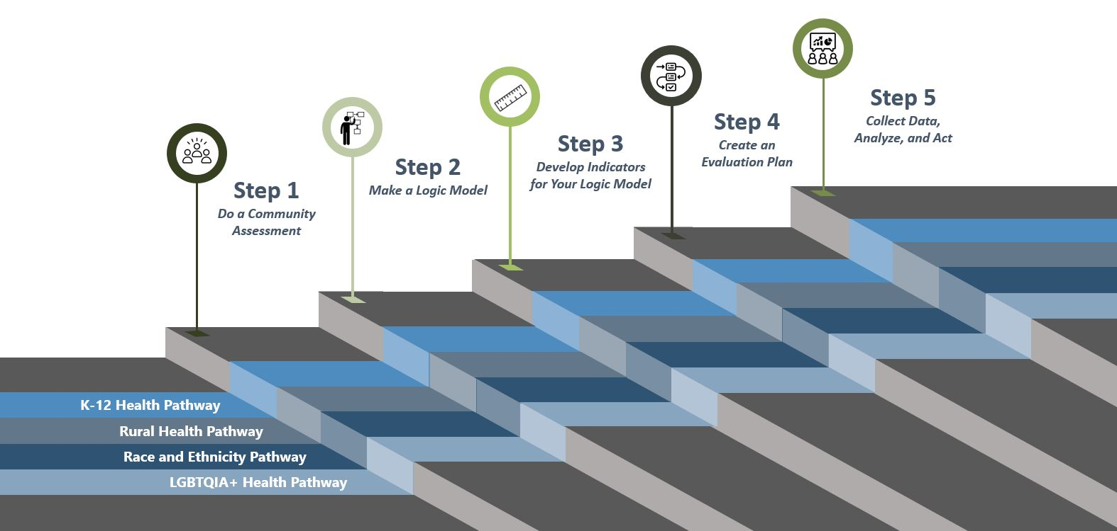
What happens at the station?
https://nnlm.gov/neo/guides/pathways
Notes:
What happens at the station? we developed 5 steps- things that happen in the station.
In our review of existing resources, we found NNLM’s 4 steps to evaluation. We wanted to build the pathways along these 4 steps to ensure that we are building upon the strong evaluation foundation that has already been built by NNLM and NEO. However, the 4 steps presented on the NEO website ended with an evaluation plan. After discussing with Serene, we added a 5th step: Collect data, analyze, and act. Then you’ll see the pathways along the steps. Each pathway, which focuses on the unique evaluation needs/considerations for a population, follows the 5 steps.
The context can change how your evaluation is designed and implemented, because different settings and populations have different needs and abilities to participate in evaluations. Considering this, the 5 steps are applied across 4 common populations (K-12 Health, Rural Health, Race & Ethnicity, and LGBTQIA+ Health) in pathways.

Slide 14
Why should we evaluate?
Are you writing a proposal or working on a project? Incorporating an evaluation into project design and implementation is essential for understanding how well the project achieves its goals.
Why evaluate?
Data gathered through evaluation ensures that we are creating the best possible programs
Learn from mistakes
Identify ways to improve
Inform changes/modifications
Monitor progress toward goals
Allows us to reflect upon the success of a program as defined by short-term, intermediate, and long-term outcomes.
Notes:
Additionally, NNLM requires an evaluation plan when applying for a grant.

Slide 15
Rural Health Pathway
Notes:
If at any time you have questions, thoughts, corrections or feedback, I invite you to put them in the chat. Billi will monitor. We approach q’s at the end

Slide 16
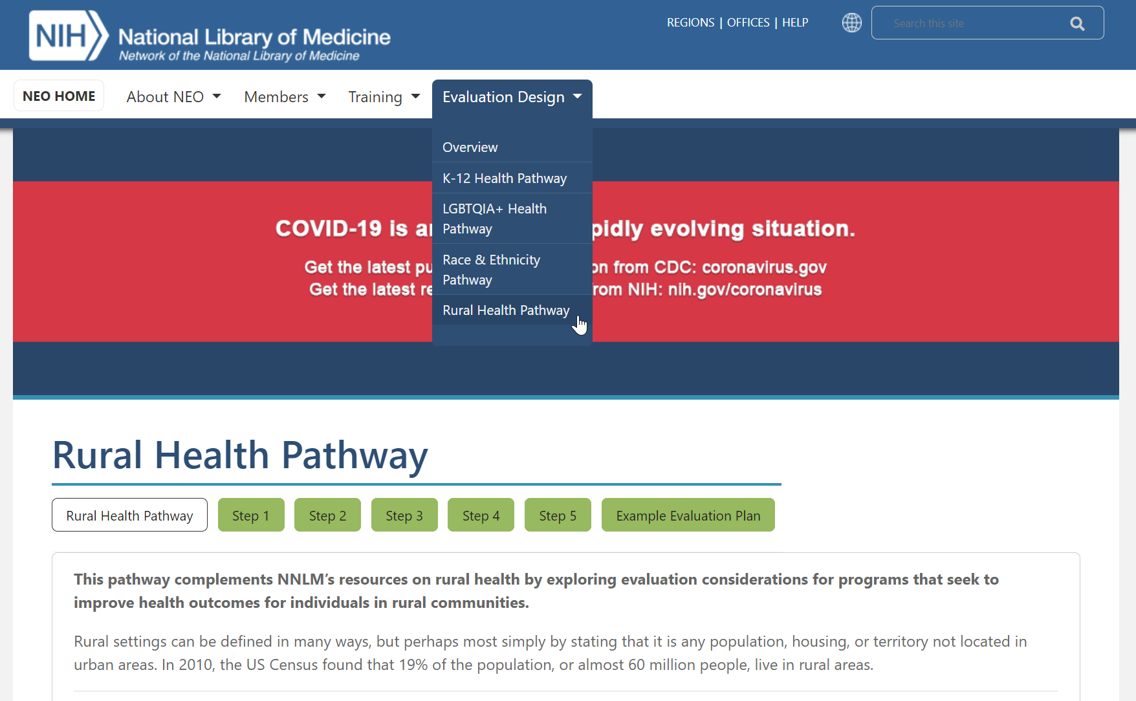
Website
https://nnlm.gov/neo/guides/rural-health-pathway
Notes:
Each of the pathways includes topic-specific information, so I will highlight those elements before moving to the website. If you’d prefer to follow along on the site, Billi will share the link in the chat.
Dropdown menu options
Overview pathway- general evaluation info and resources, 5 steps
Case example- NNLM member wanting to learn more about general evaluation → click on overview to understand the basics
Case example- NNLM member wanting to learn about evaluation from the lens of one of the 4 sub-topics → first review the overview tab, learn about specific considerations of that subtopic by clicking on the corresponding label in the drop down

Slide 17
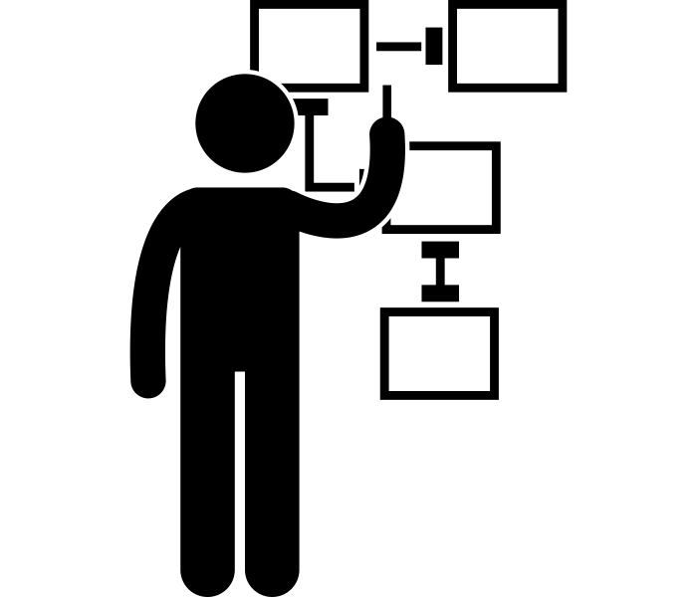
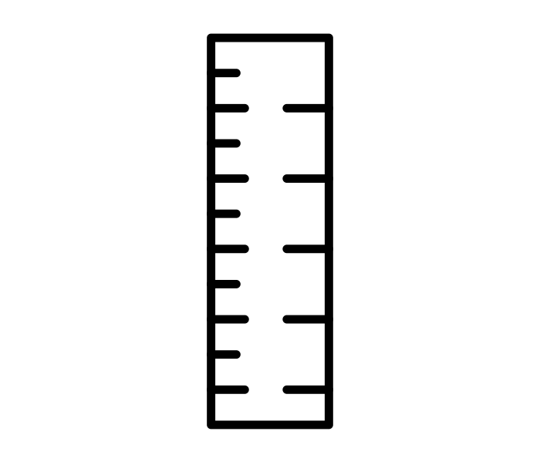
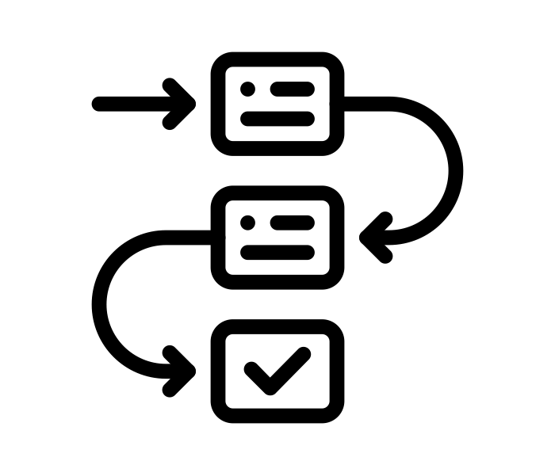
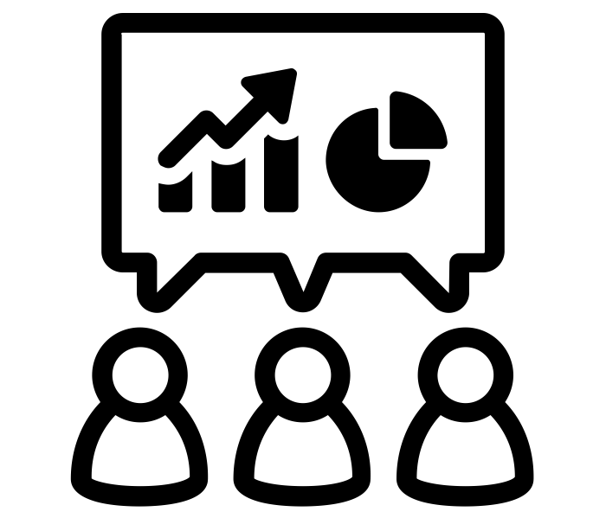
5 Steps to Evaluation
Step 1:
Do a Community Assessment
Step 2:
Make a Logic Model
Step 3:
Develop Indicators for your Logic Model
Step 4:
Create an Evaluation Plan
Step 5:
Collect Data, Analyze, and Act
On website:
Notes:
Evaluation design is broken down into 5 steps, which you can explore in detail using the “overview” tab or view the previously recorded webinar. Basic steps and worksheets are presented in the tabs above. While you are developing your evaluation plan, it is important to consider the context of your program.
Go through 5 steps one by one
Steps mirrored in the tabs that you see at the top of the website- screen shot at the bottom of this slide. You’ll also see that in addition to the 5 steps, there is a general “race and ethnicity” tab, and the example evaluation plan tab.
For the rest of the webinar we will walk through these “tabs” – starting with the rural health tab

Slide 18
Special Considerations
Introduction
Special Considerations
Access to Healthcare
Evaluate what level of access participants have to health services and information
When developing a sampling strategy, remember that issues with access may result in sampling some participant groups more than others
Review multiple dimensions of access
Social Determinants of Health & Health Disparities
Gather information on social determinants of health
Consider how health disparities change who and how participants engage in the program
Analyze data for each geographic location separately
Present health disparities from an equity lens
Health Literacy
Consider how health literacy level can change your program
Measure health literacy at the start of the program
Notes:
Rural health tab encompasses come general considerations
Evaluate what level of access participants have to health services and health information. The low-density populations of rural areas, combined with long distances to reach health services and providers, mean that residents in rural areas are more predisposed to issues with access compared to their urban counterparts.
Review multiple dimensions of access. Access includes not only whether the service or information is available or not, but also the ability to utilize the service. Finances and health insurance status, as well as transportation, broadband and internet access, and language barriers can all play a part in access.
When developing a sampling strategy, remember that issues with access may result in sampling some participant groups more than others. If you are seeking information that could be applied to the community as a whole, remember that you will have to sample the entire community, and not just those who have access to the program.

Slide 19
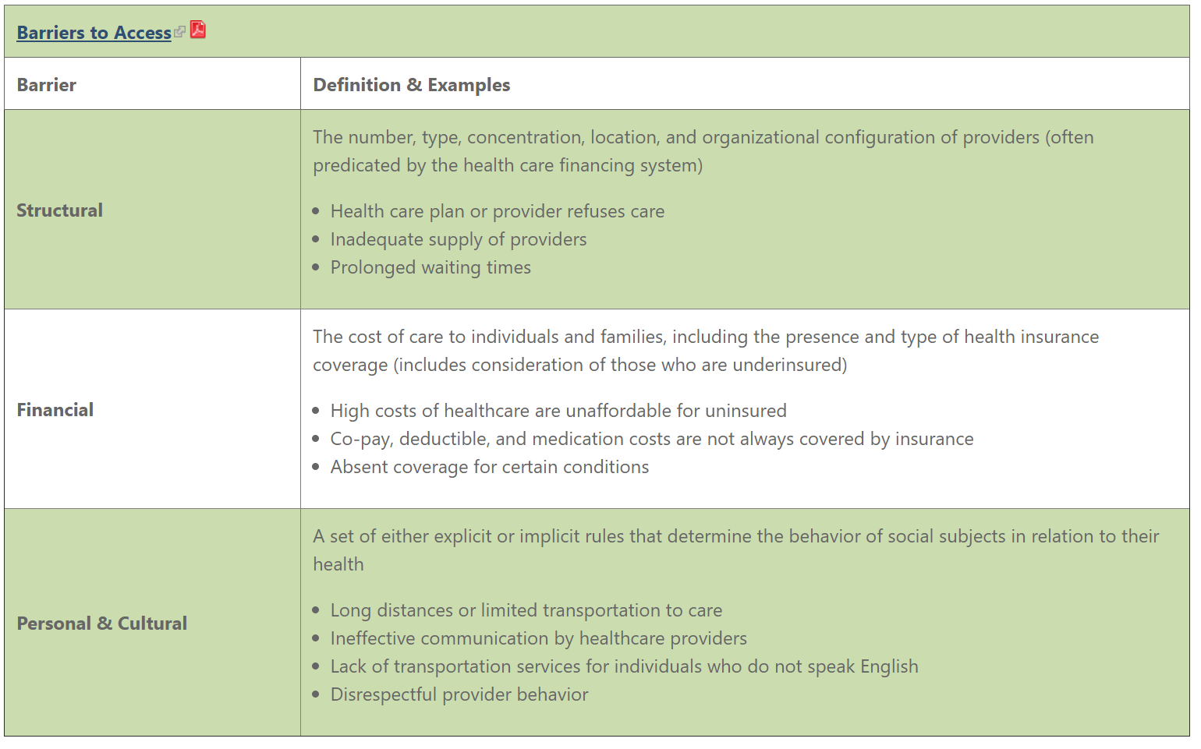
Barriers to access
Notes:
Rural health tab encompasses come general considerations
Evaluate what level of access participants have to health services and health information. The low-density populations of rural areas, combined with long distances to reach health services and providers, mean that residents in rural areas are more predisposed to issues with access compared to their urban counterparts.
Review multiple dimensions of access. Access includes not only whether the service or information is available or not, but also the ability to utilize the service. Finances and health insurance status, as well as transportation, broadband and internet access, and language barriers can all play a part in access.
When developing a sampling strategy, remember that issues with access may result in sampling some participant groups more than others. If you are seeking information that could be applied to the community as a whole, remember that you will have to sample the entire community, and not just those who have access to the program.

Slide 20
Special considerations: Social Determinants of Health & Health Disparities
Introduction
Special Considerations
Access to Healthcare
Evaluate what level of access participants have to health services and information
When developing a sampling strategy, remember that issues with access may result in sampling some participant groups more than others
Review multiple dimensions of access
Social Determinants of Health & Health Disparities
Gather information on social determinants of health
Consider how health disparities change who and how participants engage in the program
Analyze data for each geographic location separately
Present health disparities from an equity lens
Health Literacy
Consider how health literacy level can change your program
Measure health literacy at the start of the program
Notes:
Rural health tab encompasses come general considerations
Social determinants of health are the broad social, economic, and institutional circumstances that influence health throughout the life course
Gather information on social determinants of health.(link is external) The National Advisory Committee on Rural Health and Human Services advises that in order to improve health and quality of life in rural areas, policy makers should consider the social determinants of health of geography; wealth, income and poverty; education and labor markets; and transportation.
Consider how health disparities change who and how participants engage in the program. Health disparities are evident in rural populations, because of the complex systemic issues related to the social determinants of health. For example, from 1999-2014, the rates of death of all five leading causes of death in the United States were higher in rural areas than in urban areas.
Analyze data on health disparities and social determinants of health separately for each geographic location. When evaluating across multiple geographic areas, remember that social determinants of health and health disparities may be different for each area. Some areas, such as Appalachia, the US-Mexico Border, and American Indian and Alaska Native communities, have larger health disparities than other rural areas.
Present health disparities from an equity lens. Health disparities are the result of complex systemic and structural inequities, rather than qualities inherent to a group of individuals. When examining and communicating health disparities through a lens of equity, one should recognize the issues leading to the disparities, including the social determinants of health.

Slide 21
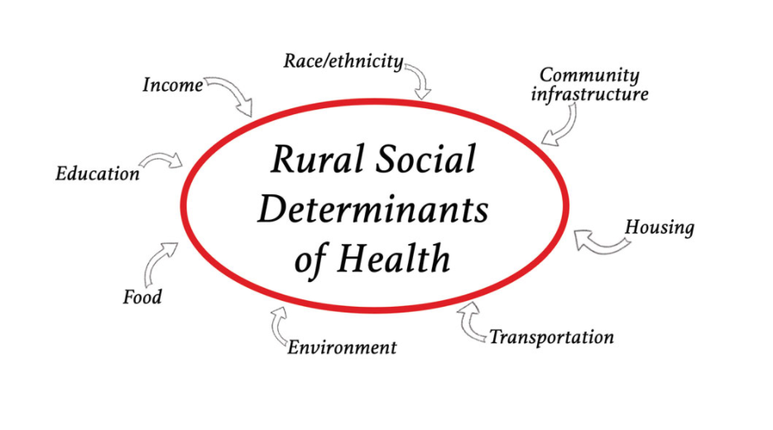
Rural social determinants of health
Notes:
Rural health tab encompasses come general considerations
By Dr. Kay Miller Temple → include visuals throughout the pathway to help engage readers and provide background to important concepts

Slide 22
Special Considerations: health literacy
Introduction
Special Considerations
Access to Healthcare
Evaluate what level of access participants have to health services and information
When developing a sampling strategy, remember that issues with access may result in sampling some participant groups more than others
Review multiple dimensions of access
Social Determinants of Health & Health Disparities
Gather information on social determinants of health
Consider how health disparities change who and how participants engage in the program
Analyze data for each geographic location separately
Present health disparities from an equity lens
Health Literacy
Consider how health literacy level can change your program
Measure health literacy at the start of the program
Notes:
Rural health tab encompasses come general considerations
Consider how health literacy levels change your program. A higher proportion of residents of rural areas have lower health literacy than urban areas, which can be explained by differences in age, gender, race, ethnicity, education and income between rural and urban populations.
Measure health literacy at the start of the program. Health literacy has been shown to change the success of programs and should be measured at the start of the program to see if it could affect program outcomes.

Slide 23
Step 1
Step 1:
Do a Community Assessment
On website:
Notes:
Evaluation design is broken down into 5 steps, which you can explore in detail using NEO’s Evaluation Booklets. Basic steps and worksheets are presented in the tabs above. While you are developing your evaluation plan, it is important to consider the context of your program. The context can change how your evaluation is designed and implemented, because different settings and populations have different needs and abilities to participate in evaluations. Considering this, the 5 steps are applied across 4 common populations (K-12 Health, Rural Health, Race & Ethnicity, and LGBTQIA+ Health) in pathways.

Slide 24
Do a Community Assessment: part 1
Step 1:
Do a Community Assessment
WHAT: A community assessment is a study of the community
WHY: helps you determine the health information needs of the community, the community resources that would support your project, and information to guide you in your choice and design of outreach strategies.
Get Organized
Gather Information
Assemble, Interpret, and Act on your findings
Ultimately:
Learn about the community, key stakeholders, and their needs.
Notes:
Get Organized
This phase includes outreach, background research, networking, reflecting on the evaluation and program goals, and formulating evaluation questions.
Conduct a stakeholder analysis to identify individuals or groups who are particularly proactive or involved in the community. Find out why they are involved, what is going well in their community, and what they would like to see improved.
Community - Organizations providing enrichment activities, workplaces for youth, places of worship, libraries, etc.

Slide 25
Get organized
Step 1:
Do a Community Assessment
Get Organized
This phase includes outreach, background research, networking, reflecting on the evaluation and program goals, and formulating evaluation questions.
Participatory Evaluation Methods
Program participants play and active role in every step of the evaluation process, including decision making
Stakeholder Analysis
Consider identifying early adopters among rural health stakeholders.
‘Positive Deviance’ method
Note this process is time and labor intensive.
May not be feasible within the time constraints of the typical NNLM-funded project.
Notes:
Get Organized
This phase includes outreach, background research, networking, reflecting on the evaluation and program goals, and formulating evaluation questions.
Conduct a stakeholder analysis to identify individuals or groups who are particularly proactive or involved in the community. Find out why they are involved, what is going well in their community, and what they would like to see improved.
In rural health settings, participatory evaluation (program participants play an active role in every step of the evaluation process) methods can help to improve the relevance and visibility of the community assessment.

Slide 26
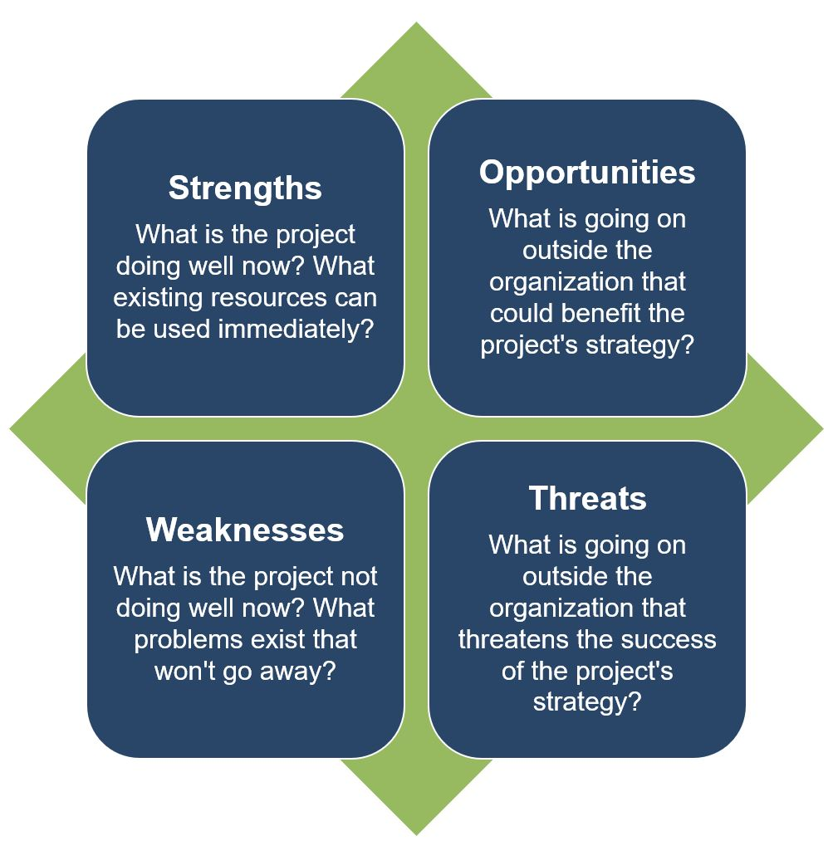
swot analysis
Step 1:
Do a Community Assessment
Get Organized
SWOT analysis
assess an organization or program's internal strengths and weaknesses opportunities
Assess threats to the organization or program in the external community.
Notes:
Use the Positive Deviance (PD) (link is external) approach to identify these early adopters.
More information on Positive Deviance
Please note this process is time and labor intensive and requires a skilled facilitator comfortable with ambiguity and uncertainty. This process may not be feasible within the time constraints of the typical NNLM-funded project.

Slide 27
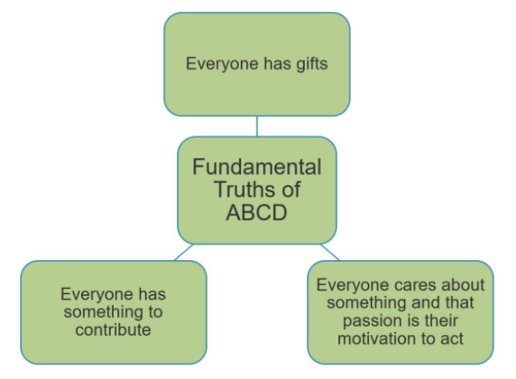
Gather information
Step 1:
Do a Community Assessment
Gather Information
This phase includes gathering data from different external and internal sources to inform the development of your program and evaluation plan.
Asset Based Community Development (ABCD) Mapping
Participatory Approach
Asset mapping is used to:
Identify individual and community gifts and assets
Stimulate discussion and planning
Connect individual community members
Link to Asset Based Community Development Institute
Notes:
Asset-based community development (ABCD) mapping approaches can be used to assess the resources available in a community and focus on participatory involvement of community members and organizations.
In general, asset mapping is used to identify individual and community gifts and assets, stimulate discussion and planning, and connect individual community members.
Guidance and resources on ABCD are available through the Asset Based Community Development Institute(link is external)

Slide 28
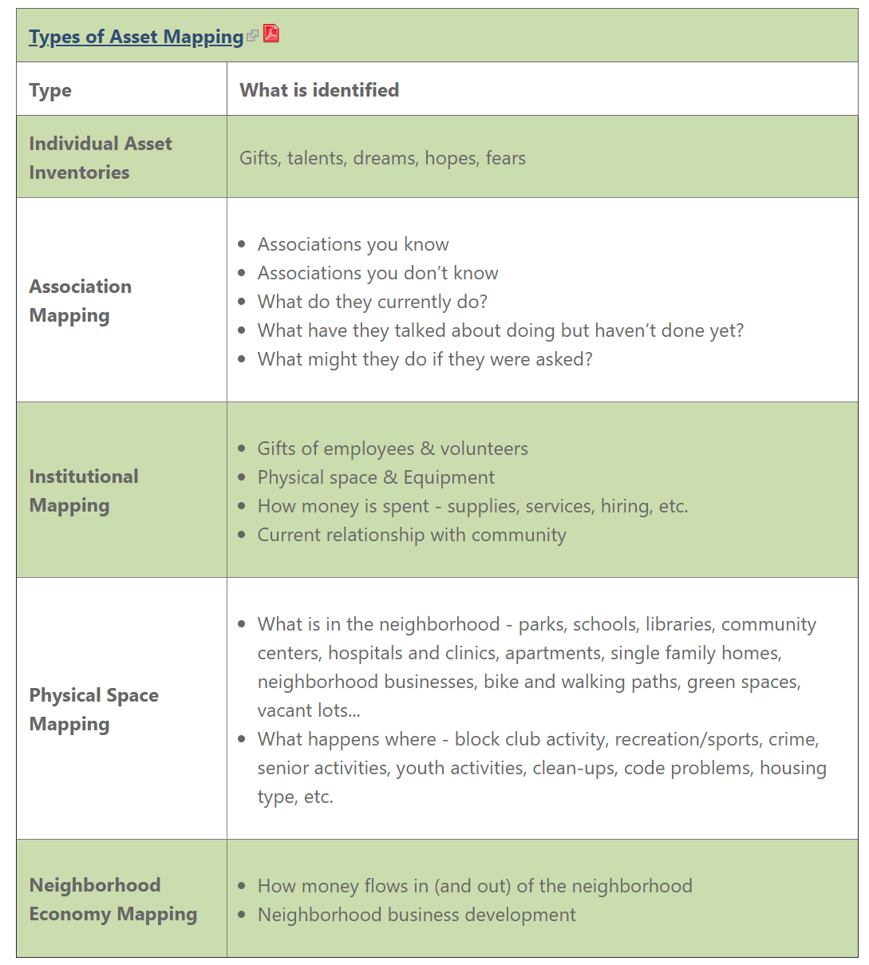
Types of asset mapping
Step 1:
Do a Community Assessment
Notes:
Asset-based community development (ABCD) mapping approaches can be used to assess the resources available in a community and focus on participatory involvement of community members and organizations.
In general, asset mapping is used to identify individual and community gifts and assets, stimulate discussion and planning, and connect individual community members.
Guidance and resources on ABCD are available through the Asset Based Community Development Institute(link is external)

Slide 29
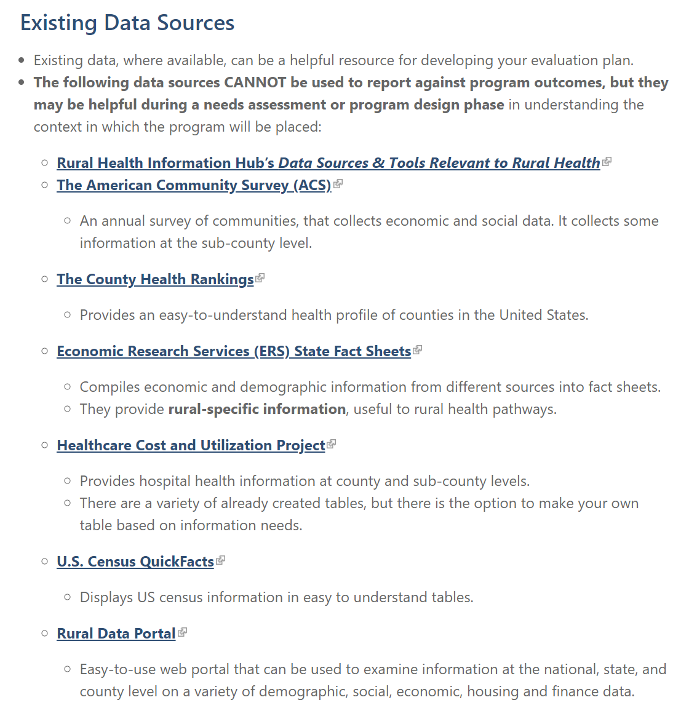
Existing data sources
Step 1:
Do a Community Assessment
Gather Information
Existing Data Sources – useful for needs assessment or program design phase
The data sources CANNOT be used to report against program outcomes
They may be helpful during a needs assessment or program design phase
Example: Want to learn what percentage of households have a computer at home in Baca County, Colorado
US Census QuickFacts
Notes:
Existing data, where available, can be a helpful resource for developing your evaluation plan.
The following data sources CANNOT be used to report against program outcomes, but they may be helpful during a needs assessment or program design phase in understanding the context in which the program will be placed:
Want to learn what percentage of households have a computer at home in Baca County, Colorado
US Census QuickFacts

Slide 30
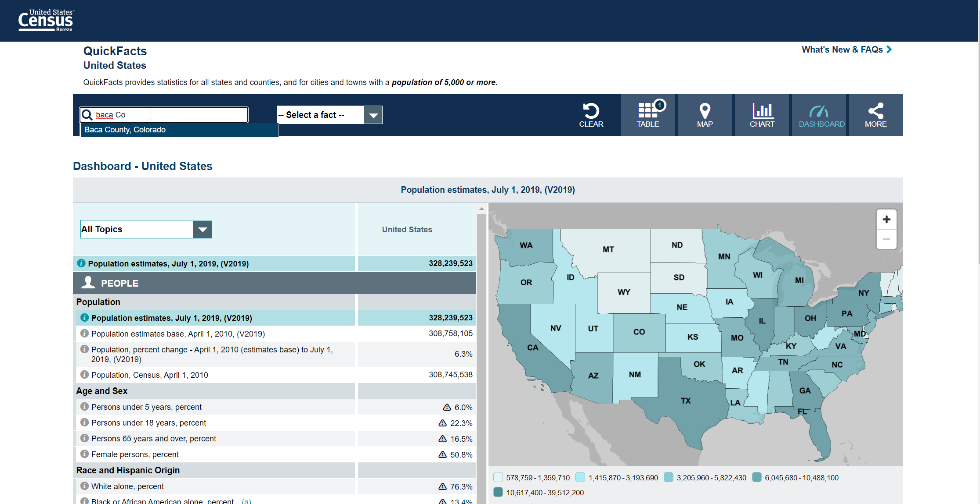
United states census
1
2
Notes:
Which will look like this when we pull it up. We would type in baca county, Colorado, choose how I want the information presented

Slide 31
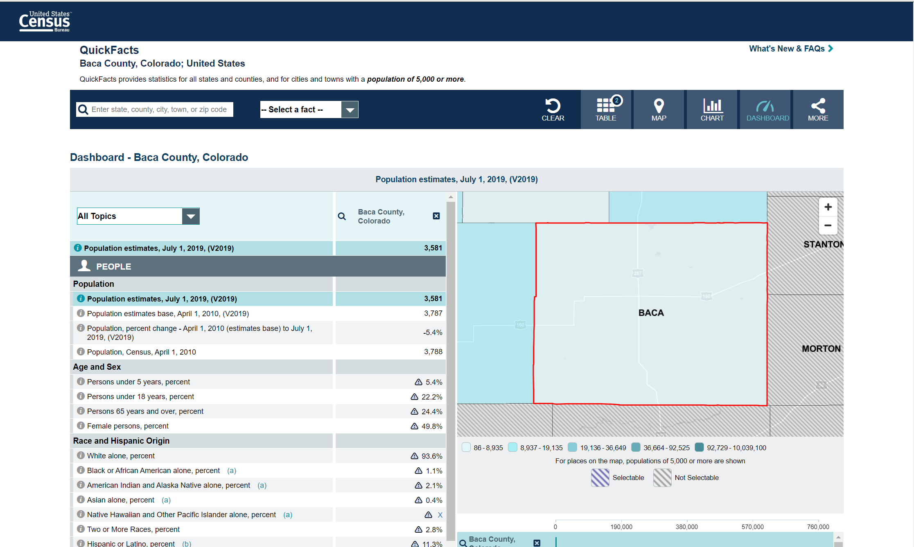
Census quick facts
Notes:
Dashboard page

Slide 32
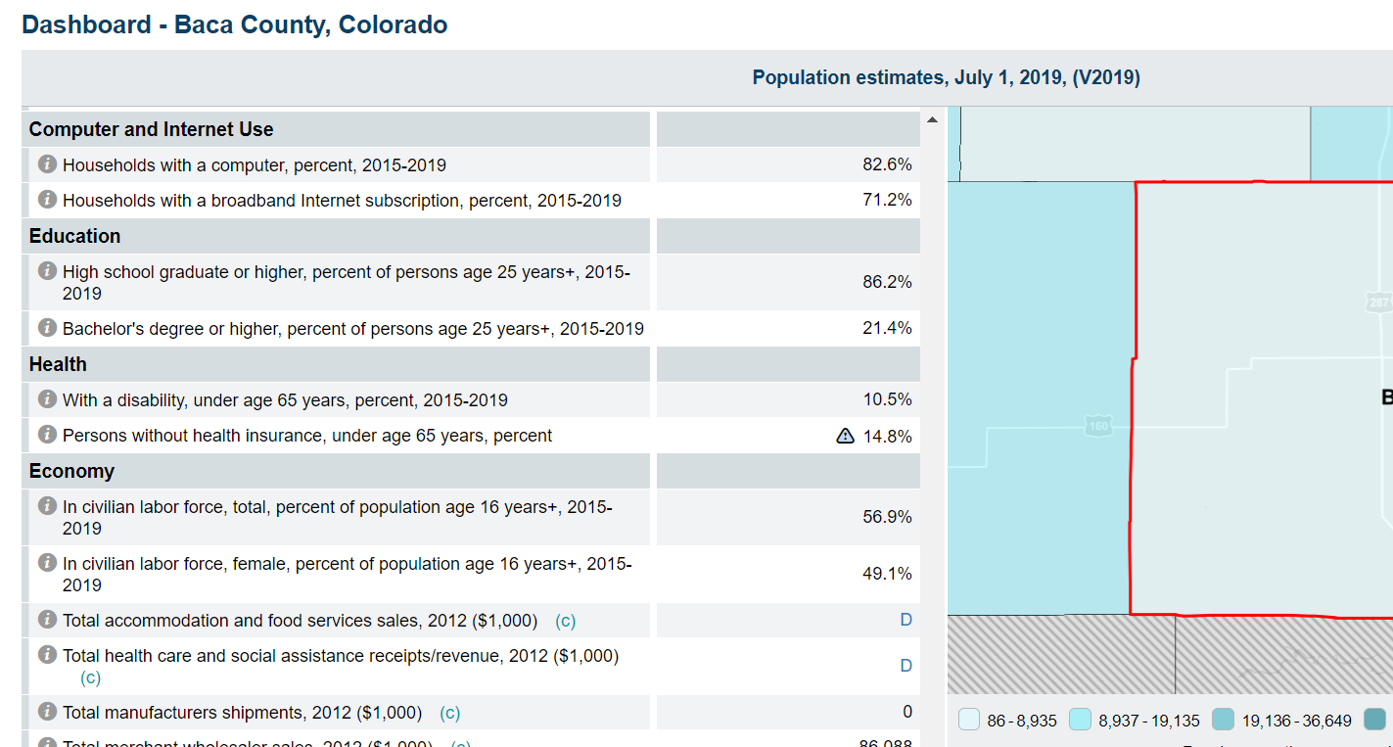
Census dashboard
Notes:
Scroll to find computer and internet use section- see that 82.6% of HH have computer, but only 71.2% have internet- large part of the population would be finding internet outside of house or mobile phones- may go to the library

Slide 33
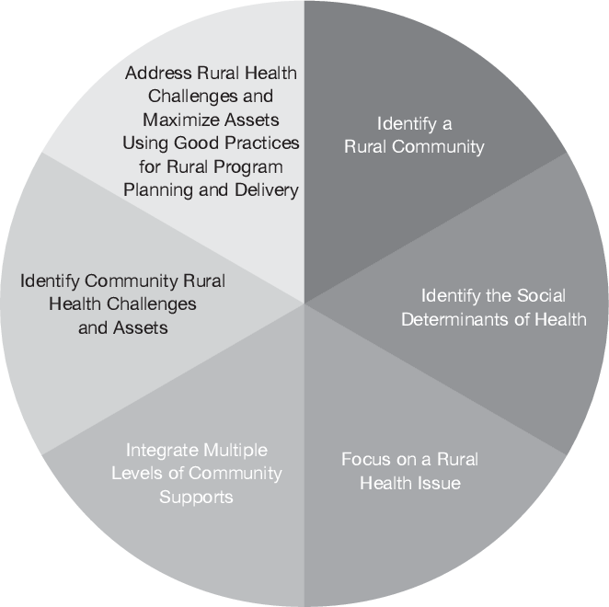
Assemble, Interpret, Act
Step 1:
Do a Community Assessment
Assemble, Interpret, Act
This phase includes processing the information gathered into understandable takeaways that can be used for the program and the evaluation
Deanna White’s Framework for rural health population programming planning and delivery.
Your community assessment can help to inform the different dimensions of the framework.
Notes:
Deanna White developed a framework(link is external) for rural health population programming planning and delivery. She emphasizes throughout the article the importance of gathering evidence to clarify and define the program.Your community assessment can help to inform the different dimensions of the framework.

Slide 34
Step 2
Step 2:
Make a Logic Model
On website:
Notes:
Evaluation design is broken down into 5 steps, which you can explore in detail using NEO’s Evaluation Booklets. Basic steps and worksheets are presented in the tabs above. While you are developing your evaluation plan, it is important to consider the context of your program. The context can change how your evaluation is designed and implemented, because different settings and populations have different needs and abilities to participate in evaluations. Considering this, the 5 steps are applied across 4 common populations (K-12 Health, Rural Health, Race & Ethnicity, and LGBTQIA+ Health) in pathways.

Slide 35
Make a Logic Model
WHAT: a diagram detailing how change occurs in the program/project
WHY: helpful for planning a program, implementing a program, monitoring the progress of a program, and evaluating the success of a program.
Step 2:
Make a Logic Model
Ask stakeholders and community members to review your logic model
Consider how change occurs across the logic model
Be careful of assumptions that blame a person or community, and don’t account for structural or systemic issues
Notes:
Consider how the program's logic model will assist in determining what is, or is not, working in the program's design to achieve the desired results.
Since access can change how rural populations interact with programs, consider how to include program growth and reach in your logic model. Including logical steps on how the program reaches the right people, at the right time can help clarify program coverage.
Be open to new and alternative patterns in your logic model. Have stakeholders and community members review your logic model, paying particular care to how change occurs across the logic model. Listen to voices who can say whether the strategies are beneficial, and whether strategies could be successful.
More information on Logic Models
Example Rural Health Logic Model
Tearless Logic Model
To facilitate the creation of the logic model, community-based organizations can consider using the Tearless Logic Model process(link is external).
The Tearless Logic Model uses a series of questions to assist non-evaluators in completing the components of the logic model. Questions used in the Tearless Logic Model

Slide 36
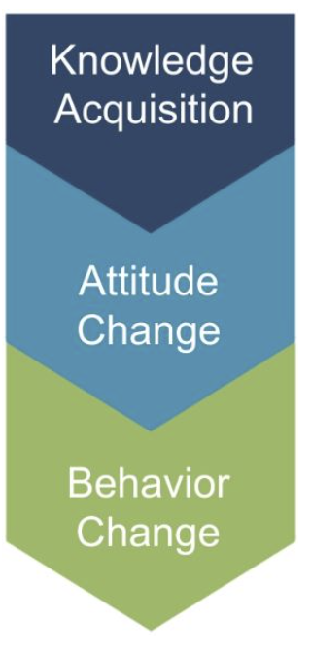
The logic model: knowledge, attitudes, and behaviors
Step 2:
Make a Logic Model
The logic model:
knowledge, attitudes, and behaviors
Knowledge Acquisition
What is the program trying to teach or show program participants?
What understanding would a program participant gain over the course of the program? Often knowledge acquisition occurs as a short-term outcome of the program.
In rural settings, it is important to consider how individuals will gain knowledge
It is important to consider the starting level of health literacy as this can affect more the downstream outcomes (attitude and behavior change).
Notes:
Programming should consider improvement in the knowledge-attitude-behavior continuum among program participants as a measure of success. The process of influencing health behavior through information, followed by attitude changes and subsequent behavior change, should be documented in the logic model.
knowledge Acquisition:
What is the program trying to teach or show program participants?
What understanding would a program participant gain over the course of the program? Often knowledge acquisition occurs as a short-term outcome of the program.
Be sure to examine not only what is learned, but where, when, and how program participants will learn it.
In rural settings, it is important to consider how individuals will gain knowledge, as the distances from residences, health literacy levels, and social determinants of health can often hinder knowledge acquisition.
It is important to consider the starting level of health literacy as this can affect more the downstream outcomes (attitude and behavior change).

Slide 37
knowledge-attitude-behavior continuum
Step 2:
Make a Logic Model
The logic model:
knowledge, attitudes, and behaviors
Knowledge Acquisition
Attitude Change
What mindsets or beliefs are the program seeking to build or change? Be sure to consider cultural differences in attitudes in the community you are working with.
Are there misconceptions about the topic or health information, and does that belief change after the program has been implemented?
To what extent do participants agree or disagree with statements related to the new material presented?
Notes:
Programming should consider improvement in the knowledge-attitude-behavior continuum among program participants as a measure of success. The process of influencing health behavior through information, followed by attitude changes and subsequent behavior change, should be documented in the logic model.
What mindsets or beliefs(link is external) are the program seeking to build or change? Be sure to consider cultural differences in attitudes in the community you are working with.
Are there misconceptions about the topic or health information, and does that belief change after the program has been implemented?
To what extent do participants agree or disagree with statements related to the program?

Slide 38
Behavior Change
Step 2:
Make a Logic Model
The logic model:
knowledge, attitudes, and behaviors
Knowledge Acquisition
Attitude Change
Behavior Change
Are the actions of program participants different than what would have been expected without the program?
Health information outreach programs will likely focus on changing information seeking practices, rather than health practices.
In rural health settings, behavior change information may be captured in reports from health facilities or may be already collected by government or non-government agencies.
Notes:
Programming should consider improvement in the knowledge-attitude-behavior continuum among program participants as a measure of success. The process of influencing health behavior through information, followed by attitude changes and subsequent behavior change, should be documented in the logic model.
When examining previously collected data, consider whether it was collected from the same target population as the program you are evaluating, and over the same time frame as the program.
Note that most NNLM projects focus on the dissemination of health information/health education and often do not take place over a long enough period of time to observe behavior change.
As such, examining/measuring behavior change may be out of the scope of the NNLM-funded project unless the projects runs for multiple cycles over an extended period of time.

Slide 39
Step 3
Step 3:
Develop Indicators for your Logic Model
On website:
Notes:
Evaluation design is broken down into 5 steps, which you can explore in detail using NEO’s Evaluation Booklets. Basic steps and worksheets are presented in the tabs above. While you are developing your evaluation plan, it is important to consider the context of your program. The context can change how your evaluation is designed and implemented, because different settings and populations have different needs and abilities to participate in evaluations. Considering this, the 5 steps are applied across 4 common populations (K-12 Health, Rural Health, Race & Ethnicity, and LGBTQIA+ Health) in pathways.

Slide 40
Develop Indicators for your Logic Model: part 1
WHAT: An indicator is a marker of accomplishment and/or progress- a way of measuring changes made by your program
WHY: To understand the way that change is happening, across your logic model from inputs to impact
Step 3:
Develop Indicators for your Logic Model
How do you develop appropriate indicators?
Involve your program stakeholders in indicator development.
Review your logic model as a template to develop indicators.
Review indicators to ensure they are specific, observable, and measurable.
Include baseline data for inputs and outcomes if you are trying to measure change.
Determine whether indicators:
Provide useful information
Are feasible in terms of data availability and timely data collection
Notes:
Consider whether your outcomes are short-term, intermediate, or long-termMost NNLM projects are of short duration and should focus only on short-term or intermediate outcomes.
It may be necessary to use more than one indicator to cover all elements of a single outcome.If possible, use multiple indicators to measure important outcomes.How to develop measurable indicatorsExample Rural Health Measurable Indicators

Slide 41
Develop Indicators for your Logic Model: part 2
Step 3:
Develop Indicators for your Logic Model
Indicators are observable signs of your outcomes and will help you measure your achievement. Identify indicators that align to the outcomes in your logic model. Tracking these indicators over time will help you reflect upon your progress and help you collect and show results.
Key Elements of an Indicator | Example
Specific | Youth who make healthy choices Youth aged 13-18 who report including vegetables as part of at least one meal daily
Observable | Library staff who can identify health protective factors The proportion of library staff who can list at least two health protective factors
Measurable | Quantifies change and generally reported in numerical terms, such as counts, percentages, proportions, or ratios
Notes:
When developing indicators, seek to accurately capture the experiences of the people that you are working with. Consider the applicability of the indicators, and the way biases, assumptions, and discrimination may alter how they reflect reality.
Indicators examining changes from programs working with specific races or ethnicities should consider that an individual’s perception of race can change how they report on specific indicators.
When developing indicators, try to avoid wording indicators in a way that prompts implicit biases.
Think through if there are multiple ways to measure the indicator, and avoid indicators that require people to rate or describe other people, including their intelligence or abilities.
Use lessons learned from the community assessment to make indicators respectful and mindful of the dynamics of race and ethnicity.
Standard assessments of mental or physiological state may not accurately reflect the experiences of Black, Indigenous and People of Color. Do not assume cross-cultural relevance of indicators, without checking the research or discussing your indicators with the community you are working with.
Programs seeking to cause social change should consider that changes to norms, structures, and systems takes considerable time. Consider how to measure incremental change, capturing a step towards a more wide-spread outcome.

Slide 42
Healthy People 2030 Leading Health Indicators
Step 3:
Develop Indicators for your Logic Model
Healthy People 2030 Leading Health Indicators

Slide 43
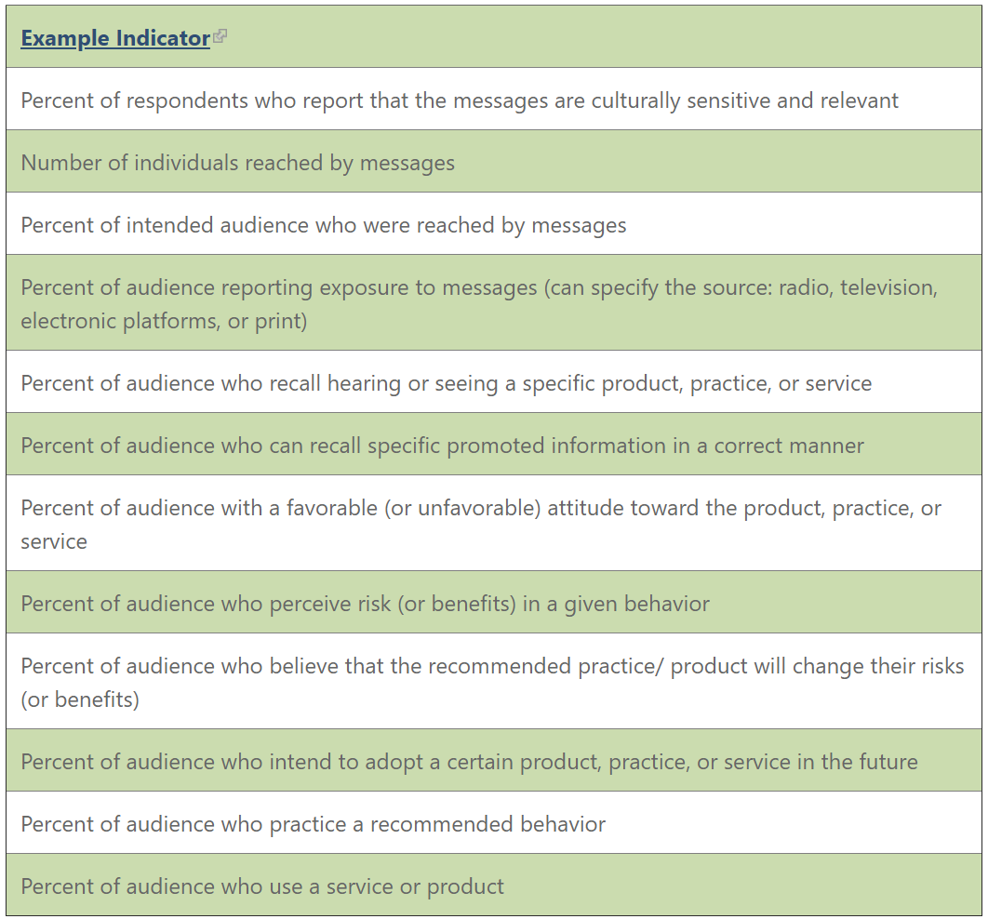
Social & Behavior Change Communication Example Indicators
Social & Behavior Change Communication Example Indicators
Step 3:
Develop Indicators for your Logic Model

Slide 44
Demographic Data
Step 3:
Develop Indicators for your Logic Model
Demographic Data
Collect data on demographics
During analysis, compare differences in backgrounds against outcomes results
Source: City Health Dashboard
Notes:
Collect data on demographics as part of your survey process. It is important to understand your participants' backgrounds and how that may affect their engagement with your program.
During analysis, compare differences in backgrounds against outcome results. If there are gaps identified in reaching certain populations, consider adjustments to program implementation to serve all participants equitably.
For example, we can look at the city health dashboard for the % of people who are uninsured in seattle. Although this is an Urban location, it illustrates the importance of collecting demographic data. Here we see it is about 5.2%

Slide 45
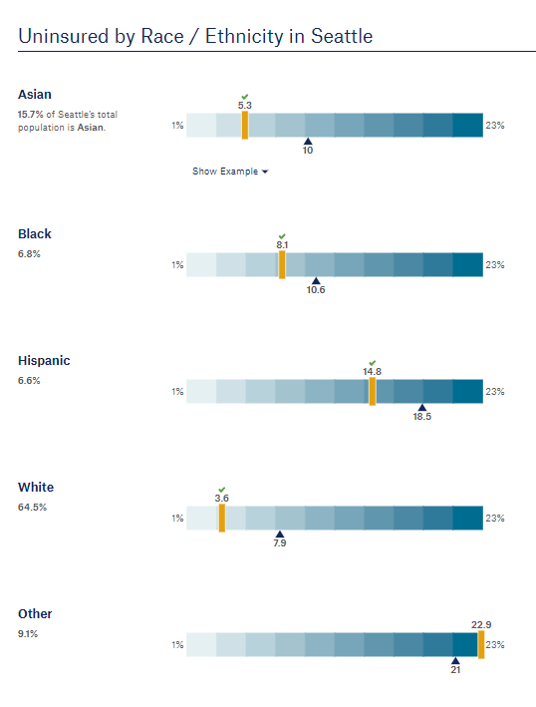
% uninsured by race/ethnicity
Step 3:
Develop Indicators for your Logic Model
Source: City Health Dashboard
Notes:
However if we look at the % uninsured by race/ethnicity, we see a very different picture. We see that white individuals have a lower uninsured rate, while Asian individuals have around the same rate at the overall city rate, while Black and Hispanic individuals have a higher rate, and “other” (which I recommend further breaking down other into the races or ethnicities that it represents) is even higher.

Slide 46
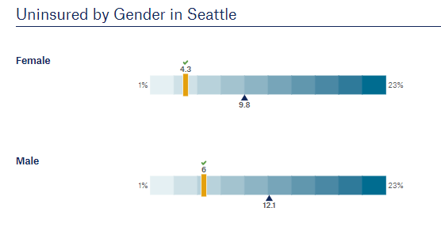
uninsured by gender
Step 3:
Develop Indicators for your Logic Model
Source: City Health Dashboard
Notes:
We can also see differences if we look and uninsured by gender, here defined as female and male (female lower, male higher)

Slide 47
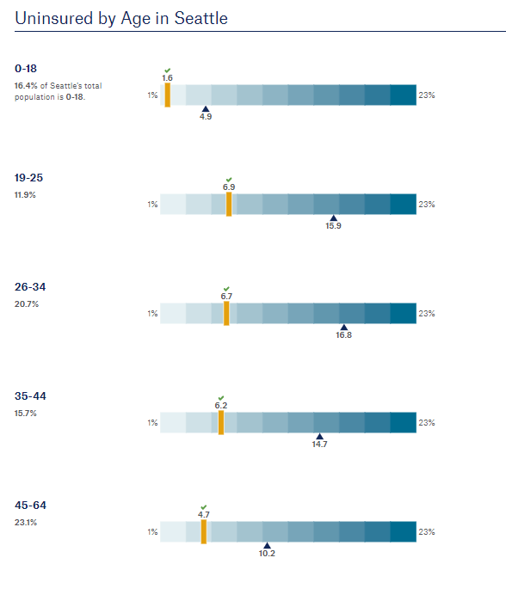
uninsured by age
Step 3:
Develop Indicators for your Logic Model
Source: City Health Dashboard
Notes:
And even differences when looking at different age groups

Slide 48
Step 4
Step 4:
Create an Evaluation Plan
On website:
Notes:
Evaluation design is broken down into 5 steps, which you can explore in detail using NEO’s Evaluation Booklets. Basic steps and worksheets are presented in the tabs above. While you are developing your evaluation plan, it is important to consider the context of your program. The context can change how your evaluation is designed and implemented, because different settings and populations have different needs and abilities to participate in evaluations. Considering this, the 5 steps are applied across 4 common populations (K-12 Health, Rural Health, Race & Ethnicity, and LGBTQIA+ Health) in pathways.

Slide 49
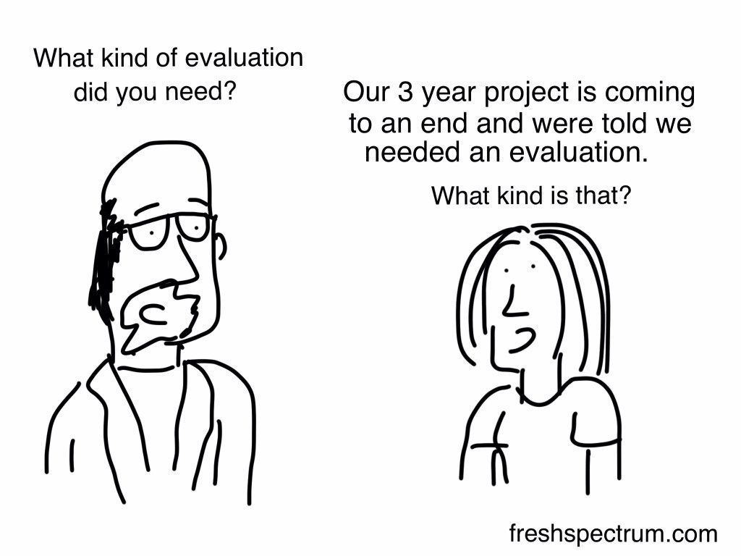
Create an Evaluation Plan
Step 4:
Create an Evaluation Plan
WHAT: An evaluation plan describes how the project will be evaluated. It articulates the purpose of the evaluation, evaluation questions, timetable, data collection tools, analysis framework, and a section articulating how data will be used and disseminated.
Define evaluation questions
Develop the evaluation design
Participatory Evaluation approach
Conduct an ethical review

Slide 50
Define evaluation questions
Step 4:
Create an Evaluation Plan
Define evaluation questions
Process questions:
Did we do what we said we were going to do?
Ex: Were all four information corners set up as planned?
Who, what, when, and how many related to program inputs, activities and outputs.
Ex: What percentage of visitors to the library interact with the information corners?
Outcome questions:
Are we accomplishing the WHY of what we wanted to do?
Did we achieve the changes or impact we wanted to see?
Ex: By the end of the program, Did Health Know-How change the level of health literacy among library patrons?
Ex: At the end of the program, did program participants’ knowledge of health topics change?
Notes:
Evaluation questions help define what to measure and provide clarity and direction to the project.
Process questions relate to the implementation of the program and ask questions about the input, activities, and outputs columns of the logic mode
Outcome questions relate to the effects of the program and relate to the short, intermediate, and long-term columns of the logic model.
Culturally responsive evaluation questions value a diversity of perspectives. Inclusion of a diversity of perspectives in your evaluation questions help to drive your evaluation towards a fair assessment of the program.
Try to anticipate how the answers to your questions will be utilized and interpreted, and whether the answers to your questions will best reflect the lives of the participants in your program. Avoid phrasing questions in a way that compares groups to a single cultural standard.
Since culture is responsible for interpreting what is “normal,” a question that seeks to measure and normalize a pattern or behavior should include the racial and/or ethnic perspectives of your program participants.

Slide 51
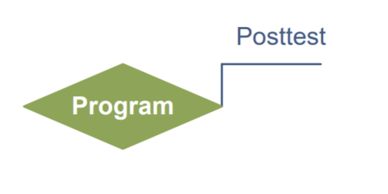
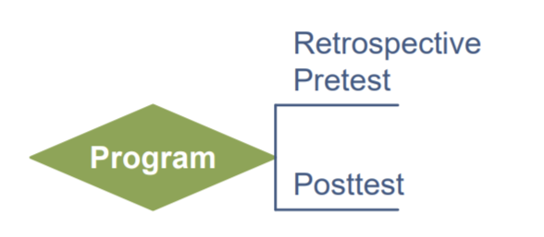
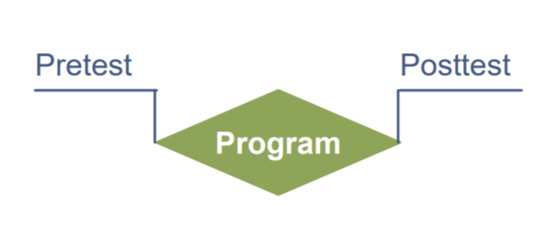
Evaluation Design part 1
Step 4:
Create an Evaluation Plan
Evaluation Design
How an evaluation will gather data to answer the evaluation questions
Posttest only
Retrospective Pre & Posttest
Pre & Posttest
Notes:
Evaluation design influences the validity of the results. Most NNLM grant projects will use a non-experimental or quasi-experimental design. Quasi-experimental evaluations include surveys of a comparison group - individuals not participating in the program but with similar characteristics to the participants - to isolate the impact of the program from other external factors that may change attitudes or behaviors.
Non-experimental evaluations only survey program participants.
If comparison groups are part of your quasi-experimental design, use a 'do no harm' approach that makes the program available to those in the comparison group after the evaluation period has ended.
Our implicit biases can change how we design evaluations because they influence our fundamental beliefs of society and what is of value. Examining our internalized biases(link is external) can help clarify evaluation goals, indicators of change, and put into sharper focus what we perceive to be the dominance or inferiority of the communities we are working with.

Slide 52
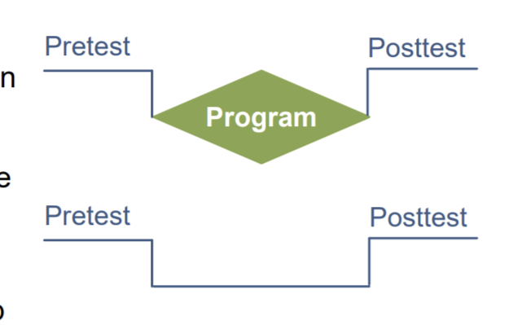
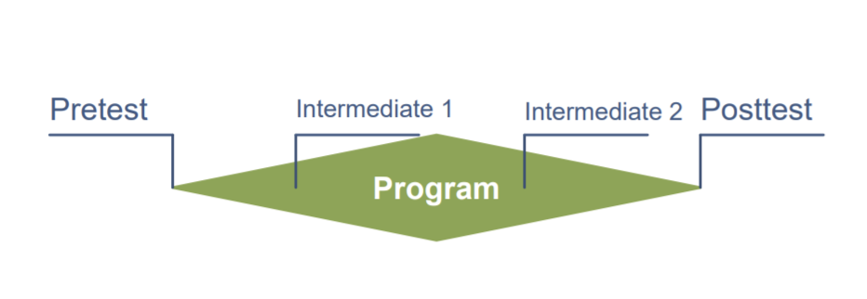
Evaluation Design Part 2
Step 4:
Create an Evaluation Plan
Evaluation Design
Pre & Posttest with Comparison Group
Pre & Posttest with Follow-up
Intermediate Testing & Posttest
Notes:
Evaluation design influences the validity of the results. Most NNLM grant projects will use a non-experimental or quasi-experimental design. Quasi-experimental evaluations include surveys of a comparison group - individuals not participating in the program but with similar characteristics to the participants - to isolate the impact of the program from other external factors that may change attitudes or behaviors.
Non-experimental evaluations only survey program participants.
If comparison groups are part of your quasi-experimental design, use a 'do no harm' approach that makes the program available to those in the comparison group after the evaluation period has ended.
Our implicit biases can change how we design evaluations because they influence our fundamental beliefs of society and what is of value. Examining our internalized biases(link is external) can help clarify evaluation goals, indicators of change, and put into sharper focus what we perceive to be the dominance or inferiority of the communities we are working with.

Slide 53
Evaluation Design Part 3
Step 4:
Create an Evaluation Plan
Notes:
This is a great opportunity to talk about another feature we have worked into the website. Throughout the pathways you will see the red pdf icons next to underlined text. This is where we have linked to pdfs that help to further explain concepts, like here for evaluation design.

Slide 54
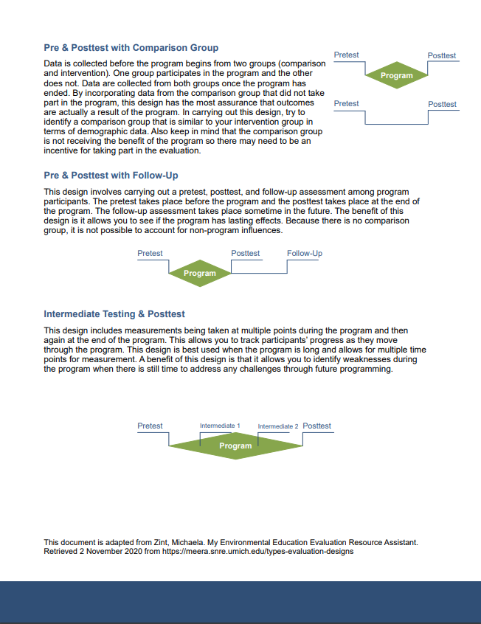
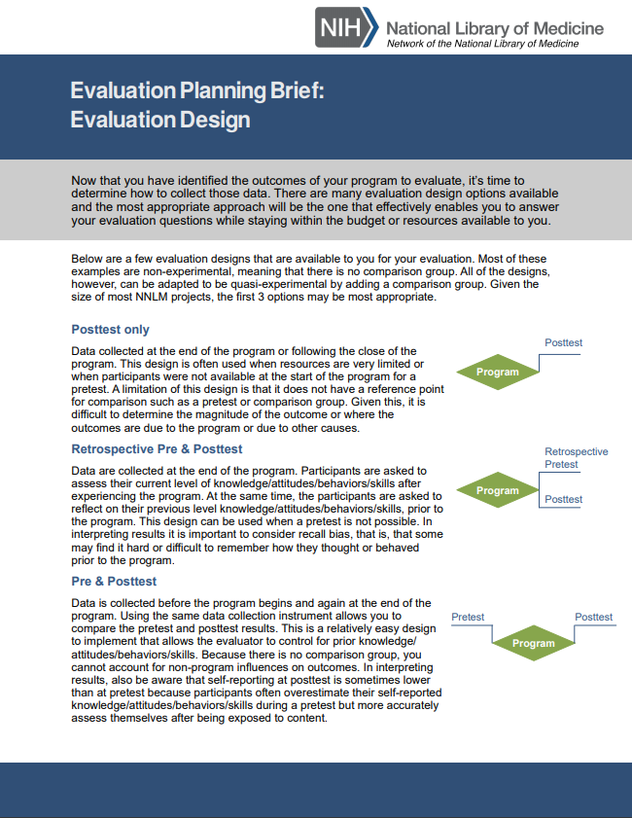
Evaluation design
Step 4:
Create an Evaluation Plan
Notes:
This is a great opportunity to talk about another feature we have worked into the website. Throughout the pathways you will see the red pdf icons next to underlined text. This is where we have linked to pdfs that help to further explain concepts, like here for evaluation design.
We created a series of briefs on evaluation planning, like the one seen sere on evaluation design. It covers in more detail the information we just covered here on the presentation- you don’t have to read the content of the brief, this is more to note that they are available to you

Slide 55
Indigenous Evaluation
Step 4:
Create an Evaluation Plan
Indigenous Evaluation
Useful to understand and use when you are evaluating a program working with indigenous or Native-American groups.
Indigenous evaluation is rooted in indigenous ways of knowing, interacting with others, and utilizes indigenous frameworks and cultural paradigms.
Different tribal communities have different cultures, and an approach that matches one context may not work in another. The community assessment can be helpful for determining if your approach meets the needs of the tribal community you are working with.
Notes:
Indigenous evaluation is useful to understand and use when you are evaluating a program working with indigenous or Native-American groups.
Indigenous evaluation is rooted in indigenous ways of knowing, interacting with others, and utilizes indigenous frameworks and cultural paradigms.
Different tribal communities have different cultures, and an approach that matches one context may not work in another. The community assessment can be helpful for determining if your approach meets the needs of the tribal community you are working with.

Slide 56
Ethical Review
Ethical Review
Consider the Belmont Report principles:
Respect for Persons
Consider if a health condition would change a participant’s ability to participate or opt out of the evaluation.
Translated versions of informed consent and data collection tools may need to be used.
Beneficence
If an individual has limited resources, you can increase the benefits they receive through monetary compensation or gifts.
In the process of completing the evaluation, consider if you are asking your participants to do things or use resources that they might not have easy access to.
Justice
In rural settings, it may be harder for some groups to receive benefits than others.
Consider how your evaluation would exacerbate or improve the distribution of benefits.
Factors that could change the distribution of benefits include the participant’s distance to the evaluation site, primary language, computer access, computer and health literacy skills, race and ethnicity, and income level.
Step 4:
Create an Evaluation Plan
Notes:
Consider the Belmont Report principles (link is external)
Respect for Persons:
It is important to consider if a health condition would change a participant’s ability to participate or opt out of the evaluation.
The primary language of a program participant can change whether they understand what is required of them for the evaluation. Translated versions of informed consent and data collection tools may need to be used.
Beneficence
If individuals have limited access to resources, it can affect how and if a participant engages with the benefits the evaluation and program provides. If an individual has limited resources, you can increase the benefits they receive through monetary compensation or gifts.
In the process of completing the evaluation, consider if you are asking your participants to do things or use resources that they might not have easy access to.
Justice
In rural settings, it may be harder for some groups to receive benefits than others.
Consider how your evaluation would exacerbate or improve the distribution of benefits.
Factors that could change the distribution of benefits include the participant’s distance to the evaluation site, primary language, computer access, computer and health literacy skills, race and ethnicity, and income level.

Slide 57
Trauma-Informed Evaluation
Step 4:
Create an Evaluation Plan
Ethical Review
Consider the Belmont Report principles:
Respect for Persons
Beneficence
Justice
Trauma-Informed Evaluation
If necessary for the evaluation to ask questions about potentially traumatic events, incorporate a trauma-informed approach.
Institutional Review Board
Administrative body established to protect the rights and welfare of human research subjects recruited to participate in research activities
Notes:
Asking someone about trauma is asking that person to recall potentially difficult events from their past.
If absolutely necessary for the evaluation to ask questions about potentially traumatic events, incorporate a trauma-informed approach to collect data in a sensitive way.
The Institutional Review Board (IRB) (link is external) is an administrative body established to protect the rights and welfare of human research subjects recruited to participate in research activities. The IRB is charged with the responsibility of reviewing all research, prior to its initiation (whether funded or not), involving human participants.
The IRB is concerned with protecting the welfare, rights, and privacy of human subjects.
The IRB has authority to approve, disapprove, monitor, and require modifications in all research activities that fall within its jurisdiction as specified by both the federal regulations and institutional policy.
Contact information to locate local IRB on website

Slide 58
Step 5
Step 5:
Collect Data, Analyze, and Act
On website:
Notes:
Evaluation design is broken down into 5 steps, which you can explore in detail using NEO’s Evaluation Booklets. Basic steps and worksheets are presented in the tabs above. While you are developing your evaluation plan, it is important to consider the context of your program. The context can change how your evaluation is designed and implemented, because different settings and populations have different needs and abilities to participate in evaluations. Considering this, the 5 steps are applied across 4 common populations (K-12 Health, Rural Health, Race & Ethnicity, and LGBTQIA+ Health) in pathways.

Slide 59
reflect upon what you have learned
Step 5:
Collect Data, analyze, and act
This is the time to reflect upon what you have learned, gather insights, and inform programming improvements.
Collect data according to your evaluation design (before, during, and/pr after your program has completed)
Complete analysis after the completion of data collection
Act upon your analysis by sharing evaluation results with stakeholders, and if needed, adapt future iterations of your program to address gaps identified through the evaluation.

Slide 60
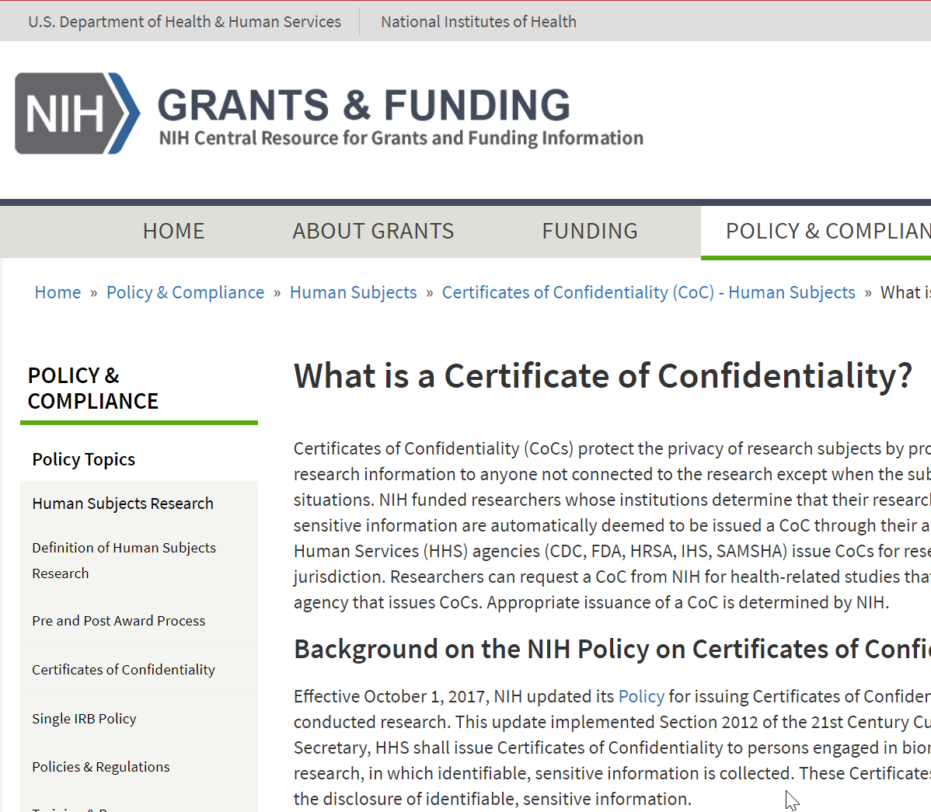
Collect Data
Collect Data
Ensure the privacy and confidentiality of all participants
Seek Consent from all evaluation participants
Consider how you will secure data collected to protect sensitive information
Password protected
If you are collecting information on illegal behaviors, such as recreational drug use, a confidentiality certificate can be used to protect sensitive information gathered from participants.
Step 5:
Collect Data, analyze, and act
Notes:
Collect Data
Ensure the privacy and confidentiality of all participants.
Select a sampling strategy that will allow for reporting on program outcomes.
Consider whether quantitative and/or qualitative data collection methods are appropriate for reporting on program outcomes.
Privacy/Confidentiality
Privacy and confidentiality of collected data should be ensured.
Seek consent from all evaluation participants.
Consider how you will secure data collected to protect sensitive information.
Data stored electronically should, at minimum, be password-protected.
If you are collecting information on illegal behaviors, such as recreational drug use, a confidentiality certificate can be used to protect sensitive information gathered from participants.
This certificate prohibits the release of identifiable, sensitive information, except in specific cases when consent is obtained from the participant. For more information, visit the NIH website on certificates of confidentiality(link is external).

Slide 61
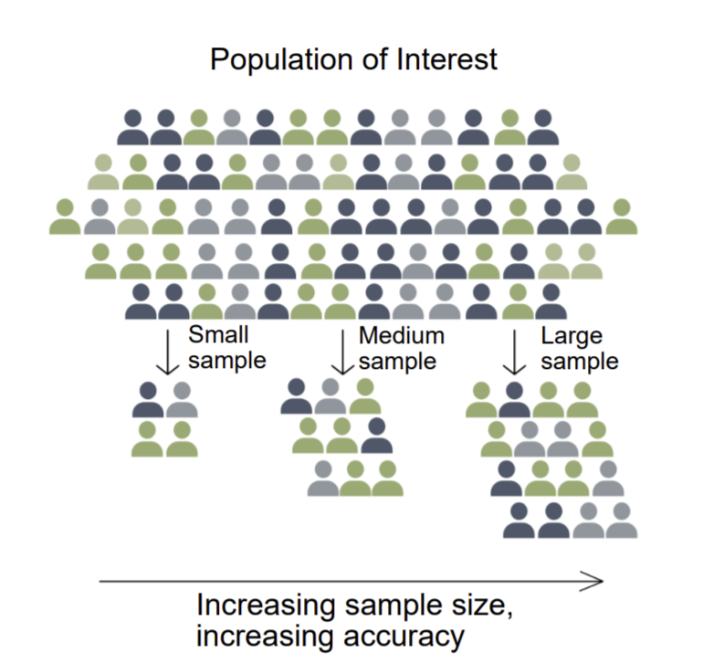
Collect Data-Select a sampling strategy
Step 5:
Collect Data, analyze, and act
Collect Data-Select a sampling strategy
Is a sample necessary?
For a small program, the total number of participants is small enough that it is likely more work to create a truly representative sample.
If a program is operating across an entire region, collecting data from a sample of students will likely save time and money and produce similar results as surveying all members of the region.
Is probability (statistical) sampling necessary?
Need a list of all individuals to be sampled.
Less important if you do not intend to generalize
Non-probability samples may provide enough information and are less cumbersome to select
Notes:
Sampling is the way that individuals are selected from a larger group to complete data collection activities.
Generally, sampling strategies can be divided into non-probability sampling and probability (random) sampling.
Sample size calculators(link is external) are useful for determining the number of data points that are needed to detect a statistically significant difference.
More information on sampling strategies
Choosing a Sampling Strategy
Is a sample needed or is your program population small enough that it is feasible to survey everyone?
If you are not trying to generalize your findings to the whole community, this may be easier to achieve.
If you want to generalize findings to the whole community, then you need to collect information from the whole community, not just program participants. In this case, consider collecting a sample.
If a sample will be selected, will it be necessary to conduct probability (statistical) sampling?
In rural health settings, it may not be possible to obtain a sampling frame, a list of all individuals or households from which a sample will be selected.
In addition, if you do not intend to generalize to the full participant population (i.e. you won't make conclusions about all participants based on data from a sample of participants), probability sampling is not necessary. Non-probability samples may provide enough information and are less cumbersome to select.

Slide 62
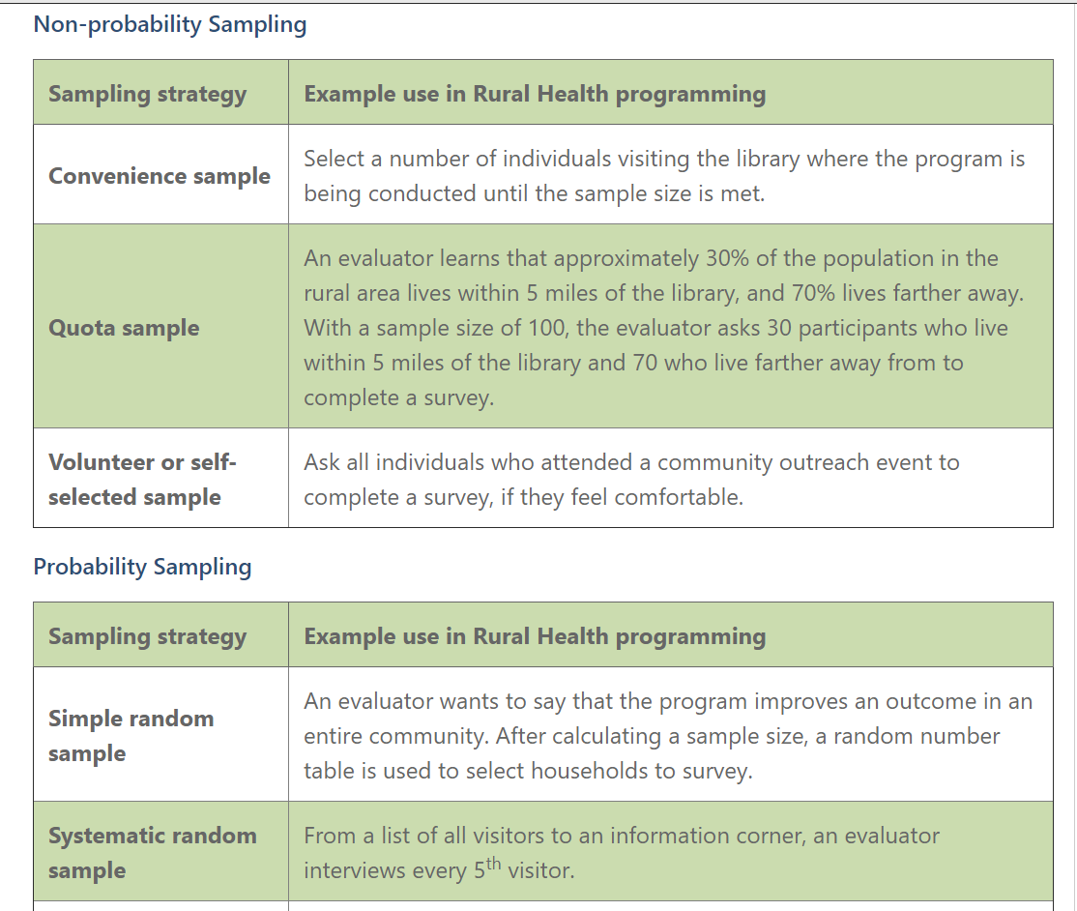
Non-probability sampling
Step 5:
Collect Data, analyze, and act
Notes:
Examples use of different sampling strategies, along with another evaluation planning pdf on sampling

Slide 63
accurately collect information on the real-life experiences
Step 5:
Collect Data, analyze, and act
Collect Data
Ensure the privacy and confidentiality of all participants
Select a sampling strategy
Consider whether quantitative and/or qualitative data collection methods are appropriate for reporting on program outcomes
Notes:
Data that reflect cultural humility can accurately collect information on the real-life experiences of the program participants.
Using pre-designed data collection instruments can save time and provide results that are more generalizable to the population. However, pre-designed instruments may not work the same way and measure the same things across different populations - a design element named cross-cultural equivalence.
To determine cross-cultural equivalence, find studies using and validating the data collection instruments for cross-cultural equivalence, or studies that have the same or similar population context as your evaluation.
Field testing all data collection instruments- that is practicing using the instrument in a real-life setting, and altering the instrument based on feedback and preliminary analysis- can help to improve the information collected.

Slide 64
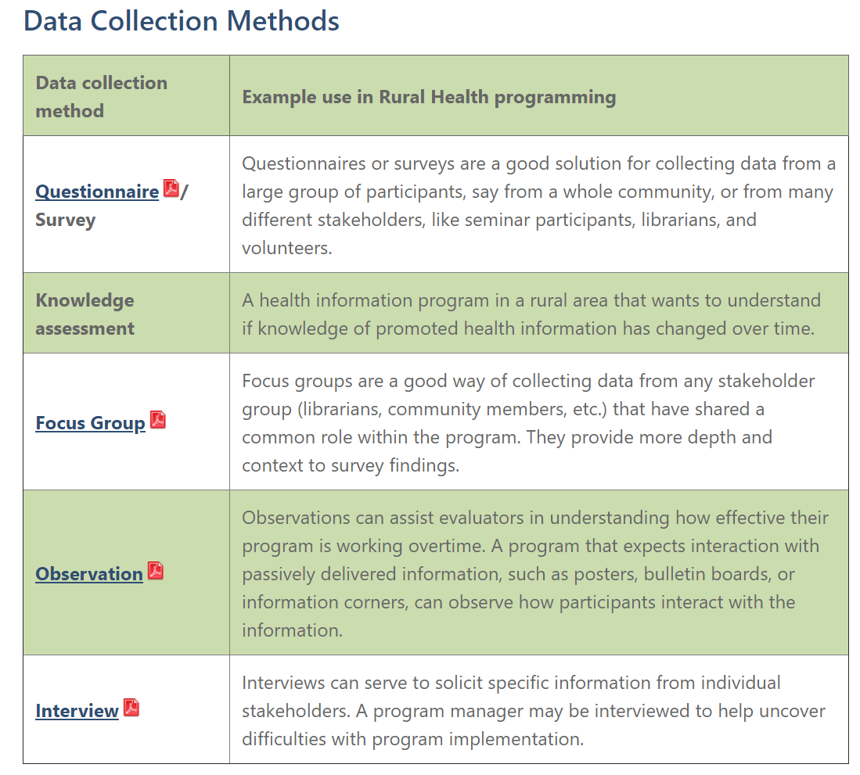
Data collection methods
Step 5:
Collect Data, analyze, and act
Notes:
Briefs from CDC explaining each data collection method in greater detail are available on the website

Slide 65
Analyze Data
Step 5:
Collect Data, analyze, and act
Analyze Data
Quantitative
Qualitative
“The setting of the workshop as well as the opening activities made me feel comfortable to share my story with the group.”
Notes:
Quantitative data are information gathered in numeric form.
Analysis of quantitative data requires statistical methods.
Results are typically summarized in graphs, tables, or charts.
More information on quantitative analysis
Qualitative data are information gathered in non-numeric form, usually in text or narrative form.
Analysis of qualitative data relies heavily on interpretation.
Qualitative data analysis can often answer the 'why' or 'how' of evaluation questions.
More information on qualitative analysis.

Slide 66
: Data Visualization and Communication
Step 5:
Collect Data, analyze, and act
Act: Data Visualization and Communication
Identify your audiences for your evaluation findings.
For each audience or stakeholder group, determine what they want or need to know.
Consider the best way to engage each audience or stakeholder group.
All outcomes found should be placed in a larger context, including the influence of structural and systemic issues like government policies, resource allocation, intergenerational wealth and education, and racism.
Responses to the outcomes found in the evaluation should include the direct involvement and decision making of multiple stakeholder groups and community members.
Create effective data visualization.
Choose the right type of graph or chart.
Simplify your results so that the key message is communicated.
Use colors, sizes, shapes, and labels to direct attention to key messages.
Title the visualization to clearly communicate the purpose/findings.
Notes:
Act
Share information gathered in your evaluation with stakeholders to ensure they understand your program successes and challenges.
Align stakeholders around the program and allow for planning for future iterations or versions of the program.
Evaluations can be summarized as evaluation reports, Power Point Presentations, dashboards, static infographics, and/or 2-page briefs depending on the needs of stakeholders.
More information on data visualization and communication strategies
Meeting Rural Health Stakeholder Needs
Creation and review of findings with community members and stakeholders can help ensure that information is presented in a respectful way.
Responses to the outcomes found in the evaluation should include the direct involvement and decision making of multiple stakeholder groups and community members.
Be open to other interpretations or responses to your evaluation findings.
If a program is renewed for subsequent program cycles, then using the findings of the evaluation can improve how responsive the program is to the needs of program participants.
The field of rural health has been gaining national attention as it has become clearer that systemic issues have led to significant health disparities. There may be opportunities to share your evaluation and methods with a growing network of rural health evaluation practitioners.

Slide 67
Demo & example
Notes:
Becky to share screen and demonstrate the resources available on the Race and Ethnicity Pathway page

Slide 68
Question & Answer
Notes:
At this time we will take any questions that the attendees have.

Slide 69
Next Steps
Upcoming pathway-specific trainings (recorded); all held at 11 am PST/2 pm EST
Previous recordings are up on the website
Documentation for small grant applicants
Notes:
To better support the socialization and use of these pathways, we have organized 5 webinars which will be recorded.

