Slide 1
Action
“I’m doing it”

Slide 2
Discussion points from last module
What shows you that a patient is in preparation?
When you notice patients in preparation, what strategies discussed last time work best for you?
Notes:
[NOTE TO FACILITATOR: If you are completing these modules in an order other than suggested in the facilitation guide, you may need to adjust these discussion points.]

Slide 3
Objectives
By the end of the program, participants will:
Define the action stage
Discuss MI techniques for patients in action

Slide 4
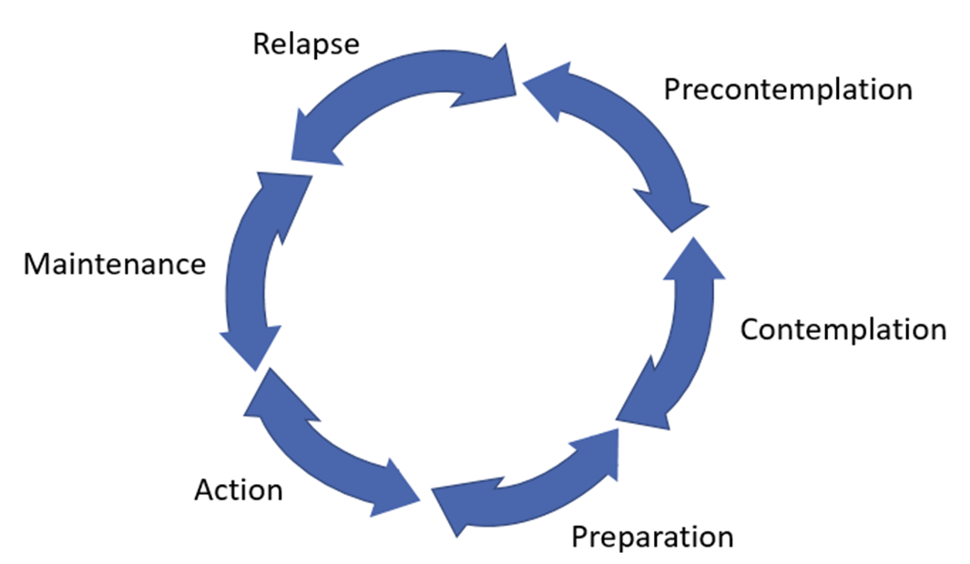
Action
Support self-efficacy & motivation
Focus on commitment
Makes the change
Action
Figure 1. Adapted from Tuccero, Railey, Briggs & Hull (2016). Behavioral Health in Prevention and Chronic Illness Management, Primary Care: Clinics in Office Practice, 43, 191-102. doi: 10.1016/j.pop.2016.01.006
Notes:
We’re moving on to the action stage. For this stage, someone has begun a healthy change, so the focus is on keeping them committed to this¹. Similar to preparation, the MI technique suggested for this stage is supporting self-efficacy¹. Self-efficacy is part of motivation, along with someone’s belief that a behavior is important⁴.
[NOTE TO FACILITATOR: If you are completing these modules in an order other than suggested in the facilitation guide, you may need to adjust these discussion points.]

Slide 5
What is Action?
A person had made changes to their behaviors or lifestyle within the past six months²
Doesn’t mean that they will never experience further ambivalence about the change⁴
Notes:
When someone has taken action, they have moved out of preparation and have started to do whatever they have been contemplating or preparing for. This is defined as being a change made within the past 6 months². Just because they have made the change, it doesn’t mean that they won’t experience ambivalence again. If you remember in the TTM, people can move back and forth between stages². So, they still might need support. Think about a time you’ve made a change - it probably wasn’t easy at the beginning and you may have had setbacks or temporarily slipped into old habits.
[NOTE TO FACILITATOR: If you are completing these modules in an order other than suggested in the facilitation guide, you may need to adjust this note.]

Slide 6
Recognizing Action
May ask questions about or make statements about the need to “stay on track”⁴
Consider what action truly means for a specific behavior²
Notes:
Patients who are in action will likely be easy to recognize because they will probably tell you that they’ve taken action. They may also have questions about how to avoid relapse or make statements about their need to “stay on track”⁴. These are points where they can still be supported. As a side note to this phase, with some behaviors, it can be good to consider what action really means². For example, if someone has reduced the number of cigarettes they smoke but hasn’t quit completely, this is considered to be more of a preparation because action would be complete cessation². This comes from definitions about what we know regarding the health effects of smoking even a small number of cigarettes². With other behaviors, such as healthy eating and exercise, there may not be as firm of a definition.

Slide 7
Action - what to do?
Help them stay on track³
Support self-efficacy¹
Affirmations⁴
Consider their support system³
Support self-efficacy & motivation
Focus on commitment
Makes the change
Action
Figure 1. Adapted from Tuccero, Railey, Briggs & Hull (2016). Behavioral Health in Prevention and Chronic Illness Management, Primary Care: Clinics in Office Practice, 43, 191-102. doi: 10.1016/j.pop.2016.01.006
Notes:
Similar to preparation, the patient likely still needs a focus on self-efficacy when in action¹. As we discussed during the preparation conversation, affirmations are one way to support self-efficacy⁴. In action, this may be affirming what personal quality allowed them to take the step or what skills they have to move forward. As we are discussing these motivational interviewing techniques that have evidence to support something like self-efficacy, remember that the others can still be used where appropriate. Just because a patient has taken action, it doesn’t mean that you can’t use reflection or summarizing to show empathy. Taking action is still a challenge. Similar to preparation, it is important to consider their social support in the action stage because they may be more successful with staying on track if they have support³.
[NOTE TO FACILITATOR: If you are completing these modules in an order other than suggested in the facilitation guide, you may need to adjust this note.]

Slide 8
Take home message
Consider:
What shows you that a patient is in action?
Practice:
When you notice patients in action, what strategies discussed today work best for you?
Developed resources reported in this presentation are supported by the National Library of Medicine (NLM), National Institutes of Health (NIH) under cooperative agreement number UG4LM012342 with the University of Pittsburgh, Health Sciences Library System. The content is solely the responsibility of the authors and does not necessarily represent the official views of the National Institutes of Health.
Notes:
As we wrap up today, some things to keep in mind are: what shows you that a patient is in action and when you notice this, which strategies from today do you think will work the best for you when working with them?
[NOTE TO FACILITATOR: If you want to complete group discussion immediately following this module content, change the title of this slide to ‘Group Discussion’ and delete the slide with corresponding questions in the next module. If you would like to have discussion take place using your internal LMS system, you can include instructions here for how participants can participate. Then, adjust the slide with the corresponding questions in the next module as needed.]

Slide 9
References
Tuccero, Railey, Briggs & Hull (2016). Behavioral Health in Prevention and Chronic Illness Management, Primary Care: Clinics in Office Practice, 43, 191-102. doi: 10.1016/j.pop.2016.01.006
Glanz, K., Rimer, B. & Viswanath, K. (Eds.). (2015). Health Behavior: theory, research and practice. San Francisco: Jossey-Bass.
Constance, A. & Sauter, C. (2011). Inspiring and Supporting Behavior Change. United States: American Dietetic Association.
Gold, M., Kelly, T., Douihy, A. (2015). Motivational Interviewing : A Guide for Medical Trainees. New York: Oxford University Press.
McGinnis P., Davis M., Howk S., DeSordi M. & Thomas M. (2014). Integrating Primary Care Practices and Community-based Resources to Manage Obesity: A Bridge-building Toolkit for Rural Primary Care Practice Transformation. Rockville, MD: Agency for Healthcare Research and Quality: AHRQ Publication No. 14-0043-EF. Retrieved from URL to source
Stewart, E., Taylor-Post, N., Nichols L., Staton E., & Schleuning A. (2014). Community Connections: Linking Primary Care Patients to Local Resources for Better Management of Obesity. Rockville, MD: Agency for Healthcare Research and Quality; AHRQ Publication No. 14-0030-EF. Retrieved from URL to Source
Center for Substance Abuse Treatment (1999). Enhancing Motivation for Change in Substance Abuse Treatment. Treatment Improvement Protocol (TIP) Series, No. 35. HHS Publication No. (SMA) 12-4212. Rockville, MD: Substance Abuse and Mental Health Services Administration. Retrieved from URL to Source

