Slide 1
NNLM Region 2 Health Data Privacy in the Library January 11, 2024
Region2@nnlm.gov| @nnlmregion2

Slide 2
Land Acknowledgement
Land acknowledgements are an honest and historically accurate way to recognize native communities of this land. Presenting land acknowledgments recognizes histories that have been systematically erased.
The native peoples of this region include the Etiwan, Kiawah, Santee, Edisto, Nachez-Kusso, and Wassamassaw people.
The Region 2 RML recognizes the native communities of the land on which we live, work and, play in Charleston, SC.

Slide 3
Labor Acknowledgement
A labor acknowledgment recognizes that much of the economic progress and development in a geographic area or industry resulted from the unpaid labor and forced servitude of people of color, specifically people who descended from Africa.
The R2 RML recognizes that the United States were built at the expense of forcefully enslaved Black people. We acknowledge that much of what we know of this country today, including its culture, economic growth, and development, has been made possible by the labor of enslaved Africans, their descendants, immigrant workers, impoverished people, domestic workers, and others who have endured tragic circumstances for the growth of the country and the privileges enjoyed by few.
This history continues the legacies of intergenerational trauma today. We strive to remain mindful and to use our work to support the health and well-being of all people.

Slide 4
Health Data Privacy
in the Library
Tess Wilson
Notes:
Feedback from NNLM member:
“The only potential problem they saw was that they feel that librarians are under a lot of stress with the book bans and they are a little concerned that librarians could get in hot water with disseminating health information. I tried to let them know that we would just send out brochures that their patrons could then do the search themselves, but I wanted to check with you to see if there was anything I should add with that.”
Cycles of influence: decide who knows your body:
https://datadetoxkit.org/en/health/cycles-of-influence/
None of their business: how to choose a private cycle tracking app:
https://datadetoxkit.org/en/health/none-of-their-business/
Cycles of control: private companies and the surveillance of reproductive health:
https://tacticaltech.org/news/cycles-of-control
Course Title: Health Data Privacy in the Library
Course Description: This webinar will explore the role libraries play in patron health journeys, which includes the layout of our physical spaces, the way we handle sensitive documents, which resources we share, and more. Privacy advocate Tess Wilson will discuss practical approaches to patron support and ways we might teach patrons about their health data safety.
Course Objectives:
Identify points of vulnerability in interactions with patron health data
Share tips and tools with patrons to support their data privacy
Apply practical approaches to library spaces, policies, and procedures as a way to maximize privacy
Course Agenda:
Introduction
What is health data?
When is our health data vulnerable?
Where do libraries come in?
Apps and tools
Q&A

Slide 5
Objectives
Learn about teaching privacy to staff and the public
Identify points of vulnerability in interactions with patron health data
Gain tips and tools to share with patrons to support their data privacy
Understand ways library staff can support our communities while they seek digital health information
Learn practical approaches to library spaces, policies, and procedures as a way to maximize privacy
Notes:
Identify points of vulnerability in interactions with patron health data
Share tips and tools with patrons to support their data privacy
Apply practical approaches to library spaces, policies, and procedures as a way to maximize privacy

Slide 6
Agenda
Introduction
What is health data?
When is health data vulnerable?
Where do libraries come in?
Q&A
Notes:
Tess

Slide 7
Introduction

Slide 8
Nice to meet you!
Tess Wilson
Library Freedom Project
tesskwilson@gmail.com
@tesskwg
Notes:
Good afternoon! My name is Tess Wilson And i use she/her pronouns
I’m the deputy director of Library Freedom Project, but before that I was a health sciences librarian with NNLM at the University of Pittsburgh in Pennsylvania! I also did my MLIS there, and it was during that time that I got interested in the intersections of privacy and librarianship.
I was a research assistant with the Youth Data Literacy Project, which took a look at teens and their relationship to privacy, as well as ways youth services librarians can integrate those conversations into programming.
During that time I also got involved with Library Freedom Project through their Library Freedom Institute (which was a six-month long intensive where we learned about privacy and the library). I continued volunteering as a trainer and advocate until taking on my current position.
At NNLM, as a health librarian, I also trained library staff, community organizations, and anyone else who’s interested on how to navigate National Library of Medicine resources, and offer ideas about how to incorporate health information in their library practice. ​And digital literacy was a big part of what I shared with learners!
​​
We live in a digital world. Practices and processes regarding privacy change daily, and get more difficult to navigate. I consider digital health to be something that affects us all, especially vulnerable populations (our seniors, our young children, our immigrant and refugee neighbors, and many other subsets of our global community). ​
I want to preface this workshop by saying something that we acknowledge a lot in the Library Freedom Project community–I’m not an expert! It’s really hard (maybe nearly impossible?) to become an expert in something–like privacy–that’s changing every single day!
What we CAN do though, is keep learning, keep sharing, and equip folks with the tools and techniques they need to combat surveillance and manage their own privacy. And that’s what we’re here to do today!

Slide 9
Library Freedom Project
A Community of Practice
Notes:
And before we really dive in, I wanted to do a short introduction to Library Freedom Project, in case some of you aren’t familiar.

Slide 10
LFP Fights Surveillance
Privacy is essential for democracy. Librarians can resist the surveillance state and help bring privacy back to local communities. Library Freedom Project can help by providing librarians and their communities with the skills necessary to turn ideals into action.
We believe intellectual freedom is achieved when there is equity of access to information; when people can seek information without threats of surveillance; and when people are informed about the power dynamics of who controls information.
Notes:
So what is Library Freedom Project?
This is a community of practice that teaches librarians about surveillance issues, privacy rights, intellectual freedom, and other issues that align with the values of our community.
The project began in 2015, when we gained recognition for our fight to support public libraries serving as public Tor relays to preserve patrons’ rights to anonymous internet access.
Since then, we’ve been working hard to fight against these kinds of threats to privacy, and we do so by creating a growing network of information professionals through trainings, resources, and community building efforts.
This includes presenting at conferences, organizing protests at conferences, facilitating learning opportunities all over the country, and contributing to publications and other professional platforms.
Like I said, it’s hard to become a true privacy expert because our digital world is constantly changing and there are new considerations all the time, but this community helps us all stay informed!
https://en.wikipedia.org/wiki/Library_Freedom_Project

Slide 11
LFP Teaching Philosophy
We believe it's possible for people and our communities to change
We affirm that people are the experts of their own lives
We believe everyone brings something to the table
We recognize power dynamics - in the world and in the room
We are ready to take risks and willing to be vulnerable
We challenge dominant ideologies and systems of oppression
We recognize trauma and how it plays a role in privacy issues
Notes:
I wanted to introduce you to the Library of Freedom teaching philosophy as a kind of framework to our conversation today and as an introduction to the way we think about teaching privacy:
We believe it's possible for people and our community to change
We affirm that people are the experts of their own lives
We believe everyone brings something to the table
We recognize power dynamics - in the world and in the room
We are ready to take risks and willing to be vulnerable
We challenge dominant ideologies and systems of oppression
We recognize trauma and how it plays a role in privacy issues
https://en.wikipedia.org/wiki/Library_Freedom_Project

Slide 12
What is health data?
Notes:
So let’s dive in! We might cover some things you already know today, but I think it’s worth it to ensure that we’re all working from the same glossary—that we all have the same information.
What IS health data?

Slide 13
What is HIPAA?
Notes:
As you can imagine, there are tons of places where issues of privacy and health information intersect. Digital health information seeking brings with it some specific privacy concerns, and these are amplified for members of marginalized communities or folks who have been historically underrepresented or ignored by medical history.
First, let’s take a quick look at an often confusing, often misattributed act: HIPAA
Becky Yoose recently wrote a piece about HIPAA and libraries for ALA if you’re interested in learning more! But here are some basics:
The Health Insurance Portability and Accountability Act (HIPAA) governs the handling and processing of protected health information (PHI) in the United States. HIPAA’s scope includes “covered entities” – hospitals, health insurers, health care clearinghouses – as well as “business associates” – any person or organization that works with PHI on behalf of covered entities. HIPAA’s Privacy Rule and Security Rule, along with HITECH, require covered entities and business associates to follow strict rules and procedures to protect patient PHI, including information security and data privacy safeguards.
Now, HIPAA’s scope does not extend to the majority of libraries unless the library in question is part of a covered entity or business associate, such as a hospital library. Traditionally, the extent of medical data collected by libraries comes in the way of the user’s activity in the library, such as using health resources and attending programs about particular health topics. In addition, libraries might also retain some health-related information through certain ADA accommodations for library users. This information, while not covered under HIPAA, should be given additional protection from potential improper use or access by staff or by the public.
HIPAA was enacted to protect employees with pre-existing conditions from losing their insurance when they changed jobs. Part of the act was the first step to modernize and improve upon the exchange of information between health care providers.
Title II of the act was the Administrative Simplification Act and that created transaction standards to ease the exchange of data between healthcare constituents but also added privacy and security protections around these data exchanges.
In 2002, the Privacy Rule was finalized and its primary concept revolves around what is and what should be considered PHI. These rules and legislative acts were created to protect patients and their privacy as Congress anticipated that patient information exchanges would be greatly facilitated by electronic methods and they knew that the resulting increased volume of such exchanges needed to be carefully considered.
For a lot of us, the definition and difference between PII and PHI can be a bit confusing, so I’ll go over these briefly!
https://chooseprivacyeveryday.org/when-libraries-become-medical-screeners-user-health-data-and-library-privacy/

Slide 14
Personal Identifiable Information (PII)
Types of PII
Mother’s maiden name
Driver’s license number
Bank account information
Credit card information
Relatives’ names
Biometric information
Telephone number
Personal characteristics
Passport information
Social Security Number
Date or place of birth
Notes:
As we talk about privacy in health information, I’d like to introduce you to the term PII. PII stands for Personally Identifiable Information.
PII is information that can be used to distinguish or trace an individual’s identity, either alone or when combined with other personal or identifying information that is linked or linkable to a specific individual.
Some information that is considered to be PII is available in public sources such as telephone books, public web sites, and university listings. This type of information is considered to be public PII and includes, for example, first and last name, address, work telephone number, email address, home telephone number, and general educational credentials.
Examples of Sensitive PII include:
Mother’s maiden name
Driver’s license number
Bank account information
Credit card information
Relatives’ names
Biometric information
Home or cellular telephone number
Personal characteristics
Passport information
Social Security Number (SSN)
Date or place of birth
Other information that would make the individual’s personal identity easily traceable

Slide 15
Protected Health Information (PHI)
Types of PHI
Patient names
Geographical elements
Dates related to individuals
Telephone numbers
Fax numbers
Email addresses
Social security numbers
Medical record numbers
Health insurance numbers
Account numbers
Certificate/license numbers
Vehicle identifiers
Device serial numbers
Digital identifiers
IP addresses
Biometric elements
Full face images
Notes:
The HIPAA Privacy Rule provides federal protections for personal health information held by covered entities and gives patients an array of rights with respect to that information. At the same time, the Privacy Rule is balanced so that it permits the disclosure of personal health information needed for patient care and other important purposes.
So what exactly IS protected health information?
For healthcare providers and insurance companies the definition of protected health information is broad. The Department of Health and Human Services (HHS) lists the 18 HIPAA identifiers as follows:
Patient names
Geographical elements (such as a street address, city, county, or zip code)
Dates related to the health or identity of individuals (including birthdates, date of admission, date of discharge, date of death, or exact age of a patient older than 89)
Telephone numbers
Fax numbers
Email addresses
Social security numbers
Medical record numbers
Health insurance beneficiary numbers
Account numbers
Certificate/license numbers
Vehicle identifiers
Device attributes or serial numbers
Digital identifiers, such as website URLs
IP addresses
Biometric elements, including finger, retinal, and voiceprints
Full face photographic images
Other identifying numbers or codes

Slide 16
Other Data
Types of Data
Location
Passwords
Clicks/Views
Images
Personal information
Notes:
And beyond that, what other personal data is potentially at risk during our health journey?
On specific piece of data is location: We know our devices track us. Even if you turn your phone off or stick it in a Faraday pouch (which is a way to shield electronic devices–really fascinating if you want to look that up! Also a very fun activity to bring to your library!), when you turn it back on it will ping a cell tower or a wifi network.
Each phone has a unique identifier, what’s called an IMEI. We know now that Google records location even if you ask your Android not to. An iPhone will leak less data, but that’s not necessarily true for its apps.
So for example, did you know that your texts might not be private? Depending on what app you use to text, your messages or metadata (information about your messages, like the phone numbers of the people you text) might be easily seen by people other than the recipient.
This can include service providers, people with access to your phone (like a spouse or parent), scammers, hackers, or governments.

Slide 17
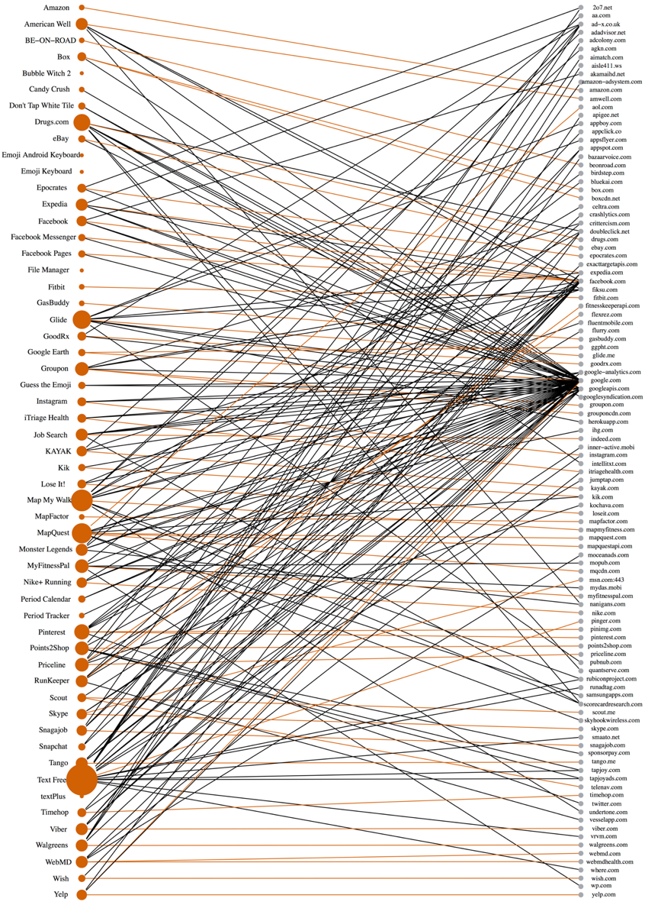
Libraryfreedom.org (5)
Android apps that share sensitive data
Where that data is shared
Notes:
This web map is from The Data Map (you can check it out yourself at thedatamap.org). This is a research project in the Data Privacy Lab, a program in the Institute for Quantitative Social Science at Harvard University.
And it’s a great illustration of how vulnerable our health data might make us.
One fascinating part of this website is the mobile health data page.
Here you can see a chart that reveals what companies or domains receive sensitive information from Android apps. A lot of these are health apps like MapMyWalk, NikeRunning, GoodRx, Fitbit, Drugs.com, and others
This can be a

Slide 18
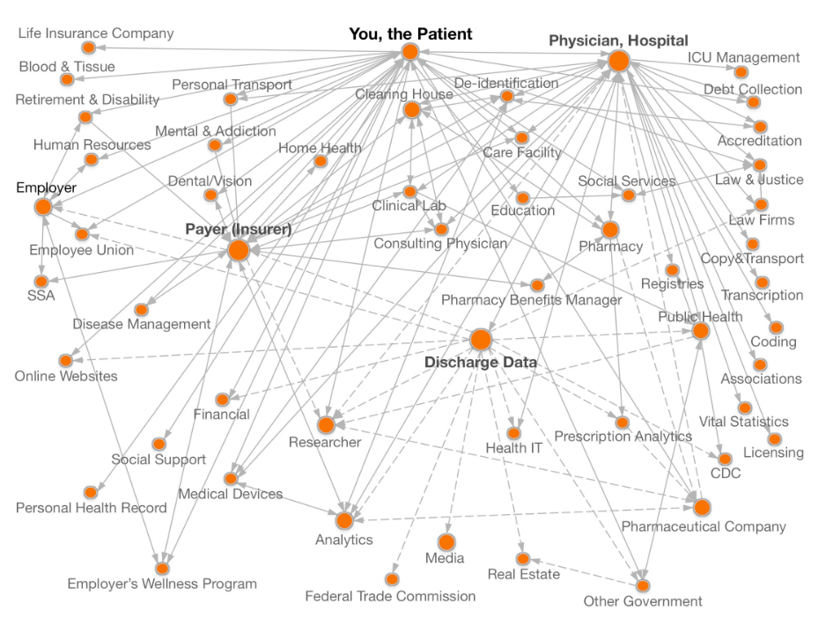
Libraryfreedom.org
Notes:
When you interact with an organization, you often leave behind personal information. The receiving organization may then share your personal information with other organizations without your explicit knowledge. This hidden data sharing can also cause you harm by making personal data available to third parties without your knowledge, while at the same time, it can make it difficult for third-parties with a legitimate interest in your data to obtain it in ways that benefit you and/or society.
And this tool allows you to take a closer look at your data flows! As you can see, one of the biggest points on this map is discharge data. Let’s take a closer look at that:

Slide 19
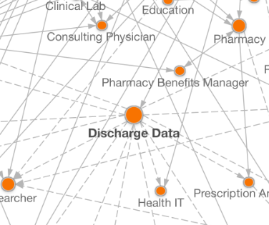
Libraryfreedom.org (2)
Notes:
Hospital consortiums or entities authorized by the state receive patient health data from providers (like hospitals and physicians) and distribute that information to researchers, analytic companies, prescription analytic companies, public health departments, the CDC, health payers, other government entities, health information technology companies, the FTC, online websites, employee unions and providers.
States and hospital consortiums receive patient health data from providers and in many states they make that data publicly available once certain identifiers like patient name and birthdate have been removed or made less detailed.
If we take a closer look at North and South Carolina, we can see what information is shared and how. This is a great tool for anyone who’s curious to know more about how your health data flows through organizations.

Slide 20
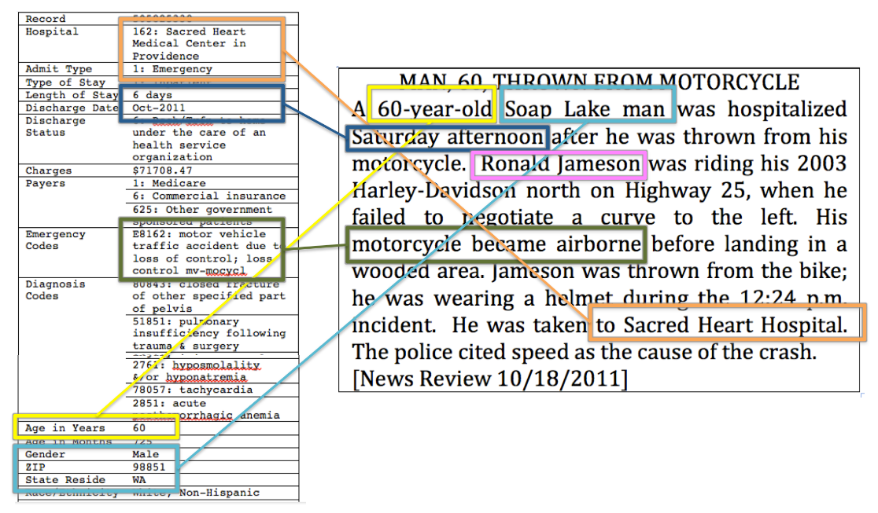
Libraryfreedom.org (4)
Notes:
For $50, the folks behind this tool purchased a publicly available dataset from Washington State. It contained virtually all hospitalizations occurring in the state in the year, including patient demographics, diagnoses, procedures, attending physician, hospital, a summary of charges, and how the bill was paid. It did not contain patient names or addresses (only five-digit ZIPs, which are U.S. postal codes).
This is what their team had to say about this experiment:
Do you think your family, friends, an employer, or bank could find you in the data? These people would know facts about hospital visits belonging to you. As a proxy for the information they would know, we used a sample of newspaper stories that reported on public incidents, such as car accidents and fires. These short reports often included a patient’s name and residential information and explained why the person was hospitalized, such as a vehicle accident or assault.
A simple analysis uniquely and exactly matched medical records in the state database for 35 of the 81 sampled news stories found in 2011 (or 43 percent), thereby putting names to patient records. As a result of this work on the HealthDataMap, Washington State changed its way of sharing these data to create three levels of access. Anyone can download tabular summaries. Anyone can pay $50 and complete a data-use agreement to receive a redacted version of the data. However, access to all the fields provided prior to this experiment are now limited to applicants who qualify through a review process.

Slide 21
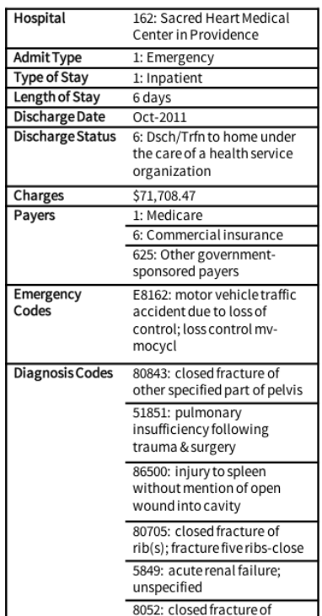
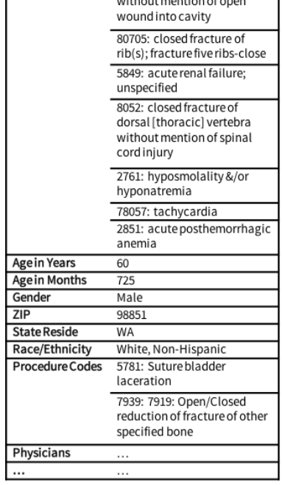
Hospital
Notes:
And this is another example of what that information looks like—you can see how this kind of data doesn’t necessarily reveal someone’s identity on its own, but could be combined with other PII to identify an individual
And that leads us to why all this matters!

Slide 22
When is health data vulnerable?
Notes:
I know I’ve given you a ton of information so far! And some of this can be pretty overwhelming.
So where do we come in as library workers? How can we help our communities understand and mitigate the risks involved with sharing health data?
Highly recommend watching Reproductive Health & the Reference Desk: How libraries can provide information post-Roe, a recent NNLM webinar presented by Barbara Alvarez! It’s a wealth of information

Slide 23
What’s at stake?
Notes:
So what’s at stake if someone does get ahold of our health data or personal data? Why should we care?

Slide 24
PII Points of Contact
PII Points of Contact
Online intake forms
Mobile health apps
Digital health programs
Medication services
Insurance paperwork
Notes:
Let’s go back to our definition of PII. This is any information that could be used to identify an individual.
Now keep in mind that some information (for instance, where or when you were born) might not constitute PII as they would not on their own allow someone to identify you. But if someone were to get ahold of several pieces of this information, it could make it very easy to identify an individual!
So that’s what we’re worried about when we talk about the risk involved with using health apps and other vulnerable points in our digital health journey.
Some of the players that might want to access your data include:
Financial institutions
Researchers
Analytics companies
Law enforcement agencies
Media companies
Law Firms
And there are larger, more concerning issues:
Medical Identity
This information could affect your credit and everything associated with that
This information could impact your insurance rates
You could face discrimination based on race, ethnicity, gender, sexuality, or health history
And of course, there are concerns about targeted advertising–clicks and views get filtered down into tailored ads and content gets pushed to us based on interests and needs.
Ad brokers use health information for targeted advertising. One example of this is that between patient information and shopping history, companies can determine if someone is pregnant or trying to get pregnant. Now, this might seem helpful (if creepy), but imagine that person is in an abusive relationship and that information might get them hurt. Or if they lose the pregnancy. This can quickly become a very personal and harmful privacy risk.
Another example might be exercise apps being targeted to someone with body dysmorphia or eating disorder, or online snake oil being peddled to those who are most desperate
And we have to remember that not everyone is affected by health data surveillance in the same way because of gaps in understanding privacy policies, health literacy, and access to reliable information. We have to consider all of this in context with existing systemic issues that disproportionately harm marginalized groups.
Now, some points of contact that involve your personal information being accessed by someone (or some company or other bad actor), that are specifically relevant to digital health information include:
Online intake forms
When we fill out our intake forms (many of which are online now!), we provide a lot of personal information in medical forms
This might include our medical history!
Digital health programs
Health programs like Noom or other digital plans can collect personal information, even some health records
Medication services
Services like prescription discount programs often require some personal information in order to access your health history or insurance information
Insurance paperwork
And speaking of insurance, many of our insurance companies are online (maybe even strictly online!) these days. We might receive digital health insurance cards or need to link our doctors offices with our insurance companies
Other digital health privacy concerns might include:
Sending PDF forms that include health information or PII
Consumer genetic research or DNA tests

Slide 25
Reward and Risk
Pros or
Reward
Cons or Risk
The ability to easily order discounted prescriptions
Apps that track your walks, runs, and workouts so you can monitor your progress
Insurance-specific apps that allow you to use your phone camera for telehealth visits
Map or GPS software/apps that store common travel patterns
Advertising customized to your interests, based on search and purchase history
Single sign-on to multiple websites or services (for example, linked to a Google account)
The ability to sign on to devices or access locations with biometrics (like fingerprints)
Notes:
First, I wanted to show you something we talk about a lot in Library Freedom Project, and that is the Privacy Risk vs Personal Reward equation.
Almost all of us use smartphones, tools, and apps to connect with people and make our lives easier. And that includes health-related devices!
Some of the same features in apps that enhance the convenience for some people can also put other people at risk.
For example, a person being stalked or experiencing intimate partner violence, or an undocumented immigrant, could have a very different risk profile than a wealthy citizen in a stable environment.
So one great way to think about this is to create a pro and con list (or note down the risks and rewards) for certain services or tools. Sometimes, when we teach privacy workshops, we ask folks to pick one side to argue and give them five minutes or so to talk about whether or not the convenience of certain tools is worth it in their minds!
Because that’s what all of our privacy education is really about–equipping folks with the knowledge they need to make their own decisions about privacy!
I’ve laid out some examples of these conveniences on the slide:
The ability to easily order discounted prescriptions
Apps that track your walks, runs, and workouts so you can monitor your progress
Insurance-specific apps that allow you to use your phone camera for telehealth visits
Map or GPS software/apps that store common travel patterns
Advertising customized to your interests, based on search and purchase history
Single sign-on to multiple websites or services (for example, linked to a Google account)
The ability to sign on to devices or access locations with biometrics (like fingerprints)

Slide 26
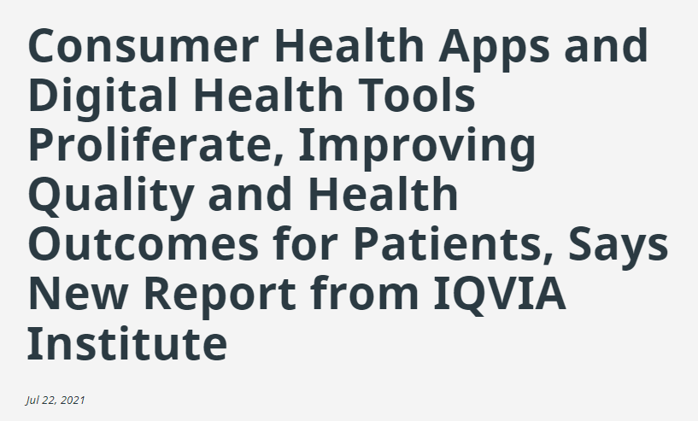
New HHS Study, Consumer Tech, and Consumer Health.
Notes:
Telehealth has been used in healthcare for a number of years, but the landscape of telehealth and digital health has changed significantly since 2020.
Apps served us differently during the pandemic. People were spending more time on apps and using digital tools more than ever because of lockdowns and an increased desire for convenience, access to healthcare, and telehealth needs. More time spent inside and the need to manage nearly every aspect of our lives, including our physical and mental health, online increased use of medical, wellness and fitness apps. As gyms shut down, everything from yoga and mindfulness apps to real-time competitive cycling to fitness tracking, saw enormous growth during this time
Consumer health apps, for example, are some of the most widely available and used digital tools. And in 2020, more than 90,000 new apps were released, resulting in more than 350,000 currently available
A 2020 Forbes article reported that app usage surged 40% during the pandemic, reaching an all-time high of over 200 billion hours during April 2020. While this a global trend, stats in individual countries vary. In India, for example, time spent in apps grew 35% from late 2019 to mid 2020. Italy and Indonesia saw growth of 30% and 25%, respectively. In the U.S., time spent in apps grew 15%. In the second quarter, consumers spent a record $27 billion in apps, up 15% year-over-year and up 25% to $10 billion on Android.
And this surge of usage goes beyond apps too! The demand for indoor sports equipment was huge. Quarterly sales for high-end indoor bike maker Peloton surged 66%, despite shipping delays, the bike’s $2,000-plus price tag, and a high monthly fee for the related app.
Just as consumers have turned to the internet for fitness solutions, wellness apps have surged as consumers look to manage stress caused by the health crisis. Headspace, a meditation and mindfulness app, saw up to a 90% increase in time spent on mobile devices. In early April of 2020, the company introduced a section just for New Yorkers and is offering all U.S. healthcare professionals who have a National Provider Identifier (NPI) free access to Headspace Plus throughout 2020. This app and others like it provide tools for adults, they also have services for kids using mobile apps
IQVIA (a pharmaceutical research and data company) had the following findings regarding health apps and tools (these are just a couple):
The use of wearables, connected sensors and digital biomarkers is expanding. They are gaining adoption in clinical trials and enabling remote monitoring of patients that can influence care delivery. Activity monitoring devices that measure heart rate, steps taken, distance traveled, and calories burned account for about 55 percent of the 384 wearable devices currently marketed to consumers. Sensors and digital biomarkers are being incorporated into the design of clinical trials for pharmaceuticals and medical devices and are enabling decentralized and hybrid trials with home visits that reduce patient and investigator burden and accelerate clinical trial timelines.
Incorporating software as a means to treat, prevent or manage specific diseases or conditions has increased. More than 250 such products are now identified, including about 150 products commercially available and the rest in development.
https://www.hhs.gov/about/news/2021/12/03/new-hhs-study-shows-63-fold-increase-in-medicare-telehealth-utilization-during-pandemic.html
https://www.forbes.com/sites/eladnatanson/2020/07/21/healthcare-apps-a-boon-today-and-tomorrow/?sh=47f75c311bb9
https://www.iqvia.com/newsroom/2021/07/consumer-health-apps-and-digital-health-tools-proliferate-improving-quality-and-health-outcomes-for

Slide 27
Other Digital Tools/Apps
Insurance-specific apps
MyUPMC
Workout apps
7-Minute Workout
Apple Health
MyFitnessPal
Digital health tools
Quizzes and games
Weight Watchers
Noom
Period-tracker apps
Clue
Flo
Wearable devices
Fitbit
Apple Watch
Garmin
COVID19 exposure trackers
Notes:
Another place where our health data is vulnerable is through mobile health apps and devices
Many mobile health apps collect sensitive information (this could workout guides, meal or water tracking apps, running or walking map apps, apps that connect to health devices like fitbits or apple watches)
What we should keep in mind when we consider health apps and devices is that even when those apps claim to value your privacy, your phone or computer might have different data privacy settings! It can be difficult to get a handle on what data is being shared with whom
And remember when we deal with apps: “if the app is free, you might be paying with your data!”
Here are some other health tools and apps our communities might be using:
Insurance specific apps
Mine, for instance, is called MyUPMC. It keeps track of my prescriptions, I can use it for telehealth visits, and it has all my insurance information on it.
There might also be employer-related health apps, especially if you’re offered incentives for maintaining fitness habits
Workout apps
These got huge during the pandemic!
Things like quick workout prompts or running and walking route trackers might collect your location data, and they might store it for long periods of time in order to offer you milestone reports
Often, apps like Apple Health are already tracking your steps. You might have to specifically opt out of these kinds of apps
MyFitnessPal was in the news in 2018 for a data breach, which brings up an important point. Data breaches are always a possibility when we use digital apps and tools. However, when the data collected by a company is more sensitive (health data, for instance) this can become a bigger concern
According to a 2021 study, “More than 93% of health care institutions have been victims of a data breach in the past 5 years,” so this is a real threat
Digital health tools
This could include health quizzes and games (we should be especially vigilant about understanding these data policies and the companies behind these apps, as they might be covertly selling you some product or service)
I’ll give you some resources for health quizzes and games from reliable sources towards the end of this workshop!
Companies like WeightWatchers and Noom offer online tools and apps that track your data with the goal of helping you lose weight and maintain habits. However, they might use your data for other purposes as well.
As one privacy blogger points out: “their Privacy Policy is dense and full of legalese and statements that seem to contradict each other. Or, at the very least, seem designed to confuse the average user. For example, they say that they “will not disclose any information Noom gathers from User on Noom’s Website, Mobile App and Services” but that’s immediately followed by the sentence “Except as set forth in this Privacy Policy, Noom does not share User’s Personal Information with third parties for those third parties’ direct marketing purposes.” In my opinion, those two sentences together are designed to make a user think that their data won’t be used for marketing purposes — except they really actually will. Because as we get further down in the Privacy Policy, we come across this sentence: “We may use a reputable third party to present or serve advertisements that you may see on the Service.” They also say that they may share personal info including performance measurements and that they may share info with law enforcement if asked.”
Like we said before, if the service is free, you’re paying with your data. If the service ISN’T free and you’re STILL paying with your data, then you might need to decide if that’s worth it!
Period tracker apps like Flo and Clue track very specific health data–period timing
This can be so helpful! But what if this data is sold to third party vendors who then know exactly when to market certain products and services to you?
Wearable devices
Because these track a ton of biometrics, including sleep patterns, geolocation, diet, and more, these are very important data tools
I wanted to add COVID19 trackers here because it raises the question of public health and personal privacy!
Speaking from personal experience, this became an “opt-out” service on iphones during the pandemic and proved to be helpful in many cases and supported contact tracing efforts
But this is where a security exercise called threat modeling could come into play. Let’s say you are an undocumented person or someone in an abusive relationship, how could this service impact your life? How important is privacy for those people in this situation?
Another thing to consider is: Who owns these apps?
For example, Google owns Fitbit and Garmin, both fitness trackers. When a company this big owns apps devices you use, you should be vigilant about your data privacy. Just like our facebook and instagram accounts might seem disparate, they’re still connected and owned by the same overarching company
In addition, apps like MyFitnessPal might be owned by a company like UnderAmour (which it was until 2020). Then we might want to question if our data is being used to sell us goods and services, or if our data is being shared with other partner companies
And another big thing to keep in mind is that almost all of us use smartphones and digital tools to connect with people and make our lives easier. Many of us use fitness or health apps to track our workouts, conduct telehealth appointments, and more!
Some of the same features in apps that enhance the convenience for some people can also put other people at risk.
I want us to remember that privacy is a tough subject and leaves room for interpretation! It’s hard to come up with what the “correct” answer is sometimes, and our goal here is not to give a blanket statement about ALL health apps or ALL fitness trackers. No, we are just taking a closer look and equipping ourselves (and our communities) with information
https://uktechnews.co.uk/2021/10/01/everything-you-need-to-know-about-the-myfitnesspal-data-breach/
https://www.ncbi.nlm.nih.gov/pmc/articles/PMC8663694/#ref13
https://www.ncbi.nlm.nih.gov/pmc/articles/PMC8663694/

Slide 28
Flo Period Tracker
Notes:
Here’s a great example of the risks of using some health apps:
This company reached a settlement agreement with the FTC after they were accused of sharing health information with third parties, and for not deleting user data in a timely manner.
A Wired article that ranked period-tracker apps by their data privacy has this to say:
Even apps that invite data deletion requests may not always execute them in a timely or complete fashion. Flo, whose security practices placed them under FTC scrutiny in 2021, states specifically in their privacy policy that upon deletion of their app, they “retain your personal data for a period of 3 years in case you decide to re-activate.” Period Tracker admits to retaining users’ mobile device IDs “for up to 24 months” after receiving a request. The safest apps should retain your data for 30 days or less, and ideally submit deletion requests to third parties on your behalf, like Clue does.
https://www.ftc.gov/legal-library/browse/cases-proceedings/192-3133-flo-health-inc
https://www.ftc.gov/news-events/news/press-releases/2021/06/ftc-finalizes-order-flo-health-fertility-tracking-app-shared-sensitive-health-data-facebook-google
https://www.wired.com/story/period-tracking-apps-flo-clue-stardust-ranked-data-privacy/

Slide 29
Activity: Where is my health data shared?
Go to https://thedatamap.org and scroll down until you see the mobile data chart.
Use the dropdown menu to find any apps you are familiar with.
Investigate:
What information is shared?
With whom is it shared?
Why is this a concern?
Notes:
And now I’d like to do a quick activity with you!
Go to https://thedatamap.org and scroll down until you see the mobile data chart.
Use the dropdown menu to find any apps you are familiar with.
Investigate:
What information is shared?
With whom is it shared?
Why is this a concern?

Slide 30
How can we help?
Notes:
So where do we come in as library workers? How can we help our communities understand and mitigate the risks involved with sharing health data?
Highly recommend watching Reproductive Health & the Reference Desk: How libraries can provide information post-Roe, a recent NNLM webinar presented by Barbara Alvarez! It’s a wealth of information

Slide 31
Potential Risks
Considerations:
Collection
Storage
Access
Reporting
Retention
Communication
Notes:
As we examine our policies and procedures, it’s important to understand any potential privacy risks that exist in your space for library users.
One example that was fairly prevalent in early 2020 was libraries asking users to complete health screenings in an attempt to prevent the spread of COVID19.
This specific health privacy concern was covered in the article “WHEN LIBRARIES BECOME MEDICAL SCREENERS: USER HEALTH DATA AND LIBRARY PRIVACY” from 2020.
In it the author says:
“While health screenings are used in other areas, such as employees returning to work, its use in a library to determine which library users can access the building brings up questions regarding user health data in the library and what libraries must think about when considering going down this path.”
The article goes on to make some recommendations library staff need to keep in mind as they consider the data journey of health information in their library, whether from a specific instance like a health screening or more broadly. They are:
Collection
What user data is being collected on the screener form? Are you collecting data about a user, such as their name or library barcode? If so, what is the current business need to collect that data? Are you collecting any other data that can tie the screener data back to the user? For example, the combination of date/time, branch location, and security camera footage can connect a real-world individual to the health data, even if you don’t collect any other identifying information about the library user.
Storage
Where are you storing the screener forms? Are you entering the data from paper forms into a database or another electronic application or document? Where are the databases, documents, or applications located – local server, cloud-hosted service, shared network drive?
Access
Who has access to the data in your library? Is this access secured through secured physical storage or through user account permission levels? What access do vendor staff have to the user health data on a third-party system? What access do the vendor’s subcontractors have to that data in the system?
Reporting
What are your state and local regulations surrounding law enforcement requests for library user data? What are the regulations surrounding public disclosure requests for library user data? Do the definitions of library user data in those regulations cover all library user data, or do they only cover a specific subset of library user data?
Retention and Deletion
How long are you keeping the completed screener forms? How are you disposing the paper forms? How are you deleting the electronic library user health data?
Another consideration on top of what we already covered is the liability of a data breach if that information includes library user health data. How will your library communicate to its users that the data breach could have included health data collected by the screeners? How would your library prepare for the possible legal and reputational consequences of such a breach?

Slide 32
Provide Reliable
Health Information
Notes:
One thing we can do is ensure folks are getting the most reliable information possible! We can’t make personal privacy decisions for our community members, but we CAN equip them with information, a health critical eye, and trustworthy sources

Slide 33
Where can I find trusted health information?
PubMed
NCCIH
MedlinePlus
A database of more than 30 million citations to articles in the fields of biomedicine and health.
Scientific research on medical practices and products not generally considered part of conventional medicine.
Curated consumer health information in many languages, produced by the NLM.
Notes:
These are just a few of the resources available from NLM:
First, PubMed: PubMed is the National Library of Medicine’s free, authoritative, database of more than 30 million citations to articles in the fields of biomedicine and health, with a specific focus on collecting original scientific research.
It’s used by around 2.5 million users each day, including clinicians, researchers, students, and other folks from a variety of fields who need access to authoritative health science research.
You can use it to find a specific research article based on some known information, such as finding the original research that prompted a news story, or to find articles written by a particular author.
NCCIH (another acronym for you!) Formerly known as the National Center for Complementary and Alternative Medicine, the National Center for Complementary and Integrative Health (NCCIH) is the lead government agency for scientific research on the diverse medical and health care systems, practices, and products that are not generally considered part of conventional medicine.
They work hard to determine what is promising, what helps and why, what doesn’t work, and what is safe when it comes to alternative medicines and practices. Now, this is a handy health tool for your own use if you take supplements or are curious about developing alternative treatments.
But it can absolutely be referred to when you’re talking to library users. How many times have we been asked health information questions that have to do with new or alternative treatments? Thinking back on my own days as a reference librarian in a small library, these types of questions were about as ubiquitous as general health questions! This way, you can feel confident leading these folks to a trustworthy resource that not only acknowledges the validity of some alternative treatments, but gauges harm and benefit through a scientific lens.
And of course, everyone's favorite NLM and NIH resource, MedlinePlus! Health Topics cover a wide range of topics, and it’s a great place to start.
The Drugs & Supplements tab has many well-known nutrition supplements; e.g., dandelion, fish oil, garlic. While not as comprehensive as some commercial herbal databases, such as Natural Medicines, MedlinePlus covers the most popular and provides freely-available, easy to read records for consumers. Most of these records come from NIH’s National Center for Complementary and Integrative Health resource.
The Videos and Tools tab has health quizzes, calculators and games. There are also guides to creating healthy fitness and eating habits
I’d also like to point out the medical encyclopedia! When you or your community are faced with complicated medical terms or topics, this is a great place to start. It contains definitions as well as links to related information. An awesome resource to point people to
Topics are available in multiple languages, with Spanish having the best coverage.

Slide 34
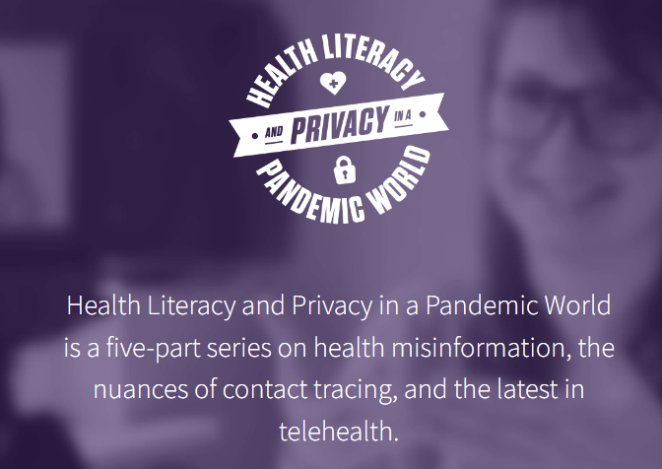
Health & Privacy Project
https://healthandprivacy.com
Notes:
Another really great resource is the Health and Privacy Webinar Series from Library Freedom Project. This was actually an NNLM-funded project in partnership with Cherry Hill Library and the Chinese American Librarians Association
Health Literacy and Privacy in a Pandemic World is a five-part series on health misinformation, the nuances of contact tracing, and the latest in telehealth. These were super informative lectures with professionals from the field, and all the recordings are available at healthandprivacy.com

Slide 35
Why did we do this?
Improve your ability to read, understand, and explain.
Provide a broad overview of health privacy issues.
Explain how these issues affect populations differently.
Provide concrete actions for minimizing threats and offer shareable resources.
Notes:
Covid revealed many systemic issues in our country and unleashed a multitude of new apps and trackers in light of the pandemic. New questions in places of employment about what can be asked, what can be mandated. We needed this information more than ever, and also really didn’t understand it because we haven’t needed it so urgently until now. If you do a quick search for “HIPAA” on librarian facebook groups, for example, you’ll see a lot of well intentioned misinformation. This was why Library Freedom Project wanted to pursue this project and make it available to folks after the fact
The goals of this project were:
Improve abilities of public library workers to read and understand health and wellness privacy issues, and improve their ability to instruct patrons on health and wellness privacy literacy.
Provide a broad overview of privacy issues related to health and wellness technology and programs, with a focus on understanding basic terminology, identifying potential issues, the intersection of systemic and personal issues and privacy, and the balance of privacy threats vs. health and wellness needs.
Increase understanding among library workers of how privacy issues concerning health and wellness affect a variety of populations differently and provide concrete actions for minimizing threats.
Provide shareable resources on health and privacy for library workers to promote on social media and other virtual platforms.
This is a great resource to share with your fellow staff as you start privacy conversations in your library!

Slide 36
Privacy Guide
Basic information about HIPAA and ADA
Tips and best practices for understanding health information
Commonly used medical terminology
Resources and reliable entities
Guide to evaluating health resources and information
https://healthandprivacy.com/Health_and_Privacy-052621.pdf
Notes:
And the conference summary from our Health & Privacy series is now available in PDF form as a privacy guide. It’s a comprehensive list of resources and includes a very handy glossary of commonly used medical terminology.
It also includes:
Basic information about HIPAA and ADA
Tips and best practices for understand health information
A guide to evaluating health resources and information
Plus, it will be translated into Spanish, Korean, Arabic, Chinese, Filipino and Vietnamese thanks to our partnership with the Chinese American Librarians Association who assisted us in hiring translators!
This is an awesome resource to point folks toward, to print off and have available for patrons, or even print out and leave copies of in a telehealth booth or health information station.

Slide 37
Teaching Privacy
Be trusting
Value learners
Stay humble
Think practically
Lead with empathy
Take small steps
Remain optimistic
Notes:
And now let’s talk for a moment about teaching privacy. Library Freedom Project uses a harm reduction lens, and comes from a place of care, which guide the way we teach!
We believe that everyone’s relationship to privacy is individual, and that what might feel comfortable for one person might not for another. When we teach, we hope to arm folks with knowledge so that they can make informed decisions about what they want to keep private and how to do that!
So how do we talk about privacy with patrons? How can we teach privacy to our coworkers? A little later on, I’ll talk about some resources, games and tools that you can integrate into your programming. But let’s first talk about some best practices when it comes to teaching privacy. We’ll go back to the Library Freedom Project’s principles:
Be trusting: People know where they fall on the privacy spectrum and what risks they want to take! We want to make sure to equip them with enough information to make their own decisions
Value learners: We should acknowledge all perspectives that come to the table and understand that this diversity ultimately makes it a stronger learning environment
Stay humble: Like I said–it’s difficult to know everything about something as ever-changing as personal online privacy. Be ready to learn as you go and challenge your own assumptions!
Remain optimistic: Remember that we believe in and are working towards change
Think practically: Giving people real-life examples and small steps can be highly impactful. This is why it’s important to stay up to date with new tools, apps, laws, and mergers
Lead with empathy: Everyone learns and comprehends things through their own lens, we need to remember that.
Take small steps: We think of privacy from a harm reduction point of view. There’s a lot that we cn’t do anything about BUT that doesn’t mean we should give up

Slide 38
Some positive talking points!
Privacy is a core value of librarianship.
Privacy is a human right.
Privacy is an equity issue.
Privacy takes time.
Data is powerful, and so is privacy.
Notes:
One of the hardest parts about teaching privacy is framing it in a way that doesn’t strike fear in the hearts of your audience. So let’s start with some reminders of why privacy is important--on the positive side!
Privacy is a core value of librarianship and is essential to intellectual freedom. Privacy is key to free thought and free expression.
Privacy is a human right. Privacy is protected by the 4th Amendment. Privacy is also codified into many other federal and state laws.
Privacy is essential to autonomy. Privacy means respecting user consent and personal choices. Privacy is one way to allow people agency and respect their boundaries. Privacy breaches are a breach of trust.
Marginalized people feel the greatest impacts from the loss of privacy. Therefore, privacy is an equity issue. Making privacy a priority is one way to show commitment to diversity equity and inclusion.
Privacy strategies and tools take some time, but less time than it takes to deal with ransomware, identity theft, doxxing, a phishing scam, etc.
Data is very powerful. By prioritizing privacy, we’re taking steps to make sure that power isn’t misused or abused. Privacy is one way to take back our power from Big Data companies and other actors.

Slide 39
Promote
Print/Web Resources
Notes:
I talked about some of these very briefly last time, but I wanted to go into more detail today. Here are some great educational resources I’d like to introduce you to! These are wonderful for your own curiosity, but I really want you to be able to take these and use them in your own spaces.

Slide 40
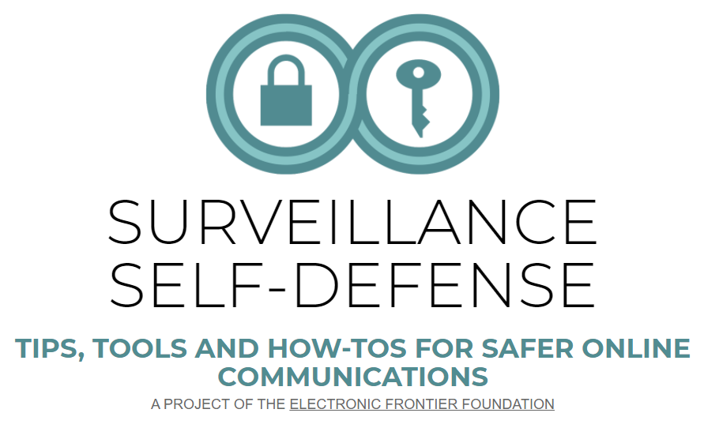
EFF’s Surveillance
Self Defense
Resources for learners and teachers
Lots of guides available
Applies to mobile use, computer access, and other risky scenarios
Notes:
The Electronic Frontier Foundation is an independent non-profit working to protect online privacy, and they’ve been doing that for nearly thirty years.
One awesome resource they have is their Surveillance Self-Defense, which is an expert guide to protecting you and your friends from online spying.
You can read the BASICS to find out how online surveillance works, dive into their TOOL GUIDES for instructions to installing our pick of the best, most secure applications
They also have more detailed information in their FURTHER LEARNING sections.
Another awesome thing they have is their Security Scenarios, which include best practices for specific populations with specific needs.
They have one for LGBTQ Youth that’s particularly useful! This guide teaches young users how to explore resources online in a safer way to help avoid accidental outing peers, family, or online advertisers as a result of online tracking or nosy snoopers.

Slide 41
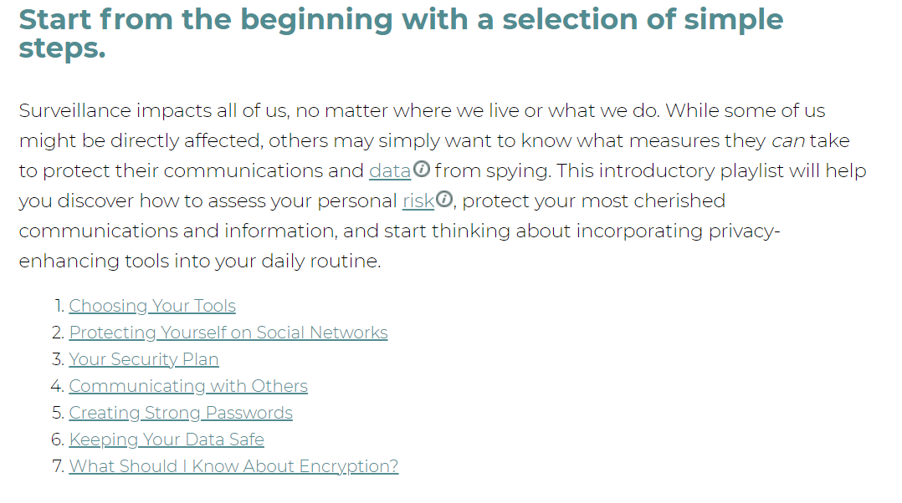
Start from the beginning
Notes:
This is a great example of what they offer. This is just a playlist of tips and guiding instructions for creating a foundation for your own personal security plan. It includes tools to assess your own threat model, create strong passwords, and design a security plan that works for you. I really love sharing this resource because it embodies what we believe in–meeting people where they are and providing small but solid steps toward privacy.
https://ssd.eff.org/en/playlist/want-security-starter-pack

Slide 42
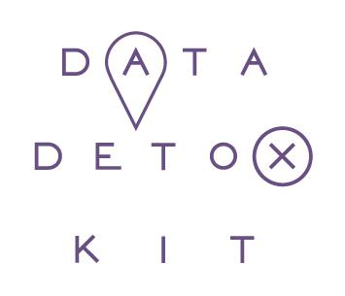
Tactical Tech’s Data Detox Kit
Everyday privacy tips
Straightforward
Step-by step approach
Youth-focused version available
Notes:
And this is one of my favorites, Tactical Tech’s Data Detox Kit!
They describe this as everyday steps you can take to control your digital privacy, security, and wellbeing in ways that feel right to you.
They have awesome toolkits and guides available! Ranging from beginners to folks who just want to do their own personal privacy audit, this is a SUPER rich resource
Tactical Tech is also the organization behind other awesome tools like Me and My Shadow, which gives you a foundation for exploring your own data footprint
https://datadetoxkit.org/en/home

Slide 43
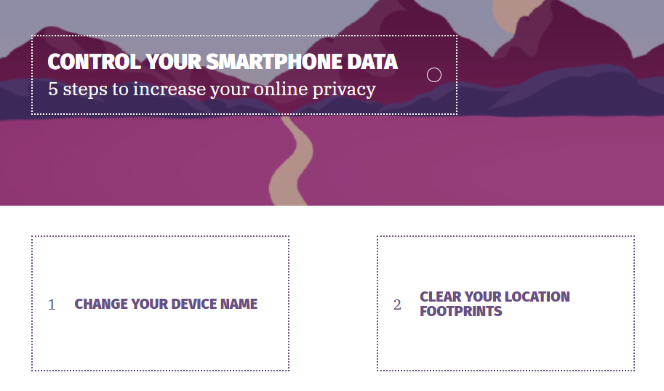
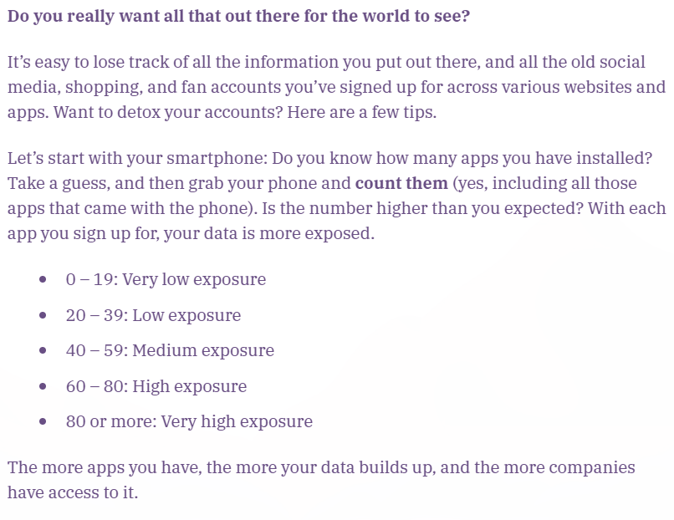
Libraryfreedom.org (6)
Notes:
They have a wealth of beautifully designed and informative resources, including ways to control your mobile footprint, scales to use when assessing how secure your accounts are, and more

Slide 44
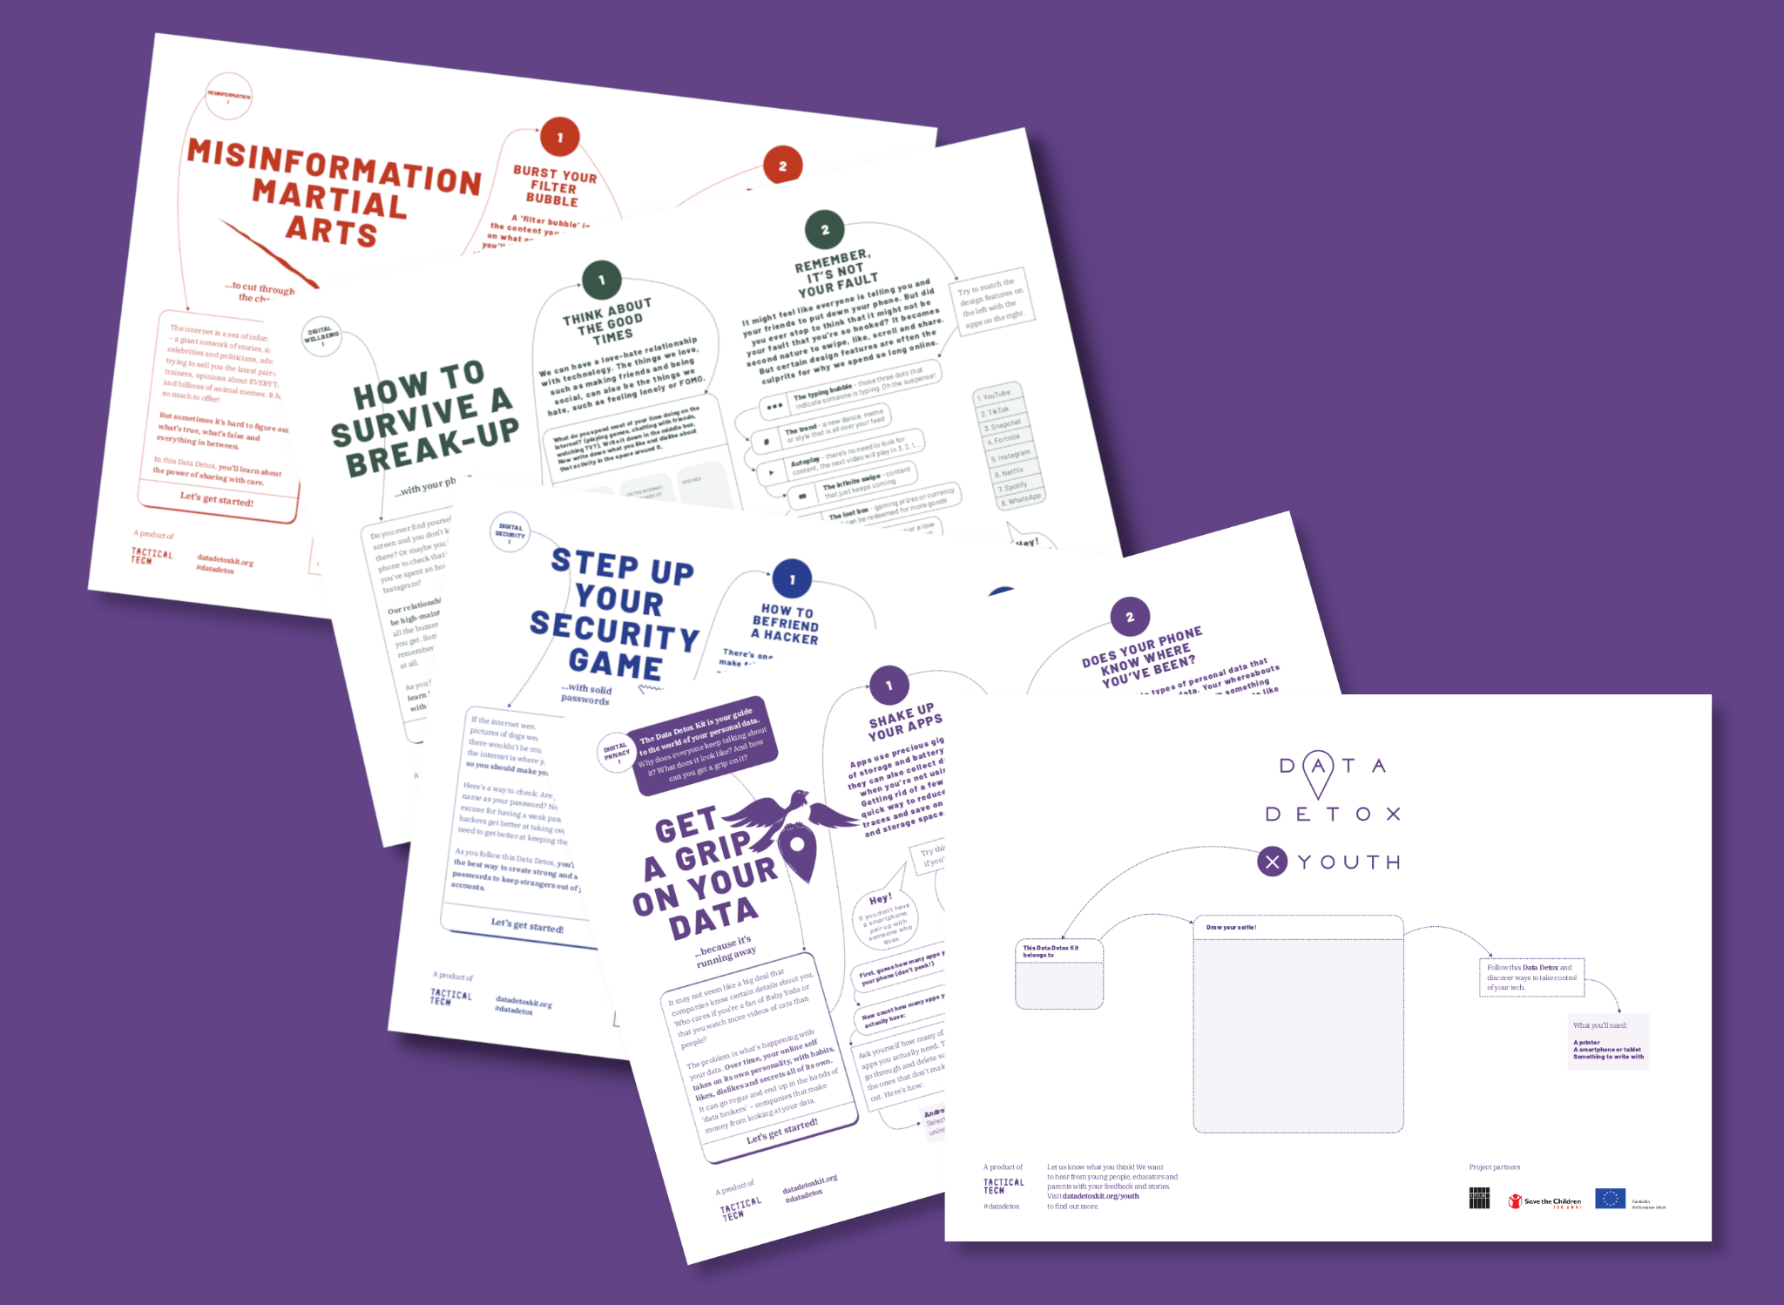
Libraryfreedom.org (7)
Notes:
And they have an awesome toolkit specifically designed for youth! This is a printable, well-designed guide that provides teens with a great foundation of knowledge and simple steps to take to increase their online privacy.

Slide 45
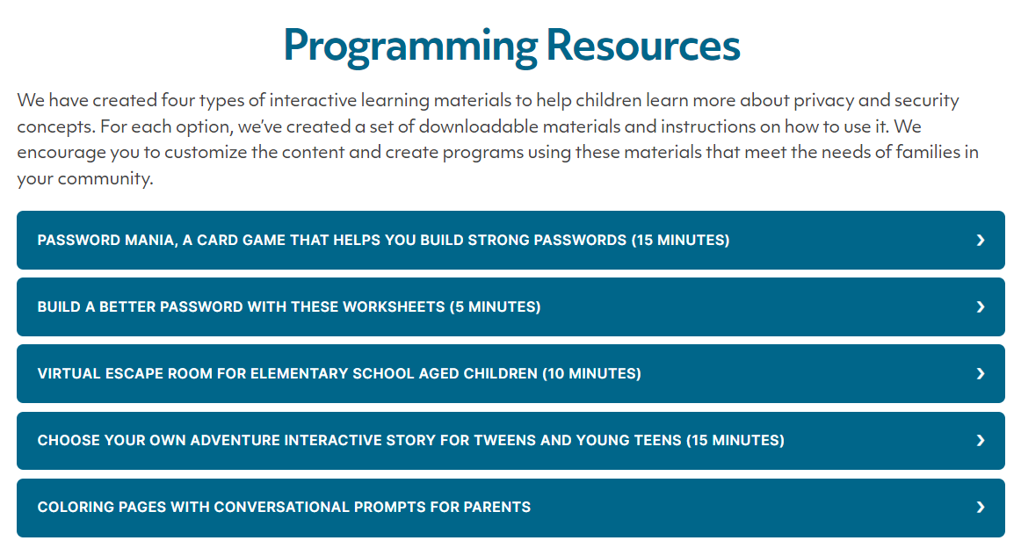
Safe Data Safe Families
Notes:
The Safe Data | Safe Families project knows that libraries provide an important outlet for many families trying to submit online forms, pay bills, complete homework, and more, which are all risky scenarios online! They’re working to address those challenges.
They’ve spent four years talking to library staff and families about these challenges, and have developed a number of resources for libraries and families that simplify and explain some of the biggest online risks and how to avoid them.
They offer resources for libraries (training, policy framework, privacy teaching moments, and programming resources) and families (privacy tips and games and activities) to help ensure that online information is protected.

Slide 46
Libraryfreedom.org (8)
Notes:
One awesome resource I wanted to share was the game Password Mania, which is designed for both children and adults to play
It teaches players about the importance of strong unique passwords through a fun card game

Slide 47
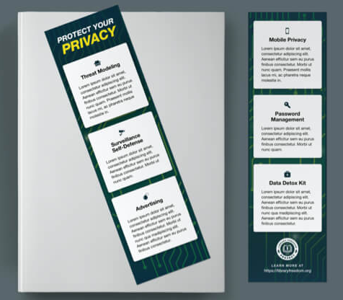
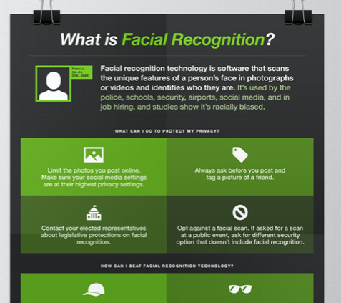
Library Freedom
Project
Flyers, zines, resource guides
Free webinars
Live and recorded
All freely available
Created by LFP advocates
libraryfreedom.org/resources
Notes:
Of course–Library Freedom Project is a great resource for privacy tools! Aside from our online and in-person trainings, we have a ton of free flyers, zines, and other stuff that has been created for the purposes of sharing with libraries!

Slide 48
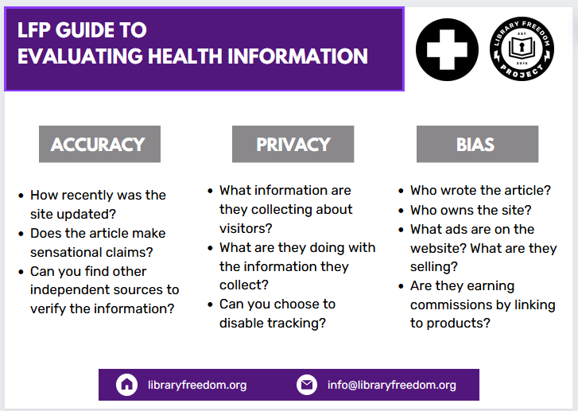
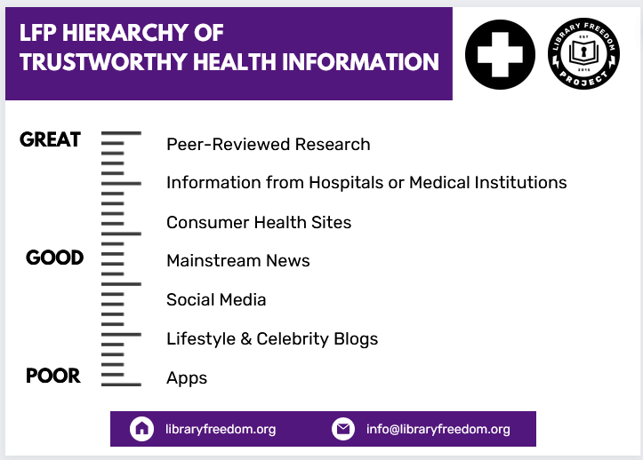
LFP Guide
Notes:
I wanted to point out this one in particular: a guide to evaluating online health information!

Slide 49
vimeo.com/libraryfreedominstitute/reproinfo
Notes:
And this video, which is available on our vimeo page: Privacy and Security for Reproductive Information Seeking
We also have a video from one of our crash courses about Reproductive and Health Privacy, which you can also find there!

Slide 50
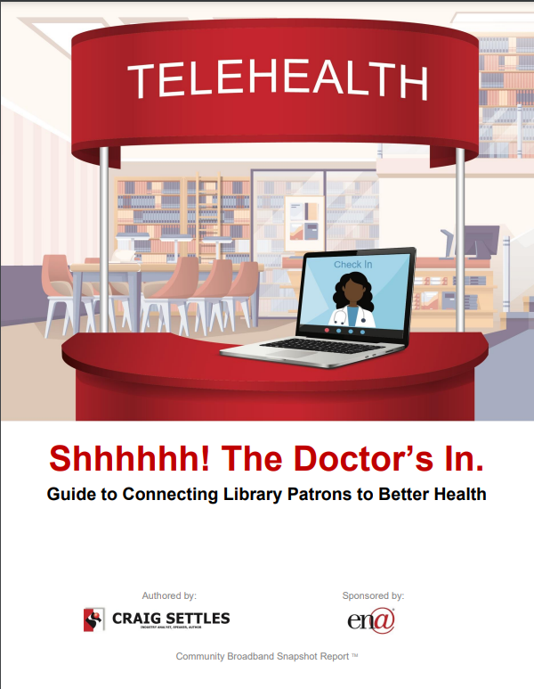
Library Telehealth Guide
Identifying patron healthcare needs
Piloting telehealth services in your community
Grant proposal and funding advice
Notes:
This Library Telehealth Guide, written by Craig Settles, is a great resource as well!
After he had a stroke he intimately understood the important role telehealth can play. This is a helpful guide as you consider implementing telehealth services in your space.
It shows you how to:
Identify patron healthcare needs
Apply for grants and market for funding opportunities
And pilot telehealth services in your community
https://cjspeaks.com/wp/wp-content/uploads/2021/05/LibraryTelehealthGuide.pdf

Slide 51
Review/Revise
Privacy Policies
Notes:
Finally, one important thing we can do is take a look at our own privacy policies and how patron privacy is (or isn’t) prioritized

Slide 52
Potential Risks (2)
Potential Risks
Considerations:
Collection
Storage
Access
Reporting
Retention
Communication
Notes:
As we examine our policies and procedures, it’s important to understand any potential privacy risks that exist in your space for library users.
One example that was fairly prevalent in early 2020 was libraries asking users to complete health screenings in an attempt to prevent the spread of COVID19.
Becky Yoose covered this specific health privacy concern in her article “WHEN LIBRARIES BECOME MEDICAL SCREENERS: USER HEALTH DATA AND LIBRARY PRIVACY” from 2020.
In it she says:
“While health screenings are used in other areas, such as employees returning to work, its use in a library to determine which library users can access the building brings up questions regarding user health data in the library and what libraries must think about when considering going down this path.”
She goes on to make some recommendations library staff need to keep in mind as they consider the data journey of health information in their library, whether from a specific instance like a health screening or more broadly. They are:
Collection
What user data is being collected on the screener form? Are you collecting data about a user, such as their name or library barcode? If so, what is the current business need to collect that data? Are you collecting any other data that can tie the screener data back to the user? For example, the combination of date/time, branch location, and security camera footage can connect a real-world individual to the health data, even if you don’t collect any other identifying information about the library user.
Storage
Where are you storing the screener forms? Are you entering the data from paper forms into a database or another electronic application or document? Where are the databases, documents, or applications located – local server, cloud-hosted service, shared network drive?
Access
Who has access to the data in your library? Is this access secured through secured physical storage or through user account permission levels? What access do vendor staff have to the user health data on a third-party system? What access do the vendor’s subcontractors have to that data in the system?
Reporting
What are your state and local regulations surrounding law enforcement requests for library user data? What are the regulations surrounding public disclosure requests for library user data? Do the definitions of library user data in those regulations cover all library user data, or do they only cover a specific subset of library user data?
Retention and Deletion
How long are you keeping the completed screener forms? How are you disposing the paper forms? How are you deleting the electronic library user health data?
Another consideration on top of what we already covered is the liability of a data breach if that information includes library user health data. How will your library communicate to its users that the data breach could have included health data collected by the screeners? How would your library prepare for the possible legal and reputational consequences of such a breach?

Slide 53
Revising Policy
How many years has it been?
What technology does it cover?
What materials does it cover?
What services does it cover?
Is it inclusive?
Is it accessible? Straightforward?
Is it logically written?
Does it use inclusive language?
Notes:
And here are some guiding questions to lead you as you take a closer look at your privacy policy:
How many years has it been?
What technology does it cover?
What materials does it cover?
What services does it cover?
Is it inclusive?
Is it accessible? Straightforward?
Is it logically written?
Does it use inclusive language?

Slide 54
Privacy Policy Audit
When was our privacy policy last reviewed?
Who are the stakeholders impacted?
What considerations are made for staff? For patrons?
Notes:
We like to think about policies this way:
Your library privacy policies and procedures are only as effective as the person with the least amount of knowledge and experience with them. In other words, if everyone can’t understand them, no one benefits.
Some other best practices when it comes to privacy policies include:
Creating interactive, scenario-based trainings to provide staff context needed to understand and implement policy and procedure
So these could be scenarios that you present to your staff at meetings, maybe inspired by real events or situations faced by your staff or others!
Providing opportunities for staff to discuss privacy-related issues in training sessions as well as asynchronous discussions in electronic staff forums or discussion lists
It might be worth scheduling time into regularly occurring staff meetings to discuss privacy issues that have either come up or that staff might be wondering about.
This is a great way to learn about the privacy concerns that ALL staff face. We might not know, for example, what the front desk folks are dealing with if we’re in the children’s section. Or we might not know what the security team is dealing with if we’re in the back office!
Have a regular training schedule for new staff as well as refresher trainings for existing staff and have training materials readily accessible to staff through the staff intranet or knowledge base
The last thing you want is a situation to arise without the folks involved knowing where to find what they need. Make sure you have regular trainings and that those materials are up to date or regularly updated.
Because as we know, new technology is emerging all the time! Privacy issues shift daily and we want to equip our staff and patrons with the most helpful and practical information.
So we recommend performing routine privacy policy audits, and here are a few questions you might ask when conducting this audit.
When was our privacy policy last reviewed?
Who are the stakeholders impacted?
What considerations are made for staff? For patrons?
By this we mean–

Slide 55
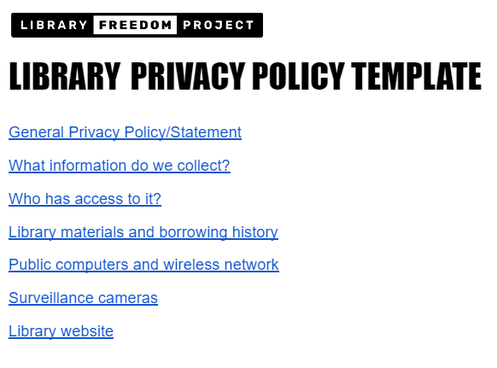
Libraryfreedom.org (9)
Notes:
I wanted to point out a couple resources in particular–the library privacy policy template!
this is a good place to start if you want to conduct a privacy policy audit in your library

Slide 56
Activity: Perusing Policy
Locate your library’s privacy policy and answer the following questions:
Was it easy to find?
Is it written in straightforward language? How long is it?
Is health data specifically mentioned?
Given our discussion, does anything stand out to you?
What would you add or change regarding health data?
Notes:
I want to provide you with this activity as something to take away from this workshop, something to do with your staff or with other library communities you might be part of.
You’ll locate your library’s privacy policy and answer the following questions:
Was it easy to find?
Is it written in straightforward language? How long is it?
Is health data specifically mentioned?
Given our discussion, does anything stand out to you?
What would you add or change regarding health data?
And at the end of this exercise, you’ll walk away with either renewed proficiency in our own policy OR some actionable ways to suggest improvement!

Slide 57
Takeaways
Remain optimistic
Take small steps
Think practically
Lead with empathy
Value learners
Stay humble
Notes:
So if you remember nothing else from today, here are some quick takeaways!
Stay optimistic! Remember that we’re working towards the possibility of change. We can make progress, and change is feasible! I don’t want you to leave this workshop feeling defeated and like online privacy is a vague, scary notion. Hopefully you are leaving with some practical resources and steps to take
Because one of the best ways to talk about and teach privacy is to use practical examples and provide practical plans to people.
Also remember that this is a learning process and we might need to take small steps!
We should meet people where they are and work with the goal of empowering them to understand and make changes that make sense to them.
As we meet our communities and teach these things, remember that everyone brings something to the table, and that our assumptions might be challenged–and ultimately staying humble (and nimble!) is a great way to teach and learn.

Slide 58
Thank you!
tess@libraryfreedom.org
libraryfreedom.org
Notes:
Finally, I would LOVE to come to your library—virtually or in person—to do a privacy workshop with your community or staff.
If you’re curious about what those look like or what we have to offer (I’ll just say it’s a HUGE range of formats and topics—from hands-on workshops at inservice days to delivering the keynote at a consortium gathering to guest lecturing for your class…and truly everything in between), please let me know! We’re currently working with a librarian who’s putting on a privacy series at her university library, so if that’s something that interests you, please get in touch!
Thanks so much for joining me today!

