Slide 1
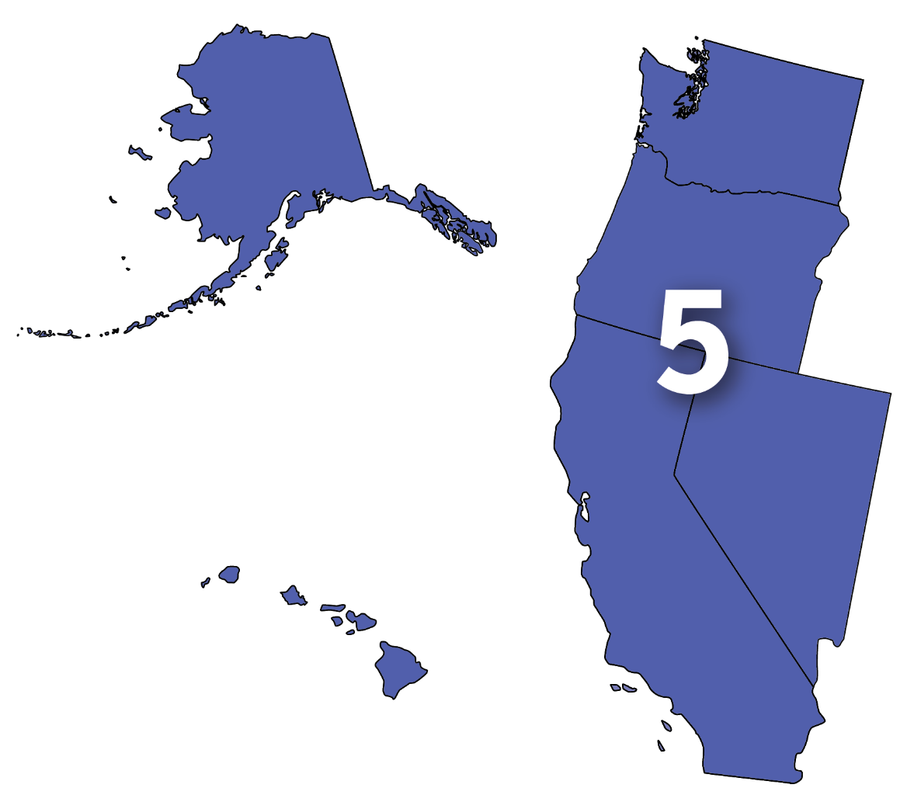
Network of the National Library of Medicine (NNLM) Region 5
NNLM Day at MLA
May 11, 2023
Notes:
Tania: Hello, and welcome to the Region 5 Update for NNLM Day at MLA.
My name is Tania Bardyn, Region 5’s Principle Investigator, and the Associate Dean for Health Sciences at the University of Washington Libraries.
Region 5 has had a busy year, and in today’s presentation, you’ll hear about some of the work Region 5 staff did and work we have planned. This year, the second year of our 5-year program, we worked on getting to know the members in Region 5. I had the opportunity to visit 12 Region 5 members and saw firsthand the good work happening in your communities. It’s been wonderful to get to know our members better, and to share information about the NNLM Region 5 program with you all. Thank you to those who hosted me, thank you to the Region 5 members who support the work of the NNLM, and thank you to the NNLM Region 5 staff for a good year.
I will now turn the presentation over to Emily Hamstra, Assistant Director, who will tell you more about our work.

Slide 2
Agenda
About the NNLM and NNLM Region 5
Review of Year 2 (May 2022 – April 2023): Programming, Funding, Outreach, and Training
Preview of Year 3 (May 2023 – April 2024): Programming, Funding, Outreach, and Training
Questions & Comments
Notes:
Emily: Thank you, Tania!
As Tania said, presentation is an opportunity for Region 5 staff to review the work we did this year, and to give you a preview of the work we’re planning to do in the coming year.
The NNLM program runs on a 5-year funding cycle. Each year, the Region 5 staff have specific goals and projects that we wrote into our proposal to NLM when we applied to be the Region 5 office. So, you’ll see that we refer to “Year 1, 2, 3,” etc. This is the year we’re in within our 5-year funding cycle.
Our fiscal year runs from May 1- April 30th. We’ve just wrapped up Year 2 and are now in Year 3.
So, in this presentation, I’ll give some information about NNLM and NNLM Region 5, and then will review Year 2, and preview Year 3. Please feel free to share questions and comments in the chat throughout the session.
This session is being recorded. If you’re watching this presentation as a recording, you can feel free to email your questions and comments to the Region 5 office at nnlm@uw.edu. The slides deck will be available with the recording. Anytime I say “there’s a link in the chat” that link is also in the slide deck, for those of you watching this as a recording.

Slide 3
Network of the National Library of Medicine (NNLM)
NIH
National Institutes of Health
NLM
National Library of Medicine
NNLM
Network of the National Library of Medicine
Nation’s research agency
World’s largest biomedical library
Outreach program of the NLM comprised of 7 Regional Libraries (RMLs) and several offices and centers
7 NNLM Regions
Notes:
I want to provide a very brief review of the Network of the National Library of Medicine, NNLM, structure.
The NNLM is the outreach program of the National Library of Medicine.
We’re organized regionally, and provide funding, free training opportunities, and programs to engage with your communities on topics related to health information.
The image on the left shows our regional configuration. The NNLM includes 7 Regions. The 7 NNLM Regions are also supported by 3 National Offices and 3 NNLM Centers.
The image on the right shows the relationship between the NNLM, the National Library of Medicine, and the National Institutes of Health: the NNLM is the outreach program of the National Library of Medicine. The National Library of Medicine is part of the National Institutes of Health.
NNLM region map https://www.nnlm.gov/about/regions

Slide 4
NNLM Mission
To advance the progress of medicine and improve the public health by providing all U.S. health professionals with equal access to biomedical information and improving the public's access to information to enable them to make informed decisions about their health.
Notes:
The NNLM mission is to advance the progress of medicine and improve the public health by providing all U.S. health professionals with equal access to biomedical information and improving the public’s access to information to enable them to make informed decisions about their health.
Towards this mission, NNLM’s main goals are to work through libraries and other member organizations to support a highly trained workforce for biomedical and health information resources and data, improve health literacy, and increase health equity through information.
We offer programs addressing this mission at a national and regional level. Today’s presentation will focus on what we’re doing at a regional level to contribute to national programs, initiatives, and goals.

Slide 5
NNLM Region 5
Serves Alaska, California, Hawaii, Nevada, Oregon, Washington, and the U.S. Territories and Freely Associated States in the Pacific
812 member organizations
Based at the University of Washington Health Sciences Library, Seattle, WA
Join the NNLM
Notes:
NNLM Region 5 serves Alaska, California, Hawaii, Nevada, Oregon, Washington, and the U.S. Territories and Freely Associated States in the Pacific.
We’re a geographically large region, covering 5 different time zones. I want to acknowledge that this presentation is at a time that’s not within working hours for those of you in Hawaii and the U.S. Territories and Freely Associated States in the Pacific. If you’re watching the recording, thank you for your patience and understanding!
Region 5 has 812 members. These member organizations include libraries of all types, public health departments, academic institutions and departments, health clinics and hospitals, community-based organizations, schools, faith-based institutions, and more. Membership means that your organization is on board with the mission of the NNLM and allows your organization to apply for funding opportunities. Membership is free. If your organization is not a member, we’d love to have you join.
A link is in the chat with more information about joining.
Join the NNLM Region 5. It’s free!: https://www.nnlm.gov/membership/join

Slide 6
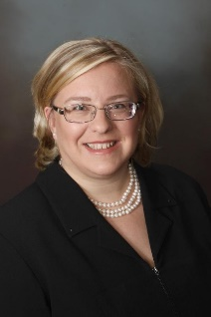
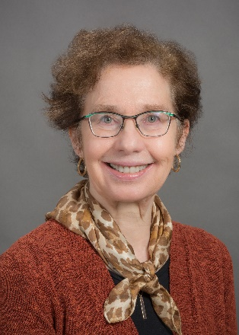
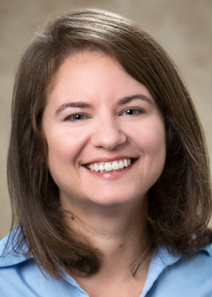
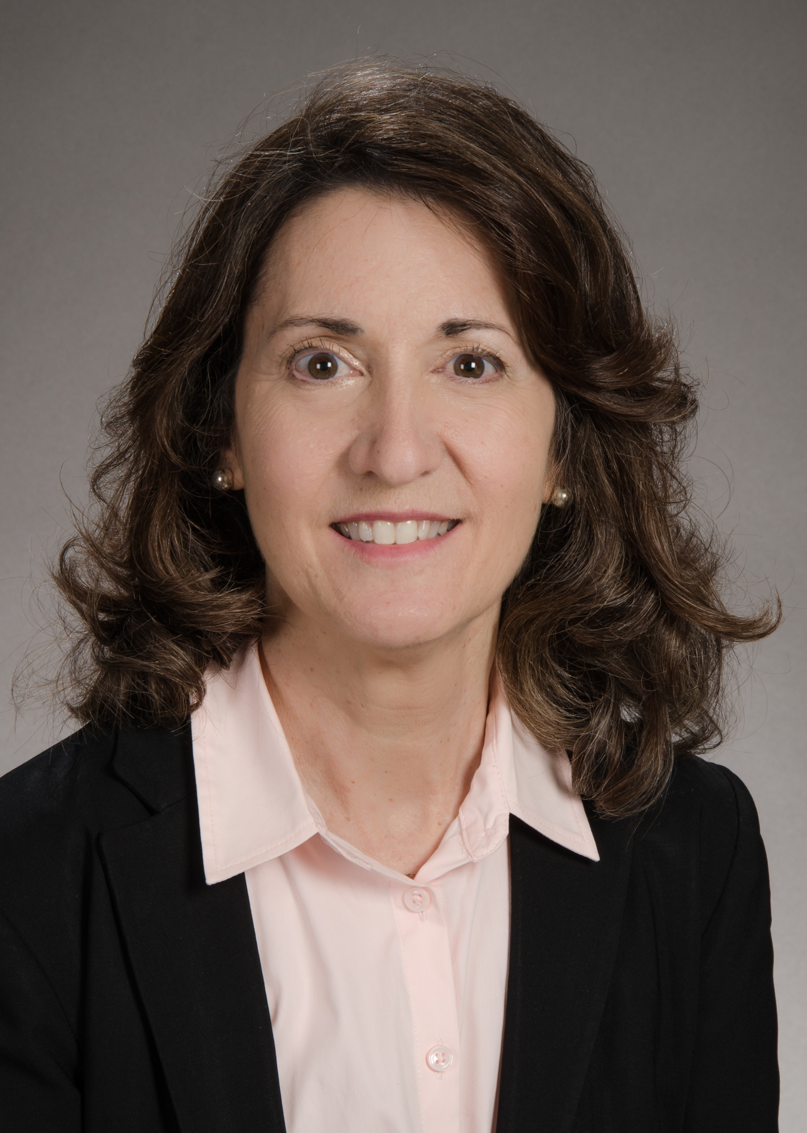
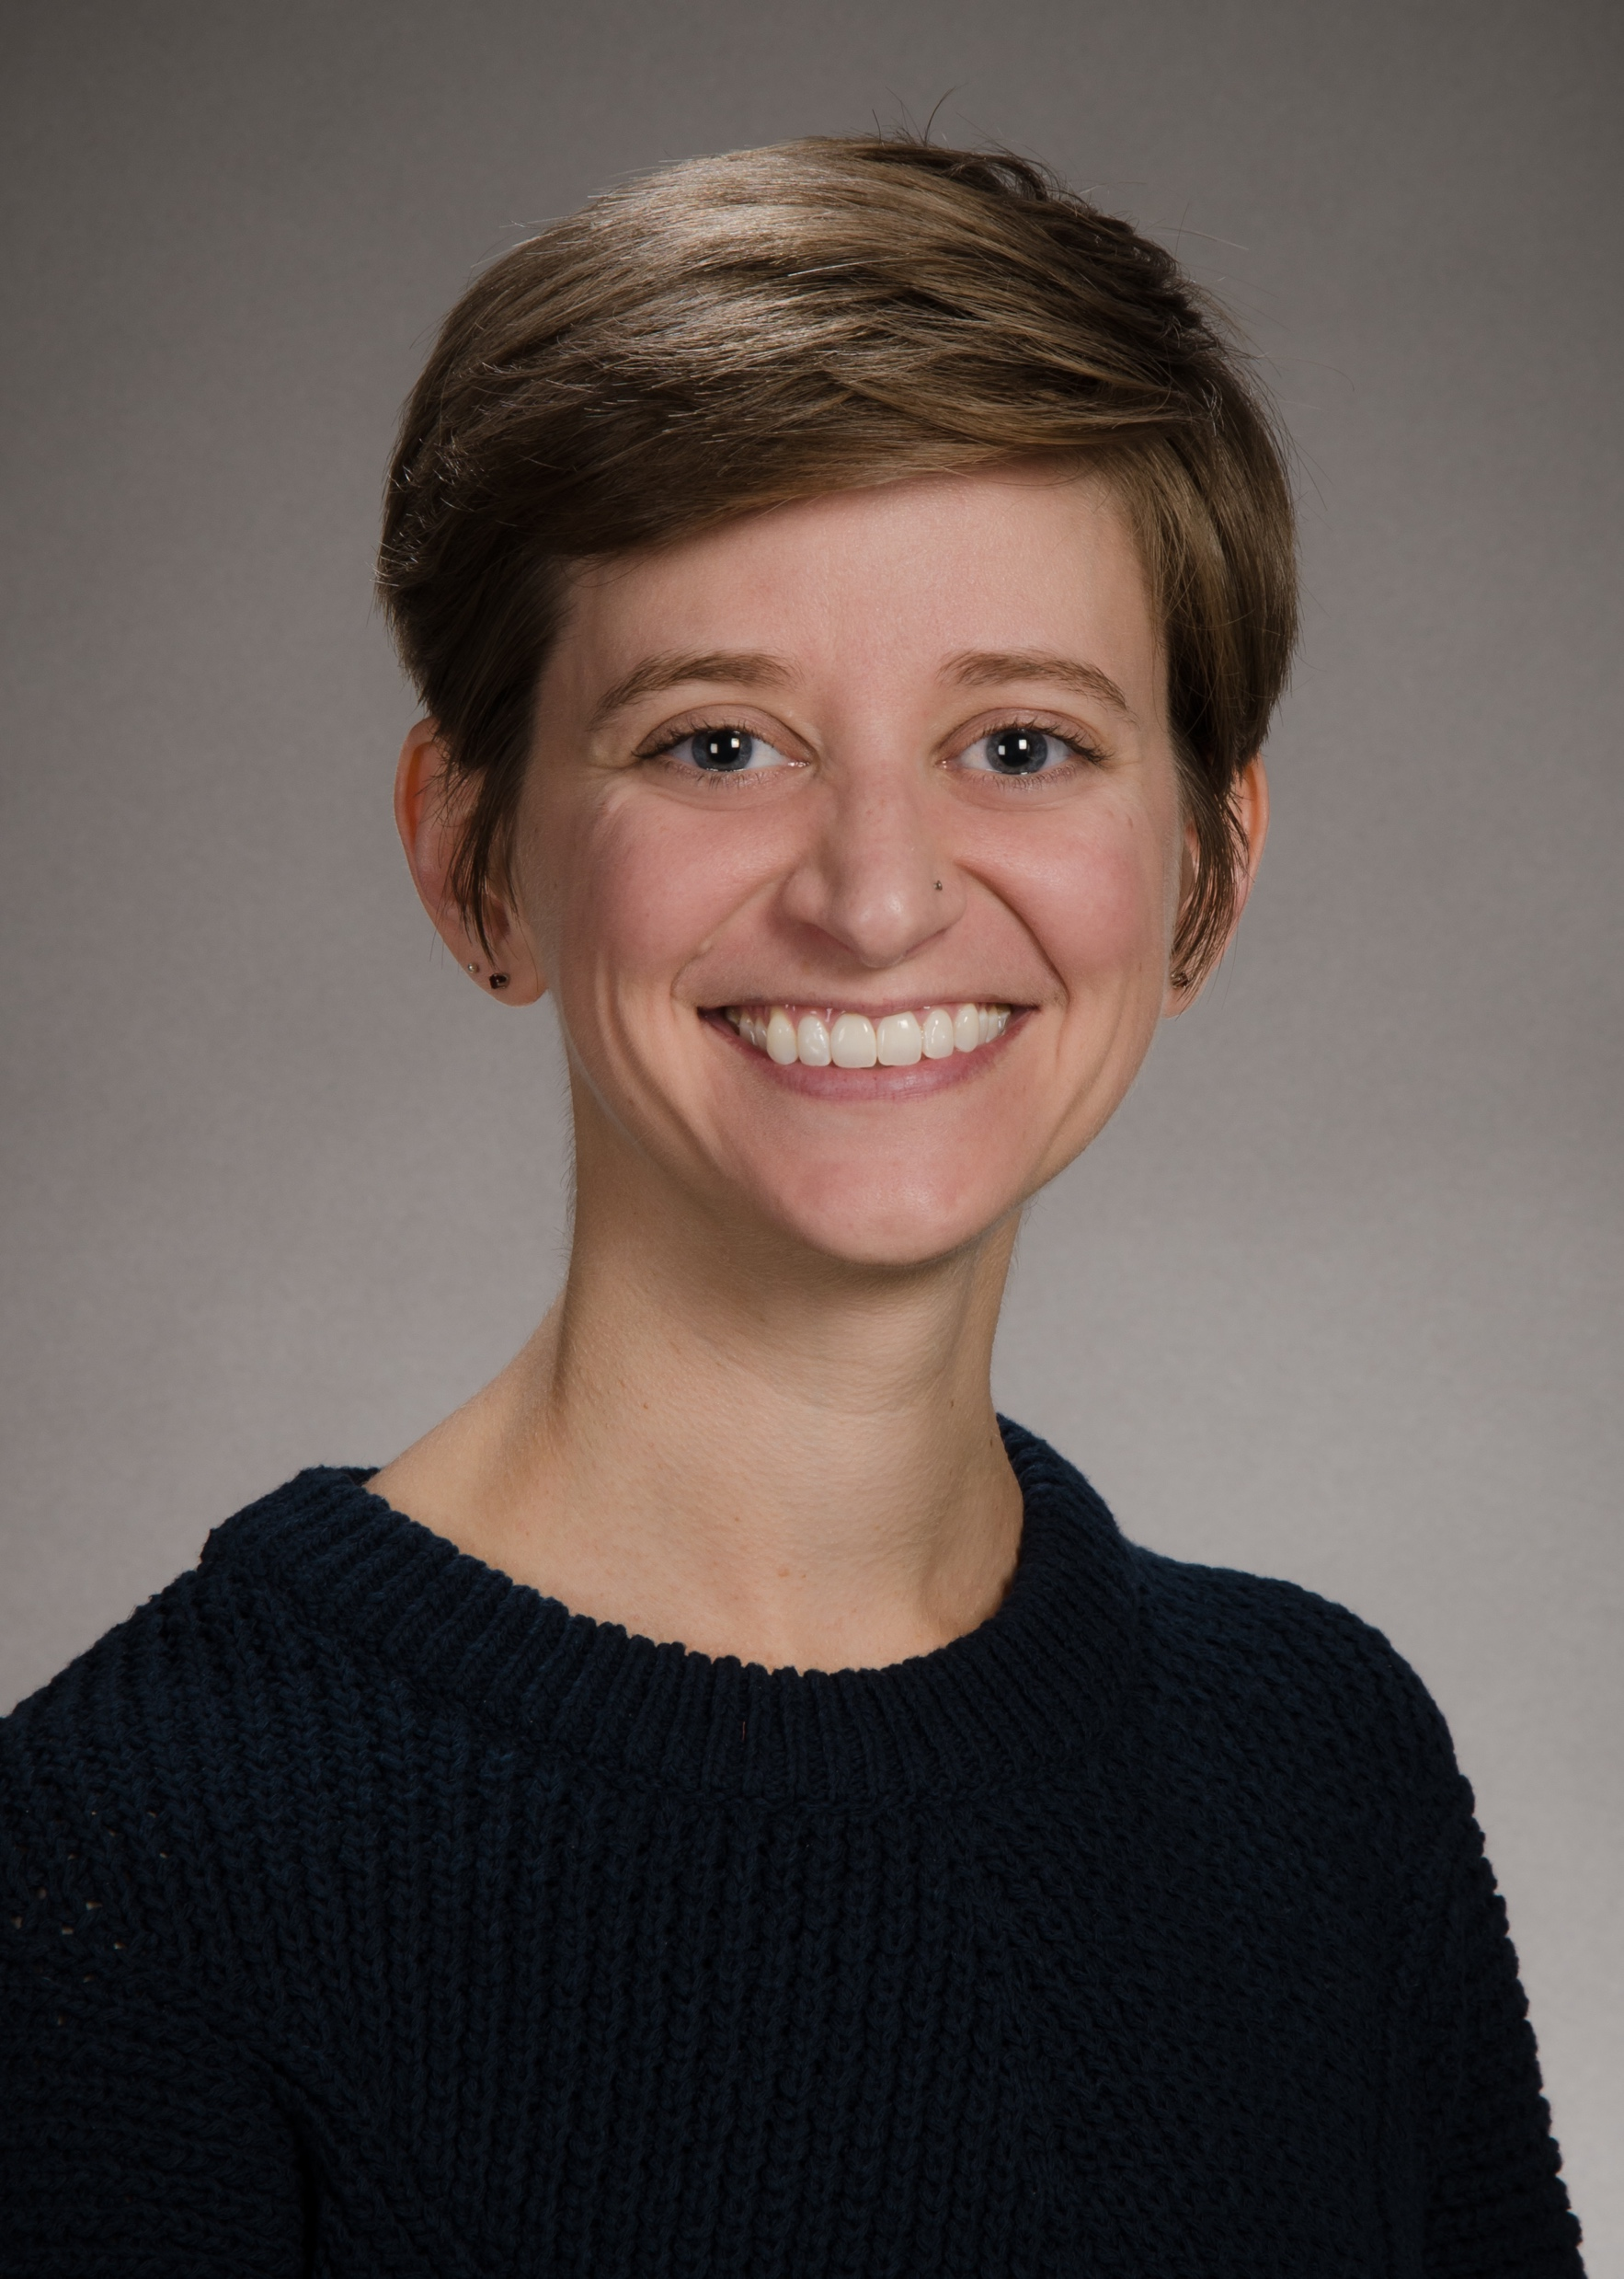
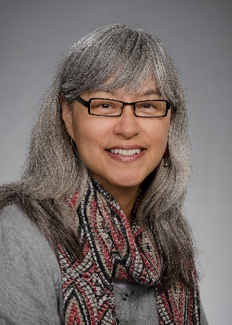
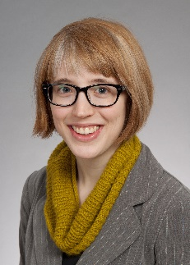
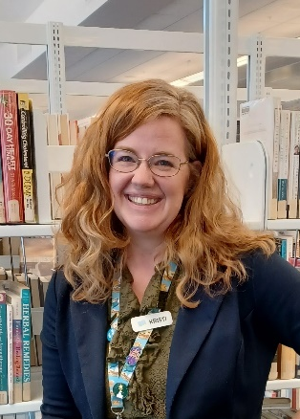
NNLM Region 5 Staff
Serving Alaska, Washington, Oregon, Nevada, California, Hawaii, and the U.S. Territories and Freely Associated States of the Pacific
Tania Bardyn, MLIS, AHIP
Principal Investigator
Cathy Burroughs, MLS
Executive Director
Carolann Curry, MLIS
Outreach & Data Coordinator
Lisa Guerrero
Grants Manager/ Budget Analyst
Emily Hamstra, MSI
Assistant Director
Carolyn Martin, MLS, AHIP
Outreach & Education Coordinator
Liz Morris, MLIS
Outreach & Access Coordinator
Maddie Romansic
Program Analyst &
Communications Specialist
Kristi Torp, MLS
Project Specialist
Notes:
The Region 5 staff carry out the work that meets the mission of the NNLM.
Introducing the team, we are led by Tania Bardyn, Principle Investigator, and Cathy Burroughs, Executive Director.
We’re looking forward to welcoming our new colleague, Carolann Curry, Outreach & Data Coordinator, in June.
Lisa Guerrero is our Grants Manger and Budget Analyst. I, Emily Hamstra, am the Assistant Director. Carolyn Martin in the Outreach & Education Coordinator. Liz Morris, Outreach & Access Coordinator, joined the team in January, and we’re so glad to have her. Maddie Romansic in our Program Analyst and Communications Specialist. And, Kristi Torp is our Project Specialist.
Congratulations to Kristi Torp! Kristi was recently accepted into the NLM Associate Fellows Program, and will be leaving Region 5 in June for Associate Fellow position. While it’s hard for us to let Kristi go, we are so excited for her, and look forward to following her work in the Associate Fellows Program and beyond.

Slide 7
Year 2 in Review May 1, 2022 – April 30, 2023
Programming
Funding
Outreach
Training
Notes:
Now that you know who we are, let’s talk about what we’ve done this year.
I’m going to review 4 key areas of work, programming, funding, outreach, and training, that took place between May 2022 and April 2023.
I’ll start with programming.

Slide 8
Programing: PNC-MLA Health Equity and Diversity Speaker Series
Storytelling as a Public Health Strategy to Address Inequities in Maternal Health Outcomes
Dr. Nakeitra L. Burse
August 24, 2022
Trans Accessible Libraries Initiative
Julie Leuzinger and Coby Condrey
December 6, 2022
Learn more: nnlm.gov/pncmlaseries
Notes:
The PNC-MLA Health Equity and Diversity Speaker Series is a collaboration between NNLM Region 5 and Pacific Northwest Chapter/Medical Library Association (PNC-MLA) through the efforts of its Diversity Committee.
The series features expert guest speakers presenting on topics pertaining to health equity and diversity.
This year, we co-hosted two webinars with PNC-MLA:
The first was “Storytelling as a Public Health Strategy to Address Inequities in Maternal Health Outcomes.” In this webinar, Dr. Nakeitra L. Burse discussed how storytelling, through the film Laboring with Hope, supports public health strategies to improve maternal health outcomes for Black women. The webinar was well-received, and led to future programming from Region 5, which I will highlight in the next slide.
The second was “Trans Accessible Libraries.” The Trans Accessible Libraries Initiative, at the University of North Texas Libraries, aims to remove some of the barriers transgender individuals face accessing information and to provide more equitable access to services and collections. The presenters, Julie Leuzinger and Coby Condrey, librarians at the University of North Texas Libraries, shared results from a needs assessment, their collection development process, their promotion and outreach, and some best practices they learned along the way.
Both sessions were recorded, and the recordings are available on YouTube. You can also find a link to the recordings on nnlm.gov/pncmlaseries.

Slide 9
Programming: Laboring with Hope
Streaming access to the 30-minute film about maternal health disparities
Conversation guide, health information resources, bibliography of peer-reviewed articles, infographics
5 NNLM members hosted programs or discussions about the film
Access will be extended through April 2024
Notes:
An idea planted during Dr. Burses’ webinar led to a new programming opportunity. We decided to offer access to the film Laboring with Hope to NNLM Region 5 members. Laboring with Hope is a 30-minute documentary that combines personal stories and expert perspectives to bring awareness of maternal health disparities for black women. Region 5 has streaming access to the film to share with members. Access to the film comes with a conversation guide, health information resources, a bibliography of peer-reviewed articles, and infographics.
This year, 5 NNLM members hosted programs or discussions about the film.
We’ve had positive feedback on this program and will be extending access through April 2024.
The film would be an excellent addition to nursing and public health classes. Please contact the Region 5 office if you’re interested in accessing the film, and we’ll help you get set up.

Slide 10
Health Misinformation Symposium
Recordings available on YouTube
Highlights from Region 5:
The Etiology of Medical Misinformation, Jevin West
Coming Together to Counter Health Misinformation in Local Communities: An Academic and Public Libraries Partnership, Margaret Henderson and Tricia Lantzy
Misinformation Escape Room: A Gamified Approach to Building Health (Mis)Information Literacy, Chris Coward
Notes:
Confronting Health Misinformation is a NNLM-wide initiative. A crucial part of Confronting Health Misinformation is understanding how and why it spreads.
The NNLM Health Misinformation Symposium, held in April, addressed this and many other related topics.
Recordings of the event are available on the NNLM YouTube channel.
There were several speakers from Region 5, including
"The Etiology of Medical Misinformation“, a keynote by Jevin West from the University of Washington’s Center for an Informed Public,
“Coming Together to Counter Health Misinformation in Local Communities: An Academic and Public Libraries Partnership”: Margaret Henderson (San Diego State University) and Tricia Lantzy (California State University, San Marcos) talked about the San Diego Circuit Consortium’s work to address health misinformation in their county.
“Misinformation Escape Room: A Gamified Approach to Building Health (Mis)Information Literacy” from Chris Coward, faculty at the University of Washington iSchool featured a misinformation escape room game designed for cancer patients and survivors who are frequently the targets of cancer nutrition misinformation, and the sharing of pilot study findings of the game.
Thank you to Carolyn Martin, Region 5’s Outreach & Education Coordinator, for her work on the NNLM committee that planned and hosted this symposium.
NNLM National Health Misinformation Symposium YouTube Playlist
https://youtube.com/playlist?list=PLUlRqrjIldD77zi_WpUBaTUx6tf8cv1X8

Slide 11
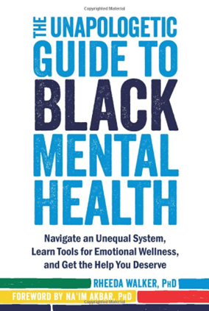
Collection Equity Awards
In Year 1 & 2, 38 awards funded
Over 1400 unique resources collected
Reflect communities in Region 5
Expand access to diverse voices in library collections
Notes:
NNLM Region 5 funded a total of 38 Collection Equity Outreach Awards in Years 1 and 2 to member organizations in the region who used the grants to purchase materials that supported the collection equity goals submitted in their applications.
As a requirement of the award, each member organization submitted a bibliography of purchased materials using a template provided by NNLM staff. These bibliographies were then used to compile the content for the Divers Voices Toolkit. The most popular topics focused on BIPOC and LGBTQIA+ as well as mental health.

Slide 12
Diverse Voices Collection Development Toolkit
Available from several places on the NNLM website
Please use and share the direct link to the Diverse Voices in Health and Medicine Collection Toolkit
Access collection guides for Adults, Children, Young Adults, and Zines
Notes:
The Diverse Voices Toolkit includes detailed collection guides in PDF format for Adult collections, Children's collections, Young Adult collections, and even Zine collections. These collections are a great place to start if your library is working to create inclusive representation in your health collections.
Once downloaded, users can easily browse by topic using the hyperlinks in the Subject List of each collection guide.
I want to thank Kristi Torp, Region 5’s Project Specialist for her excellent work on creating and maintaining the toolkit. It’s proving to be a very useful resource to many! The toolkit had had over 1000 unique downloads since October 2022.
Kristi will be presenting a lightning talk at MLA about the Diverse Voices Collection Development Toolkit. Be sure to add that to your calendar! Her presentation will be on Wednesday May 17, 2023, during the Virtual Lightning Talks, Session 1, from 1:30-3pm. Drop in at 2pm Eastern Time to catch Kristi’s presentation.
Download the toolkit: https://www.nnlm.gov/diversevoices

Slide 13
NNLM Discovery Podcast
Explores how the NNLM engages with communities
Hosted by Yamila El-Khayat
NNLM Discovery Podcast
Notes:
The Collection Equity Awards are highlighted in the NNLM Discovery Podcast.
We're excited to share that NNLM has launched the NNLM Discovery Podcast, which is currently available wherever you get your podcasts.
This podcast series explores how NNLM is engaging with communities to provide access to trusted information for the purpose of improving the public’s health. The first season highlights the community impact network members have through NNLM funded projects. Region 5’s episode shares how three libraries in Alaska, Hawaii and Nevada used Collection Equity Awards to enhance diverse representation in their collections and support health literacy in their libraries.
We’re looking forward to hearing more podcasts in this series!
https://www.nnlm.gov/podcast

Slide 14
Data Engagement Awards May 1, 2022- April 30, 2023
San Diego State University--$14,685 Award
Training Health Sciences Students to Find Data for Local and Global Research and Service Project
University of California, San Francisco--$24,934 Award
Data Journalism Course in a Box: The COVID Tracking Project Archives
University of Hawai’i at Manoa Library--$24,999 Award
Mālama i ka ‘ikepili Caring for Data: Supporting Hawai’i’s Research Data Needs through a Library Data Services Program
Notes:
Now, we’ll move on from programming to funding. Programming and funding are very interconnected!
This year, we were thrilled to support three Data Engagement projects.
San Diego State University was funded to help future health and social sciences professionals learn how to find and use data to help their communities. Participants attended workshops to learn how to find government and other open sources of data and learn citation management and data analysis and visualization. The workshops also covered ethics, social justice, health disparities, and the value of open science.
University of California, San Francisco was funded to create a course module using data from the COVID Tracking Project, to help journalism students and public health communicators learn methodologies of data collection, communication and transparency in community-science projects.
The University of Hawai’i at Manoa (UHM) Library was funded for their project Caring for Data: Supporting Hawai’i’s Research Data Needs through a Library Data Services Program. The UHM Library developed a biomedical data management and data sharing course optimized for Hawai’i researchers and students. The funding allowed the library to conduct a data needs assessment, develop the asynchronous online course, and organize a live symposium as its culmination in Spring 2023. This project will lay the foundation for data services in the Library going forward.

Slide 15
Outreach & Engagement Awards May 1, 2022- April 30, 2023
California State University, Chico--$24,998 Award
Rural Access to Health Information: Training Community Health Navigators in Northern California to Expand Access to Virtual Health Information Tools
San Francisco State University--$24,998 Award
Challenging Racism Within the Context of Dental Care Through Ethnic and Local Media and With Public Libraries as Safe, Neutral Spaces for Reaching Medically Underserved Populations
Notes:
We are equally excited to support four Outreach & Engagement awards:
California State University, Chico led a project to improve access to medical information for rural communities in Northern California by training health navigators in English and Spanish on MedlinePlus and other reliable health information resources.
San Francisco State University was funded to address the public health challenge of racism within the context of dental care in their project Challenging Racism Within the Context of Dental Care Through Ethnic and Local Media and With Libraries as Safe, Neutral Spaces for Reaching Medically Underserved Populations. The project aimed to demonstrate the effectiveness of utilizing public libraries as alternative, neutral spaces for underserved racial and ethnic minority prospective patients. Up to five dental health fairs at local public libraries in medically underrepresented areas brought together prospective patients, libraries, and university students to create stronger trust and understanding between these groups to further alleviate health disparities.

Slide 16
Outreach & Engagement Awards May 1, 2022- April 30, 2023
University of California, San Diego--$24,998 Award
Building Resilience to Health Misinformation in San Diego County, California Communities: An Online Outreach Toolkit for Library Workers
Sacramento Public Library -- $24,709 Award
H.E.A.L.T.H. (Health Equity Access: Library Telehealth Hub)
Notes:
The University of California, San Diego was funded to support a consortium of public and academic libraries in San Diego County, the San Diego Circuit Libraries, in developing an online outreach toolkit to help library workers mitigate health misinformation and engage community members for improved health information literacy.
The toolkit, available in English and Spanish, was recently released and it focuses on raising awareness of health misinformation and teaching techniques for evaluating health claims, finding reliable sources, and responding to misinformation ethically.
Finally, the Sacramento Public Library, was funded to station a private booth at one library branch to be used for telehealth purposes. The booth is equipped with wi-fi, a laptop, monitor, printer, additional lighting, webcam, and microphone to ensure high-quality video for virtual, private appointments with health professionals.
This will be the first telehealth service in a public library in Northern CA, and if it goes well, Sacramento Public Library expects to expand it to other branches.
Congratulations to all our funded partners on your excellent work!

Slide 17
Outreach: Membership Drive
Identified 83 Minority Serving Institutions (MSI) in Region 5 who are not members
Sent an email to each institution’s library inviting them to join
Benefits of the NNLM:
Access to PubMed instruction resources
Training resources
Open funding opportunities
DOCLINE access (if library qualifies)
Membership
Notes:
And now, I’ll review some key outreach we did this year.
This year, we reached out to academic institutions in Region 5 who receive federal funding through the Minority Serving Institutions program. We identified 83 institutions who receive MSI funding, and are not members of NNLM. Then we identified contacts at these institution’s libraries, using library websites.
One of Region 5’s advisory committees, the Subcommittee on Access and Outreach, provided feedback and input on a letter that we emailed to the contact identified at each institution’s library. The letter included information about NNLM Region 5, including information about available resources for PubMed instruction, our classes and webinars, open funding opportunities, DOCLINE, and membership.
As a result of this outreach, we have 8 new members.

Slide 18
Welcome new members!
Alaska
Ninilchik Community Library
California
HealthImpact
Vascular Cures
Presentation High School
University of Southern California - Keck School of Medicine, Center for Emerging Pathogens
Buck Institute for Research on Aging
Chaffey College Library
Columbia College Library
Vanguard University - O. Cope Budge Library
Santa Monica College Library
California State University, San Marcos
California State University, San Bernardino Libraries
T’ena Health
Guam
Guam Community Health Centers
Hawaii
Obama Hawaiian Africana Museum
Chaminade University - Sullivan Family Library
Nevada
North Las Vegas Library District
Oregon
Marshallese Women's Education and Health Network
Driftwood Public Library
Oregon State Department of Human Services
Central Oregon Community College, Barber Library
The Next Door
Washington
Midwives' Association of Washington State, MAWS
Clark College Libraries
Upper Skagit Library
Richland Public Library
Clover Park Technical College
Spokane Falls Community College
Spokane Falls Community College Library
Notes:
In all, 29 new members joined Region 5 in Year 2!

Slide 19
Welcome New Members!
Alaska
Ninilchik Community Library
California
HealthImpact
Vascular Cures
Presentation High School
University of Southern California - Keck School of Medicine, Center for Emerging Pathogens
Buck Institute for Research on Aging
Chaffey College Library
Columbia College Library
Vanguard University – O. Cope Budge Library
Santa Monica College Library
California State University, San Marcos
California State University, San Bernardino Libraries
T’ena Health
Guam
Guam Community Health Centers
Hawaii
Obama Hawaiian Africana Museum
Chaminade University – Sullivan Family Library
Nevada
North Las Vegas Library District
Oregon
Marshallese Women's Education and Health Network
Driftwood Public Library
Oregon State Department of Human Services
Central Oregon Community College, Barber Library
The Next Door
Washington
Midwives' Association of Washington State, MAWS
Clark College Libraries
Upper Skagit Library
Richland Public Library
Clover Park Technical College
Spokane Falls Community College
Spokane Falls Community College Library
Notes:
And, speaking of new members… This year, we welcome 29 new members to NNLM Region 5, representing Region 5’s wide geography. Our new members, listed here, include public libraries, academic libraries, public health organizations and departments, museums, health centers, community-based organizations, and research organizations.
8 of these members joined in response to the membership drive described on the previous slide.
Remember, membership in the NNLM is free, and allows your organization to apply for funding. All members are listed in our public-facing members directory on our website, nnlm.gov. If your organization is not a member, and is interested in membership, you can contact me directly, or sign up using the membership form on our website.

Slide 20
Welcome New Members!
Alaska
Ninilchik Community Library
California
HealthImpact
Vascular Cures
Presentation High School
University of Southern California - Keck School of Medicine, Center for Emerging Pathogens
Buck Institute for Research on Aging
Chaffey College Library
Columbia College Library
Vanguard University – O. Cope Budge Library
Santa Monica College Library
California State University, San Marcos
California State University, San Bernardino Libraries
T’ena Health
Oregon
Marshallese Women's Education and Health Network
Driftwood Public Library
Oregon State Department of Human Services
Central Oregon Community College, Barber Library
The Next Door
Washington
Midwives' Association of Washington State, MAWS
Clark College Libraries
Upper Skagit Library
Richland Public Library
Clover Park Technical College
Spokane Falls Community College
Spokane Falls Community College Library
Guam
Guam Community Health Centers
Hawaii
Obama Hawaiian Africana Museum
Chaminade University – Sullivan Family Library
Nevada
North Las Vegas Library District
Notes:
And, speaking of new members… This year, we welcome 29 new members to NNLM Region 5, representing Region 5’s wide geography. Our new members, listed here, include public libraries, academic libraries, public health organizations and departments, museums, health centers, community-based organizations, and research organizations.
8 of these members joined in response to the membership drive described on the previous slide.
Remember, membership in the NNLM is free, and allows your organization to apply for funding. All members are listed in our public-facing members directory on our website, nnlm.gov. If your organization is not a member, and is interested in membership, you can contact nnlm@uw.edu, or sign up using the membership form on our website.

Slide 21
Outreach: Conferences
Hawaii Library Association Conference
Medical Library Association Annual Meeting
Pacific Northwest Chapter- Medical Library Association
Northwest Interlibrary Loan Conference
MLGSCA/NCNMLG Joint Spring Symposium
Washington Library Association Conference
Alaska Library Association Conference
Hawaii Pacific Chapter- Medical Library Association
Notes:
Presenting and exhibiting at conferences continues to be a way that we connect with you all. This year, Region 5 staff attended 8 conferences to present and/ or exhibit on behalf of Region 5. Perhaps our paths crossed at one of these conferences!

Slide 22
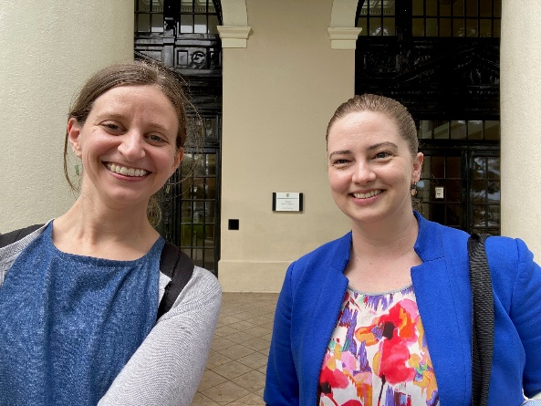
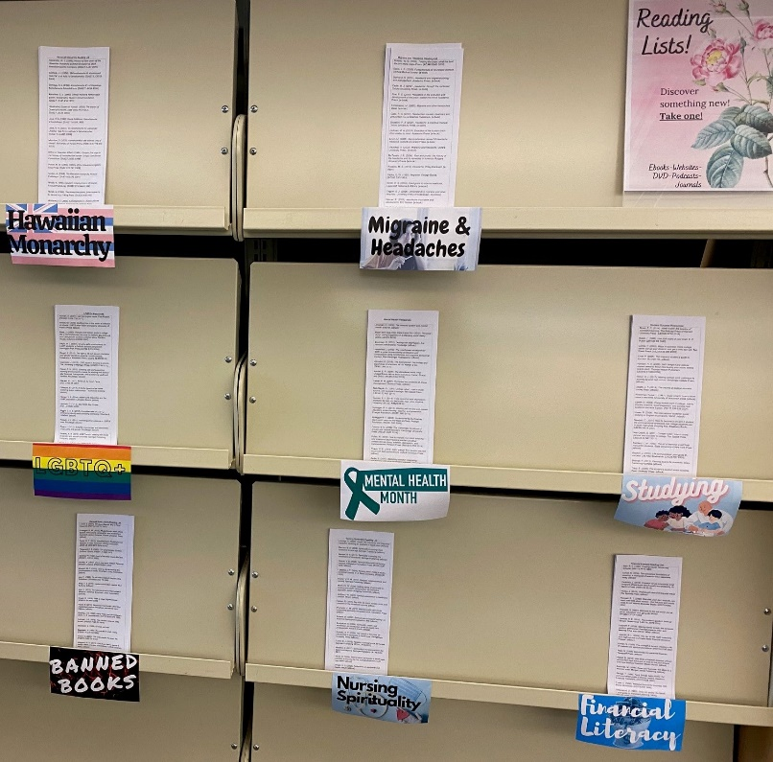
Outreach: Site Visits
Washington (8)
Nevada (5)
Hawaii (6)
Outcomes:
3 new members
new opportunities for programming partnerships
better understanding of member needs
Reading lists encourage wellbeing at the Sullivan Family Library, Chaminade University
Hawaii State Library
Notes:
This year, Region 5 staff visited 19 members and potential members in Washington, Nevada, and Hawaii. This resulted in 3 new members joining the NNLM and opened opportunities for programming partnerships and a better understanding among Region 5 staff of member needs. Tania Bardyn, Region 5’s PI, did 12 of these site visits.
The photos on this slide are from site visits that Liz Morris and I did last month in Honolulu.

Slide 23
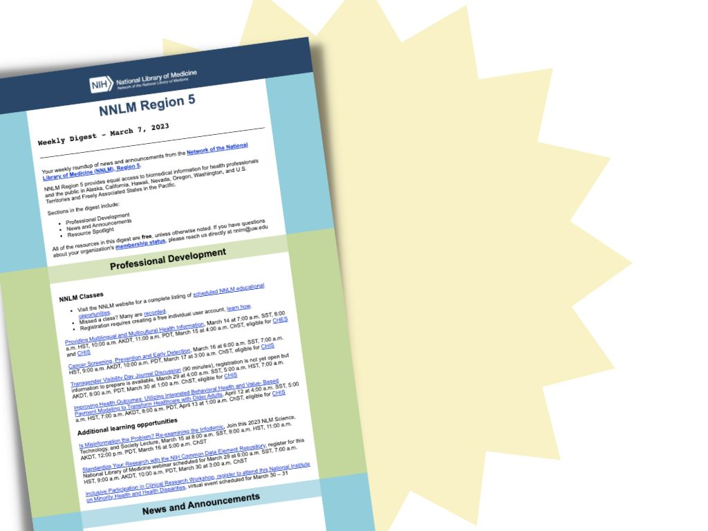
NNLM Region 5 Weekly Digest
The Weekly Digest has a new format
Provides information about:
Upcoming NNLM classes and additional professional development opportunities
News from
NNLM (including funding)
National Library of Medicine
National Institutes of Health
Highlighted resources
To subscribe, visit the Region 5 website
Notes:
Have you been receiving our Weekly Digest? The Weekly Digest is our weekly newsletter, compiled each week by Carolyn Martin with input from Region 5 staff. The Weekly Digest includes upcoming classes, funding announcements and opportunities, news about health information resources or what’s happening at NLM and NIH. This year, we changed the format and method of distribution for the Weekly Digest, in order to reach more people.
If you have an NNLM User account that you use to register for classes, you are probably already subscribed. That is the easiest way to get subscribed but if you prefer not to create a user account, you can visit our Region 5 webpage for more information
https://www.nnlm.gov/about/regions/region5

Slide 24
Training: New Course, CHIS On-Demand
Self-paced/ on-demand course
Up to 5 CEs available
Option to pick and choose which modules you want to take
Counts towards CHIS Level 1
Learn more and register:
CHIS On-Demand
Consumer Health Information Specialization (CHIS)
Notes:
And now, for training:
Carolyn Martin was instrumental in creating the new course, CHIS on-demand. CHIS, or the Consumer Health Information Specialization, is a credential from the Medical Library Association.
CHIS On-Demand is self-paced and available anytime. There are 5 modules included in the course. Each modules takes 1 hour to complete. The modules are:
Know the Community
Know the Health Consumer
Knowledge of Subject Matter and Resources
Evaluation of Health Information
Communication, Reference, and Instruction
You may pick and choose which modules you want to take, and which order you take them in. 1 Medical Library Association Continuing Education credit, or MLA CE, is earned for each module. These CEs count towards the CHIS Level 1. You can register for the course through the NNLM.gov website, and a direct link is in the chat.
Register for CHIS On-Demand: https://www.nnlm.gov/training/class/chis-demand
Remember, NNLM has funding to cover your CHIS application fee. So, please contact us if you have any questions about receiving that funding.

Slide 25
Training: Library Carpentry Workshop
Hosted in December 2022
Workshop Lessons:
Introduction to Working with Data (Regular Expressions)
OpenRefine
Introduction to R
21 attended
Offered again in October 2023, exact date TBD
Notes:
In December 2022, Region 5 offered access to a Library Carpentry workshop. Library Carpentry focuses on building software and data skills within library and information-related communities. Their hands-on, approachable workshops empower people in a variety of roles to use software and data in their own work and support effective, efficient, reproducible practices. The workshop was broken into three lessons: Introduction to Working with Data (Regular Expressions), OpenRefine, and Introduction to R.
Registration from Region 5 was prioritized, and 21 attended the workshop. Maddie Romansic coordinated registration, communication, and participated in the workshop for us.
We are offering the workshop again in October 2023, exact date TBD

Slide 26
Year 3 Preview May 1, 2023 – April 30, 2024
Programming
Funding
Outreach
Training
Notes:
Phew! Year 2 was exciting and busy.
Looking to the present and near-future, we’re planning an equally exciting and busy year of programming, funding, outreach, training. Let’s talk about some highlights.

Slide 27
Year 3 Programming
Laboring with Hope
PNC-MLA Health Equity and Diversity Speaker Series continue
Environmental Health Webinar series
MedlinePlus mini tutorials for community health workers
Notes:
Building on successful programming from last year, we’re planning to continue two programs:
As mentioned earlier in this presentation, we are continuing to provide streaming access to the 30-minute documentary Laboring with Hope. We have access through April 2024. This is an excellent opportunity to start conversations in your community, hospitals, classrooms, and libraries on the maternal health disparities disproportionately experienced by black women.
We’ll also continue our partnership with PNC-MLA to host the Health Equity and Diversity Speaker Series.
Region 5 staff will also be coordinating a NNLM Environmental Health Webinar Series, to address the NNLM national initiative on environmental determinants of health. This will be a collaborative, and national endeavor, and will include input from all NNLM regions, offices, and centers.
Watch the NNLM training calendar for scheduled events. And also, if you have recommendations for speakers for either series, we’d love to hear those recommendations. Contact the nnlm@uw.edu.
Region 5 staff are working on mini tutorials on MedlinePlus for community health workers. These plain langague, mini-tutorials about using MedlinePlus will assist community health workers in their engagement with their communities to provide more equitable access to health information.

Slide 28
Year 3 Funding
In process:
Collection Equity Awards
Technology Equity Awards
Coming soon:
Professional Development Awards
Notes:
Funding is underway! We’re in the process of awarding recipients of the Collection Equity Awards and Technology Equity Awards. Cathy Burroughs and Lisa Guerrero have been very busy setting up the funding and other infrastructure for these awards. Thank you, Cathy and Lisa!
We look forward to officially announcing the recipients of the Collection Equity Awards and Technology Equity Awards soon.
Also coming soon-- we’ll open opportunities for Professional Development Awards. Individuals and member institutions are encouraged to apply for this funding for training, conferences, or other professional development opportunities. We will announce this funding opportunity through the Weekly Digest, so please stay tuned to the Weekly Digest for more information.

Slide 29
Year 3 Outreach
Conferences:
Oregon Reference Summit (May)
California Library Association Conference (June)
ALA Annual Conference (June)
Traveling Exhibits: are you hosting an exhibit?
Outreach planned to professional associations who serve healthcare providers, clinical social workers, and family caregivers
Notes:
Are you planning to attend the Oregon Reference Summit, the California Library Association Conference, or the American Library Association Annual Conference? If so, watch for Region 5 staff! Liz Morris will be exhibiting at the California Library Association Conference, and Carolyn Martin is presenting at ALA and the Oregon Reference Summit.
Are you hosting a NLM Traveling Exhibit this year? If so, we’ll be in touch with you to see if there’s an opportunity for us to share information about the exhibit through our communication channels, and discuss other ways we might support your exhibit.
Last year, we did a membership drive for Minority Serving Institutions, and this year we’ll focus on a different group for targeted outreach. Outreach is planned for professional associations that serve healthcare providers and clinical social workers, and also organizations that support family caregivers.

Slide 30
Year 3 Training
Upcoming classes
How PubMed Works series, July 2023
NNLM Book Discussion
Telehealth in Libraries
In revision
Beyond an Apple a Day
New classes
Additional modules for CHIS On Demand
Mentorship for UW iSchool Capstone Project
Notes:
Region 5 staff are involved in a few upcoming classes on note:
The How PubMed Works series will be offered in a series of live webinars in July.
Staff are also involved in the facilitation of the NNLM Book Discussion and Telehealth in Libraries courses.
Beyond an Apple a Day, our cornerstone consumer health class, will be revised this year.
3 new modules will be added to CHIS On-Demand to address CHIS Level 2 core competencies.
Student engagement is a priority area for NLM and NIH, and to address that priority area, Carolyn is supervising a UW iSchool Capstone project to create a guide on Cultural Humility for NNLM. The project will introduce students to the resources and work of NIH, NLM, and NNLM.

Slide 31
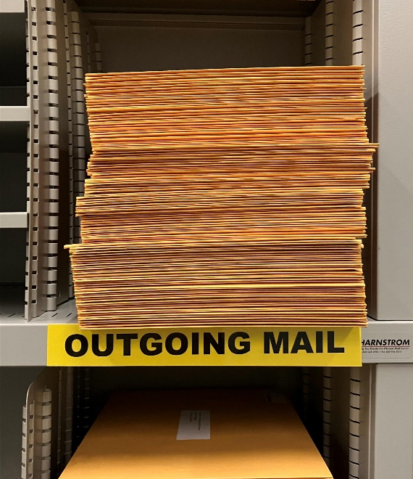
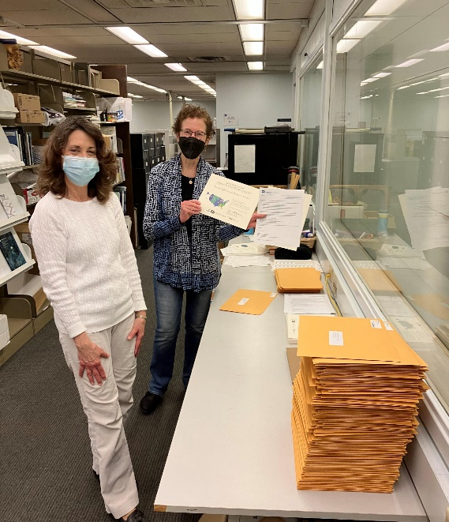
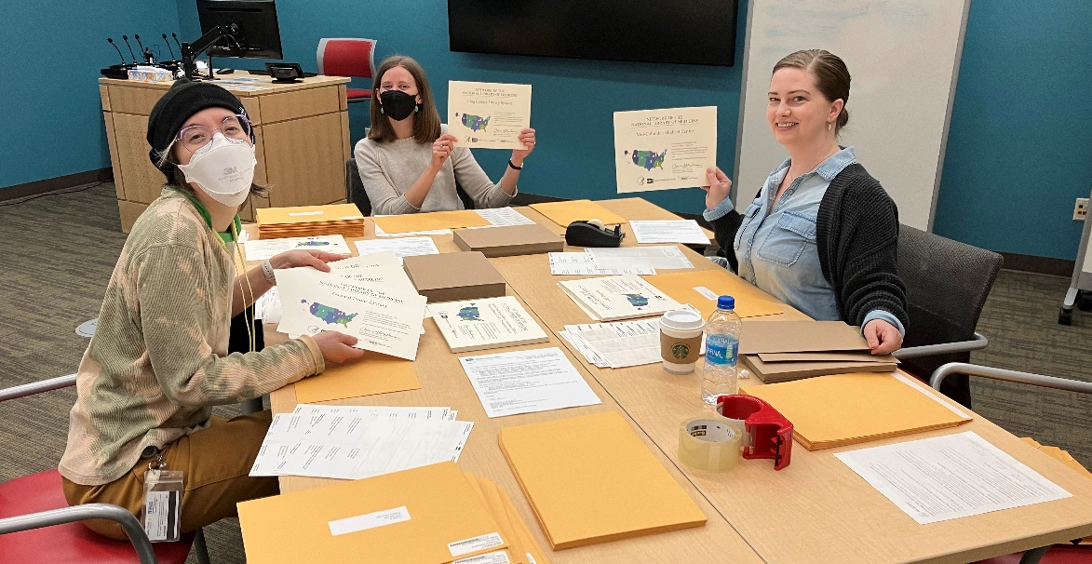
Questions & Comments
Contact NNLM Region 5
Email: nnlm@uw.edu
Webpage: https://nnlm.gov/region5
Social Media: @nnlmregion5
DOCLINE Support: docline@uw.edu
Notes:
One fun project for us this year was sending out membership certificates to our 812 members. The photos on this slide are of Region 5 staff assembling and mailing those out to each of you.
Year 2 was a busy year for us, and we’re looking forward to continuing the good work in Year 3.
And now, what questions or comments do you have for us?
To wrap up:
Remember you can always contact the Region 5 staff through our office email, nnlm@uw.edu or through social media.
I didn’t talk about DOCLINE Support in the presentation, but you can always contact regional DOCLINE support at DOCLINE@uw.edu. I’ll respond to your request.

