Slide 1
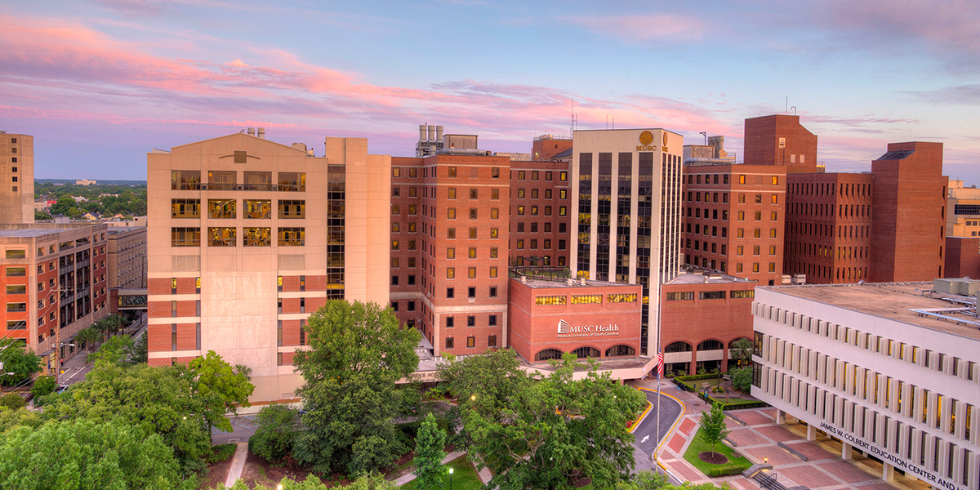
MedlinePlus & MedlinePlus Español Overview
Javier Chavez, Bilingual Programs Lead javier.chavez@nih.gov Español Team: Felipe Lagos felipe.lagos@bixal.com Paulina Aguilar paulina.aguilar@nih.gov https://medlineplus.gov/spanish/ @mplusgov & @medlineplusenespanol

Slide 2
Agenda
Consumer Background
Why Translate
About MedlinePlus
Translation & Transcreation
Cultural Challenges
MedlinePlus Español Resources
Sample Social Media
Sample Pages

Slide 3
The U.S. Bilingual Consumer
In the U.S., there are 62.1 million people who identify as Hispanic or Latino.
Spanish is the most common non-English language spoken at home for an estimated 38.5 million U.S. residents.
People in the U.S. are adopting a bilingual culture and embracing a multi-language approach across public health.
Notes:
Background information on the US residents who identify as Latinos and speak Spanish at home

Slide 4
Why Translate to Spanish?
Alignment with the NLM Strategic Plan.
Strategic Plan Goal #2: Reach more people in more ways through enhanced dissemination and engagement pathways.
Specifically, the M+ Español program helps “reduce health disparities and support underserved communities that bear a disproportionate burden of disease.”
Notes:
Reference Strategic Goal #2

Slide 5
About MedlinePlus
Nearly all information is available in English and Spanish
Health Topics: MedlinePlus
Some information available in other languages
Health Information in Multiple Languages: MedlinePlus
MedlinePlus: Medical Tests
Notes:
Background MedlinePlus Espanol, highlight the mirror image of the English and Spanish programs

Slide 6
About MedlinePlus (continued)
Links to additional resources
Government & Non-governmental organizations: HHS, CDC, SAMHSA, FDA, Hopkins, Merck, VA, etc.
PubMed (nih.gov)
Home | ClinicalTrials.gov
MedlinePlus: MedlinePlus Connect
Notes:
Background MedlinePlus Espanol, highlight the mirror image of the English and Spanish programs

Slide 7
About MedlinePlus (other)
Licensed data
Animated Dissection of Anatomy for Medicine (ADAM) Medical Encyclopedia: MedlinePlus
American Society of Health-System Pharmacists (ASHP) Drugs, Herbs and Supplements: MedlinePlus
Natural Medicines Comprehensive Database Herbs and Supplements: MedlinePlus
Notes:
Background MedlinePlus Espanol, highlight the mirror image of the English and Spanish programs

Slide 8
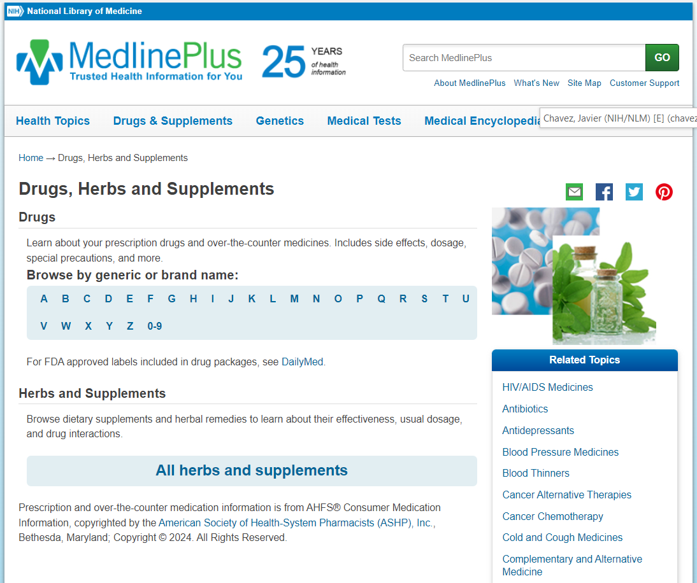
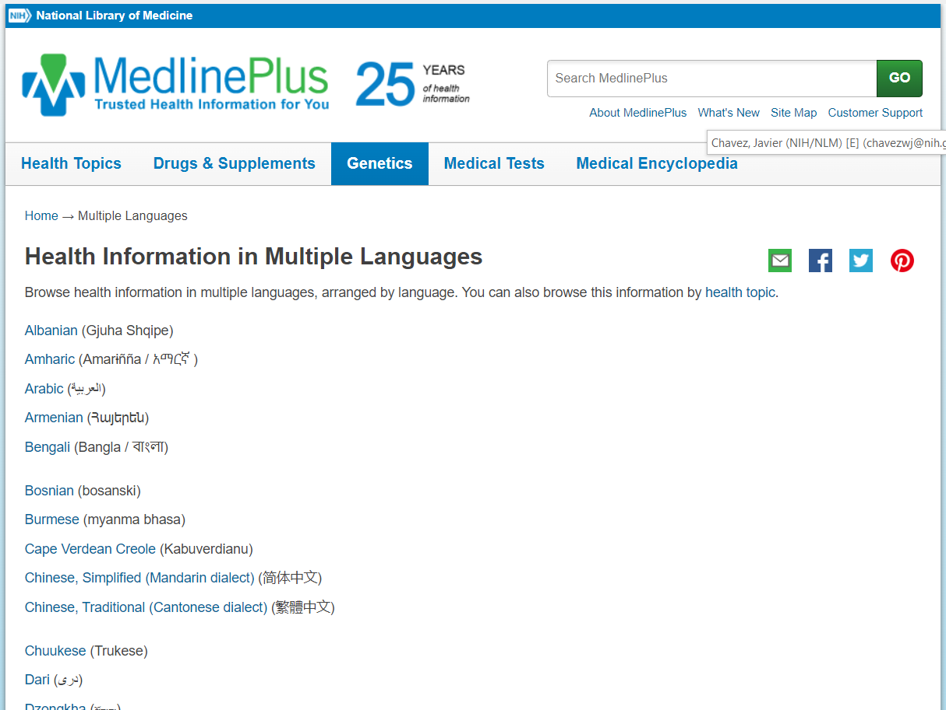
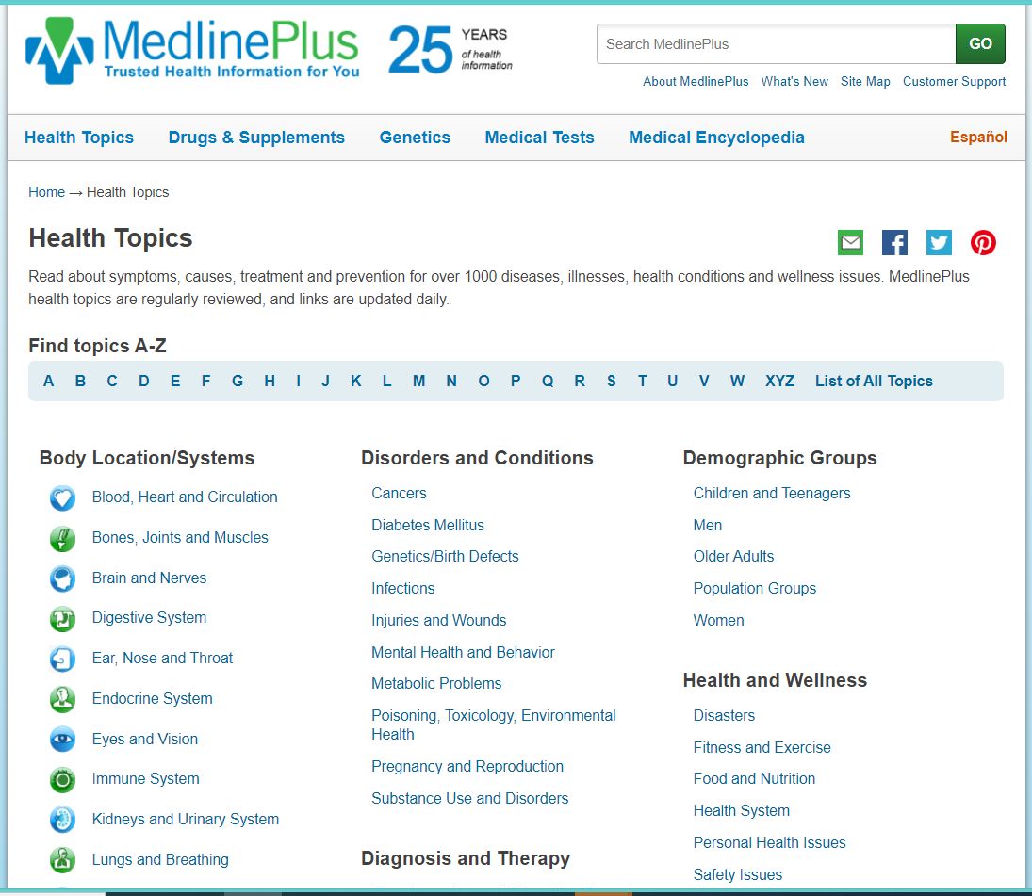
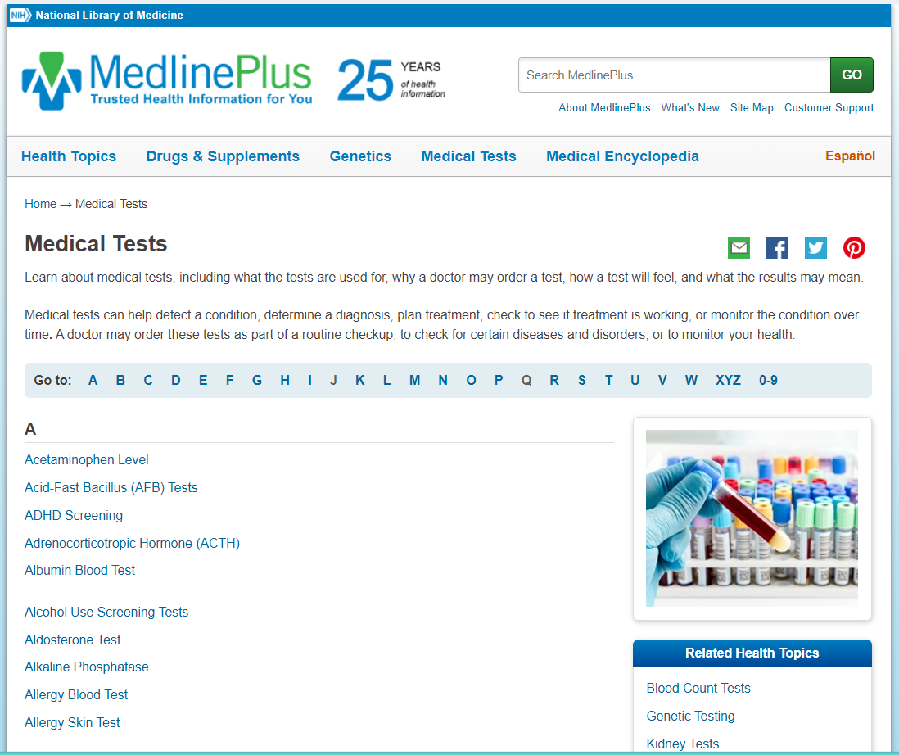
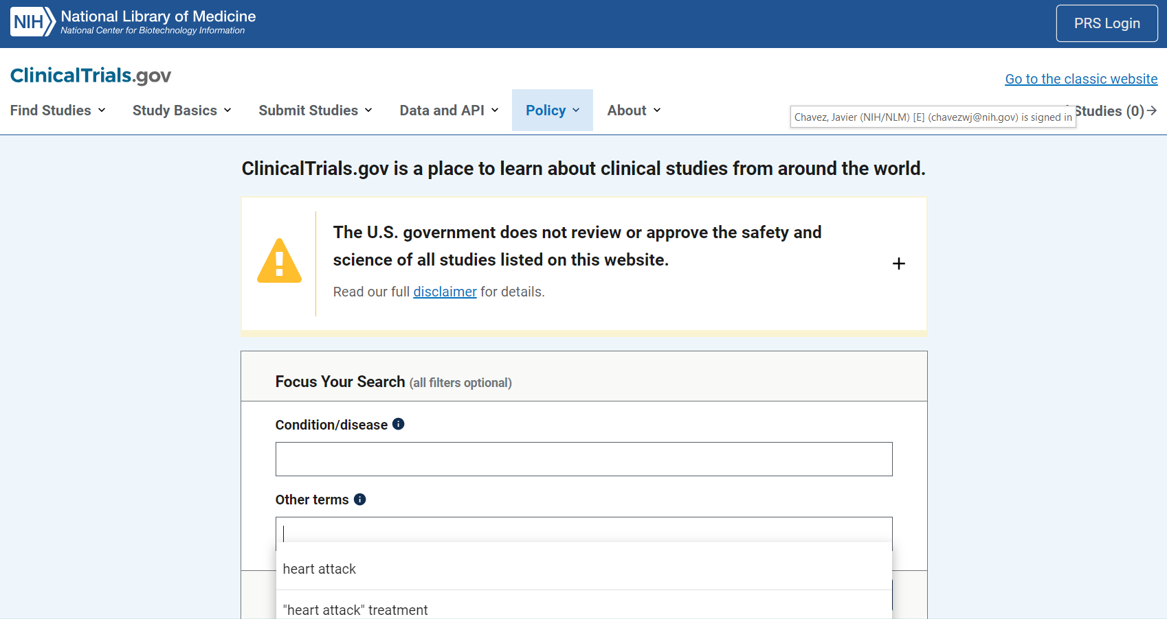
About MedlinePlus (visual)
Notes:
Background MedlinePlus Espanol, highlight the mirror image of the English and Spanish programs

Slide 9
MedlinePlus Español Health Topics
Our original content is translated by a team of Spanish Health Content Specialists
Almost 13,000 links to authoritative health information (Spanish) & 22,000 (English)
We cross-reference authoritative sources to ensure the information is accurate and trustworthy
We are respectful and sensitive to cultural nuances
We thrive at the meeting point of translation and transcreation
Notes:
Background MedlinePlus Espanol, highlight the mirror image of the English and Spanish programs

Slide 10
Intersection of Translation and Transcreation
Translation focuses on the meaning of individual words
Finds appropriate interpretation closest to the original term
Transcreation gives linguists more freedom to focus on the complete message
Maintains intent, style, tone, and context
Considers several different aspects, such as emotions and cultural and socio-economic factors
Notes:
Highlight Transcreation as a new term, being used more and more in bilingual health conversations

Slide 11
Intersection of Translation and Transcreation (2)
Intersection of Translation and Transcreation
Translation → the meaning of words
Transcreation → freedom to focus on the message
Conveying the message instead of replicating it in a different language
Written content that is targeted for one audience will not always resonate with a different group
How the message is perceived by the target is everything!
Notes:
Highlight Transcreation as a new term, being used more and more in bilingual health conversations. Highlight the difference between translation and transcreation.

Slide 12
Editing Process Updates Translations
Marijuana Topic Editing:
NIDA revises their content to include the term “cannabis” https://nida.nih.gov/research-topics/cannabis-marijuana
This prompts an update to the M+ English health topic/topic summary
M+ Español team reviews content, then translates/transcreates
We identify culturally relevant language used across the US
Regional language comes from different parts of the Spanish-speaking world
Notes:
Highlight the editing process from English to Spanish; discuss regional use of Spanish language

Slide 13
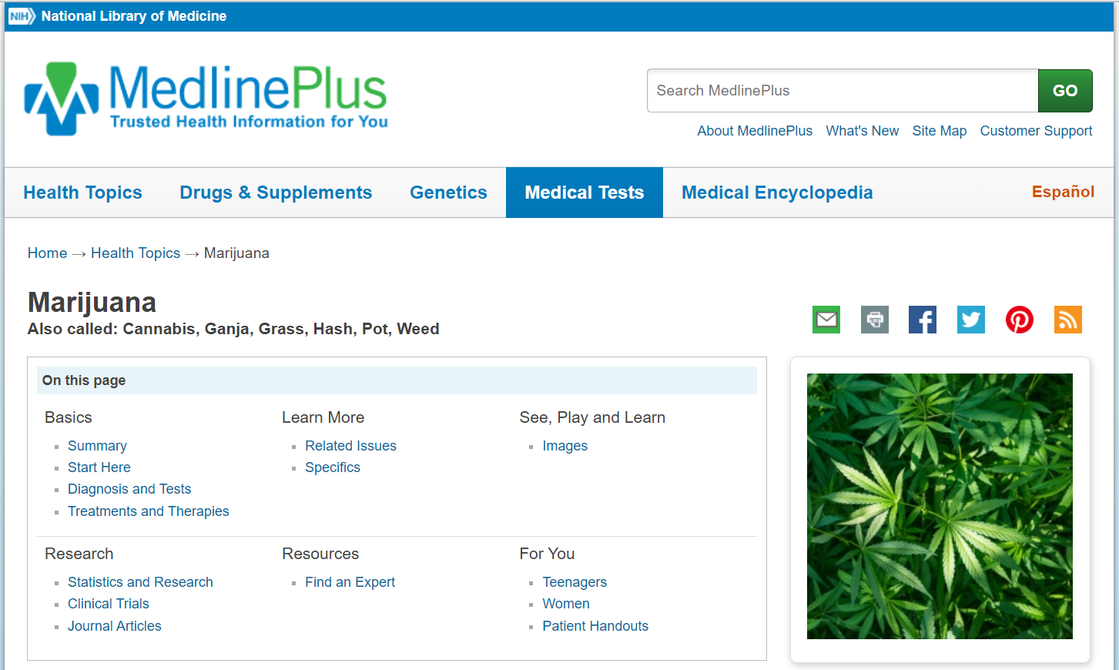
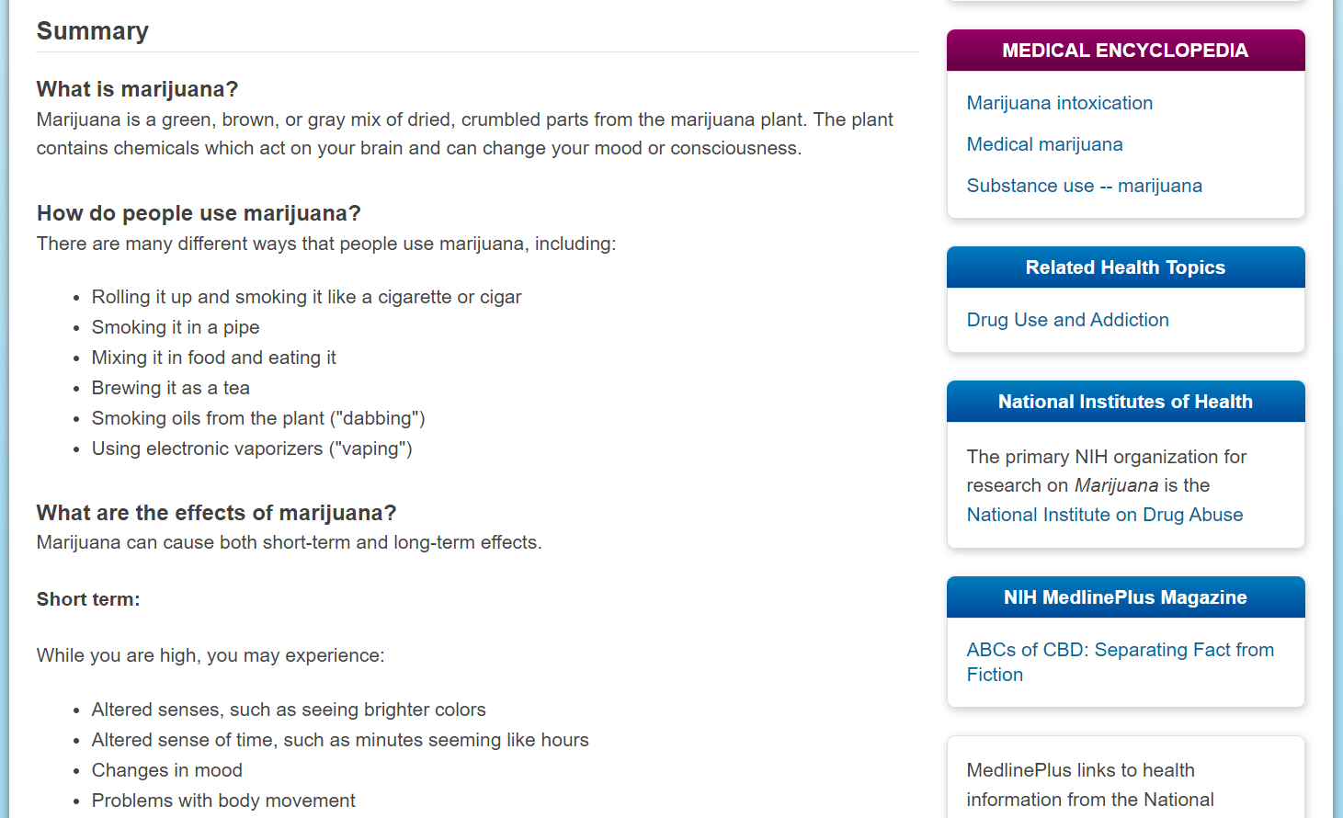
Sample Editing
Notes:
Highlight the Espanol toggle feature; discuss the name change, provide credit to the IC responsible for the information update

Slide 14
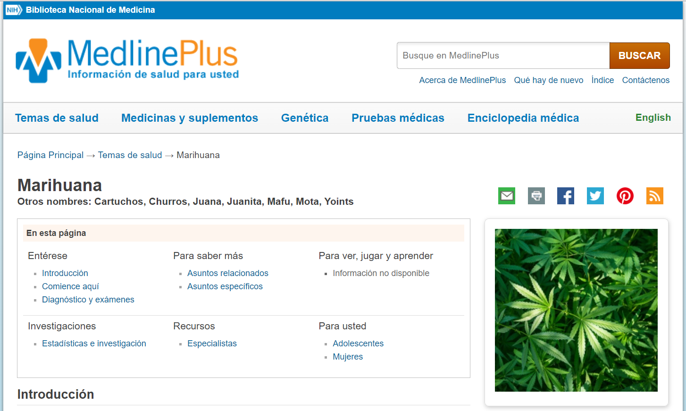
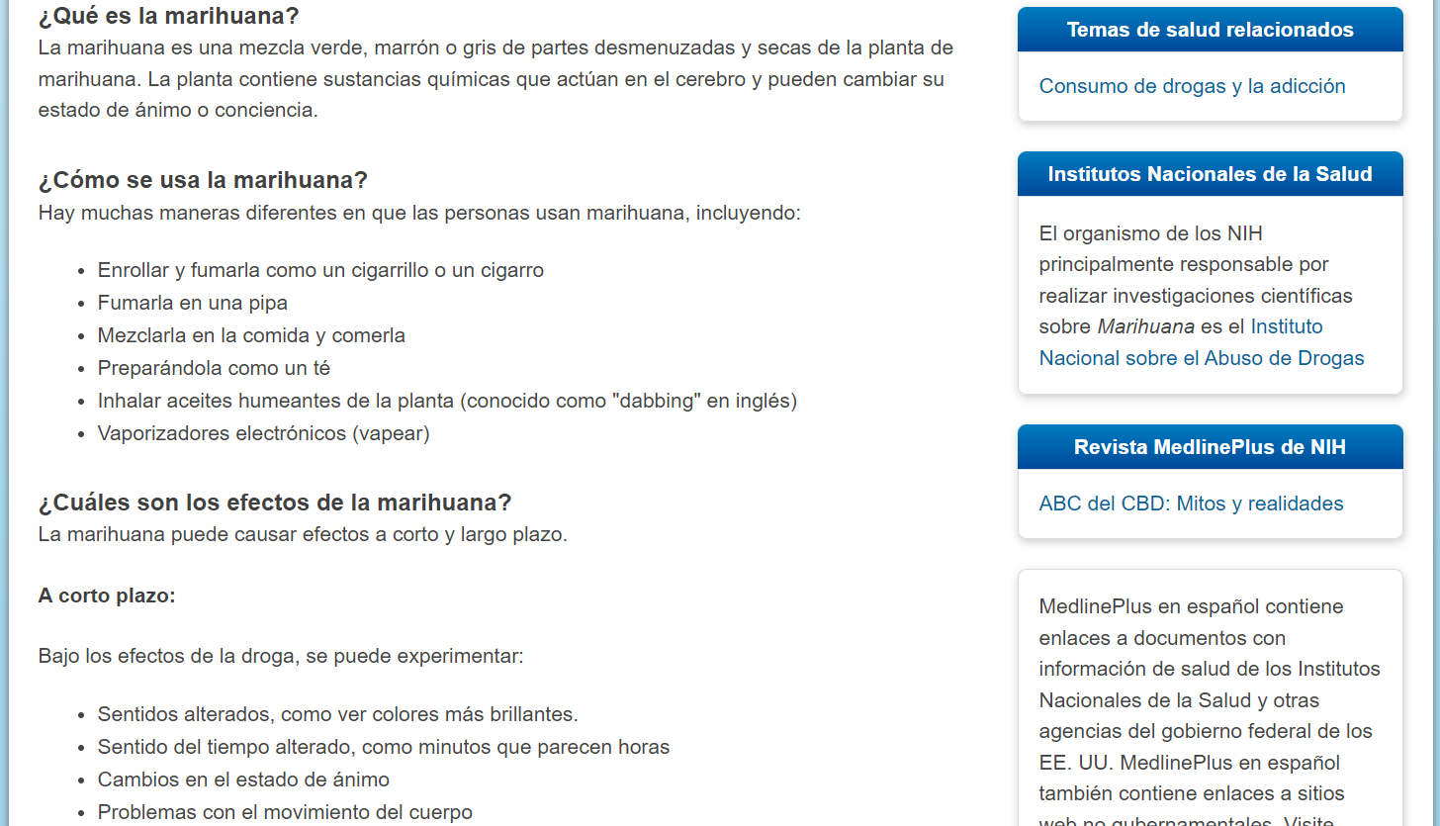
Sample Editing Español
Notes:
Highlight the Español toggle feature; discuss the name change, provide credit to the IC responsible for the information update (all in Spanish)

Slide 15
Other Cultural Challenges
Concerns when reaching out to Spanish-speaking consumers:
Ethnic classification
Cultural barriers, values and beliefs
Many dialects, one language
Localisms and healthcare misconceptions
Path of acculturation
Research qualification criteria
Informed consent
Notes:
Background of other challenges experienced by colleagues across NIH, i.e. research qualification criteria and informed consent

Slide 16
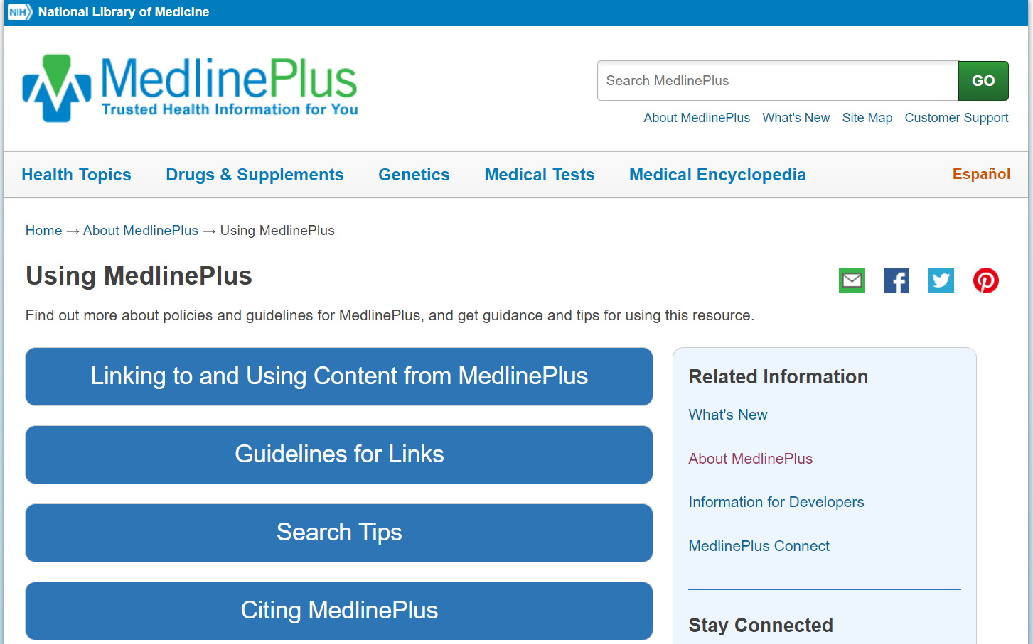
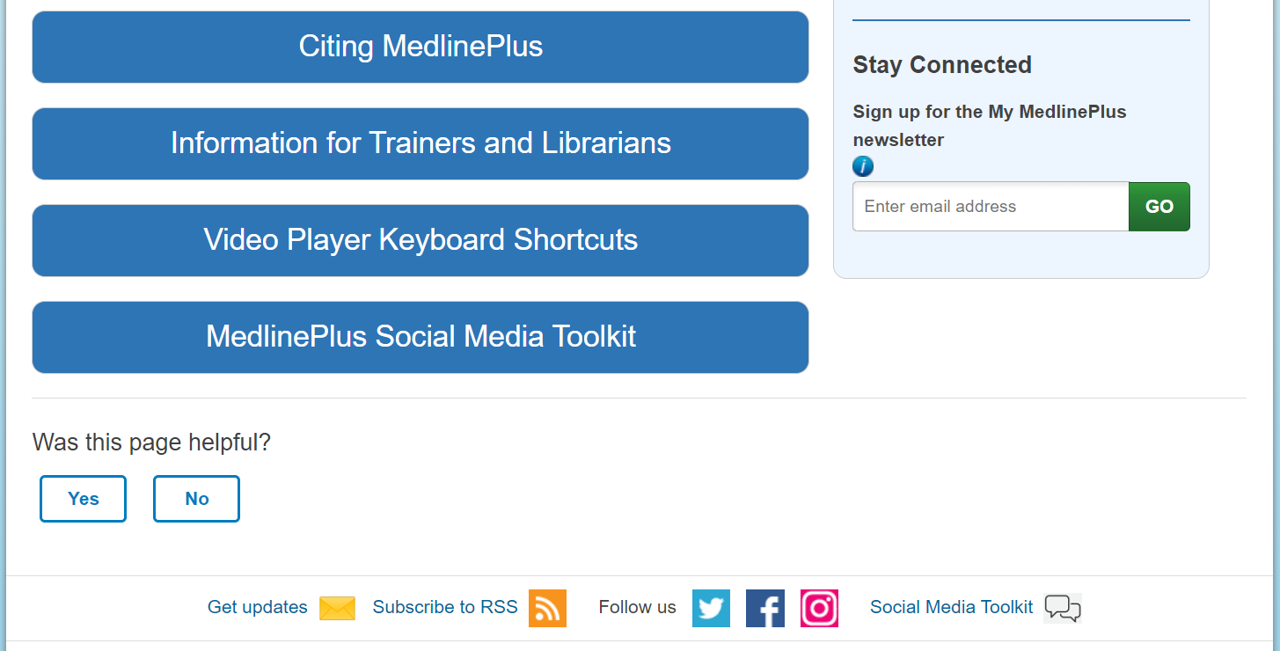
Using MedlinePlus & MedlinePlus Español
Notes:
Highlight the information for Trainers and Librarians link on the About Us page

Slide 17
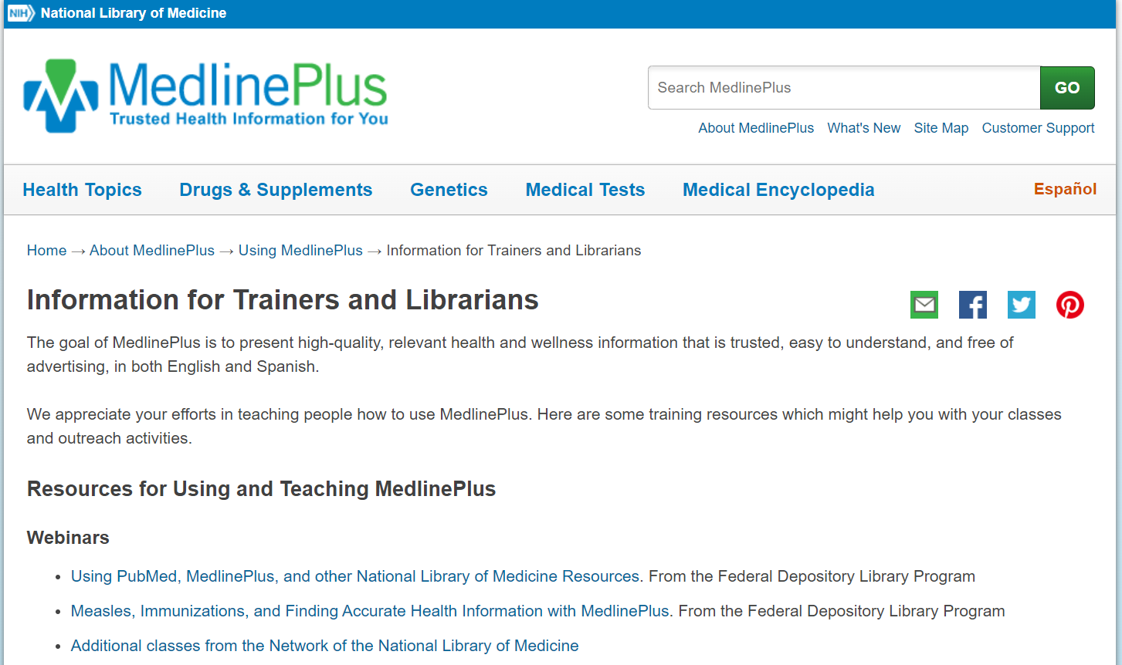
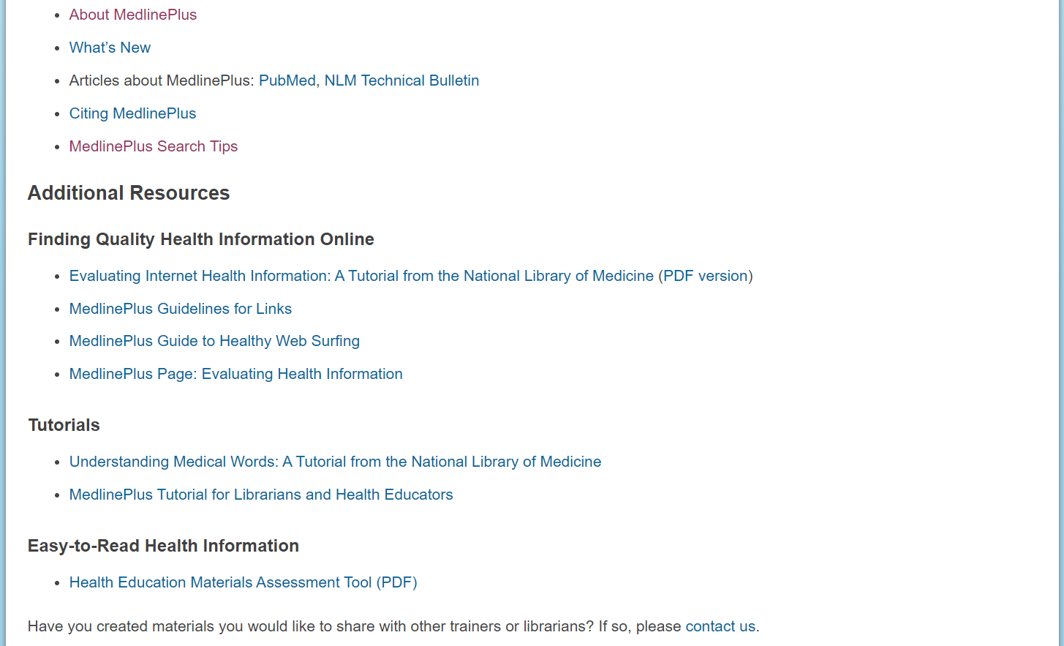
MedlinePlus & MedlinePlus Español as Resources
Notes:
Highlight the additional resources links available for Trainers and Librarians, including the HEMAT

Slide 18
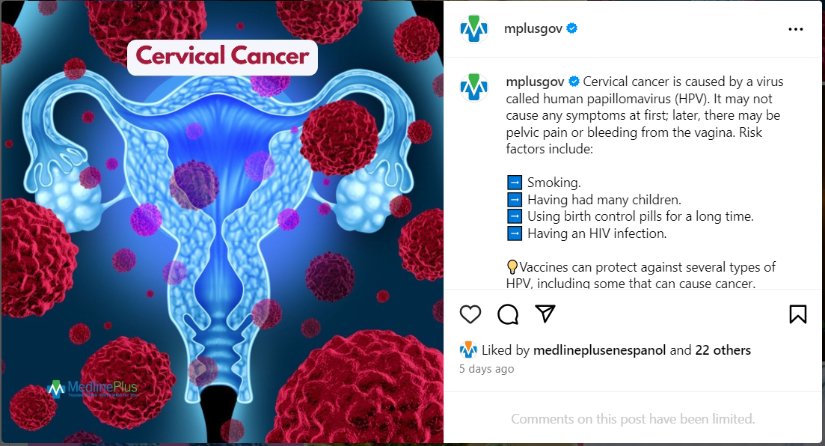
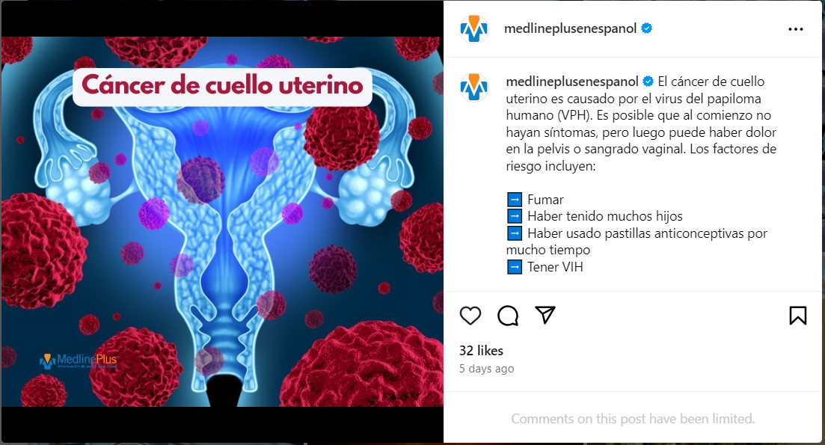
Sample Social Media Cervical cancer
Notes:
Highlight sample social media capture topic Cervical Cancer

Slide 19
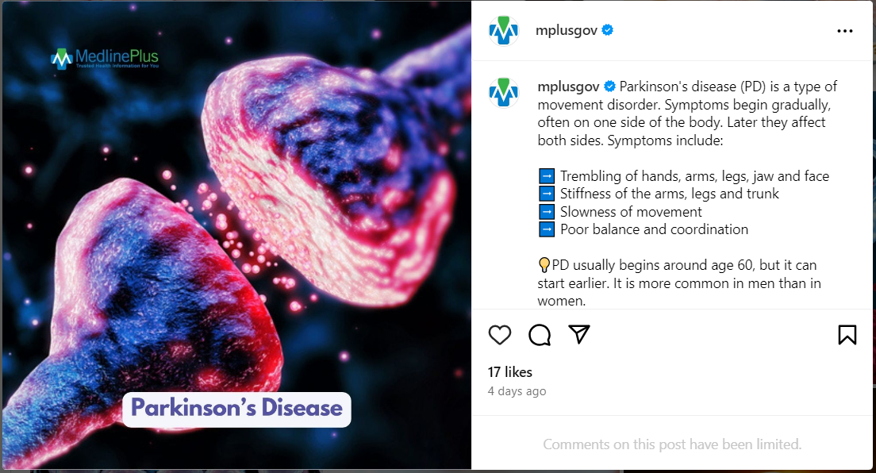
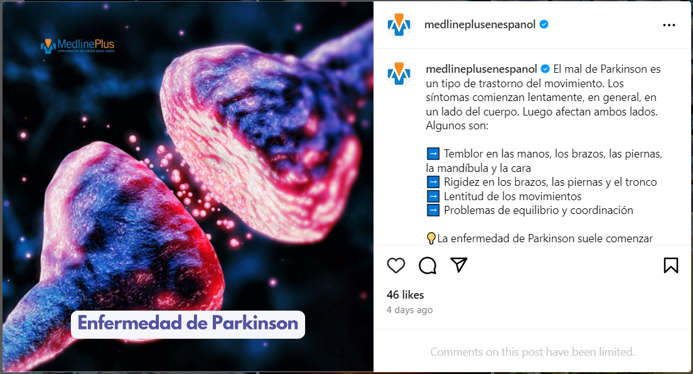
Sample Social Media: Parkinson’s Disease
Notes:
Highlight social media capture topic Parkinson’s Disease

Slide 20
Sample Social Media: Mental health
Notes:
Highlight social media capture topic Mental Health

Slide 21
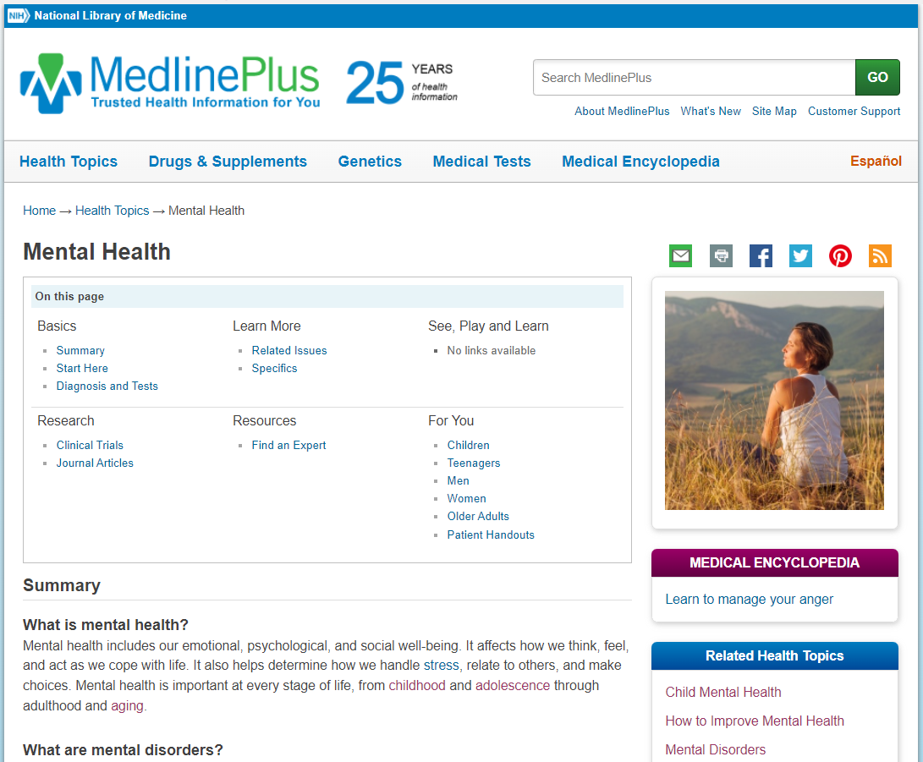
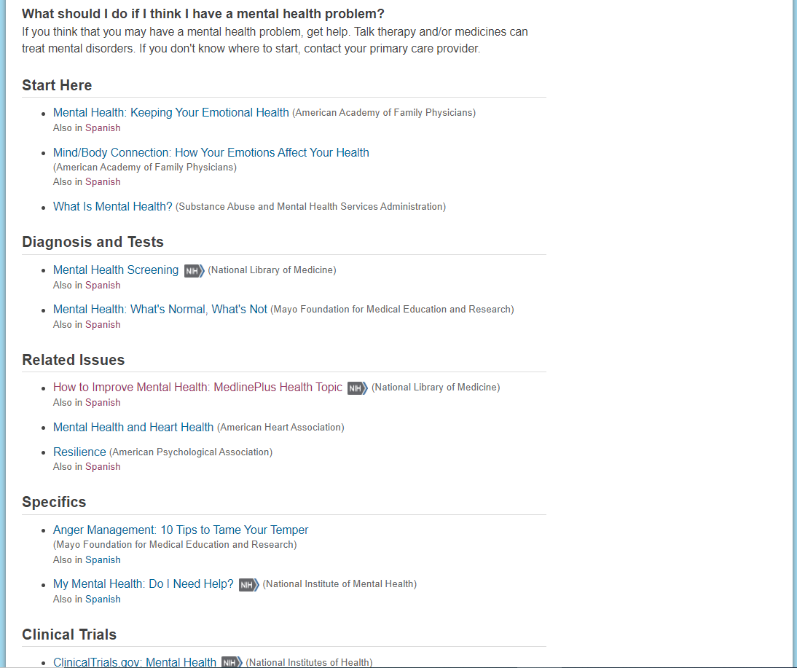
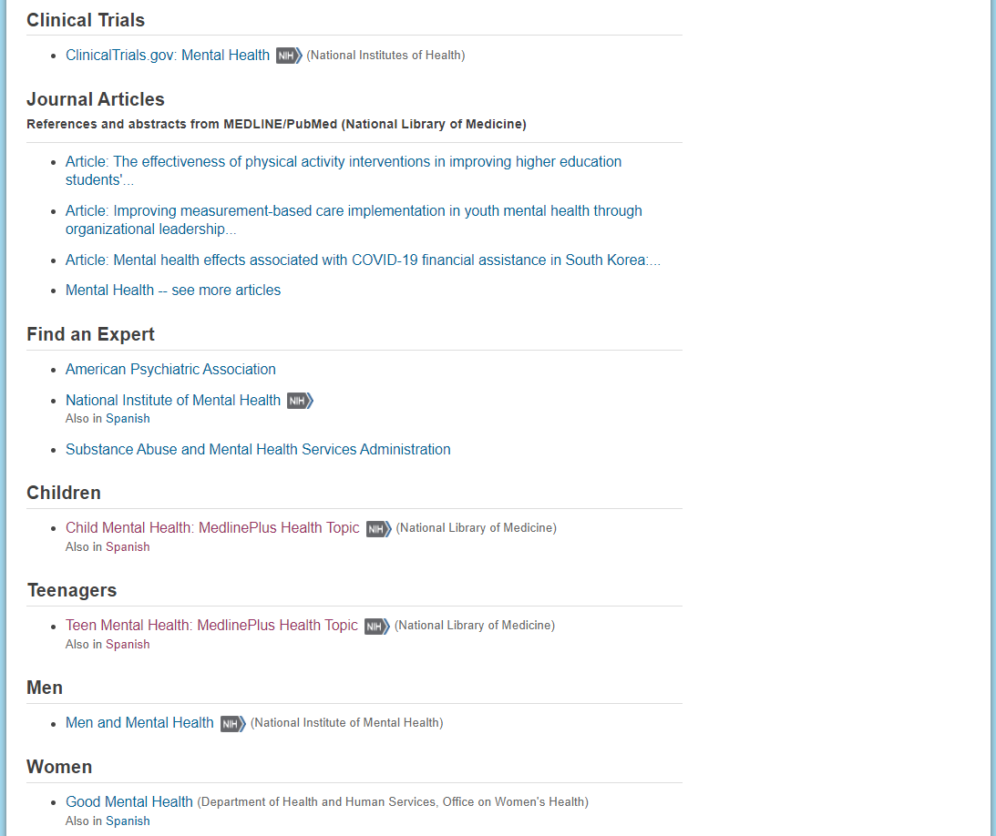
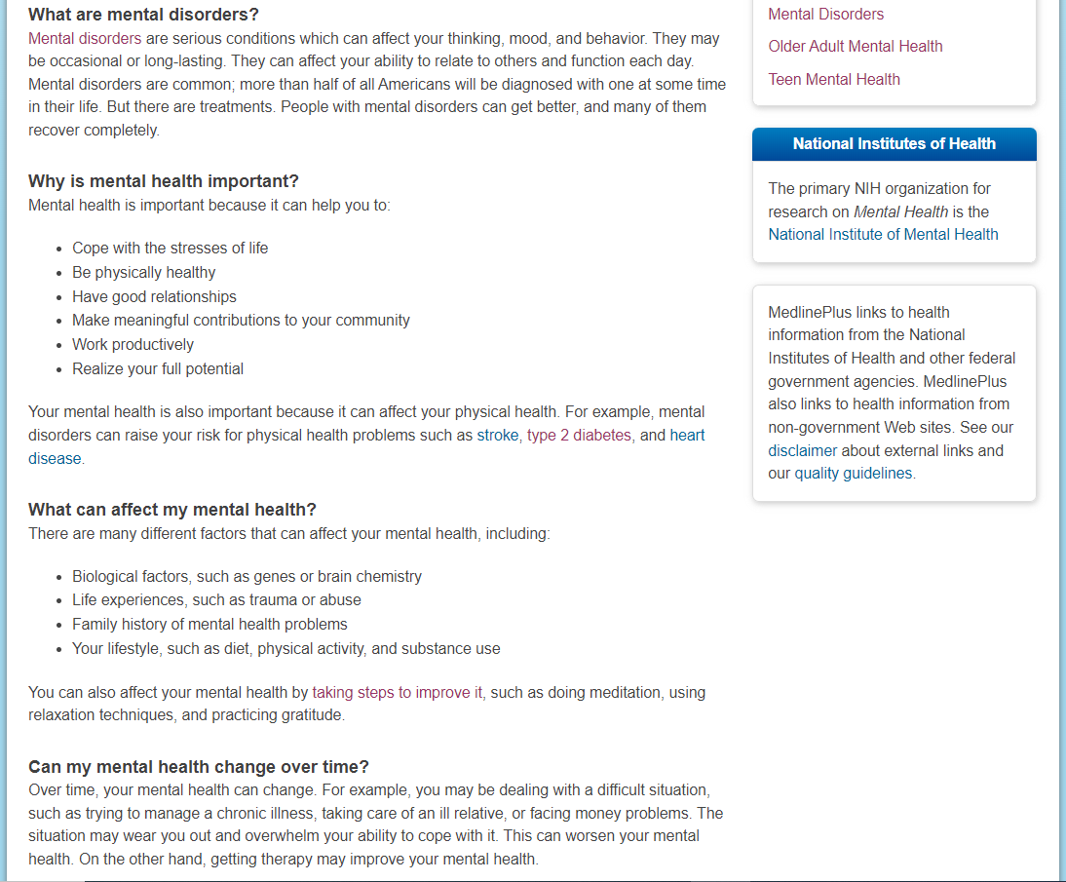
Sample Health Topic: Mental Health
Notes:
Sample Health Topic Page; Mental Health

Slide 22
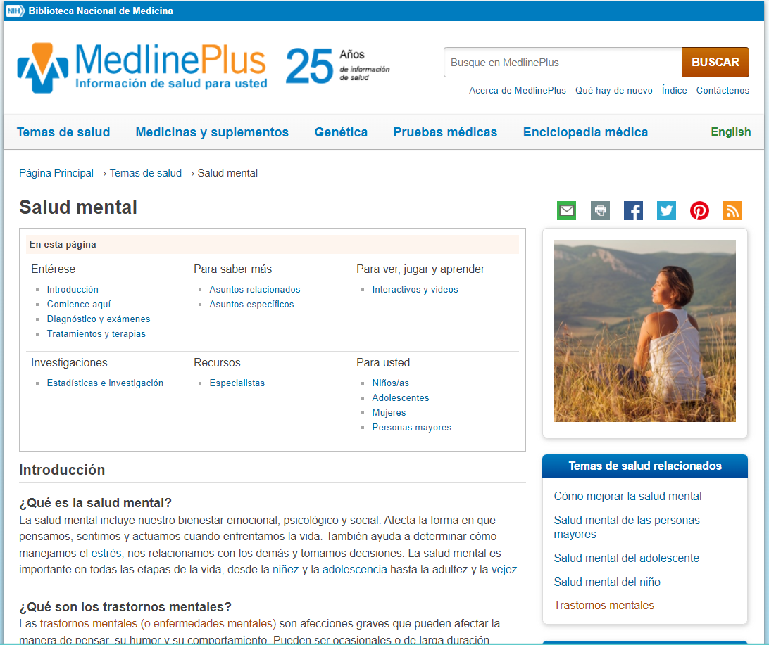
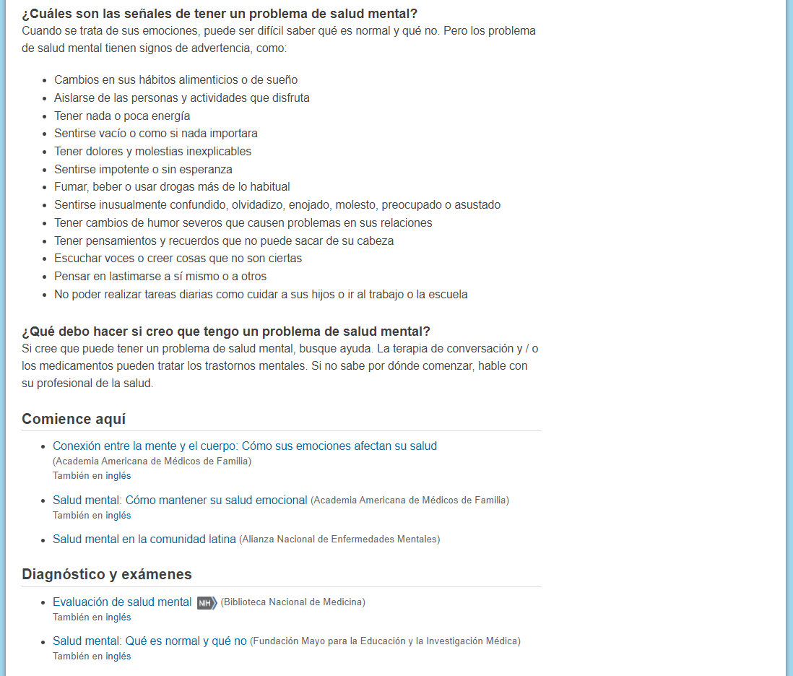
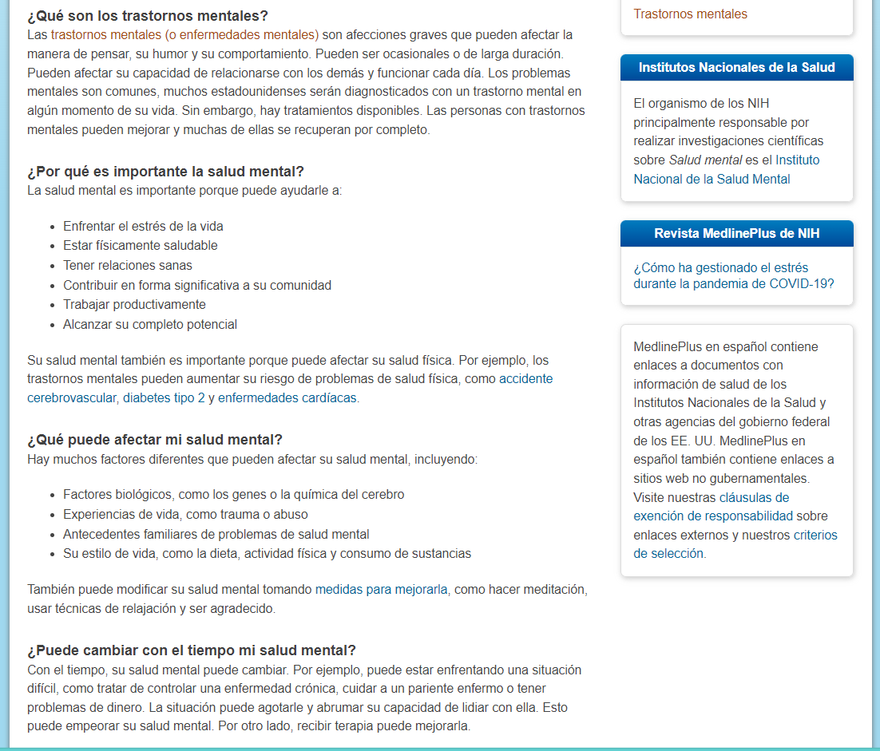
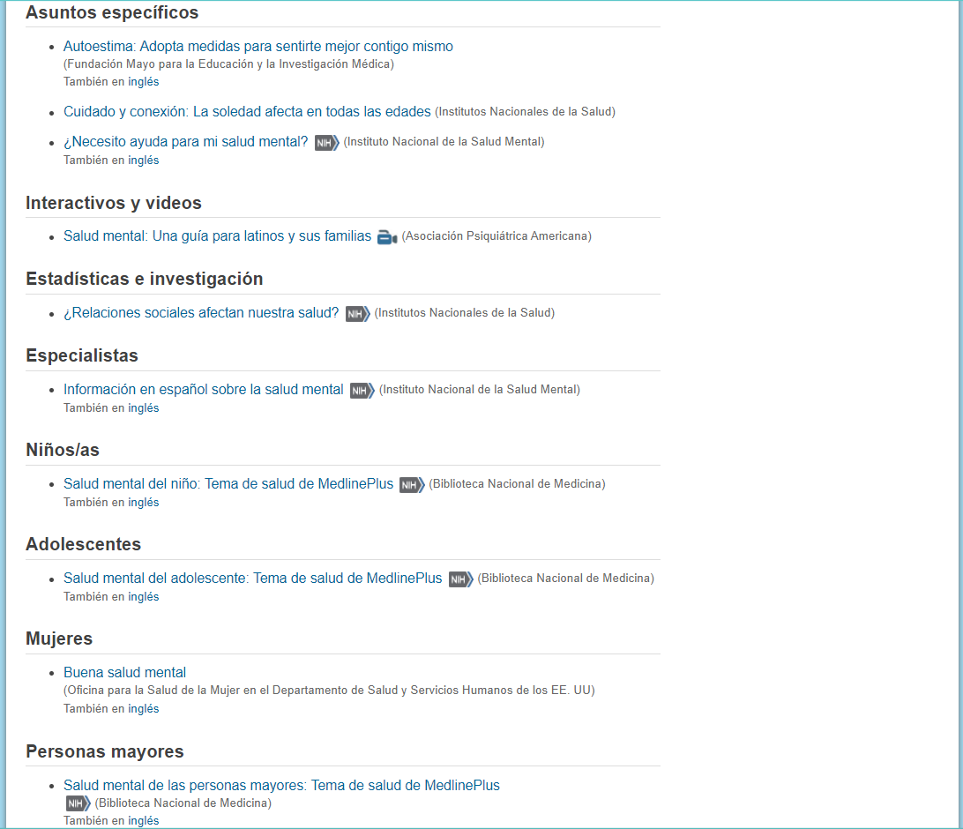
Sample Health Topic: Salud Mental
Notes:
Sample Health Topic Page; Mental Health in Spanish

Slide 23
¿Preguntas?
Notes:
Q & A

