Slide 1
Ethical Considerations of Data Session 1: Ethics Background
Lecturer: Nicole Contaxis, MLIS, MA
With Guest Speaker, Kiran Samuel
Notes:
Start at 1:03ish

Slide 2
Agenda:
Welcome
What is Data Ethics?
Ethical Frameworks
Values
Guest Speaker, Kiran Samuel

Slide 3
Welcome!
This is a class from the new National Center for Data Services (NCDS) from the Network of the National Library of Medicine (NNLM).
The NCDS aims to:
Develop capacity to conduct data science and/or deliver data services in the health information community
Partner with other national data and/or health sciences organizations to maximize impact
Support NIH priorities in the domain of data science, data services, and data governance

Slide 4
Welcome! (2)
You can find our class materials online through the NNLM’s Learning Object Repository
Class materials include:
Syllabus and Code of Conduct
Slides (posted after each class session)
Class sessions will be recorded for our reference but will not be shared
Class materials will be made public after the class.

Slide 5
Instructors

Slide 6
Class Series Structure
Data Ethics and Ethical Frameworks
Ethical frameworks, values, and the role of those values in regulations and policies relevant to data ethics
Ethics and Data Collection
Ethical implications of how data are collected and why data are collected
Ethical Data Communication
Ethics of communicating data, including issues like uncertainty and empathy
Ethical Technology and Data Use in Libraries
The role of social justice in this issues, particularly how they impact the choice and use of different technologies and data in libraries

Slide 7
Code of Conduct
Included in the syllabus

Slide 8
What is Data Ethics?
“The shift from information ethics to data ethics is probably more semantic than conceptual, but it does highlight the need to concentrate on what is being handled as the true invariant of our concerns. This is why labels such as ‘robo-ethics’ or ‘machine ethics’ miss the point, anachronistically stepping back to a time when ‘computer ethics’ seemed to provide the right perspective. It is not the hardware that causes ethical problems, it is what the hardware does with the software and the data that represents the source of our new difficulties.”
Floridi L, Taddeo M. 2016 What is data ethics? Phil. Trans. R. Soc. A 374:20160360.

Slide 9
What is Data Ethics? (2)
“…data ethics can be defined as the branch of ethics that studies and evaluates moral problems related to data (including generation, recording, curation, processing, dissemination, sharing and use), algorithms (including artificial intelligence, artificial agents, machine learning and robots) and corresponding practices (including responsible innovation, programming, hacking and professional codes), in order to formulate and support morally good solutions (e.g. right conducts or right values). This means that the ethical challenges posed by data science can be mapped within the conceptual space delineated by three axes of research: the ethics of data, the ethics of algorithms and the ethics of practices”
Floridi L, Taddeo M. 2016 What is data ethics? Phil. Trans. R. Soc. A 374:20160360.

Slide 10
What is Data Ethics? (3)
Related to previous areas of inquiry like computer ethics and information ethics, data ethics focus our attention on what we are handling when we work with data and how we are handling it
Data ethics investigates three general areas:
Ethics of data (how we collect, manage, share, process data)
Ethics of algorithms (how we analyze data using tools like artificial intelligence)
Ethics of practice (how we govern our work with data and algorithms)

Slide 11
Ethical Frameworks
Ways to think about and approach ethical decision-making

Slide 12
A Library Data Ethics Situation
You are on a library statistics task force, working with other librarians and administrators to decide what information should be tracked in order to guide internal decision-making, reports to external entities like AAHSL, and reports to the larger institution.
In this process, a colleague suggests having librarians forward the names of ‘library champions’ for future interviews as a way to collect qualitative data about library interactions. You feel uneasy about this suggestion. What do you do?

Slide 13
A Library Data Ethics Situation (2)
You are on a library statistics task force, working with other librarians and administrators to decide what information should be tracked in order to guide internal decision-making, report to external entities like AAHSL, and report to the larger institution.
In this process, a colleagues suggests having librarians forward the names of ‘library champions’ for future interviews as a way to collect qualitative data about library interactions. You feel uneasy about this suggestion. What do you do? Tell me in the chat!
Possible Approaches:
You discuss possible outcomes of compiling this list with the team
You look to your professional association’s rule book for guidance on compiling a list like this
You discuss what one of your mentors or role models might do in this situation
You discuss what your responsibilities are to your patrons as a librarian or library worker

Slide 14
a) Examine Possible Outcomes
Philosophical Approach: Consequentialism
(Outrageously) Quick Summary: Actions should be judged based on its consequences
Possible Response Informed by this Approach:
After weighing the possible benefits of maintaining such a list with the risks, the group decides that the ‘library champions’ may feel like their privacy was violated if such a list were maintained. So, the group decides against collecting names.

Slide 15
B) Review Professional Association’s Guidance
Philosophical Approach: Deontology
(Outrageously) Quick Summary: Actions should be judged based on their adherence to moral norms or universal moral laws
Possible Response Informed by this Approach:
The group reviews guidance on evaluation practices from the Medical Library Association and follows that guidance.

Slide 16
C) Consider What A Role Model Would Do
Philosophical Approach: Virtue Ethics
(Outrageously) Quick Summary: Actions should be judged based on whether they build the character or virtue of the agent taking that action
Possible Response Informed by this Approach:
The group decides that they want to be the type of people who welcome patron input, and they decide that these interviews are necessary in order to receive feedback to improve themselves and the library.

Slide 17
D) Discuss Your Responsibilities to Your Patrons
Philosophical Approach: Social contract theory
(Outrageously) Quick Summary: People have obligations to social institutions and vice versa, as structured by social norms
Possible Response Informed by this Approach:
The group decides that they have an obligation to represent their patrons opinions in strategic decision-making, so they decide it is important to pursue interviews and collect the names of possibly interested patrons.

Slide 18
Another Example
A healthy patient wants to donate a kidney to an ill patient. Is it permissible for a doctor to remove a kidney from a healthy patient?
Possible Consequentialist Approach
It is permissible to take a kidney from a healthy patient because it will allow a sick person to live
Possible Deontological Approach
It is not permissible to take a kidney from a healthy patient because the Hippocratic Oath says, “Do no harm”
Possible Virtue Ethics Approach
It is permissible to take a kidney from a healthy patient because the process helps hone the doctor’s sense of empathy for her patients
Possible Social Contract Approach
It is not permissible to take a kidney from a healthy patient because of the obligations of a doctor to her patient

Slide 19
Breakout Rooms
With your group, please pick one of the two scenarios below and describe possible responses to this issue from each of the ethical frameworks presented.
A researcher wants to do a Systematic Review but is insistent on doing a quick search of only PubMed using only English abstracts.
A researcher wants to include video data from an experiment that includes the death of an animal in a repository you manage.
Link to reference sheet
Notes:
Should be around 1:16PM at this point

Slide 20
Breakout Rooms (2)
With your group, please pick one of the two scenarios below and describe possible responses to this issue for each of the ethical frameworks.
A researcher wants to do a Systematic Review but is insistent on doing a quick search of only PubMed using only English abstracts.
A researcher wants to include video data from an experiment that includes the death of an animal in a repository you manage.
Report Out
Notes:
Should end Breakout rooms around 1:26pm and around 1:31PM from Report out.

Slide 21
Takeaways
Your framework informs but does not dictate your response
Within one framework there is space for nearly infinite disagreements. There are even many sub-categories in these rough frameworks I’ve presented
Few of us are strictly one thing (e.g., a consequentialist), but finding inconsistencies in your decision-making may help you locate your own biases
Discussions and decisions frequently happen in teams, which can complicate matters

Slide 22
Values
What to think about when thinking about ethics

Slide 23
Where do these Values Come From?
Hippocratic Oath
“Do no harm”
Nuremberg Code
List of rules for human subjects research compiled in the wake of the Nuremberg Trials
Never accepted into law or official ethics guidance

Slide 24
Where do these Values Come From? (2)
Declaration of Helsinki
Created by the World Medical Association in 1964
Not international law but used to inform national and regional regulation
Belmont Report
Created in the wake of the Tuskegee Experiments
Common Rule
Operationalizes these codes, reports, and declarations in the United States

Slide 25
Takeaways
Keep in mind the distinction between law (regulation and legislation) and guidance (codes, reports, and declarations)
Many of these documents are reacting to specific events in history (e.g., Nazi human experimentation, American human experimentation)
These guidance and laws are relatively recent and semi-frequently updated

Slide 26
The Values We Will Discuss Today
Respect for Persons/ Autonomy
Beneficence
Non-maleficence
Justice
Quick note: Solidarity is also considered one of the core values of medical and research ethics.

Slide 27
Respect for Persons / Autonomy
Defining Points
People need to be treated as autonomous agents, meaning that they have the ability to govern themselves and their decisions
People with diminished autonomy are entitles to additional protections
Examples
Researchers must obtain subject’s permission to share subject’s research data
Research done on employees, children, incarcerated peoples, etc. is subject to additional scrutiny

Slide 28
Beneficence
Defining Points
People need to be treated in a way that aims to help their wellbeing
Effectively, this is a value that calls us to maximize benefit and minimize risk
Examples
Researchers must design research experiments so that the lowest possible risk is incurred by the research participants

Slide 29
Non-Maleficence
Defining Points
Do no harm
The analysis of a problem that considers beneficence will likely cover non-maleficence, but not always
Examples
Whether or not it is ethical to use placebos while testing the efficacy of a new drug when there is already a known treatment

Slide 30
Justice
Defining Points
The benefits and burdens of an action should be distributed equally across a population
Examples
Ethical concerns regarding paying research subjects (and how much…)

Slide 31
Breakout Rooms (3)
With your group, please discuss how each of these values informs your work. Example questions to consider for each value are:
How does this value inform how you interact with patrons?
How does this value inform how you develop educational or outreach initiatives?
How does this value impact how you describe resources at your library?
Link to reference sheet
Notes:
Should be around 1:44PM

Slide 32
Breakout Rooms (4)
With your group, please discuss how each of these values informs your work. Example questions to consider for each value are:
How does this value inform how you interact with patrons?
How does this value inform how you develop educational or outreach initiatives?
How does this value impact how you describe resources at your library?
Notes:
Should end discussions around 1:54 and Report Out around 1:59PM

Slide 33
Values in Action and Regulation
Looking at current regulations and controversies to see how the real world implications of these values

Slide 34
Relevant Regulations
Common Rule
HIPAA
FERPA
Regulates the exchange of educational information
GDPR
Regulates the collection and exchange of data on citizens from the EU
Data breach notification laws
Export Controls
Only pertains to information related to possible weapons, including biological weapons
Contracts and research agreements
Can be generated by grant funders, publishers, for-profit partners, etc.

Slide 35
Example 1: Informed Consent (Common Rule)
Informed consent is the process of getting permission to perform a clinical or research intervention from the patient or research subject.
Informed consent is defined by five tenets:
Voluntariness: Person can make their decisions free of influence
Disclosure: Person is provided with all pertinent information on risk and benefits
Understanding: Person understands the information provided (i.e., it is written in plain language)
Competence: Person has the capacity to understand the information provided
Consent: Person provides consent for the intervention

Slide 36
Example 1: Informed Consent (Common Rule) (2)
Which of the values below do you think is most relevant to the process of informed consent?
Respect for Persons/ Autonomy
Beneficence
Non-maleficence
Justice
Put your response in the chat!

Slide 37
Example 2: HIPAA
HIPAA | HIPAA Privacy | HIPAA Security
The Health Insurance Portability and Accountability Act, or HIPAA, is a federal law that protects individually identifiable information called Protected Health Information, or PHI. | The HIPAA Privacy Rule establishes patient rights and requirements that must be followed for proper use and disclosure of PHI. Uses and disclosures for treatment, payment, and health care operations purposes Authorizations Minimum necessary rule Notice of Privacy Practices Amendments Inspect/obtain medical records Confidential communications Accounting of disclosures | The HIPAA Security Rule establishes standards to protect individuals’ electronic PHI, also known as e-PHI” that is created, received, used or maintained by covered entities such as NYU Langone Health. Access controls (username/passwords) Workstation use and security standards (automatic log outs; malicious software protections) Audit capabilities

Slide 38
Example 2: HIPAA (2)
HIPAA Approved Deidentification strategies:
Expert determination: A person deemed an expert uses accepted statistical principles to render the information not individually identifiable
Safe Harbor methods: Remove a prescribed set of fields from a dataset

Slide 39
Example 2: HIPAA (3)
Safe Harbor fields include:
Names
Geographic subdivisions
Telephone number
Fax number
Social security number
Medical record number
Health plan beneficiary numbers
Account numbers
Date
Photos
Certificate / license numbers
Vehicle identifier
Biometric identifier
Device identifier
Email address
Web URL
IP address
Other unique identifiers

Slide 40
Example 2: HIPAA (4)
Which of the values below do you think is most relevant to the privacy aspects of HIPAA?
Respect for Persons/ Autonomy
Beneficence
Non-maleficence
Justice
Put your response in the chat!

Slide 41
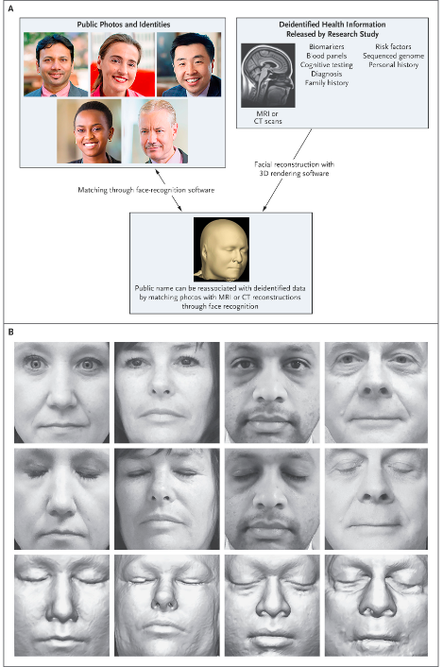
Deidentification & Reidentification
Schwarz, Christopher G., Walter K. Kremers, Terry M. Therneau, Richard R. Sharp, Jeffrey L. Gunter, Prashanthi Vemuri, Arvin Arani, et al. “Identification of Anonymous MRI Research Participants with Face-Recognition Software.” New England Journal of Medicine 381, no. 17 (October 24, 2019): 1684–86. https://doi.org/10.1056/NEJMc1908881.

Slide 42
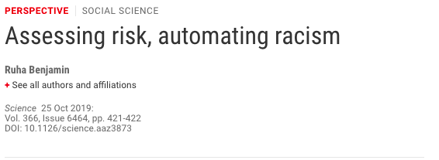
Example 3: Clinical AI

Slide 43
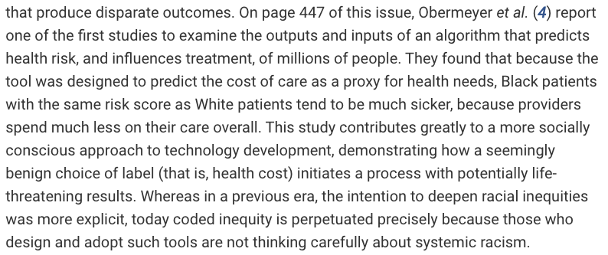
Example 3: Clinical AI (2)

Slide 44
Example 3: Clinical AI
In the creation and implementation of the algorithm described by Benjamin, which of these values do you think was most violated?
Respect for Persons/ Autonomy
Beneficence
Non-maleficence
Justice
Put your response in the chat!

Slide 45
Takeaways (2)
There will be significant disagreement about these values, how they can be implemented in practice and regulation, and how they should be implemented in practice and regulation
Tying a regulation to the values that it is meant to protect can help us figure out if that regulation is adequate or if something new is needed
Considering your values ahead of time can help give clarity to your possible approaches to future issues

Slide 46
Bibliography
Schwarz, Christopher G., Walter K. Kremers, Terry M. Therneau, Richard R. Sharp, Jeffrey L. Gunter, Prashanthi Vemuri, Arvin Arani, et al. “Identification of Anonymous MRI Research Participants with Face-Recognition Software.” New England Journal of Medicine 381, no. 17 (October 24, 2019): 1684–86. https://doi.org/10.1056/NEJMc1908881.
Benjamin, Ruha. “Assessing Risk, Automating Racism.” Science 366, no. 6464 (October 25, 2019): 421–22. https://doi.org/10.1126/science.aaz3873.
NIH Office of History. “The Nuremberg Code.” Accessed October 24, 2019. https://history.nih.gov/research/downloads/nuremberg.pdf.
HHS. “The Belmont Report.” Accessed October 24, 2019. https://www.hhs.gov/ohrp/regulations-and-policy/belmont-report/read-the-belmont-report/index.html.
“Federal Policy for the Protection of Human Subjects ('Common Rule’).” U.S. Department of Health and Human Services, n.d. https://www.hhs.gov/ohrp/regulations-and-policy/regulations/common-rule/index.html.
Definitions of philosophical frameworks adapted from Stanford Encyclopedia of Philosophy: plato.stanford.edu
Definitions of clinical/research ethics values adapted from: Beauchamp, Tom L., and James F. Childress. Principles of Biomedical Ethics. 7th ed. New York: Oxford University Press, 2013.

Slide 47
Readings I’ve Enjoyed In Clinical Data Ethics
Emanuel, E. J., D. Wendler, and C. Grady. “What Makes Clinical Research Ethical?” JAMA 283, no. 20 (May 24, 2000): 2701–11. https://doi.org/10.1001/jama.283.20.2701.
Harris, Theresa L., and Jessica M. Wyndham. “Data Rights and Responsibilities: A Human Rights Perspective on Data Sharing.” Journal of Empirical Research on Human Research Ethics: JERHRE 10, no. 3 (July 2015): 334–37. https://doi.org/10.1177/1556264615591558.
Koenig, Barbara A. “Have We Asked Too Much of Consent?” Hastings Center Report 44, no. 4 (July 2014): 33–34. https://doi.org/10.1002/hast.329.
Lee, Lisa M. “Ethics and Subsequent Use of Electronic Health Record Data.” Journal of Biomedical Informatics 71 (July 2017): 143–46. https://doi.org/10.1016/j.jbi.2017.05.022.
O’Neill, Onora. “Informed Consent and Public Health.” Edited by R. M. May, A. R. McLean, J. Pattison, and R. A. Weiss. Philosophical Transactions of the Royal Society of London. Series B: Biological Sciences 359, no. 1447 (July 29, 2004): 1133–36. https://doi.org/10.1098/rstb.2004.1486.
Shuster, Evelyne. “The Nuremberg Code: Hippocratic Ethics and Human Rights.” The Lancet 351, no. 9107 (March 1998): 974–77. https://doi.org/10.1016/S0140-6736(05)60641-1.

Slide 48
Guest Speaker, Kiran Samuel!
But first, a quick break
Notes:
Should end around 2:10PM; Break ends at 2:15PM
Kiran Samuel is an interdisciplinary scholar interested in innovation culture and its impact on social life — particularly the development of predictive AI technologies and where and how they're deployed. Her dissertation research explores how investment capital impacts how startup founders in the AI space define and engage with "ethics" as they work to bring their product to market. She is currently a PhD student in the Department of Sociology at Columbia University, and holds an MA in Media, Culture, and Communication at New York University. She is also a founding affiliate of the Center for Critical Race and Digital Studies. Prior to academia, she worked as a creative strategist in the advertising industry, with clients including Google, YouTube, Sephora, and other companies turned subjects of her research.

