Slide 1
THE Research Data Services LANDSCAPE
How do you start and where does your library fit in?

Slide 2
Learning Objectives
Upon completion, attendees will be able to
describe the common types of research data services offered in health sciences libraries
explain the current trends and challenges in data services
determine next steps for their practice

Slide 3
AGENDA
1. Overview of the different types of data services
2. Benefits of having data services in your library
4. Current trends/landscape
5. Next steps

Slide 4
What is "Research data services"?

Slide 5
Two branches of data services (as of 2022)
Data management and curation
FAIR principles
file naming conventions
metadata
data depositing
digital archives
preservation
data sharing
data discovery
policies and ethics
Data science and data literacy
data cleaning
data visualization
GIS
programming languages
data collection/survey instruments
machine learning
high performance computing
data analysis
statistics
methods and ethics

Slide 6
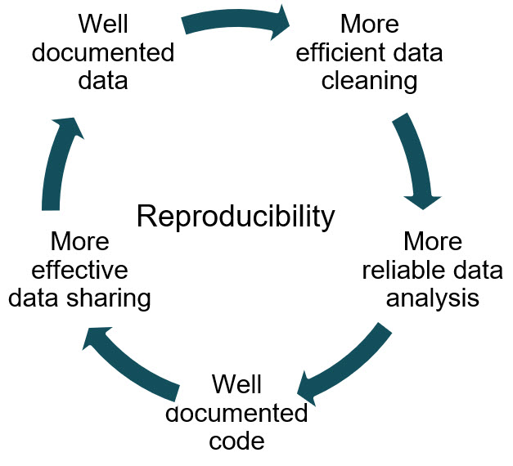
How do they interact?
Data management
FAIR principles
File naming
Metadata
Data depositing
Digital preservation
Data sharing
Data science
Machine Learning
R/Python programming
Text mining
Data cleaning
Data Analysis
Statistics

Slide 7
How do they interact Cont’d?
Data management
FAIR principles
File naming
Metadata
Data depositing
Digital preservation
Data sharing
Data science
Machine Learning
R/Python programming
Text mining
Data cleaning
Data Analysis
Statistics
But the skill sets are very different!

Slide 8
HOW DOES RDS DIFFER FOR HEALTH SCIENCES LIBRARIES?
For libraries in health sciences institutions, particularly those with clinical areas, there is a greater focus on
privacy and deidentification (PHI)
secure storage and use of HIPAA-compliant tools, like REDCap
supporting researchers working to deposit in biomedical discipline-specific repositories, such as NIH-supported repositories
increased emphasis on data use agreements to protect human subjects and intellectual property
accessing and use of protected data such as EHR data
implications of data ethics for bioethics

Slide 9
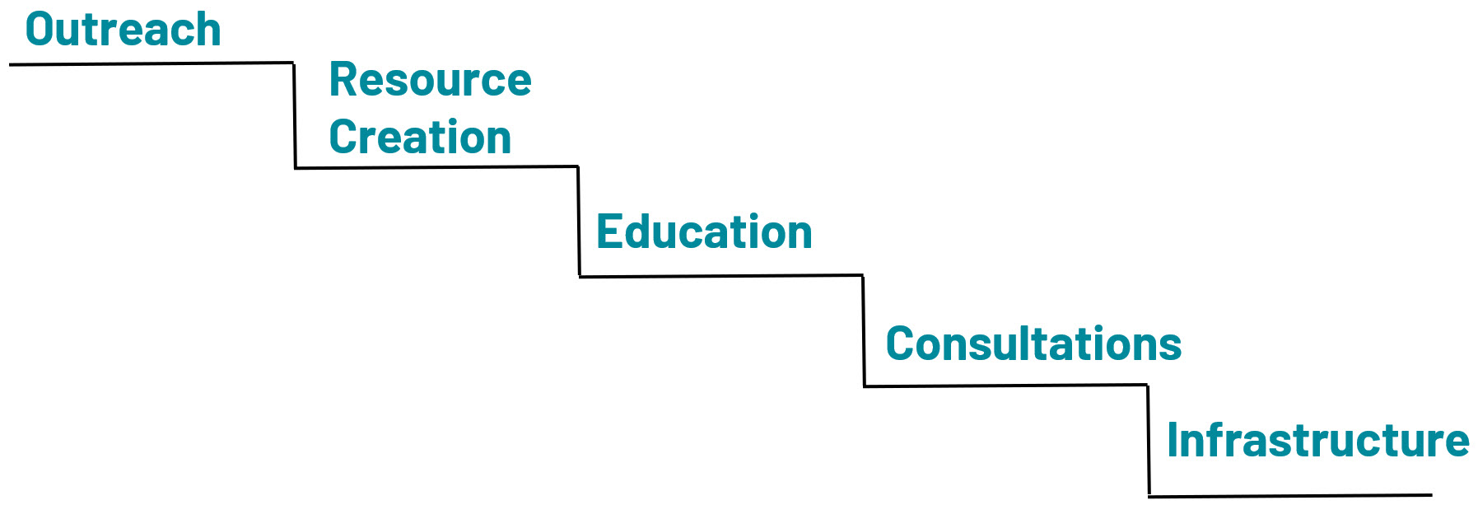
Levels of Services
FTE and Level of data expertise in the library

Slide 10
Levels of Services 1
OUTREACH: Raising awareness of open science / open data issues and policies that may affect researchers

Slide 11
Levels of Services 2
RESOURCE CREATION: Compile resources relevant to data support & create research guides to contextualize resources.

Slide 12
Levels of Services 3
EDUCATION: Develop and/or teach workshops, stand alone classes, and courses for curricular and non-curricular education. May include asynchronous or synchronous classes/materials.

Slide 13
Levels of Services 4
CONSULTATIONS: one-on-one with researchers, labs, departments to advise on and support data management best practices, OR to advise and troubleshoot on data cleaning, analysis, visualization.

Slide 14
Levels of Services 5
INFRASTRUCTURE: Develop and/or support policies and technical capabilities, including a data catalog or data repository, high performance computing, lab space, software and virtual computing access.

Slide 15
MANY Potential Services
Plan & Design
DMPs/DMSPs
Metadata Documentation
Use agreements
Collect & Create
File Naming
Version Control
README
Directory Structure
Analyze & Collaborate
Data Cleaning
Lab notes
Software
Access & Reuse
Open Access
Reproducibility
Offboarding
Share & Disseminate
Data Repositories
Data Sharing
Pre-prints
Scholarly Outputs
Evaluate & Archive
Data Retention
Intellectual Property
Archives & Records

Slide 16
Why data services in libraries?

Slide 17
Traditional academic outputs
Book Chapters
Journal Articles
Books
Conference Papers

Slide 18
Supporting traditional academic outputs
Expert Searching
Cataloging
Systematic
reviews
Content management

Slide 19
RECOGNIZED academic outputs
Journal articles
Books
Book Chapters
Conference papers
Datasets

Slide 20
Supporting DATASETS
Metadata & Documentation
Finding Data
Sharing & Discovery
Reproducibility

Slide 21
RECOGNIZED academic outputs Cont’d
Journal articles
Books
Book Chapters
Conference papers
Software
Datasets

Slide 22
As academic outputs evolve, so must libraries
As academic outputs evolve, so must libraries
Notes:
Image source: https://www.institutefordigitaltransformation.org/impact-of-digital-transformation-on-the-future-of-library-work/

Slide 23
Current landscape

Slide 24
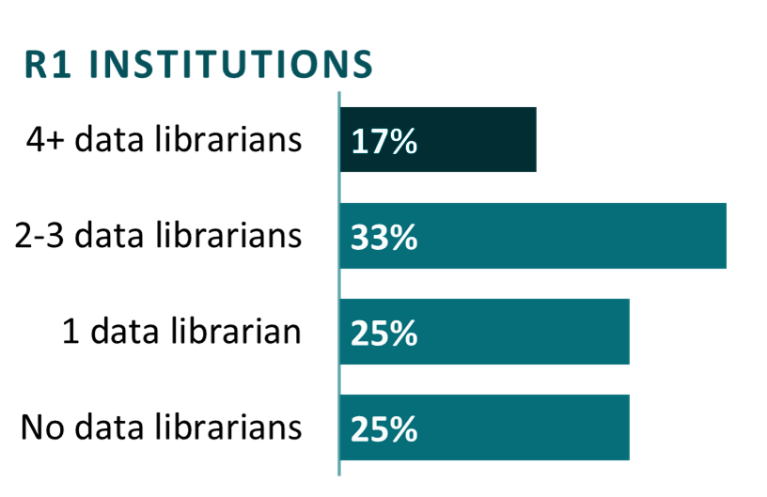
Academic Libraries with Data Services
At R1 universities, he average number of librarians primarily providing data services is just over 2 per institution.
*The average includes institutions with no data librarians.

Slide 25
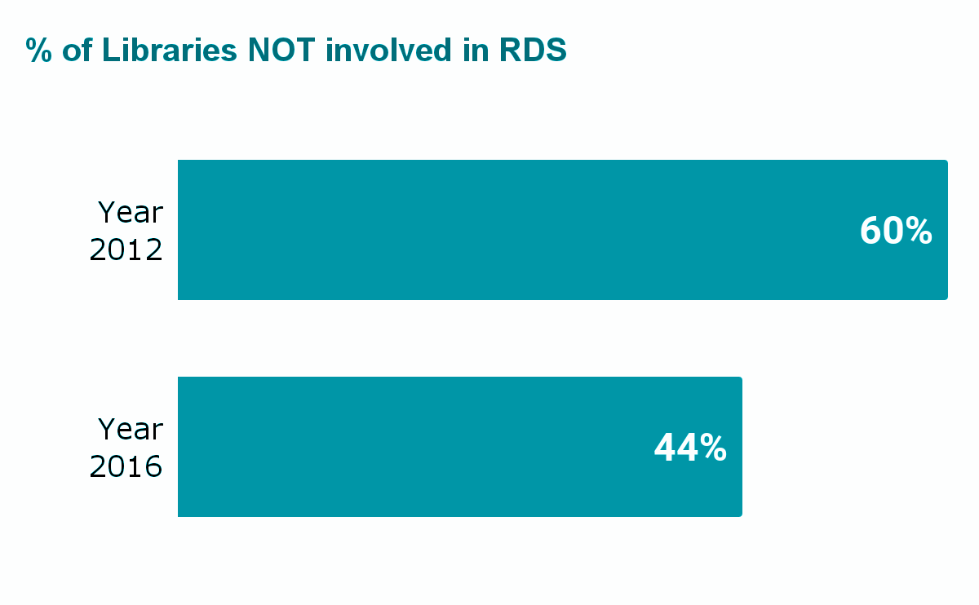
Data Services IS A GROWING NEED
Increase in technical and consultative data services
Preparing metadata
Preparing data
Technical support
Consulting on metadata
Consulting on data management plans
Creating web guides
Data policy development
16% growth in libraries providing RDS in just 4 years.

Slide 26
Analyses of data librarian jobs
Most data librarian jobs are in R1 and R2 level institutions
Job ads frequently mention that candidate will need to build campus relations and library infrastructure around data use (Hagman et al., 2022)
Commonly Listed Job Responsibilities :
86% listed general data management
68% listed data repositories
56% listed data curation
Libraries were also looking for traditional LIS skills including instruction (77%), consultation ( 67%), and a public services perspective (38%) (Thielen & Nesser, 2020)

Slide 27
Needed Skills
Ranked Most Important
Personal Attributes
oral communication and presentation skills, teamwork and interpersonal skills, written communication
Teaching and Outreach
Building relationships with researchers, consultations, and instruction
Technology Skills
Visualization, coding, statistical software, and web development were all similarly ranked

Slide 28
The Great U-turn of 2022-
More R, Python, Jupyter Notebooks
RDM Services
NIH DMSP Policy
announced!
RDM! but also still R Python etc.
More Open Access Policies & Support
Open Access!
RDM, FAIR, R, Python and more!

Slide 29
Continuing on the path to Open Data
Funder mandates
Publisher support
International efforts

Slide 30
Next Steps

Slide 31
What might a DATA MANAGEMENT Librarian do?
Advise on data organization
Curate data to be shared
Develop metadata to maximize discovery
Teach research data management
Assist in writing or reviewing Data Management Plans
Assist in identifying appropriate repositories for data sharing
Teach and/or consult on use of data collection software

Slide 32
What might a DATA SCIENCE Librarian do?
Coding (e.g., R, Python)
Use of data collection tools (e.g., REDCap, Qualtrics)
Data cleaning (e.g., coding, OpenRefine)
Data analytics tools (e.g., SPSS, NVIVO, and MATLAB)
Data visualization (e.g., coding, Tableau)
How to perform statistics within a particular programming environment

Slide 33
What else Do Data Librarians Do?
Finding data
Accessing data
Teach rigor and reproducibility

Slide 34
TIPS for developing a homegrown data librarian
Training and Support
Value different backgrounds
Data cannot just be an add-on to their responsibilities
Give time for growth into the role and provide clear goals to accomplish

Slide 35
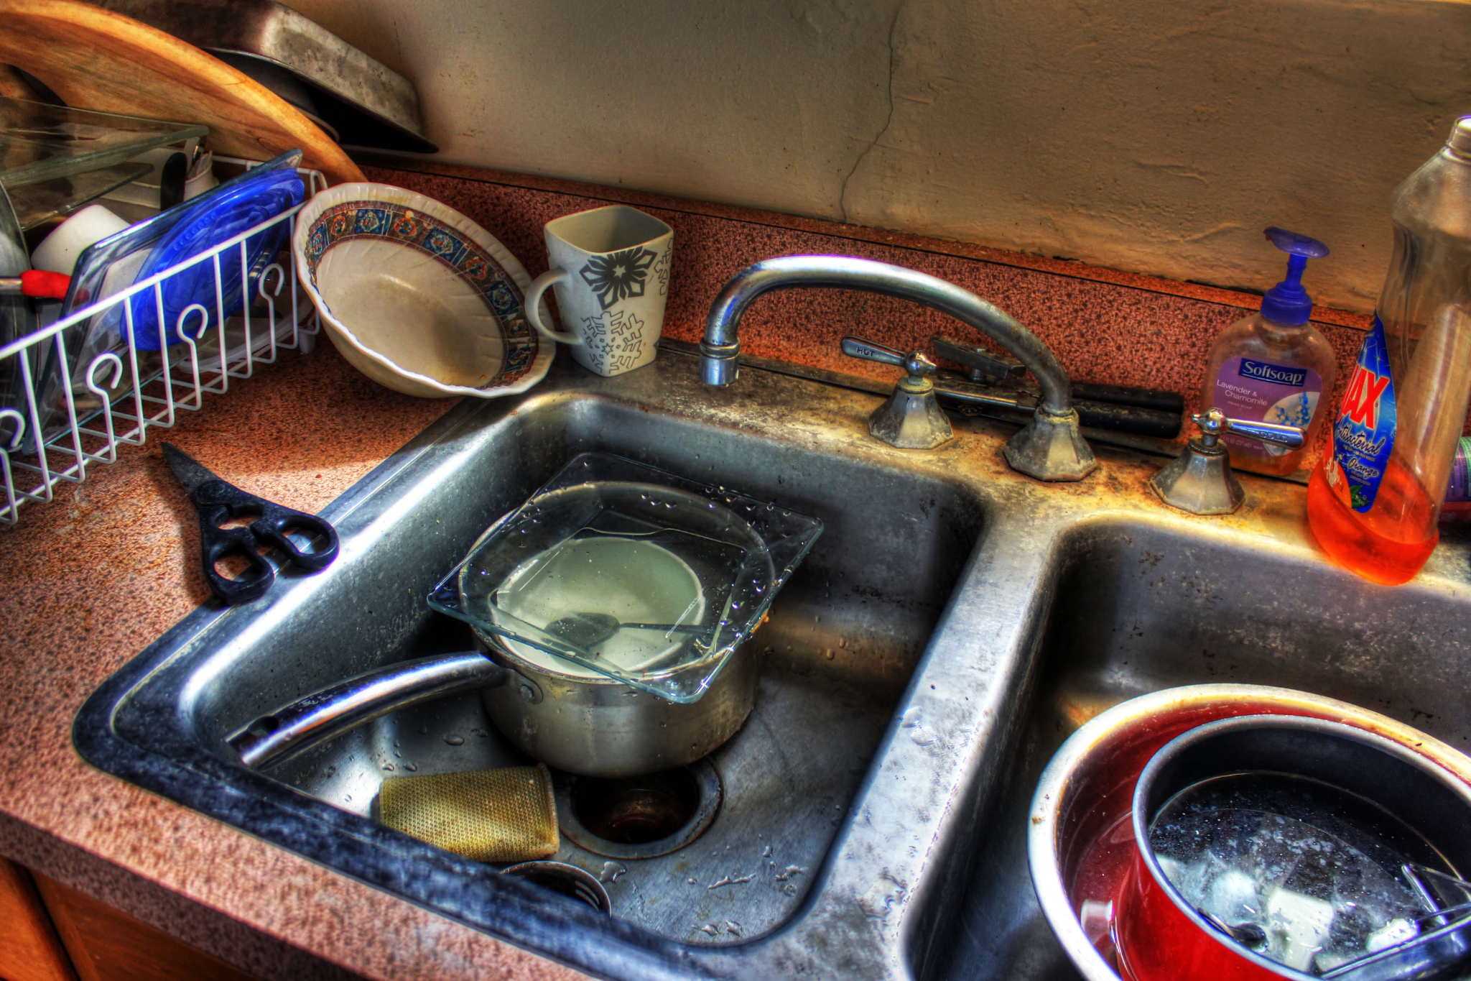
WATCH OUT FOR THE BIGGEST PITFALL
Do not write a kitchen sink job description.

Slide 36
KITCHEN SINK EXAMPLE
DATA SERVICES LIBRARIAN Department: Reference Rate of Pay: competitive
Shelley University seeks a motivated and experienced individual to provide research data management and data literacy support, training, and partnerships to faculty, students, and researchers in the 5 campuses across the metropolitan area. The Data Services Librarian will partner with researchers to evaluate data planning needs and assess options for sharing data and will be leading research data management and curation services, and the scope of responsibilities for this position includes developing and implementing policies, procedures, and best practices for research data acquisition, creation, analysis, visualization, management, curation, and preservation, particularly in regard to meeting requirements for National Institute of Health data management and sharing plans. The individual will be a part of the reference team in the Health Sciences Library. This is a renewable faculty appointment reporting to the Head of Reference. Roles include: Assisting researchers with creating data management and sharing plans meeting NIH requirements; and promoting new metrics for research evaluation. Promote research data services to campuses. Teaching data literacy & management awareness and skills among faculty, researchers, and students Assessing research impact and altmetrics for researchers. Researching the impact of the libraries' services as well as collection circulation and evaluation data. Staffing the service desk 12 hours per week. Serving as a subject liaison to the following programs: Pharmacy, Biology, Biomedical Informatics, Dental Hygiene, Healthcare Administration, and Medical and Molecular Biology. Minimum Qualifications: Master’s degree in Library and Information Science, or equivalent, from an ALA-accredited institution; Knowledge of the research data lifecycle and data management and sharing best practices. Familiarity with appropriate data repositories and public data sets in a variety of disciplines. Strong project management skills and ability to motivate others. Evidence of the ability to do research, publication, and service consonant with tenure and promotion standards Preferred Qualifications: 2 or more years of experience with using a variety of data analysis, visualization, and mapping tools; Experience with conducting quantitative or qualitative research and data analysis; Familiarity with data curation and preservation practices; Experience with data services across the research lifecycle, including creating, processing, analyzing, preserving, accessing, and reusing research data; Experience using quantitative or qualitative research and data tools such as R or Python, PowerBI or Tableau, Nvivo, Javascript, SQL, HTML, SAS, SPSS, or STATA.
Characteristics of a "kitchen sink" post:
multiple responsibilities spanning both data services tracks as well as other responsibilities
large list of required technical skills and software
no salary listed or salary not commensurate with responsibilities
unclear how the position within the library or position in an ill-fitting department

Slide 37
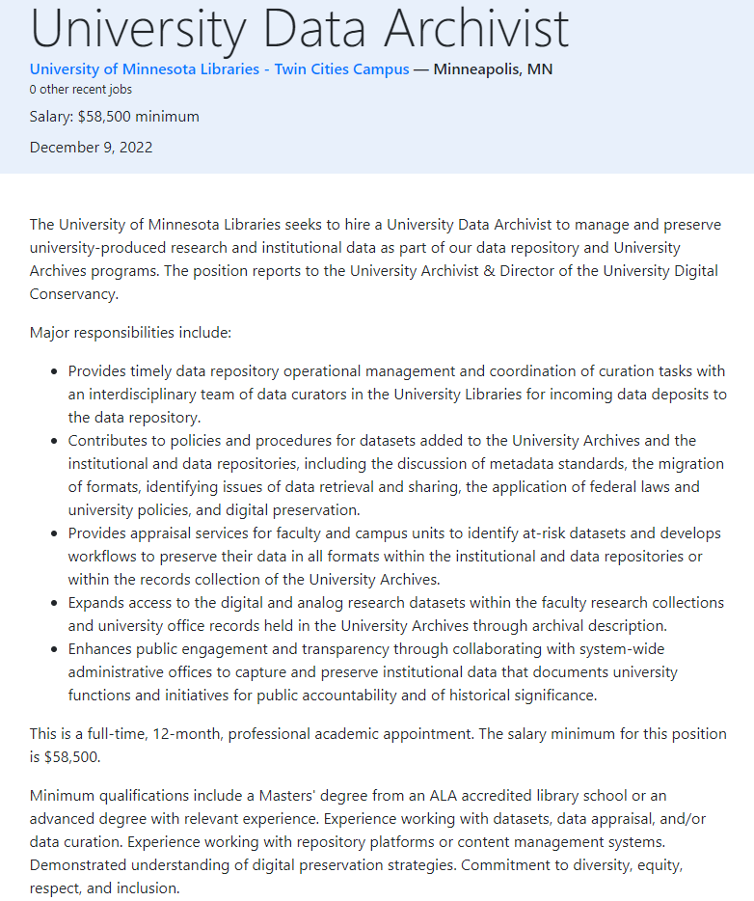
Good job - Example 1
Characteristics of a quality job description:
clearly outlined scope
reporting line is included
required experience is relevant
salary is posted

Slide 38
Good job - Example 2
GEOSPATIAL LIBRARIAN/SPECIALIST (ASSISTANT OR ASSOCIATE) Department: Research Engagement Department Website Link: https://new.library.arizona.edu/about/organization Rate of Pay: $63,000 - $76,000
The University of Arizona Libraries’ Data Cooperative provides data science and visualization services, geospatial services, and digital scholarship services for the University. The incumbent will develop a robust program supporting geographic information systems (GIS) and geospatial data services … The Geospatial Specialist / Librarian will: stay abreast of trends and tools available in the evolving geospatial data ecosystem; provide technical support and training in the use of tools and workflows to support GIS applications; work with library colleagues and researchers to identify appropriate tools, platforms, and resources for geospatial projects; collaborate with other members of the Data Cooperative and Research Engagement to develop outreach strategies and partnerships; work with members of the Libraries’ Technical Services and Support (TeSS) department … Knowledge, Skills, and Abilities … Proficiency in one or more geospatial software suites, such as QGIS, GRASS, or the ESRI suite Knowledge of at least one scripting language (including but not limited to bash, javascript, python, and/or R) Minimum Qualifications Advanced degree in a geospatial, geographic information systems, geography, natural resources, or related field or masters degree in library and information science Demonstrated experience with evolving landscape of geospatial technologies and resources, such as GIS and remote sensing Preferred Qualifications Professional experience working in an academic research library Carpentries Instructor Certification Demonstrated experience in training audiences with diversity of experiences and backgrounds Experience applying geospatial analytical or visualization approaches to a range of user needs and expertise Experience with multiple kinds of geospatial data formats (geoJSON, Shapefile, Spatialite) and relevant metadata standards (e.g. CSDGM, Aardvark) Experience with aerial and satellite imagery data Experience with scripting languages such as JavaScript, Python, or R Experience using PostGIS (geospatial database extender for PostgreSQL software) Experience working in a bash/terminal environment Demonstrated experience in pursuing independent and collaborative scholarship, such as peer-reviewed research, creative works, or open software projects
Characteristics of a quality job description:
clearly outlined scope
departmental information establishes what has been done and where this position fits in
required technical qualifications align with the position
salary is posted

Slide 39
Tips for hiring a data librarian: Tip 1
Tip #1
Consider the collaborators in the institution and in the library.

Slide 40
Tips for hiring a data librarian: Tip 2
Tip #2
Consider the market for people with data science skills.

Slide 41
Tips for hiring a data librarian Tip: 3
Tip #3
Make space and build opportunities.

Slide 42
Tips for hiring a data librarian: Tip 4
Tip #4
Be flexible.

Slide 43
Tips for hiring a data librarian: Tip 5
Tip #5
Integrate them into the existing ecosystem.
Notes:
img src = https://ceo.umich.edu/wp-content/uploads/2020/06/IMG_9307-1920x960.jpg

Slide 44
CHALLENGES IN Starting data services
limitations to the role
authority
shoot the messenger problems
on-the-job learning
associating the library with data

Slide 45
Where to start

Slide 46
Specialization through MLA Data Services Competencies
Applies principles of data literacy
Establishes and advances data services
Supports research data best practices across the data lifecycle
Applies knowledge of research methods, research ethics and rigor, and open science practices
Provides training and consultation for data-related topics
Notes:
https://www.ncbi.nlm.nih.gov/pmc/articles/PMC7069817/

Slide 47
NNLM Data OFferings
Courses:
Fundamentals of Health Sciences Research Data Management
Fundamentals of Health Data Science
Additional Webinars:
Creating Data Management Plans with DMPTool
Overview of the NIH Data Management and Sharing Policy
On Demand Modules:
Research Data Management
Research Data Sharing
Supporting Open Science: Tools and Trends
Data Ethics

Slide 48
NNLM Data Resources
Data Pathways
Data Glossary
Data Repository Finder
NIH Data Management & Sharing Policy Toolkit

