Slide 1
Ethical technology and data use in libraries
Justin de la Cruz
Program Specialist, National Center for Data Services

Slide 2
MEET OUR TEAM
Nicole Contaxis
Genevieve Milliken
Fred LaPolla
Justin de la Cruz
Ethical Frameworks
Data Collection
Data Communication
Technology Use
Notes:
Quick recap of sessions.

Slide 3
Session Goals
Present ethical issues in technology and data use in libraries by linking library data practices to wider cultural / social justice issues.
Present newer technologies, their issues, and their use / possible future use in libraries.
Contemplate / discuss how libraries could (ideally) do better when working with data.
Guest speaker, Dr. Nathan Alexander — “Beyond Ethics: Considerations for Centering Equity-Minded Data Science.”

Slide 4
AGENDA
Technology Ethics
Libraries & User Data
Libraries & Automated Systems
Breakout Rooms & Discussion
Guest Lecture: Dr. Nathan Alexander
Notes:
Austere presentation: black and white on ethical issues.

Slide 5
Technology Ethics

Slide 6
Question 1
What do you think of when you hear “technology ethics”?
Notes:
4.30

Slide 7
Technology ethics?
“any technology or technology-mediated practice is never politically neutral but is always already embedded within a particular social context and guided by the power asymmetries that exist therein.”
“Users today are encouraged by technical and ideological mechanisms to increasingly “datify” themselves, creating the resources that, on the one hand, will allow them to better manage themselves, but on the other hand, will also leave the door open for them to be exploited in new and more violent ways for economic and political purposes.”
[Ferreira & Vardi, 2021]

Slide 8
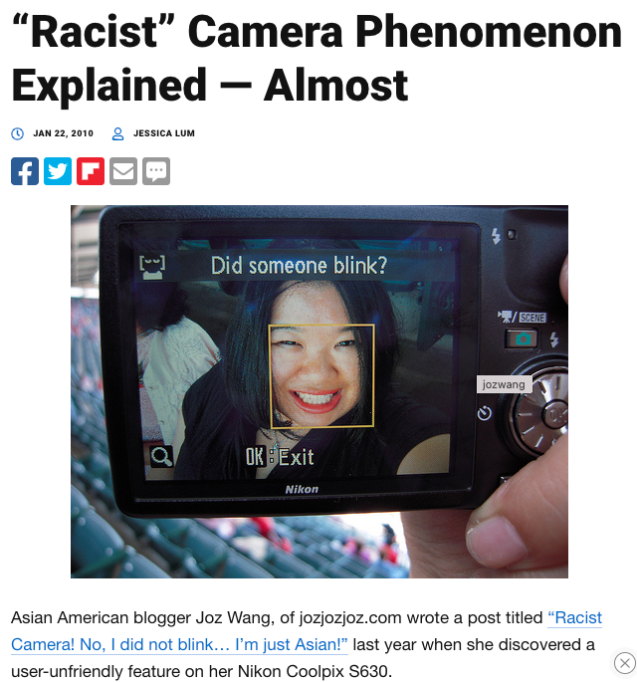
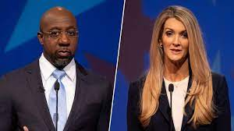
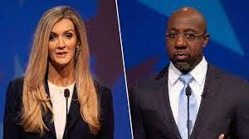
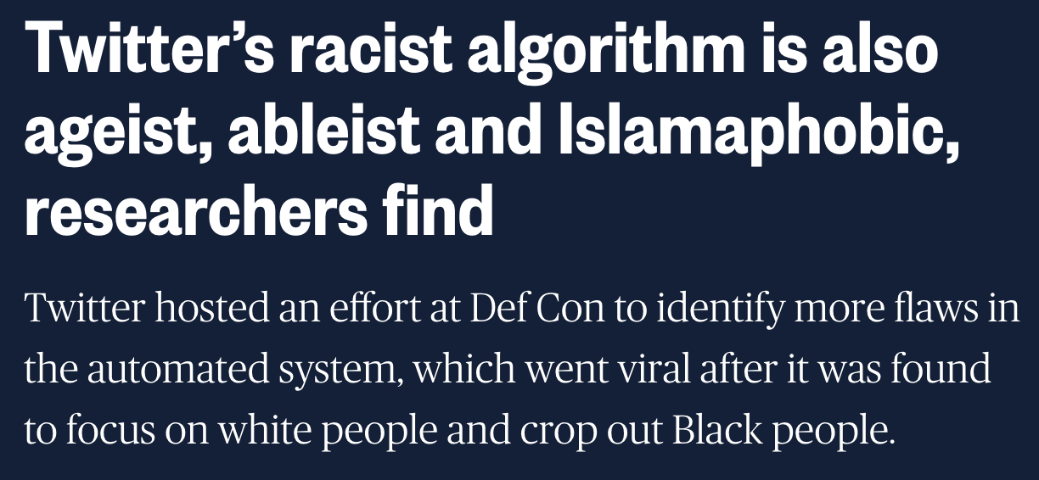
Technology ethics: Photo examples
“Pre-existing bias can be implicit and subconscious, rather than malicious in intent. Yet, this sort of bias still has negative effects by failing to provide appropriate technologies for underrepresented minorities in STEM” [Hankerson, 2016]
Cropping bias: Twitter
Offensive mislabeling:
Google
Face Detection: Nikon
Notes:
Raphael Warnock vs Kelly Loeffler
Researchers looked at how the algorithm, which automatically edited photos to focus on people’s faces, dealt with a variety of different people and saw evidence that Muslims, people with disabilities and older people faced similar discrimination. The same artificial intelligence had learned to ignore people with white or gray hair, who wore headscarves for religious or other reasons, or who used wheelchairs, researchers said.

Slide 9
Technology ethics: Personal Data examples
“Born as a data mine for targeted marketing / And no one will listen up until you become a hashtag or a meme” —Jeff Rosenstock, “To Be a Ghost…”
Shopping Data:
Target
Social Media & Politics:
FB / Cambridge Analytica
Genetic Testing Data:
23andMe
Notes:
Need to have examples that are more linked to exploitation: Cambridge Analytica & targeting BLM folks… etc.

Slide 10
Question 2
What other examples of technology bias or personal data issues have you seen?
Notes:
Voice assistants saving snippets of your voice commands online.
20.00 min

Slide 11
Topics to consider
Tech Owners
What benefits are they receiving from user data? How do they use it?
A.I.
What’s the makeup of the datasets they’re trained on? How are updates made, and how often? Are their methods openly shared or proprietary?
Organizations
How do they decide what technologies to use? How do they balance user rights against tech offerings and interests?
Users
How are their data being collected and used? Do users know? How does that impact their experience with the tech? (Examples: Google Mail ads, Plus auto accounts, Maps location history, voice commands.)

Slide 12
Libraries & User Data

Slide 13
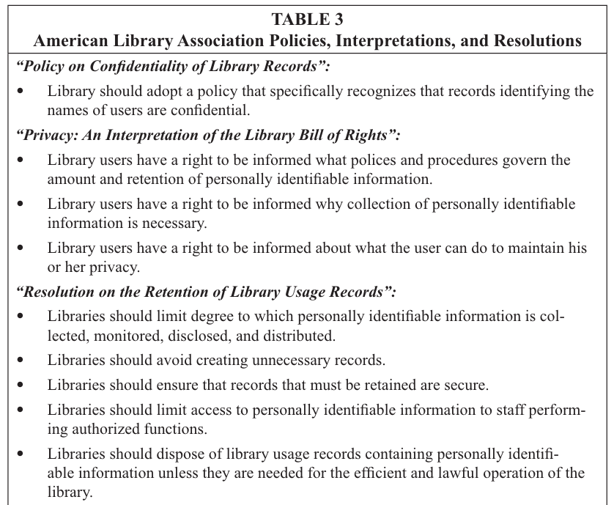
Libraries & User Data: Vendors
A 2010 review of 27 library vendors (by Trina Magi) found that the “privacy policies of major vendors of online library resources fail to express a commitment to many of the standards articulated by the librarian profession and information technology industry for the handling and protection of user information.”
Library organizations have strongly worded guidelines on user rights and a history of opposing government data collection, for example, but tend to work with vendors who don’t empower users.
Vendors provided notice about information collection and sharing but didn’t let users control what happens to their info.
Vendors don’t specify how they protect user info and offer no clear recourse for users who feel the terms of the policy have been violated.
Notes:
Magi 2010:
“Librarians would be wise to remember that some of the vendors from whom they buy library databases are also in the business of selling personal information. For example, LexisNexis sells various marketing lists with titles such as “Consumer,” “Homeowner,” and “Relatives and Roommates.” The LexisNexis database that generates these lists has records on over 225 million consumers and 118 million households, with a superior depth of demographic and lifestyle indicators.”
“Other vendors, such as EBSCO Publishing, belong to parent companies whose mission is vastly different from that of the library. EBSCO Industries is a conglomerate that includes a fishing lure manufacturer, a specialty office and computer furniture retailer, a real estate company, and a rifle manufacturer.”

Slide 14
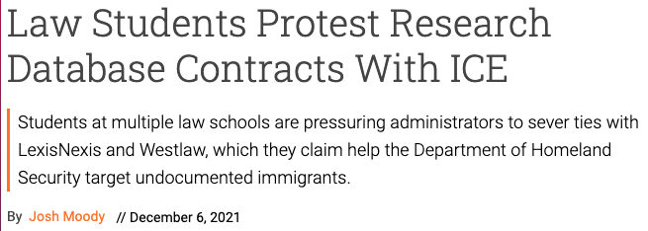
Libraries & User Data: Vendors (Cont’d)
April 2, 2021, LexisNexis signed a multi-million dollar contract with U.S. Immigration and Customs Enforcement. Their databases offer ”an oceanic computerized view of a person’s existence,” and they will provide the agency with “the data it needs to locate people with little if any oversight.”
Library subscriptions fund these systems of surveillance: LexisNexis parent company RELX and Thompson Reuters have built online tracking systems that aggregate user data and then sell the services to others, including governments and law enforcement.
Washington Post: this is an example of how government agencies have “exploited commercial sources to access information they are not authorized to compile on their own.”
SPARC has seen ”large vendors reject libraries’ suggested contract language related to privacy and insist on their own more permissive clauses.”
Notes:
SPARC Report

Slide 15
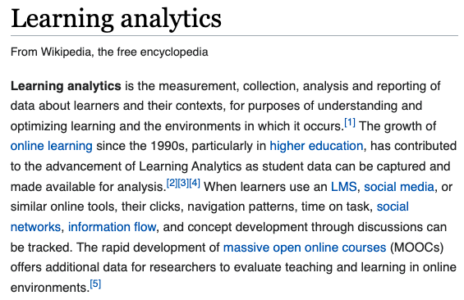
Libraries & User Data: Learning Analytics
Briney (2019) reviewed data management practices in academic library learning analytics: 54 published studies compared to the National Information Standards Organization’s principles on digital privacy.
Caveat: article reporting of data practices is spotty.
26 studies stated they retained user data longer than normal (or indefinitely long) in order to use it for analytics studies.
Only 2 studies explicitly discussed deleting data at the end of a project.
“The longer libraries hold on to sensitive information, the greater the risk that it can be accessed via legal or illegal methods.”

Slide 16
Libraries & User Data: learning analytics (Briney, 2019, cont’d)
Many analytics projects range campus offices / data sets and aren’t concerned with “data minimization” (only collected what is absolutely necessary) but try to gather and analyze all types of data from physical card swipes to student website clicks.
Studies might attempt to anonymize or deidentify data but are flawed at doing so. Key demographic info can still be identifying without a name or student number: Sweeney (2000) said 87% of Americans are uniquely identifiable by the combination of their birthdate, zip code, and gender.
“Improper anonymization can harm already marginalized populations.” Removing names and ID #s are not sufficient to protect small subpopulations of users, especially in studies that only have a handful of responses from one ethnic group.
Only 3 (of 54) studies analyzed data on students who opted into the study. Only 1 study had an opt-out mechanism. 0 studies described any way for patrons to receive their raw data that was used in the study.

Slide 17
Question 3
What other uses of user data in libraries have you seen?

Slide 18
Libraries & Automated Systems

Slide 19
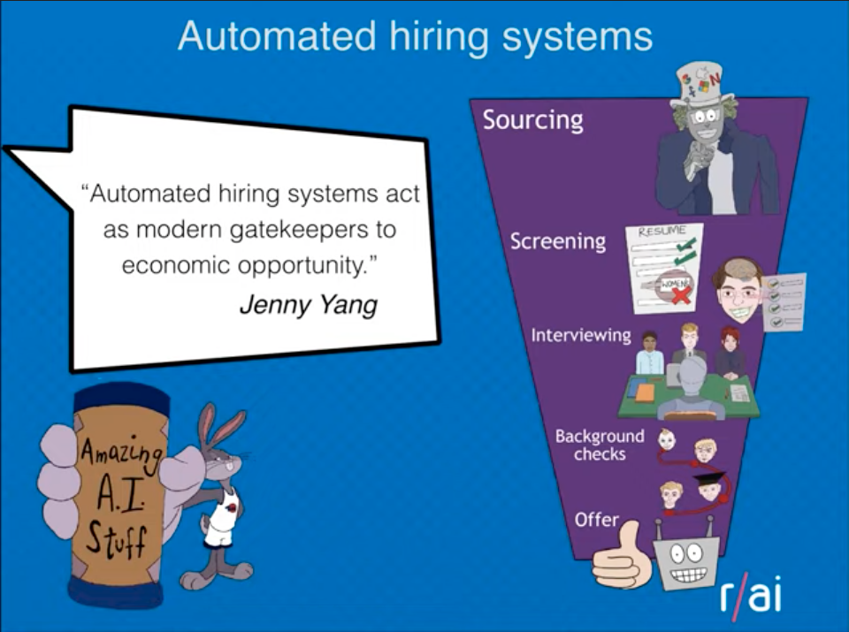
Libraries & Automated Systems: AI for job hiring
Some think that tech is naturally neutral or objective or fair, but it takes on the biases of its creators, culture, source data, environment.
Women were less likely to be shown ads for high-paying jobs on Google; Companies like Amazon have scrapped AI recruiting tools that showed bias against women; and AI tools have been shown to be biased against people experiencing mental illness via personality tests.
When the internet was taking off, some people called it a democratizer without acknowledging limits to access and control over info. Similarly, “automated hiring systems act as modern gatekeepers to economic opportunity.”
Building Data Equity Systems by Dr. Julia Stoyanovich
AI Ethics: Global Perspectives
https://www.youtube.com/watch?v=g5epgc8m8Ho

Slide 20
Libraries & Automated Systems: Machine Learning in Healthcare
“Data routinely collected in the process of care are heavily influenced by long-standing social, cultural, and institutional biases. Unless the underlying inequities in our communities are addressed, algorithms will perpetuate, if not magnify, existing health disparities.” [McLennan et al., 2020]
In 2019 a commercial prediction algorithm affecting millions of U.S. patients showed racial bias, dramatically underestimating the health needs of Black patients. [Obermeyer, 2019]
The algorithm used health care cost to determine the need for more comprehensive care, but was designed to exclude race, even though Black patients incur less in medical costs and are less likely to be identified as a high-risk for complex care.

Slide 21
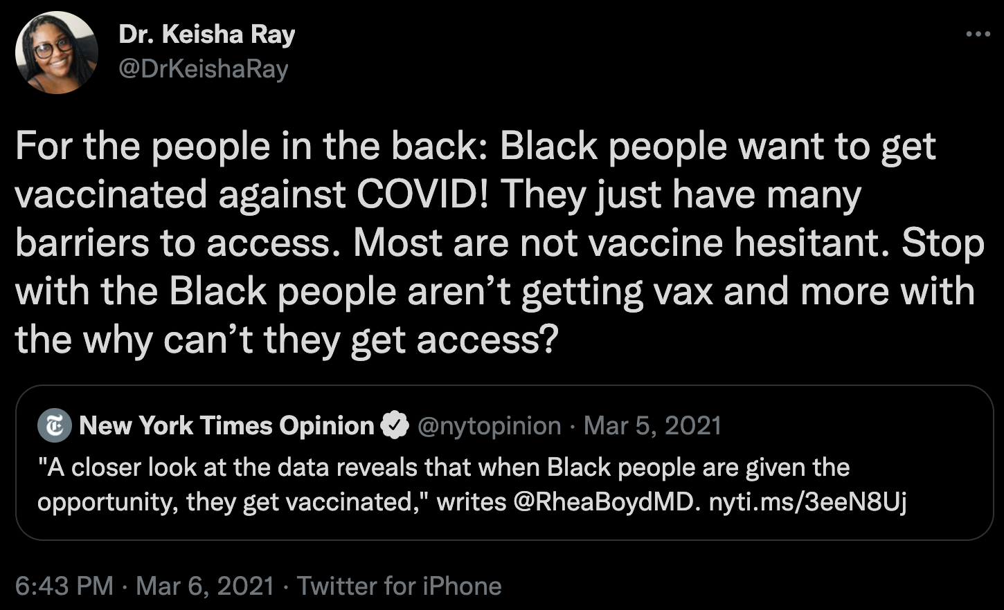
Tweet from Dr. Keisha Ray

Slide 22
Libraries & Automated Systems: Augmented Intelligence
Wojcik (2020) explores augmented intelligence in other fields and examines how they might be used in libraries, and what problems could be faced with that.
Augmented intelligence lies at the “border between AI and human intelligence” – systems that enhance people’s abilities to their work, but still relies on people’s judgments, not on technology alone.
Speculation on how augmented intelligence can be used in libraries: back office activities (cataloguing, acquisitions, management activities); user services; education; cultural activities; library promotion / PR.
Caveats: people can have a positive new technology bias, thinking that new tech solutions are automatically better than old ones; the data that could come from augmented intelligence might include very personal data, including the functioning of someone’s brain, or how they make decisions.
Notes:
Pronounciation: woy-chik

Slide 23
Question 4
Have you seen other developing/emerging technologies that could create ethical issues if they’re used in libraries?

Slide 24
Who’s giving up what for technology?
Giving up data for access to convenient “free” technology
Giving up data for access to scholarship & research tools

Slide 25
Breakout Rooms & Discussion
https://etherpad.wikimedia.org/p/ethics-in-libraries

Slide 26
Guest Lecture: Dr. Nathan Alexander

Slide 27
Evaluations & THANK YOU!

Slide 28
bibliography
Briney, K. A. (2019). Data Management Practices in Academic Library Learning Analytics: A Critical Review. Journal of Librarianship and Scholarly Communication, 7(1). https://doi.org/10.7710/2162-3309.2268
“Building Data Equity Systems” by Dr. Julia Stoyanovich: https://www.youtube.com/watch?v=g5epgc8m8Ho
“The Data That Turned the World Upside Down: How Cambridge Analytica used your Facebook data to help the Donald Trump campaign in the 2016 election.” by Hannes Grassegger and Mikael Krogerus for Vice: https://www.vice.com/en/article/mg9vvn/how-our-likes-helped-trump-win
“DNA-testing companies like 23andMe sell your genetic data to drugmakers and other Silicon Valley startups” by Eric Brodwin for Business Insider: https://www.businessinsider.com/dna-testing-ancestry-23andme-share-data-companies-2018-8
Duhigg, C. (2012). The power of habit: Why we do what we do in life and business. Kennett Square, Pa.: Soundview Executive Book Summaries.
Ferreira, R., & Vardi, M. Y. (2021). Deep Tech Ethics: An Approach to Teaching Social Justice in Computer Science. Proceedings of the 52nd ACM Technical Symposium on Computer Science Education, 1041–1047. https://doi.org/10.1145/3408877.3432449
“Google engineer apologizes after Photos app tags two black people as gorillas” by Loren Grush for The Verge: https://www.theverge.com/2015/7/1/8880363/google-apologizes-photos-app-tags-two-black-people-gorillas
Hankerson, D., Marshall, A. R., Booker, J., El Mimouni, H., Walker, I., & Rode, J. A. (2016). Does Technology Have Race? Proceedings of the 2016 CHI Conference Extended Abstracts on Human Factors in Computing Systems, 473–486. https://doi.org/10.1145/2851581.2892578

Slide 29
Bibliography (2)
Magi, T. J. (2010). A Content Analysis of Library Vendor Privacy Policies: Do They Meet Our Standards? College & Research Libraries, 71(3), 254–272. https://doi.org/10.5860/0710254
McLennan, S., Lee, M. M., Fiske, A., & Celi, L. A. (2020). AI Ethics Is Not a Panacea. The American Journal of Bioethics, 20(11), 20–22. https://doi.org/10.1080/15265161.2020.1819470
Obermeyer, Z., Powers, B., Vogeli, C., & Mullainathan, S. (2019). Dissecting racial bias in an algorithm used to manage the health of populations. Science, 366(6464), 447–453. https://doi.org/10.1126/science.aax2342
““Racist” Camera Phenomenon Explained — Almost” by Jessica Lum for PetaPixel: https://petapixel.com/2010/01/22/racist-camera-phenomenon-explained-almost/
Ray, K. (2021). Tweet: https://twitter.com/DrKeishaRay/status/1368346508828028928?s=20&t=GcjZKMByDEJkTaamuDAH5w
“Twitter apologises for 'racist' image-cropping algorithm” by Alex Hern for The Guardian: https://www.theguardian.com/technology/2020/sep/21/twitter-apologises-for-racist-image-cropping-algorithm
“Twitter’s racist algorithm is also ageist, ableist and Islamaphobic, researchers find” by Kevin Collier for NBCNews: https://www.nbcnews.com/tech/tech-news/twitters-racist-algorithm-also-ageist-ableist-islamaphobic-researchers-rcna1632
Wójcik, M. (2021). Augmented intelligence technology. The ethical and practical problems of its implementation in libraries. Library Hi Tech, 39(2), 435–447. https://doi.org/10.1108/LHT-02-2020-0043

