Slide 1
How PubMed Works: Selection

Slide 2
Agenda
The contents of PubMed
The current publishing landscape and PubMed
The National Library of Medicine processes and policies for PubMed content
Resources for reviewing the quality of journals

Slide 3
NLM Journal Records
NLM Catalog contains the largest set of records
NLM Journals Collection is a subset of all catalog records
PubMed journals are a subset of the journal collection

Slide 4
PubMed Contents
Most citations in PubMed are from MEDLINE journals
PubMed also includes citations to full-text articles from PMC
PMC is also a repository for organizations with public access policies
PubMed also includes records for chapters, reports and books from the NCBI Bookshelf
PubMed includes preprints for NIH-funded research

Slide 5
Publishing Landscape
The volume of publishing
The growth of open access and
Public access policies

Slide 6
Volume of Publishing
Grows every year

Slide 7
Journal Publishing Models
Subscription model
Open access model
Hybrid model

Slide 8
Public Access and the NIH Public Access Policy

Slide 9
NLM Collection Development Guidelines
Transparent and publicly available set of criteria that NLM uses in reviewing and evaluating journals
Guidelines include a Journal Selection Policy that applies to MEDLINE, PMC, and Bookshelf.

Slide 10
NLM Subject Guidelines
Focus on:
Biomedicine
Health sciences
Life sciences
Notes:
In addition to the Journal Selection Policy, the Collection Development Guidelines include guidance for the specific types of science that fall within the collection’s scope. These more detailed scope guidelines outline what NLM considers biomedicine, health care, and many areas of the life sciences.
--------------------------------------
[Source: https://www.ncbi.nlm.nih.gov/books/NBK518767]
Image: Microsoft Stock Images

Slide 11
NLM Journal Selection Policy
Publication Operations
ISSN and Title
Collection of articles
Demonstrates regular publishing
Content Type
Original research
Review
Case reports
Data
Processes and Policies
Good editorial quality
Evidence of scientific rigor
Objectivity, credibility, scientific quality
Best Practices
Well-defined methods for selecting articles
Transparent peer review process
Author and editor conflicts of interest policies

Slide 12
Evaluating Publishers
Follows industry best practices
Active business for 2+ years
Accurate and transparent information
Notes:
In addition to reviewing the individual journal, NLM staff review publishers that are new to NLM before journal titles are considered for PubMed Central or MEDLINE to determine whether the publisher is eligible to have their journals in the NLM Collection.
We look to see that publishers follow guidelines and best practices from professional organizations, including Recommendations for the Conduct, Reporting, Editing, and Publication of Scholarly Work in Medical Journals from ICMJE and Principles of Transparency and Best Practice in Scholarly Publishing (which is a joint statement by COPE, DOAJ, WAME, and OASPA).
Generally, NLM will only consider an application from an organization that has been publishing scholarly content for a minimum of two years. This is the answer to #3 on your handout: NLM will consider an application from an organization that has been publishing scholarly content for a minimum of two years.
We look for accurate information, evidence that the publishers knows how to operate a journal, and evidence that journal content is actively maintained.
If they don’t pass this review, the publisher may reapply after a period of time.
Some publishers may make misleading claims or engage in other fraudulent practices; others simply lack the knowledge or resources to produce a scientific journal of the quality required for MEDLINE or PMC.
NLM does not use publisher blacklists found on web sites, but simply tries to ensure that the publishers of journals in PMC and MEDLINE are following current best practices.
--------------------------
https://www.ncbi.nlm.nih.gov/books/NBK518737/
https://www.ncbi.nlm.nih.gov/pmc/about/guidelines/#pubpract
Image: Microsoft Stock Images

Slide 13
Handout Question #4 Review:
What are some specific best practices NLM looks for to gauge whether a journal meets the selection policy?

Slide 14
NLM Journal Selection Policy Best Practices
Publication Operations
ISSN and Title
Collection of articles
Demonstrates regular publishing
Content Type
Original research
Review
Case reports
Data
Processes and Policies
Good editorial quality
Evidence of scientific rigor
Objectivity, credibility, scientific quality
Best Practices
Well-defined methods for selecting articles
Transparent peer review process
Author and editor conflicts of interest policies
Notes:
These are some best practices NLM looks for in a journal to gauge the objectivity, credibility and scientific quality of journal content:
Well-defined methods for selecting articles
A transparent peer review process
Author and editor conflicts of interest

Slide 15
Two Journal Literature Databases in PubMed
Notes:
Now let’s focus on the journal content that comes to PubMed from MEDLINE and PubMed Central. ​
​
​

Slide 16
PubMed Contents Overview
MEDLINE is the largest component of PubMed.
Currently contains more than 29 million citations
More than 5,200 journals published worldwide.
PMC full-text journals
Over 3200
Almost 7 million citations in PubMed.

Slide 17
MEDLINE: A History
1879: Index Medicus first published
1963: MEDLARS launched
1971: MEDLINE begins
1997: PubMed begins
2004: Index Medicus ends

Slide 18
PMC: A History
2000: PMC established
2005: NIH encourages researchers to submit to PMC
2008: NIH Public Access Policy becomes law
2013: White House memo expanding public access to new government agencies
2022: OSTP expands public access to all tax-payer funded research results
Notes:
OSTP stands for Office of Science and Technology Policy

Slide 19
PMC Components
2005 – Present: Funder repository
2000 – Present: Journal archive

Slide 20
MEDLINE and PMC distinct purposes and characteristics
 | MEDLINE | PMC
Types of Content | Mostly peer-reviewed journals | Mostly peer-reviewed journals
Citations searchable in PubMed? | Yes | Yes
Indexed with MeSH terms? | Yes | No
Full-text content or citation only? | Citation only | Full-text
Biomedical focus? | Yes | Yes
Year started? | 1971 | 2000
Scientific quality evaluation? | Yes | Yes

Slide 21
Review Process for MEDLINE and PMC: Initial Application Screening
Journal publisher submits application
Initial application screening
Scientific Quality Review
Technical Requirements

Slide 22
Initial Application Screening
MEDLINE | Requirement | PMC
40 | Minimum PR article number | 25
English titles & abstracts | Language requirements | Full-text English or Spanish
Yes | Registered ISSN | Yes
Yes | Able to provide access | Yes
12 Months | Minimum time publishing | No requirement
Yes | Biomedical subject | Yes
Yes | Publisher 2-year history | Yes

Slide 23
Review Process for MEDLINE and PMC: Scientific Quality Review
Journal publisher submits application
Initial application screening
Scientific Quality Review
Technical Requirements

Slide 24
External Reviewers
MEDLINE
PMC
LSTRC (Literature Selection Technical Review Committee)
15 members meet 3 times/year
Includes medical librarians and scientists
~300 applications per year*
2 expert consultants, including a medical librarian and scientist
Many are former LSTRC members
~500 applications per year
based on 3-year average
Notes:
Let’s review who our external reviewers are.
For MEDLINE, this review is done by the Literature Selection Technical Review Committee, or LSTRC. LSTRC has 15 members and meets 3 times a year. It includes medical librarians and scientists. On average, MEDLINE reviews ~300 applications per year.
PMC’s review is completed by 2 expert consultants, including a medical librarian and scientist. Many are former LSTRC members. On average, PMC reviews ~500 applications per year.
The LSTRC and PMC expert consultants make recommendations to the NLM and then NLM staff make the final decision about a journal.

Slide 25
Scientific Quality Review
 | MEDLINE | PMC
Scientific rigor | Yes | Yes
Editorial quality | Yes | Yes
Detailed policies | Yes | Yes
Ethics policy enforcement | Yes | Yes
Research significance | Yes | No
Journal impact | Yes | No
Website functionality | Yes | No
Impact factor | No | No
Indexing status | No | No

Slide 26
Review Process for MEDLINE and PMC: Technical Requirements
Journal publisher submits application
Initial application screening
Scientific Quality Review
Technical Requirements

Slide 27
Monitoring Journals
Changes in journal policies and/or practices
Has verifiable and persistent scientific or editorial quality concerns
Notes:
We do realize that a publisher’s business practices or a journal’s policies may change over time.
If a journal undergoes significant changes, the NLM may reevaluate it for continued collection. These include significant changes to the journal’s editorial board, its aims and scope, its publisher, or its scientific or editorial quality.
If an issue is found, NLM may reevaluate the journal to ensure that it continues to meet the scientific quality standard for PMC or MEDLINE. The re-evaluation process will largely look the same as the journal selection process for new titles.
If the publisher is no longer meeting best practices, then we may decide to not collect the titles from this publisher going forward.
It is important to note that if a decision is made to no longer collect a title in MEDLINE or PMC, the records already publicly available will remain publicly available for archival purposes.
-----------------------
Image: Microsoft stock images

Slide 28
Finding a Journal’s Indexing Status
MEDLINE
PMC

Slide 29
Handout #6 Exercise:
What NLM Catalog search string retrieves records for all journals currently indexed in MEDLINE?
Follow these steps:
Search the Web for NLM Catalog
Under NLM Catalog Tools, go to Journals in NCBI Databases
Select Journals currently indexed in MEDLINE
Notes:
We’ll start with MEDLINE journals.
This exercise is also on the handout as question #6, so you can follow along there, too.
My question is: What NLM Catalog search string retrieves records for all journals currently indexed in MEDLINE?
The steps on this slide walk you through one fast way to do this. First, open up any web browser and search for “NLM Catalog". Under the “NLM Catalog Tools” menu, select “Journals in the NCBI Databases". On that page, click "Journals currently indexed in MEDLINE" located below the search bar. What’s the search string that appears in the search bar?
Once you’ve got it, give me a thumbs up.
----------------------------------------------------------------------
https://www.nlm.nih.gov/bsd/pmresources.html#journals

Slide 30
How to Find MEDLINE Journals
Start at the NLM Catalog
Search for currentlyindexed
Or you can use the filter on the left side
Journals currently indexed in MEDLINE

Slide 31
Handout Question #7 Exercise
What NLM Catalog filter limits your search to the journals currently being added to PubMed Central (PMC)?
Hint:
Click show additional filters
Notes:
Now let’s look at finding the list of journals currently being added to PubMed Central.
This is #7 on your handout. My question is: What NLM Catalog filter limits your search to the journals currently being added to PubMed Central (PMC)? I’ll give you a hint: Click on the show additional filters button.
Once you’ve found it, give me a thumbs up.

Slide 32
How to Find PMC journals
Start at the NLM Catalog
Click on Show additional filters on the left-side menu
Select the PubMed/PMC journals filter
Click Show
Run a search for all[sb]
Apply the PubMed Central journals or the PubMed Central forthcoming journals filter
Notes:
Let’s review the answer.
To find a list of PubMed Central Journals, click on Show additional filters from the NLM Catalog filters menu, select PubMed/PMC journals and click Show.

Slide 33
Handout Question #8 Exercise:
What is the search string to use in the NLM Catalog to list all journals that are currently added to PubMed?
Notes:
And finally, we can combine these two search strategies to find all journals that are currently added to PubMed. This is #8 on your handout.
So my question is, “What is the search string to use in the NLM Catalog to list all journals that are currently added to PubMed?”
So we’ve done 2 searches in the NLM Catalog so far: Currently indexed MEDLINE journals and PMC journals. To find ALL journals currently added to PubMed, we need to combine these two searches. How would you do that to create one search for all currently added PubMed journals?
Let me know what you think in the chat.

Slide 34
How to Find PubMed Journals
Start at the NLM Catalog
Use the following combined search string:
currentlyindexed OR journalspmc

Slide 35
Breaking down PMC records as of June 2023
9.1 million articles archived in PMC
PMC journals and publisher programs = 6,754,600 records
Biomedical journal digitization projects = 1,441,533 records
Accepted author manuscripts = 902,213 records
10,000 preprint records

Slide 36
Author Manuscripts
Notes:
We’ll start with author manuscripts in PMC.

Slide 37
Author Manuscripts in PubMed
The author manuscript is the version of a paper that has been peer reviewed and accepted for publication by the journal.
This version should include all changes made during the peer review process.
Any author manuscript in PMC will have corresponding citation in PubMed
Notes:
Any author manuscripts in PMC will have corresponding citations in PubMed, as represented by the blue circle on this slide.

Slide 38
PMC as Funder Repository
PMC has been named the repository for funded research by:
10 U.S. federal agencies
37 European funders, and
Many others
Notes:
Author manuscripts come from a variety of journals because of the large number of funders who have named PMC as their central repository for funded research.
At this time, PMC serves as the repository for 10 U.S. federal agencies. These include the major funding agencies within the Department of Health and Human Services—like the NIH, CDC, FDA, and others.
It also includes other science funders such as the Department of Homeland Security, the National Institute of Standards and Technology, the EPA, and the Department of Veterans Affairs.
PMC also partners with some private funders like the Howard Hughes Medical Institute, the Gates Foundation and the Health Research Alliance.
Through Europe PMC, PMC serves as the repository for 37 European funders.
Other funding organizations may reference PMC (or Europe PMC) as one option for authors to use as a repository to comply with their public access policies. This includes NASA, the Canadian Institutes of Health Research and several others.
Because of the variety of sources of manuscripts in PubMed Central, they reflect a wider range of journals than you might expect in a biomedical database.
----------------------------
ncbi.nlm.nih.gov/pmc/about/authorms/
https://www.ncbi.nlm.nih.gov/pmc/about/public-access/

Slide 39
Most NIH-Funded Papers are in MEDLINE Journals
90% are in MEDLINE journals
10% are in non-MEDLINE journals
Notes:
Let’s focus on NIH-funded author manuscripts for a moment.
They are primarily published in MEDLINE journals.
About 90% of the more than 1 and a half million NIH-funded papers are published in MEDLINE journals, which you can see on this pie chart. This is the answer to #9 on your handout: About 90% of NIH-funded author manuscripts in PMC are published in MEDLINE journals.
But what about that 10% NOT in a MEDLINE journal?
For author manuscripts that are not from a MEDLINE journal or not in the NLM Collection, it’s good to keep in mind that there are a few reasons this may be –
It could be that a journal has not yet undergone scientific review by NLM,
It could be that the journal is traditionally out of scope for the NLM collection—for example, we see a growing amount of NIH research being published in engineering journals, or
It may be that the journal itself has not met NLM’s standards for MEDLINE or the Collection.

Slide 40
How to Identify Author Manuscripts in PMC
Funder Branding banner at top and along side of entire page
Author Manuscript label
Links to publisher version in yellow box below citation
Notes:
It’s easy to identify Author Manuscripts in PMC because:
A funder-branded author manuscript banner is visible at the top and down the side of the entire page
Also, the citation includes the paper’s manuscript status and
The DOI and a link to the published version are provided in a yellow box below the citation
You can also link from the journal title at the top to the NLM Catalog to view the status of a journal.

Slide 41
Links from PMC to NLM Catalog record
Navigate to the NLM Catalog from a PMC record
Click on the journal title in the top left and select View in NLM Catalog from the dropdown menu.
Check the Current Indexing Status

Slide 42
NIH Preprint Pilot
Notes:
Next, I’ll briefly review the Preprint Pilot that is making NIH-funded preprints available via PMC.
Give me a thumbs up if you’re familiar with preprints and what they are.
To make sure we’re on the same page - Preprints are complete and public drafts of scientific documents that have not yet been peer reviewed.

Slide 43
Preprints in PubMed
NLM launched Phase 1 of the NIH Preprint Pilot
Focus on preprints from NIH-funded research relating to COVID-19
Phase 1 ran from June 2020 – present
Phase 2 launched in January 2023
includes any NIH-funded work
There are currently over 10,000 preprints in PMC, represented by the small blue dot on this screen.
Because these preprints are available through PMC, they are discoverable in PubMed.

Slide 44
Preprints in PMC
Clearly labeled with a green banner in PubMed and PMC with:
This is a preprint. It has not yet been peer reviewed by a journal
Notes:
Preprints are clearly labeled in PubMed and PMC with a green label across the top of the record that includes a link to more information about the pilot.
On your handout is a link to an in-depth description of this pilot at PMC.

Slide 45
Bookshelf in PubMed
Notes:
Finally, let’s take a look at the last source of PubMed records: The NCBI Bookshelf.

Slide 46
Bookshelf
10,500 books and documents in life sciences and healthcare
Systematic reviews = 40%
Technical reports and Grey literature = 40%
Clinical Guidelines = 10%
Reference works = 5%
Monographs = 4&
Textbooks = 1%
Full text browse and search

Slide 47
Bookshelf Review Process
Publisher submits application
Initial application screening
Scientific quality review
Technical quality review

Slide 48
PubMed Contents Recap
Most citations in PubMed are from MEDLINE journals
PubMed also includes citations to full-text articles from PMC
PMC is also a repository for organizations with public access policies
PubMed also includes records for chapters, reports and books from the NCBI Bookshelf
PubMed includes preprints for NIH-funded research

Slide 49
Handout #10 & #11 Exercise:
10. What is the indexing status of the journal BMC Pulmonary Medicine?
11. What issues of BMC Pulmonary Medicine are in PubMed Central?
Notes:
Now that we’ve talked about our selection policies and procedures for various NLM products, let’s work together to find additional journal data in NLM databases, specifically in the context of PubMed. This is on your handout as questions #11 and #12.
This exercise requires you to remember my presentation, specifically the section on finding Indexing status information.
Who can tell us in chat where we should start our search in order to find the indexing status of a journal?
Yes, you want to start in the NLM Catalog. From there, you can answer these two questions:
11. What is the indexing status of the journal BMC Pulmonary Medicine?
12. What issues of BMC Pulmonary Medicine are in PubMed Central?
Give me a thumbs up when you have the answers.

Slide 50
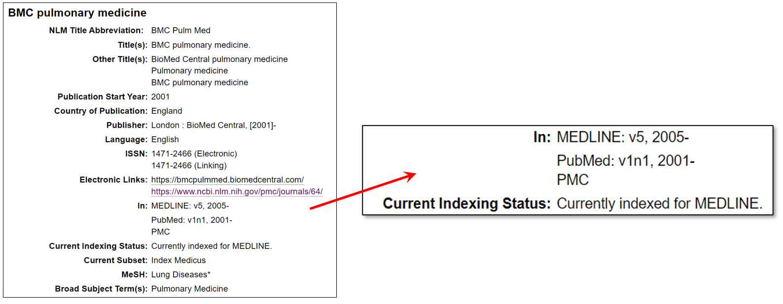
NLM Catalog: Journal Information
Notes:
Let’s look at the answers together.
In the NLM Catalog, click on the title for any record to learn more about that title. Journal records contain indexing information, including the dates of inclusion for MEDLINE, PubMed and PubMed Central. Here’s an example that shows a journal indexed in MEDLINE and available full text in PMC.
If you would like to learn more about any particular journal’s participation level in PubMed Central, follow the link to PMC.

Slide 51
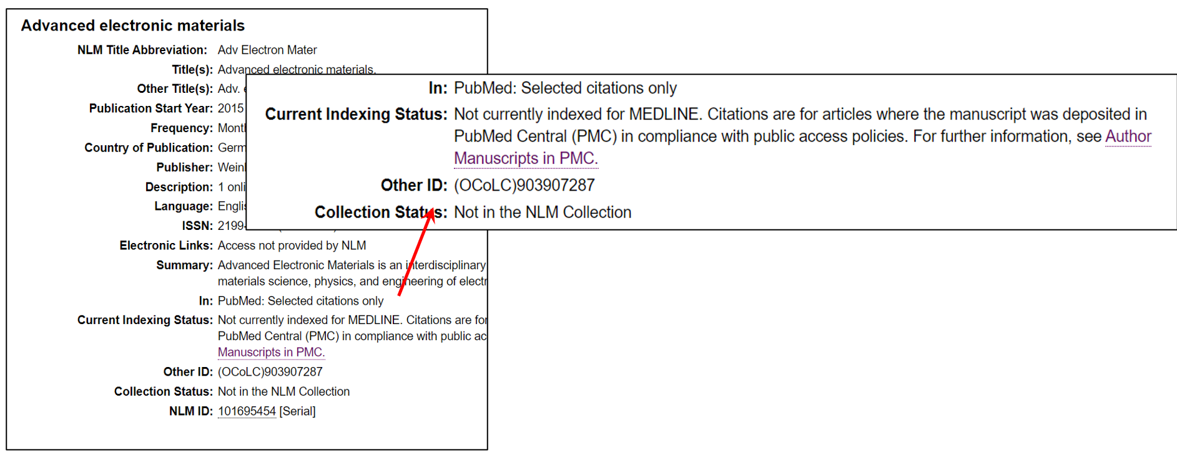
Journal Not Currently Indexed
Notes:
This is an example of a journal that is not currently indexed for MEDLINE and not in the NLM Collection. Instead, it includes a note that “citations are for articles where the manuscript was deposited in PubMed Central (PMC) in compliance with public access policies.”

Slide 52
GUIDING authors And Researchers
Notes:
Let’s move on to our final topic. I’ll talk just briefly about guidance to help authors and researchers at your institution navigate the complex landscape of scholarly journal publishing today. We know these issues of journal and article quality are not specific to NLM.
We also know that these challenges, while daunting, are an opportunity for librarians.

Slide 53
FTC Consumer Guidance
Check with your institution’s librarian.
Report concerns about a publisher or journal.
Notes:
In fact, in 2016, the FTC issued consumer guidance about journal quality concerns, and they directed researchers to librarians.
You are the experts here. This is not just a selection issue for libraries but also an education opportunity. Helping your researchers assess a journal’s transparency, quality, and peer review process could be a very valuable asset to your institution.
The FTC consumer guidance also offers a link where researchers can report concerns about a publisher’s business practices. This is the answer to #12 on your handout, “Where can you report concerns about a publisher or journal?” The answer is to the Federal Trade Commission. A link to the FTC is on your handout.
-----------------------
https://reportfraud.ftc.gov/#/

Slide 54
Cross-Industry Guidance
Think. Check. Submit.

Slide 55
Checklists for Different Content Types
Prisma
CARE: case report guidelines
ARRIVE
equator network

Slide 56
Take-aways
PubMed contains citations from:
MEDLINE journals
PMC journals
Individual articles to comply with funder policies
NCBI Bookshelf content
NIH-funded preprints
Selection processes include:
A check for minimum requirements
A scientific quality review
A technical review
Librarians have an important role in helping readers discern good quality sources.
Notes:
To summarize what we’d like you to take away from this presentation:
In addition to MEDLINE and PMC participating journals, PubMed also includes records for individual articles that are in PMC to comply with public access policies, as well as records for select content in the NCBI Bookshelf and preprints of NIH-funded research from the NIH Preprint Pilot.
Selection processes are different for different NLM products but include: A check for minimum requirements, a scientific quality review, and a technical review.
Acceptance into the NLM Collection is a prerequisite for inclusion in MEDLINE, PubMed Central at the journal level, and Bookshelf.
A final note: These three resources are scientific literature databases offered to the public by the U.S. National Library of Medicine (NLM). Once publications are selected for inclusion in a database, NLM does not review, evaluate, or judge the quality of individual articles and relies on the scientific publishing process to identify and address problems through published comments, corrections, and retractions. The presence of any article, book, or document in these databases does not imply an endorsement of, or concurrence with, the contents by NLM, the National Institutes of Health (NIH), or the U.S. Federal Government.
If you do have quality concerns about particular articles or journals in PubMed, we encourage you to contact us, and contact the editor or publisher.
Librarians have an important role in educating and assisting authors and researchers in discerning high quality publications. Please let us at NLM know how we can work together in this endeavor.

