Slide 1
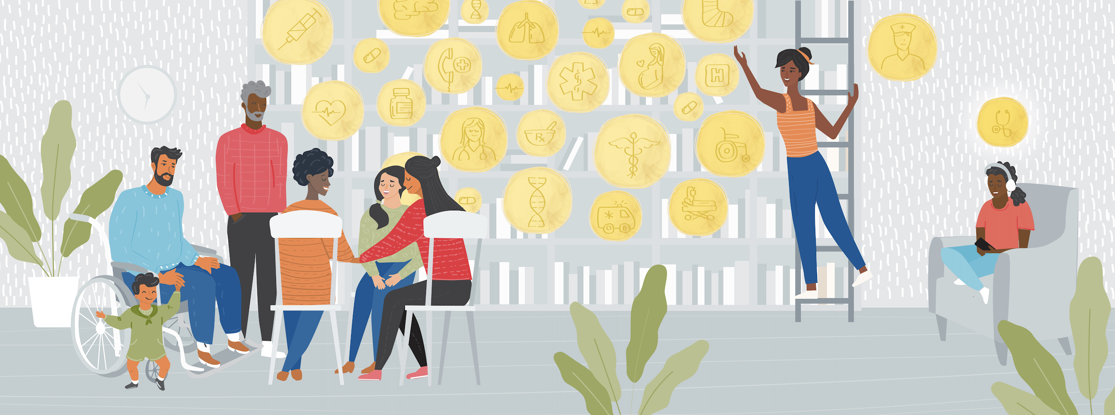
Please join us for a virtual health and wellness storytelling and listening event.
ALL OUR VOICES
Conversations About Health & Wellness
Date: Time:
This event is free and open for all. To learn more and register, please visit _____________
(add library logo here)

Slide 2
Please join us for a health and wellness storytelling and listening event at (LIBRARY NAME)
ALL OUR VOICES
Conversations About Health & Wellness
Date:
Time:
Location:
This event is free and open for all. To learn more and register, please visit _____________
(add library logo here)

