Slide 1
Writing and Submitting Your NNLM Proposal for Region 1 Grants
Part 3: Go!
October 4, 2022
Nancy Patterson
Outreach Librarian
Tony Nguyen
Executive Director

Slide 2
Agenda
Telling the Story
Connect Your Research
Logic Models
SMART Goals
Tying it All Together
Evaluation Criteria
Q&A

Slide 3
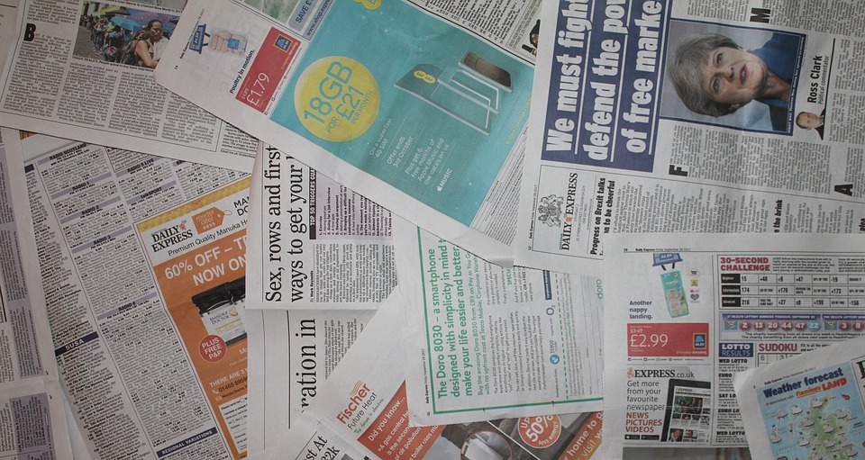
Telling the Story
Narrative reads like a story filled with facts and statistics
Make a compelling case
Share your approach
Draw in the peer reviewer
Balance between complete and concise

Slide 4
Connect Your Research and Data

Slide 5
NNLM National Evaluation Center: NEC
Evaluation Materials
Evaluation Design
Coming soon…
Dissemination & Impact Resources
Community & Capacity Building Resources
Resources for Subawardees
https://nnlm.gov/nec/resources

Slide 6
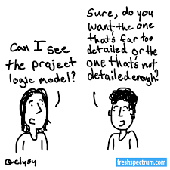
Logic Models

Slide 7
Logic Model

Slide 8
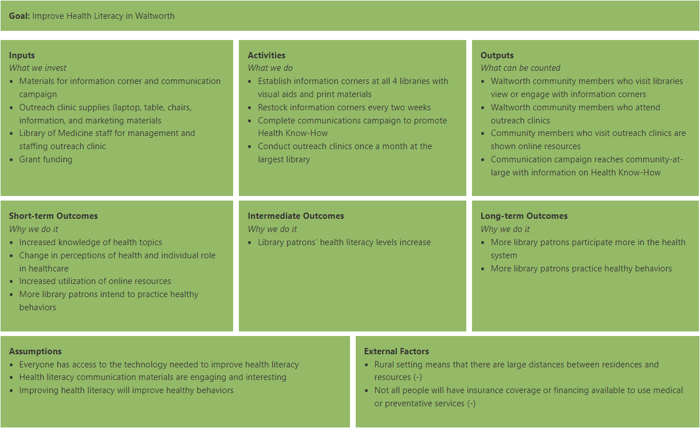
Logic Model Example
https://nnlm.gov/nec/evaldesign/rural-health-pathway

Slide 9
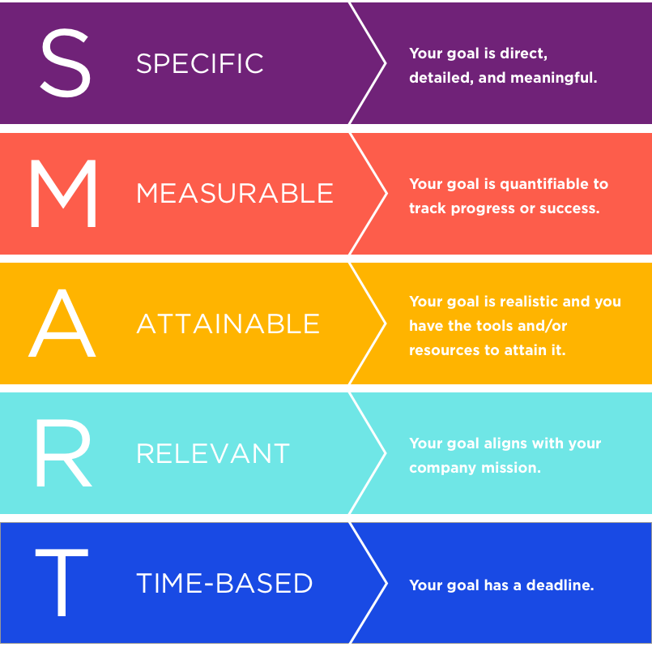
SMART Goals

Slide 10
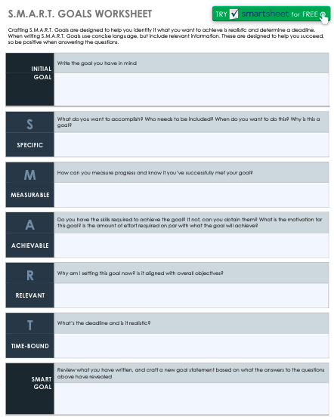
SMART Goal Template
Notes:
https://www.smartsheet.com/sites/default/files/IC-SMART-Goals-Worksheet-9237-PDF.pdf

Slide 11
SMART Goal Example
Instead of….
We will improve health literacy in our community.
Try saying this…
Combat hypertension in Baltimore City by providing physical activity and educational sessions for community members over a six-month project period.
Objectives:
Partner with UMB nursing students
Assess and compare blood pressure pre/post project period.
Lead 3 Community Walks per week
Provide 1 Healthy Eating class per week

Slide 12
Resources
Logic Models
NNLM NEC: Developing a Logic Model
NNLM NEC: Step 2 - Make a Logic Model (Worksheet: Logic Models)
Community Toolbox: Section 1 - Developing a Logic Model or Theory of Change
GJCPP Tools: Tearless Logic Model
NNLM NEC: Tearless Logic Model Questions
SMART Goals
Smartsheet.com: S.M.A.R.T. Goals Work Template
University of California SMART Goals:
A How To Guide
Stanford University: How to Write SMART Goals
CDC Develop SMART Objectives (includes SWOT analysis)
DevelopGoodHabits: Alternatives to SMART Goals

Slide 13
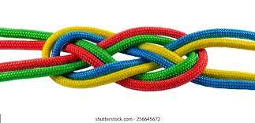
Tying It All Together
Take sections and start a build:
Community partners
Needs/Assets
Budget
Project timeline
Logic model
SMART goals > objectives/tasks
Evaluation built in
Identify what’s missing or weak

Slide 14
Brainstorming Exercise
Scenarios
Lack of healthy food options
Lack of physical activity programs
Lack of activities for students
Lack of activities for older adults
Players
Your organization
Public school with green areas
Senior housing with green areas
Parks and Rec with a kitchen
NNLM funding
Outreach Project
Resources
MedlinePlus

Slide 15
Write to the Evaluation Criteria
How do peer-reviewers evaluate your proposal?
Three reviewers will review your proposal
Remember: Reviewers do not know you or your organization.
Each question is scored from 1 (low) to 5 (high) for a total of 100 points.
Scores will be averaged for a composite score up to 100 points.

Slide 16
Significance
Application clearly explains the need for the project including demographic information about the target population or geographic area. (5 points)
Applicant effectively uses data (e.g., statistics, anecdotes, needs assessment) to demonstrate the project need. (5 points)
Application contributes to NNLM goals and objectives. See NNLM goals and objectives. (5 points)

Slide 17
Methodology/Approach Questions
Application demonstrates the ability to execute the project within the proposed timeline. (5 points)
Application proposes an approach that is suitable for the target population and geographic area and includes data to support this. (5 points)
Application demonstrates appropriate use of NLM materials and products, if available. (5 points)
Application provides a rationale for selecting the proposed approach(es). (5 points)
Application is creative, original, or demonstrates the potential to serve as a model for a similar NNLM project. (5 points)
Application clearly outlines activities, milestones, and methods that are feasible and relevant to the project. (5 points)
Application provides a long-term plan to sustain and continue the project, sustain one or more key components, or incorporate lessons learned into future projects. (5 points)
Application provides an effective and/or creative plan to promote the project. (5 points)

Slide 18
Evaluation
Evaluation
Evaluation plan is well aligned with the project goals and objectives. (5 points)
Evaluation plan clearly indicates how to measure success and project outcomes. (5 points)
Evaluation clearly explains types of data that would be collected, who will collect the data, methods of data collection (instruments/ tools and frequency of data collection) and analysis, and how project findings will be shared and used. (5 points)

Slide 19
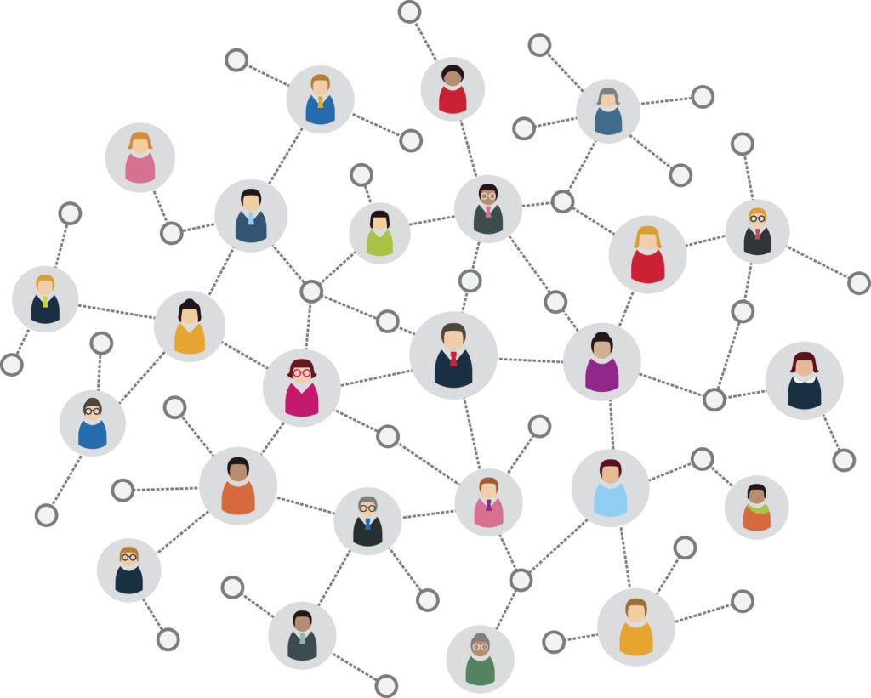
Project Staff
Application clearly explains qualifications (expertise and experience) of the project lead and the project staff. (5 points)
Application clearly identifies and outlines roles and time commitment of the project lead, project staff, (and project partners, if needed). (5 points)
Application provides information on institutional resources (e.g. equipment) and support to be utilized for the project. (5 points)

Slide 20
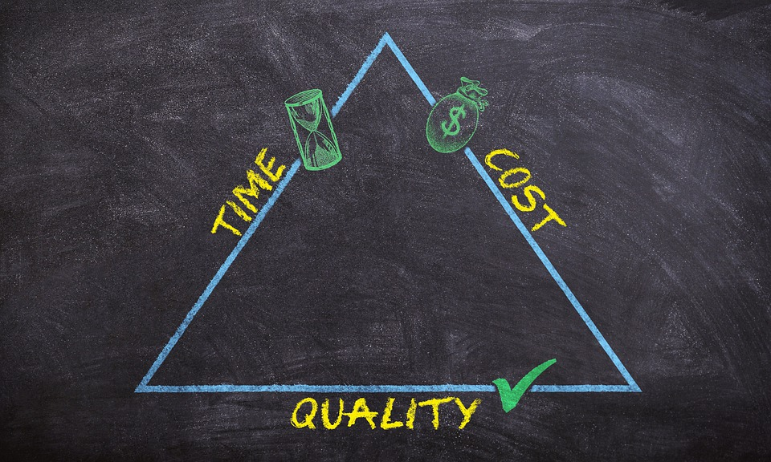
Budget
Proposed budget is appropriate with a budget narrative that justifies expenses. (5 points)
Proposed budget includes only expenses that are allowable under the Regional Medical Library or Office and NIH regulations. (5 points) See NIH Regulations.

Slide 21
Diversity, Equity, and Inclusion
Application identifies inequities and disparities and suggests appropriate approaches to enhance diversity, equity, and inclusion
*OR*
The target population of the project is underrepresented in biomedical research (UBR)
(5 points)
NIH-designated U.S. health disparity populations:
Blacks/African Americans
Hispanics/Latinos
American Indians/Alaska Natives
Asian Americans
Native Hawaiians and other Pacific Islanders
Socioeconomically disadvantaged populations
Underserved rural populations
Individuals with a physical or mental disability
Sexual and gender minorities
Individuals under 18 or over 65
Individuals with less than a high school degree

Slide 22
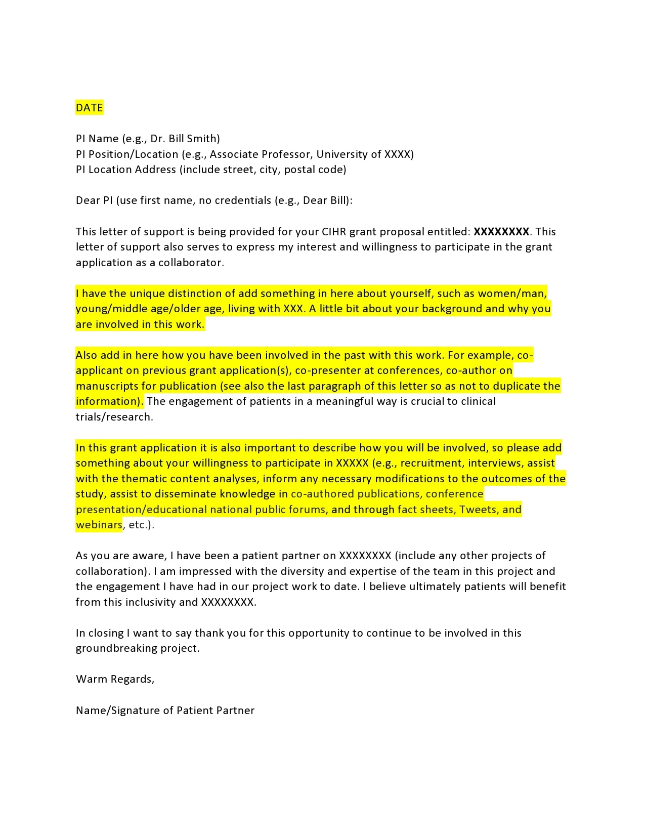
Letters of Support
Invite partner organizations and collaborators to write a letter of support for your project proposal.
Not a general letter supporting the project.
Outline how they are specifically supporting the project proposal.
Share a draft in advance.
Combine all documentation together when uploading.

Slide 23
Part 4 of this Webinar Series: “Show”
October 11, 2022, 12 PM ET
Register: https://nnlm.gov/training/schedule
Review Part 1 and
Part 2 of this series
Agenda
Wrapping it Up
Evaluation
Reporting
Carrying it Forward
Q&A
Notes:
https://nnlm.gov/training/class-catalog/nnlm-region-1-4-part-funding-webinar-series
https://nnlm.gov/training/class/nnlm-region-1-funding-webinar-part-4-show

Slide 24
Questions?
Nancy Patterson​
Outreach Librarian
npatters@hshsl.umaryland.edu
https://www.calendly.com/nancy-nnlm
Tony Nguyen​
Executive Director
ttnguyen@hshsl.umaryland.edu
https://calendly.com/ttnguyen-1

