Slide 1
Cultural Humility
Begin the Process…

Slide 2
Discussion points from last module
How do you currently engage in self-reflection?
What are ways you plan to incorporate cultural humility principles into your work?
Notes:
(Note: Read the material on the slide) Then ask, who is willing to share some ideas on how to learn from clients and patients what they have determined are the most important aspects of their culture. (There are no wrong answers. If no one volunteers, say that asking questions and listening are probably the most effective ways to learn. (Don’t spend more than a minute on this discussion)

Slide 3
Objectives
By the end of the program participants will:
Begin the process of self-reflection and life-long learning.
Notes:
(Note: Read the material on the slide)

Slide 4
Moving Forward
“Cultural humility challenges us to ask difficult questions instead of reducing our clients to a set of norms we have learned in a training course about ‘difference’”¹
Notes:
Today is the final session in the training modules on cultural humility, but remember, the idea of cultural humility means that it is an ongoing process, there is no completion score today where you finish a training and no longer think about some of the concepts we have been discussing. That is why the objective of our final module is to begin the process of lifelong learning. You may have thought of this since the take home point asked you to consider how you currently engage in self-reflection. This isn’t an easy process, which is why the session today begins with this statement from the last module: “Cultural humility challenges us to ask difficult questions instead of reducing our clients to a set of norms we have learned in a training course about ‘difference’”¹. It’s hard to ask ourselves difficult questions, but necessary to move forward in the process of cultural humility.

Slide 5
Reflection of Values
Reflection of Person: looking at your own personal beliefs, biases and values and the influences they may have on interactions¹
Reflection of Profession: considering how a biomedical worldview influences how you see the world¹
Notes:
One way to continuously develop cultural humility is through reflection.² This has been discussed through the other modules, but it is important that we understand how our own views of the world may guide our actions.² Reflecting of person involves looking at everything from race, gender, and religion that were included on the power and privilege wheel to things like family experiences, where you grew up, your relationships, and peer influences¹. These all work together to influence who you are and are important to reflect upon.² Reflection of profession relates back to the fact that healthcare itself is a type of culture to which patients will not belong, unless you treat another provider.² When a patient doesn't belong to this culture, they might not understand certain language, values and practices associated with the culture of healthcare². Reflection is an important strategy to engage in as part of an ongoing cultural humility journey.³ Remember that culture can change over time^{5,9}, including yours, so doing this once and checking it off your to do list is not within the spirit of cultural humility.

Slide 6
Building Relationships
Building relationships can help a provider work in the “space between” their own values and the values of a patient³
Kleinman Explanatory Models Approach: helps determine the link between someone’s social world is affected by their illness⁵
Notes:
Another important part of cultural humility is building relationships with patients themselves^{2,3}. Many of you likely already do this, but it is still worth noting in the context of cultural humility. Understanding someone else's values and cultures can help us see and interact in the "space between" our own values and those of our patients³. Finding out more about someone's values could involve the Kleinman Explanatory Model⁵, some of the motivational interviewing techniques included in a different section of this training, or other methods that you may already employ. [Note to Facilitator: If you would like, you can ask your group to share how they build relationships with patients]

Slide 7
Being Aware of Past & Present
Consider how the history of our country has contributed to current advantages and disadvantages²
How might this influence a patient’s worldview?
“…We are a-historical as a culture- we think that the present is disconnected from the past, that the current distribution of advantage or disadvantage is a happenstance…”
~Dr. Camara Jones
Notes:
Another consideration when it comes to cultural humility is being aware of the past and the present2. Dr. Camara Jones has the a-historical culture in America as one of the barriers to health equity6. She says that this means that we don’t always connect our country’s history of racism with present inequalities- we instead assume that disparities and other advantages and disadvantages we see in society are “happenstance”6. This idea of being a-historical also means that we assume our current structures and systems cannot be changed- we take them as a given6. We have, as you all know, a history in our country of slavery, racism and segregation that have contributed to health disparities, and recognizing these is important2. this history can be a source of mistrust in current systems, including healthcare, that has only been exacerbated by lack of true cultural understanding and a need for better patient-provider communication2. However, it is important to remember that not every member of a vulnerable or minority population will have mistrust of the healthcare system2 and that not every healthcare provider has poor communication skills and/or lacks cultural humility. However, recognizing our past and avoiding a-historical thinking can help with the understanding of our current patients.

Slide 8
Mindfulness
Trying to avoid “auto-pilot” when busy²
Looking at situations without a filter²
Responding to the current situation thoughtfully²
Notes:
[Note to Facilitator: if you would like, before you go into the information here, you can ask the group to share any experiences they have had with mindfulness, perhaps for stress relief or relaxation] For those of you who are not familiar with mindfulness, it is a practice of being in the present moment². You might be surprised to hear it presented here, because mindfulness is typically discussed in a stress management type of setting. However, it also has a role in cultural humility². If you remember, in a previous module we discussed that implicit bias is more likely to take hold when someone is feeling stressed or multi-tasking.^{7,8} Mindfulness can be described in this context as looking at our circumstances without a filter to better see what is really happening and responding appropriately². Because mindfulness can take someone out of auto-pilot, it can be help them acknowledge their attitudes or biases as they go through their day and consider how they might be affecting others².

Slide 9
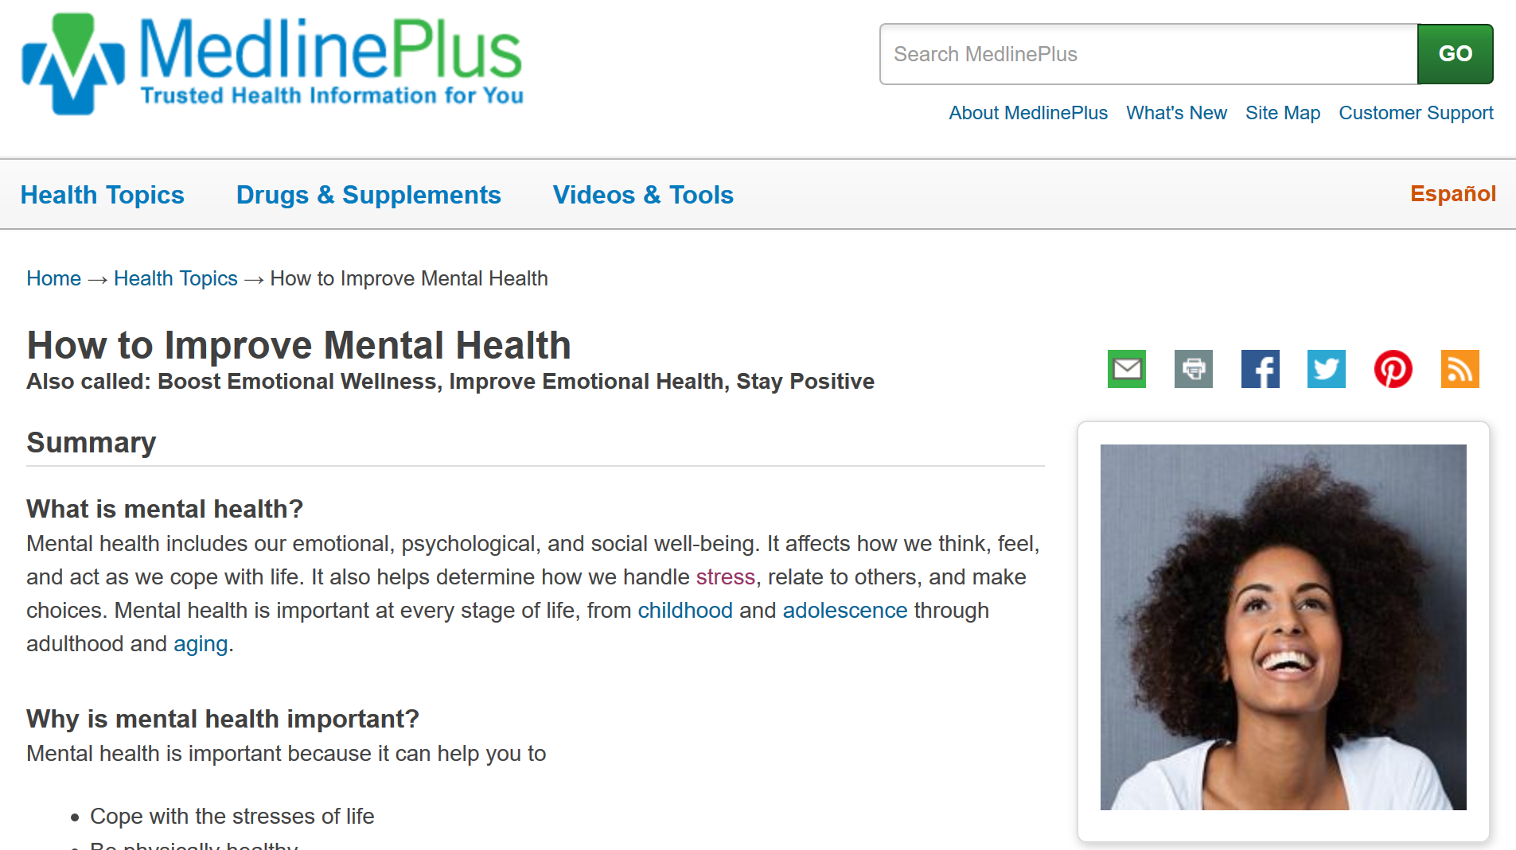
MedlinePlus
Notes:
Just like cultural humility, being more mindful is a learned process. There are a lot of guides out there about how to be more mindful, including some quick reads linked on the How to Improve Mental Health topic page in MedlinePlus. I can send you the link to this page in a follow up e-mail [Note to Facilitator: only say this if you plan to send e-mail #4].

Slide 10
5R’s of Cultural Humility
Reflection. “What did I learn from each person in that encounter?” ¹⁰
Respect. “Did I treat everyone involved in that encounter respectfully?” ¹⁰
Regard. “Did unconscious biases drive this interaction?” ¹⁰
Relevance. “How was cultural humility relevant in this encounter?” ¹⁰
Resiliency. “How was my personal resiliency affected by this interaction?” ¹⁰
Notes:
The last thing to consider around developing cultural humility is the 5R’s. This was developed as a tool for clinicians to engage in brief reflections through their day¹⁰. Each “R” is associated with an action that equates to the process of cultural humility and, here, you can see a question that a person could ask themselves associated with each “R”¹⁰. Reflection has been mentioned several times already, but the question here is, “what did I learn from each person in that encounter?”¹⁰. Respect is second, and while most of us probably already strive to do this, the intention of including this is because situations can sometimes get difficult¹⁰. Respect includes engaging patients in their care and ensuring they understand¹⁰. Regard in this context refers to avoiding unconscious bias¹⁰. As we have discussed, it is common to be in a hurry in settings where we work and this rush can allow bias to creep in. Regard refers to valuing a patient for who they are, including their values¹⁰. Relevance refers to understanding the need for cultural humility in interactions with patients to balance power differences¹⁰. Finally, Resiliency. This refers to taking care of ourselves¹⁰. It’s easy to start feeling burn out during the day and resiliency is about being compassionate to ourselves when feeling emotionally exhausted¹⁰. It is worth nothing, however, that using practices that improve communication not only increase patient connection, but reduce the risk of feeling burned out¹⁰.

Slide 11
More Training
Notes:
We’ve talked about how cultural humility is a lifelong learning process, so this being our last module doesn’t meant that you know everything there is to know. For self-paced learning on this topic, you can sign up for this series of courses from the National Network of Libraries of Medicine that focus on working with diverse communities. I can send you the link to the registration page for these on-demand trainings [NOTE TO FACILITATOR: only say this if you plan to send e-mail follow up #4]

Slide 12
Take home message
Consider:
What do you intend to do to continually engage in the process of cultural humility?
Developed resources reported in this presentation are supported by the National Library of Medicine (NLM), National Institutes of Health (NIH) under cooperative agreement number UG4LM012342 with the University of Pittsburgh, Health Sciences Library System. The content is solely the responsibility of the authors and does not necessarily represent the official views of the National Institutes of Health.

Slide 13
Please complete the post-test questions
Notes:
[NOTE TO FACILITATOR: if you choose not to have participants complete the knowledge assessment questions, delete this slide.]

Slide 14
References
Fisher-Borne, M., Montana Cain, J. & Martin, S. (2015). From Mastery to Accountability: Cultural Humility as an Alternative to Cultural Competence. Social Work Education, 34(2), 165-181.
Yeager, K., Bauer-Wu, S. (2013). Cultural Humility: Essential Foundation for Clinical Researchers. Applied Nursing Research, 26(4).
Hughes, V., Delva, S., Nkimbeng, M., Spaulding, E., Turkson-Ocran, R., Cudjoe…Han, H. (2018). Not Missing the Opportunity: Strategies to Promote Cultural Humility Among Future Nursing Faculty, Journal of Professional Nursing, URL to Source
Masters, C., Robinson, D., Faulkner, S., Patterson, E., McIlraith, T., Ansari, A. (2019). Addressing Biases in Patient Care with the 5Rs of Cultural Humility, a Clinician Coaching Tool. Journal of General Infernal Medicine, 34(4), 627-630.
Kleinman, A. & Benson, P. (2006). Anthropology in the Clinic: The Problem of Cultural Competency and How to Fix It. Plos Med 3(10): e294.
Drexel Dornsife School of Public Health (2016). Achieving Health Equity: Tools for a National Conversation on Racism, 2016 Jonathon Mann Health and Human Rights Memorial Lecture, APHA President and Noted Scholar Camara Jones Wants to Talk – and She’s Got Stories to Tell. Retrieved from: URL to Source

Slide 15
References (2)
Byrne, A. & Tanesini, A. (2015). Instilling New Habits: Addressing Implicit Bias in Healthcare Professionals. Advances in Health Sciences Education, 20, 1255-1262.
White, A. & Stubblefield-Tave, B. (2017). Some Advice for Physicians and Other Clinicians Treating Minorities, Women, and other Patients at Risk of Receiving Health Care Disparities. Journal of Racial and Ethnic Health Disparities, 4, 472-479.
Napier, D., Ancarno, C., Butler, B., Calabrese, J., Chater, A., Chaterjee, H… Guesnet, F. (2014). Culture and Health. The Lancet, 384, 1607-1639.
Masters, C., Robinson, D., Faulker, S., Patterson, E., McIlraith, T., Ansari, A. (2018). Addressing Biases in Patient Care with the 5Rs of Cultural Humility, a Clinician Coaching Tool.

