Slide 1
Piecing Together Systematic Reviews Series Phase 1: Proposal what is the scope and rationale for the review?
June 26, 2024
Sponsored by NNLM Region 3
Margaret J. Foster, MS,MPH
Center for Systematic Reviews and Research Syntheses
Medical Sciences Library, Texas A&M University
https://library.tamu.edu/reviews/

Slide 2
Objectives
After attending this session, participants will be able to:
Define the steps needed to determine the feasibility of the review scope
Describe how to match the review scope to review type
List topics to be covered during the initial reference interview
Detail how to guide clients to determine the rationale for their review project

Slide 3
Agenda
Quick recap
Overview of Phase I Proposal
Planning & reference interview
Preliminary searching & client tasks
Bringing it together

Slide 4
Defining review types
Traditional reviews
Systematic Reviews
Qualitative Reviews
Mixed Methods
Reviews of Reviews
Rapid Reviews
Purposive (Misc.)
This article categorized review types and offers a references to guidance on searching for each as available.
Meeting the review family: exploring review types and associated information retrieval requirements

Slide 5
Librarians & reviews
Evidence of librarian impact
Clients needs
Potential roles

Slide 6
Review Project Cycle
Notes:
The PIECES Cycle is designed to:
organized model of 8 phases & 8 processes
encourages planning and testing of processes
demonstrates multiple outputs that can be produced, encouraging scholarly communication
highlights most important aspects of the phase
The cycle is not designed:
For narrative reviews that are more exploratory in nature- these projects generally do not have an a priori process
To replace the need for more detailed guides, standards, and consulting experts
The 8 phases of a review project can overlap, can have multiple outputs, which can be published or informal. And of course, some phases are optional. The phases also connect together in a cycle, for when the updating algorithm says its time to update, you then move back into the proposal phase. Now let's look at each phase separately.

Slide 7
Phases 1- 4
Proposal- What is the review type? Scope of the review? Is the question feasible?
Protocol- What are the methods for the review?
Production- Designing and running all searches? When to stop searching?
Paper- What are the most important findings and where do they fit into previous research?

Slide 8
Phase 1: Proposal steps
Plan
Determine review type and purpose
Frame the question
Identify>Evaluate> Collect> Combine
3. Find related reviews
4. Scoping search for studies
Explain, Summarize, Share
5. Rationale
6. Proposal outline

Slide 9
Planning & Reference Interview
1. Review type & purpose 2. Framing the question

Slide 10
Reference interview
What type of review?
What is your definition of ____ review?
What is the expected outcome of the review? Published paper, class assignment, grant proposal
What is the timeline?
What role are you looking for from librarian?
Guidance for client:
Articles on study types
Discuss reasonable timelines
Setting clear expectations

Slide 11
Systematic Reviews
A well-done review:
Transparent (record & report all methods)
Follows standards and best practices
Has comprehensive search
Minimizes bias (at least 2 independent researchers on each process, screen/ code/assess)
Definition:
a research method that aims to answer a question by analyzing studies meeting a specified criteria
Notes:
Systematic review is a research method that aims to answer a question by analyzing studies meeting a specified criteria. Put another way, it is a study of studies. To answer this question, there 6 steps Plan, Identify, Evaluate, Code, Explain, and Summarize. We will be going over these steps again later in this module, and then focusing on each one with its own module.
Throughout these steps there are 3 main principles:
Transparent, state all methods, there are several standards to explain the methods and reporting of methods
Follow standards and evidence based practices
Minimize bias by being rigorous and systematic with each step of the process

Slide 12
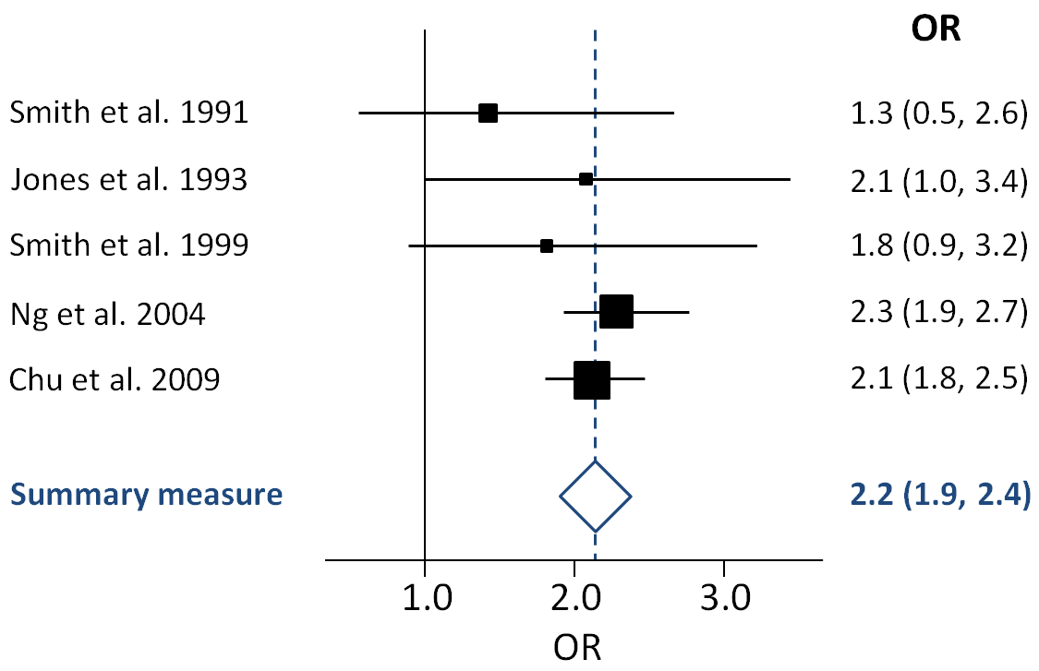
Meta-Analysis
a statistical method which combines data from studies
Usually starts with a systematic review
Run tests to determine if study data can be combined
Combine study data from multiple studies into one final outcome
Systematic reviews: synthesis of best evidence for clinical decisions

Slide 13
Issues with Systematic reviews
Researcher wants to include:
variety of studies/articles
answer a broader question
Difficult to conduct a SR if:
few studies available
studies available focus on variety of questions

Slide 14
Scoping review
Do authors want to answer a specific question or inform practice?
Systematic review- Will need to have a set of criteria for specific type of study/evidence to answer question
Do authors want to explore/identify concepts/characteristics in an area of research literature?
Scoping review- Criteria will be more open, include a wider range of studies/evidence from different perspectives
Systematic review or scoping review? Guidance for authors when choosing between a systematic or scoping review approach.
Notes:
Scoping review is similar to a systematic review in that it has a set of standards to be followed, but different in that it has a broad question. The review aims to addresses an exploratory research question aimed at mapping key concepts, types of evidence, and gaps in research related to a defined area or field. The bar graph shows the increase in articles indexed in PubMed with scoping review in the title.

Slide 15
Review Spectrum

Slide 16
Techniques for determining review method- what is most important to client?
What is most important to client? Conducting a systematic review, changing the question changed as needed?
OR answering the question as stated and shopping for a review type to best match?

Slide 17
Systematic review categories
Type of study
Quantitative
Qualitative
Umbrella (systematic reviews)
By time
Rapid reviews
Living reviews
Type of question
Effectiveness
Economics
Harm/Benefit of exposure
Prevalence
By synthesis
Meta analysis
Qualitative
Bayesian
Network meta-analysis

Slide 18
Which review? Example A
What is the current literature on accessible design policies in library settings?
narrative scoping/mapping systematic

Slide 19
Which review? Example B
What does AI mean for college level writing courses?
narrative scoping systematic

Slide 20
Which review? Example C
Which review? Example C
What are the impacts library outreach programs during freshmen orientations ?
narrative scoping/mapping systematic

Slide 21
Tips on selecting type
Listen to the proposed frame the question
Is this appropriate as a systematic review question?
Would another type of review match the topic better?
Does it have elements of a set framework?
Most questions can be reframed to be another type of review

Slide 22
Step 2: Frame the question
Select best framework to match the question
Eligibility criteria
Basis of every decisions forward

Slide 23
Reference interview continued…
What are the eligibility criteria for included studies?
What is the scope of the review question? Particular years? Disciplines? Other limiters to scope?
What type of research will be included in this review? (RCT, Cohort, etc.)

Slide 24
Systematic review frameworks Part 1
Review type | Framework
Effectiveness | PICO: Population, Intervention, Comparator(s), Outcomes
Etiology/ Risk/ Benefit | PEO: Population, Exposure(s), Outcomes
Prevalence/ Incidence | PCS: Population, Condition, Setting or context
Diagnostic Test Accuracy | PIRD: Population, Index Test, Reference Test, Diagnosis of Interest
Psychometric | PTM: Population, Type of measurement instrument, Measurement properties
From What kind of systematic review should I conduct? A proposed typology and guidance for systematic reviewers in the medical and health sciences.

Slide 25
Systematic review frameworks Part 2
Review type | Framework
Qualitative | PICo: Population, phenomenon of Interest, Context
Costs/ Economic Evaluation | PICOC: Population, Intervention, Comparator(s), Outcomes, Context
Expert opinion/ policy | PICo: Population, phenomenon of Interest, Context
Prognostic/ Prediction | PFO: Population, prognostic Factors (or models of interest), Outcome
Methodology | SDMO: types of Studies, types of Data, types of Methods, Outcomes
From What kind of systematic review should I conduct? A proposed typology and guidance for systematic reviewers in the medical and health sciences.

Slide 26
Scoping review framework

Slide 27
What are the effects of Vitamin-D on obesity?
PICO 1
Patient: obesity
Intervention: vit D
Outcome: effects
Study design- RCTs
PICO 2
Patient: age group/other
Intervention: vit D
Outcome: obesity
Study design- cohort (follow over time)
PEO
Population: obesity
Exposure: Vit D
Outcome: effects
Study design- surveys (cross sectional)
Scoping review
Population: Obesity
Concept: Vit D intake
Context: could be a setting, geography, population, age group
No set study design

Slide 28
Eligibility criteria
Eligibility criteria- set of characteristics required to be included in review
Inclusion: characteristics for include articles, can be limiters such as years
Exclusion: exceptions to inclusion (not just opposite of inclusion
Search criteria- translation of eligibility criteria to appropriate concepts for search
Exclusion reasons- labels for excluded articles- these are opposite of inclusion, shown in PRISMA flowchart

Slide 29
Resources to help with framing questions
Website for guidance on selecting between scoping, systematic, and/or qualitative. Also provides glossary and bibliography.
Right Review
The web-based “Right Review” tool asks reviewers simple questions to suggest methods from 41 knowledge synthesis methods

Slide 30
Preliminary Searches
3. Related reviews 4. Scoping search

Slide 31
Step 3: Related reviews
Look for related reviews
Evaluate the reviews for their scope in relation to proposed review
Helps in establishing the rationale of the review

Slide 32
Search for reviews
Resources to search
review databases
Campbell Collaboration
What works clearinghouse
Protocol databases
OSF
Prospero
Campbell Collaboration
Subject specific
Medline
APA PsycINFO
Dissertation and theses databases
Overall tips
Keep the terms very broad
Looking at much smaller group of articles
Looking for anything related
Difficulty- may not be named a systematic review by the authors

Slide 33
Create table of the reviews
When first evaluating the reviews, just look at scope Then expand to appraise the quality after scope of review is finalized.
Article | #1 | #2 | #3
Review type | Narrative review | Scoping review | Systematic review
question | Review on the association of time spent in the library and academic success for college students | What are the academic outcomes for graduate students who attend library workshops? | What is the effectiveness of librarian led interventions to improve writing assignments for undergraduate students?
search | (2010-2022) ERIC, Education Full Text, Academic Ultimate, Web of science | (2002-2021) ERIC, Education Full Text, Google Scholar, LISTA, LISA | (2002-2018) ERIC, Education Full Text, Google Scholar, LISTA, LISA, Scopus
Population | college students | Graduate students | undergraduate
Interventions or factors | time spent in library | Library workshops | librarian presentation
Outcomes | Academic success | academic outcomes | Quality of writing assignment

Slide 34
Table on differences with proposed review

Slide 35
Step 4: scoping search
Quick search to see what is out there
First search in developing main search
Start with most important database

Slide 36
Start with a Venn diagram
Population
Intervention/ exposure
Type of study
Creating a Venn Diagram
Helps to establish main criteria of search
Aids in clients’ understanding of how things will be combined.
Color code with sections of search
Notes:
A scoping search is a quick search to get an idea of what is out there- 10, 100, or 1000s of articles. This especially good when you are not sure if anything has been published or how narrow with population to choose.

Slide 37
Consider standards of searching (Cochrane Handbook)
Concepts to search
population terms
AND
intervention or exposure or concept
AND
study type (if appropriate)
For the most part, outcomes should not be in the search (sometimes necessary)
Best to wait until feasibility is determined before making it “perfect”
Still, good to start documenting the search
Test already known articles as search develops to improve it

Slide 38
Scoping search- identify
What are the attitudes of graduate students towards library instruction?
This is just one way to search.
How would you search differently?

Slide 39
Scoping search- evaluating
Potential tools
Rayyan
Abstractr
Covidence
DistillerSR

Slide 40
Evaluating the results
Found too little
Found too much??
Try another database
Search for cited/citing references
Where are these articles indexed
How are they indexed?
Increase the
Further limit population
Further limit intervention
Years?
Notes:
Reviewing the results you may fall into found too little or found too much. If you found too little, you can try another database and/or try a database that keeps track of who’s citing who. How’s do this help? These databases index a wide variety of

Slide 41
Scoping search- collect
Create a brief table of the results
Goal is to help client consider eligibility criteria
Lead author (year) | Population | Intervention / exposure | Outcomes | Study design

Slide 42
Bringing it all together
5. Rationale 6. Proposal

Slide 43
Is it feasible?
Did the question change? Did the criteria change?
Write out the finalized question & eligibility criteria
Keep scope in mind throughout the process- it should guide everything

Slide 44
Scope creep
It may change as during the planning steps, but after that it needs to stay firm- avoiding “scope creep”

Slide 45
Do you have what is needed?
Time
Resources
Expertise
Data
Audience
Booth, Sutton, and Papaioannou Systematic Approaches to a Successful Literature Review, 2nd Edition. 2016

Slide 46
T R E A D Time: Timeline
How long??
Average is one year
Depends highly on number of citations to be sorted
experience with review type
Tips:
Set completion dates
Cochrane Handbook offers a possible timeline over a year

Slide 47
T R E A D Resources- software
Plan: Protocol development, Concept mapping
Identify: Citation management, Text analysis, MeSH analyzer
Evaluate: Sorting tools, Automated analysis
Collect & Code: Forms, Spreadsheets
Explain & Summarize: Data Visualization, Data Analysis
Throughout the process: Communication, Whole SR process, Project management, File manager

Slide 48
T R E A D Expertise: The team
Researcher to lead review
Researchers to assist in screening and coding
Consultants (suggested):
Subject expert
Search expert
Biostatistician
List and consider stakeholders role

Slide 49
T R E A D Audience: Researchers, public, policy makers
Who should be included in developing the review?
Who wants to know this information?

Slide 50
T R E A D Data
Is there enough?
Which databases are needed?
Major databases
Grey literature

Slide 51
Step 5: Rationale
Reasons for conducting review:
Include summary and evaluation of previous reviews
Importance of topic
Could include table

Slide 52
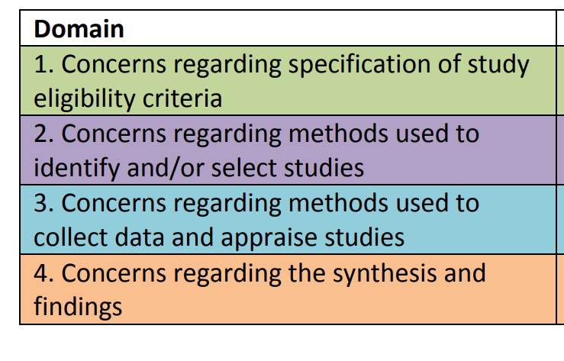
Quality appraisal for reviews
ROBIS: risk of bias in systematic reviews (see table >)
AMSTAR checklist: focuses on conducting of review including meta-analysis
CASP: Critical Appraisal Skills Programme

Slide 53
Logic models
Not a requirement
Options:
start with logic model (whether explicit or not)
develop a logic model (whether just described in the narrative or not)
Pre/Post logic model
See Cochrane Handbook section

Slide 54
#6 Proposal outline
Provide an explicit statement of the question(s) the review will address with reference to participants, interventions, comparators, and outcomes (PICO)
Logic model if appropriate
Specify the study characteristics (such as PICO, study design, setting, time frame) and report characteristics (such as years considered, language, publication status) to be used as criteria for eligibility for the review
Describe the rationale for the review in the context of what is already known including summary of related reviews
example articles
Share and get feedback

Slide 55
On my bookshelf
Foster MJ and Jewell ST (Eds.) (2022) Piecing Together Systematic Reviews and Other Evidence Syntheses. (Medical Library Association Books Series) Lanham: Rowman & Littlefield. Dec 2022.
Levay, P., & Craven, J. (2019). Systematic searching: Practical ideas for improving results. London Facet Publishing.
Booth, A., Sutton, A., Clowes, M., & Martyn-St James, M. (2022). Systematic approaches to a successful literature review (Third edition). SAGE.

