Slide 1
MeSH Changes and PubMed Searching
Catherine Staley, Kate Majewski, Rebecca Brown NLM, NNLM Training Office

Slide 2
Agenda
Pre-Test
What happens when MeSH is updated?
Examples of MeSH changes
Post-Test

Slide 3
New MeSH Terms in the New Year
New term with same meaning
New term that is more specific
Hierarchy changes

Slide 4
MeSH changes are documented:
On the MeSH homepage
In the NLM Technical Bulletin

Slide 5
Quiz 1
How far back can you search with the MeSH term Post-Acute COVID-19 Syndrome?
1963
1983
2020
2023

Slide 6
Quiz 1 Answer
How far back can you search with the MeSH term Post-Acute COVID-19 Syndrome?
C) 2020 is the answer

Slide 7
Quiz 2
How far back can you search with the MeSH term Plastic Surgery Procedures?
1963
1998
2022
2023

Slide 8
Quiz 2 Answer
How far back can you search with the MeSH term Plastic Surgery Procedures?
B) 1998 is the answer

Slide 9
New Term with Same Meaning

Slide 10
New Term with Same Meaning
Existing PubMed records ARE changed
the old term is added as an entry term
Usually, you need to do nothing
Consider adding the new preferred term to your searches

Slide 11
Quiz 3
Which MeSH term does a search for Alien Hand Syndrome map to?
Alien Hand Syndrome
Alien Limb Phenomenon
It does not map
Alien Limb Syndrome

Slide 12
Quiz 3 Answer
Which MeSH term does a search for Alien Hand Syndrome map to?
b) Alien Limb Phenomenon

Slide 13
New Term that is More Specific
Existing records are generally NOT changed
Consider using the new, more specific term to retrieve newly indexed records
Use Previous Indexing and/or the broader term with the [mhda] search tag to search previously-indexed records

Slide 14
Exercise 1: Question 1
How far back can I search with Knee Fractures?
Answer: 2023

Slide 15
Exercise 1:Question 2
Where do I look in the MeSH record for terms used prior to 2023?
Answer: Previous Indexing

Slide 16
Exercise 1:Question 3
What field tag do I use to limit to records indexed between 2006 and 2022?
Answer: [mhda]

Slide 17
Hierarchy Changes: Example 1/Part 1
MeSH 2022

Slide 18
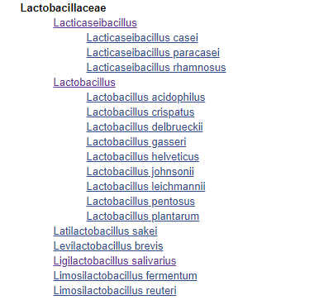
Hierarchy Changes: Example 1/Part 2
MeSH 2023

Slide 19
Exercise 2
MeSH 2022
MeSH 2023

Slide 20
Hierarchy Changes: Example 2/Part 1
MeSH 2022

Slide 21
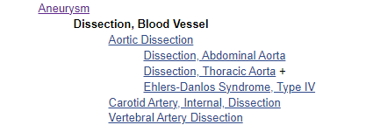
Hierarchy Changes: Example 2/Part 2
MeSH 2023

Slide 22
Exercise 3

Slide 23
Hierarchy Changes
Can result in dramatic retrieval changes
Offer an improvement to your explosions
Take a fresh look at the new hierarchy and reconsider your search

Slide 24
Exercise 4
You want to search PubMed as comprehensively as possible, back to 2010, for literature related to Paramedicine. How would you do this?

Slide 25
Exercise 5
You want to search PubMed as comprehensively as possible, back to 2015, for literature related to Dust Mite Allergy. How would you do this?

Slide 26
Post-Test
When a new, more specific MeSH heading is added to the vocabulary, it is applied to records that were indexed in previous years.
True
False
When a MeSH term is replaced, the term that was replaced is retained in MeSH as a(n):
MeSH Term
Entry Term
Supplementary Concept
The PubMed search results for a new, more specific term (e.g., Systemic Racism) will be included in the results for the broader term above it (e.g., Racism).
True
False
If my saved search suddenly retrieves many more or many fewer citations on a regular basis starting at the end of a calendar year, what is the most likely explanation? (Check the best answer)
A changed MeSH term with the same meaning
A new MeSH concept
Hierarchy changes to MeSH

Slide 27
Post-Test Answers
When a new, more specific MeSH heading is added to the vocabulary, it is applied to records that were indexed in previous years.
False
When a MeSH term is replaced, the term that was replaced is retained in MeSH as a(n):
Supplementary Concept
The PubMed search results for a new, more specific term (e.g., Systemic Racism) will be included in the results for the broader term above it (e.g., Racism).
False
If my saved search suddenly retrieves many more or many fewer citations on a regular basis starting at the end of a calendar year, what is the most likely explanation? (Check the best answer)
Hierarchy changes to MeSH

Slide 28
Summary
To adjust to changes in MeSH,
Check MeSH mappings in your PubMed Search Details
Check automatic explosions in MeSH
Craft searches for older records by using:
Year Introduced
Previous Indexing and/or broader terms with
[mhda]
Read about the MeSH changes in October and the year-end changes to MEDLINE in December in the NLM Technical Bulletin.

