Slide 1
Lack of Access 101
How public libraries combat disparities and bridge the digital divide
Carlette D. Dennis
2022-2023 NLM Associate Fellows

Slide 2
Objectives
Participants will leave knowing how to assist non-technology-savvy patrons with finding health resources in person and online.
Participants will be introduced to what other public libraries around the U.S. are doing to address the lack of access to internet services within their communities.
Participants will leave this training with a better understanding of their role as an advocate for access to health resources.
Participants will leave with an understanding of the digital divide and how it affects members of the community they serve.

Slide 3
What is the Digital Divide?
“The digital divide is the gap between those who have affordable access, skills, and support to effectively engage online and those who do not. As technology constantly evolves, the digital divide prevents equal participation and opportunity in all parts of life, disproportionately affecting people of color, Indigenous peoples, households with low incomes, people with disabilities, people in rural areas, and older adults.”
…Network of the National Library of Medicine website
Definition from National Digital Inclusion Alliance

Slide 4
Digital Inclusion
“refers to the activities necessary to ensure that all individuals and communities, including the most disadvantaged, have access to and use of (ICTs) Information and Communication Technologies, including such things as affordable, strong broadband internet service; internet-enabled devices, and access to digital literacy training.”
Definition from the National Digital Inclusion Alliance

Slide 5
Digital Equity
“is a condition where all individuals and communities have the information technology capacity needed for full participation in our society, democracy, and economy. Digital equity is necessary for civic and cultural participation, employment, lifelong learning, and access to essential services.”
Definition from National Digital Inclusion Alliance

Slide 6
Digital Redlining
“is discrimination by internet service providers in the deployment, maintenance, or upgrade of infrastructure or delivery of services.”
Definition from the National Digital Inclusion Alliance

Slide 7
Broadband Adoption
“has traditionally been defined as residential subscribership to high-speed Internet access. But for those in the field working to increase the digital capacity of communities, broadband adoption is daily access to the Internet…”
Definition from the National Digital Inclusion Alliance

Slide 8
Digital Literacy
ALA’s Digital Literacy Task Force defines digital literacy as “the ability to use information and communication technologies (ICTs) to find, evaluate, create, and communicate information, requiring cognitive and technical skills.”
Definition from the American Library Association.

Slide 9
What is a Reference Interview?
According to Wikipedia, “A reference interview is a conversation between a librarian and a library user, usually at a reference desk, in which the librarian responds to the user's initial explanation of his or her information need by first attempting to clarify that need and then by directing the user to appropriate information resources.”
Definition from Wikipedia

Slide 10
Meet Mary Young
Mary is 74 years old
Married
Grandmother of 6
Retired
Recently gifted a tablet
She has some health problems

Slide 11
Dos and Don’ts of a Health Reference Interview
DO: Listen & Pay Attention
DON’T: Talk over the patron
DO: Be Discreet with the patron’s private information
DON’T: Leave information where others can view
DO: Be Compassionate
DON’T: Accept unnecessary details
DO: Provide a Private Space – if possible
DON’T: Give Medical Advice
DO: Check in to see if additional assistance is needed

Slide 12
How to assist the patron over the phone and/or online?
Continuing with the Patron

Slide 13
Tips for Assisting Non-Technology-Savvy Patrons
Listen to what the patron is asking for and look for non-verbal cues.
Use the same terminology the patron uses; sometimes, library jargon can be confusing.
Make sure that the patron has the correct information before getting started
Website
Email login information
Confirmation number
Create a paper document that has fields for the patron to manually fill out for recurring assistance
Food Stamp Application
Social Security Application
Unemployment Application
One App (local school applications)
Follow up with the patron, confirm that what they needed was completed, and ask if they need assistance with anything else.

Slide 14
Health Resources and Digital Access

Slide 15
Access to Health Resources
Computers for public use
Courtesy phones
Internet enable devices for loan
In-person Programs
Nutrition Classes
Fitness/Yoga Classes
ACA sign-up assistance
STD/STI testing
Telehealth Booths
Medical and Health Database access both at home and in the Library
Passive Programs
An after-school snack program
Seed/plant pick-up
Take and Make recipe kits
Free Condom giveaway
Medical Handouts
Guides to MedlinePlus
Info on PubMed & PubMed Central
Local Health Fairs
Local resources to hospitals and clinics.
Library Hosted Events
Live
Recorded

Slide 16
My Past Programs
New Orleans Public Library

Slide 17
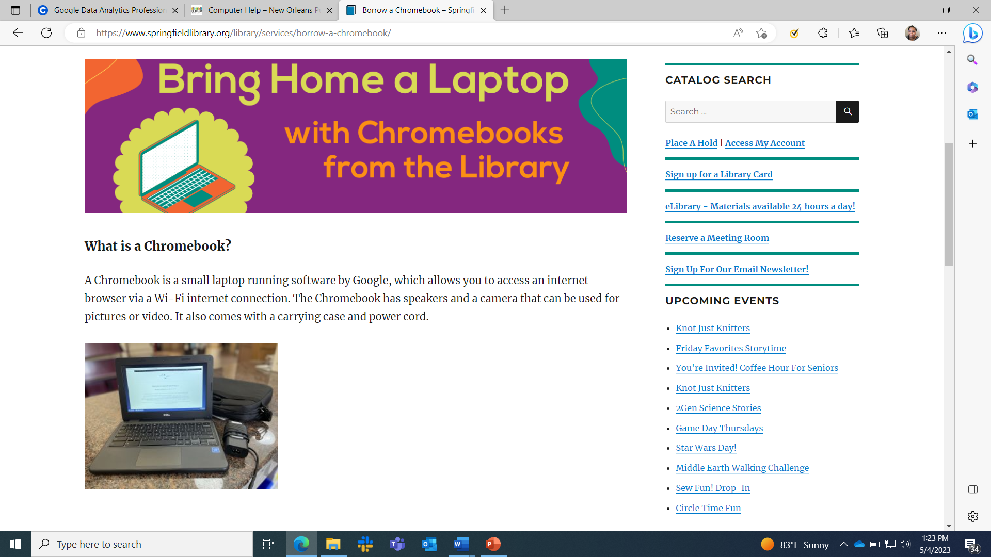
Take Home Tablets and Laptops Programs
Springfield Public Library
New Orleans Public Library

Slide 18
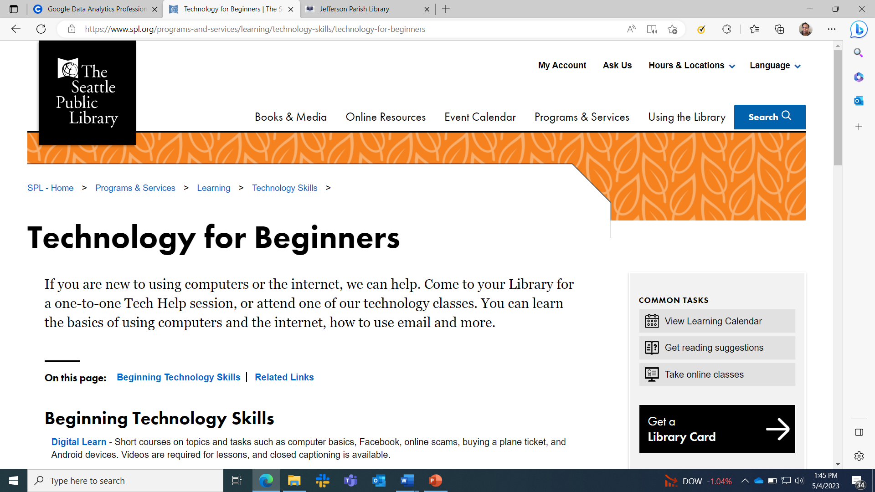
Technology Services for All
Detroit Public Library
Seattle Public Library

Slide 19
Resources
Public Library Association’s Tech Skills Checklist for Public Library Supervisors and Staff
Partners Bridging the Digital Divide mission is to assist agencies that provide digital inclusion services, including equipment, training, technical support & broadband connectivity. It has several resources, including a list of Spanish Resources for Digital Inclusion Training Classes
NNLM has a page dedicated to Public Libraries, including classes and free information resources.

Slide 20
Thank you
Carlette D. Dennis 2022-2023 NLM Associate Fellow
Connect on LinkedIn

