Slide 1
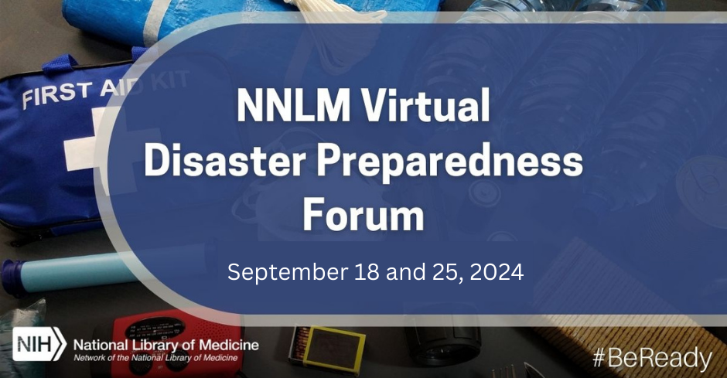
Climate resilience resources from OASH
Climate Resilience Resources from the Office of the Assistant Secretary for Health
September 25, 2024
Speakers from OASH Region 3
Dalton Paxon and Gabby Battaglia
Stephanie Cole and Ta Misha Bascombe

Slide 2
Today’s session
Use Chat to share your comments
Use Q&A to submit your questions for our speaker
Closed Caption available
Session is being recorded
Continuing Education credit available

Slide 3
NNLM

Slide 4
Hierarchy of NIH, NLM, and NNLM
National Institutes of Health
Nation’s leading research agency
NIH
NNLM
ROC
NLM
National Library of Medicine
World’s largest biomedical library
Network of the
National Library of Medicine
Outreach program of the NLM
Regions, Offices, and Centers
7 regional medical libraries
3 national offices
4 national centers
NNLM Homepage
nnlm.gov

Slide 5
NNLM Reading Club
https://www.nnlm.gov/reading-club
September 2023: Disasters and Emergencies
Books include
The devil never sleeps
Walk through fire
A fire story
Notes:
We’re also excited to highlight collaboration with another NNLM Program!
In observance of National Preparedness Month 2023, the NNLM Reading Club selected three books, and gathered information from trustworthy resources, to help you take action and stay safe.
More information is available on the NNLM Reading club website – we’ll drop that link into the Chat, too.
https://www.nnlm.gov/reading-club

Slide 6
Today’s Presenters:
Dalton Paxman, Regional Health Administrator
Gabby Battaglia, Public Health Analyst
Stephanie Cole, Administration for Community Living
Ta Misha Bascombe, Public Health Analyst
Notes:
It’s my great pleasure to introduce our speaker for today’s session.
Dalton Paxman, Ph.D., Regional Health Administrator, Office of Regional Health Operations, Region 3. Dalton Paxman, PhD is the Regional Health Administrator (RHA) for the mid-Atlantic region, where he oversees public health initiatives for the Office of the Assistant Secretary for Health (OASH), in the U.S. Department of Health and Human Services (HHS). Dr. Paxman is currently the longest serving RHA, having been in this position since 2000.
Gabby Battaglia, MPH, Regional Women’s Health Analyst, Office of Regional Health Operations, Region 3, Office of the Assistant Secretary for Health, U.S. Department of Health and Human Services (HHS).
I am now going to turn off my camera and turn the session over to you.
NOTE ATTENDEE NUMBERS

Slide 7
HHS Tools to Build Climate Resilience
Network of the National Library of Medicine
September 25. 2024
Dalton Paxman, PhD Gabby Battaglia, MPH Stephanie Cole Ta Misha Bascombe
Regional Health Administrator Public Health Analyst Regional Administrator, Region 3 Public Health Analyst
Office of the Assistant Secretary for Health (OASH) – Region 3 Administration for Community Living (ACL) Office of Climate Change and Health Equity (OCCHE)
US Department of Health and Human Services

Slide 8
The Office of Climate Change and Health Equity (OCCHE)

Slide 9
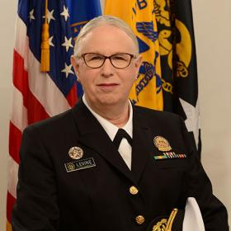
Office of the Assistant Secretary for Health
Office of the Assistant Secretary for Administration (ASA)
Office of the Assistant Secretary for Health (OASH)
Office of Global Affairs (OGA)
Office of the Assistant Secretary for Financial Resources (ASFR)
Office of the Assistant Secretary for Planning and Evaluation (ASPE)
Office of the Assistant Secretary for Public Affairs (ASPA)
Office for Civil Rights (OCR)
Office of the Assistant Secretary for Legislation (ASL)
Secretary
Deputy Secretary
Chief of Staff
Office of the Secretary
Operating Divisions
(next slide)
Office of Environmental Justice - Est. 2022
Dr. Sharunda Buchanan Interim Director
Office of Climate Change and Health Equity - Est. 2021
Dr. John Balbus
Director
Assistant Secretary for Health
Admiral Rachel L. Levine

Slide 10
Sustainability, Climate Resilience, Environmental Justice– Aligned Efforts Across HHS
Sustainability Team - Chief Sustainability Officer - Mobilizing HHS facilities, fleets and workforce to become fully sustainable and resilient in line with administration goals
Climate Change and Health Equity Working Group - Office of Climate Change and Health Equity - Mobilizing HHS divisions to protect the health of people throughout the US in the face of climate change, especially those experiencing a higher share of exposures and impacts
Team Equity - HHS Equity Leadership - Mobilizing HHS divisions to advance racial equity and support for underserved communities through the federal government
Environmental Justice Working Group - Office of Environmental Justice - Mobilizing HHS divisions to protect the health of disadvantaged communities and vulnerable populations on the frontlines of pollution and other environmental hazards that affect health

Slide 11
The Office of Climate Change and Health Equity
Officially created August 31, 2021, in fulfillment of HHS mandate from E.O. 14008
3-fold mission: health protection of most vulnerable people, climate resilience of health systems, sustainability of health sector
Serves as catalyst and coordinating hub to:
HHS Divisions and Agencies
Federal Health Systems (e.g., Military, Veteran’s, and Indian Health Systems)
Other federal agencies
Develops unique informational resources like Climate Health Outlook and Portal
Stimulates private sector actions through National Academy of Medicine Climate Collaborative, HHS-White House Health Sector Climate Pledge, technical assistance

Slide 12
The OCCHE “Hub”: Setting Strategy, Coordinating Action

Slide 13
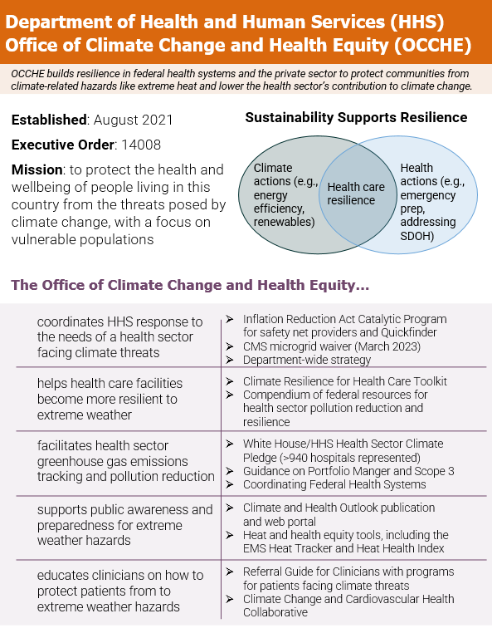
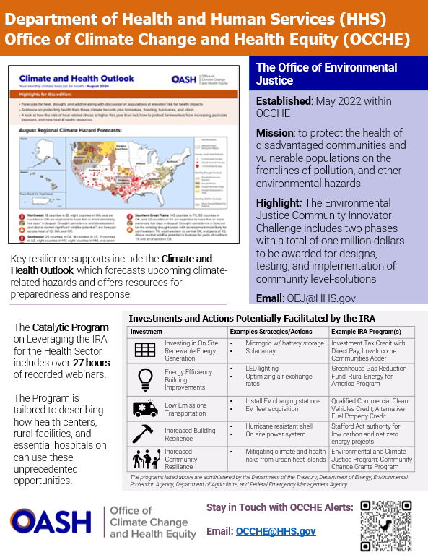
OCCHE Initiatives
Notes:
EJ Innovator Challenge
Catalytic Program and Associated Case Studies
Climate and Health Outlook and Portal
Extreme Heat Webinars

Slide 14
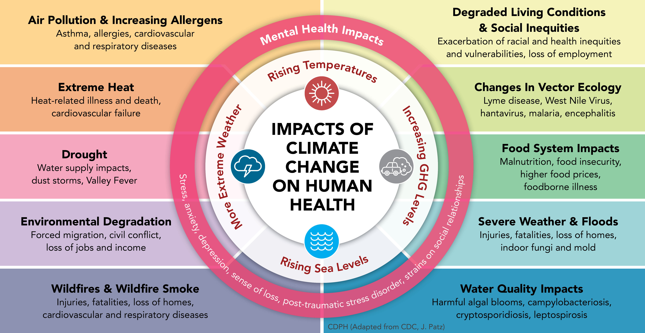
Impact of Climate Change on human health
https://www.cdph.ca.gov/Programs/OHE/pages/CCHEP.aspx
Notes:
Now that I’ve given some background on the Office of Climate Change and Health Equity, I’d like to go over the negative effects of climate change on human health that OCCHE and the rest of HHS are working to mitigate.
[explain graphic]

Slide 15
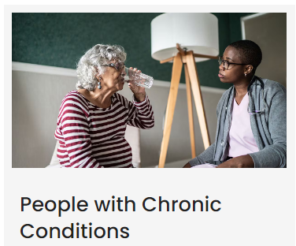
People at Increased Risk for Heat-Related Illness

Slide 16
Special Concerns for Older Adults & Individuals with Disabilities
Extreme heat impacts everyone but can be cause for special concern for older adults and individuals living with disabilities, due to health risks:
Keep Cool – Whether it is at home or a public space like a library, senior center, or other familiar location individuals should know of a place to comfortably spend time on hot days.
Stay Indoors – Plan activities early in the morning or at dusk when temperatures are cooler.
Cover Up – When going outside, ensure you are protected from the sun by wearing sunscreen and a wide-brimmed hat.
Stay Hydrated – Drink plenty of water at home and if going out, be sure to take a bottle of water with you.
Breath Easy – Stay inside when humidity and pollen levels are high.
Stay Informed – Follow local weather reports to know when your community is experiencing severe heat.
*ACL’s printable flyer on healthy living tips for heat & summer: Healthy Living Tips (acl.gov)

Slide 17
OASH Region 3 & Extreme Heat
Purpose
Share federal data tools & resources related to extreme heat and health
Priority Populations
Pregnant individuals & children
Older Adults
Audience
PA Emergency Preparedness staff
Mid-Atlantic Federal Climate Partners
Maternal & Child Health and Older Adult clinicians, researchers and public health professionals
Local government, CBOs, healthcare systems from HHS Regions 3/5
ACF staff
American Public Human Services Association
Partners

Slide 18
Addressing Extreme Heat
Preparedness Tools
Notes:
Currently in region 3, our priority related to climate change is addressing and mitigating the impacts of extreme heat. We are working closely with our colleagues at the Office of Climate Change and Health Equity and NOAA on a variety of initiatives, including addressing the impact of extreme heat on maternal and child health.
Today I’m going to share with you some tools and resources to help keep pregnant individuals and children safe from heat-related illness.
First, I’ll be going over some data tools that can be used to predict which areas will be most impacted by extreme heat in the coming days and months, as well as other resources to help prepare for upcoming heat waves.

Slide 19
CDC/NOAA HeatRisk
Notes:
Released in April, collaboration between NOAA and CDC
Best for immediate planning, understanding the risk for that day
identifies the level of heat-related health risk over the next 24 hours.
illustrated by a color/number along with identifying the groups potentially most at risk at that level.
takes into account variables such as how unusual the temperature is for the time of year, and how much it’s expected to cool off overnight

Slide 20
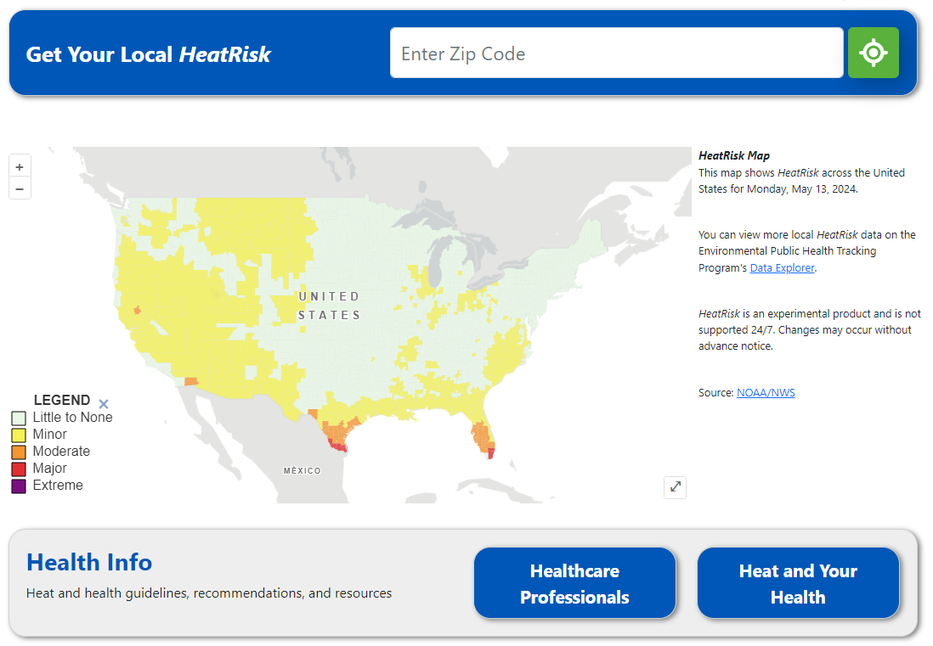
CDC HeatRisk Dashboard
Predicts HeatRisk for the next week
Links to resources for providers and the general public
Also shows Air Quality Index (AQI)
Access the HeatRisk Dashboard
Notes:
To support the launch of HeatRisk, the CDC released the HeatRisk Dashboard. This tool shows the predicted HeatRisk for the next week by zip code. Also included are resources for healthcare providers and the general public on extreme heat, and the Air Quality Index, as poor air quality can exacerbate the health impact of extreme heat.

Slide 21
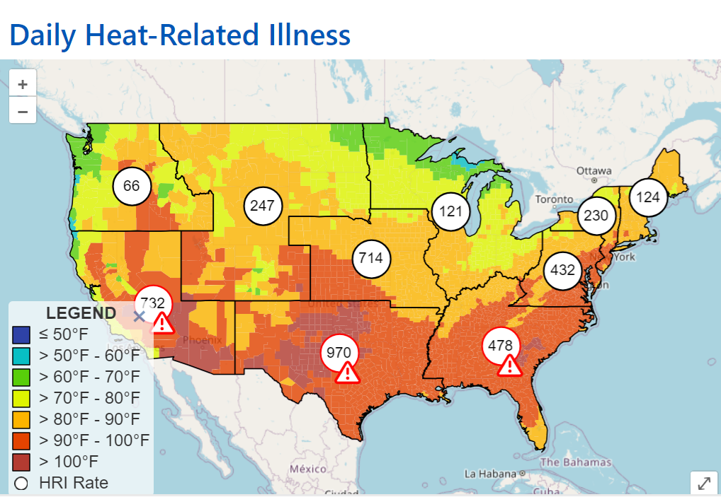
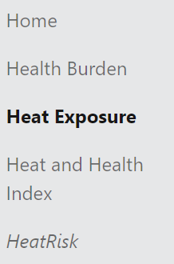
Heat and Health Tracker
Access the Heat and Health Tracker
Notes:
Tons of information built into one tool
Historical health burden data- general public and workers
Heat exposure- historical, current (heatrisk), monthly forecast, and projected
Heat & Health index-for identifying communities most at-risk of the negative health impacts of extreme heat

Slide 22
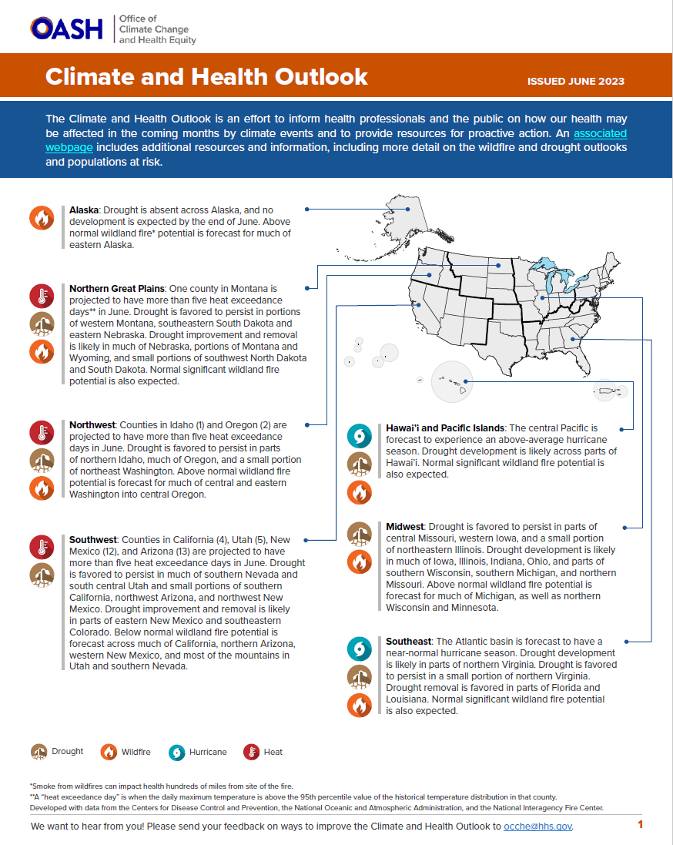
Climate and Health Outlook
Monthly seasonal forecast & retrospective
Describing regional climate hazards, identifying at-risk populations, pointing to protective resources
Extreme Heat
Wildfire
Drought
Hurricane
Tickborne Illnesses
Pollen
Spring Flooding
Climate and Health Outlook
Notes:
Anticipate and react The Office of Climate Change and Health Equity within the Office of the Assistant Secretary for Health, releases a monthly climate and health outlook. This tool, which is available as both an interactive map and monthly publication, identifies areas that will be facing extreme weather in the next month, including extreme heat. The interactive map provides additional information on the socioeconomic risk factors of the areas predicted to face extreme weather, while the publication includes information on the potential impacts of the upcoming weather events and how to reduce them.

Slide 23
Head Start and Environmental Hazards
Score= percentile for exposure to extreme heat compared to other Head Start students nationwide
Scores available for multiple environmental hazards
Access the Head Start Tool
Notes:
The Head Start and Environmental Hazards mapping tool can help you identify low-income children that are most likely to be impacted by extreme heat. This tool assigns a score to each census tract with a Head Start location to show the likelihood of students in that area being impacted by extreme heat relative to their Head Start peers. Demographic information is also available for each tract, as well as scores for other environmental hazards such as wildfire smoke.

Slide 24
National Integrated Heat Health Information System
News and Events
Additional Data Tools
Educational Resources
Urban Heat Island Data
Info on High-Risk Groups
Planning and Preparedness Guides
Funding Opportunities
https://Heat.gov
Notes:
There are a multitude of other tools and resources available to understand and prepare for extreme heat. The National Integrated Heat Health Information System (NIHHIS) is an interagency integrated information system to develop and provide actionable, science-based information to help protect people from heat. NIHHIS’s website, Heat.gov, serves as the premier source of heat and health information for the nation to reduce the health, economic, and infrastructural impacts of extreme heat. On heat.gov you can find additional mapping tools that complement the ones I’ve shared today, as well as information on high-risk groups such as pregnant women, funding opportunities, and a multitude of other resources related to heat.

Slide 25
Addressing Extreme Heat for Specific Populations
Response Resources for Pregnant Individuals, Children, and Older Adults
Notes:
So what are some things we can do to respond when temperatures do rise?

Slide 26
CDC Heat and Your Health Guidance
View the Guidance
Notes:
Available via HeatRisk dashboard
Guidance for general public such as the graphic on the left
Also includes handouts for specific high-risk populations like pregnant women and children with asthma

Slide 27
Identifying Heat-Related Illness
More Information on Heat-Related Illness
Notes:
Heat-related illness can be deadly but is preventable
Those working directly with communities should look out for these signs and symptoms
Spread awareness so clients can look out for their loved ones

Slide 28
SAMHSA Tips for People Who Take Medication
Many common medications for mental health and/or chronic disease can increase heat sensitivity
Download the Handout
Notes:
Many medications to treat conditions like depression, personality disorders, heart disease, allergies can increase heat sensitivity
SAMHSA has a handout you can share with individuals with chronic physical or mental health problems
Example medications: SSRIs, mood stabilizers, beta blockers, NSAIDs, antihistamines

Slide 29
Low-Income Home Energy Assistance Program (LIHEAP)
1-866-674-6327
energyassistance@ncat.org
Notes:
Families can also be referred to the Low-Income Home Energy Assistance Program, LIHEAP, which is a valuable resource that can protect low-income pregnant women and their families from extreme heat. Eligible households receive help paying heating or cooling bills, crisis assistance, weatherization support, repair or replacement of heating or cooling equipment, education on how to manage energy usage, and disaster assistance to help ensure safe indoor air temperature.

Slide 30
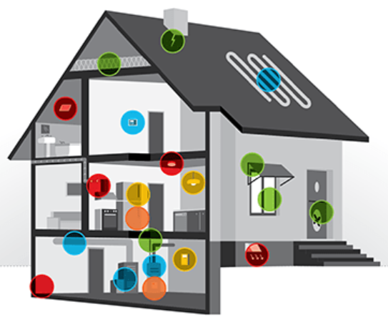
Weatherization Assistance Program (WAP)
How to Apply for Weatherization Assistance
Notes:
The Weatherization Assistance Program is another resource available to families that may limit their use of fans or air conditioning due to the associated energy costs, or whose home cooling systems may not very efficient. The WAP provides free, comprehensive energy efficiency improvements to homes that can help participants save hundreds on their utility bills each year.

Slide 31
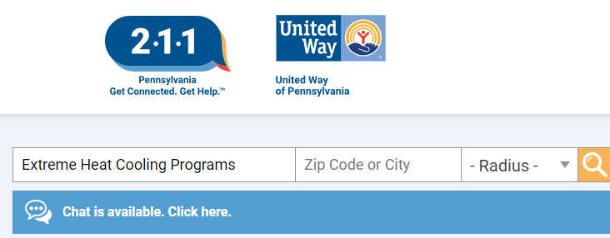
Locating Cooling Centers
Call 2-1-1or visit 211.org
National Center for Healthy Housing: Cooling Centers by State
Note: Fans aren’t enough to prevent heat-related illness. A/C is essential to keep individuals safe
Notes:
Many local jurisdictions open cooling centers on extremely hot days. To assist individuals in locating these cooling centers, you can dial 2-1-1 or visit 211.org to get a list of cooling centers by zip code. In addition, some jurisdictions have their own cooling center locator, as seen here with Washington, D.C. The National Center for Healthy Housing has a webpage that links to the best way to locate cooling centers in each state.
Note: fans aren’t enough to prevent heat-related illness. If folks don’t have AC, they should head to a cooling center or elsewhere with air conditioning

Slide 32
National Maternal Mental Health Hotline
Are you a new parent - or about to be - and feeling sad, worried, overwhelmed, or concerned that you aren’t good enough?
For emotional support and resources
CALL OR TEXT 1-833-TLC-MAMA (1-833-852-6262)
1
Free – Confidential – 24/7
60+ Languages
https://mchb.hrsa.gov/national-maternal-mental-health-hotline
Notes:
Extreme weather can cause stress and exacerbate existing mental health challenges. For those struggling, you can refer them to the National Maternal Mental Health Hotline, which provides free, 24/7 confidential emotional support, information, and referrals to any pregnant and postpartum mothers facing mental health challenges and their loved ones.
Of note, while the hotline is available 24/7 and staffed by professional counselors, it is NOT a “crisis line” for individuals in imminent danger of harm to self or others. The Maternal Mental Health Hotline Counselors can make a warm-line transfer to 988 Suicide and Crisis Lifeline, as well as to the National Domestic Violence Hotline and the Disaster Distress Hotline, when needed. If an individual is in immediate crisis, e.g., in imminent danger of harm to self or others, they should call 911. If they have an immediate behavioral health crisis, they should contact 988.

Slide 33
Disability Information & Access Line (DIAL)
ACL has tools to assist individuals in finding resources:
At dial.acl.gov, users can enter a city/state or Zip Code search to find disability providers near them
An online chat feature is also available here
Agents are available by phone or text Monday-Friday 8am-9pm at 1-888-677-1199
Users in need of ASL communication can connect directly to an agent for assistance via ASL NOW by visiting the dial.acl.gov website
To access DIAL online, go to: DIAL | Home (acl.gov)

Slide 34
Eldercare Locator
At eldercare.acl.gov, users can enter a city/state or Zip Code search to find aging services providers near them
An online chat feature available
Email is also available
Agents are available by phone or text Monday-Friday 8am-9pm at 1-800-677-1116
The Eldercare Locator webpage also contains a variety of resource links for older adults and caregivers with areas like support services, housing, elder rights, insurance and benefits, health and transportation.
To access the Eldercare Locator online, go to: Eldercare Locator (acl.gov)

Slide 35
Questions

Slide 36
Thank You
Dalton Paxman Dalton.Paxman@hhs.gov
Gabby Battaglia Gabriella.Battaglia@hhs.gov
Stephanie Cole Stephanie.Cole@acl.hhs.gov
Ta Misha Bascombe Tamisha.Bascombe@hhs.gov

Slide 37
Thank You!
NNLM Emergency and Disaster Resources Guide
NNLM Rural Health Webinar Series November 2024
You will receive an email with a link to the recording
Funded by the National Library of Medicine. NLM and NNLM are service marks
of the US Department of Health and Human Services.

