Slide 1
How to Apply for NNLM Funding
Network of the National Library of Medicine
Margot Malachowski, MLS, AHIP (she/her)
NNLM 2024 Showcase Symposium
January 24, 2024

Slide 2
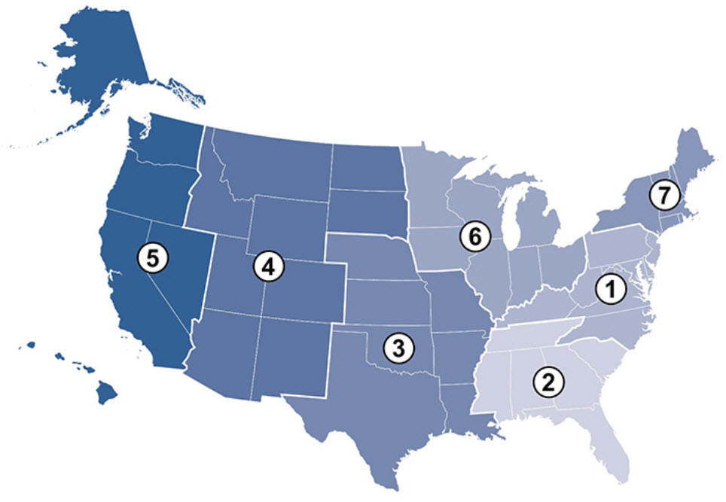
NNLM

Slide 3
After this webinar:
NNLM funding
Proposal
Documents
Common mistakes

Slide 4
Have you applied before?

Slide 5
Organizational Membership
User account
Organization
Contact person
Directory

Slide 6
Filter by Region (nnlm.gov/funding/rfa)
Types of Awards
Amounts of Awards
Vary by Region and Type

Slide 7
Health-related Project
Social determinants of health
Patient engagement
Health promotion
Self-management
Health screenings
Peer support

Slide 8
Past Projects and Current Initiatives
Confronting Health Misinformation
Bridging the Digital Divide
Environmental Determinants of Health

Slide 9
NNLM YouTube Channel

Slide 10
Getting Ready
Draft proposal
Keep a copy!

Slide 11
Funders’ Terms
RFP
RFA
CFA
Letter of Intent
Letter of Application

Slide 12
Evidence of Need
Your organization
Public data
Stakeholders
Users and non-users

Slide 13
Nothing About Us Without Us

Slide 14
Evidence of Need: Publicly Available Data
Robert Wood Johnson Foundation’s County Health Rankings
United States Census Data
Rural Health Information Hub
Community Health Needs Assessments (nonprofit hospitals)
Pew Research Center Internet Trends
Annie E. Casey Foundation Kids Count Data
Local Urban Planning Organizations

Slide 15
Logic Models
INPUTS | ACTIVITIES | OUTPUTS | SHORT TERM | INTERMEDIATE | LONG TERM
Staff Internal/External partners Time Money | Coordinate staff/partners Develop project Conduct project Evaluate project | Training Attendance Technology Circulation Data Services | How to… Identify Apply Produce | Search MedlinePlus Utilize library hotspots Consult librarian for data management | Improve health

Slide 16
Project Timeline
Kickoff Meeting
Planning Sessions
Project
Evaluation
Final Report

Slide 17
Additional Documents
Resumes
Letters of support
Budget

Slide 18
Plans to include
Evaluation plan
Continuation plan

Slide 19
Evaluation Design

Slide 20
Budget
Personnel
Consultant Costs
Equipment
Supplies
Travel
Indirect Costs

Slide 21
People Costs
Personnel
Consultant Costs

Slide 22
Items Costs
Equipment
Supplies

Slide 23
Travel and Facilities Costs
Travel
Indirect Costs

Slide 24
Five Common Mistakes
Last minute
Purpose
Instructions
Budget narrative
Assumptions

Slide 25
Criteria
NNLM mission
Need
Logical
Feasible
NLM resources
NNLM initiatives
Evaluation
Staff
Budget
Diversity, Equity and Inclusion

Slide 26
Dementia Friendly Nahant
102 people with dementia
168 caregivers
Nearly 8% population
Nahant Public Library
Council on Aging
Nahant Village Church
Greater Lynn Senior Services

Slide 27
Census Data
Based on the 2010 US Census, Nahant is a small community with an aging population. As the Baby Boom generation is expected to live to be 80 years and older, an increased percentage of the population will be experiencing dementia within the next ten years. (citation included)

Slide 28
Community Health Needs Data
In the Community Health Needs Assessment by Spaulding Rehabilitation, dementia was mentioned as one of several mental health issues for the Massachusetts North Shore. (citation included)

Slide 29
Library Users
One patron periodically comes to the library, pleasantly asking the same questions of the desk staff at each visit, not remembering that he had asked before.

Slide 30
Objective One
Offer circulating materials in a variety of formats that are easily understood by and inviting to patrons with cognitive difficulties, in order to afford these patrons positive interactions with literature and music, to improve mental health and quality of life.

Slide 31
Objective Two
Provide authoritative information on diagnosis, treatment, and coping strategies to people with cognitive loss, their caregivers, and the public using the website MedlinePlus.

Slide 32
Objective Three
Host a monthly "Memory Cafe“ for people with cognitive loss and their caregivers and host a town-wide read for the community, to foster meaningful socialization and education, reduce feelings of isolation, and improve social behavior and quality of life.

Slide 33
Letters of Support
Nahant Council on Aging
Nahant Village Church
Greater Lynn Senior Services

