Slide 1
How do I search in PubMed using keywords?
Acquire

Slide 2
Discussion question
Think of a few questions you’ve had recently. What resources from last time would you want to use to answer them?
Notes:
[NOTE TO FACILITATOR: If you are completing these modules in an order other than suggested in the facilitation guide, you may need to adjust these discussion points.]

Slide 3
Objectives
By the end of the program, participants will:
Describe how to identify search terms and use them to find evidence in PubMed

Slide 4
What do you think?
If you were researching the effects of wearable fitness trackers on weight loss in young adults, what are some keywords you might want to search for?
Notes:
Discussion question: If you were researching the effects of wearable fitness trackers on weight loss in teens, what are some keywords you might want to search for?
------
Let’s hear some of your suggestions.
(audience participation – write responses on whiteboard, etc. if possible)
You might notice that these keywords are falling into topical groupings, like:
Keywords relating to adults
Keywords relating to weight loss Keywords relating to fitness trackers
Each of these is one of the major elements of our research topic.

Slide 5
Search term generation: the return of PICO(T)
Research question: Are wearable fitness trackers more or less effective than health counseling in helping overweight and obese individuals ages 19-24 lose weight?
Patient/Population | Intervention | Comparison | Outcome
Overweight & obese young adults | Fitness trackers | Counseling | Weight loss
Young adults Ages 19-24 College students | Fitness trackers Activity tracker Fitbit Personal fitness tracker | Health counseling Weight loss advice Weight loss therapy | Weight loss Body weight Weight reduction
Notes:
Although the research topic on the previous slide wasn’t formatted like a research question, we can see how it might become one, and how its major components can easily become elements of the PICO(T) framework. Here I’ve created a sample research question: Are wearable fitness trackers used in combination with health counseling more effective than health counseling alone in helping overweight and obese individuals ages 19-24 lose weight? And I’ve also filled in the PICO components. I left out a time frame, since it’s optional.
I’ve filled in some examples of keywords, some of which you thought of a minute ago, but these are certainly not exhaustive.
You can see how using your PICO(T) components is a good way to organize your search term brainstorming and how a well-constructed research question can help guide your searching. Don’t worry if you haven’t thought of every possible term here – we’ll look at some ways to add terms to your list very soon.
[NOTE TO FACILITATOR: If you are completing these modules in an order other than suggested in the facilitation guide, you may need to adjust this slide/note.]

Slide 6
Keyword searching on PubMed
Notes:
When you search in PubMed, you can always just pop any keyword you want into the search box at the top of the main page and click search. A preliminary search is a good way to start to see what kind of literature is available and how broad or narrow you might need to make your search to be successful.

Slide 7
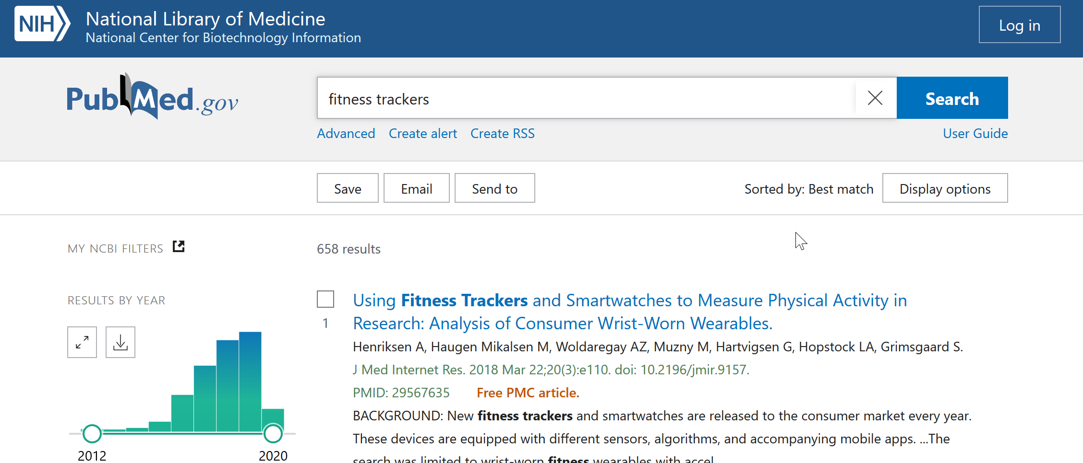
Keyword searching on PubMed- preliminary searches
Notes:
Preliminary searches are also a good way to find more search terms! For example, if you searched for “fitness trackers,” here’s what your results page might look like. If you keep scrolling, you’d see articles on the first page that might suggest these other phrases to you:
Wearable fitness trackers
Mobile fitness trackers
Wearable fitness devices
Fitness tracking technology
Consumer-wearable activity trackers
Fitness technology
…And more!
If you look closely, you might also notice that this search only yielded under 500 results, which isn’t very high for a broad search on PubMed. In contrast, a search for “obesity” yields over 300,000 results! This could be a hint that you will need to take care not to make your search overly specific. Remember, you can always revise your research question if you aren’t finding the results you need. Even if you need to broaden the scope of your question, you may still be able to find useful and relevant evidence, so don’t give up!

Slide 8
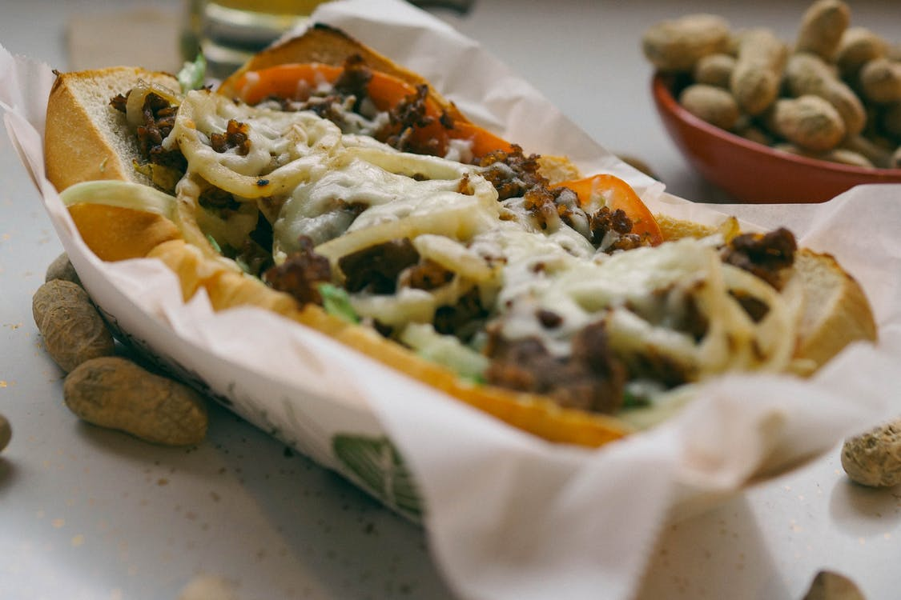
Combining search terms
Peanut butter jelly bread →
Notes:
Another useful trick to expand your search a bit is to add and combine search terms. Rather than just throwing them into the search box, give yourself a little bit more control and organization by grouping them together in logical units. Let me give you an example.
If you’re searching a big sandwich recipe database for recipes for peanut butter and jelly sandwiches, you have 3 essential components that are going to define that sandwich: bread, peanut butter, and jelly. Now, PubMed actually automatically searches for all three together, but this isn’t the same for all databases, so it’s best to always construct your search so the database doesn’t have an option to interpret your search any other way.
If you don’t tell a database how to search, you might end up with results that contain any of the three ingredients, rather than all 3. You could get recipes for peanut butter and banana sandwiches, cream cheese and jelly sandwiches, and other concoctions.
However, you can use very simple syntax to tell the database what you really want – recipes that have all 3 components.

Slide 9
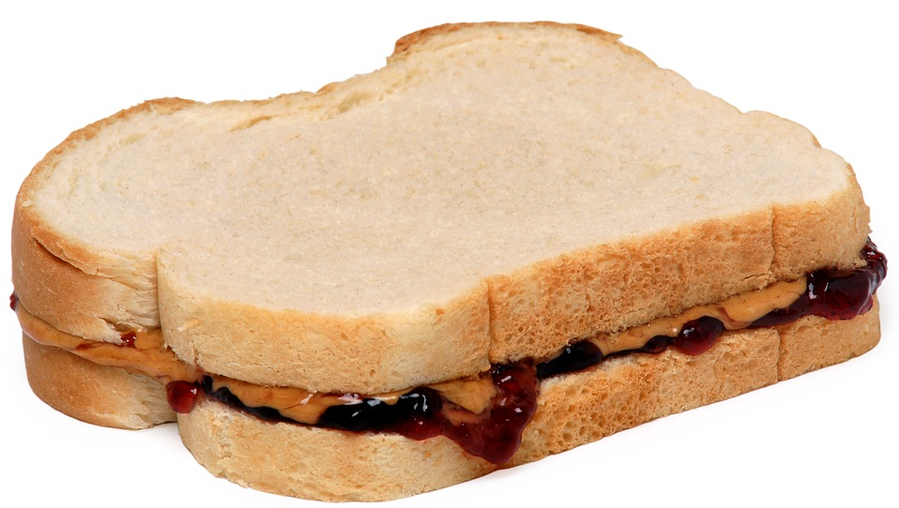
Combining search terms with AND
Peanut butter AND jelly
AND bread →
Notes:
You can use AND (make sure you use capital letters) to tell the database to search for recipes, or articles, that contain BOTH of the terms on either side of it. In this case, you’d want to search for peanut butter AND jelly AND bread.
Most databases will recognize this syntax.

Slide 10
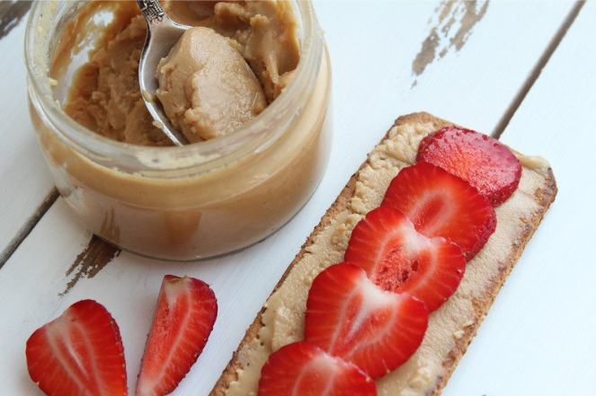
Combining search terms with OR and ( )
(peanut butter OR almond butter OR sunflower seed butter)
AND
(jelly OR jam OR preserves)
AND
bread
Notes:
What if you want to mix things up a little? You can construct your search by putting all of your similar terms together in parentheses, separated by an OR (again, all caps). Keep the AND between the grouped sets of terms so your results still have all three component categories.
Setting up your search this way makes it easy to stay organized, add or remove specific search terms as needed, and broaden or narrow your search.
If you’re setting up a search with more than a few keywords, I recommend writing it out separately in a word processing program of your choice and then pasting it into the database to search. This makes it easier to keep track of and edit.

Slide 11
Building an organized search query
(young adults AND (overweight OR obese))
AND
((fitness trackers OR wearable fitness monitors OR consumer activity trackers) OR (health counseling OR weight loss counseling OR weight loss therapy))
AND
(weight loss OR weight reduction)
Notes:
To bring this back to the topic at hand, here’s a small sample search you might construct for our previous research question.
Note that you can nest sets of parentheses to further organize your search.
Again, once you’ve done a search, feel free to adjust your query based on the results that you’re seeing.

Slide 12
The search details box
Notes:
There’s one other thing I want to point out that will help you in your searching, and that’s the search details box on PubMed. You can locate this by selecting “advanced” on the main search bar and then looking at the “history and search details”.
Don’t worry about most of the syntax here yet – you can ignore what’s in the square brackets for now. I used this particular search to illustrate what can happen when you search for a broad term like “smoking cessation.” PubMed is going to automatically translate that search into its own ‘language’ to help you get to the information that you’re most likely to need based on your search terms. You can use this box can indicate to you if one of your search terms is problematic, for example, if it has many potential meanings and may be pulling in a lot of irrelevant results. However, another lesson from looking at this is that PubMed is working behind the scenes to get you to the articles you need. So, an easy way to start a PubMed search is to just type the primary terms of interest from your PICO question into the search box to see what PubMed maps you to behind the scenes.

Slide 13
Take home message
Consider:
Practice doing some simple searches in PubMed and explore other ways the database allows you to narrow your search results
Remember:
PICO(T) questions guide you in brainstorming search terms, and you can find more with preliminary searches
You can organize your search terms using simple syntax and check how PubMed is interpreting it with the Search Details box
Developed resources reported in this presentation are supported by the National Library of Medicine (NLM), National Institutes of Health (NIH) under cooperative agreement number UG4LM012342 with the University of Pittsburgh, Health Sciences Library System. The content is solely the responsibility of the authors and does not necessarily represent the official views of the National Institutes of Health.
Notes:
So, the main takeaways from today are that your PICO(T) research question should guide you in brainstorming search terms, that you can use preliminary searches to come up with more search terms, and that you can organize your search terms with simple syntax. Additionally, the search details box can give you important information about how PubMed is interpreting your search.
After you leave today, take some time to do some simple searches in PubMed and look at other ways the database allows you to narrow down your search results.
[NOTE TO FACILITATOR: If you want to complete group discussion immediately following this module content, change the title of this slide to ‘Group Discussion’ and delete the slide with corresponding questions in the next module. If you would like to have discussion take place using your internal LMS system, you can include instructions here for how participants can participate. Then, adjust the slide with the corresponding questions in the next module as needed.]

