Slide 1
All of Us Research Program
Notes:
Today’s program is funded through an award from the Network of the National Library of Medicine – a partner of the All of Us Research Program.
What is the All of Us Research Program?
The All of Us Research Program is a large research program from the National Institutes of Health. The goal is to help researchers understand more about why people get sick or stay healthy. We hope that more than one million people will join the All of Us Research Program. People who join will share information about their health, habits, and what it’s like where they live. By looking for patterns in this information, researchers may learn more about what affects people’s health.
The All of Us Research Program will last for 10 years or more. This will allow researchers to study health over time. If you decide to join the All of Us Research Program, you will be contributing to an effort to improve the health of generations to come. You also may learn about your own health.
To Learn more about the All of us Research Program visit www.joinallofus.org/nlm
Presenter Notes: Share All of Us Research Program handout with link.
Presenter Notes: As an important note, public library staff and other NNLM Network members are not be asked to recruit for or represent the All of Us Research Program.

Slide 2
What is All of Us?
Available on YouTube with Captions
Notes:
Talking Points:
Here is a short animation about All of Us. YouTube Link with captions: https://youtu.be/ti50nS7B5vI
To Learn more about the All of Us Research Program visit www.joinallofus.org/nlm
1 Min 55 sec

Slide 3
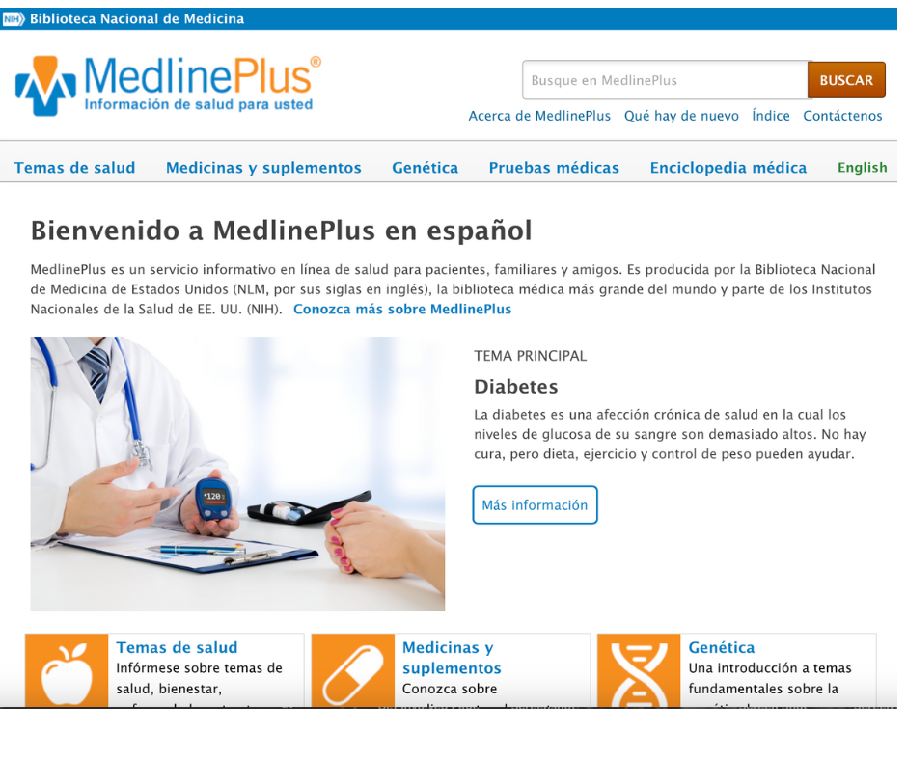
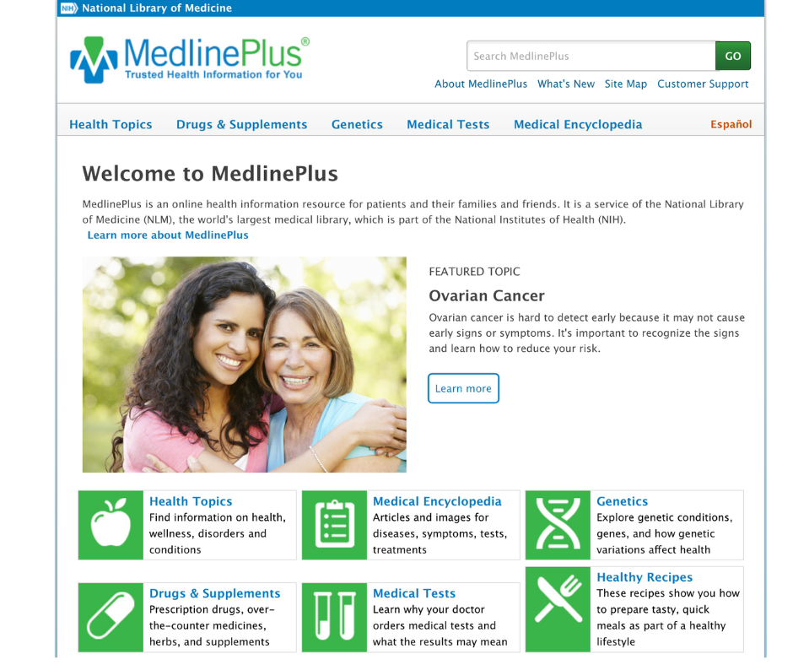
MedlinePlus
Health Information from the National Library of Medicine
English and Spanish
45+ additional languages
Learn about health topics, medications, genetics, and more
Explore Healthy Recipes and databases on Drugs, Herbs, and Supplements
Notes:
MedlinePlus is an online health information resource for patients and their families and friends.
MedlinePlus is a service of the National Library of Medicine (NLM), the world's largest medical library, which is part of the National Institutes of Health (NIH).
MedlinePlus offers information on health topics, human genetics, medical tests, medications, dietary supplements, and healthy recipes.
MedlinePlus is available entirely in English and Spanish including navigation and menus. Other languages are available for select health topics linked from the health topics pages.
Features to discuss:
The Drugs database that provides information about prescription drugs and over-the-counter medicines includes side effects, dosage, special precautions, and more.
The Herbs and Supplements database which provides information about dietary supplements and herbal remedies to learn about their effectiveness, usual dosage, and drug interactions.
Healthy recipes available from MedlinePlus use a variety of fruits and vegetables, fat-free or low-fat dairy, various proteins, and healthy oils. A complete Nutrition Facts label is included for each recipe.

Slide 4
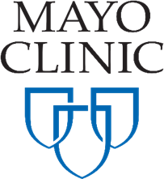
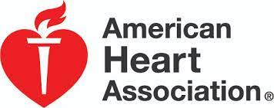
MedlinePlus
Reasons to love MedlinePlus
Lots of great resources – one website
No ads or endorsements
Sources are cited
Printer friendly
Notes:
MedlinePlus organizes health information from a variety of expert sources like the Mayo Clinic, American Academy of Pediatrics, American Cancer Society, Centers for Disease Control, and other Institutes of the National Institutes of Health
Again, MedlinePlus curates resources from many high quality organizations
There are many reasons to use MedlinePlus
It’s always free
There are no ads ever
Sources are cited clearly – librarians love to see that
And each page has a printer friendly option.

Slide 5
Funded by the Network of the National Library of Medicine
This resource is funded by the National Library of Medicine, National Institutes of Health, Department of Health and Human Services, under Cooperative Agreement Number U24LM014070 with the University of Iowa, Hardin Library for the Health Sciences, and the University of Pittsburgh, Health Sciences Library System.

