Slide 1
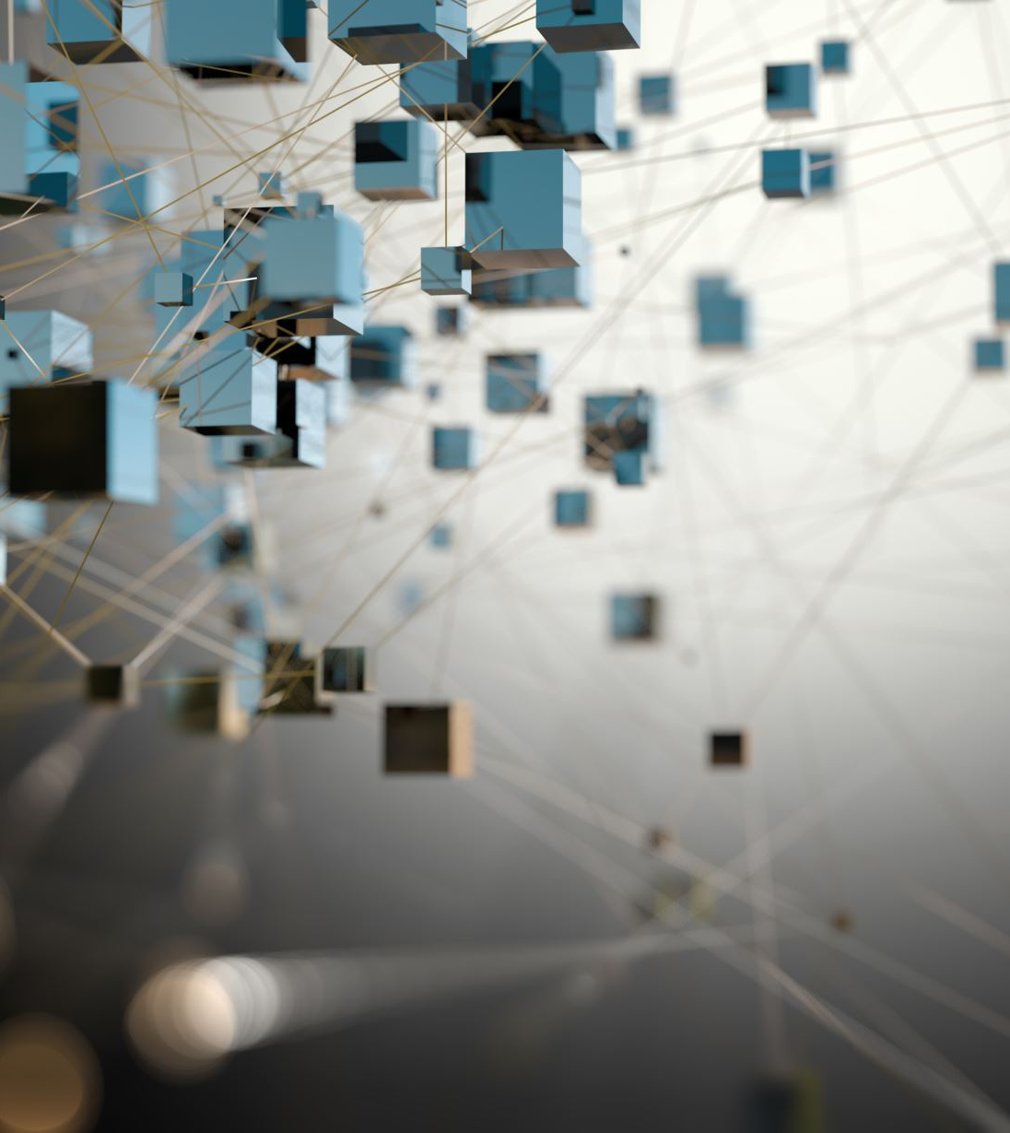
Ethical Considerations of Data Collection
Genevieve Milliken, MA, MSLIS
Data Services Librarian, NYU Health Sciences Library
Content Expert, NNLM National Center for Data Services

Slide 2
Code of Conduct
This Data Ethics Series enable its participants to receive continuing education, build professional networks, and learn about important topics related to the field of librarianship. To provide all participants the opportunity to benefit from the curriculum, we are committed to providing a harassment-free environment for everyone, regardless of gender, sexual orientation, gender identity, gender expression, disability, physical appearance, race, ethnicity, religion, or other group identity.

Slide 3
Recap from Last Session
Ethical frameworks for decision making
Breakout groups
Regulatory bodies
Understanding Ethics & AI with Kiran Samuel

Slide 4
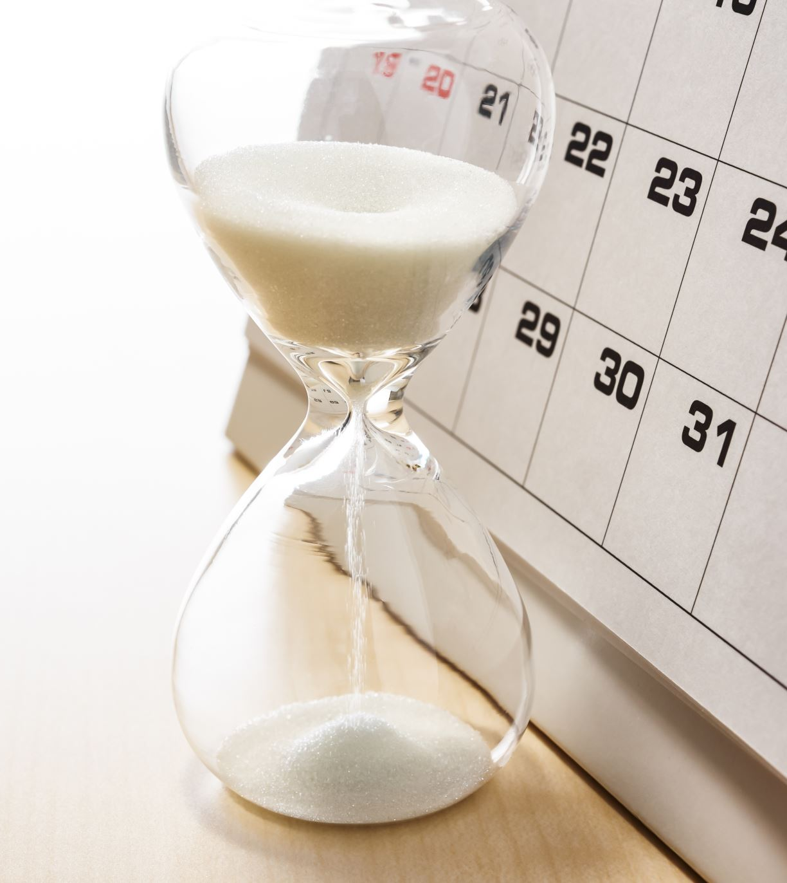
Agenda
What is data (ethics)
What is data collection
The ethics of data collection
Additional ethical frameworks
Breakout sessions & discussions
Wrap up
Guest lecture with Dr. Kellie Owens

Slide 5
1. Data (Ethics)

Slide 6
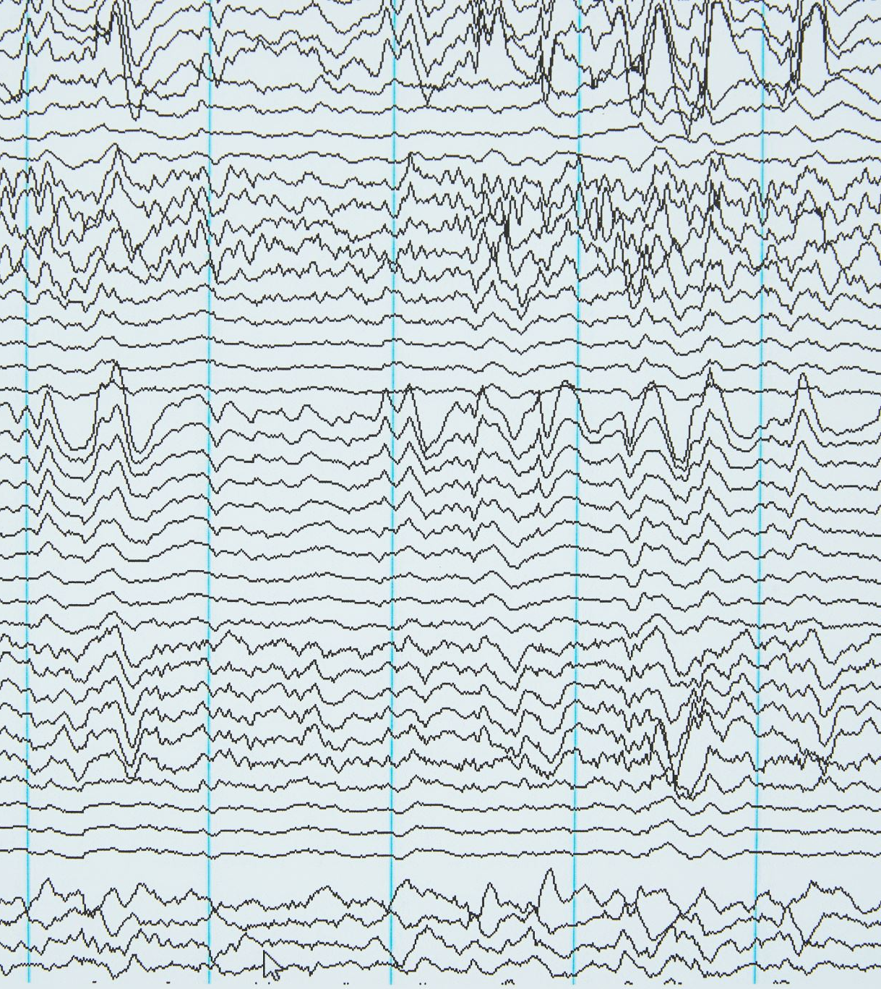
What is Data?
"[a] re-interpretable representation of information in a formalized manner suitable for communication, interpretation, or processing. Examples of data include a sequence of bits, a table of numbers, the characters on a page, the recording of sounds made by a person speaking, or a moon rock specimen."
― Open Archival Information System (OAIS)

Slide 7
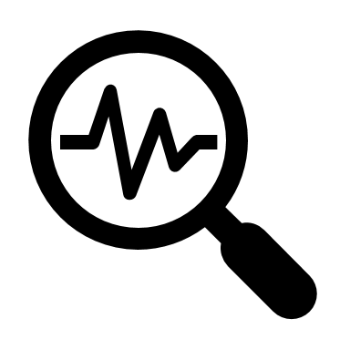
What is Research Data?
In research contexts, data is information made traceable or
recordable
Can be processed by a computer or computer like operations
Basis for research, analysis, statistical significance, and research findings & conclusions

Slide 8
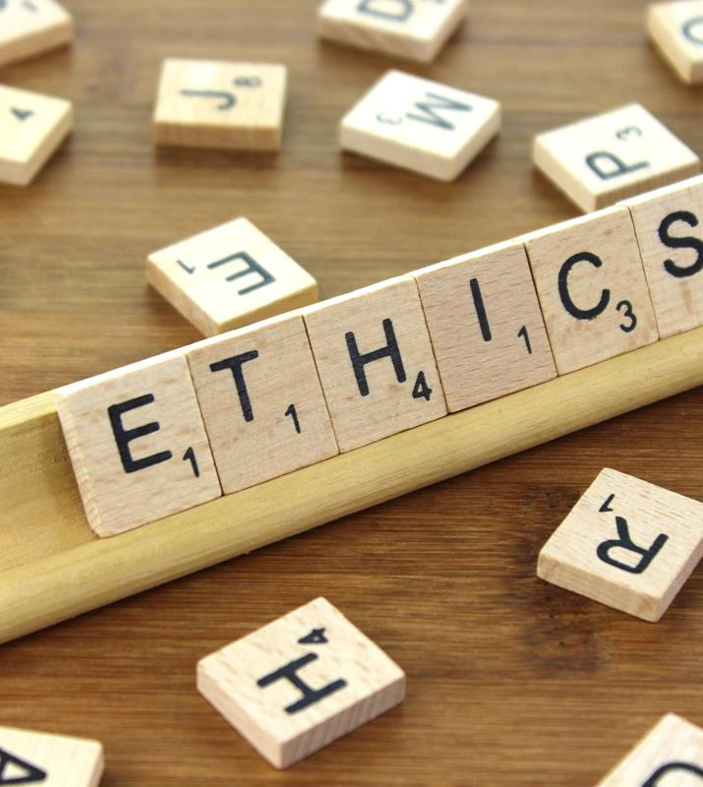
Data Ethics
data ethics is a new branch of ethics that studies and evaluates moral problems related to:
data (including generation (e.g., collection), recording, curation, processing, dissemination, sharing and use)
algorithms (including artificial intelligence, artificial agents, machine learning and robots)
and corresponding practices (including responsible innovation, programming, hacking and professional codes)
In order to formulate and support morally good solutions (e.g. right conducts or right values)
- Floridi & Taddeo, 2016

Slide 9
Ethics of Data Science
Data analysist perform countless acts of implicit ethical deliberation while trying to make machines learn something useful, valuable, and reliable
Ethics of Data Cleaning: dealing with dirty and incomplete data is as much a moral as a practical concern; dealing with and documenting error
data scientists do not use the language of ethics to talk about these practices
Data scientists, as the ones closest to the work, are often the best positioned to address ethical concerns, but they often need help from those who are willing to take time to understand what they are doing and the challenges of their practice.
Barocas & Boyd (2017)

Slide 10
Data is Contextual
Even what is collected is often a very narrow, especially when compared to someone’s lived experiences
Should be contextualized with other factors, including other collected data, geographic location, socioeconomic status, community, etc.
What is collected can be limited by researcher’s interests, fundings, and outreach

Slide 11
2. Methods of Data Collection

Slide 12
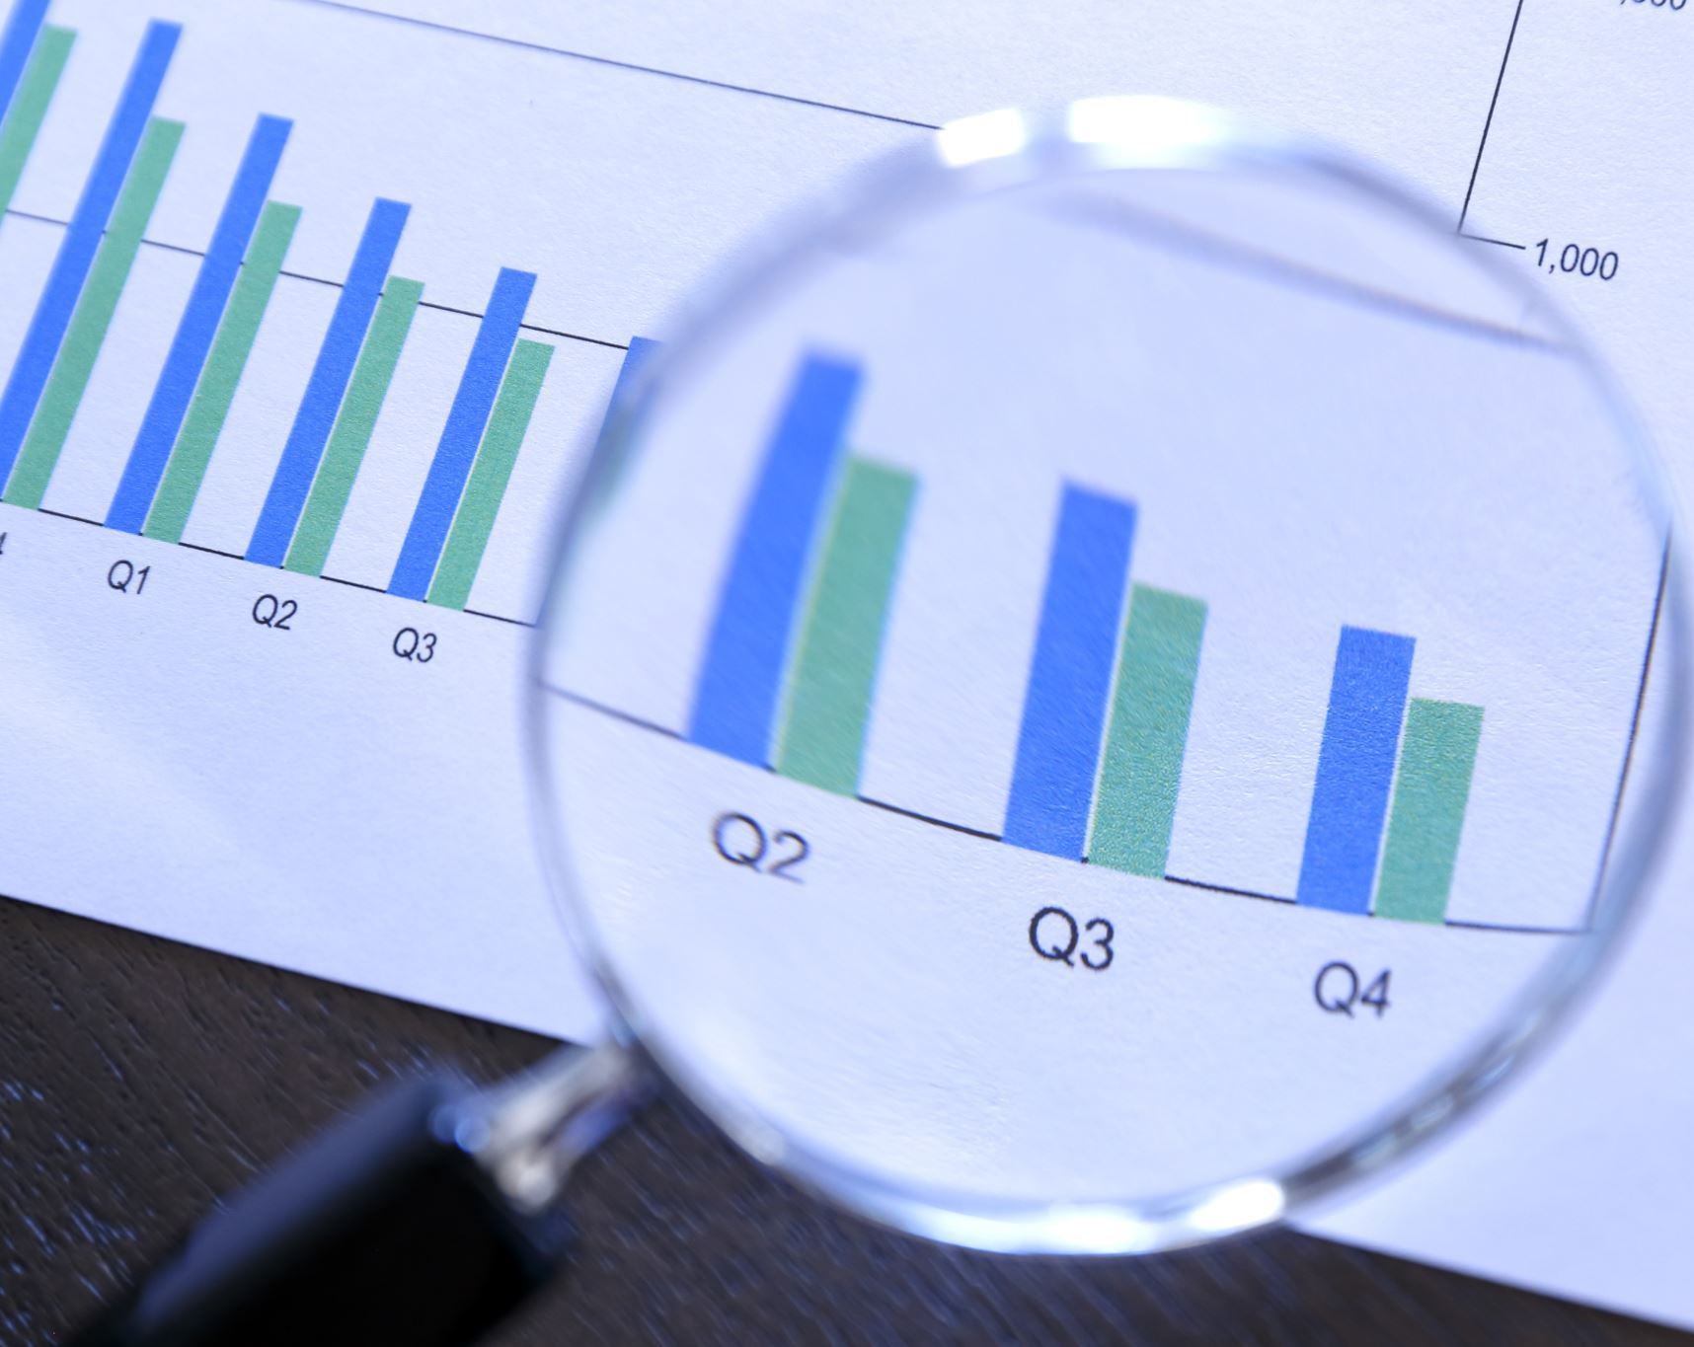
What is Data Collection?
Data collection is the process of gathering and measuring information on variables of interest, in an established systematic fashion that enables one to answer stated research questions, test hypotheses, and evaluate outcomes.
- Adapted from Responsible Conduct in Research Management (2005)

Slide 13
Forms of Data Collection
Surveys
Questionnaires or surveys used in human subject's research
Paper Forms
Patient data is recorded in paper format and scanned or entered into a computer
Electronic Health Records (EHR)
demographic, medical history, diagnoses, lab results; often “evidence” for treatment
Public Health Surveillance
Collect information about the health and behaviors of communities and guides public health interventions
Clinical Trials
Tests to efficacy of a certain medicine, therapeutic, and medical devices
Interviews
One-on-one or focus-group interviews using qualitative research methods and coding
13

Slide 14
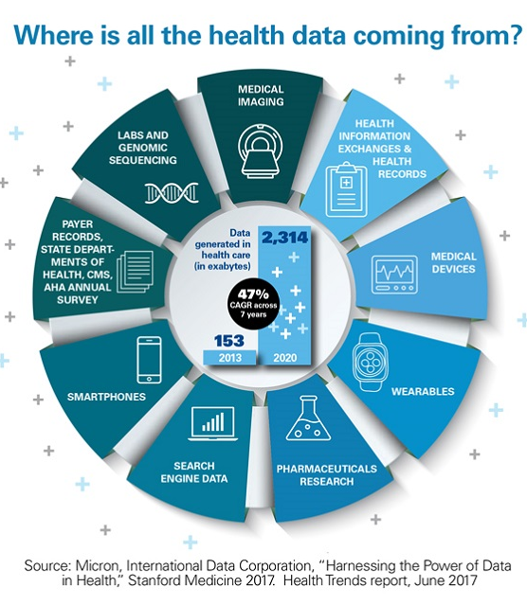
Data Collection in Health Care
Genomic sequencing
genome registries
Health and community survey
Medical devices / wearables
mHealth apps
Medical Imaging and microscopy

Slide 15
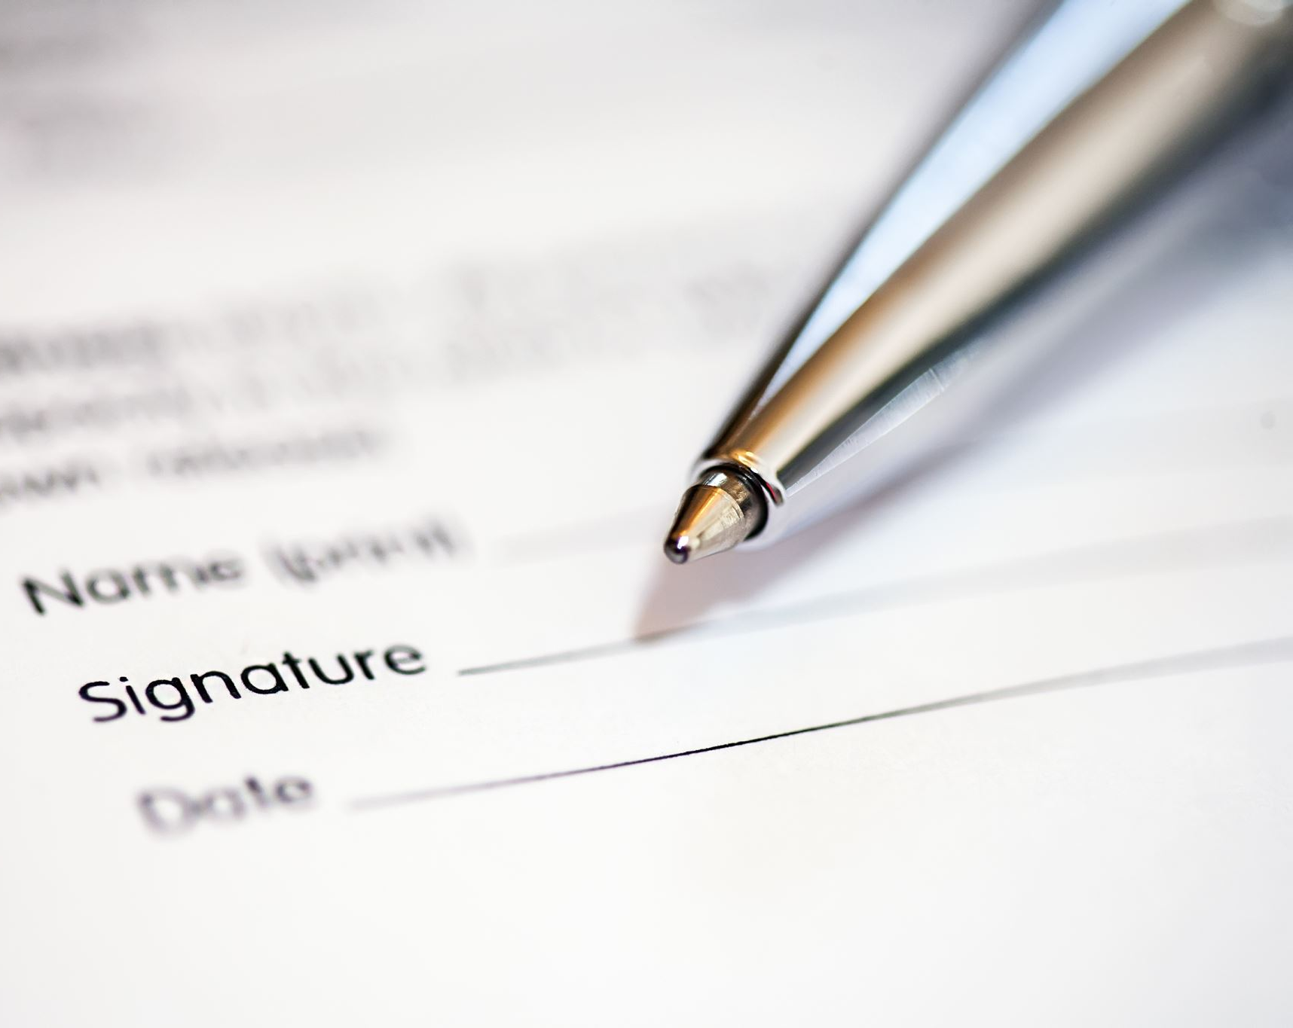
Forms of Data Collection in Libraries
Surveys and Questionnaires Community/Professional Surveys about "Data Librarianship" or "Burn Out" or "COVID and Librarianship", etc.
Evaluation Data Teaching evaluations, pedagogy and classroom effectiveness
Patron Data and User Metrics Resource usage, google analytics, ticketing systems
Interviews and Focus Groups librarians as researchers; scenario-based interviews, UX, testing a new teaching method, etc.

Slide 16
Question 1
In the chat, what methods for data collection have you encountered, conducted, or participated?

Slide 17
What is Done with Collected Data?
Policy Decisions
Data-driven policy making builds upon the concept of evidence-based policy making; data science and analysis
Resource Allocation
Funding prioritization, clinics, food assistance, infrastructure, and other services
Health interventions
Population level health; mask mandate and social distancing
Research/ Publications
discipline-specific publications of findings
Secondary Research
Data sharing and reuse
Future Research
Jumping-off point for further research

Slide 18
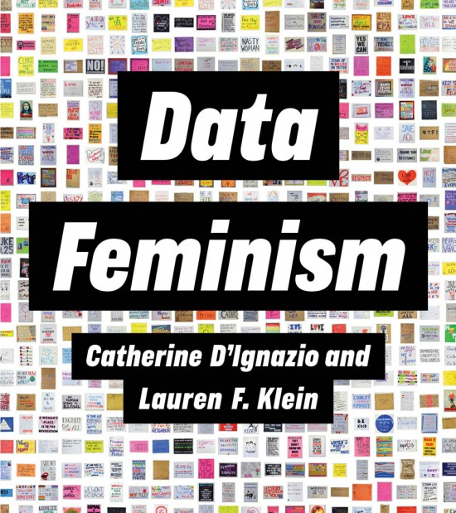
What does this tell us?
"What gets counted, counts"
What is counted often becomes the basis for decision-making
What is not counted becomes invisible; reinforcing health inequities
Data collection can be positive and empowering
’data for good’ or for social change

Slide 19
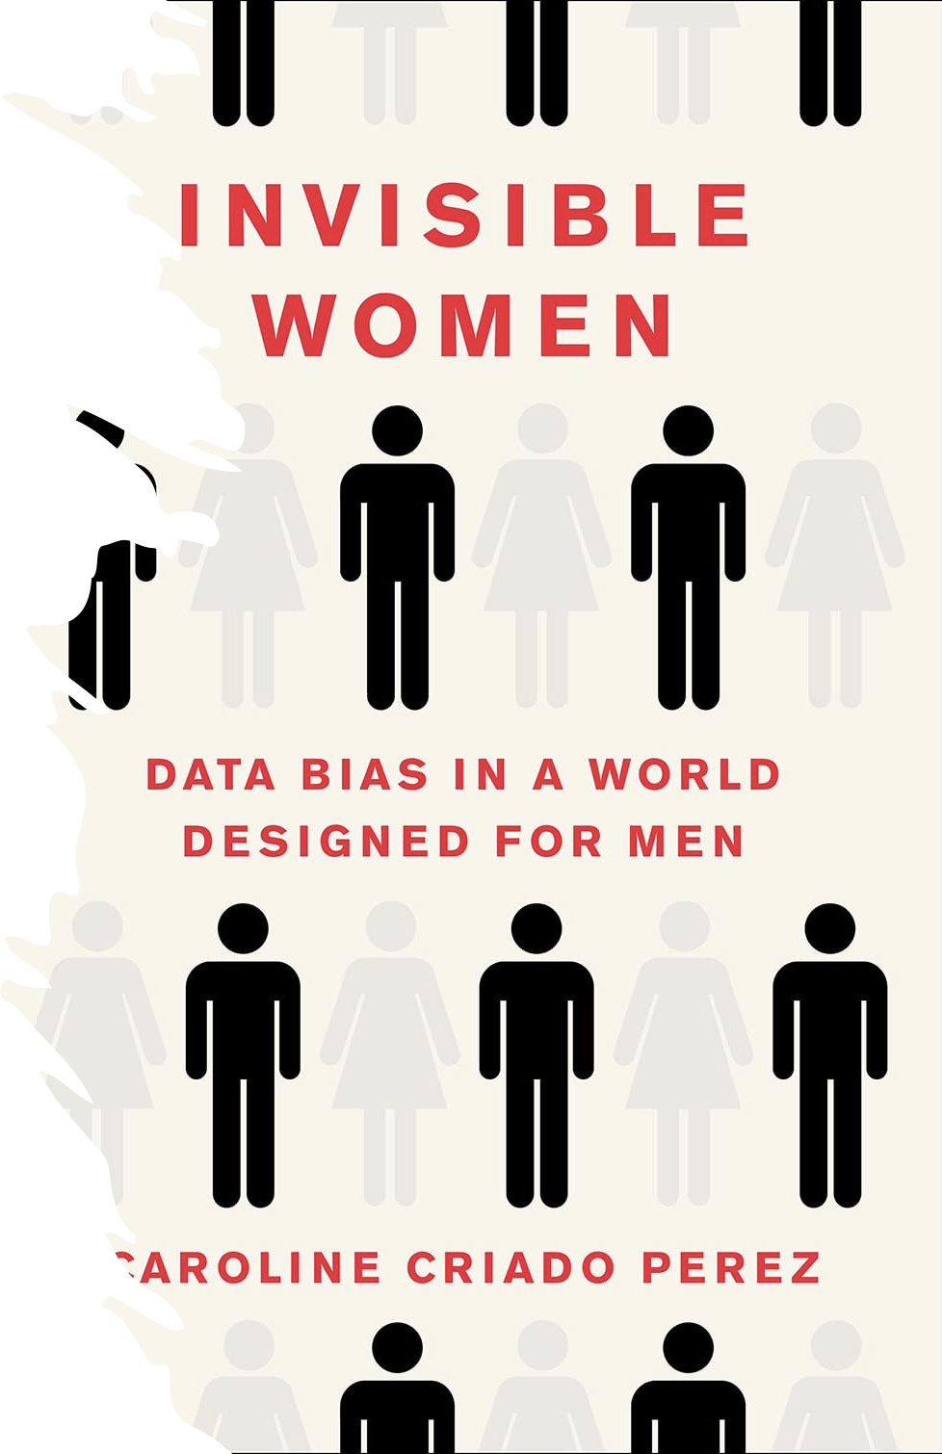
Invisible Women
medical systems systematically discriminating against women, "leaving them chronically misunderstood, mistreated and misdiagnosed."
Gender gap in medical texts books / animal research
Most early research into cardiovascular disease was conducted on men, and women continue to be under-represented, making up only 25% of participants across thirty-one landmark trials for congestive heart failure between 1987 and 2012
Data bias in research relating to pregnancy, menstruation/period pain, medication, diabetes, clinical trials, dosing
(Perez 2019)

Slide 20
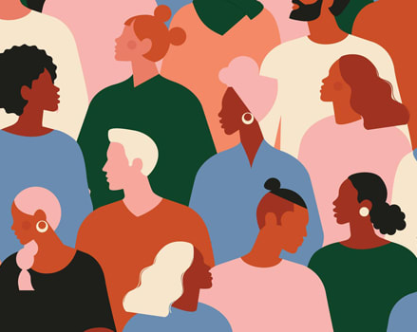
Representation in Clinical Trials
Under-representation of Women and the elderly in Cardiovascular RCTs (Vitale, et al., 2017)
Black men in prostate cancer clinical trials (Rencsok, et. al., 2020)
Racial and ethnic minorities & health disparities ( Clark, et. al., 2019; Caplan & Friesen, 2017)

Slide 21
Rural and Remote Locations
Rural Alaska, Idaho, Oregon, and Washington (Bekemeier, et al., 2019)
Finger Lakes Region / Upstate New York (Pierce & Scherra, 2004)

Slide 22
Question 2
In thinking about “what gets counted, counts”, what other topics or communities do you think are often obscured from data collection?

Slide 23
3. Ethical Frameworks

Slide 24
Ethical Principles
Ethical Tenet​​ | Consideration​​ | Scientific Integrity​​
Autonomy​​ | Right to participate​​ Right to decline​​ Free from coercion​​ | Participants decision making capacity​​ Appropriate to audience (e.g. culture, values)​​
Beneficence ​​ | Welfare of research participants ​​ Contributions to the wellbeing of others​​ | Tested for psychometric properties​​ Shared & applied to clinical practice​​ Welfare of participants​​
Non-malfeasance ​​ | Limiting or eliminating disturbing, uncomfortable, negative impact ​​ | Transparency about any psychosocial events​​ Data security, PI, confidentiality​​ ​​ ​​
Justice ​​ | Benefit/inclusion of diverse population​​ solidarity and reciprocity​​ health inequalities vs. equity​​ | Findings should be applicable to diverse populations​​ Efforts should be made to eliminate or mitigate bias​​
Adapted from Hammer (2017)

Slide 25
A Few Questions to Ask
Can the research be done using publicly available or pre-existing data? (Non-malfeasance)
Is the proposed research likely to have significant public health and/or biomedical value? (Beneficence)
Does the research require sensitive data? (Autonomy)
Are there greater than minimal risk of harm arising from privacy breaches?
Can these be reduced to minimal? (Non-malfeasance)
Is consent given and is transparency being practiced? (Autonomy)
Is the sample representative of the community? (Justice)
Will the community under study benefit from this research? (Beneficence, Justice, Solidarity)
Adapted from Mann, et al., 2016

Slide 26
Tenets for Health Equity
All people should be valued equally
Health has a particular value for individuals because it is essential to an individual's well-being and ability to participate fully in the workforce and a democratic society
Every person should be able to achieve his/her optimal health status, without distinction based on race or ethnic group, skin color, religion, language, or nationality
Health differences adversely affecting socially disadvantaged groups are particularly unacceptable because ill health can be an obstacle to overcoming social disadvantage.
Health equity is the value underlying a commitment to reduce and ultimately eliminate health disparities.

Slide 27
Health Disparities & Social Justice
Health disparities are systematic, plausibly avoidable health differences adversely affecting socially disadvantaged groups
Health disparities include differences that occur by gender, race or ethnicity, education or income, disability, living in rural localities, or sexual orientation
Health disparities need to be a high social justice concern because they are shaped by social contexts and, as such, be put in the broader context of social justice and human rights.
Braveman, et. al., “Health Disparities and Health Equity:
The Issue is Justice” (2011)
Unnatural Causes: Is Inequality Making Us Sick? (2008)

Slide 28
Community-Based Participatory Research (CBPR)
Researchers and community stakeholders engage as equal partners in all steps of the research process with the goals of educating, improving practice or bringing about social change
Questions the power relationships that are inherently embedded in Western knowledge production
Acknowledges the legitimacy of experiential knowledge
Useful when working with populations that experience marginalization because it supports the establishment of respectful relationships with these groups, and the sharing of control over individual and group health and social conditions
Tremblay, et. al, 2018

Slide 29
Non-western / Indigenous Perspectives
Disconnect between Western methodologies and indigenous research
‘Indigenous statistics’ operate as unequal power relations and are defined for and by non-indigenous producers and consumers
Not aligned with Western perspectives of difference, disparity, disadvantage, dysfunction and deprivation in health
Walter & Suina, 2019

Slide 30
4. Breakout Groups

Slide 31
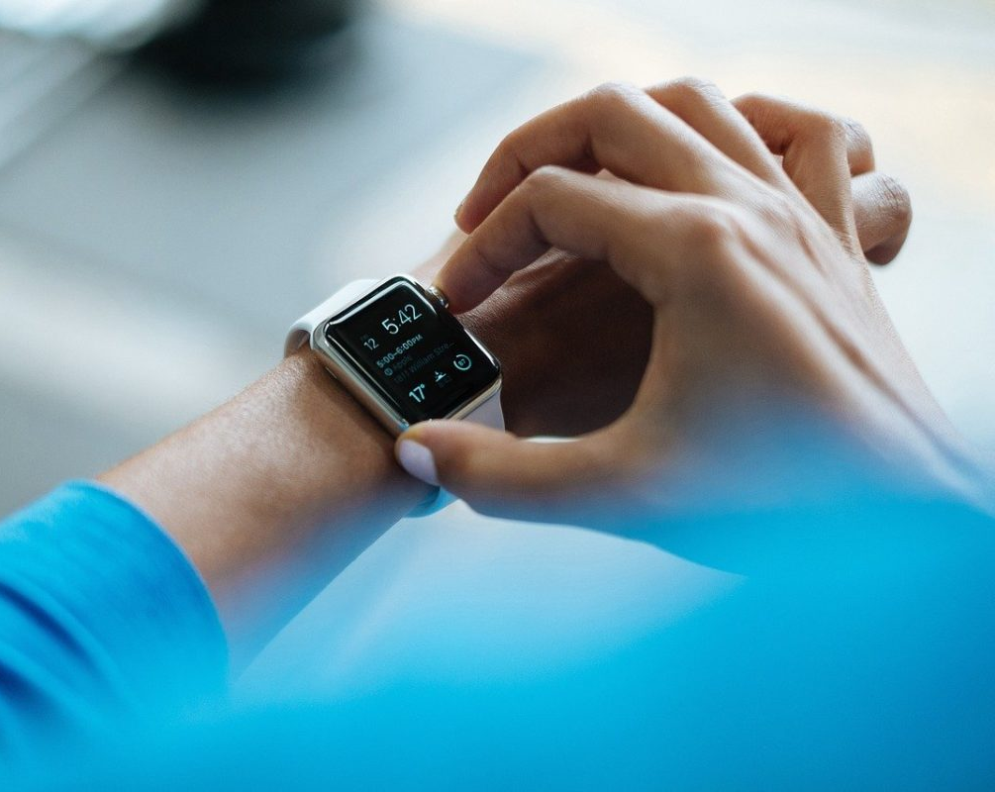
Trackers & Wearables
Types of Wearables
Fitness Trackers
Smart Heart Watches
Wearable ECG/EEG monitors
Wearable Blood Pressure Monitors
Biosensors
Technology
Sleep Trackers
mHealth Apps
Heart Tracker

Slide 32
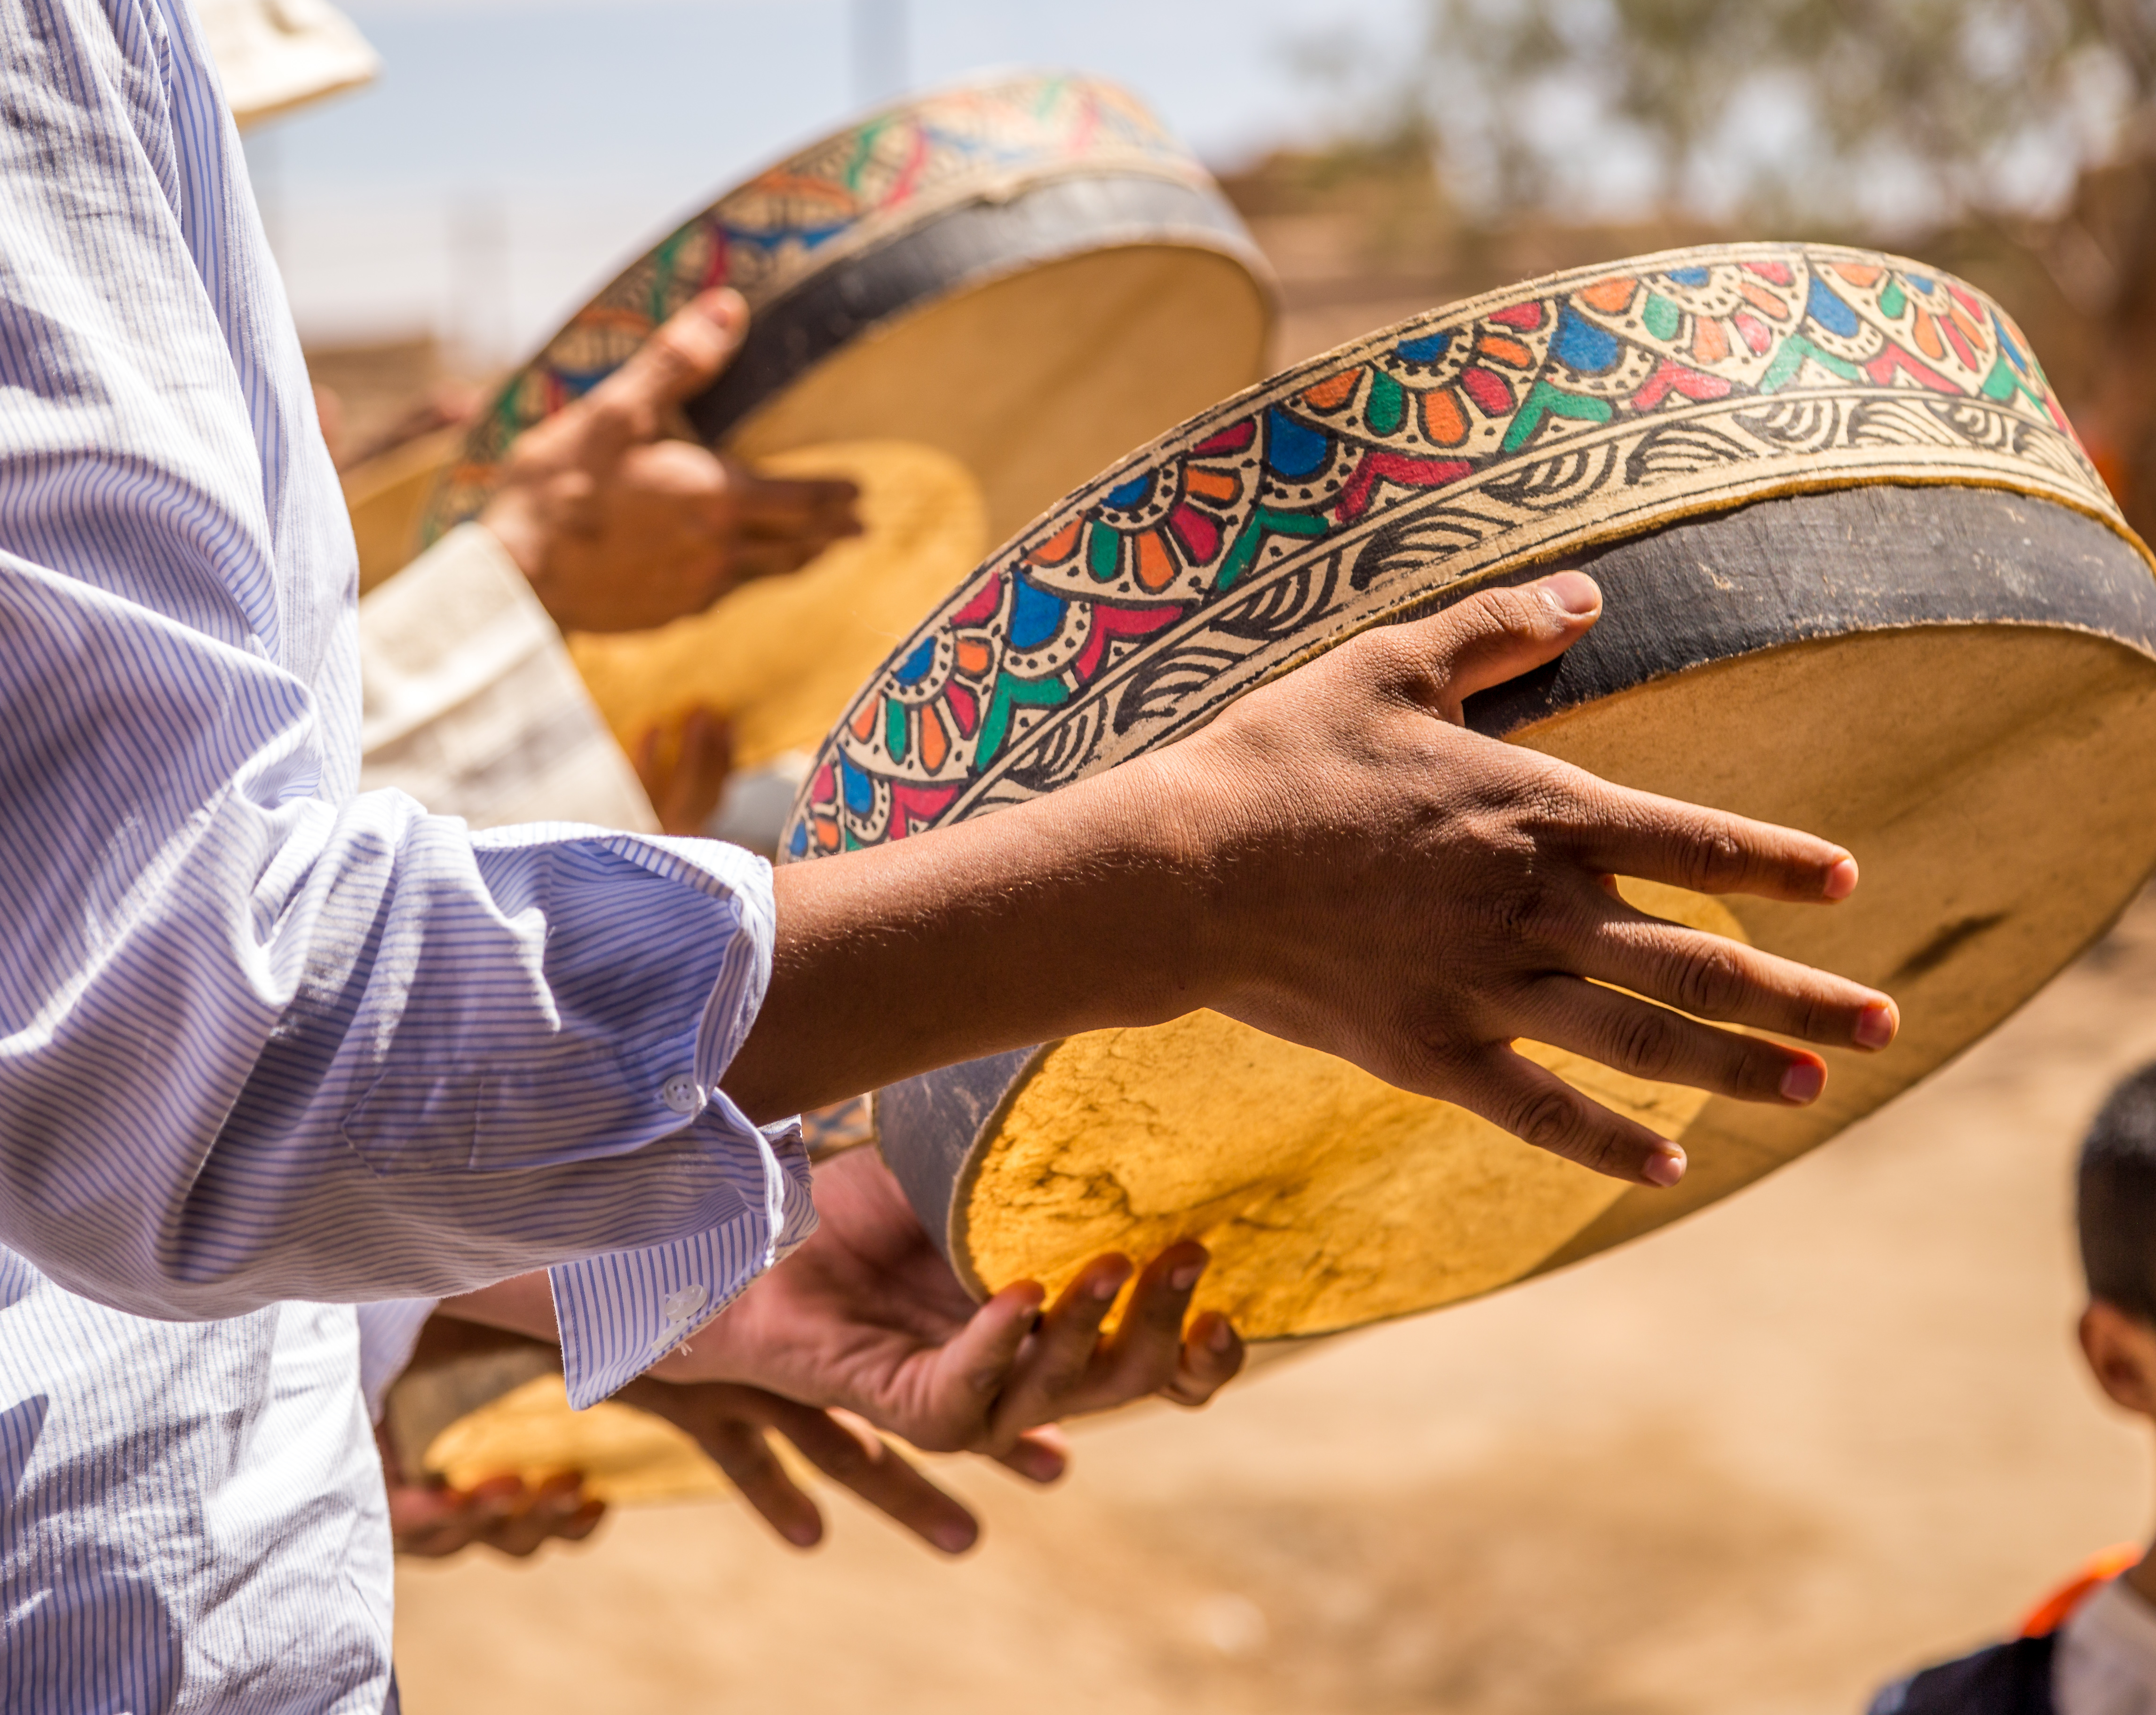
Indigenous Data Collection
"Indigenous data sovereignty is the right of a nation to govern the collection, ownership, and application of its own data. It derives from tribes’ inherent right to govern their peoples, lands, and resources." (Indigenous Data Sovereignty Network)
To determine the means of collection, access, analysis, interpretation, management, dissemination and reuse of data pertaining to the Indigenous peoples from whom it has been derived, or to whom it relates
CARE Principles (as supplement to the FAIR principles)
Collective Benefit
Authority to Control
Responsibility
Ethics

Slide 33
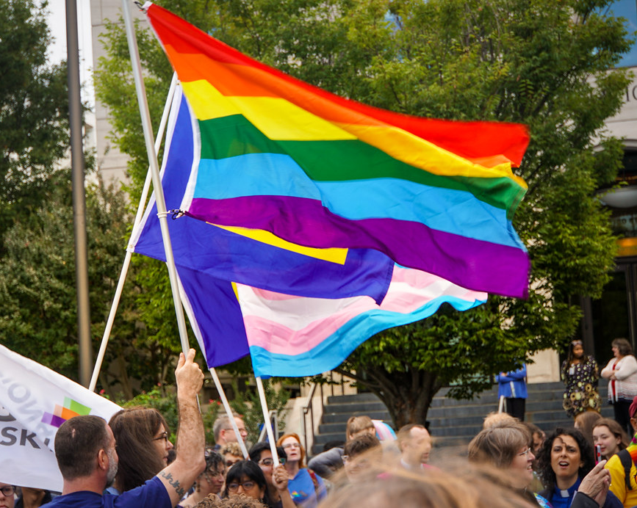
LGBTQ Data Collection
Data collection on gender identity, sexual orientation, and heatlh disparities that affect the lesbian, gay, bisexual, and transgender population
This can include population surveys, online surveys, intake forms and applications, clinical interactions, clinical records, social media research

Slide 34
Library Data Collection
Some considerations:
Collection of student, staff and patron data
Inadequate or inconsistent ethical oversight and procedures
Patron trust and consent
Metrics and analytics used in decision making
Leaning analytics and education assessment
checkout records, location swipes, database usage, article downloads, interlibrary loan, etc.
Your own perspectives and experiences

Slide 35
Library Research and Data Collection
Information professionals and research integrity
Research data collection and methods
Potential editorial (mis)conduct / citation manipulation
LIS Ethical Frameworks (or lack thereof)
Ethical challenges in LIS Research

Slide 36
Suggested Questions
Which ethical values do you think are most important relevant to consider and why: Autonomy, Beneficence, Non-malfeasance, or Justice?
How could the data collected improve health or education vs. negatively impact its respective community?
Can ethical principles, community-based research, a stronger focus on health equity and social justice, or concepts from Non-western or Indigenous Data Sovereignty be incorporated?
What are some of the ethical considerations that should be discussed before, during, and after data collection?
Are their security and privacy concerns regarding the data collection?
What other ethical considerations came up for you while reading, researching, thinking, and/or discussing on this topic?
Open discussion of your own thoughts, feelings, experiences, insights to these topics

Slide 37
Discussion

Slide 38
Thank you
Genevieve.milliken@nyulangone.org

Slide 39
Kellie Owens, PhD

Slide 40
Bibliography
Arriagada Bruneau, G., Gilthorpe, M., & Müller, V. C. (2020). The ethical imperatives of the COVID-19 pandemic: A review from data ethics. Los Imperativos Éticos de La Pandemia de COVID-19: Un Análisis Desde La Ética de Los Datos., 46, 13–35.
Barocas, S., & Boyd, D. (2017). Engaging the Ethics of Data Science in Practice. Communications of the ACM, 60(11), 23–25.
Bekemeier, B., Park, S., Backonja, U., Ornelas, I., & Turner, A. M. (2019). Data, capacity-building, and training needs to address rural health inequities in the Northwest United States: A qualitative study. Journal of the American Medical Informatics Association : JAMIA, 26(8–9), 825–834. https://doi.org/10.1093/jamia/ocz037
Braveman, P. A., Kumanyika, S., Fielding, J., LaVeist, T., Borrell, L. N., Manderscheid, R., & Troutman, A. (2011). Health Disparities and Health Equity: The Issue Is Justice. American Journal of Public Health, 101(S1), S149–S155. https://doi.org/10.2105/AJPH.2010.300062
Caplan, A., & Friesen, P. (2017). Health disparities and clinical trial recruitment: Is there a duty to tweet? PLOS Biology, 15(3), e2002040. https://doi.org/10.1371/journal.pbio.2002040
Cilliers, L. (2020). Wearable devices in healthcare: Privacy and information security issues. Health Information Management Journal, 49(2–3), 150–156. https://doi.org/10.1177/1833358319851684
Charles and Lynn Schusterman Foundation. (2020). More Than Numbers: A Guide Toward Diversity, Equity and Inclusion in Data Collection. https://www.schusterman.org/blogs/rella-kaplowitz/how-we-collect-data-determines-whose-voice-is-heard
Clark, L. T., Watkins, L., Piña, I. L., Elmer, M., Akinboboye, O., Gorham, M., Jamerson, B., McCullough, C., Pierre, C., Polis, A. B., Puckrein, G., & Regnante, J. M. (2019). Increasing Diversity in Clinical Trials: Overcoming Critical Barriers. Current Problems in Cardiology, 44(5), 148–172. https://doi.org/10.1016/j.cpcardiol.2018.11.002
Cornelius, L. (2014). A social justice approach to survey design and analysis. Oxford University Press.
D’Ignazio, C., & Klein, L. F. (2020). Data Feminism. MIT Press. https://data-feminism.mitpress.mit.edu/
Dincelli, E., Jafarian, H., Yayla, A., & Zhou, X. (2021). Wearable Devices and Privacy Concerns: Data Collection, Analysis, and Interpretation. In Privacy Concerns Surrounding Personal Information Sharing on Health and Fitness Mobile Apps.

Slide 41
Bibliography (2)
Floridi, L., & Taddeo, M. (2016). Introduction: What is data ethics? Philosophical Transactions: Mathematical, Physical and Engineering Sciences, 374(2083), 1–5.
Fox, K. (2020). The Illusion of Inclusion—The “All of Us” Research Program and Indigenous Peoples’ DNA. New England Journal of Medicine, 383(5), 411–413. https://doi.org/10.1056/NEJMp1915987
Garrison, N. A., Hudson, M., Ballantyne, L. L., Garba, I., Martinez, A., Taualii, M., Arbour, L., Caron, N. R., & Rainie, S. C. (2019). Genomic Research Through an Indigenous Lens: Understanding the Expectations. Annual Review of Genomics and Human Genetics, 20(1), 495–517. https://doi.org/10.1146/annurev-genom-083118-015434
Goodluck, K. (2020, December 14). Why the U.S. is terrible at collecting Indigenous data. https://www.hcn.org/articles/indigenous-affairs-interview-why-the-u-s-is-terrible-at-collecting-indigenous-data
Hammer, M. (2017). Ethical Considerations for Data Collection Using Surveys. Oncology Nursing Forum, 1–4. https://doi.org/10.1188/17.ONF.157-159
Lar-Son, K. (2021, February 2). Data as Relation: Indigenous Data Sovereignty and Ethic of Care. https://www.youtube.com/watch?v=QGYse9iDPWI&feature=youtu.be
Mann, S. P., Savulescu, J., & Sahakian, B. J. (2016). Facilitating the ethical use of health data for the benefit of society: Electronic health records, consent and the duty of easy rescue. Philosophical Transactions: Mathematical, Physical and Engineering Sciences, 374(2083), 1–17.
McInroy, L. B. (2016). Pitfalls, Potentials, and Ethics of Online Survey Research: LGBTQ and Other Marginalized and Hard-to-Access Youths. Social Work Research, 40(2), 83–94. https://doi.org/10.1093/swr/svw005
ORARC. (n.d.). Inclusive Demographic Data Collection. Retrieved from https://cdn1.sph.harvard.edu/wp-content/uploads/sites/2102/2020/04/ORARC-Tip-Sheet-Inclusive-Demographic-Data-Collection.pdf
Pierce, C., & Scherra, E. (2004). The Challenges of Data Collection in Rural Dwelling Samples. Online Journal of Rural Nursing and Health Care, 4(2), 25–30. https://doi.org/10.14574/ojrnhc.v4i2.197
Perez, C. C. (2021). Going to the Doctor. In Invisible Women: Data Bias in a World Designed for Men. Harry N. Abrams.

Slide 42
Bibliography (3)
Rencsok, E. M., Bazzi, L. A., McKay, R. R., Huang, F. W., Friedant, A., Vinson, J., Peisch, S., Zarif, J. C., Simmons, S., Hawthorne, K., Villanti, P., Kantoff, P. W., Heath, E., George, D. J., & Mucci, L. A. (2020). Diversity of Enrollment in Prostate Cancer Clinical Trials: Current Status and Future Directions. Cancer Epidemiology and Prevention Biomarkers, 29(7), 1374–1380. https://doi.org/10.1158/1055-9965.EPI-19-1616
Responsible Conduct in Research Management. (n.d.). Data Collection. Retrieved January 14, 2021, from https://ori.hhs.gov/education/products/n_illinois_u/datamanagement/dctopic.html
Riddell, J. K., Salamanca, A., Pepler, D. J., Cardinal, S., & McIvor, O. (2017). Laying the Groundwork: A Practical Guide for Ethical Research with Indigenous Communities. International Indigenous Policy Journal, 8(2), Article 2. https://doi.org/10.18584/iipj.2017.8.2.6
Tremblay, M.-C., Martin, D. H., McComber, A. M., McGregor, A., & Macaulay, A. C. (2018). Understanding community-based participatory research through a social movement framework: A case study of the Kahnawake Schools Diabetes Prevention Project. BMC Public Health, 18(1), 487. https://doi.org/10.1186/s12889-018-5412-y
University of Illinois Chicago. (2020, October 21). Ethics of Wearables: Health Data and Wellness Technology. UIC Online Health Informatics. https://healthinformatics.uic.edu/blog/ethics-of-wearables/
US Census Bureau. (n.d.). Counting People in Rural and Remote Locations. The United States Census Bureau. Retrieved February 27, 2021, from https://www.census.gov/library/stories/2019/12/counting-people-in-rural-and-remote-locations.html
Vitale, C., Fini, M., Spoletini, I., Lainscak, M., Seferovic, P., & Rosano, G. M. (2017). Under-representation of elderly and women in clinical trials. International Journal of Cardiology, 232, 216–221. https://doi.org/10.1016/j.ijcard.2017.01.018
Walter, M., & Suina, M. (2019). Indigenous data, indigenous methodologies and indigenous data sovereignty. International Journal of Social Research Methodology, 22(3), 233–243. https://doi.org/10.1080/13645579.2018.1531228
Wilcox, A. B., Gallagher, K. D., Boden-Albala, B., & Bakken, S. R. (2012). Research Data Collection Methods: From Paper to Tablet Computers. Medical Care, 50(7), S68–S73.
Yallop, A. C., & Aliasghar, O. (2020). No business as usual: A case for data ethics and data governance in the age of coronavirus. Online Information Review, 44(6), 1217–1221. https://doi.org/10.1108/OIR-06-2020-0257

