Slide 1
Listening Event
DATE
YOUR LIBRARY’S NAME

Slide 2
All Our Voices Listening Event
[SAMPLE AGENDA]
Welcome
Introduction to All Our Voices Recording Campaign & StoryCorps
Story Share
Guest Panelists
Closing, Thank you, and Call to Action

Slide 3
All Our Voices Listening Event
[SAMPLE AGENDA]
Welcome
Introduction to All Our Voices Recording Campaign & StoryCorps
Story Share
Guest Panelists
Closing, Thank you, and Call to Action

Slide 4
INTRODUCING STORYCORPS
A StoryCorps interview is an opportunity to record an uninterrupted, intentional
conversation with someone you know about anything you’d like, from favorite memories
to important life questions. It’s also a way to connect with family and friends in a time
when visiting in person is extremely limited.

Slide 5
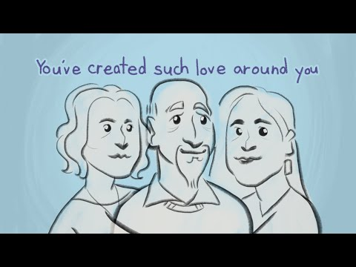
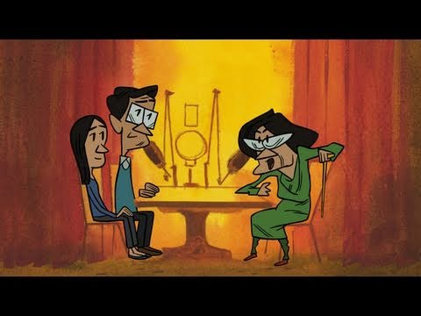
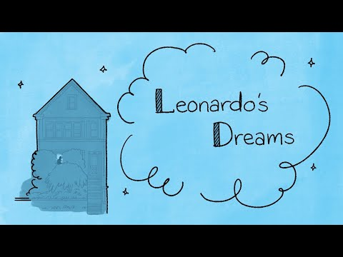
FEATURED ANIMATIONS
A Wonderful Life (3.5 min.)
No More Questions (3.5 min.)
Leonardo’s Dreams (3 min.)

Slide 6
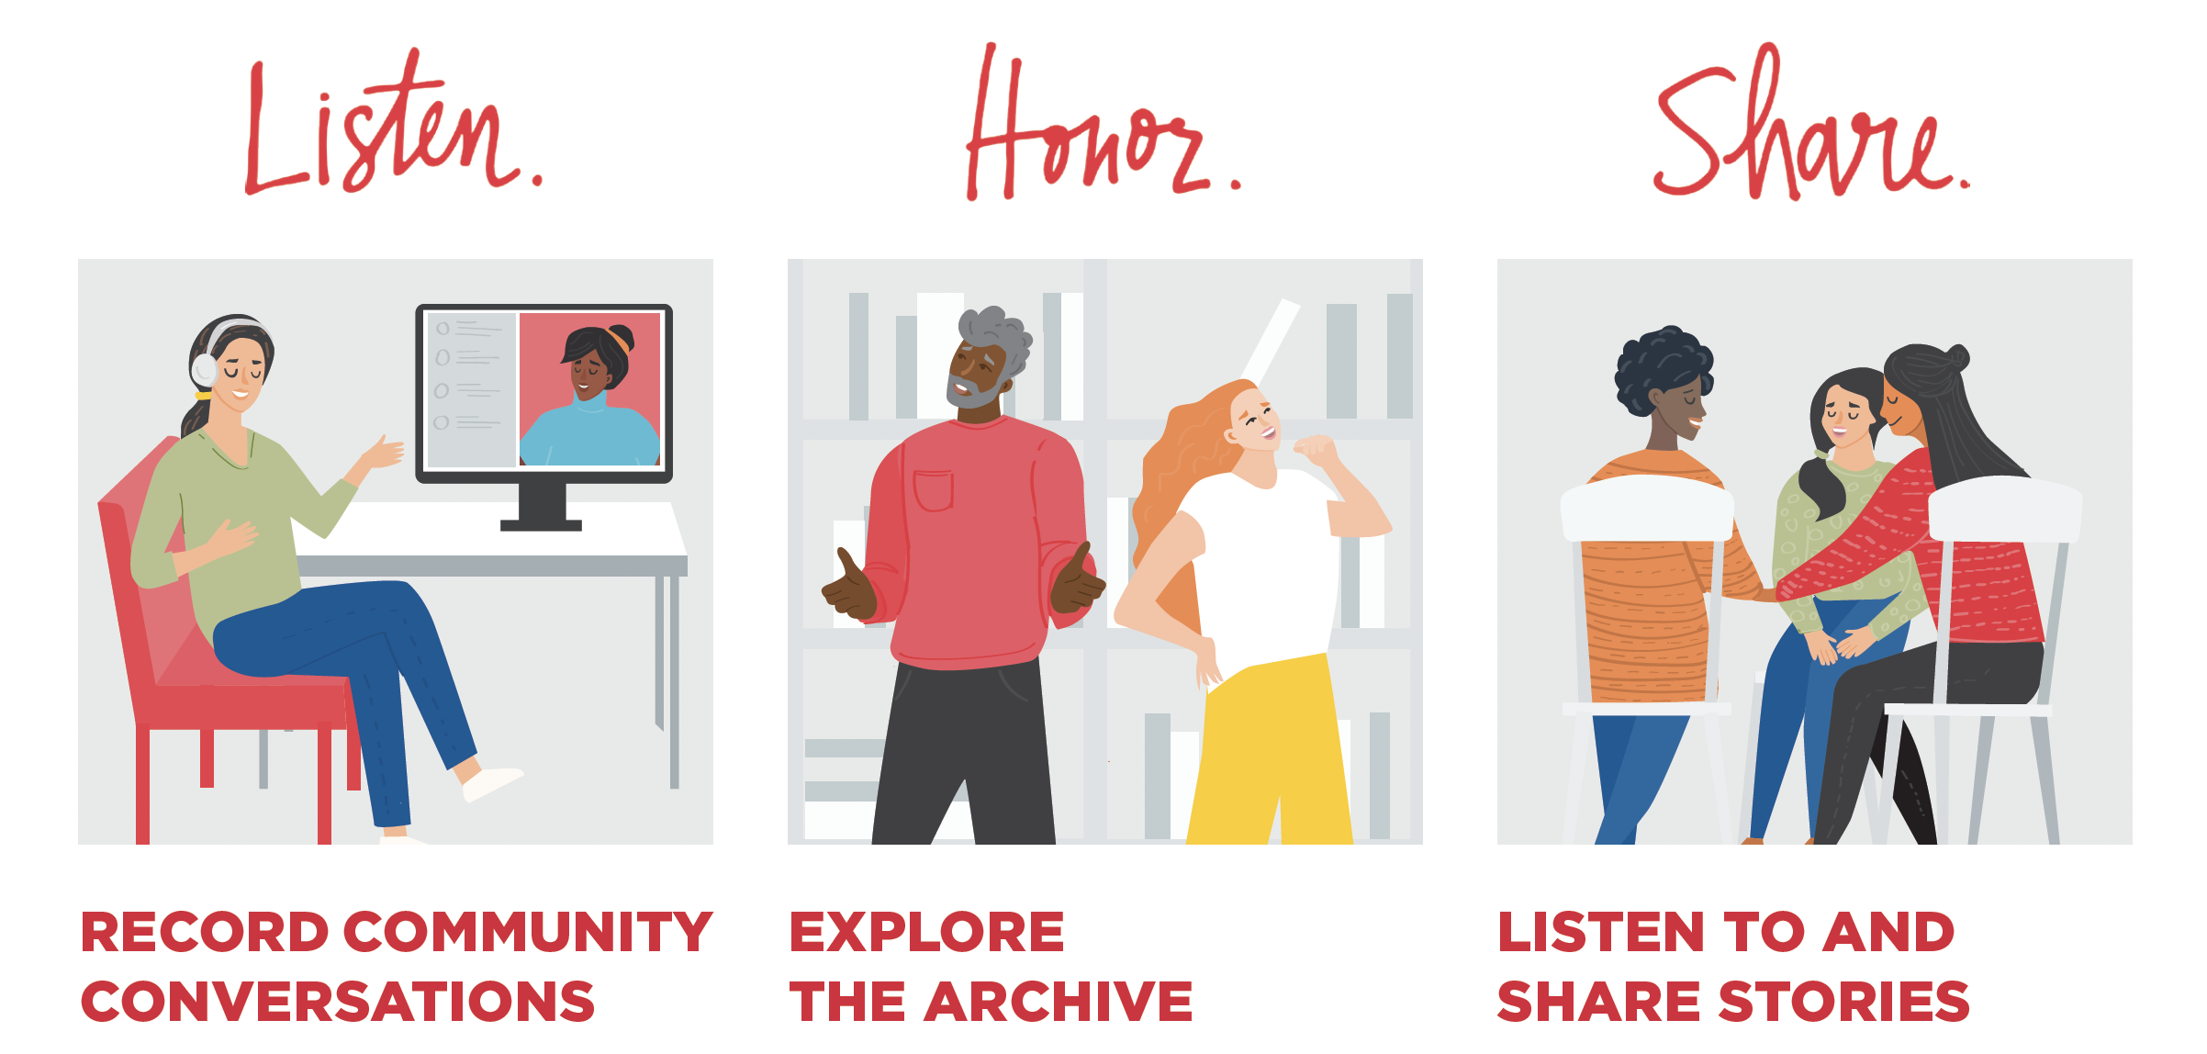

Slide 8
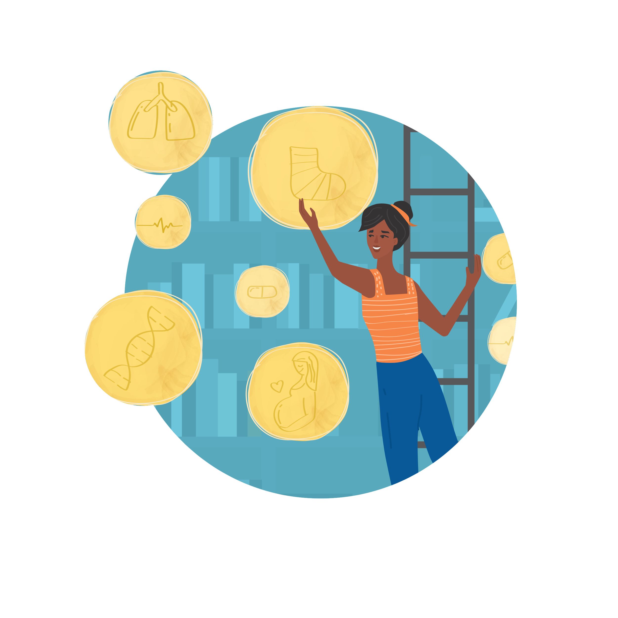

Slide 9
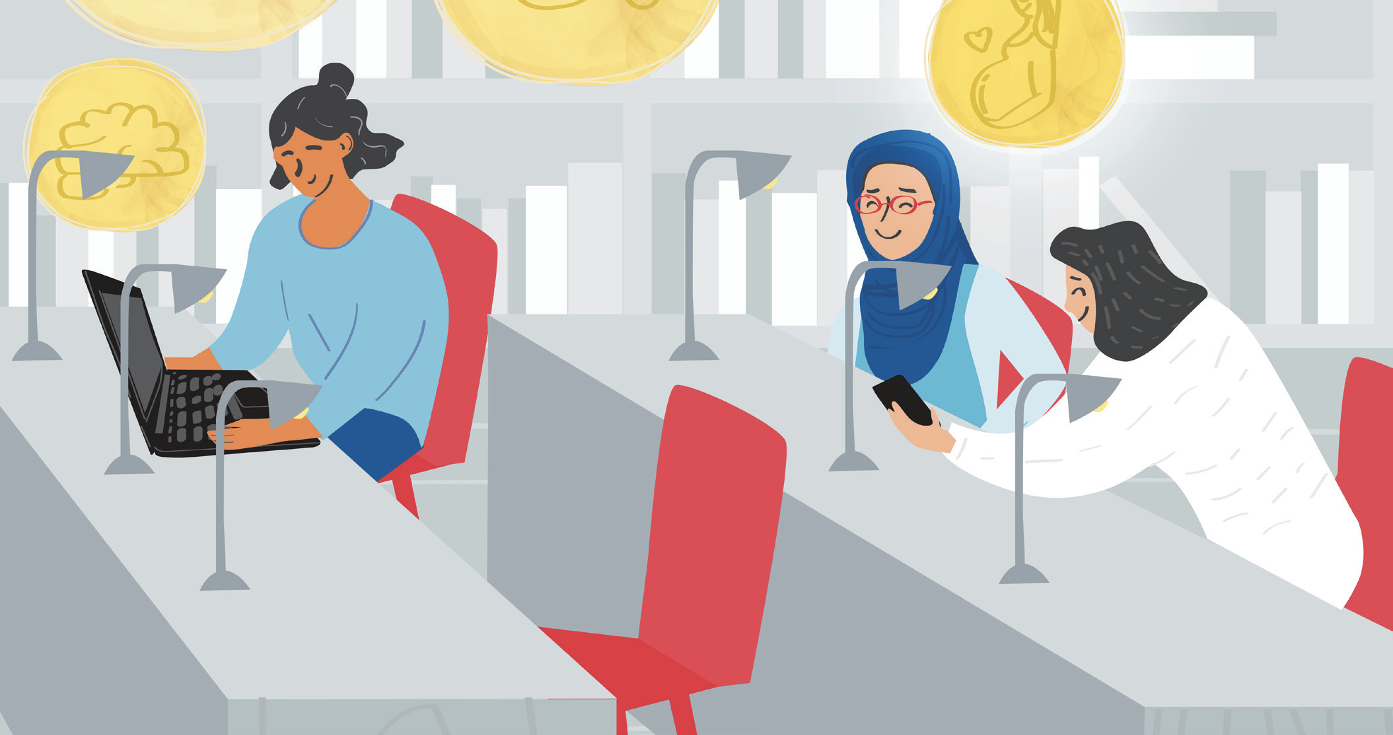

Slide 10
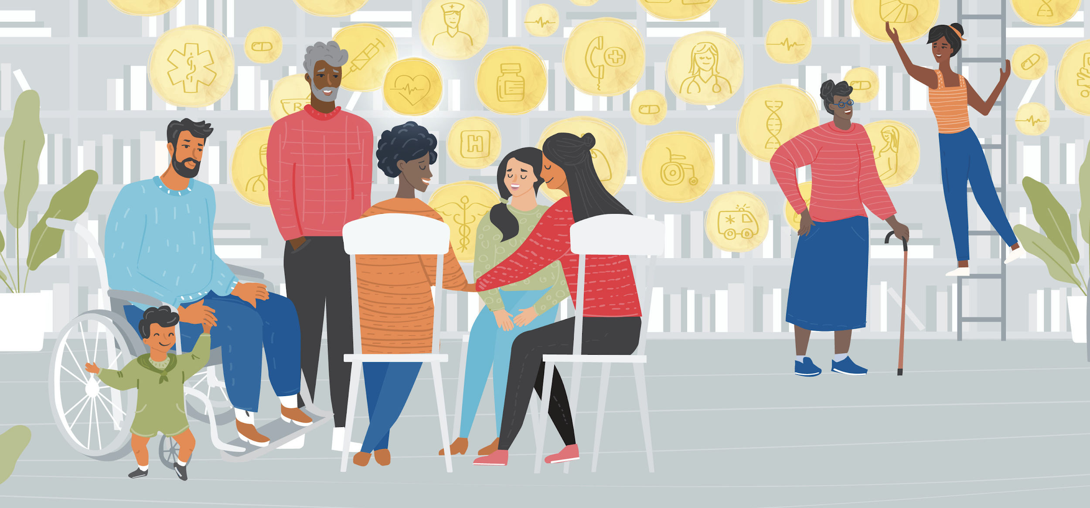

Slide 12
