Slide 1
A Simple Process for Creating a One-page Disaster Plan
Dan Wilson, Deputy Director, University of Virginia Health Sciences Library

Slide 2
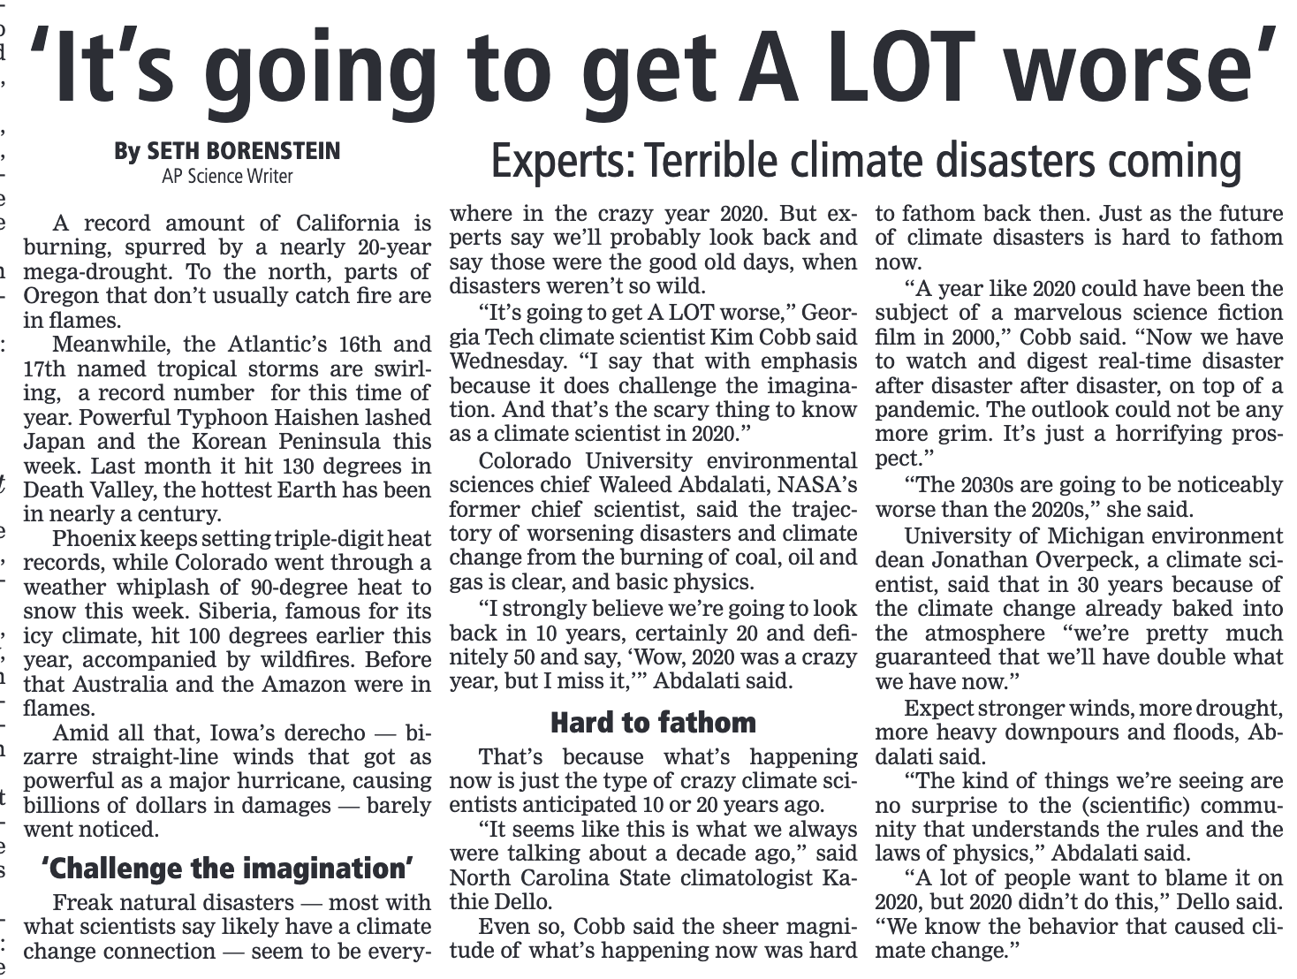
Slide 2

Slide 3
Slide 3
“There are emergency preparedness plans in place for earthquakes and hurricanes, heat waves and ice storms. There are plans for power outages of a few days, affecting as many as several million people. But if a highly populated area was without electricity for a period of months or even weeks, there is no master plan for the civilian population.” ― Ted Koppel, Lights Out: A Cyberattack, A Nation Unprepared, Surviving the Aftermath

Slide 4
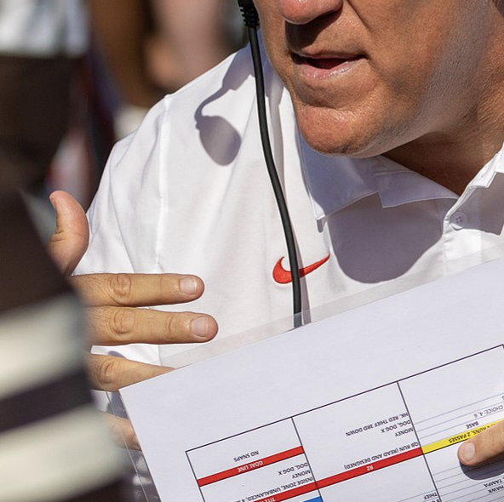
Slide 4
A one-page disaster plan is the equivalent of a football coach’s play sheet.

Slide 5
It’s All About Planning
secure core print materials
response station
continuity of operations
72-hour home preparedness
regular drills
effectiveness of response
know your risks
table-top exercise
after-action review
up-to-date disaster plan
partnerships
determine core services

Slide 6
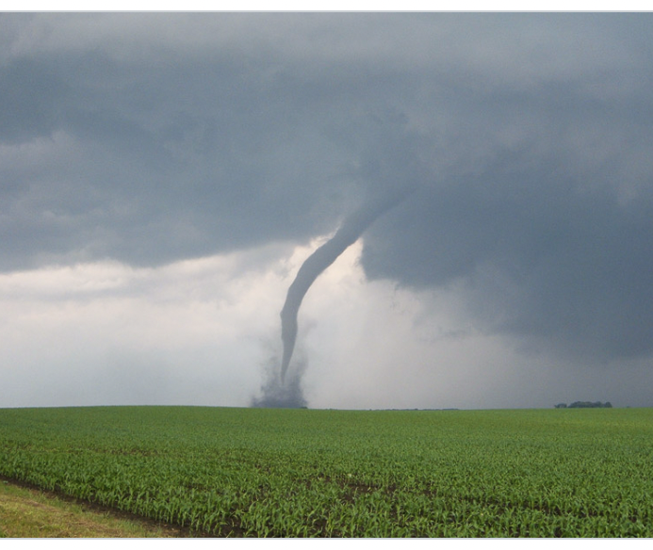
Leadership Transition

Slide 7
Exercising Your One-page plan

Slide 8
Psychological Impact

Slide 9
Partnership

Slide 10
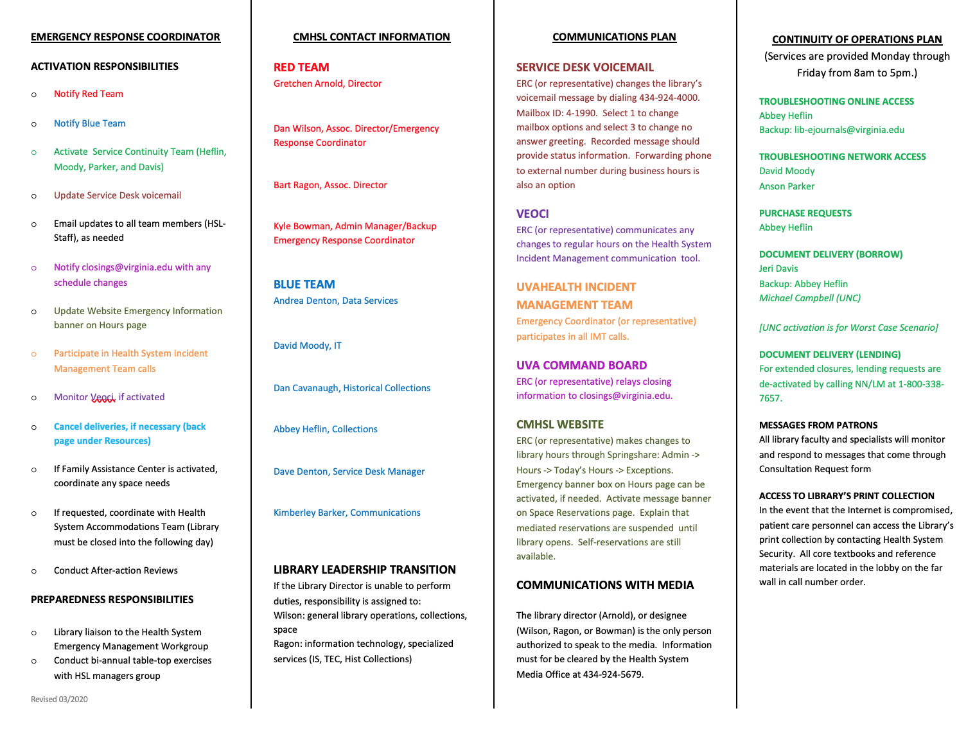
One page plan example 1

Slide 11
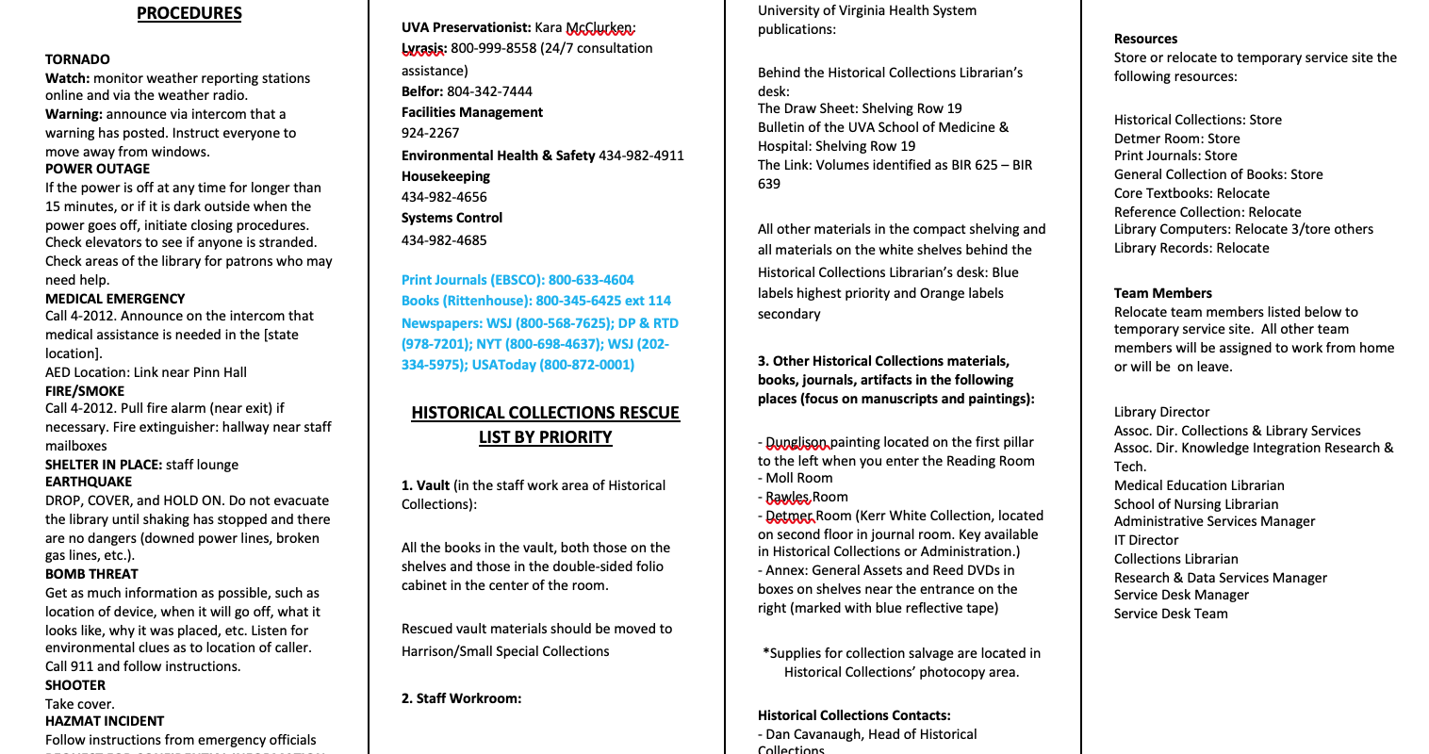
One page plan example 2
Notes:
The column on the right

Slide 12
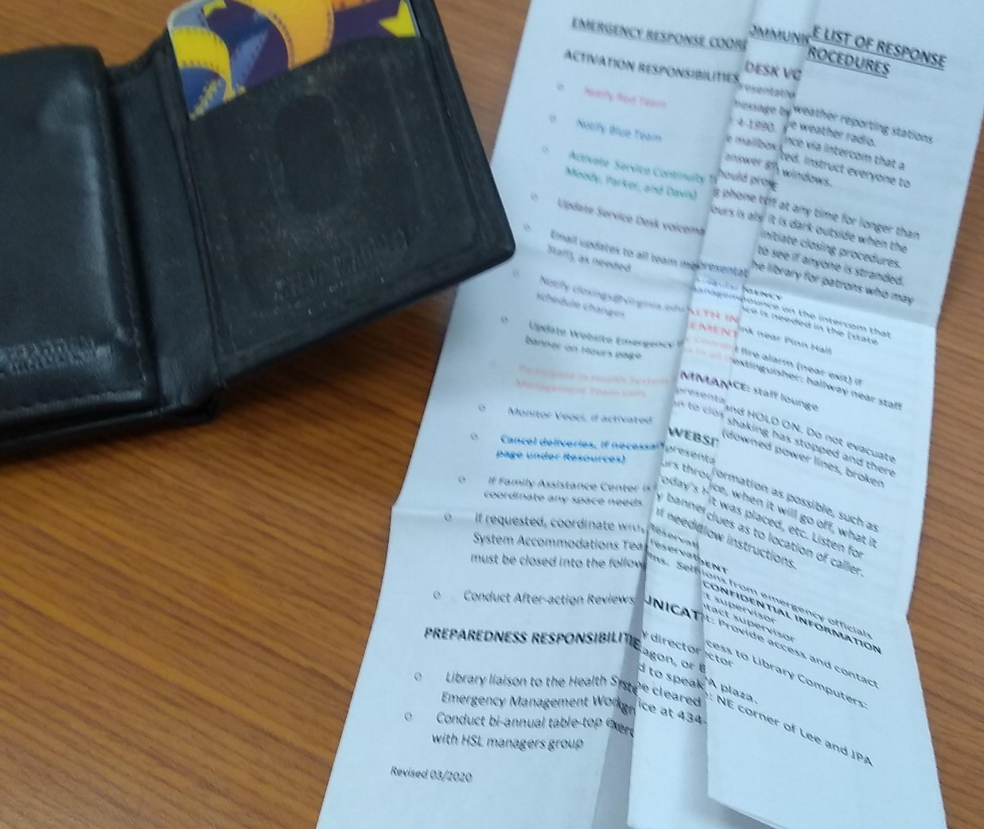
Questions

Slide 13
Contact Information: danwilson@virginia.edu
Link to One-page Microsoft Word Template: https://guides.hsl.virginia.edu/dan-wilson

