Slide 1
Research Data Services “Shop Talk” with NNLM Region 2 November 30, 2023
Notes:
Hello and Welcome to New Member Orientation -> Webinar – high school feeling
We are happy to have you here
I’ll lead you
We invited new users, member organizations who have signed up since

Slide 2
Land Acknowledgement
Land acknowledgements are an honest and historically accurate way to recognize native communities. Presenting land acknowledgments recognizes histories that have been systematically erased.
The native peoples of this region include the Etiwan, Kiawah, Santee, Edisto, Nachez-Kusso, and Wassamassaw people.
The Region 2 RML recognizes the native communities of the land on which we live and work in Charleston, South Carolina. We commit to remaining mindful and to use our work to support the health and well-being of all people, including native communities.
Notes:
See the Native Governance Center's "A Guide to Indigenous Land Acknowledgement" to learn more about land acknowledgments and their significance: https://nativegov.org/news/a-guide-to-indigenous-land-acknowledgment/ & the National Environmental Education Foundation's Guide: https://www.neefusa.org/guide-indigenous-land-acknowledgment

Slide 3
Labor Acknowledgement
Labor acknowledgments recognize how historically, much of the substantial economic development in a geographic area or industry resulted from the unpaid labor and forced servitude of people of color, specifically people from Africa.
The R2 RML acknowledges that much of what we know of this country today was possible because of the labor of enslaved Africans, their descendants, immigrant workers, impoverished people, domestic workers, and others.
We commit to remaining mindful and to use our work to support the health and well-being of all people, including those whose labor has been historically exploited.
Notes:
See the Native Governance Center's "A Guide to Indigenous Land Acknowledgement" to learn more about land acknowledgments and their significance: https://nativegov.org/news/a-guide-to-indigenous-land-acknowledgment/ & the National Environmental Education Foundation's Guide: https://www.neefusa.org/guide-indigenous-land-acknowledgment

Slide 4
Community Agreements
Take care of yourself
No one knows everything/Together we know a lot
Make Space/Take Space
One mic/One voice
Understand the difference between impact and intent
Respect confidentiality
Be curious and respectful
Adapted from GLSEN Guidelines from Respectful GSA Spaces
https://www.glsen.org/activity/guidelines-respectful-gsa-spaces
Notes:
Take care of yourself – Feel free to take breaks and hydrate as you need to.
No one knows everything / Together we know a lot - Listen to understand.
Make Space / Take Space – Be aware of how much you are speaking. If you are speaking a lot, be mindful to make space for those with quieter voices, especially those from marginalized groups.
One mic / One voice - Only one person should speak at a time. Speak from your own experiences. Do not assume other people’s experiences or generalize.
Understand the difference between impact and intent – What you are intending is less important than how it impacts another person.
Respect confidentiality – What we learn here, leaves here…what we say here, stays here.
Be curious and respectful – Be a mindful listener. Do not blame or shame. -

Slide 5
Today’s Agenda
Introduction
Attendee Poll
Lightning Talks
Megan Sheffield, Emory University
Marla Hertz, University of Alabama Birmingham
Savannah Kelly, University of Mississippi
Mandy Swygart-Hobaugh, Georgia State University
Ali Krzton, Auburn University
Q&A
Further Discussion / Wrap-Up
Notes:
Take care of yourself – Feel free to take breaks and hydrate as you need to.
No one knows everything / Together we know a lot - Listen to understand.
Make Space / Take Space – Be aware of how much you are speaking. If you are speaking a lot, be mindful to make space for those with quieter voices, especially those from marginalized groups.
One mic / One voice - Only one person should speak at a time. Speak from your own experiences. Do not assume other people’s experiences or generalize.
Understand the difference between impact and intent – What you are intending is less important than how it impacts another person.
Respect confidentiality – What we learn here, leaves here…what we say here, stays here.
Be curious and respectful – Be a mindful listener. Do not blame or shame. -

Slide 6
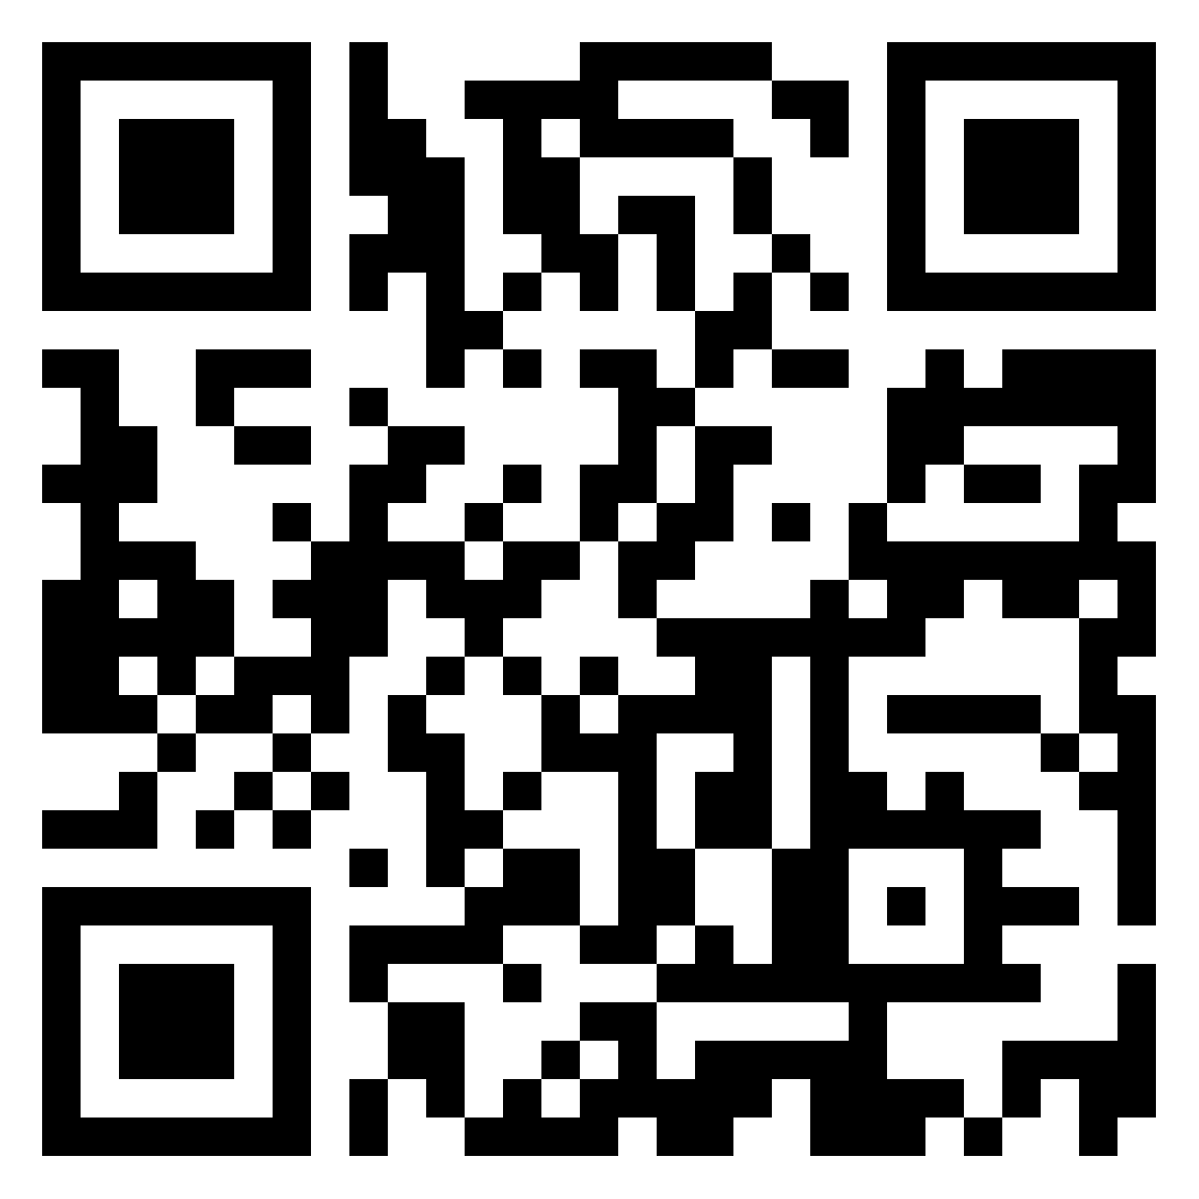
Padlet Poll – 10 min
Submit and view answers in Padlet here: https://tinyurl.com/NNLM-RDS
What data services does your library currently offer?
What are your biggest challenges in the data services space?
What is your primary role? Are you part of a data services team?
How did data services get started at your institution? How long has it taken to grow RDS?
Notes:
Take care of yourself – Feel free to take breaks and hydrate as you need to.
No one knows everything / Together we know a lot - Listen to understand.
Make Space / Take Space – Be aware of how much you are speaking. If you are speaking a lot, be mindful to make space for those with quieter voices, especially those from marginalized groups.
One mic / One voice - Only one person should speak at a time. Speak from your own experiences. Do not assume other people’s experiences or generalize.
Understand the difference between impact and intent – What you are intending is less important than how it impacts another person.
Respect confidentiality – What we learn here, leaves here…what we say here, stays here.
Be curious and respectful – Be a mindful listener. Do not blame or shame. -

Slide 7
Navigating a Research Data Services Career Transition:
Lessons from a Data Librarian's Leap into IT
Megan Sheffield, Emory University
RDS Shop Talks, November 30, 2023

Slide 8
My Career
Grad School
2006: BS in Biology
2008: MS in Biology (thesis on evolutionary biomechanics)
2009: MLIS (focus on academic librarianship, internship at NSF)
Professional Positions
2010-2012: University of South Florida (faculty)
2012-2023: Clemson University (faculty)
2012-2019: eScience Librarian (rank: Assistant Librarian)
2019: Achieved Tenure
2019-2023: Data Services Librarian (rank: Associate Librarian)
2021-2023: Interim Head of Open Scholarship Department
2022-2023: Faculty Senator (Lead for Library)
2023-Present: Emory University
Research Data Practices Lead (staff)

Slide 9
Wait!
You left a tenured faculty position for staff? Left the library for IT?
Yep, sure did, but I’m still a librarian at heart!
I’ve learned a lot from the transition...

Slide 10
Current Job Market Trends
Growing field
Branches of RDM
Overlap with IT
Different titles, similar skills
Focus more on systems and technology
Still need context of OA and scholarly communications!
Most jobs fit in one of two broad categories:
Data Management & Curation
Data Science & Literacy
RDS jobs are becoming more and more common as more funding agencies highlight the importance of Open Scholarship

Slide 11
Role of Libraries
Role of
Libraries
From the ARL/DCN “Realities of Academic Data Sharing (RADS) Initiative”

Slide 12
Role of IT
Role of
IT
From the ARL/DCN “Realities of Academic Data Sharing (RADS) Initiative”

Slide 13
Biggest Difference:
Approaches to Customer Service
Library
Information Technology
Focus on innovation and maximizing access; never say “no”
Employees encouraged to develop rapport with patrons for a “personal touch”
High visibility of individuals
Focus on security and compliance
Employees encouraged to maintain standard and repeatable level of service
Low visibility of individuals

Slide 14
Transferable Skills
These are mine - yours might look different!
Subject Matter Expertise
Communication & Instruction
Creative & Collaborative
I am very knowledgeable about not only data management practices, but the bigger picture of the research/data lifecycles and scholarly communications
Although I may lack some of the technical expertise of my colleagues, I am VERY comfortable planning lessons, speaking to crowds, or working closely with researchers to get to the heart of their issue
I have tons (...TONS) of experience working with all sorts of people to run effective meetings, manage team projects, write strategic plans,

Slide 15
My Big Takeaways
01
02
03
Don’t limit yourself! The perfect job might be out there even if it doesn’t include the word “librarian.”
It’s a culture shock for sure!
I don’t miss faculty status... most of the time

Slide 16
Thanks!
Megan.Sheffield@emory.edu

Slide 17
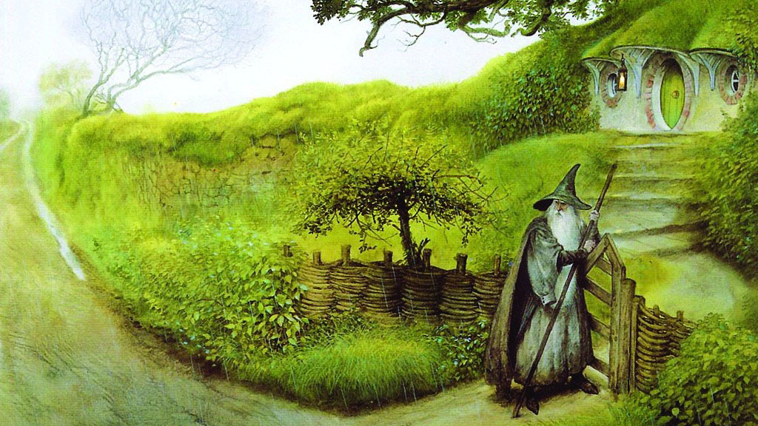
There and back again
November 30, 2023 | RDM Shop Talk | NNLM Region 2
There and back again:
Tips for effective communication with researchers from a former bench scientist
Marla Hertz, PhD | Associate Professor
Research Data Management Librarian
UAB Libraries
The University of Alabama at Birmingham
205.934.0694 | mihertz@uab.edu
© John Howe
Notes:
10 minutes
There and back again: Tips for effective communication with researchers from a former bench scientist
Abstract: Effective communication between librarians and scientific researchers is an essential part of providing research data management (RDM) services. As a former researcher myself, I have been on both sides of this conversation and will offer insights into some of its challenges and potential solutions. By understanding researchers' perspectives and implementing strategic approaches, librarians can play a pivotal role in promoting data management across diverse research disciplines.

Slide 18
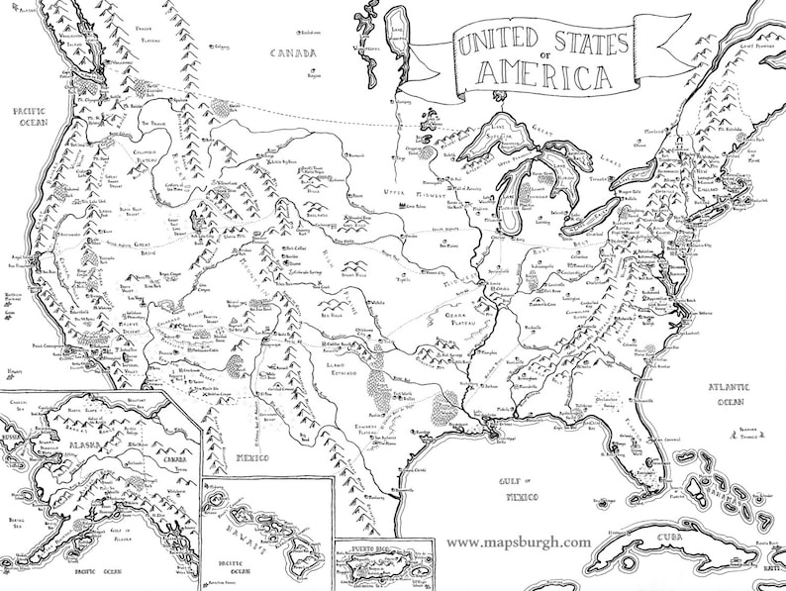
In a hole in the ground there lived a hobbit librarian – My journey to data librarianship
Postdoc to senior scientist
Infectious disease/global health
Microbiology
Undergrad
RDM
Librarian
Graduate school = Microbiology PhD
Research/teaching Postdoctoral fellowship
Notes:
Alt text: Map of the US in a Tolkien style with pins in Maryland, Birmingham, Alabama and St. Louis, Missouri. The pins track my career journey from MD to Birmingham to St. Louis and back to Birmingham.

Slide 19
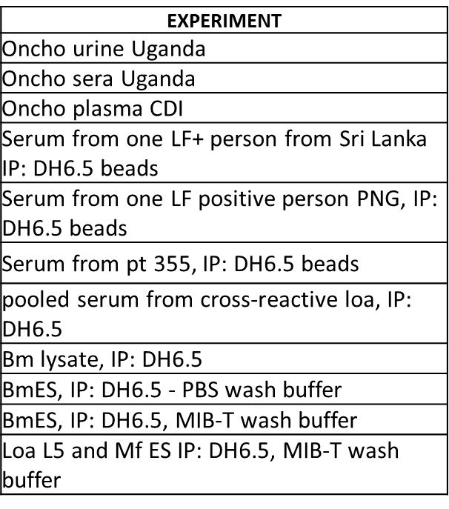
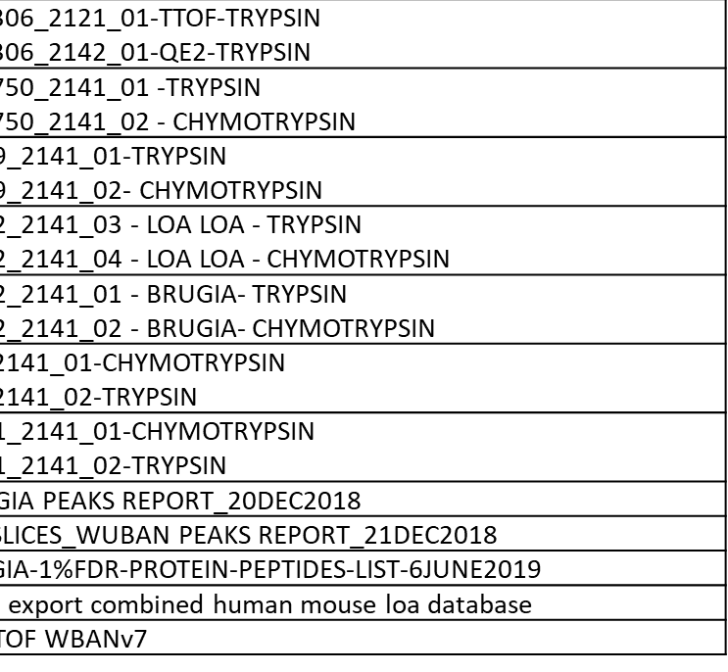
True story of a data management mishap
70+ sets of experimental preparations
70+ sets of data files
EXPERIMENT
LCMS FILES
“Lunar Landscape (Roverandom)” J.R.R. Tolkien
Notes:
Alt text: This is an illustration of a data management mishap. The left image is a representative table of experimental preparations, and the right is a list of data files with identifying information blurred out. The mishap occurred during the data analysis phase when the research team realized they were unable to match each sample preparation to its corresponding data file. Background image is a modified “Lunar Landscape (Roverandom)” by J.R.R. Tolkien

Slide 20
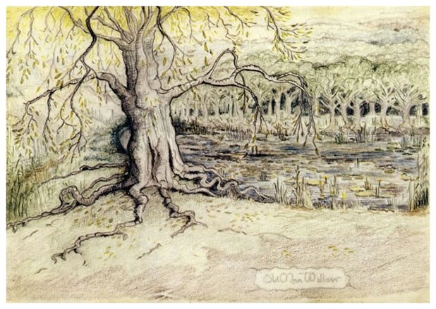
Challenge: Researchers have little to no formal training in RDM
Training tends to be ad hoc and sporadic
Not follow best practices but rather “this is the way I learned to do it”
Researchers need practice thinking through the RDM lens
“Old Man Willow” J.R.R. Tolkien
Notes:
Alt text: Background image is a washed-out version of “Old Man Willow” by J.R.R. Tolkien

Slide 21
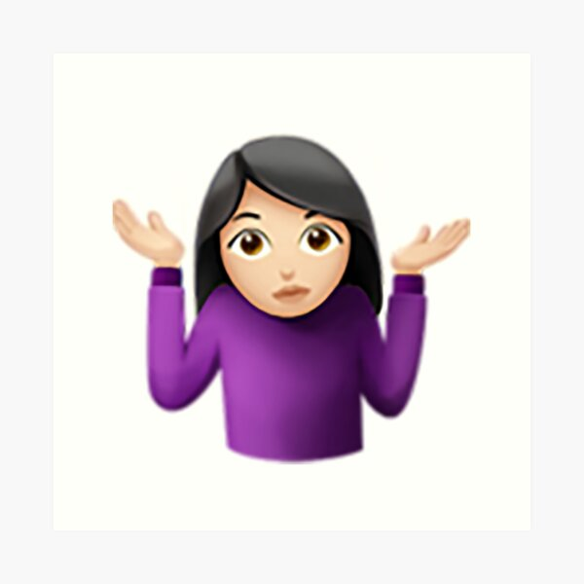
One consequences of no formal RDM training
Actual reasons I did not share my data as a researcher (in no particular order)
I didn’t know it was an option
Share by request sounded reasonable to me
My PI said we didn’t need to
I thought I did
(PDF of a table of summary values with +/- standard deviation)
Untitled Misty Mountains J.R.R. Tolkien
Notes:
Alt text: Image of a shrugging white woman sharing reasons I did not share my data. Background image is a washed-out version of “Untitled Misty Mountains” by J.R.R. Tolkien

Slide 22
Address the challenge: Formal RDM training
Offer workshops in RDM topics
Integrate RDM materials into courses
Institutionalize RDM requirements into training programs
© Larnie Nicolson Photography | Credit: Larnie Nicolson
Notes:
Alt text: Background image is a washed-out photo by © Larnie Nicolson Photography

Slide 23
Address the challenge: focus on educating early career researchers
Stage | Strategy
Undergraduate | “Share” data with students and talk about what is needed to understand the data
Graduate student/postdoc | Discuss a research article and determine which data would need to be shared to reproduce the analysis
Early career faculty | Emphasize the benefits of the paradigm shift to open data, dispel fears about scooping, share resources to find appropriate repositories
Notes:
Alt text: Background image is a depiction of the fellowship of the rings by unknown artist.

Slide 24
Call to action: Go where the researchers are
Faculty meetings
Orientation events
Center or departmental retreats
Student run organizations
Graduate student/Postdoc associations
Poster sessions/presentations on campus
Recent example: GIS day
Judge undergraduate research days
Research discipline conferences
“Rivendell” by J.R.R. Tolkien
Notes:
Alt text: “Rivendell” by J.R.R. Tolkien

Slide 25
Questions?
Marla Hertz
mihertz@uab.edu
Smaug atop his horde. David Demaret Wikimedia Commons

Slide 26
FROM IDEA TO IMPACT
Building an R Programming Workshop Series for Graduate Students
Savannah L. Kelly, PhD
Data Science & Reproducibility Librarian
University of Mississippi Libraries

Slide 27
LET’S TEACH R
STRENGTHS
CHALLENGES
Flexibility of a new department - Let’s try new things!
I had been a recent graduate student and was familiar with the interdisciplinary statistics curriculum
Paving the road while you drive on it
Purview and Perceptions
Will they even come?

Slide 28
WHAT TO COVER
(I.E., NOT STATS)
WHAT DO MOST DISCIPLINES NEED TO KNOW?
DATA IMPORT AND MANIPULATION
TIDYVERSE
DATA
VISUALIZATION
QUARTO
REPRODUCIBLE
OUTPUT

Slide 29
HOW TO STRUCTURE?
SEQUENTIAL
7-WEEK SERIES, 60 MINUTES, EVERY OTHER WEEK
LIMITED TO GRADUATE STUDENTS
LIMITED TO 20
PARTICIPANTS
Closed to undergrads, faculty, researchers
Must sign-up for the entire series
Any academic
discipline
$250

Slide 30
LESSONS LEARNED
BE CLEAR ABOUT SCOPE
WE COVER THIS, WE DO NOT COVER THIS
HAVE REALLY BIG SCREENS IN YOUR TEACHING SPACE
BE OKAY WITH LEARNING ON THE FLY
YOU GET BETTER EVERY TIME
We had to set up projectors until screens were replaced
You won’t know everything and that’s totally fine
This was essential to the success of the series
$250

Slide 31
THANK YOU
What questions can I answer?
Savannah L. Kelly, PhD
slkelly@olemiss.edu
Scholar Support and Data Services
University of Mississippi Libraries

Slide 32
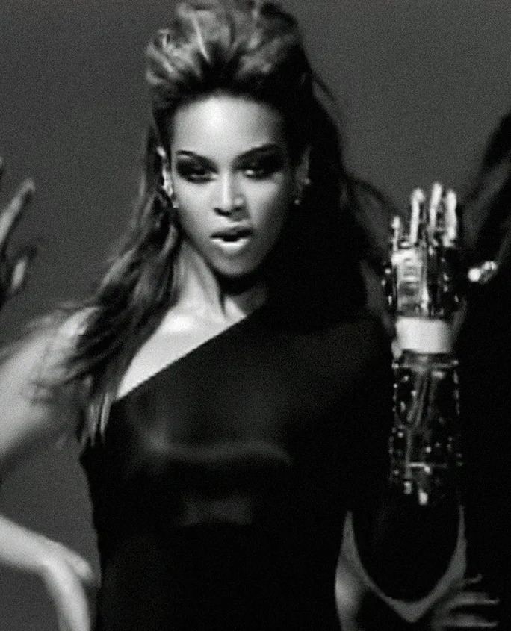
If you LEARNED it, then you shoulda put a BADGE on it…
If you LEARNED it, then you shoulda
put a BADGE on it…
GSU Data Ready! Badge Micro-Credentials
LIB.GSU.EDU/DATA-READY
www.billboard.com/music/pop/beyonce-single-ladies-put-a-ring-on-it-oral-history-8467159/
DR. MANDY SWYGART-HOBAUGH | HEAD, RESEARCH DATA SERVICES (RDS) | ASWYGARTHOBAUGH@GSU.EDU

Slide 33
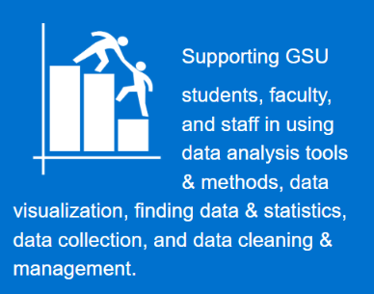
GSU Research Data Services (RDS)
ANALYTIC TOOLS & METHODS – R, SAS, SPSS, Stata, Python, NVivo; quantitative, qualitative, mixed methods; survey design; and machine learning.
DATA VIZ – ArcGIS, Tableau, Power BI, Social Explorer, Viz with R, SPSS, etc.
FINDING DATA & STATISTICS – SocSci, Health, Business
DATA CLEANING & MANAGEMENT

Slide 34
GSU Research Data Services (RDS) 2
GSU Research Data Services (RDS)
2016
2020
2022

Slide 35
WHAT?
Two tracks:
target group = UNDERGRAD
core data literacy skills/concepts with real-life examples
variety of data tools
9 video tutorials → 1 badge
lib.gsu.edu/badges-data-literacy
lib.gsu.edu/badges-software-coding
target group = EVERYONE
data analysis/viz ~ R, Python, SPSS, SAS, Stata, ArcGIS, Tableau, NVivo
11 total badges

Slide 36
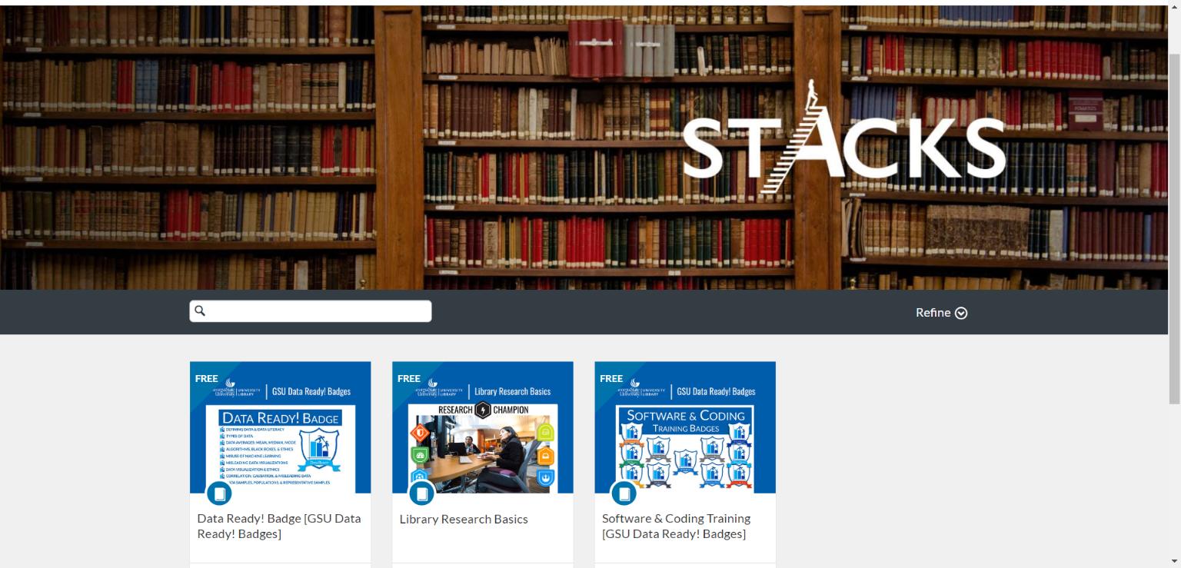
HOW does it work?
1
Enroll in “course” [no course credit but FREE] via Stacks/Canvas
2
Select badge module in Canvas
Do workshops [~ 5 - 7.5 hours]
Take quizzes [~ 10 - 15 ?s]
Score 100% on all quizzes...

Slide 37
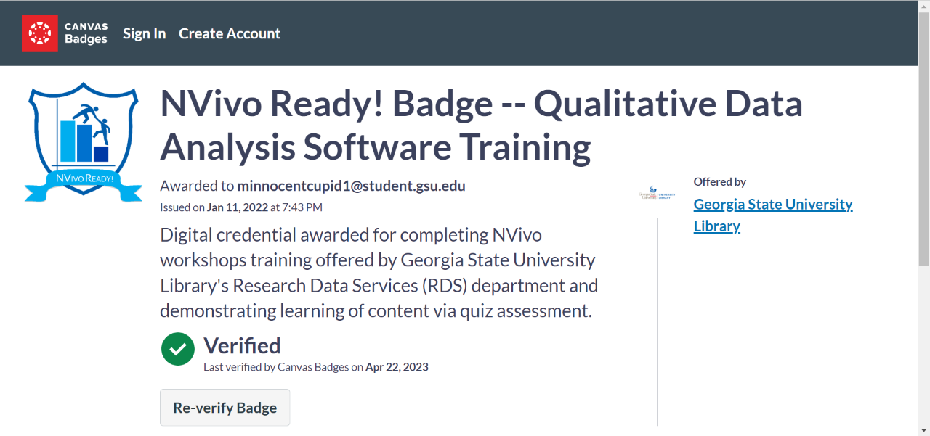
HOW does it work? (2)
HOW does it work?
3
CONGRATS! Get badge automatically via Canvas-Badgr
4
Share that badge!
Text/email direct links
Embed code on sites
Post to social media

Slide 38
WHY should STUDENTS (& EVERYONE!) get badges?
Marker of ACHIEVEMENT
Demonstrate LEARNING
Data Skills = JOBS!

Slide 39
YEAR1 (2022) – 345 BADGES EARNED…
54% awarded to graduate students, 36% to undergraduates, and 10% to faculty/staff.
…& 203 EARNERS!
AVG 2 BADGES PER EARNER
Near equal split of undergraduates (46%) and graduate students (43%) and spanning 50 academic majors.
BADGE EARNERS BY STATUS
Undergraduate 93 (46%) Graduate 87 (43%) Employee 23 (11%)

Slide 40
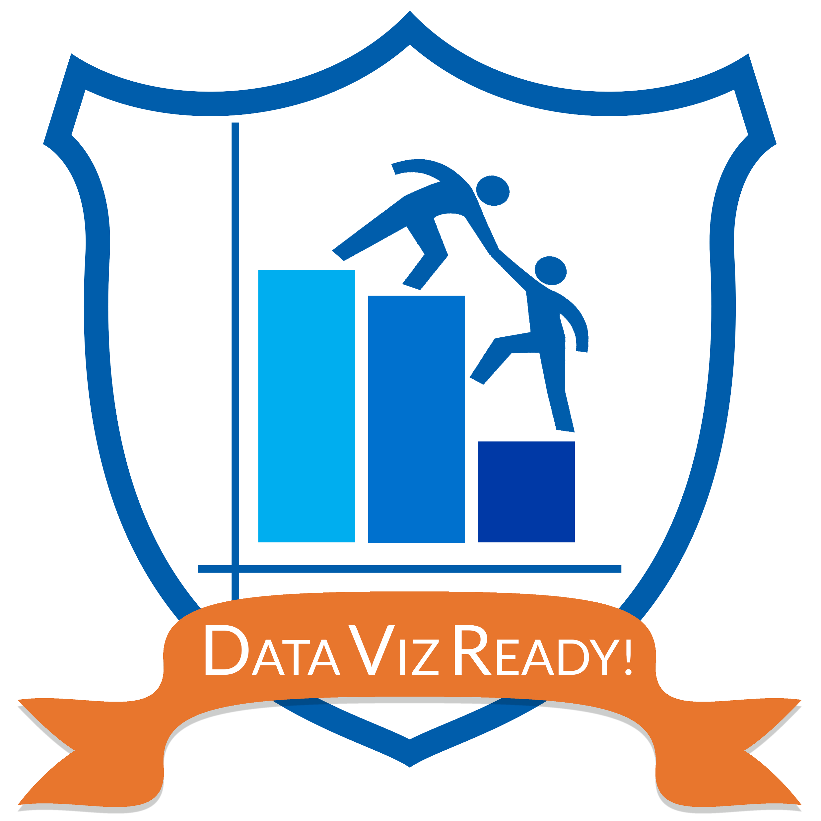
YEAR1 – 345
BADGES EARNED!
2022 – Data Ready
107 Badges
69 Undergrad
25 Grad
13 Fac/Staff
2022 – GIS
16 Badges
4 Undergrad
10 Grad
2 Fac/Staff
65%
2022 – R Basics
42 Badges
5 Undergrad
33 Grad
4 Fac/Staff
2022 – NVivo
31 Badges
4 Undergrad
22 Grad
5 Fac/Staff
2022 – Stata
11 Badges
1 Undergrad
9 Grad
1 Fac/Staff
2022 – R Advanced
20 Badges
1 Undergrad
18 Grad
1 Fac/Staff
2022 – Python
19 Badges
4 Undergrad
14 Grad
1 Fac/Staff
2022 – SAS
9 Badges
1 Undergrad
8 Grad
2022 – Data Viz
65 Badges
32 Undergrad
29 Grad
4 Fac/Staff
2022 – SPSS
17 Badges
3 Undergrad
12 Grad
2 Fac/Staff
2022 – Web Scraping
8 Badges
1 Undergrad
7 Grad
49%

Slide 41
YEAR1 – 345
BADGES EARNED! (2)
YEAR1 – 345
BADGES EARNED!
2022 – Data Ready
107 Badges
69 Undergrad
25 Grad
13 Fac/Staff
2022 – GIS
16 Badges
4 Undergrad
10 Grad
2 Fac/Staff
2022 – R Basics
42 Badges
5 Undergrad
33 Grad
4 Fac/Staff
2022 – NVivo
31 Badges
4 Undergrad
22 Grad
5 Fac/Staff
2022 – Stata
11 Badges
1 Undergrad
9 Grad
1 Fac/Staff
78%
2022 – R Advanced
20 Badges
1 Undergrad
18 Grad
1 Fac/Staff
2022 – Python
19 Badges
4 Undergrad
14 Grad
1 Fac/Staff
2022 – SAS
9 Badges
1 Undergrad
8 Grad
90%
74%
2022 – Data Viz
65 Badges
32 Undergrad
29 Grad
4 Fac/Staff
2022 – SPSS
17 Badges
3 Undergrad
12 Grad
2 Fac/Staff
2022 – Web Scraping
8 Badges
1 Undergrad
7 Grad

Slide 42
WHO’S ON BOARD?
GSU Academic Programs/Profs assigning Badges that we’re aware of – could be more!
Master of International Business program
College of Law Legal Analytics Certificate program
Nursing PhD program
Grad School’s GRAD 7999 Data Jam Course
College-to-Career “Ready, Set, Go!” trainings
Individual professors assigning in courses
AND: College of Arts & Sciences DATA 1501 course, launching in Fall 2024, intends to use as a curriculum component.

Slide 43
If you LEARNED it, then you shoulda put a BADGE on it… (2)
If you LEARNED it, then you shoulda
put a BADGE on it…
GSU Data Ready! Badge Micro-Credentials
LIB.GSU.EDU/DATA-READY
www.billboard.com/music/pop/beyonce-single-ladies-put-a-ring-on-it-oral-history-8467159/
DR. MANDY SWYGART-HOBAUGH | HEAD, RESEARCH DATA SERVICES (RDS) | ASWYGARTHOBAUGH@GSU.EDU

Slide 44
Formulating Research Data Policy as an Institution
Ali Krzton, Research Data Management Librarian
Auburn University Libraries

Slide 45
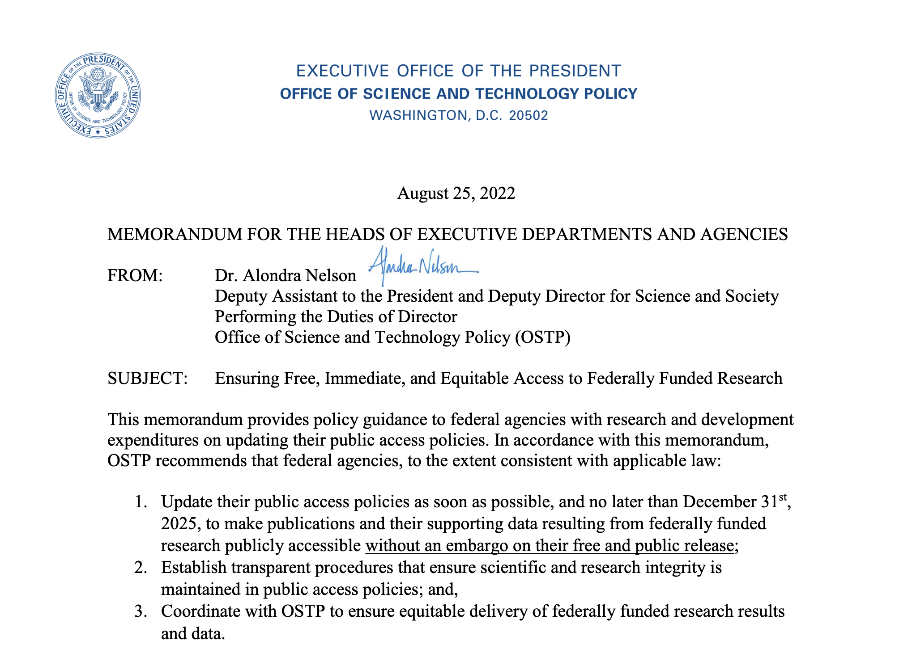
Research data policy: who needs it?
Federal agencies, funding bodies, and publications have data policies, so why should an institution make its own?
Clarity and consistency for all researchers across units
Data policy should not be solely tied to research sponsors
Investigators prefer it!

Slide 46
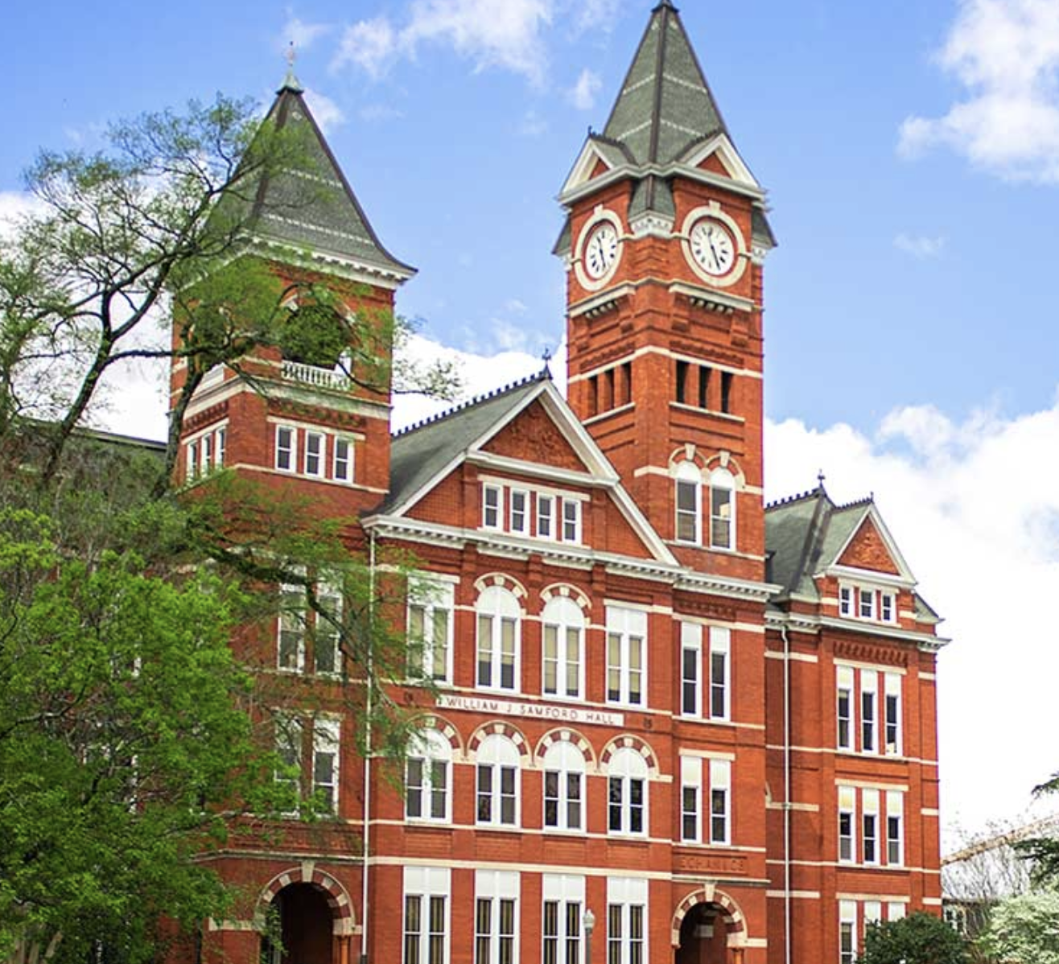
Profile of Auburn University
Established in 1856, land-grant university since 1872
Specialties include agriculture, veterinary science, engineering
Over 31,000 students across 12 colleges
Became an R1 institution in 2018
Made the NSF HERD top 100

Slide 47
Groundwork in the Libraries
AU Libraries began data policy planning in 2020
Chief participants: RDM librarian and two other science librarians
Researched policies at other institutions, identified models
Considered researcher needs and local context
Developed institutional strategy and talking points

Slide 48
Research Administration takes notice
AU Libraries briefed the Vice President for Research on our research data policy planning in early 2021
An Associate Dean for Research raised the issue of inadequate university-level data policy shortly thereafter
Research administration recognized the need for institutional policy and supported the existing Libraries-led effort

Slide 49
Involvement of the Senate
Summer of 2021—Draft research data policy presented as an information item to the University Senate
Faculty Research Committee tasked with the project
Fall of 2021—FRC subcommittee solicits feedback from researchers around campus, updates draft policy based on input
January 2022—Research data policy presented to Senate for potential vote, discussion indicates further revisions needed

Slide 50
Final push
Administrative interest kept momentum up through the Senate
RDM Librarian consulted with several faculty to hear their comments and concerns regarding the data policy
Campus General Counsel brought in to check legal/regulatory feasibility in February/March, but they did NOT draft the policy
April 2022—Final version of the policy put to a vote, passes
June 2022—Research data policy made official: https://aub.ie/researchdatapolicy

Slide 51
Lessons learned (2)
Lessons learned
Open communication across units is essential
Be ready to brief important stakeholders
Broader support/buy-in helps
There is no “perfect” policy and no pleasing everyone
“Own the project” to avoid getting bogged down

Slide 52
Q & A
Please submit questions for our presenters in the chat!
Megan Sheffield Navigating a Research Data Services Career Transition
Marla Hertz Tips for effective communication with researchers
Savannah Kelly Building an R Programming Workshop Series for Graduate Students
Mandy Swygart-Hobaugh GSU Data Ready! Badge Micro-Credentials
Ali Krzton Formulating Research Data Policy as an Institution
Notes:
We want to serve you in the best way possible. What do you want to learn more about?

Slide 53
Further Discussion
Submit and view answers in Padlet here: https://tinyurl.com/NNLM-RDS
What lingering topics would you like to explore further in RDS?
Do you want to be part of future conversations around data services?
Add your contact info to the Padlet!
Notes:
We want to serve you in the best way possible. What do you want to learn more about?

Slide 54
Let's Connect
Find us on socials @nnlmregion2
E-mail: Region2@nnlm.gov

