Slide 1
Course Approval 101- Consumer Health for Library Students

Slide 2
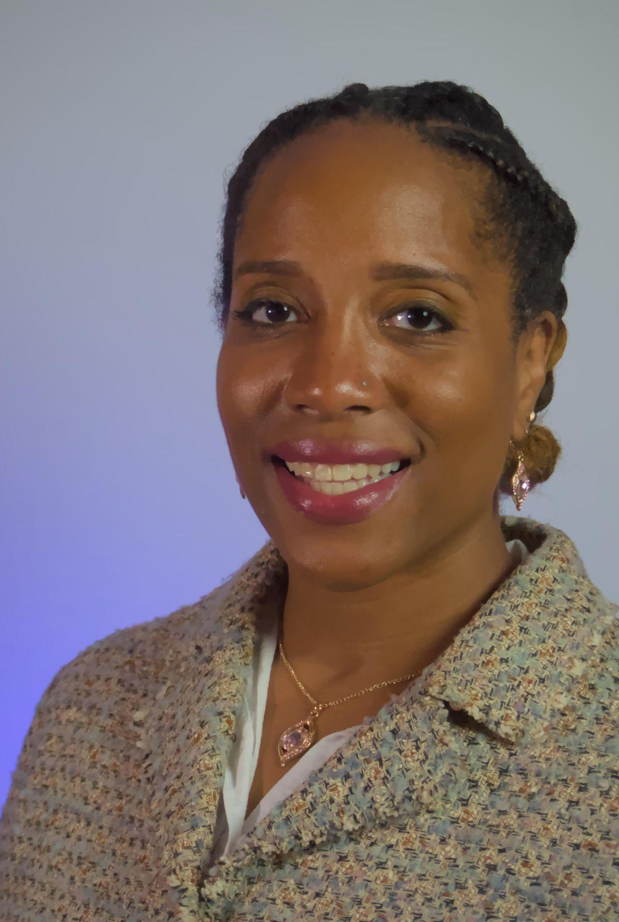
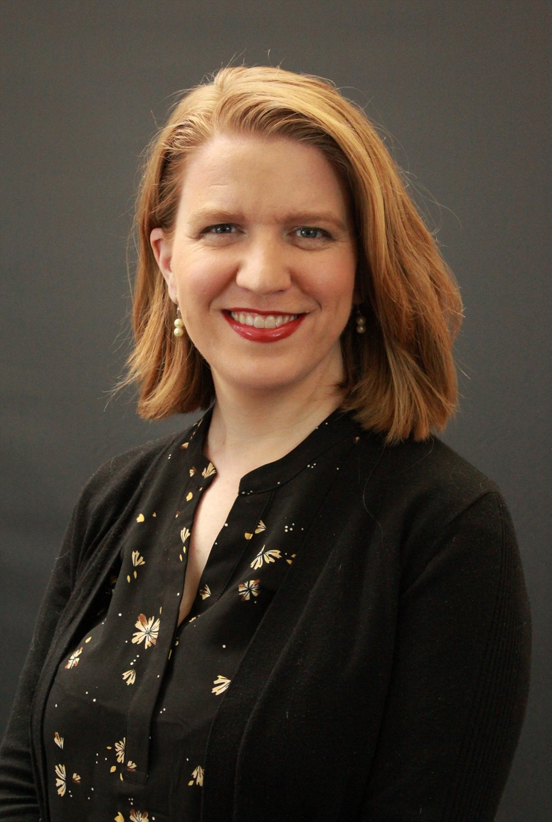
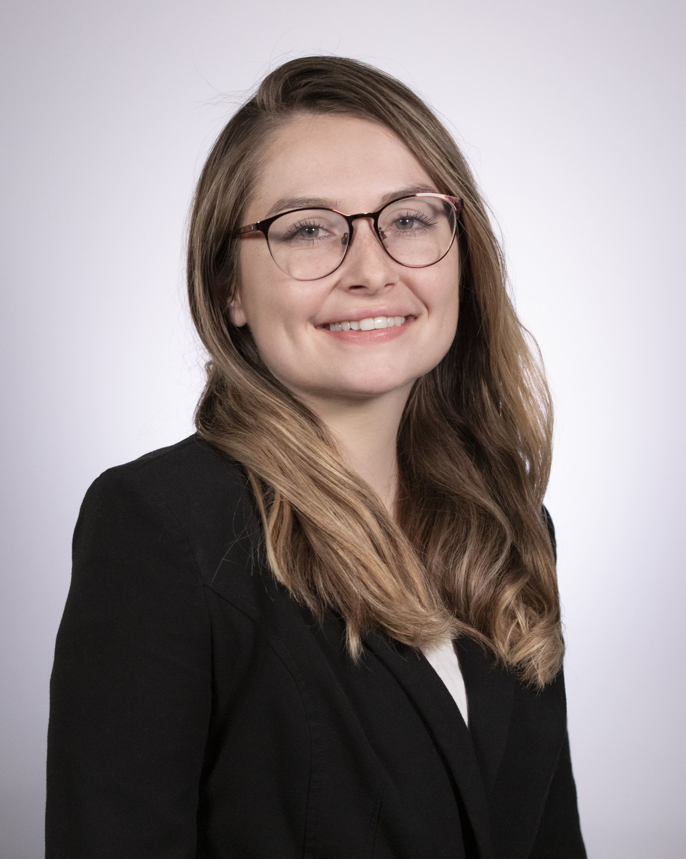
Agenda
Jamia Williams, MLS
Consumer Health Program Specialist
NNLM Training Office
University of Utah
Introductions
The Medical Library Association(MLA)
Consumer Health Information Specialization(CHIS)
Consumer Health for Library Students
Universities Approved to Offer CHIS
Requirements & Steps for Class Approval
Faculty Spotlight: Emily Vardell, MLS, PhD, AHIP
Q & A
Emily Vardell, MLS, PhD, AHIP
Associate Professor
School of Library and Information Management
Emporia State University
Samantha Nunn
Project Manager
NNLM Region 4
University of Utah
Notes:
sam and jamia

Slide 3
The Medical Library Association
The Medical Library Association (MLA) is a global, nonprofit educational organization, with a membership of more than 400 institutions and 3,000 professionals in the health information field. Since 1898, MLA has fostered excellence in the professional practice and leadership of health sciences library and information professionals to enhance health care, education, and research throughout the world. MLA educates health information professionals, supports health information research, promotes access to the world’s health sciences information, and works to ensure that the best health information is available to all.
Visit MLA’s Website

Slide 4
What is CHIS?
Consumer Health Information Specialization is a way that librarians, other information, and health professionals to acquire skills and knowledge needed to become a confident, expert provider of health information to your community. Your CHIS shows employers, colleagues, and the public you serve that you are committed to offering quality consumer health information services and to staying current with developments in consumer health information resources, technologies, and services.
For more information about CHIS
Consumer Health Information Specialization (MLA CHIS webpage)
Chart Your Path to CHIS (NNLM CHIS webpage)

Slide 5
Consumer Health for Library Students
In partnership with MLA, NNLM guides LIS/iSchool professors on getting their class approved to offer CHIS certificates to students.
This is a great way for students to learn skills in providing health information services to consumers, and is recognized by their future employers as reliable skills.
Notes:
This is a great way for students to learn skills in providing health information services to consumers, and is recognized by their future employers as reliable skills.
Additionally, this is a great tool to use to recruit more students to register for your class.
Once the course is complete, students can apply for a CHIS Certificate, which usually involves a application fee. But what's great is that NNLM, through their CHIS sponsorship program, can cover the application fees (members: $99, non-members: $129) for the students.

Slide 6
Universities Approved to Offer CHIS
Notes:
All LIS/iSchool Programs from the list of universities were approved to offer a Level 2 CHIS certificate.
We’re currently working with another university on getting their courses approved to offer CHIS.

Slide 7
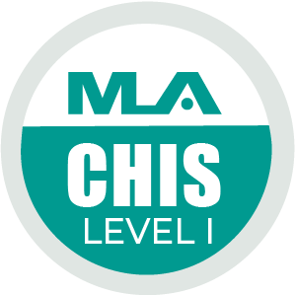
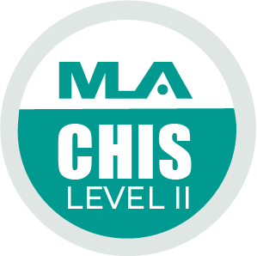
What are the Requirements to Have Your Class MLA-Approved as a Consumer Health Course?
Your course must address one or more of the eight core competencies:
CHIS Competencies
Required for Level 1
C1 - Know the Community
C2 - Know the Health Consumer
C3 - Knowledge of Subject Matter and Resources
C4 - Evaluation of Health Information
C5 - Communication, Reference, and Instruction
Required for Level 2, in addition to Level 1 requirements
C6 - Literacy and Health Literacy
C7 - Technology and Health
C8 - Ethical and Legal Issues
Notes:
Your course must address one or more of the eight core competencies for providing consumer health information services. NNLM and MLA will work with you to ensure that your coursework entails the CHIS competencies listed.
Each level requires 12 MLA CE credit hours of coursework. Before a student can earn a level 2 CHIS certification, they must complete all the competencies for level 1.

Slide 8
Steps 1 & 2 to get course approved by MLA
Step 1: Contact Sam Nunn at NNLM and Jim Westwood from MLA to notify your interest in applying to get your course approved to become an MLA consumer health information course.
Step 2: Email Jim Westwood your course syllabus and a description of how the course covers one or more of the eight CHIS competencies for review.
You are welcome to use the table located on page 3 of the MLA Course Approval Guides to describe which competencies the course covers.
Samantha Nunn
Project Manager
NNLM Region 4
University of Utah
sam.nunn@utah.edu
Jim Westwood
Membership Concierge &
Professional Development
Administrator
jim.westwood@mlahq.org
312-728-3415
Notes:
Step 1: Contact Sam Nunn at NNLM and Jim Westwood from MLA to notify your interest in applying to get your course approved to become an MLA consumer health information course.
Step 2: Email Jim Westwood your course syllabus and a description of how the course covers one or more of the eight CHIS competencies for review.
You are welcome to use the table located on page 3 of the MLA Course Approval Guides to describe which competencies the course covers.

Slide 9
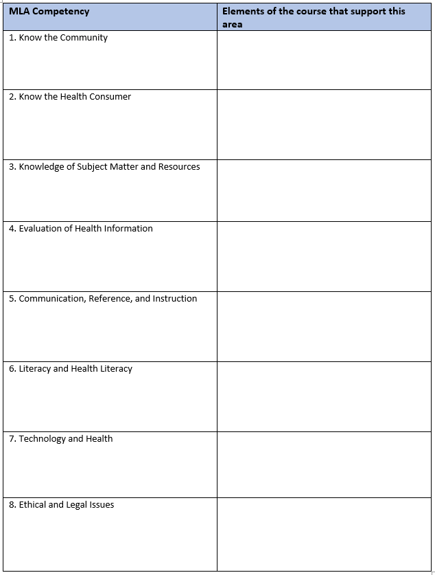
Table Example

Slide 10
Step 3 to get course approved by MLA: The Application
Step 3: Once Jim Westwood verifies that your course aligns with one or more CHIS competencies, go to the MLA application portal to fill out your application.
Note that you do not have to be an MLA member to apply. You will need to have an MLA account to complete the form. Request a free guest account at MLA to get started.
Notes:
Step 3: Once Jim Westwood verifies that your course aligns with one or more CHIS competencies, go to the MLA application portal to fill out your application.
Note that you do not have to be an MLA member to apply. You will need to have an MLA account to complete the form. To request a free guest account, go to www.mlanet.org/r/us/ to get started.

Slide 11
Steps 4 & 5 to get course approved by MLA
Step 4: Throughout the process, please keep in touch with Jim and Sam on the status of your application. If you have any questions about the required information, please contact Jim Westwood or Sam Nunn for assistance.
Step 5: Once you've submitted the form, notify Jim Westwood and Sam Nunn of your completion. MLA will review your application, and a representative will contact you about your submission.
Notes:
Step 4: Throughout the process, please keep in touch with Jim and Sam on the status of your application. If you have any questions about the required information, please contact Jim Westwood or Sam Nunn for assistance.
Step 5: Once you've submitted the form, notify Jim Westwood and Sam Nunn of your completion. MLA will review your application, and a representative will contact you about your submission.

Slide 12
Items to keep in mind as you fill out the form: NNLM Course
When choosing the submission type, select “NLM and NNLM Courses Only”, This selection helps MLA identify if you are participating in the Consumer Health for Library Students Program.
Notes:
When choosing the submission type, select “NLM and NNLM Courses Only”, This selection helps MLA identify if you are participating in the Consumer Health for Library Students Program.

Slide 13
Items to keep in mind as you fill out the form: CE Credits
When you have reached the “MLA CE Credits” section of the form, it will ask you to indicate how many MLA CE hours you seek approval. The CE hours can be determined by the number of hours of in-person work done in the class.
One hour of in-person work is equivalent to one CE credit.
Notes:
When you have reached the “MLA CE Credits” section of the form, it will ask you to indicate how many MLA CE hours you seek approval. The CE hours can be determined by the number of hours of in-person work done in the class.
One hour of in-person work is equivalent to one CE credit.

Slide 14
Items to keep in mind as you fill out the form: Approval Term
When you have reached the term approval section, it will ask you to indicate how long you would like your course to be eligible for MLA CE. Click the drop-down button and choose "3 years". The program offers to cover all the fees related to having your course offer MLA CE credit for up to 3 years.

Slide 15
Items to keep in mind once class is approved: Scheduling
If you are planning to teach your class again, you will need to fill out the “Schedule a Course on the MEDLIB-ED" form to schedule the course on MEDLIB-ED before the semester begins.
This form notifies MLA that you are teaching the class again. They will generate a new code for you to give to your future students to claim credit after completing the course.
If you don’t want your class listed on MEDLIB-ED, you can notify MLA to remove your class from the list.
Notes:
If you are planning to teach your class again, you will need to fill out the “Schedule a Course on the MEDLIB-ED" form to schedule the course on MEDLIB-ED before the semester begins.
This form notifies MLA that you are teaching the class again. They will generate a new code for you to give to your future students to claim credit after completing the course.
If you don’t want your class listed on MEDLIB-ED, you can notify MLA to remove your class from the list. Some universities like having their class promoted on the MEDLIB-ED. While others prefer to have it not listed.

Slide 16
Emily Vardell, MLS, PhD, AHIP (she/her)
Dr. Vardell is the associate professor in the School of Library and Information Management at Emporia State University.
She teaches courses on the foundations of library science, reference, research methods, and the CHIS certified course health sciences librarianship.
Her research interests focus broadly on information behavior, including health insurance literacy and infertility information practices. She also studies library science education best practices and trends.
Notes:
Sam

Slide 17
Getting Your Course Approved
Instructor Information
Course Description
Audience
Learning Outcomes
Instructional Methods
Participant Engagement
MLA Competencies
Specialization
Visit MLA’s CHIS page to start the process!

Slide 18
Course Outline → Syllabus
CHIS Competencies
Level 1
Know the Community
Know the Health Consumer
Knowledge of Subject Matter and Existing Resources
Health Information Evaluation
Communication and Instruction
Level 2
Literacy and Health Literacy
Technology and Health
Ethical and Legal Issues
Syllabus
History of Consumer and Patient Health Librarianship and Health Information Literacy
Evaluating Consumer- and Patient-Friendly Technology Resources and Consumer Health Reference Service
Ethical Issues in Providing Consumer and Patient Health Information
Outreach and Community Engagement
Health Programming
Health Disparities/Cultural Humility
Where to Start? Needs Assessment
Health Insurance Information Needs
Social Media for Health Consumers and Patients
Marketing Health Library Services
Graphic Medicine
Prized Assets/Strategic Partnerships
Costs, Budgeting, and Funding

Slide 19
Course Outline → Syllabus
CHIS Competencies
Syllabus
Level 1
Know the Community
Know the Health Consumer
Knowledge of Subject Matter and Existing Resources
Health Information Evaluation
Communication and Instruction
Level 2
Literacy and Health Literacy
Technology and Health
Ethical and Legal Issues
History of Consumer and Patient Health Librarianship and Health Information Literacy
Evaluating Consumer- and Patient-Friendly Technology Resources and Consumer Health Reference Service
Ethical Issues in Providing Consumer and Patient Health Information
Outreach and Community Engagement
Health Programming
Health Disparities/Cultural Humility
Where to Start? Needs Assessment
Health Insurance Information Needs
Social Media for Health Consumers and Patients
Marketing Health Library Services
Graphic Medicine
Prized Assets/Strategic Partnerships
Costs, Budgeting, and Funding

Slide 20
MLA as a Collaborator
Here are instructions so your students taking "Health Sciences Librarianship” can earn CHIS Level 2. The instructions below will guide them to:
Create a free guest account on MLANET
Claim credit for the course in MEDLIB-ED
Request NNLM sponsorship of the CHIS application fee
Complete the CHIS online application

Slide 21
Knowing Your Audience
Anyone can take this class, not just the library students
There is a need for more training on consumer health information resources and health literacy
People want to take this classes, they just need to know about it
Promoting that you don’t need to be a medical librarian to get the CHIS certificate

Slide 22
Benefits
Two courses approved for CHIS II
One course approved for DIS
Added value for students!
“This is so great, thank you so much! I really appreciate your advocacy.”

Slide 23
Launching a New Program
Offering this course with CHIS certification
helped Emporia State University launch its
Health Information Professionals Concentration and Health Information Professionals Certificate

Slide 24
Grateful Students
“This has been my favorite course in my MLS program so far. I gained knowledge of resources I can use in the field, and really appreciate Dr. Vardell arranging for the course to count towards CHIS certification through MLA.”

Slide 25
CHIS Skills in Action: Testimonial
“I just wanted to share something that happened to me today that I was better prepared for because of your classes. I had a patron coming in looking for a book on schizophrenia. She needed more information on the basis of the diagnosis. However; all of our books were more of biographies or of medical advancements in treating it. I was able to direct her to MedlinePlus and show her how to do a basic search in order for her to find the information she was needing. It was the highlight of my day being able to help someone with a medical reference question, and I just wanted to share.”

Slide 26
CHIS Skills in Action: Level 2
“I just wanted to let you know that I got my Level II CHIS certification! Thanks for a great a class. :)
On a personal note, I also wanted to let you know that I was able to use the skills I learned in class to convince my sister to get vaccinated! I will be forever grateful I took this class if for no other reason than that.”

Slide 27
Questions?
Notes:
sam and jamia

Slide 28
Contact Information
Jamia Williams, MLS
Consumer Health Program Specialist
NNLM Training Office
University of Utah
jamia.williams@utah.edu
Emily Vardell, MLS, PhD, AHIP
Associate Professor
School of Library and Information Management
Emporia State University
evardell@emporia.edu
Samantha Nunn
Project Manager
NNLM Region 4
University of Utah
sam.nunn@utah.edu
Notes:
sam and jamia

