Slide 1
Discovering Library Science & Health Literacy: A High School Push-in Program
Terrie R. Wheeler, Diana Delgado, Sarah T. Jewell, Michael A. Wood, Andy Hickner, Jessica Boyle
06-18-2025

Slide 2
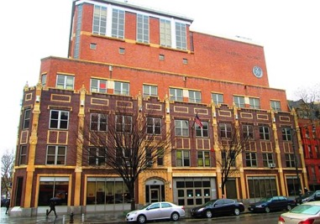
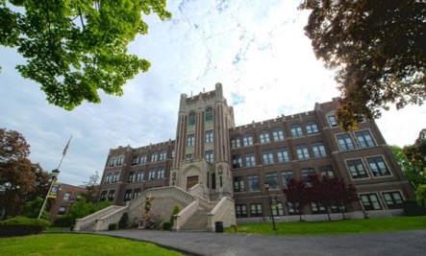
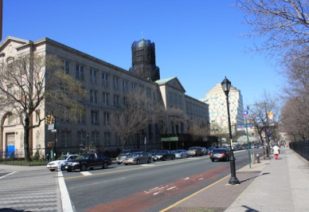
Introduction
Funded by IMLS Grant RE-254913-OLS-23
Community Health Ambassador Program (CHAmP) Curriculum
Partners: WCM Wood Librarians, Mentoring in Medicine, Advisory Board
High Schools:
Thurgood Marshall
Academy, Harlem, NY
Knowledge and Power Preparatory Academy (KAPPA) International High School, Bronx, NY
Mount Saint Michael Academy, Bronx NY

Slide 3
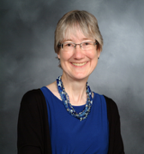
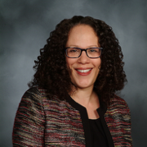
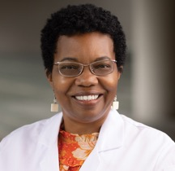
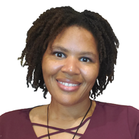
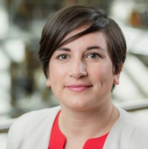
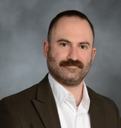
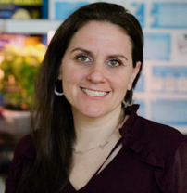
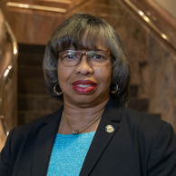
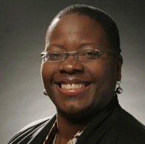
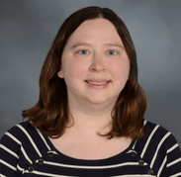
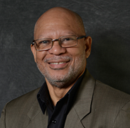
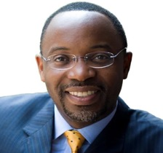
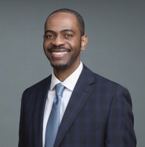
Partners
WCM Wood Medical Librarians
Mentoring in Medicine Team
IMLS Grant Advisory Board
Terrie Wheeler Diana Delgado Andy Hickner Sarah Jewell Michael Wood
Lynne Holden, MD Andrew Morrison Jessica Boyle
Kawanna Bright, PhD
Pamela Espinosa de los Monteros
Sandra Franklin
Shannon Jones, EdD
Barnaby Nicolas

Slide 4
Process over Two Years (2023 – 2025)
Modules and Learning objectives
Curriculum and Activities
Exemplar
Rubric
Teach
Student Feedback
Revise Curriculum Modules and Activities, Rubric, Exemplar
Student Engagement
Student Feedback
Teach
ToolKit
Train the Trainer
ToolKit: https://med.cornell.libguides.com/champ/home

Slide 5
Objective 1: Examine Best Practices for Student Engagement and Why They Work

Slide 6
Best Practices for Student Engagement used in this Curriculum
Task based learning woven through learning objectives to deliver content
Learning target and Rubric in student friendly language
Relevant content reflected in students' lives
Student choice based on interest
You were hired by (insert celebrity) as a medical librarian to clear up misinformation present in social media about their recent diagnosis. Your task is to create a media presentation informing the community about the actual disease and decrease the stigma by spotting misleading information about this disease!
You will design components of your presentation campaign throughout the unit and create a polished overall product that showcases your learning. You will present your presentation to a panel of judges (peers).
The top two groups who have the most compelling presentation with accurate reliable health information that also decreases stigma about the disease will win the health media campaign and prize!

Slide 7
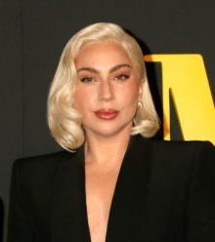
Why these best practices work
Students see relevance where they can make connections to their own lives and learnings increasing engagement.
By using student friendly learning targets, rubrics and exemplars students understand expectations and have the scaffolds necessary to meet the expectations.
Decrease lecture based teaching to less than five-ten minutes per module.
Each module had a learning objective that was assessed at the end of the class period/module and grounded in the task.
Students received actionable feedback and class time to implement feedback for their final task.
Lady Gaga Fibromyalgia

Slide 8
Objective 2: Identify various activities and methods used to increase engagement and promote student-led learning.

Slide 9
Sample of Activities and Methods used throughout the curriculum to increase engagement and student led learning
Jigsaw Activity to learn about library professions (how students taught each other about various library professions).
High interest games/activities-"Guess My Salary", writing questions for different real world librarians to answer.
Four Corners activity to increase movement and access prior knowledge and discussion
Flexible Grouping based on activity
Daily chunked tasks with actionable feedback. (ex. Disease research during research module, correct citations during citations module)
Students become experts on one library profession
Students check expert answers with a key and prepare for round two
Students teach each other about their assigned profession in small groups

Slide 10
Objective 3: Provide an overview of a freely available curriculum that can be used to increase high school students' awareness of the library profession and teach essential health literacy skills

Slide 11
Module 0 Introduction to the Curriculum

Slide 12
Module 0: Pre-test
Which statement best defines misinformation?
False or misleading information that is spread unintentionally
False information that is spread intentionally
Information that aligns with personal beliefs and opinions
Facts and data obtained from social media platforms
Librarians work in many fields. The role of a health sciences librarian is to?
Provide medical advice to patients
Work with doctors to find reliable sources of information
Provide medical advice to doctors
Write articles on accurate procedures in the health field

Slide 13
Module 0: Grading Rubric
Domain | Above Standard (4) | Meets Standard (3) | Approaches Standard (2) | Below Standard (1)
Misinformation in popular media | Social media post or popular information is displayed and all indications of potential misinformation about the disease are clearly identified. If no misinformation is found, claims are supported by other sources cited. | Most of the indications of potential misinformation are identified (1 is missing), or a claim is properly identified as correct, but a source to verify the information is missing. | Social media post or popular information is misidentified as either misinformation or accurate information. At least one evaluation of a claim or one indication of misinformation is present. | Social media post or popular information is missing, and no evaluation of the post is included in the project.
Disease Content Knowledge | Thorough explanation of the disease, cause, symptoms, treatments, and how common it is. | Correct explanation of the disease, cause, symptoms, treatments, and how common it is. | The explanation of the disease, cause, symptoms, treatments, and how common it is may be missing some components or be inaccurate | The explanation of the disease, cause, symptoms, treatments, and how common it is missing most components or is inaccurate
Evaluate a source using SIFT | Identifies relevant details about the credibility &/or point of view of the source; locates and cites a source that supports or refutes the claim; identifies the original source of the claim and how it was located | Addresses at least 2 of the criteria in “Above Standard” | Addresses at least 1 of the criteria in “Above Standard” | Addresses none of the criteria in “Above Standard”
Citations & References in APA Format | Correctly cites all references in APA format. All references are correctly identified as scholarly or popular. At least 4 references are present | Minimal errors in references are present but do not detract from the ability to locate the source (for example, misuse of periods, commas, and indentations). Correctly identifies most resources as a scholarly or a popular resource. At least 3 references are present | Errors are apparent and detract from the ability to locate the source (for example missing title, year of publication, and author). Correctly identifies some resources as a scholarly or a popular resource. Citations and references are present but do not follow APA style. | References are missing. Quotations, paraphrases, and summaries are not cited. Does not correctly identify any resources as a scholarly or a popular resource.
Presentation | Meets all the following criteria: Complete coverage of the topic Accuracy Organization Correct written English Includes images Visually appealing Polished verbal presentation | Problems with 1-2 of the criteria | Problems with 3-4 of the criteria | Problems with 5 or more of the criteria

Slide 14
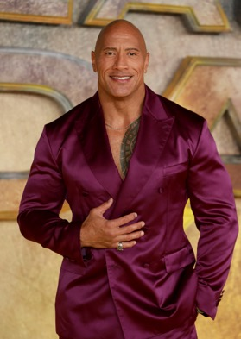
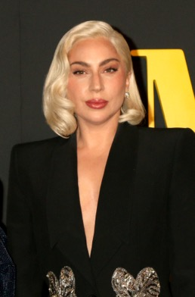
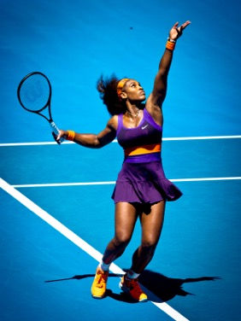
Module 0: Performance Task
You were hired by (insert celebrity) as a medical librarian to clear up misinformation present in social media about their recent diagnosis. Your task is to create a media presentation informing the community about the actual disease and decrease the stigma by spotting misleading information about this disease!
You will design components of your presentation campaign throughout the unit and create a polished overall product that showcases your learning. You will present your presentation to a panel of judges (peers).
The top two groups who have the most compelling presentation with accurate reliable health information that also decreases stigma about the disease will win the health media campaign and prize!
The Rock
Depression
Lady Gaga Fibromyalgia
Serena Williams
Blood Clots

Slide 15
Module 1
Credible Information and Disease Research

Slide 16
MedlinePlus
Module 1: Finding Credible Information for Your Disease Research
Students discussed their sources for credible information and why
Introduced MedlinePlus and explained that it provided UNBIASED information
Public service, funded by YOU
Maintained by the National Library of Medicine (NLM)
Provides unbiased information
Your first step for fact-checking health information
Info in both English and Spanish
Easy to understand - no scientific jargon
https://medlineplus.gov

Slide 17
Module 1: Finding Credible Information for Your Disease Research (Cont'd)
Reviewed exemplar
of final project and
Rubric (shown here)
2. Students coached on
how to locate celebrity
disease info in
Medline Plus
Above Standard | Meets Standard | Approaches Standard | Below Standard
Thorough explanation of the disease, cause, symptoms, treatments, and how common it is. | Correct explanation of the disease, cause, symptoms, treatments, and how common it is. | The explanation of the disease, cause, symptoms, treatments, and how common it is may be missing some components or be inaccurate | The explanation of the disease, cause, symptoms, treatments, and how common it is missing most components or is inaccurate

Slide 18
Module 2
Career Introduction

Slide 19
Module 2: Career Introduction
Do now in pairs -
Guess my salary
Identify the most important thing a librarian does a day
Research types of librarianship in groups (Jigsaw method)
Small group share out
Ask a librarian: come up with a list of student questions to be answered by working librarians

Slide 20
Module 2: Career Exploration Activity
Directions:
Step 1- With your group complete the following expert worksheet
Step 2- Check your work with each other and the key
Medical
School
Library Director
Helpful Link: Here
School Librarian Helpful Link: Here
College Librarian Helpful Link: Here
College
Systems Librarian
Public

Slide 21
Module 3
Find and Identify Credible Health Information

Slide 22
Module 3: Find and identify credible health information
Learning Objectives:
Define credibility in the context of health information
Evaluate the credibility of a source
Locate health information from a credible source (e.g. MedlinePlus)
Students discussed these terms
Credibility
Believable/
trustworthy
Bias
Prejudiced in favor of/against something or someone
What makes health information credible?
Unbiased
Fact Based
Pseudoscience
Pretends to be scientific - but isn’t

Slide 23
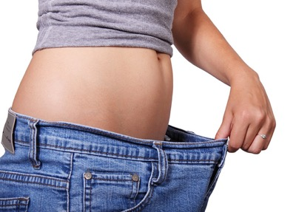
Module 3: Find and identify credible health information (Cont'd)
We discussed credibility in the context of diets
We used an exercise to evaluate a fad diet using MedlinePlus and Wikipedia
Fad Diets
A fad diet is a diet that is popular, generally only for a short time, similar to fads in fashion, without being a standard scientific dietary recommendation, and often making unreasonable claims for fast weight loss or health improvements; as such it is often considered a type of pseudoscientific diet.^{[1][2][3][4][5]} Fad diets are usually not supported by clinical research and their health recommendations are not peer-reviewed, thus they often make unsubstantiated statements about health and disease.^{[3]}
Wikipedia contributors. (2024, July 12). Fad diet. In Wikipedia, The Free Encyclopedia. Retrieved 19:14, July 18, 2024, from https://en.wikipedia.org/w/index.php?title=Fad_diet&oldid=1234032245
https://commons.wikimedia.org/wiki/File:Young_woman_wearing_loose_jeans.jpg
Petr Kratochvil, CC0, via Wikimedia Commons

Slide 24
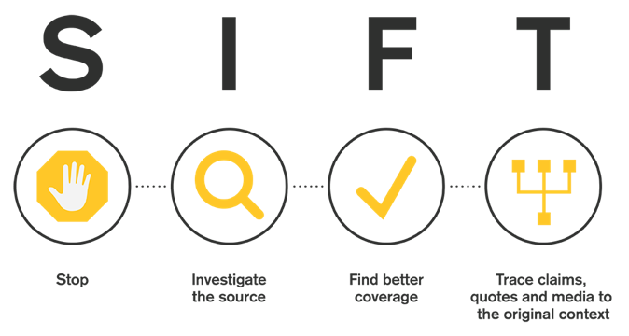
Module 3: The SIFT framework
We introduced the SIFT framework and explained how to use it to evaluate a fad diet
S = Stop
I = Investigate the source
F = find better coverage
T = Trace claims, quotes and media to the original context
Caulfield, Mike (2019, June 19). SIFT (The Four Moves). Hapgood. https://hapgood.us/2019/06/19/sift-the-four-moves/

Slide 25
S = Stop
Before digging further, students gave their overall impressions of the website based on headlines, graphics and layout. They asked:
1. what was the emotional appeal?
2. What stood out to them?
3. What was the site domain?
4. Did they notice anything unusual?

Slide 26
I = Investigate the source
Here students looked up the author of the site or content They asked:
1. who was the site author?
2. What were his credentials?
3. Does his training make him an expert on nutrition?
4. What is the purpose of the site?
5. Where did links in the site lead?

Slide 27
F = Find better coverage
Next the students looked for corroborating information on trusted sites, like Medline Plus and Wikipedia. They asked:
1. How does Medline Plus describe a healthy diet? Does this align with the Carnivore Diet?
2. Could they corroborate the claims of the Carnivore Diet elsewhere?
3. What does Wikipedia say about the Carnivore Diet?

Slide 28
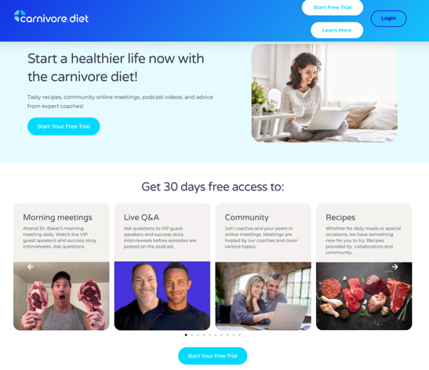
T = Trace claims, quotes, links to the original context
Students traced Carnivore Diet links to learn the cost of participation (shown here). They also traced the diet's history and health concerns on Wikipedia They asked:
1. How does this diet's history and health concerns square with the website's claims about this diet?
2. Is there scientific evidence that this diet worked?
3. Are there any sites outside of this one that support this site's claims?

Slide 29
Module 4
Health Literacy and Misinformation

Slide 30
Module 4: Complexity in Evaluating Information
Do Now
Learning Objectives
Define health literacy, misinformation, and disinformation
Identify misinformation/disinformation by recognizing red flags
Evaluate a social media post about your celebrity’s disease
Students practice asking questions for their doctors.
Four Corners Exercise
If a medical doctor publishes something in a research article, it must be true.
This exercise helps students understand the complexity in evaluating information.
Talk to students about their reasoning
The answer depends on context
Strongly disagree | Strongly agree
Slightly disagree | Slightly agree

Slide 31
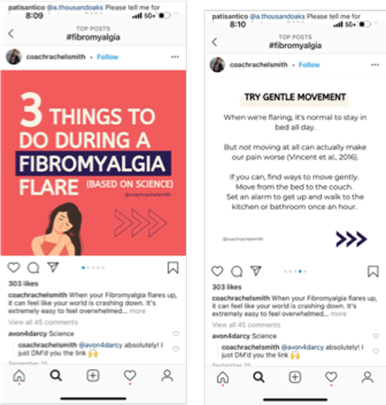
Module 4: Evaluating a Social Media Post
“Coach” Rachel Smith is selling services
When I look up the cited article, the article I find does not make the same claims
Also, I don’t know her credentials
#False - I wouldn’t share this post!
Recommended preparation:
Provide social media posts so you have examples for each project topic, and provide images and URLs (social media access may be blocked in schools)
Try to provide both "good" and "bad" examples of informational posts

Slide 32
Module 5
Differentiating Scholarly from Popular Literature & Citing Sources

Slide 33
Module 5 - Scholarly Vs. Popular & Citing
Differentiate between scholarly literature and popular literature
Define plagiarism
State when a citation is necessary
Explain the purpose of a proper citation
Correctly cite sources using APA style for project

Slide 34
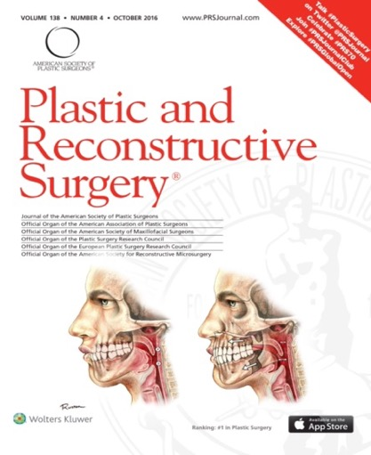
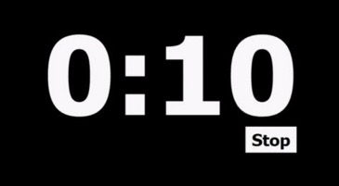
Module 5: Activity
Scholarly
or
Popular
University of Wisconsin School of Medicine and Public Health. (2019, March 11). From sketchbook to scalpel: The medical illustrations of dr. Ruston Sanchez. Department of Surgery. https://www.surgery.wisc.edu/2019/03/07/from-sketchbook-to-scalpel-the-medical-illustrations-of-dr-ruston-sanchez/ ​
​
Notes:
Wrong citation - Tool Kit slides must be fixed

Slide 35
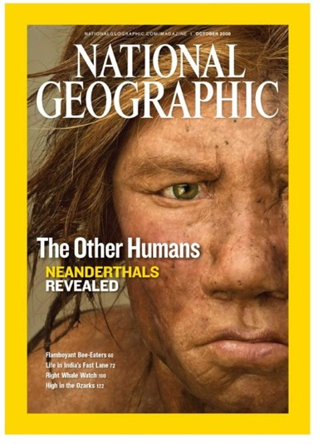
Module 5: Activity (example 2)
Scholarly
or
Popular
National Geographic Magazine: 50 Years of covers. National Geographic. (2021, May 3). https://www.nationalgeographic.com/magazine/article/national-geographic-magazine-50-years-of-covers

Slide 36
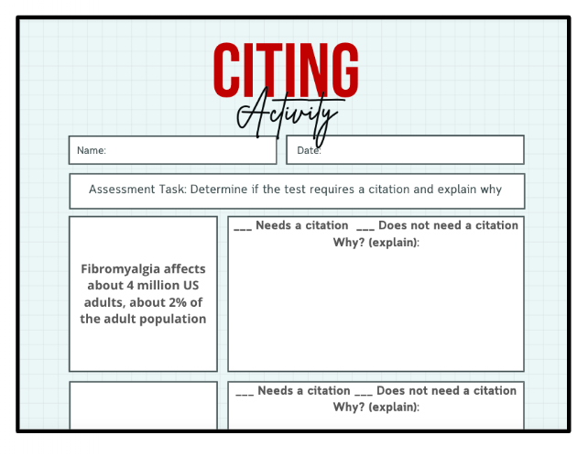
Module 5: Citing Activity
Fibromyalgia affects about 4 million US adults, about 2% of the adult population.
Needs a citation
or
Does not need a citation

Slide 37
Module 5: Activity – does this need a citation?
Fibromyalgia is arguably the least understood disease.
Needs a citation
or
Does not need a citation

Slide 38
Wrap-up: Focus group evaluations, student presentations, and the toolkit

Slide 39
Wrap Up: Feedback from Students (Student Quotes)
"I had no clue that it requires a masters.”
"What I learned was learning in-depth about health librarian. Cuz at first I was like, “What is that? Is it just like a normal librarian?” So I got to learn more about the differences in the career and how much work they actually go through, which is a lot, especially in the research process."
"I liked the curriculum, it was cool. A lot of informational stuff. My favorite part was the activities we did, the in-class activities were pretty fun."
"I enjoyed the final project because like she said it was easy to research, cuz they taught us how to see if it’s scholarly or popular or if it comes from a good site, so it was pretty easy to do the project."
“What I liked about the curriculum was we got to pick our medical condition, it wasn’t forced on us. I got to learn about Billie Eilish, I never knew about synesthesia either.”
"I learnt about spreading false information. It is very fascinating how people are just gonna take what you say without really looking into it.”
Notes:
The perspectives and contributions of the high school students from underrepresented backgrounds are critically important to the success of this program. To gather these perspectives, students engaged in focus groups before being introduced to the curriculum and after the curriculum was delivered.
Based on Student feedback we learned that students enjoyed the project and felt like they learned something from it.
Students learned the importance of, and how, to evaluate the credibility of information sources and that librarianship required a graduate degree, and librarians work in a wide range of fields.

Slide 40
Wrap Up: Feedback from Students (More Student Quotes)
It was really fun how we got to work together to create the slides. My group researched epilepsy with Lil’ Wayne. He was diagnosed with epilepsy and our claim was how – do you know what sizurp is? It’s popular with rappers and singers to do it, and it’s like drugs. It’s like Lean mixed with stuff. We did research on whether that was one of the factors that led to his seizures. It turns out that according to the National Library of Medicine it can lead to seizures as well as fatality. In a study it led to death in a lot of people, like over 50%.
It was time-consuming, not really hard, it just took a lot of time to make sure you were doing it right. But it also helped us learn how much effort and dedication the health librarians put into their work. So that also helped with us learning.
I would say it is a good experience and I definitely learned about what it takes to be a health librarian, what you need to become a health librarian, the different types, and how important the job was.
My overall experience with this topic was really well. I learned a lot of things, like how to tell a website was scholarly or popular. And I learned a lot more about illnesses and stuff, and bipolar disorder, how even though it changes your mood, people can still live their life the same way. I learned how to tell whether a quote is biased or unbiased. I learned a lot about what a health librarian does, and you know, their job and how they help doctors.
Notes:
The perspectives and contributions of the high school students from underrepresented backgrounds are critically important to the success of this program. To gather these perspectives, students engaged in focus groups before being introduced to the curriculum and after the curriculum was delivered.
Based on Student feedback we learned that students enjoyed the project and felt like they learned something from it.
Students learned the importance of, and how, to evaluate the credibility of information sources and that librarianship required a graduate degree, and librarians work in a wide range of fields.

Slide 41
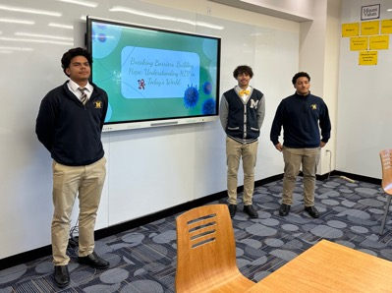
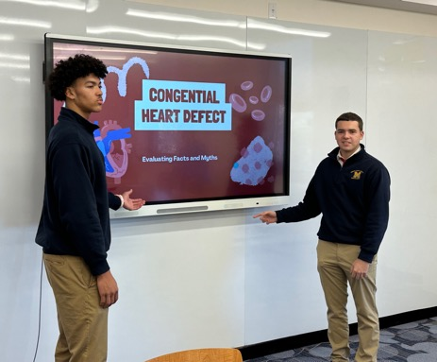
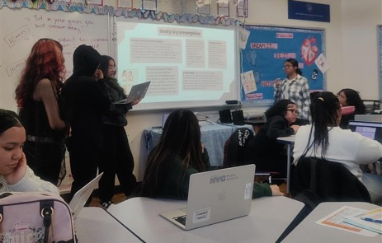
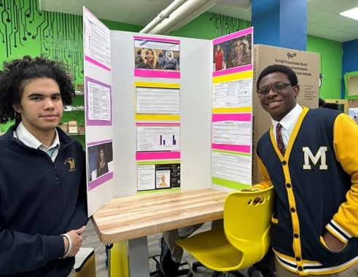
Wrap Up: Student Project Presentations
ToolKit: https://med.cornell.libguides.com/champ/home

Slide 42
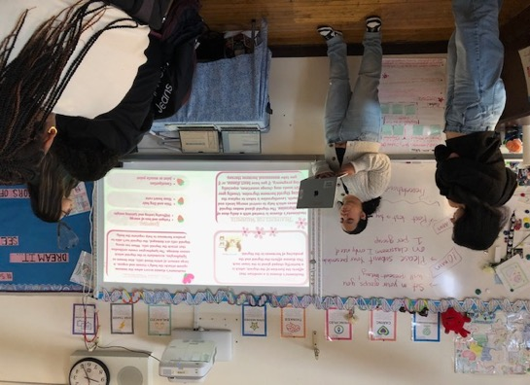
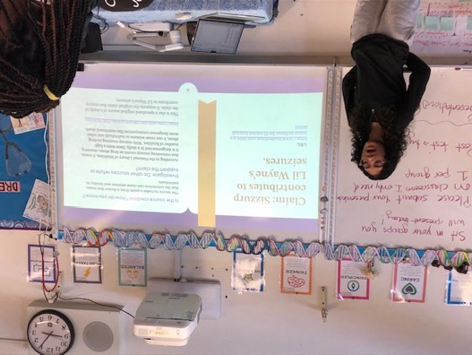
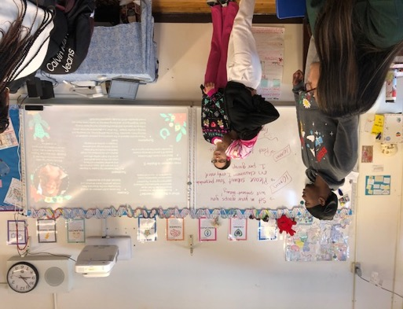
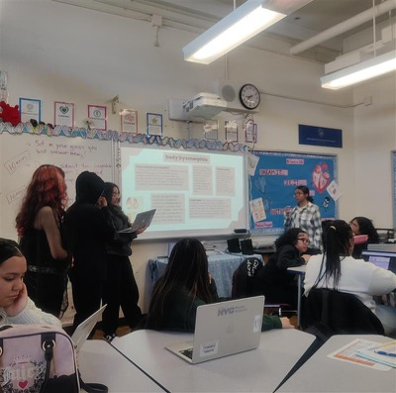
Student Project Presentations
ToolKit: https://med.cornell.libguides.com/champ/home

Slide 43
QR Code for ToolKit
ToolKit: https://med.cornell.libguides.com/champ/home
Notes:
AH: copy https://med.cornell.libguides.com/champ/home and paste it into the chat

Slide 44
This project was made possible in part by the Institute of Museum and Library Services [RE-254913-OLS-23].
Este proyecto ha sido posible en parte por el Instituto de Servicios de Museos y Bibliotecas, [RE-254913-OLS-23].

Slide 45
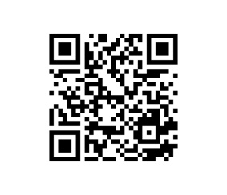
Questions?
Toolkit

Slide 46
Thank you

Slide 47
Closing slide with weill cornell logo

