Slide 1
Clear Communication
Get your point across and improve outcomes

Slide 2
Discussion points from last module
In addition to appropriate health information, what can you do to improve communication with patients?
How can you recommend patients use MedlinePlus when looking for health information at home?
Notes:
NOTE TO FACILITATOR: If you are completing these modules in an order other than suggested in the facilitation guide, you may need to adjust these discussion points.

Slide 3
Objectives
By the end of the program, participants will:
Describe universal precaution for health communication
Apply methods of clear communication

Slide 4
Factors Affecting Health Literacy
Even people who read well and are comfortable using numbers can face health literacy issues when:
They aren’t familiar with medical terms or how their bodies work
They have to interpret statistics and evaluate risks and benefits
They are diagnosed with a serious illness and are scared and confused
They have health conditions that require complicated self-care³
Notes:
Last week we had a good discussion on MedlinePlus and how trusted sources of health information can support efforts to address health literacy. During this session, we will return to our discussion on how our own communication can address health literacy. In an earlier session, we also talked about red flags for recognizing health literacy. While these are helpful reminders for us to address health literacy with our patients who are raising these red flags, there is a need for us to consider how we communicate with all patients regardless of if they are presenting these red flags to us. Why is this important? Well, first, we often don’t have a way to assess health literacy when working with a patient. Second, as you can see here, even people who read well and feel comfortable with numbers may experience issues when they aren’t familiar with certain terms or have to interpret statistics to determine risk and benefit³. They could also have trouble understanding when emotions are involved, such as feeling scared and confused, or could start to struggle when being asked to manage a condition that requires complicated self-care³.
[NOTE TO FACILITATOR: If you are completing these modules in an order other than suggested in the facilitation guide, you may need to adjust this note.]

Slide 5
Universal Precaution for Health Communication
You can’t tell by looking
Use clear communication strategies with everyone
Treat everyone as though they have low health literacy
Notes:
So, really, everyone we treat could be at risk for misunderstanding. How many of you know about Universal Precautions for Clinical Care?
Universal Precautions for clinical care were implemented when medical professionals realized they couldn’t look at someone and tell whether they had an infectious disease. They started using certain safety precautions with everyone with the goal to reduce risk and control infection rates, such as:
Hand washing
Using gowns, gloves, and masks
Handling needles safely
Cleaning the environment and tools¹
Similarly, we have realized that we can’t look at someone and tell whether they are at risk for misunderstanding the information they receive, so the goal is to communicate in ways everyone can understand¹. Screening patients for health literacy hasn’t been proven to be effective, further showing the need for the practice of universal precaution⁷. In addition, studies show that even those who can read at higher levels or have more knowledge of health still prefer simple health information¹.

Slide 6
What is Clear Communication?
According to the Centers for Disease Control and Prevention, “clear communication means using familiar concepts, words, numbers and images presented in ways that make sense to the people who need the information.”³
Notes:
So how do we go about communicating with all of our patients in a way they can understand? There are a lot of ways that health literacy can be addressed through communication, and as we move forward we’ll discuss several of them. The first one - clear communication - is what we’ll spend the rest of today’s time on. According to the Centers for Disease Control and Prevention, clear communication means that a provider uses familiar concepts, words, numbers, and images presented in way that make sense to the people who need the information³. This is similar to the concept of using plain language that was highlighted previously, but it goes a little deeper than just using words that people are familiar with.
[NOTE TO FACILITATOR: If you are completing these modules in an order other than suggested in the facilitation guide, you may need to adjust this note.]

Slide 7
Are you using clear communication?
One study found that while physicians believed communication is important, they overestimated how well they were communicating with patients
During patient interactions, jargon terms were used at a rate of two per minute
While questions were frequently asked during patient encounters, they were not commonly asked in an open-ended manner⁴
Notes:
Clear communication sounds really simple and we’re likely all already striving to do this with patients. No one is intentionally using language that will confuse their patients. But, it’s easy to get busy and forget what a patient may not understand. In one study, physicians were surveyed about clear communication and while they all felt it was important, they tended to overestimate how well they were communicating⁴. For example, when researchers looked at one communication skill, teach back, they found that 48% of physicians reported using it, but only 22% used it during standardized encounters during the study⁴. In addition, this study found that during patient interactions, jargon terms were used at a rate of two per minute, and while doctors in the sample were soliciting questions 94% of the time, only 11% asked these questions in an open-ended way, which is another way to improve patient communication⁴.

Slide 8
Strategies for communicating clearly (1)
Greet patients warmly
Make eye contact
Listen carefully
Slow down
Limit and repeat content
Be specific and concrete¹
Notes:
Luckily, the Agency for Healthcare Research and Quality has a set of strategies for communicating clearly as part of their Universal Precautions Toolkit. You can see some of these here - the list begins with things that are a little easier to do once they become part of a routine, such as greeting patients warmly and making eye contact¹. They also suggest listening carefully to patients in order to use the same words that they use to describe their conditions and slowing down the pace in which you explain things¹. To ensure that they understand, it’s also a good idea to limit the content to 3-5 main points and repeat them more than once during the encounter¹. To ensure that you’re on the same page with the patient, you should also be specific and concrete - this means not using vague terms that can be interpreted in different ways¹. An example of a term that can be interpreted in different ways comes from the AHRQ toolkit, where one practice provided a story of a patient who was told that they could not use a local treatment for her wound¹. She misunderstood and thought the doctor meant that she would have to go out of town to get treatment¹.

Slide 9
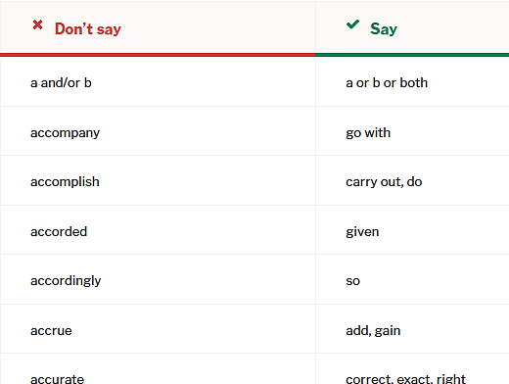
Strategies for communicating clearly (2)
Use plain, non-medical language
Use the patient's words¹
Notes:
The previous example of the local treatment ties to the next recommendation of using plain, non-medical language. We briefly discussed this when talking about plain language. As a review, this means using non-medical words and listening to use the patient’s words to describe their health. The picture you see here is from the website plainlanguage.gov⁵, which offers suggestions on how to shorten certain words to use plain language.
[NOTE TO FACILITATOR: If you are completing these modules in an order other than suggested in the facilitation guide, you may need to adjust this note.]

Slide 10
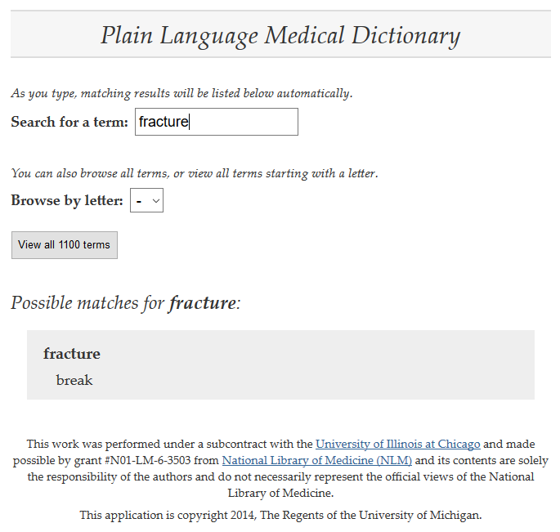
Plain Language Medical Dictionary
Notes:
This is a tool from the University of Michigan library that was developed with funding from the National Library of Medicine⁶. It allows you to type in a medical word and then see what a more patient friendly suggestion might be. Of course, you’re not going to turn to one of these tools mid-conversation, but they can be good to consider if you find yourself regularly using a word that patients don’t understand and can’t think of another way to describe it.

Slide 11
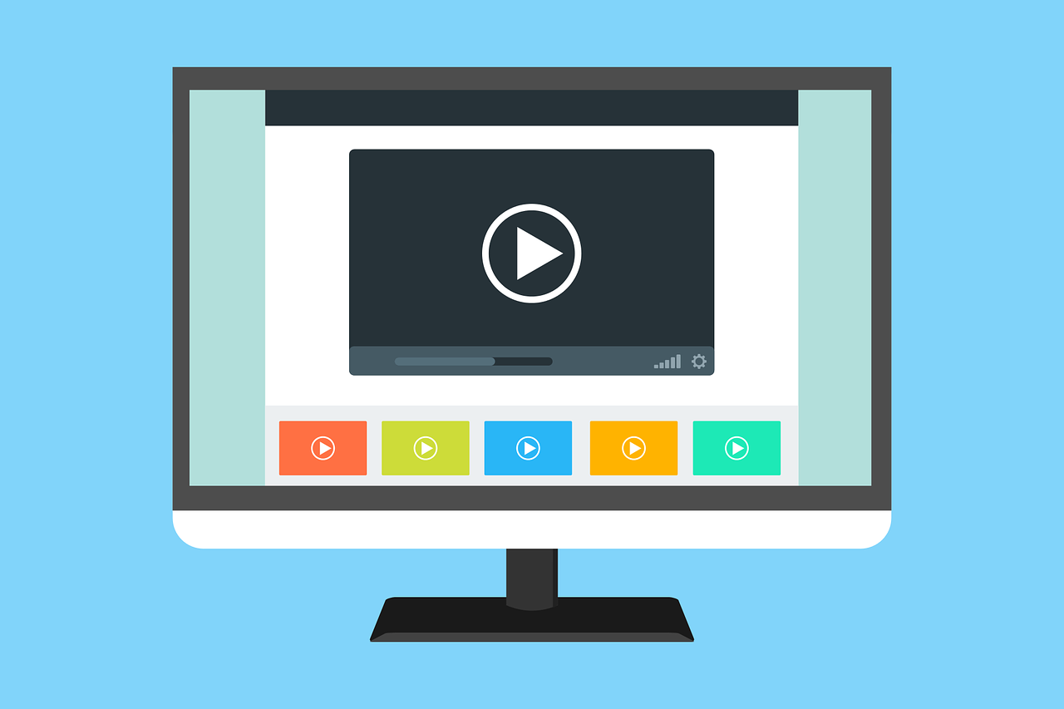
Strategies for communicating clearly (3)
Demonstrate how it's done¹
URL for House MD Video
Notes:
Another way to communicate clearly is to demonstrate how something should be done¹. Let’s take a look at a quick clip from the TV show H.O.U.S.E.
How could this misunderstanding have been avoided if the prescribing doctor had demonstrated how an inhaler should be used?

Slide 12
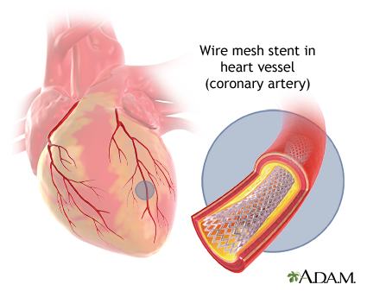
Strategies for communicating clearly (4)
Show graphics¹
Find images using MedlinePlus
Notes:
The last recommendation we’ll discuss today is showing graphics. You may remember from our conversation about MedlinePlus that the videos and images can be helpful for some patient’s understanding. This is reiterated here. Some patients may learn visually and have better understanding after seeing an image. One precaution to take with this recommendation is to be sure images are clear and simple, only demonstrating the primary concept you want the patient to learn¹. This image from MedlinePlus is a good example - it shows a stent and where in the heart it will go without showing lots of other detail.
[NOTE TO FACILITATOR: If you are completing these modules in an order other than suggested in the facilitation guide, you may need to adjust this note.]

Slide 13
Strategies for communicating clearly (5)
Invite patient participation
Encourage questions
Apply teach back¹
These will be covered more during future sessions
Notes:
The last three strategies suggestion for clear communication are listed here: inviting patient participation, encouraging questions and applying teach back¹. These will be discussed as we move forward into other conversations.
[NOTE TO FACILITATOR: If you are completing these modules in an order other than suggested in the facilitation guide, you may need to adjust this note.]

Slide 14
Take home message
Consider:
How can you improve your communication with patients?
Practice:
Practice universal precaution for health communication
Use clear communication strategies with patients
Developed resources reported in this presentation are supported by the National Library of Medicine (NLM), National Institutes of Health (NIH) under cooperative agreement number UG4LM012342 with the University of Pittsburgh, Health Sciences Library System. The content is solely the responsibility of the authors and does not necessarily represent the official views of the National Institutes of Health.
Notes:
As you move forward from today’s conversation, I ask you to consider how you can improve communication with your patients and practice the two strategies that we discussed: universal precaution and clear communication. The more you integrate these communication tools into practice, the more they will feel like second nature. If you already do some of these things, are there ways you can improve or new things you might try?
[NOTE TO FACILITATOR: If you want to complete group discussion immediately following this module content, change the title of this slide to ‘Group Discussion’ and delete the slide with corresponding questions in the next module. If you would like to have discussion take place using your internal LMS system, you can include instructions here for how participants can participate. Then, adjust the slide with the corresponding questions in the next module as needed.]

Slide 15
References
Brega AG, Barnard J, Mabachi NM, Weiss BD, DeWalt DA, Brach C, Cifuentes M, Albright K, West, DR. (2015). AHRQ Health Literacy Universal Precautions Toolkit, Second Edition. (Prepared by Colorado Health Outcomes Program, University of Colorado Anschutz Medical Campus under Contract No. HHSA290200710008, TO#10.) AHRQ Publication No. 15-0023-EF. Rockville, MD. Agency for Healthcare Research and Quality. Retrieved from URL to Source
Broussard, I. & Kahwaji, C. (2019). Universal Precautions. Treasure Island (FL): StatPearls Publishing. Retrieved from: URL to Source
Centers for Disease Control and Prevention (2016). Health Literacy Basics. Retrieved from: URL to source
Howard, T., Jacobson, K. & Kripalani, S. (2013). Doctor Talk: Physicians' Use of Clear Verbal Communication. Journal of Health Communication, 18(8), 991-1001. doi: 10.1080/10810730.2012.757398
Plain Language Action and Information Network (2017). Plain Language Guidelines. Retrieved from: URL to Source
University of Michigan (2015). Plain Language Medical Dictionary. Retrieved from: URL to Source
Hersh, L., Salzman, B. & Snyderman, D. (2015). Health Literacy in Primary Care Practice. American Family Physician, 92(2), 118-124.

