Slide 1
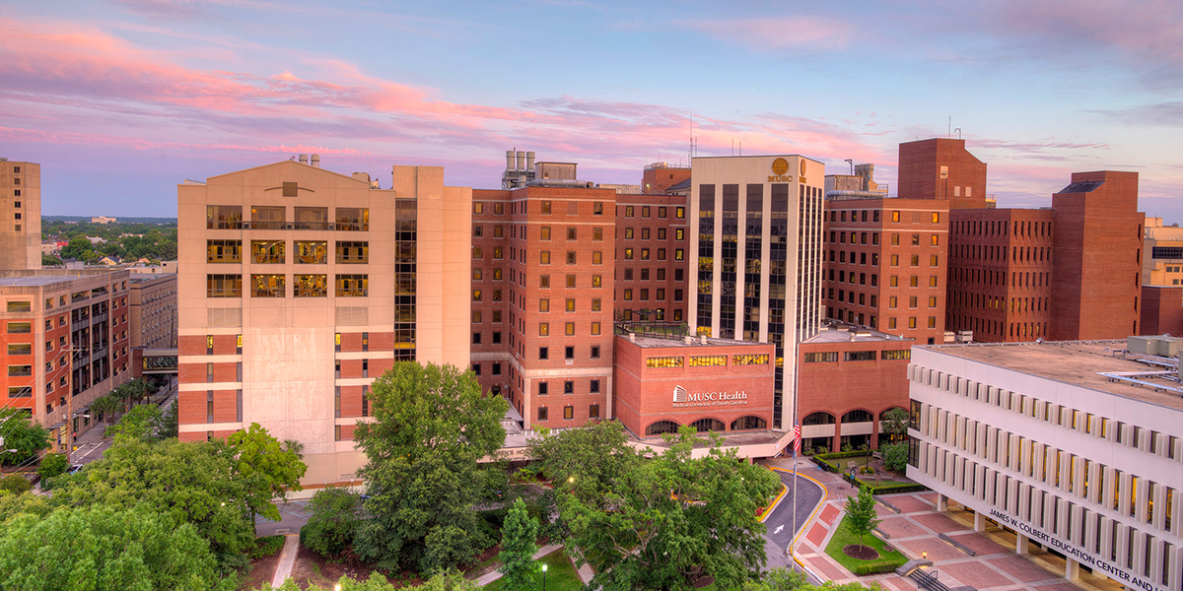
New Member Orientation December 1, 2022
Region2@nnlm.gov| @nnlmregion2
Notes:
Hello and Welcome to the very first…..New Member Orientation -> Webinar – high school feeling
We are happy to have you here
I’ll lead you
We invited new users, member organizations who have signed up in the last 6 months….
Start with an ice breaker, what small thing are you grateful for (Dove soap, birdsong)

Slide 2
Land Acknowledgements
Land acknowledgements are an honest and historically accurate way to recognize native communities of this land. Presenting land acknowledgments recognizes histories that have been systematically erased.
The native peoples of this region include the Etiwan, Kiawah, Santee, Edisto, Nachez-Kusso, and Wassamassaw people.
The Region 2 RML recognizes the native communities of the land on which we live, work and, play in Charleston, SC.
Notes:
Current Land Acknowledgments

Slide 3
Community Agreements
Take care of yourself
No one knows everything/Together we know a lot
Make Space/Take Space
One mic/One voice
Understand the difference between impact and intent
Respect confidentiality
Be curious and respectful
Adapted from GLSEN Guidelines from Respectful GSA Spaces
https://www.glsen.org/activity/guidelines-respectful-gsa-spaces
Notes:
Take care of yourself – Feel free to take breaks and hydrate as you need to.
No one knows everything / Together we know a lot - Listen to understand.
Make Space / Take Space – Be aware of how much you are speaking. If you are speaking a lot, be mindful to make space for those with quieter voices, especially those from marginalized groups.
One mic / One voice - Only one person should speak at a time. Speak from your own experiences. Do not assume other people’s experiences or generalize.
Understand the difference between impact and intent – What you are intending is less important than how it impacts another person.
Respect confidentiality – What we learn here, leaves here…what we say here, stays here.
Be curious and respectful – Be a mindful listener. Do not blame or shame. -

Slide 4
National Library of Medicine
World’s largest biomedical library
NIH
NNLM
Region 2
NLM
National Institutes of Health
Nation’s research agency
27 institutes and offices
Network of the National
Library of Medicine
Program of the NLM comprised of 7 Regional Libraries (RMLs) and 3 offices
Notes:
Let me tell you a bit about the NNLM.
The National Institutes of Health (NIH) is the nation’s leading medical research agency.
The National Library of Medicine (NLM) is the world’s largest biomedical library and maintains a print collection and produces electronic information resources like MedlinePlus and PubMed.
The Network of the National Library of Medicine (NNLM) is an outreach program of NLM.

Slide 5
NNLM Mission
“...To advance the progress of medicine and improve the public’s health by providing all U.S. health professionals with equal access to biomedical information and improving the public's access to information to enable them to make informed decisions about their health.”

Slide 6
NNLM Initiatives 2021 - 2026
Confronting Health Misinformation
Bridging the Digital Divide
Environmental Determinants of Health
Notes:
Throw in the chat if any of your work weaves through one or more of these initiatives?

Slide 7
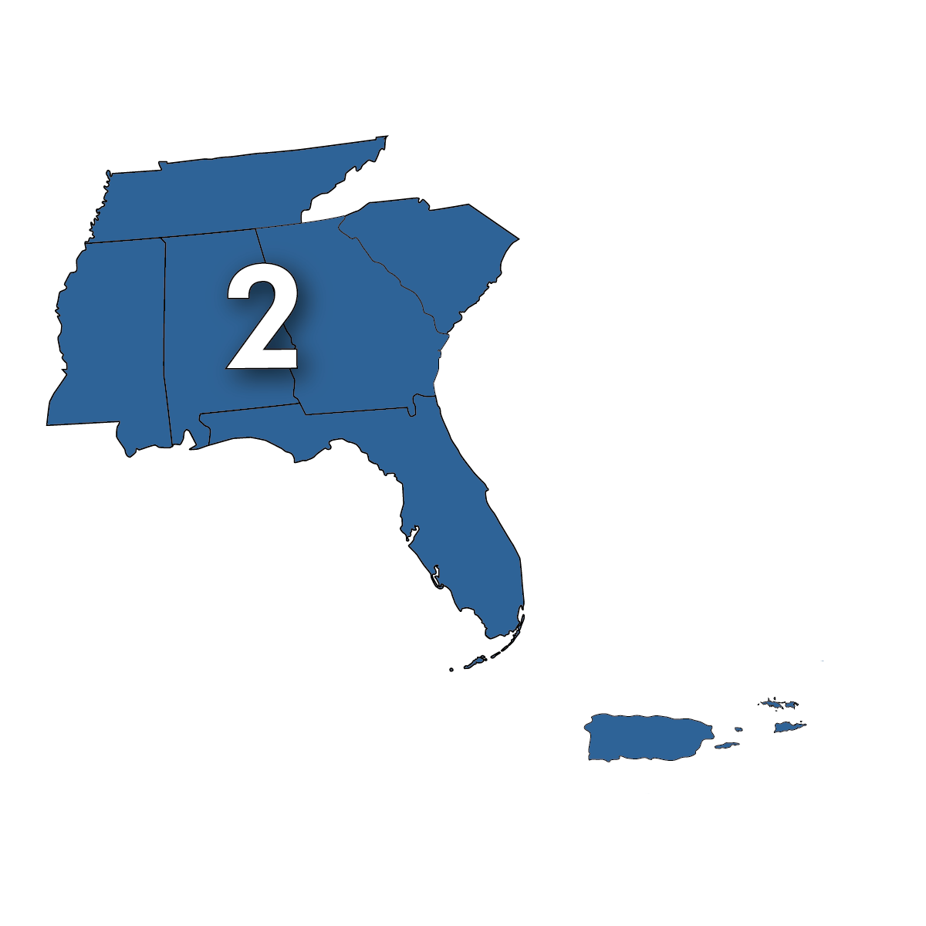
NNLM Region 2 ​
Alabama​ Florida​
Georgia​
Mississippi​
Commonwealth of Puerto Rico​
South Carolina​
Tennessee​
US Virgin Islands

Slide 8
Region 2 Membership Breakdown

Slide 9
Poll #1
Where in Region 2 are you Zooming in from today?
What is your organization type?
Why did you join NNLM this year?

Slide 10
Administrative Team
Earlnesha Lumpkin, MS (she/her) | Program Assistant​
Isaac Chery, MBA, MPM, CRA (he/him) | Grant Administrator and Office Manager US Virgin Islands
Lorin Jackson, MA, MI (she/they) | Executive Director Mississippi & Commonwealth of Puerto Rico

Slide 11
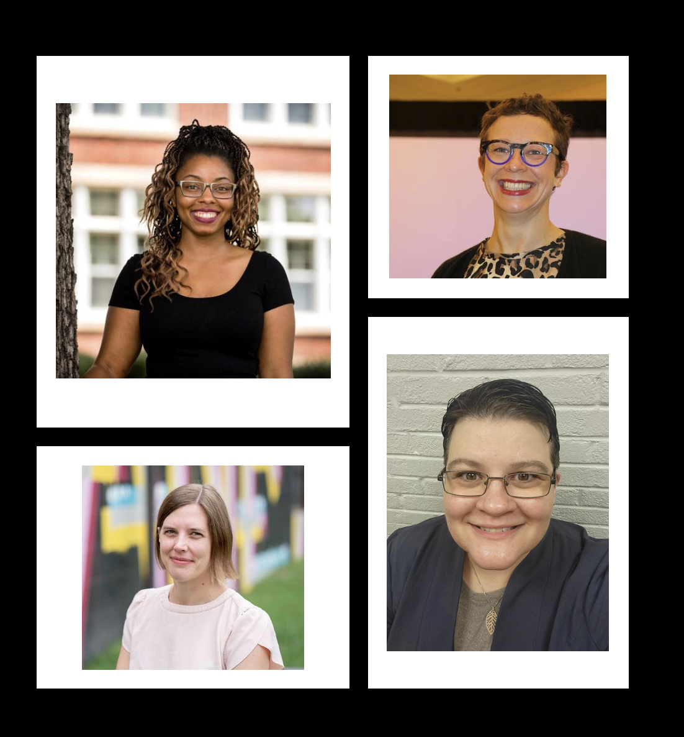
Strategist Team​
DeAnn Brame, MLS (she/her) | Technology and Innovation Strategist, Georgia​
Sarah Fischer, MA (she/her) | Community Engagement and Outreach Strategist, Alabama & South Florida​
Elizabeth Roth, MA (she/her) | Research and Data Science Strategist, Tennessee​
Debra Trogdon-Livingston, MLS (she/her)| User Experience and Education Strategist, South Carolina & North Florida

Slide 12
Be Engaged
Communications
Membership Welcome Letter
Monthly Newsletter
Emergency Communications
Social Media
Governance Boards (more info on slide. 17)
Consortium of Southern Biomedical Libraries (CONBLS)
Emergency Response and Preparedness Advisory Committee (ERPAC)
Health Literacy Think Tank (HLTT)
Regional Advisory Board (RAB)
State Liaison
Direct contact NNLM Region 2
Region2@nnlm.gov
Notes:
Region2@nnlm.gov
Ways to be connected to R2 office and R2 region.
State Liaison - Direct contact to the happenings in NNLM Region 2 RML; in turn - You as members – are the finger to the pulse, feeling the beat of the ground, you are connection to local, state and regional information

Slide 13
Communications
Membership Welcome Letter -
Welcome and Introduction to R2
Monthly Newsletter - The Pulse
Link to November Pulse:
https://mailchi.mp/3baa4651b38c/nnlm-region-2-pulse-newsletter-read-about-funding-programing-more-7373545?e=bed91dcaec
Emergency Communications
Weather Advisory
Social Media

Slide 14
Just another day at the RML…
Host monthly Region 2 webinar series
Publish a monthly newsletter “The Pulse”
Post on social media (Twitter, Facebook, LinkedIn)
Teach national NNLM classes online
Coordinate DOCLINE
Travel to exhibit and present at conferences
Assist subawardees with project implementation
Participate in NNLM working and planning groups
Recruit and lead four Region 2 governance boards
Seek member feedback and continuous quality improvement

Slide 15
Education and Trainings – Region 2 Webinar Series
Notes:
https://www.nnlm.gov/training

Slide 16
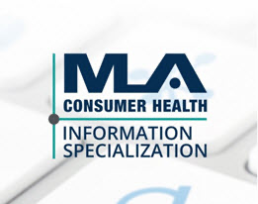
Specializations
Programs are offered by the Medical Library Association (MLA)
Class formats: live webinars, on-demand/online/recorded
NNLM sponsors the application fees
Consumer Health Information Specialization (CHIS)
Provide health information, resources, technologies and services for communities (Level 1 12 CE Hours, Level 2 12 CE Hours)
Data Services Specialization (DSS)
Current and quality data services, data management and support for researchers, clinicians, students, librarians, public (Basic Level)
Disaster Information Specialization (DIS) - Ends April 2023
https://nnlm.gov/guides/specialization

Slide 17
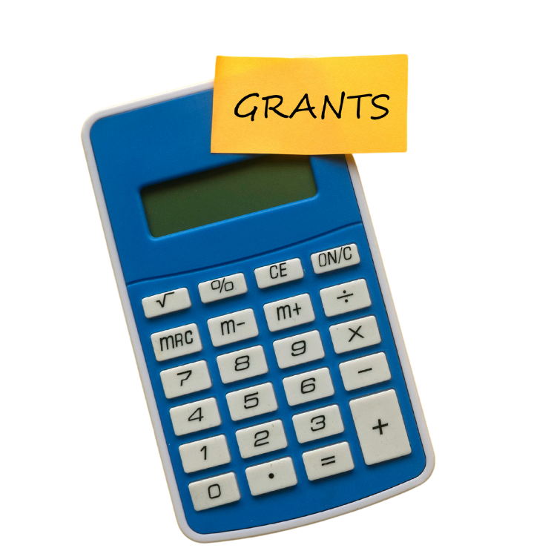
Current Year 2 funding cycle: May 1, 2022 – April 30, 2023 Upcoming Year 3 funding cycle: May 1, 2023 – April 30, 2024 Previous Funding Award project categories: Health Information Outreach Technology Improvement Professional Development Exhibit Award Disaster Preparedness and Recovery Membership Catalyst (MS, PR) *Proposal writing toolkit: https://www.nnlm.gov/guides/nnlm-proposal-writing-toolkit
Grant Funding
Notes:
https://www.nnlm.gov/guides/nnlm-proposal-writing-toolkit

Slide 18
Governance Boards
Regional Advisory Board (RAB) | Emergency Response & Preparedness Advisory Committee (ERPAC) | Consortium of Southern Biomedical Libraries (CONBLS) | Health Literacy Think Tank (HLTT)
Chair: Lorin Jackson R2 Rep: Elizabeth Roth Diverse representation across Region 2 Advises in planning, implementation, and evaluation of regional programs & services Recruitment for new members opens in January 2023 (annual commitment) Kick-off meeting for RAB Y2 in February 2023 | Co-Chairs: Sarah Fischer, Shannon Jones R2 Rep: Isaac Chery, Brian Fors (MUSC) Passionate, diverse core group Develop a regional response plan 4 quarterly meetings/grant cycle Recruiting members: TN, PR | R2 Reps: Shannon Jones (lead), Lorin Jackson, DeAnn Brame Directors/deans of southern biomedical libraries based in Region 2 Tackling resource library program and brainstorming support from R2 on emergency preparedness to inform ERPAC | Co-Chairs: Rachel R. Walden (ETSU), Rena Lubker (MUSC) R2 Rep: Debra Trogdon-Livingston Focus on external community & health organization partnerships Healthy People 2030 Work to identify best practices for combining digital and health literacy 2nd SE Health Literacy Conference, April 2023
R2 Led
Notes:
Weather Communications – we would like to hear from you

Slide 19
Emergency Preparedness in NNLM Region 2 (R2)
R2 can provide support in preparing for/responding to disasters and localized emergencies.
Emergency Response and Preparedness Advisory Committee (ERPAC)
September National Preparedness Month -
Inclusive Disaster Planning: Considering the Needs of People with Disabilities
Emergency preparedness grant funding
USVI Ham Radio
Emergency Communications > Weather Advisory
Region 2 Emergency Preparedness Resources
Notes:
Weather Communications – we would like to hear from you

Slide 20
Poll #2
What topics strike you?
Data Management
Health Literacy
Health Disparities
Emergency Preparedness
Which R2 social media platform do you prefer?
Twitter
Facebook
Instagram

Slide 21
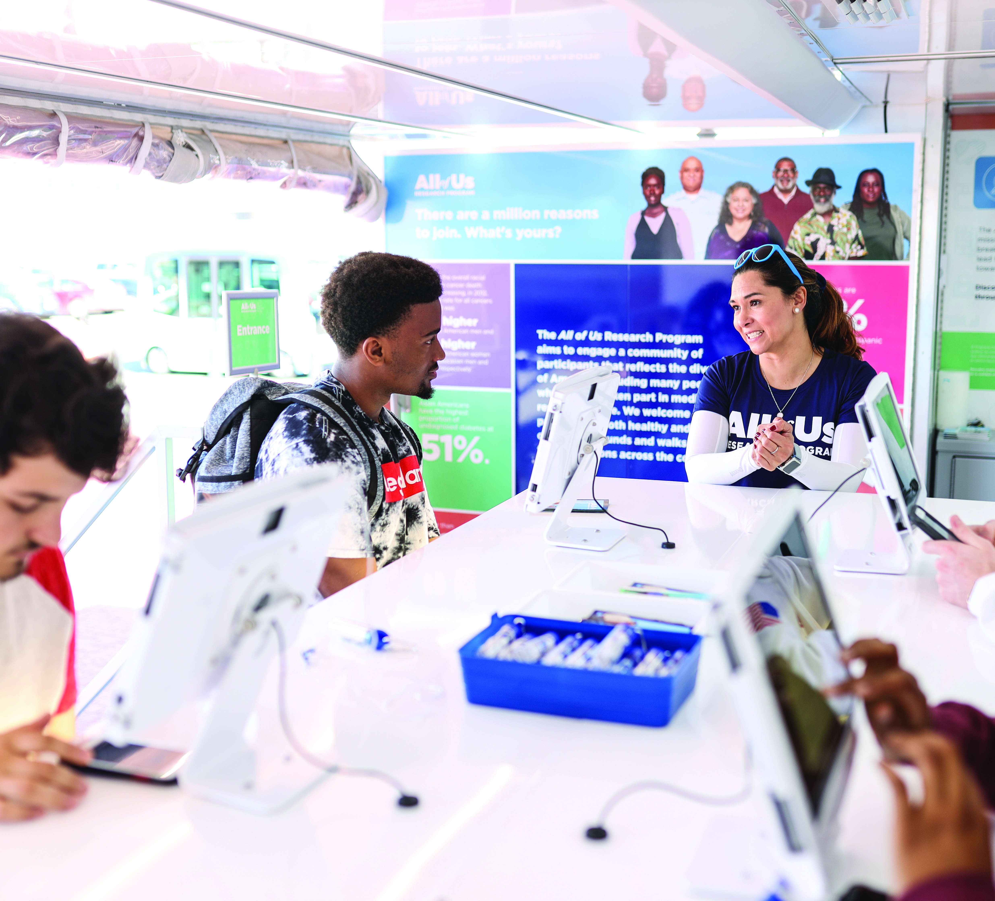
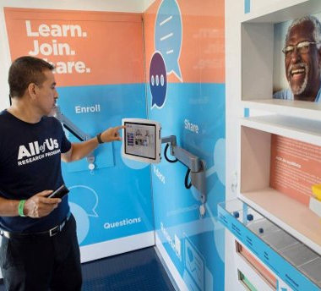
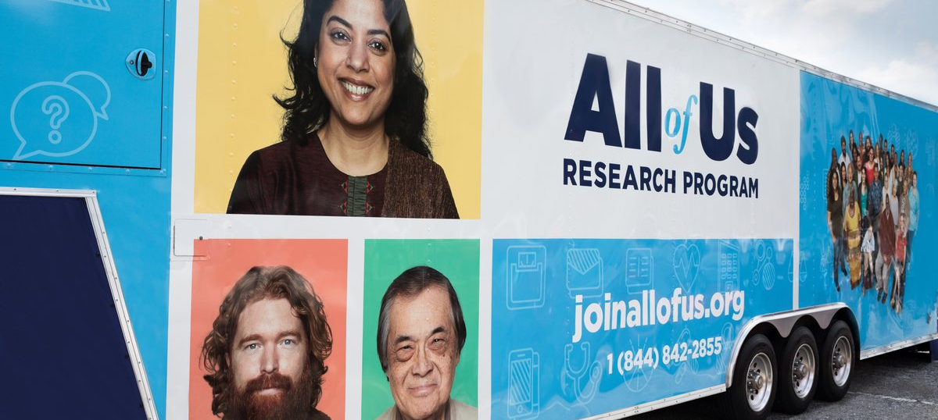
All of Us Journey
Interactive exhibits to learn about the All of Us Research Program and precision medicine.
Opportunities:
Host the All of Us Journey
Promote All of Us Journey visits
3/6 – 3/26 North Charleston, SC
4/10 – 4/30 Jackson, MS
5/15 – 5/21 Memphis, TN
5/29 – 6/18 Nashville, TN
joinallofus.org/journey-and-events
Notes:
Does anyone remember/currently listen to the band Journey?
What is the All of Us Journey? – It is a traveling All of Us Education and Enrollment Center visiting cities across the United States to raise awareness about the National Institute of Health's All of Us Research Program. The All of Us Journey features interactive activities designed to help visitors of all ages learn about precision medicine research.
The Journey provides cross country outreach for the All of Us Research Program and enrollment for people interested in joining the program. But it's also an opportunity for All of Us to take the program and meet people where they are, in their communities, with interactive exhibits and the ability to ask questions in-person.
Opportunities for NNLM Members include hosting the Journey. The All of Us Journey is looking for host sites to park and engage with community members. This can also help bring in people to your library or organization, especially if you plan to host your own health event in conjunction with the All of Us Journey visiting!
If you are unable to host the Journey, we would still love if you would promote it when it comes to your area! You can view updates to the All of Us Journey schedule on their website: ww.joinallofus.org/journey-and-events There are already some confirmed locations for South Carolina and more will be added as they confirm locations.

Slide 22
Q & A
Does anyone need to reset their password?
Notes:
We want to serve you in the best way possible. What do you want to learn more about?

Slide 23
Let's Connect
Find us on Facebook, LinkedIn, and Twitter @nnlmregion2
E-mail: Region2@nnlm.gov
Notes:
Are links good? Email is it new Region2@nnlm.gov

