Slide 1
Applications of Generative AI in Libraries

Slide 2
What is your name and area of librarianship?
ⓘ
Click Present with Slido or install our Chrome extension to activate this poll while presenting.
Notes:
📣 This is Slido interaction slide, please don't delete it. ✅ Click on 'Present with Slido' and the poll will launch automatically when you get to this slide.

Slide 3
Learning Objectives
By the end of today’s session students will be able to…
Describe how generative AI can be incorporated into and enhance library services.
Identify services that can use generative AI such as for text generation, chat and recommendation/ranking systems.
Identify the benefits and challenges of implementing generative AI in libraries.

Slide 4
Have you used Generative AI in your work, and if so, how?
ⓘ
Click Present with Slido or install our Chrome extension to activate this poll while presenting.
Notes:
📣 This is Slido interaction slide, please don't delete it. ✅ Click on 'Present with Slido' and the poll will launch automatically when you get to this slide.

Slide 5
Tasks AI excels at:
Searching
Summarizing
Extracting
Verifying
Classifying
Transforming
Generating

Slide 6
Tasks AI excels at:
Searching - Finding information or language in a body of text
Summarizing
Extracting
Verifying
Classifying
Transforming
Generating

Slide 7
Tasks AI excels at:
Searching
Summarizing - Condensing a body of information
Extracting
Verifying
Classifying
Transforming
Generating

Slide 8
Tasks AI excels at:
Searching
Summarizing
Extracting - Pulling out data from a body of text
Verifying
Classifying
Transforming
Generating

Slide 9
Tasks AI excels at:
Searching
Summarizing
Extracting
Verifying - Confirming that a body of text contains some information
Classifying
Transforming
Generating

Slide 10
Tasks AI excels at:
Searching
Summarizing
Extracting
Verifying
Classifying - Categorizing text in some way, for example by sentiment
Transforming
Generating

Slide 11
Tasks AI excels at:
Searching
Summarizing
Extracting
Verifying
Classifying
Transforming - Changing text in some way, for example translating languages or offering simpler text
Generating

Slide 12
Tasks AI excels at:
Searching
Summarizing
Extracting
Verifying
Classifying
Transforming
Generating - Creating original text content

Slide 13
Library Resources, Catalogs, and Collections

Slide 14
Lund et al 2024 Integrative Review
Discusses many uses including chatBots, assistance in reference and navigation, research and writing assistance (though noting that there are opposing views), and cataloging/metadata creation.
The paper highlights that AI presents shifting importance of digital literacy concepts.
Highlights anxieties over job loss as well as opportunities in providing the human contact point and helping users navigate new tools (1).

Slide 15
Lund et al 2024 Integrative Review
Provides a framework for evaluation use of AI
Define evaluation criteria
Curate a test dataset
Create realistic scenarios
Engage staff in testing
Assess accuracy
Evaluate contextual understanding
Test specialized medical knowledge
Measure response times
Gather user feedback
Document and report findings (1).

Slide 16
Adetayo 2023
Highlights results of a student survey:
Users like the interface and convenience
Do not feel it can answer complex questions, understand emotion and feel it provides outdated information (2)

Slide 17
Resource identification and location
Currently several libraries are exploring working with their catalog systems and generative AI to offer a plain language interface:
Experimental work at Harvard has read in text metadata to help locate physical resources (3).

Slide 18
Resource identification and location
Currently several libraries are exploring working with their catalog systems and generative AI to offer a plain language interface:
NYU Langone Health is exploring the use of chatbot creation to create a first-line ticket triage system and identify correct pathways for different types of requests.

Slide 19
Resource identification and location
Both of these cases rely on AI to extract information from the catalog or library sites and transform it from technical information into plain language for users.

Slide 20
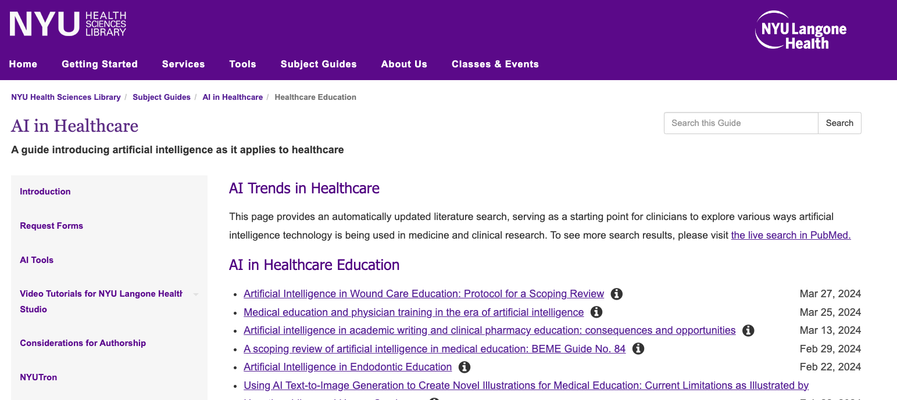
Use in library guides
AI can be employed to assist in adding functionality to library guides and other site resources.
LibGuide creators who formerly had less technical expertise have been able to use an LLM to create dynamic lists of literature that employ API pulls from PubMed for up to date results.
https://hslguides.med.nyu.edu/aihsl/healthcare-ed (4).

Slide 21
How do you feel about the idea of an AI enhanced catalog? What benefits and drawbacks may there be?
ⓘ
Click Present with Slido or install our Chrome extension to activate this poll while presenting.
Notes:
📣 This is Slido interaction slide, please don't delete it. ✅ Click on 'Present with Slido' and the poll will launch automatically when you get to this slide.

Slide 22
Library Event Programming

Slide 23
Helping generate class plans and syllabi
Generative AI can be tasked with helping generate an outline of a new class (5).
You are an instructional designer helping to create a class on generative AI. Draft a lesson plan for a 90 minute session on use cases of AI in medical libraries

Slide 24
Helping generate learning outcomes
Outcome oriented learning and backwards design can help event planners think about what they hope learners will take away from a course (5).
You are an instructional designer helping to create a class on generative AI. Draft three learning objectives that use achievable Bloom’s Taxonomy verbs. The course covers….

Slide 25
Helping generate assessments
Asking short “quiz” questions is an excellent way to reinforce learning and check on learner progress (5).
It can be very helpful to use AI to assist in drafting these questions, particularly for multiple choice answers.
You are an instructional designer helping to create a class on generative AI. Draft a multiple choice question about areas AI might be helpful with one right answer and three wrong answers. If you don’t know return “IDK”.

Slide 26
Class creation
In all of the above cases, we are using generative AI to help generate information.
It is always important to check output for false information.
Additionally, often the formatting and language will need tweaking to meet your standards.

Slide 27
Create a prompt for quizzing students about when to use the Boolean operator "OR"
ⓘ
Click Present with Slido or install our Chrome extension to activate this poll while presenting.
Notes:
📣 This is Slido interaction slide, please don't delete it. ✅ Click on 'Present with Slido' and the poll will launch automatically when you get to this slide.

Slide 28
Are there elements of your library's educational programming that you could see yourself using AI for?
ⓘ
Click Present with Slido or install our Chrome extension to activate this poll while presenting.
Notes:
📣 This is Slido interaction slide, please don't delete it. ✅ Click on 'Present with Slido' and the poll will launch automatically when you get to this slide.

Slide 29
Data Analysis and Systems

Slide 30
Helping generate code
Generative AI can be used when coding, for example analyzing usage statistics:
You are a data analyst in R. Provide code to get the counts for each librarian’s number of consults, assuming currently each row lists a single librarian’s name in a column labeled “libr”. If you don’t know return “IDK”

Slide 31
Helping generate code
Benefits: Can save time in finding solutions to code problems rather than sifting through bulletin board style sites like Stack Exchange
Drawbacks: Still requires a fair amount of trouble shooting and customization. Additionally due to model drift, you may get worse results or merely different results over time.

Slide 32
Does your library collect usage stats and do you see AI as potentially helping in analysis?
ⓘ
Click Present with Slido or install our Chrome extension to activate this poll while presenting.
Notes:
📣 This is Slido interaction slide, please don't delete it. ✅ Click on 'Present with Slido' and the poll will launch automatically when you get to this slide.

Slide 33
Literature Review

Slide 34
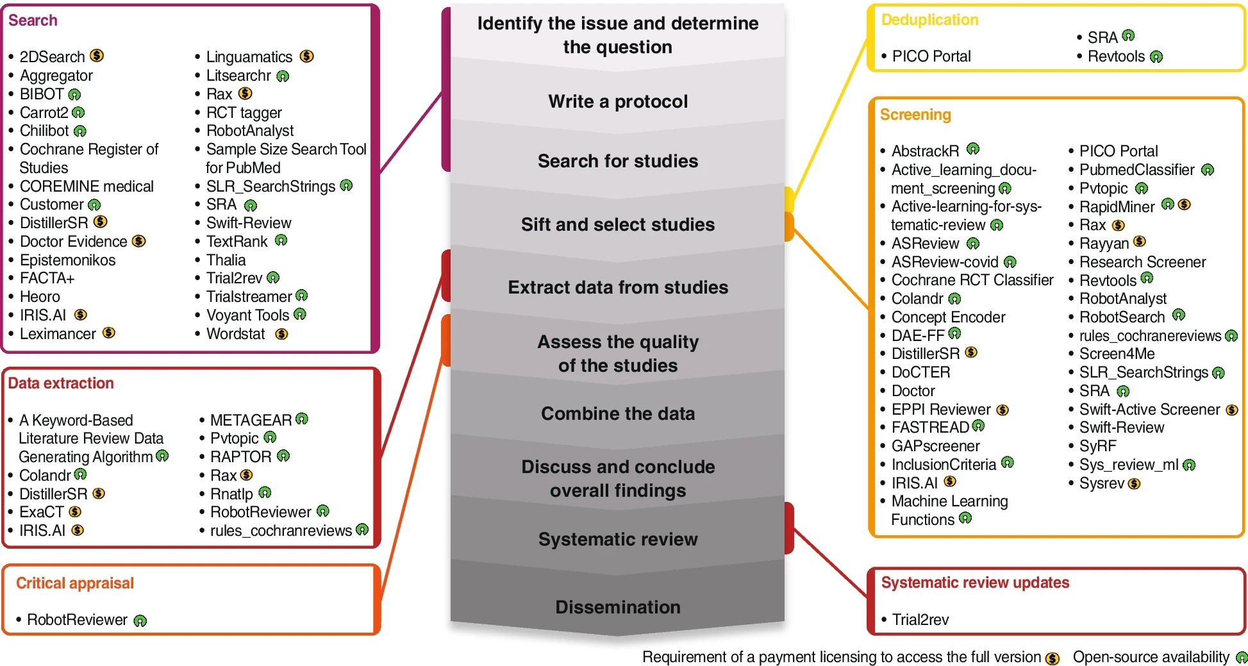
Jimenez et al. 2022
Noted papers on 63 tools with 119 descriptions of their use for machine learning in systematic reviews (6).
Pre-Chat GPT.
Highlights a lot of interest.

Slide 35
Qureshi et al. 2023
Note still in infancy for ChatGPT in Systematic Reviews.
Helped propose inclusion/exclusion criteria.
Could help write analysis code, though needs expert.
Similar could help non-experts make a search but needs improving.
Could have potential for summarizing, but currently risk of errors makes unreliable (7).

Slide 36
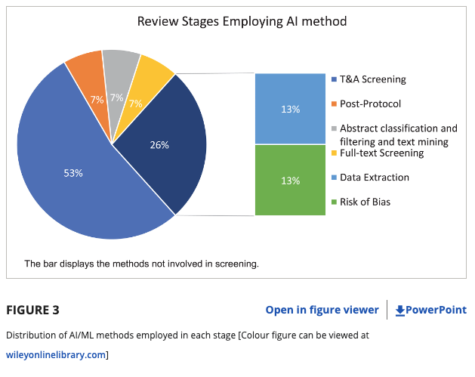
Blaizot et. al. 2022 Looked at AI in Systematic Reviews
In 5 of 15 papers in the final review, authors expressed concerns about missed titles, mischaracterized study types and data extraction problems.
Also report issues mitigated by duplicate screening.
83% reported greatly reduced workloads and expedited review times (8).

Slide 37
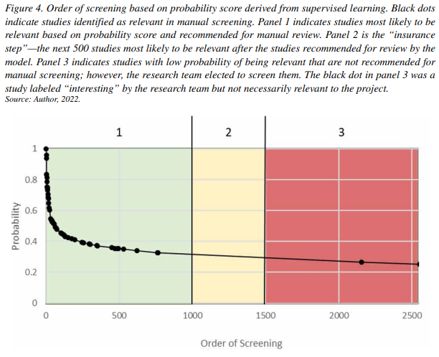
Cawley 2022
Describes use of AI in:
Identifying clusters of possibly relevant literature in a corpus to review (clustering/unsupervised learning).
Prioritization of literature for review (with supervised models).
Predict probability of articles being relevant (with machine learning) (9).

Slide 38
Cawley 2022
“Health sciences librarians in particular should seize the opportunity to leverage their deep understanding of bibliographic data and databases to improve the efficiency of locating evidence for large, comprehensive research questions, including systematic reviews….ML-based approaches are not one-size-fits-all; research teams need an experienced domain expert to apply this technology effectively. Similar to developing a search strategy, an iterative approach is necessary when applying ML to bibliographic data. Ultimately, academic librarians have an opening to serve on research teams as subject matter experts around automation techniques for bibliographic data (9).”

Slide 39
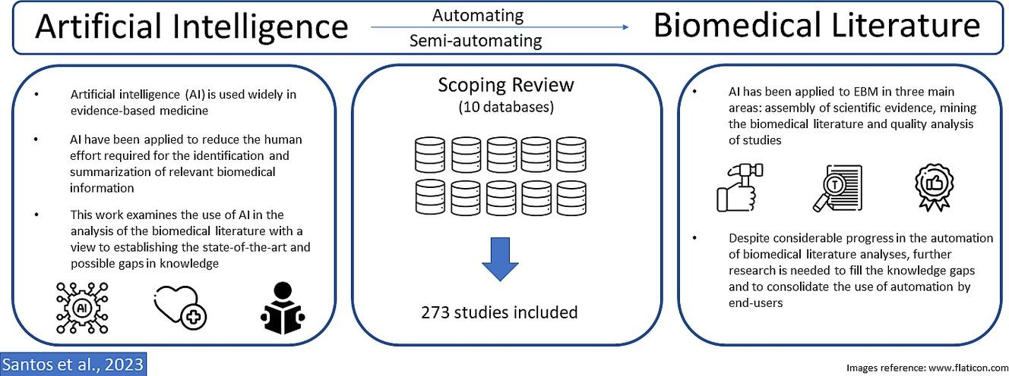
Dos Santos Et Al 2023
Note increasing volumes of papers using AI to assist in Systematic Reviews, primarily in collecting articles, mining data and QA (with the last being the least common (10).

Slide 40
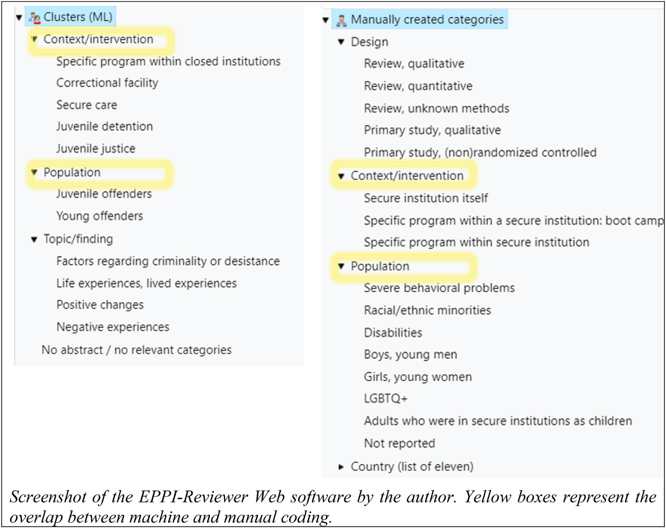
Muller et al 2022
Muller et al note in describing a Lingo3G tool that ML approaches can be faster than manual review in categorizing literature, though both AI and human manual review missed themes the other identified (11).

Slide 41
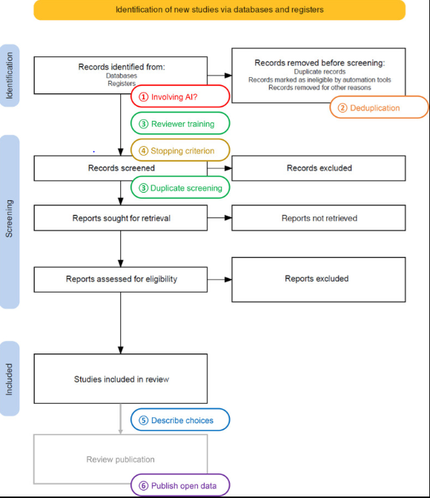
van Dijk et al 2023
Evaluate a tool called ASReview.
Found it to be helpful in screening literature: reduced numbers screened.
Article did not evaluate for accuracy (limitation).
Provided tool with a training set of 6 articles, three relevant, three not.
Tool provided a researcher with likely relevant articles, once 100 not relevant articles had been found, the dual review stopped (12).

Slide 42
What are your thoughts on the use of AI in literature review processes? What might be benefits and what might be pitfalls?
ⓘ
Click Present with Slido or install our Chrome extension to activate this poll while presenting.
Notes:
📣 This is Slido interaction slide, please don't delete it. ✅ Click on 'Present with Slido' and the poll will launch automatically when you get to this slide.

Slide 43
Administrative Tasks

Slide 44
Summarizing feedback
AI systems can be used to summarize user feedback to evaluation forms and identify common issues, including the tone of responses.
Can also be used to summarize notes from meetings into a short executive summary
Useful for helping improve the tone of written items for specific audiences.

Slide 45
Rewording Materials
Generative AI can be tasked with helping simplify language:
Please reword the following message in friendly cheerful language at a high school reading level.

Slide 46
Challenges and Issues

Slide 47
Bias and accuracy
The systems you work with may have blind spots when screening literature, or suggesting course designs.
Important always to maintain a human reviewer.

Slide 48
Legal concerns
With any proprietary tool that has not been explicitly licensed there may be concerns that your library’s business information may be transmitted insecurely.
For research papers, if the use and data sharing is not explicit, you may be providing your institutions’ research efforts to a company in a manner that goes against your institutions’ policies.

Slide 49
Worsening results over time
AI can get worse at certain tasks over time especially when provided new tasks that were outside the original scope.
This can lead to worse results in any of the tasks suggested above (13).

Slide 50
Review

Slide 51
Libraries are using AI in resource discovery by:
ⓘ
Click Present with Slido or install our Chrome extension to activate this poll while presenting.
Notes:
📣 This is Slido interaction slide, please don't delete it. ✅ Click on 'Present with Slido' and the poll will launch automatically when you get to this slide.

Slide 52
When analyzing usage statistics, generative AI can help:
ⓘ
Click Present with Slido or install our Chrome extension to activate this poll while presenting.
Notes:
📣 This is Slido interaction slide, please don't delete it. ✅ Click on 'Present with Slido' and the poll will launch automatically when you get to this slide.

Slide 53
When creating library classes and workshops, generative AI may be used to:
ⓘ
Click Present with Slido or install our Chrome extension to activate this poll while presenting.
Notes:
📣 This is Slido interaction slide, please don't delete it. ✅ Click on 'Present with Slido' and the poll will launch automatically when you get to this slide.

Slide 54
In systematic reviews, AI has been used to:
ⓘ
Click Present with Slido or install our Chrome extension to activate this poll while presenting.
Notes:
📣 This is Slido interaction slide, please don't delete it. ✅ Click on 'Present with Slido' and the poll will launch automatically when you get to this slide.

Slide 55
Breakout Activity 20 minutes
You are chairing a working group to explore Generative AI in your library. In your group choose from one of the five following domains:
Resource discovery
Library educational programming (classes)
Tracking statistics
Literature review support
Administrative help
With your group outline potential ways generative AI might help, potential pitfalls, social, legal and ethical challenges, what sorts of infrastructure may be needed, and how you might evaluate your efforts. Choose a notetaker who will report back to the group.

Slide 56
To help in Breakout work, consider Lund et al’s Framework
Provides a framework for evaluation use of AI
Define evaluation criteria
Curate a test dataset
Create realistic scenarios
Engage staff in testing
Assess accuracy
Evaluate contextual understanding
Test specialized medical knowledge
Measure response times
Gather user feedback
Document and report findings (1).

Slide 57
Please report on what you discussed.
ⓘ
Click Present with Slido or install our Chrome extension to activate this poll while presenting.
Notes:
📣 This is Slido interaction slide, please don't delete it. ✅ Click on 'Present with Slido' and the poll will launch automatically when you get to this slide.

Slide 58
Works cited
1. Lund BD, Khan D, Yuvaraj M. ChatGPT in medical libraries, possibilities and future directions: An integrative review. Health Inf Libr J. 2024;41(1):4–15.
2. Adetayo AJ. ChatGPT and Librarians for Reference Consultations. Internet Ref Serv Q. 2023 Jul 3;27(3):131–47.
3. McMahon M. Libraries and AI. 2024.
4. DeSimone D. Subject Guides: AI in Healthcare: Healthcare Education [Internet]. [cited 2024 Apr 17]. Available from: https://hslguides.med.nyu.edu/aihsl/healthcare-ed
5. Mollick ER, Mollick L. Using AI to Implement Effective Teaching Strategies in Classrooms: Five Strategies, Including Prompts. SSRN Electron J [Internet]. 2023 [cited 2023 Aug 1]; Available from: https://www.ssrn.com/abstract=4391243
6. Cierco Jimenez R, Lee T, Rosillo N, Cordova R, Cree IA, Gonzalez A, et al. Machine learning computational tools to assist the performance of systematic reviews: A mapping review. BMC Med Res Methodol. 2022 Dec 16;22(1):322.
7. Qureshi R, Shaughnessy D, Gill KAR, Robinson KA, Li T, Agai E. Are ChatGPT and large language models “the answer” to bringing us closer to systematic review automation? Syst Rev. 2023 Apr 29;12:72.
8. Blaizot A, Veettil SK, Saidoung P, Moreno-Garcia CF, Wiratunga N, Aceves-Martins M, et al. Using artificial intelligence methods for systematic review in health sciences: A systematic review. Res Synth Methods. 2022;13(3):353–62.
9. Cawley MA. Using Machine Learning to Locate Evidence More Efficiently: New Roles for Academic Research Librarians. In: Mani NS, Cawley MA, editors. Advances in Library and Information Science [Internet]. IGI Global; 2022 [cited 2024 Mar 14]. p. 144–68. Available from: https://services.igi-global.com/resolvedoi/resolve.aspx?doi=10.4018/978-1-7998-9702-6.ch008
10. Santos ÁOD, da Silva ES, Couto LM, Reis GVL, Belo VS. The use of artificial intelligence for automating or semi-automating biomedical literature analyses: A scoping review. J Biomed Inform. 2023 Jun;142:104389.
11. Muller AE, Ames HMR, Jardim PSJ, Rose CJ. Machine learning in systematic reviews: Comparing automated text clustering with Lingo3G and human researcher categorization in a rapid review. Res Synth Methods. 2022 Mar;13(2):229–41.
12. van Dijk SHB, Brusse-Keizer MGJ, Bucsán CC, van der Palen J, Doggen CJM, Lenferink A. Artificial intelligence in systematic reviews: promising when appropriately used. BMJ Open. 2023 Jul 7;13(7):e072254.
13. What is a “AI drift” and why is it making ChatGPT dumber? [Internet]. [cited 2024 Apr 17]. Available from: https://www.zdnet.com/article/what-is-a-ai-drift-and-why-is-it-making-chatgpt-dumber/

