Slide 1
Ethical Communication with Data

Slide 2
Learning Objectives
Students will be able to critique how different common chart design decisions present or obscure uncertainty in research findings.
Explain how diverse view points may be ignored in data visualizations
Compare the benefits and drawbacks of design choices relating to simplified messaging in charts

Slide 3
Why might we communicate with data, for example in charts and graphs?
Add your answer to the chat

Slide 4
Uncertainty & Error

Slide 5
How would you define error?
Add your answer to the chat

Slide 6
Error
The difference between observed values and true values

Slide 7
Most measurements have some degree of error
Variability inherent to a sample
Imprecise measures
Inaccurate tools

Slide 8
Case Study
 | Program A | Program B | Program C
 | 5 | 4 | 2
 | 5 | 5 | 4
 | 5 | 4 | 5
 | 5 | 4 | 5
 | 5 | 5 | 4
 | 5 | 3
 | 5 | 2
 | 3 | 4
 | 1 | 5
 | 1 | 4
 | 4 | 4
Mean | 4 | 4 | 4
Median | 5 | 4 | 4
Standard Deviation | 1.61245155 | 0.89442719 | 1.22474487
Standard Error | 0.48617243 | 0.26967994 | 0.54772256
Let’s say you survey participants in three different library programs as to how they would rate a workshop’s overall utility to them. The three workshops average 4, but with different sort of responses:

Slide 9
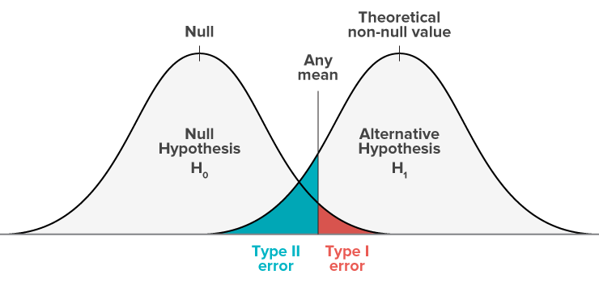
“Significance”
A p value is a probability that if the null hypothesis were true that we would see the results we saw.
Alpha, α, is a threshold at which we would say it is unlikely that our experimental results are as “far” from our control group if they are actually the same thing. Often it is .05.
So, if p = .05, we are saying, in 5 out of 100 repetitions we would expect our results if there was no difference.

Slide 10
Presenting uncertainty
Common techniques include error bars, gradients and ranges, as well as showing individual data points (dot plots) (Correll and Gleicher 2014).
Hullman et. al. (2019) note that in a review of papers discussing uncertainty, experiences with different charts and comfort with statistics vary greatly and therefore so too do interpretations and confidence of how to use data visualizations with error.

Slide 11
Presenting uncertainty (2)
Hullman et. al. (2019) note that in a review of papers discussing uncertainty, experiences with different charts and comfort with statistics vary greatly and therefore so too do interpretations and confidence of how to use data visualizations with error.

Slide 12
How might you provide information on uncertainty in your communications?
Type your answer in the chat

Slide 13
Simplicity & Detail

Slide 14
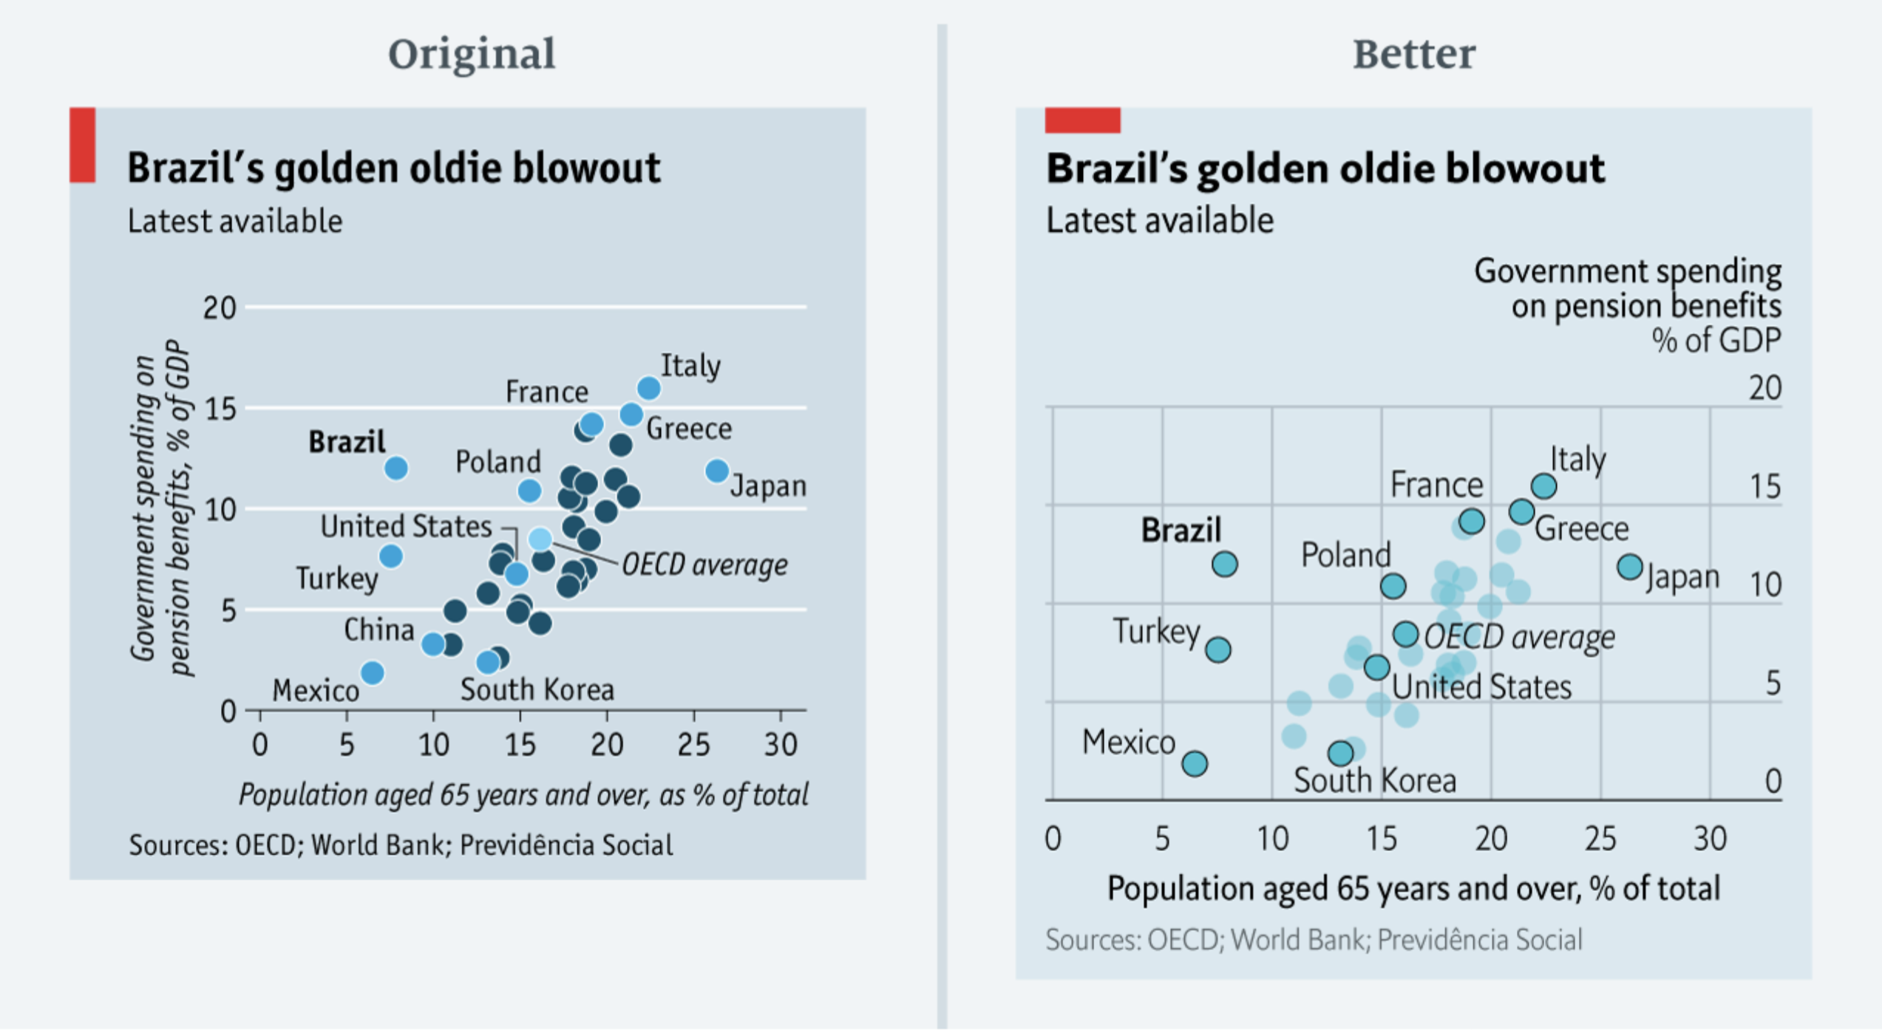
Hold for Economist 1
Type your answer in the chat

Slide 15
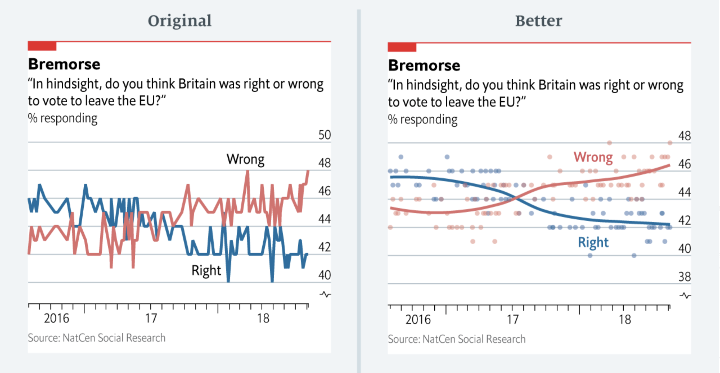
Hold for Economist 2
Type your answer in the chat

Slide 16
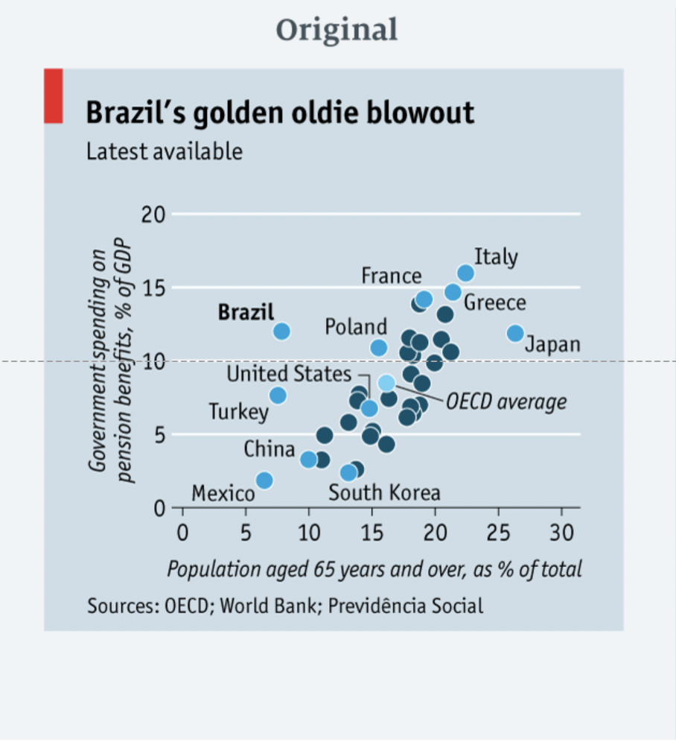
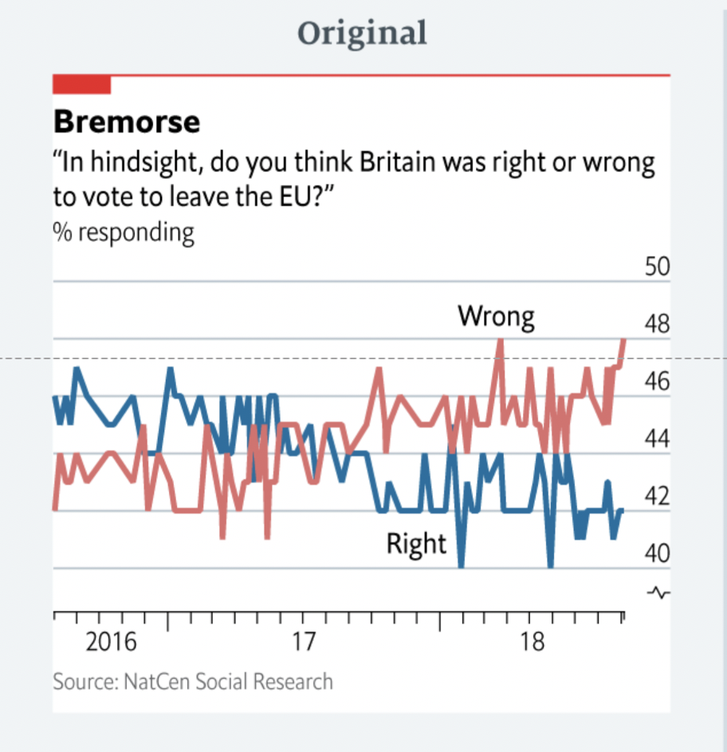
What if anything would you change about these charts?
Type your answer in the chat

Slide 17
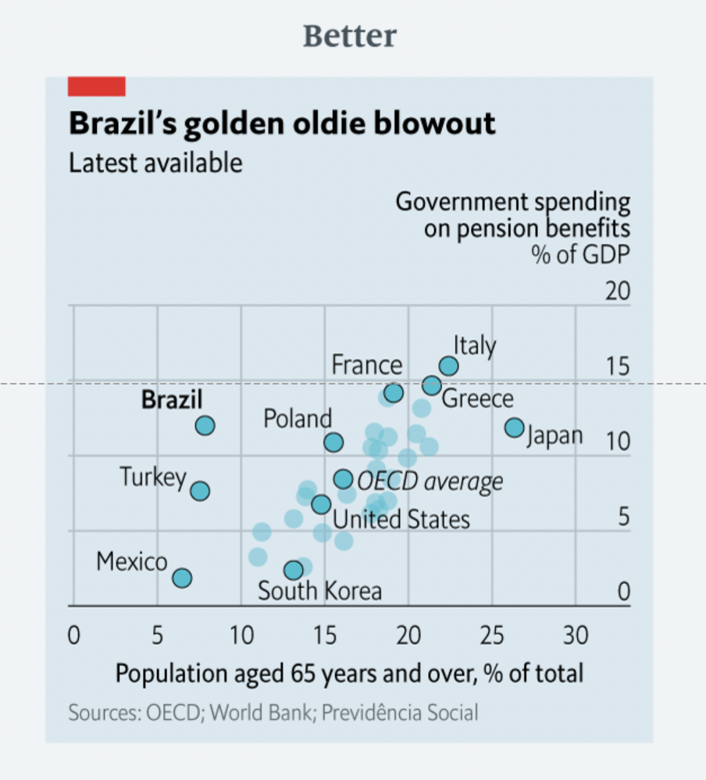
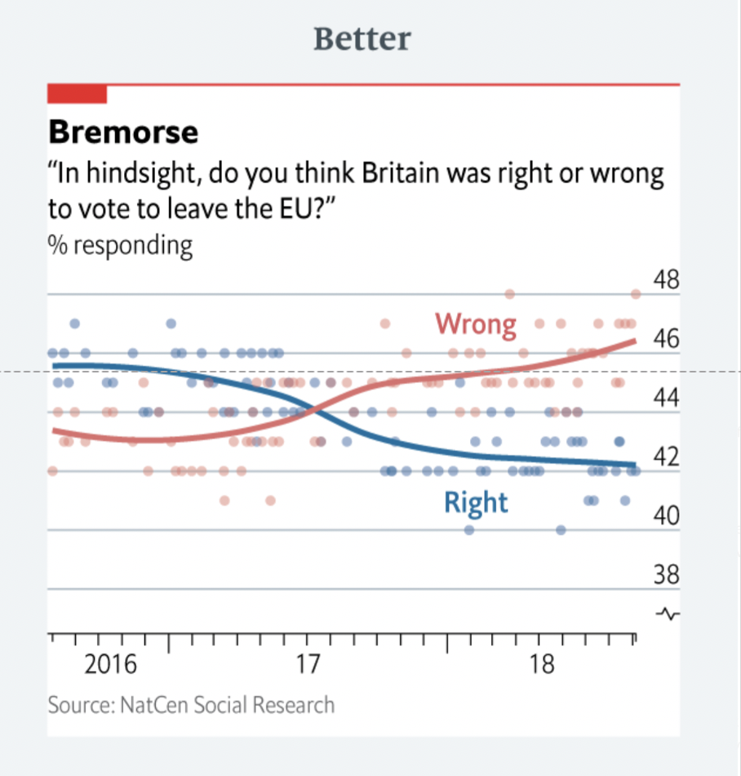
What if anything would you change about these charts? (2)

Slide 18
Simplicity & Detail
Typically we want to provide a clear, truthful message to the people we are communicating with.
Communication is inherently a rhetorical act: meaning we are trying to persuade our reader of something.
"Who will win in an agonistic encounter between two authors, and between them and all the others they need to build up a statement ? Answer: the one able to muster on the spot the largest number of well aligned and faithful allies" -Bruno Latour

Slide 19
Simplicity & Detail (2)
As we saw with The Economist’s visualizations, making charts entails decisions around what to highlight, where to draw attention, when to smooth, when to show detail.
These decisions are done essentially to present information to others, and the goal is typically to support the point we are making.
This is not to imply one is trying to mislead, but just that that data visualizations are presented in order to communicate a message and convince readers that the message is reliable and true.
Therefore, our visualization design choices are rhetorical decisions, and we should make our design choices ethically.

Slide 20
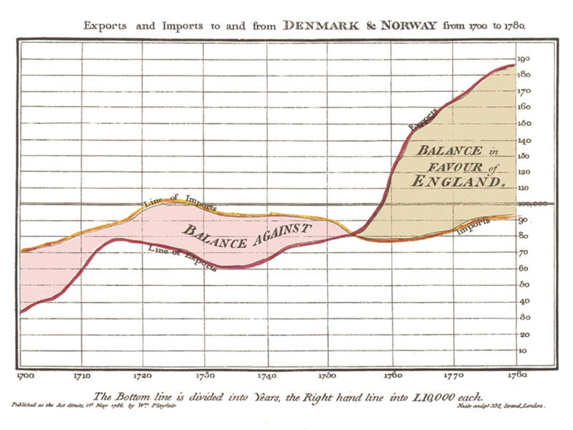
Visualization in Context
Data visualization as a practice has increased greatly with the increased use of computers and data collection.
Historically early examples include William Playfair, John Snow, and Minard presenting data on British commerce, epidemiology and the Napoleonic wars, respectively.
In more contemporary times, a wealth of data visualization experts, thought leaders and gurus have sprung up: Edward Tufte, Cole Nussbaum Knaflic and Alberto Cairo to name a few.

Slide 21
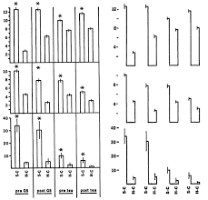
Visualization in Context (1)
Many of these experts espouse a philosophy that visualizations should be clear, draw your attention to the points you want to make, and minimize clutter or “visual load.”
For example Tufte(2001) recommends minimizing the “data-ink ratio” where any “ink” (or on computers bits) that are not conveying information are undesirable.

Slide 22
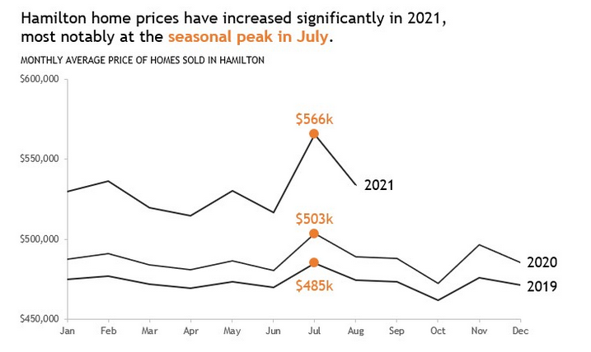
Visualization in Context (2)
Knaflic (2015) recommends highlighting key data points of interest and graying out other information. For example Tufte(2001) recommends minimizing the “data-ink ratio” where any “ink” (or on computers bits) that are not conveying information are undesirable.
Designers and researchers point to Gestahlt Psychology and ideas of visual load to recommend a “cleaner” design of data visualization.

Slide 23
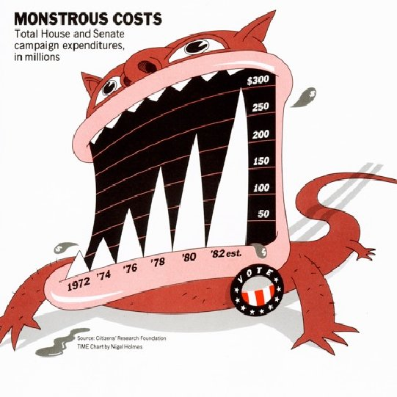
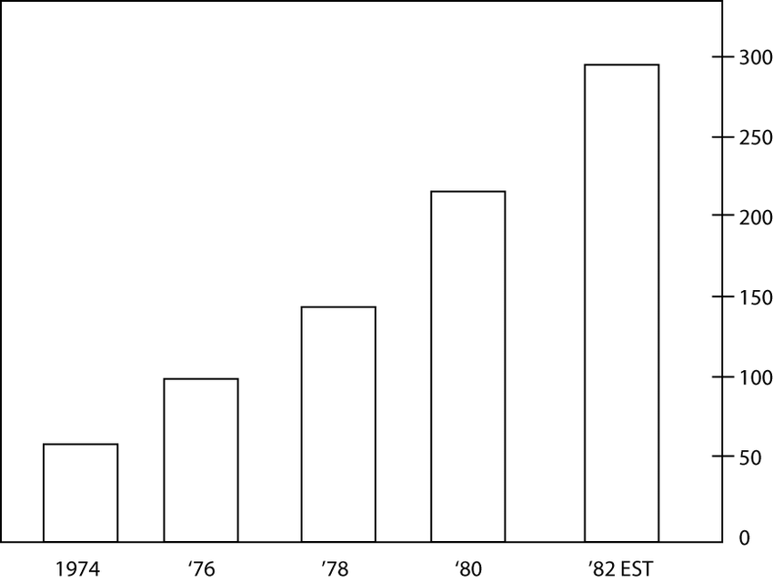
Visualization in Context (3)
Conversely, Bateman et. al. (2010) tested out showing minimal, “Tufte-approved” type charts to a chart from a newspaper.
Their study found that there did not seem to be any clear advantage in comprehension of either chart type.
The heavily designed chart may have improved recall

Slide 24
Visualization in Context (4)
A growing body of “critical data” researchers assert that the recommendation for simplicity, in the sense of minimal, uncluttered and clear designs is a rhetorical act aiming to create the appearance of authority (an appeal to ethos) and logic (an appeal to logos). (Wikipedia Modes of Persuasion 2019).

Slide 25
Visualization in Context (5)
Kostelnick (2008) notes that clarity may be context specific, for example in how much granular detail is provided. For example, information provided to library stakeholders about spending and resources may be much more granular to make decisions than those that a casual library patron would be interested in.

Slide 26
Data and Rhetoric
Data driven communications are rhetorical, meaning they are used to express and support an argument. Therefore, ethical considerations driving visualization design decisions are more complex than avoiding deception, since honesty and clarity are complex considerations themselves.
Visualizing data entails many decisions, and the decisions we make are shaped by ethical and rhetorical concerns as much or more than “clarity.”

Slide 27
Ignored Voices & Privileged Perspectives

Slide 28
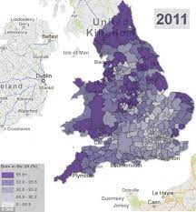
Ignored Voices and Privileged Perspectives
Kennedy, Hill, Aiello & Allen (2016) argue that visual conventions (e.g. using recognizable chart types in a clean, efficient way) both decrease the amount of work the reader has to do to understand what is being presented, but also bolster the argument by appearing to be objective and scientific, regardless of the data presented.

Slide 29
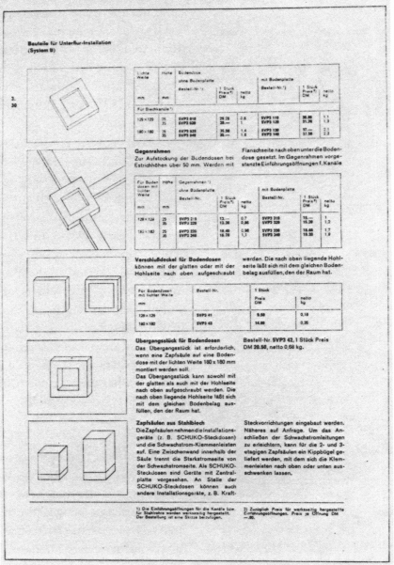
Ignored Voices and Privileged Perspectives (2)
Kinross (1985) argues that in the post-war period, the use of minimal designs (think sans serif fonts and clean spaces) was done to present an ideal of universalism and reason. By employing these design motifs we are effectively making a rhetorical argument that our data is not biased.

Slide 30
Ignored Voices and Privileged Perspectives (3)
Kennedy, Hill, Aiello & Allen (2016): “The association of abstraction, including geometric shapes and lines, with the universal emphasises a belief in their ability to offer the same meaning to all viewers and to present data which are universally true.”

Slide 31
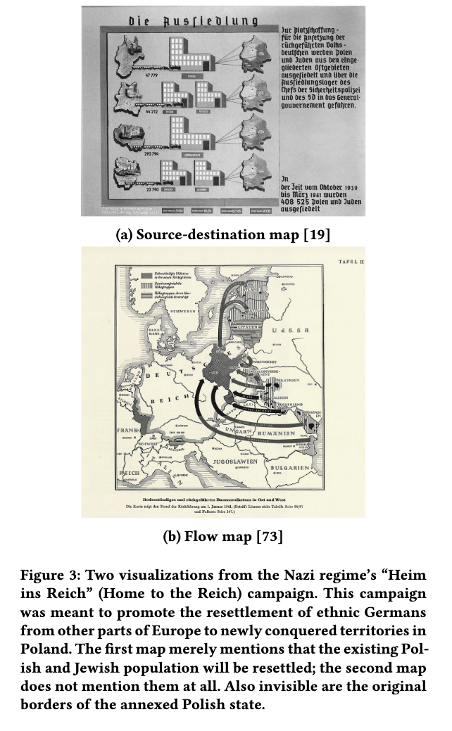
Visualizations
Cairo is quoted by Zer-Aviv (2015) expressing doubts on empathy in visualization: “By hiding faces, we reduce empathy, which might be actually good, as it lets us approach issues in a more dispassionate and neutral manner”
Dragga and Voss (2001) note that often statistics and plain charts may elide a humanitarian concerns by expressing injury and loss of life as blandly as logistical values.
Correll (2018) highlights this issue starkly in the contrast between the dispassionate view of these Nazi maps and the actual subject matter of forced repopulation and genocide.

Slide 32
Case Study

Slide 33
Casework
Colleagues of yours are making a comparison of the popularity of two different programs at the library. They are basing outcomes on patron evaluations where users could rate how much they liked workshops on a 4 point scale of dislike a lot - dislike a bit - like a bit - like a lot. They condense these data down into like vs dislike and run a Chi Square analysis. They conclude that one program is significantly more popular than another due to a p value < .05.
What information is missed by this explanation?
What other voices/points of view may be important?
What issues may arise from relying on p values and significance?
 | Program A | Program B
Like | n = 50 (77%) | n = 25 (45.5%)
Dislike | n = 15 (23%) | n = 30 (54.5%)

Slide 34
Review Questions
Why can “significance” be problematic to communicate?
What are drawbacks of “simple” visualizations?
What are some ways we might present ambiguity?

Slide 35
Guest Lecture

Slide 36
Bibliography
My presentations/
Saved
DS
1
2
3
4
5
6
7
8
9
10
11
12
13
14
15
16
17
18
19
20
21
22
23
24
25
26
27
28
29
30
31
32
33
34
35
36
37
38
39
40
41
42
43
44
45
46
47
48
My presentations
You have reached the end of the presentation!
Go to www.menti.com and use the code 6946 8834
0
The slide image appears in your audience’s devices
Add meta description
Image caption
Media layout
Centered
As background
Image
Reactions
Alt text
CommunicatingWithData2022 - Mentimeter

Slide 37
Bibliography (2)
Library of Congress, Washington, D.C. 20540 USA. “[A Series of Statistical Charts Illustrating the Condition of the Descendants of Former African Slaves Now in Residence in the United States of America] Proportion of Freemen and Slaves among American Negroes.” Image. Accessed September 4, 2020. https://www.loc.gov/item/2014645356/.
Aiello, Giorgia. “Theoretical Advances in Critical Visual Analysis: Perception, Ideology, Mythologies, and Social Semiotics.” Journal of Visual Literacy 26, no. 2 (January 1, 2006): 89–102. https://doi.org/10.1080/23796529.2006.11674635.
Alexander, Larry, and Michael Moore. “Deontological Ethics.” In Stanford Encyclopedia of Philosophy, n.d. https://plato.stanford.edu/entries/ethics-deontological/.
Amrhein, Valentin, Sander Greenland, and Blake McShane. “Scientists Rise up against Statistical Significance.” Nature 567, no. 7748 (March 2019): 305–7. https://doi.org/10.1038/d41586-019-00857-9.
Anscombe, GEM. “Modern Moral Philosophy.” Philosophy 33 (1958): 1–19.
BARTON, BEN F., and MARTHALEE S. BARTON. “Modes of Power in Technical and Professional Visuals.” Journal of Business and Technical Communication 7, no. 1 (January 1, 1993): 138–62. https://doi.org/10.1177/1050651993007001007.
Bateman, Scott, Regan L. Mandryk, Carl Gutwin, Aaron Genest, David McDine, and Christopher Brooks. “Useful Junk?: The Effects of Visual Embellishment on Comprehension and Memorability of Charts.” In Proceedings of the 28th International Conference on Human Factors in Computing Systems - CHI ’10, 2573. Atlanta, Georgia, USA: ACM Press, 2010. https://doi.org/10.1145/1753326.1753716.
Belia, Sarah, Fiona Fidler, Jennifer Williams, and Geoff Cumming. “Researchers Misunderstand Confidence Intervals and Standard Error Bars.” Psychological Methods 10, no. 4 (December 2005): 389–96. https://doi.org/10.1037/1082-989X.10.4.389.
Bentham, Jeremy. An Introduction to the Principles of Morals and Legislation. Oxford: Clarendon Press, 1907.
Boden, Catherine, Marie T. Ascher, and Jonathan D. Eldredge. “Learning While Doing: Program Evaluation of the Medical Library Association Systematic Review Project.” Journal of the Medical Library Association 106 (July 2, 2018): 284–93. https://doi.org/10.5195/jmla.2018.286.

Slide 38
Bibliography (3)
Boukhelifa, Nadia, and David John Duke. “Uncertainty Visualization: Why Might It Fail?” CHI ’09 Extended Abstracts on Human Factors in Computing Systems. Boston, MA, USA: Association for Computing Machinery, 2009. https://doi.org/10.1145/1520340.1520616.
12Boy, Jeremy, Anshul Vikram Pandey, John Emerson, Margaret Satterthwaite, Oded Nov, and Enrico Bertini. “Showing People Behind Data: Does Anthropomorphizing Visualizations Elicit More Empathy for Human Rights Data?” In Proceedings of the 2017 CHI Conference on Human Factors in Computing Systems, 5462–74. CHI ’17. New York, NY, USA: Association for Computing Machinery, 2017. https://doi.org/10.1145/3025453.3025512.
13. Boyd, Solon Barocas, Danah. “Engaging the Ethics of Data Science in Practice.” Accessed September 3, 2020. https://cacm.acm.org/magazines/2017/11/222176-engaging-the-ethics-of-data-science-in-practice/fulltext.
14. Burgio, Valeria. “Uncertain Infographics: Expressing Doubt in Data Visualization.” Semiotica 2019, no. 230 (October 25, 2019): 143–66. https://doi.org/10.1515/sem-2018-0114.
15. Burns, Lynette Sheridan, and Benjamin J. Matthews. “First Things First: Teaching Data Journalism as a Core Skill.” Asia Pacific Media Educator 28, no. 1 (June 2018): 91–105. https://doi.org/10.1177/1326365X18765530.
C. Kostelnick. “The Visual Rhetoric of Data Displays: The Conundrum of Clarity*.” IEEE Transactions on Professional Communication 51, no. 1 (March 2008): 116–30. https://doi.org/10.1109/TPC.2007.914869.
C. T. Silva, J. Freire, and S. P. Callahan. “Provenance for Visualizations: Reproducibility and Beyond.” Computing in Science & Engineering 9, no. 5 (October 2007): 82–89. https://doi.org/10.1109/MCSE.2007.106.
Caplan, Arthur, and Phoebe Friesen. “Health Disparities and Clinical Trial Recruitment: Is There a Duty to Tweet?” PLOS Biology 15, no. 3 (March 1, 2017): e2002040. https://doi.org/10.1371/journal.pbio.2002040.
Cassim, Fatima. “Hands On, Hearts On, Minds On: Design Thinking within an Education Context.” International Journal of Art & Design Education 32, no. 2 (June 2013): 190–202. https://doi.org/10.1111/j.1476-8070.2013.01752.x.
Correll, M, Heer J. “Black Hat Visualization.” In Workshop on Dealing with Cognitive Biases in Visualisations (DECISIVe). IEEE Vis, 2017. http://idl.cs.washington.edu/papers/blackhatvis.

Slide 39
Bibliography (4)
Correll, Michael. “Ethical Dimensions of Visualization Research.” In Proceedings of the 2019 CHI Conference on Human Factors in Computing Systems - CHI ’19, 1–13. Glasgow, Scotland Uk: ACM Press, 2019. https://doi.org/10.1145/3290605.3300418.
Correll, Michael, and Michael Gleicher. “Error Bars Considered Harmful: Exploring Alternate Encodings for Mean and Error.” IEEE Transactions on Visualization and Computer Graphics 20, no. 12 (December 31, 2014): 2142–51. https://doi.org/10.1109/TVCG.2014.2346298.
D. Hahn, R. Shangraw, M. Keith, and D. Coursey. “Does Visualization Affect Perceptions of Ethically Complex Policy Decisions: An Experimental Study.” In 2007 40th Annual Hawaii International Conference on System Sciences (HICSS’07), 96–96, 2007. https://doi.org/10.1109/HICSS.2007.185.
D’Agostino, Fred, Gerald Gaus, and John Thrasher. “Contemporary Approaches to the Social Contract.” In Stanford Encyclopedia of Philosophy, n.d. https://plato.stanford.edu/archives/fall2019/entries/contractarianism-contemporary.
Dalton, C; Thatcher, J. “What Does A Critical Data Studies Look Like, And Why Do We Care?” https://www.societyandspace.org/articles/what-does-a-critical-data-studies-look-like-and-why-do-we-care. Accessed September 4, 2020. https://www.societyandspace.org/articles/what-does-a-critical-data-studies-look-like-and-why-do-we-care.
“Data Doesn’t Speak for Itself — Storytelling with Data.” Accessed February 3, 2021. http://www.storytellingwithdata.com/blog/2021/1/14/data-doesnt-speak-for-itself.
D’Ignazio, C., and Lauren F. Klein. “Feminist Data Visualization,” 2016.
D’Ignazio, Catherine. “What Would Feminist Data Visualization Look Like?” MIT Civic Media (blog), December 1, 2015. https://civic.mit.edu/feminist-data-visualization.
Dombrowski, Paul M. “Ethics and Technical Communication: The Past Quarter Century.” Journal of Technical Writing and Communication 30, no. 1 (January 1, 2000): 3–29. https://doi.org/10.2190/3YBY-TYNY-EQG8-N9FC.
Dong, Xiaoxu. “Data Visualization: A Unique Storyteller.” Technoetic Arts 17, no. 3 (October 1, 2019): 259–79. https://doi.org/10.1386/tear_00020_1.

Slide 40
Bibliography (5)
Dörk, Marian, Patrick Feng, Christopher Collins, and Sheelagh Carpendale. “Critical InfoVis: Exploring the Politics of Visualization.” In CHI ’13 Extended Abstracts on Human Factors in Computing Systems, 2189–98. CHI EA ’13. New York, NY, USA: Association for Computing Machinery, 2013. https://doi.org/10.1145/2468356.2468739.
Dragga, Sam, and Dan Voss. “Cruel Pies: The Inhumanity of Technical Illustrations.” Technical Communication 48, no. 3 (August 2001): 265.
Fairfield, Joshua, and Hannah Shtein. “Big Data, Big Problems: Emerging Issues in the Ethics of Data Science and Journalism.” Journal of Mass Media Ethics 29, no. 1 (January 2, 2014): 38–51. https://doi.org/10.1080/08900523.2014.863126.
Feyman, Yevgeniy, Frank Provenzano, and Frank S. David. “Disparities in Clinical Trial Access Across US Urban Areas.” JAMA Network Open 3, no. 2 (February 5, 2020): e200172–e200172. https://doi.org/10.1001/jamanetworkopen.2020.0172.
Foley, Katherine Ellen. “How Bad Covid-19 Data Visualizations Mislead the Public.” Quartz. Accessed September 1, 2020. https://qz.com/1872980/how-bad-covid-19-data-visualizations-mislead-the-public/.
Fortun, K. Net Risk: Environmental Information Design, Access, and Literacy. Edited by T. Cherkasky, J. Greenbaum, P. Mambrey, and J. K. Pors. Pdc 2000: Proceedings of the Participatory Design Conference. Palo Alto: Computer Professionals Social Responsibility, 2000.
“Graphical Redesign.” Accessed February 23, 2021. http://jcsites.juniata.edu/faculty/rhodes/ida/graphicalredes.html.
Hepworth, Katherine, and Christopher Church. “Racism in the Machine: Visualization Ethics in Digital Humanities Projects.” Digital Humanities Quarterly 12, no. 4 (2018): UNSP 05.
Hepworth, Katherine J. “Make Me Care: Ethical Visualization for Impact in the Sciences and Data Sciences.” In Design, User Experience, and Usability. Interaction Design, edited by Aaron Marcus and Elizabeth Rosenzweig, 12200:385–404. Lecture Notes in Computer Science. Cham: Springer International Publishing, 2020. https://doi.org/10.1007/978-3-030-49713-2_27.
Hickey, Walt. “EXPOSED: Here Are The Tricks That Fox News Uses To Manipulate Statistics On Its Graphics.” Business Insider. Accessed September 1, 2020. https://www.businessinsider.com/fox-news-charts-tricks-data-2012-11.

Slide 41
Bibliography (6)
Hill, Rosemary Lucy, Helen Kennedy, and Ysabel Gerrard. “Visualizing Junk: Big Data Visualizations and the Need for Feminist Data Studies.” Journal of Communication Inquiry 40, no. 4 (August 22, 2016): 331–50. https://doi.org/10.1177/0196859916666041.
Hullman, J., X. Qiao, M. Correll, A. Kale, and M. Kay. “In Pursuit of Error: A Survey of Uncertainty Visualization Evaluation.” IEEE Transactions on Visualization and Computer Graphics 25, no. 1 (January 2019): 903–13. https://doi.org/10.1109/TVCG.2018.2864889.
Hullman, Jessica. “What Is Visualization Research? What Should It Be?” Medium, November 13, 2018. https://medium.com/multiple-views-visualization-research-explained/what-is-visualization-research-what-should-it-be-8840a9ba658.
Hursthouse, Rosalind, and Glen Pettigrove. “Virtue Ethics.” In Stanford Encyclopedia of Philosophy, n.d. https://plato.stanford.edu/archives/win2018/entries/ethics-virtue/.
J. Fekete and J. Freire. “Exploring Reproducibility in Visualization.” IEEE Computer Graphics and Applications 40, no. 5 (October 1, 2020): 108–19. https://doi.org/10.1109/MCG.2020.3006412.
The Metropolitan Museum of Art. “James Peale | Still Life: Balsam Apple and Vegetables | American | The Met.” Accessed October 16, 2020. https://www.metmuseum.org/art/collection/search/11734.
Kennedy, Helen, Rosemary Lucy Hill, Giorgia Aiello, and William Allen. “The Work That Visualisation Conventions Do.” Information, Communication & Society 19, no. 6 (June 2, 2016): 715–35. https://doi.org/10.1080/1369118X.2016.1153126.
Kinross, Robin. “The Rhetoric of Neutrality.” Design Issues 2, no. 2 (1985): 18–30. https://doi.org/10.2307/1511415.
Kirby, Jay. “A Unified Theory of Information Design: Visuals, Text & Ethics.” Technical Communication 61, no. 1 (February 2014): 53–54.
Knaflic, Cole Nussbaumer, author. Storytelling with Data : A Data Visualization Guide for Business Professionals. Hoboken, New Jersey : Wiley, 2015.

Slide 42
Bibliography (7)
Kong, Ha-Kyung, Zhicheng Liu, and Karrie Karahalios. “Frames and Slants in Titles of Visualizations on Controversial Topics.” In Proceedings of the 2018 CHI Conference on Human Factors in Computing Systems, 1–12. CHI ’18. New York, NY, USA: Association for Computing Machinery, 2018. https://doi.org/10.1145/3173574.3174012.
LaPolla, Fred WZ, and Nicole Contaxis. “The Charts Are Off: Approaches to Ethical Decision-Making in Data Visualization.” Webinar presented at the NNLM Research Data Management Webinar Series, October 14, 2020. https://news.nnlm.gov/sea/2020/10/14/the-charts-are-off-approaches-to-ethical-decision-making-in-data-visualization/.
Latour, Bruno. “« Visualisation and Cognition: Drawing Things Together ».” In Knowledge and Society Studies in the Sociology of Culture Past and Present, edited by H Kuklick, 6:33. Jai Press, 1986.
Leo, Sarah. “Mistakes, We’ve Drawn a Few.” Medium, May 15, 2019. https://medium.economist.com/mistakes-weve-drawn-a-few-8cdd8a42d368.
Mill, John Stuart. Utilitarianism. Oxford: Oxford University Press, 1998.
“Modes of Persuasion.” In Wikipedia, August 19, 2020. https://en.wikipedia.org/w/index.php?title=Modes_of_persuasion&oldid=973839933.
Rawls, John. A Theory of Justice. New York: Columbia University Press, 1999.
Richards, Anne R. “Argument and Authority in the Visual Representations of Science.” Technical Communication Quarterly 12, no. 2 (April 1, 2003): 183–206. https://doi.org/10.1207/s15427625tcq1202_3.
Rieger, Kendra L., Christina H. West, Amanda Kenny, Rishma Chooniedass, Lisa Demczuk, Kim M. Mitchell, Joanne Chateau, and Shannon D. Scott. “Digital Storytelling as a Method in Health Research: A Systematic Review Protocol.” Systematic Reviews 7 (March 5, 2018): 41. https://doi.org/10.1186/s13643-018-0704-y.
Rosenquist, Christina. “Visual Form, Ethics, and a Typology of Purpose: Teaching Effective Information Design.” Business and Professional Communication Quarterly 75, no. 1 (March 2012): 45–60. https://doi.org/10.1177/1080569911428670.

Slide 43
Bibliography (8)
Singer, Peter. How Are We to Live? Ethics in an Age of Self-Interest. Oxford: Oxford University Press, 1997.
SInnott-Armstrong, Walter. “Consequentialism.” In The Stanford Encyclopedia of Philosophy, n.d. https://plato.stanford.edu/archives/sum2019/entries/consequentialism/.
Tufte, Edward R., 1942-. The Visual Display of Quantitative Information. 2nd ed.. Cheshire, Conn. : Graphics Press, 2001.
Weissgerber, Tracey L., Stacey J. Winham, Ethan P. Heinzen, Jelena S. Milin-Lazovic, Oscar Garcia-Valencia, Zoran Bukumiric, Marko D. Savic, Vesna D. Garovic, and Natasa M. Milic. “Reveal, Don’t Conceal: Transforming Data Visualization to Improve Transparency.” Circulation 140, no. 18 (October 29, 2019): 1506–18. https://doi.org/10.1161/CIRCULATIONAHA.118.037777.
“William Playfair.” In Wikipedia, February 23, 2021. https://en.wikipedia.org/w/index.php?title=William_Playfair&oldid=1008484691.
Williams, Sean D. User Experience Design for Technical Communication: Expanding Our Notions of Quality Information Design. 2007 Ieee International Professional Communication Conference. New York: Ieee, 2007.
Yau, Nathan. “Fox News Continues Charting Excellence.” FlowingData (blog), August 6, 2012. https://flowingdata.com/2012/08/06/fox-news-continues-charting-excellence/.
Young, Bessie A. “Health Disparities in Advanced Heart Failure Treatment: The Intersection of Race and Sex.” JAMA Network Open 3, no. 7 (July 1, 2020): e2011034–e2011034. https://doi.org/10.1001/jamanetworkopen.2020.11034.
Zer-Aviv, M. “DataViz—The UnEmpathetic Art.” Responsible Data (blog), October 19, 2015. https://responsibledata.io/2015/10/19/dataviz-the-unempathetic-art/.

