Slide 1
How do I search in PubMed using MeSH?
Acquire

Slide 2
Discussion question
What are some ways you have used PubMed to narrow search results?
Notes:
[NOTE TO FACILITATOR: If you are completing these modules in an order other than suggested in the facilitation guide, you may need to adjust these discussion points.]

Slide 3
Objectives
By the end of the program, participants will:
Describe basic information and use of MeSH controlled vocabulary

Slide 4
What do you think?
What might you call this common pink anti-inflammatory drug?
Notes:
Before we talk about what MeSH is, let’s examine why it exists. Give me some ideas for what you might search for to find articles about this common pink anti-inflammatory drug?
[ibuprofen, advil, motrin…]
Those are the most common terms. But, it can also be referred to as:
2-(4-Isobutylphenyl)propanoic
Nuprin
Rufen
Brufen
…And more.
If you wanted to find all the articles about this drug, you might assume you need to put all these terms into your search box. After all, you wouldn’t want to search for Advil and miss articles that call the drug Motrin instead.

Slide 5
Medical Subject Headings
MeSH (Medical Subject Headings) is a controlled vocabulary, which means it is a set of terms used to index content and facilitate retrieval.
Notes:
Luckily, most databases make use of a controlled vocabulary to make the searching process much easier. A controlled vocabulary is like a thesaurus. It’s a set of terms used to index content and facilitate retrieval. PubMed’s vocabulary is called MeSH, which stands for Medical Subject Headings.

Slide 6
MeSH
Numerous search terms are placed under one MeSH heading, which is what MeSH terms are called.
Similar to a thesaurus entry term
These synonymous or nearly-synonymous terms are listed as entry terms under that MeSH heading.
Similar to the synonyms in a thesaurus
Notes:
MeSH and other database vocabularies work by placing a number of search terms under one “MeSH heading.” These terms are then used to describe articles. When you search for a MeSH term, you are searching for articles that have been described as having that term (or one of its listed synonyms, or entry terms) as a subject. Remember, MeSH is like a thesaurus. So, the MeSH heading is like the thesaurus entry term, and the entry terms are like the listed synonyms.
The most important point here is that searching for a MeSH term automatically searches for all of the entry terms as well! And, if you search for one of the synonymous terms, PubMed will automatically map it to the MeSH term and search for it (and therefore all the other entry terms) as well. Using MeSH terms is a great way to simplify your search and make sure you’re getting as much of the relevant literature as possible. However, be aware that not every article in PubMed is indexed with MeSH terms, so searching with MeSH terms alone will not give you comprehensive results.

Slide 7
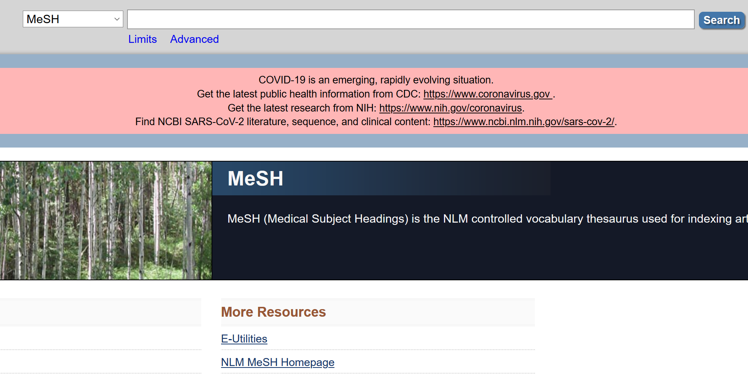
The MeSH Database (1)
Notes:
Let’s look at how to access the MeSH database. On the bottom of the PubMed homepage, you can click “MeSH database” under the icon that says “explore”. Here you’ll find a search bar to search the MeSH database as well as links to some help, tutorials, and more information about MeSH.

Slide 8
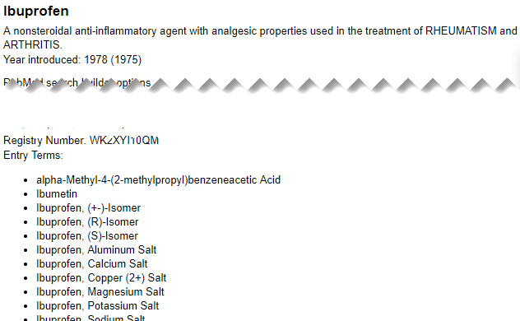
The MeSH Database (2)
Notes:
Now let’s take a closer look using our ibuprofen example.
I searched the MeSH database for Advil. This immediately brings up the page for Ibuprofen. In some cases, you’ll get a results page and you can then select the term you were looking for. For instance, if you search for diabetes, you can select between several MeSH headings related to diabetes.
On the entry page, there are a few things to point out. First, at the top is the definition (you can check this to make sure you’ve selected the right term). Further down the page are the entry terms, or the synonyms. Remember, when you search for a MeSH term in PubMed it’s also searching for all of these terms!

Slide 9
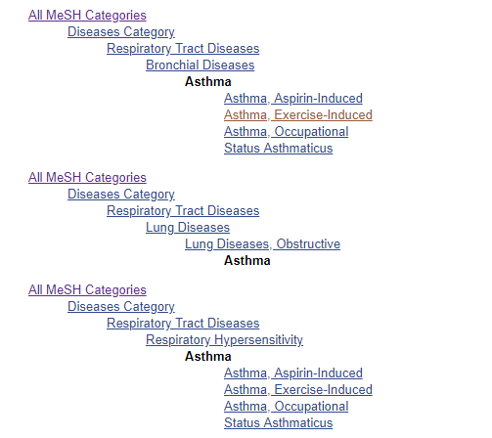
The MeSH Database
MeSH has a hierarchical structure.
MeSH headings can be located in multiple places within this hierarchy.
Notes:
At the bottom is a hierarchy depicting where the MeSH term falls in the structure of MeSH. MeSH is structured hierarchically, with categories of increasing specificity the further down (or the further indented, in this case) you go.
I’ve included an image of part of the MeSH hierarchy for asthma here so you can visualize this. Notice that the terms start very broad and get more specific the farther down you move. Below asthma you can also see that there are some narrower MeSH terms.
Looking at these terms is a good way to be sure you’re searching at the correct focus level – in other words, you might see that you actually want to search for a bit broader of a category, or you might see a narrower term that is more useful to you.

Slide 10
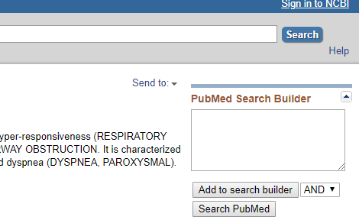
Search Builder
Notes:
So you’ve decided on your MeSH term and you’re ready to go. Great! You can start building your search using the Search Builder tool on the upper right side of the page. From any MeSH term page, click either “Search PubMed” to search right away, or click “add to search builder” if you want to add more terms. Don’t worry – if you navigate to another MeSH page, it will save what you’ve already added to the search builder, so you can add multiple MeSH terms easily. You can choose to combine the term you’re adding to what’s already there with AND or OR here as well. (NOT is an option too, but using this is NOT recommended)
A word of warning: be careful to review your Search Builder entry before searching if you’ve added multiple terms with AND/OR. It can do strange things with parentheses, so make sure everything is arranged and nested correctly before you search.

Slide 11
Take home message
Consider:
If you’re building a search with MeSH terms, what might you do if you find that one of your terms does not have an appropriate MeSH term to use?
Remember:
MeSH is a controlled vocabulary, like a thesaurus, with a hierarchical structure
You can find MeSH terms for your search in the MeSH database
Developed resources reported in this presentation are supported by the National Library of Medicine (NLM), National Institutes of Health (NIH) under cooperative agreement number UG4LM012342 with the University of Pittsburgh, Health Sciences Library System. The content is solely the responsibility of the authors and does not necessarily represent the official views of the National Institutes of Health.
Notes:
Now that you’ve learned about using MeSH headings to search in PubMed, think about what you might do if you find that one of your terms does not have an appropriate MeSH term to use.
The main takeaways for today are that PubMed utilizes a controlled vocabulary called MeSH, which is like a thesaurus with a hierarchical structure. Using MeSH terms can make your search both more thorough and simpler, and PubMed will also automatically find MeSH headings based on your search terms when possible. You can also find your own MeSH terms for your search in the MeSH database, which is accessible from the PubMed homepage and main search bar.
[NOTE TO FACILITATOR: If you want to complete group discussion immediately following this module content, change the title of this slide to ‘Group Discussion’ and delete the slide with corresponding questions in the next module. If you would like to have discussion take place using your internal LMS system, you can include instructions here for how participants can participate. Then, adjust the slide with the corresponding questions in the next module as needed.]

