Slide 1
STIGMA, TRAUMA, AND PEOPLE WHO USE DRUGS
April 13, 2023

Slide 2
Training Objectives & Agenda
By the end of this training, participants should be able to:
Understand stigma and the impact it has on people who use drugs.
Understand how trauma and racial injustice have impacted communities.
Understand how to respond to stigma in the workplace.
Defining stigma and its impact on people who use drugs
Science behind stigma
History of drug criminalization in America
Questions & Wrap-up

Slide 3
STIGMA, NOT-QUITE-DEFINED
“I know it when I see it.”
- U.S. Supreme Court Justice Potter Stewart, in Jacobellis v Ohio, 1964, re the concept of “obscenity”

Slide 4
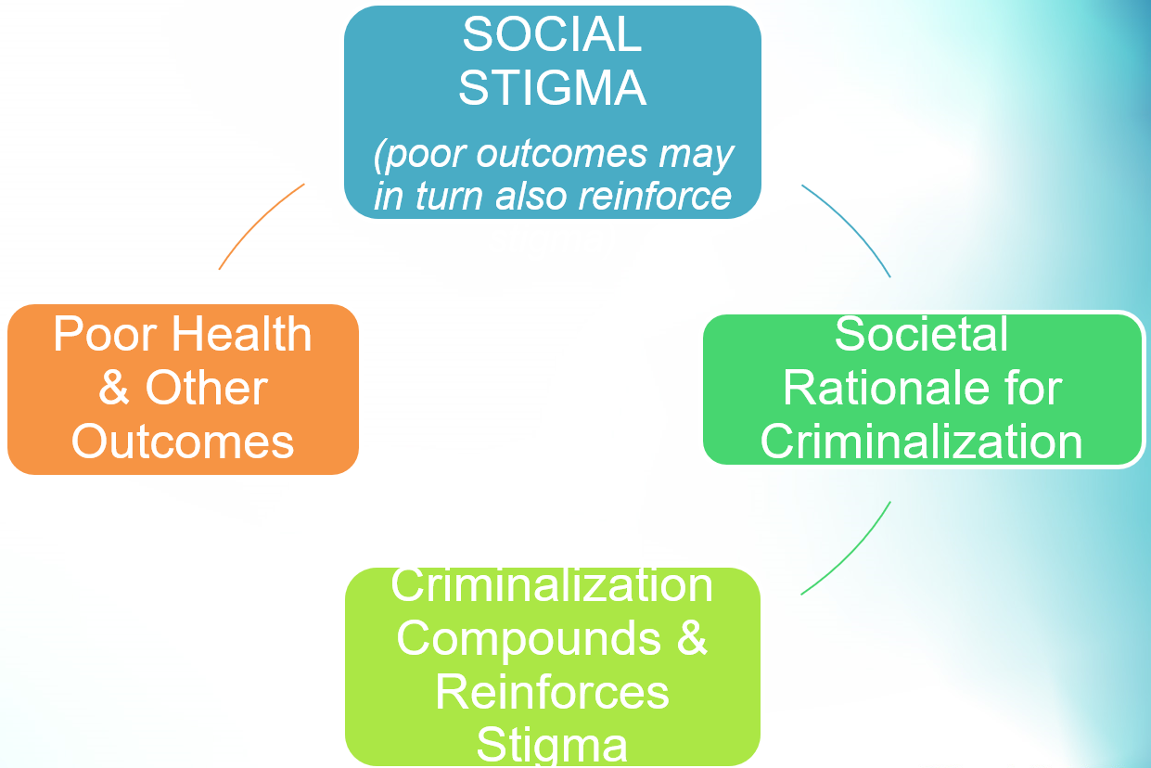
STIGMA & Drug Criminalization
Why does
DRUG CRIMINALIZATION
matter in a discussion about STIGMA?
What third key factor is missing?

Slide 5
Video: Clip from “the house I live in,” A brief history of drug laws in America

Slide 6
The war on drugs (part 1)
“YOU WANT TO KNOW WHAT THIS WAS REALLY ALL ABOUT?
THE NIXON CAMPAIGN IN 1968, AND THE NIXON WHITE HOUSE AFTER THAT,HAD TWO ENEMIES:
THE ANTIWAR LEFT AND BLACK PEOPLE.”

Slide 7
The war on drugs (part 2)
“YOU UNDERSTAND WHAT I’M SAYING?
WE KNEW WE COULDN’T MAKE IT ILLEGAL
TO BE EITHER AGAINST the war or
BLACK…”

Slide 8
The war on drugs (part 3)
“BUT BY GETTING THE PUBLIC TO
ASSOCIATE THE HIPPIES WITH MARIJUANA AND BLACKS WITH HEROIN AND THEN CRIMINALIZING BOTH HEAVILY,
WE COULD DISRUPT THOSE COMMUNITIES.”

Slide 9
The war on drugs (part 4)
“WE COULD
ARREST THEIR LEADERS, RAID THEIR HOMES, BREAK UP THEIR MEETINGS,
AND VILIFY THEM NIGHT AFTER NIGHT ON THE EVENING NEWS.”

Slide 10
The war on drugs (part 5)
“DID WE KNOW WE WERE LYING ABOUT THE DRUGS?
OF COURSE WE DID.”
- JOHN EHRLICHMAN, DOMESTIC POLICY CHIEF, NIXON ADMINISTRATION. HARPER’S MAGAZINE, 1994

Slide 11
Video: a history of the war on drugs: from prohibition to gold rush

Slide 12
Stigma, defined – Goffman (1963)
“The term stigma, then, will be used to refer to an attribute that is deeply discrediting, but it should be seen that a language of relationships, not attributes, is really needed.”
“By definition, of course, we believe the person with a stigma is not quite human. On this assumption we exercise varieties of discrimination, through which we effectively, if often unthinkingly, reduce his life chances.”
Note: Stigma is a relational / social phenomenon,
so manifests differently both by society and over time

Slide 13
Stigma, defined – Link & Phelan (2001)
“We define stigma as the co-occurrence of its components –
Labeling
Stereotyping
Separation (from the non-stigmatized)
Status Loss (as a result of components 1-3)
Discrimination (perpetrated by the non-stigmatized with greater access to social / economic / political power, manifests as discrimination)
– and further indicate that for stigmatization to occur, power must be exercised.”

Slide 14
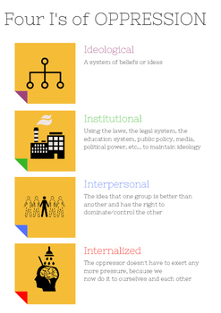
INTERNALIZED STIGMA / INTERNALIZED OPPRESSION
Parallel frameworks – the stigmatized / oppressed come to believe the negative traits attributed to them
Internalized stigma can be an extremely powerful influence on PWUD
Stigmatized persons in turn may stigmatize their peers
Acting out related to internalized stigma can look like anything from “passive powerlessness” to aggressive violence
Internalized stigma has been found to be an independent risk for “substance use problems,” and may represent a unique contributor

Slide 15
BRAIN DISEASE MODEL OF Addiction: A COMPLICATED RELATIONSHIP
COUNTERING OLD STIGMA
CREATING NEW STIGMA
Alternative theory counters damaging “moral failing” / “lacking willpower” narratives
Enables investigation into novel treatment approaches
Adds to our broader understanding of substance use disorder (SUD)
Offers additional evidence for health-based vs. punitive approaches to solutions
May help alleviate self-blame among some people who use drugs
Pathologizes PWUD
Disease models require “sick” patients – not all PWUD should be considered, or consider themselves sick
May be interpreted that PWUD aren’t to ever be trusted, because of their “disease” that could reappear
“Addiction” is not a “Disease,” per se
No pathogen or infection, no standard diagnostic criteria – listed as “disorder(s)” in DSM-V
More similar to mental health “disorders” – a deviation from the norm, w/ diagnostic criteria that may be refined over time
Can be disempowering, suggesting biological problems “healed” through medical intervention
Could actually support punitive measures – can & has been used to support coercive, forced “treatment” / “rehabilitation”

Slide 16
Video: Did rats start the drug war?

Slide 17
Join us for Part 2
Join us for part 2 of Stigma, Trauma, and PWUD on April 20th, 2023!

Slide 18
Thank you!
Miera Corey
MaHRTI Associate Director
100 S. Charles Street,
Tower II, 8th Floor,
Baltimore, MD, 21201
Phone: 410-637-1900
Website: www.mahrti.org
Facebook: www.facebook.com/BHSBaltimore
Twitter: @BHSBaltimore

