Slide 1
Update on the NIH Data Management and Sharing Policy and Implementation Presentation to the Network of the National Library of Medicine National Center for Data Services May 24, 2022
Taunton Paine, MA
Director, Scientific Data Sharing Policy Division
Office of Science Policy
National Institutes of Health
Cindy Danielson, PhD
Associate Director, Systems Integration,
Office of Research Reporting and Analysis
Office of Extramural Research
National Institutes of Health
sciencepolicy@mail.nih.gov

Slide 2
Why does NIH Want Data to be Shared?
Advance rigorous and reproducible research
Enable validation of research results
Make high-value datasets accessible
Accelerate future research directions
Increase opportunities for citation and collaboration
Promote public trust in research
Foster transparency and accountability
Demonstrate stewardship over taxpayer funds
Maximize research participants’ contributions
Support appropriate protections of research participants’ data

Slide 3
Major NIH-wide Data Sharing Policies
Policy | Expectations | Year
NIH Data Sharing Policy | Expects investigators seeking more than $500K in direct support in any given year to submit a data sharing plan with their application or to indicate why data sharing is not possible. | 2003
Genomic Data Sharing Policy | Expects sharing of large-scale human and non-human genomic data from NIH-funded studies through a publicly available data repository. All studies with human genomic data should be registered in dbGaP, and the data should be submitted to an NIH-designated data repository. Non-human data may be submitted to any widely used data repository. | 2014
Intramural Human Data Sharing Policy | Expects all intramural investigators generating or collecting human research data to develop a data sharing plan describing how data will be shared. | 2015

Slide 4
Examples of NIH ICO and Domain Specific Data Sharing Policies*
NIH Data Sharing Policy for Autism Data
Expects all raw and analyzed data from human subjects research related to autism to be deposited into the NIMH Data Archive
NIMH Data Sharing Policy
Expects all raw and analyzed data from NIMH-funded human subjects research to be deposited into the NIMH Data Archive
NHLBI Clinical Trials and Epidemiological Studies Data Sharing Policy
Expects data submission to BioLINCC or another suitable repository no later than 3 years after clinical trial or epidemiological study completion or 2 years after the main paper is published
NCI Cancer Moonshot Public Access and Data Sharing Policy
Expects a Public Access and Data Sharing Plan for making publications resulting from Cancer Moonshot funding and their underlying primary data publicly available immediately to the extent possible
HEAL Initiative Public Access and Data Sharing Policy
Expects a Public Access and Data Sharing Plan from HEAL funding with proposed process for making and their underlying primary data publicly available immediately to the extent possible
*Non-comprehensive list of NIH data sharing policies

Slide 5
Data Accessibility: Still Work to Do
“Data sharing practices and data availability upon request differ across scientific disciplines,” Tedersoo et al., Scientific Data volume 8, Article number: 192 (2021)
Evaluated data availability in 875 Nature and Science papers across nine disciplines published 2000-2019
Data initially obtained from authors in 39.4% of requests on average; ranged 27.9–56.1% among research fields, improved with repeated follow-up
19.4% of data requests were declined on average
“Reproducibility in Cancer Biology: Challenges for assessing replicability in preclinical cancer biology,” Errington et al., eLife 2021;10:e67995 (published Dec. 7, 2021)
Attempted to repeat 193 experiments from 53 high-impact cancer biology papers
Unable to obtain data for 68% of experiments
39 of 53 papers cited NIH funding (75%)

Slide 6
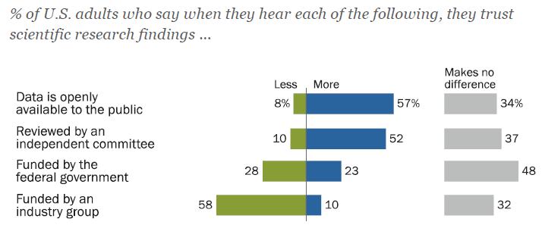
A Matter of Trust
https://www.pewresearch.org/science/wp-content/uploads/sites/16/2019/08/PS_08.02.19_trust.in_.scientists_FULLREPORT.pdf

Slide 7
Iterative Policy Development through Consistent Community Engagement
Tribal Consultation*
Input from Secretary’s Advisory Committee for Human Research Protections & other agencies
2020
Final Policy Released
2023
Policy Effective
2019
RFC: Draft Policy and
Guidance
2018
RFI: Proposed Provisions for a Draft Policy
2016
RFI: Strategies on Data Management, Sharing, and Citation
*See “NIH Tribal Consultation Report: NIH Draft Policy for Data Management and Sharing”

Slide 8
NIH Policy for Data Management and Sharing
Submission of Data Management & Sharing Plan for all NIH-funded research (how/where/when)
Compliance with the ICO-approved Plan (may affect future funding)
Effective January 25, 2023 (replaces 2003 Data Sharing Policy)
Aims to foster data stewardship

Slide 9
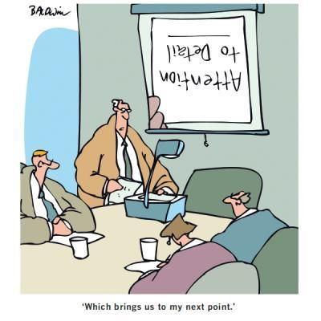
Details [of the Policy] Matter!
Scope: All NIH-supported research generating scientific data
What’s in: “Recorded factual material… of sufficient quality to validate and replicate research findings, regardless of whether the data are used to support scholarly publications”—relates to the proposed research questions and findings can include unpublished null results
What’s out: lab notebooks, preliminary analyses, case report forms, physical objects
Timelines:
When to share data? no later than publication or end of award (for data underlying findings not published in peer- reviewed journals)
How long to share data? consider other relevant requirements and expectations (e.g., journal policies, repository policies)

Slide 10
Additional Expectations for Plans
SHARING SHOULD BE …
The default practice
Data sharing should be maximized (with justifiable limitations)
All data should be managed; not all must be shared
Responsibly implemented
Plans should outline protection of privacy, rights, and confidentiality
Abide by existing laws, regulations, and policies
Prospectively planned for at all stages of the research process

Slide 11
Supplemental Information: Elements of a Data Management and Sharing Plan
Recommended elements of a Plan:
Data type
Identifying data to be preserved and shared
Related tools, software, code
Tools and software needed to access and manipulate data
Standards
Standards to be applied to scientific data and metadata
Data preservation, access, timelines
Repository to be used, persistent unique identifier, and when/ how long data will be available
Access, distribution, reuse considerations
Description of factors for data access, distribution, or reuse
Oversight of data management
Plan compliance will be monitored/ managed and by whom

Slide 12
Supplemental Information: Repository Selection
Encourages use of established repositories
Helps investigators identify appropriate data repositories
E.g., use of persistent unique identifiers, attached metadata, facilitates quality assurance
Refers to list of NIH-supported Data Repositories
NIH ICs may designate specific data repository(ies)

Slide 13
Examples of Established Generalist Repositories
Dataverse
Zenodo
Open Science Framework
Dryad
Figshare
Mendeley Data
PubMed Central (small datasets only)
Synapse
Vivli
re3data.org (1500+ repositories)

Slide 14
NEW: The Generalist Repository Ecosystem Initiative
Solicit applications from generalist repositories working together to:
Expected Outcomes
Implement consistent capabilities (NOT-OD-21-016)
Engage the research community
Create better access to & discovery of NIH funded data
Conduct outreach & train on FAIR data practices
Make data sharing easier
Encourage secondary use of data
Improve discoverability
Increase reproducibility of research

Slide 15
Supplemental Information: Allowable Costs
Reasonable costs allowed in budget requests (must be incurred during the performance period)
Curating data/developing supporting documentation
Preserving/sharing data through repositories
Local data management considerations
NOT considered data sharing costs
Infrastructure costs typically included in indirect costs
Costs associated with the routine conduct of research (e.g., costs of gaining access to research data)
Over time NIH hopes to learn more about what constitutes reasonable costs for various data management and sharing activities

Slide 16
Plan Submission and Review: A Guide
Extramural Grant Awards*
Plan Submission
With application
Brief Plan description in Budget Justification
Full Plan as separate attachment
Plan Assessment
Peer reviewers comment on (not score) budget
NIH program staff assess Plans
Plans can be revised
Plan Compliance
Incorporated into Terms and Conditions
Monitored at regular reporting intervals – mechanisms and tools to support oversight under development
Compliance may factor into future funding decisions
*Analogous requirements for contracts, Other Transaction Awards, NIH Intramural Research Program

Slide 17
Implementation Areas of Consideration
Activities for the implementation window (through Jan 2023)
Collaborative trans-NIH effort – Working with trans-NIH stakeholders and committees to implement the policy
Approaches and workflows – Determine the appropriate roles, responsibilities, and processes by which ICs will assess Plans and monitor compliance
System changes – Enhance award management systems and develop tools to support the submission, assessment, and compliance monitoring of Plans
Considering approaches for public posting of Plans including how they will link to repositories, employment of persistent identifiers such as DOI, and FAIR principles
Planning communications and guidance to ensure investigators, institutions, and NIH staff are prepared for the Policy

Slide 18
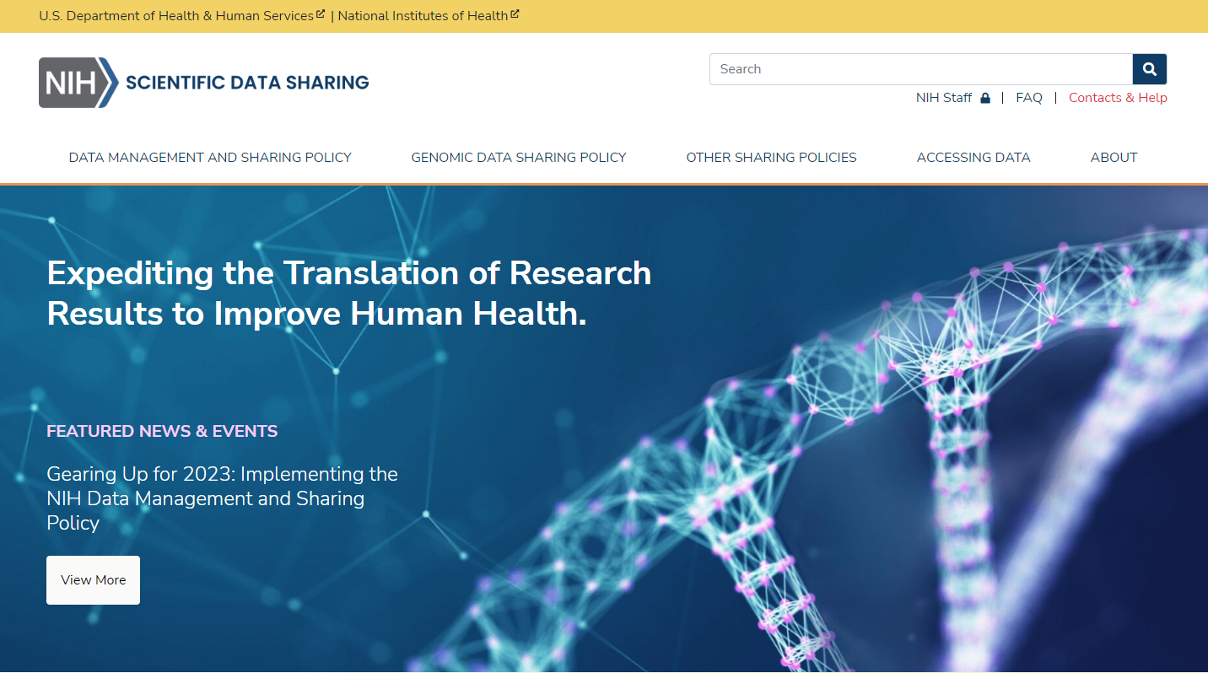
New website released April 5: sharing.nih.gov
Provides a central source of guidance related to multiple NIH data sharing policies
Covers Data Management and Sharing, Genomic Data Sharing, Model Organisms, and Research Tools policies
Content will be updated

Slide 19
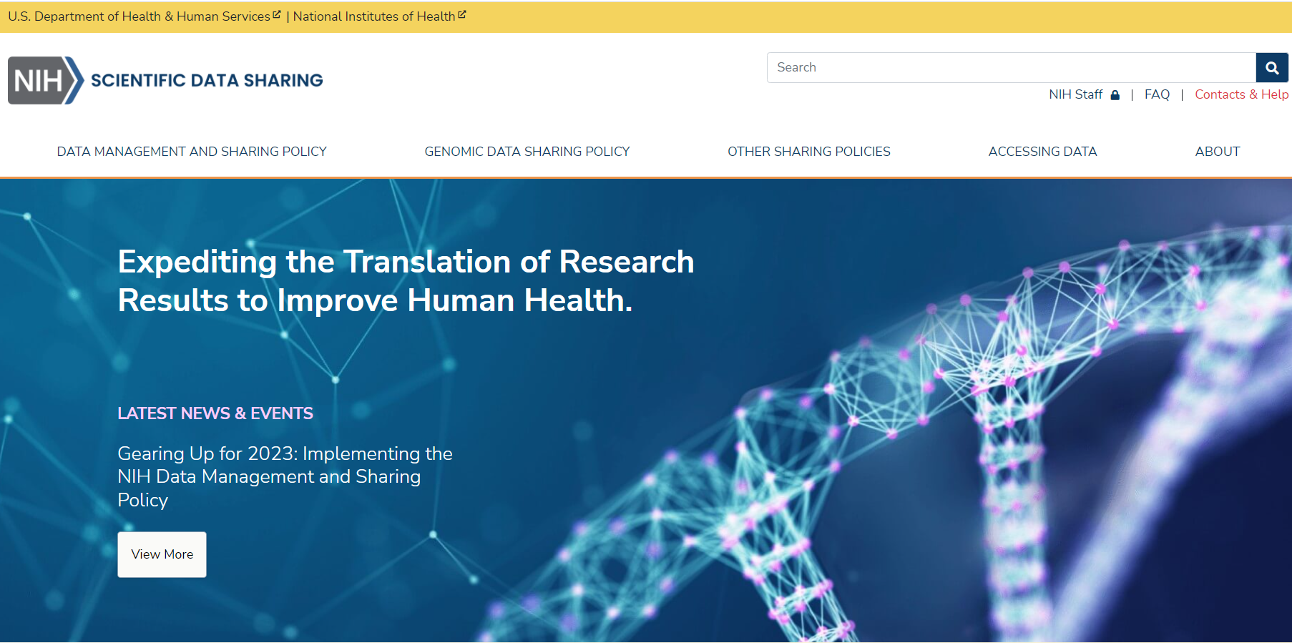
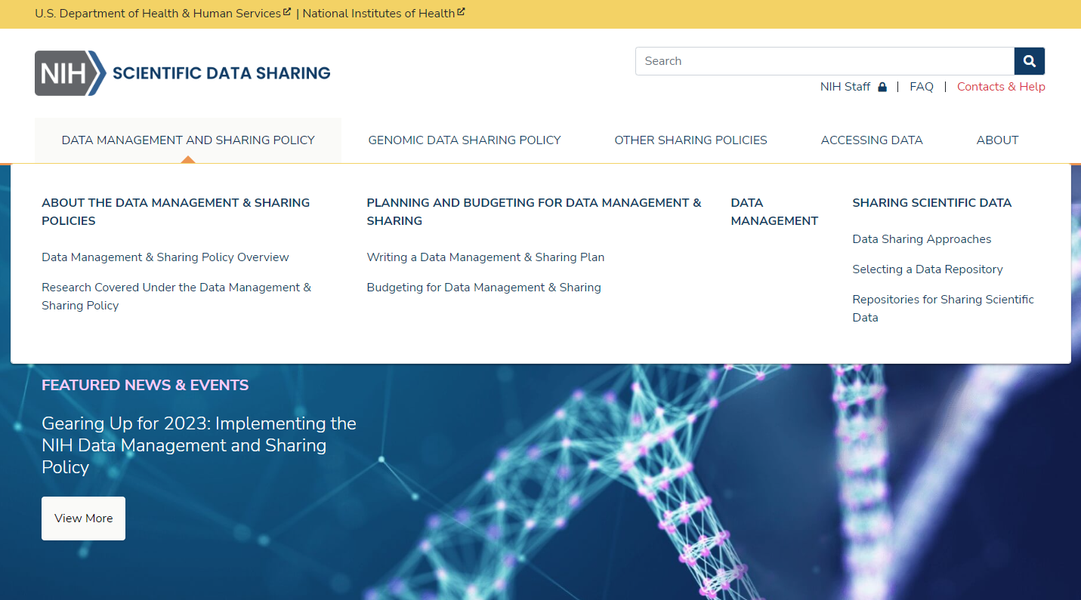
Resources for…
Provides a central source of guidance related to multiple NIH data sharing policies
Covers Data Management and Sharing, Genomic Data Sharing, Model Organisms, and Research Tools policies
Content will be updated

Slide 20
Resources for: Planning and Budgeting
Expectations for writing a Data Management & Sharing Plan
Budgeting for data management & sharing in your application for funding
Will be updated by early fall with instructions and format for submitting Plans

Slide 21
Resources for: Sharing Scientific Data
Data sharing approaches
Selecting data repositories

Slide 22
Resources for: Understanding Sharing Policies
Explore NIH sharing policies
Tool to find which policies apply to you

Slide 23
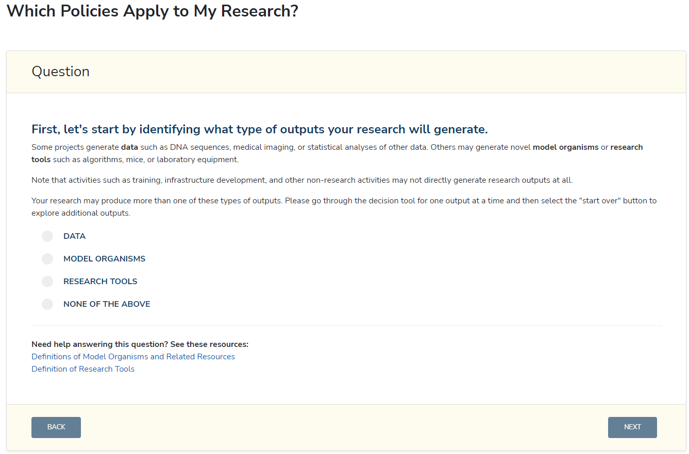
Resources for: Which Policies Apply to You?
Explore NIH sharing policies
Tool to find which policies apply to you

Slide 24
Roadmap to 2023 and Beyond
Recent OSP Under the Poliscope and Open Mike blogs provide a general roadmap for what to expect leading to 2023 and afterward
Out now!
Webinars & FAQs
DRAFT supplemental information for researchers working with AI/AN Participants—comments due April 28, 2022
Before 2023:
Additional supplemental information (i.e., budget considerations, protecting privacy)
Sample Plans and templates, additional webinars
Harmonization of GDS Policy
Beyond 2023:
Ongoing assessment of the Policy for short- and long-term goals
Incentives for data sharing

Slide 25
DMS Policy FAQs
Policy Scope
How does the DMS Policy fit in with other NIH data sharing policies and requirements?
How does the DMS Policy interact with the data sharing expectations of other research partners (e.g., other funding agencies, collaborators)?
Are projects establishing repositories or creating data infrastructure subject to the DMS Policy (i.e., establishing a data coordinating center with no research question proposed)?
Managing and Sharing Scientific Data
Does the timeline for sharing scientific data change in the event of a no cost extension?
What are justifiable reasons for limiting sharing of data?
Do SBIR/STTR projects have to share scientific data under the DMS Policy?
Considerations for Scientific Data Derived from Human Participants
What steps does the DMS Policy take to ensure institutions and researchers protect research participants?
Does the DMS Policy expect that when consent is obtained for research involving human participants, it must be for broad sharing and the future use of data?
Compliance and Enforcement
How will noncompliance with the NIH DMS Policy be handled?

Slide 26
New Resource: Informed Consent for Secondary Research with Data and Biospecimens: Points to Consider and Sample Language for Future Use and/or Sharing
Both data and biospecimens can be reused to benefit science and society
Responsible stewardship is essential
Effective consent is needed to facilitate data and biospecimen storage and sharing
Serves as a resource to:
Uphold individual autonomy, strengthen trust in research
Communicate clearly the potential risks, benefits
Revised based on community input
“Points to consider" for investigators, IRBs when modifying consent language
Sample consent language for data, biospecimen storage, sharing
Use is completely voluntary

Slide 27
Draft Supplemental Information: Privacy and De-identification of Human Research Data
Operational Principles for Protecting Participant Privacy
Considering protections beyond de-identification (e.g., controlled access)
Institutional review of conditions for data sharing
Communicating in consent forms how data will be shared and used
Considering protections for data generated in non-research settings
Best Practices for Protecting Participant Privacy
De-identifying to the greatest extent possible, while maintaining utility
Agreements for data sharing and use
Legal protections against disclosure and misuse (Certificates of Confidentiality)
Points to Consider for Designating Data for Controlled-Access
Situations where de-identification cannot sufficiently reduce the possibility of re-identification
Considerations for sensitive data, new risks, and as imposed by regulations, laws, and policies

Slide 28
Draft Supplemental Information: Responsible Management and Sharing of AI/AN Participant Data
Purpose is to support NIH funded researchers conducting research with American Indian and Alaska Native (AI/AN) Tribes to:
Bolster understanding of Tribal sovereignty and Tribal research laws, policies, and processes;
Build awareness of historic harms to AI/AN Tribes in relation to data oversight and privacy, and provide guidance to minimize potential risks associated with informed consent, data oversight, privacy/confidentiality, and security;
Cultivate partnerships with AI/AN Tribes that are built upon proactive engagement and are respectful, sustained, and equitable;
Submit an appropriate, mutually agreed upon, and culturally aware Plan for data management and sharing when conducting research with AI/AN Tribes

Slide 29
Preparing for 2023—No Time like the Present
Steps you can take to begin preparing for the Policy:
Try drafting a data management and sharing plan for your work based on the recommended elements (NOT-OD-21-014)
Identify existing resources within your institution that may be able to assist you, such as data librarians
Review your past data sharing practices to meet other funder or publisher expectations and consider what you may need to update for the new Policy in the future

Slide 30
Thank You!
sharing.nih.gov
OSP Data Management and Sharing Website:
NOT-OD-21-013 – Final NIH Policy for Data Management and Sharing
NOT-OD-21-014 – Supplemental Information to the NIH Policy for Data Management and Sharing: Elements of an NIH Data Management and Sharing Plan
NOT-OD-21-015 – Supplemental Information to the NIH Policy for Data Management and Sharing: Allowable Costs for Data Management and Sharing
NOT-OD-21-016 – Supplemental Information to the NIH Policy for Data Management and Sharing: Selecting a Repository for Data Resulting from NIH-Supported Research
Questions? sciencepolicy@mail.nih.gov
Follow us on Twitter: @NIH_OSP

