Slide 1
Preparation
“I’m getting ready for it”

Slide 2
Discussion points from last module
What shows you that a patient is in contemplation?
When you notice patients in contemplation, what strategies discussed last time work best for you?
Notes:
[NOTE TO FACILITATOR: If you are completing these modules in an order other than suggested in the facilitation guide, you may need to adjust these discussion points.]

Slide 3
Objectives
By the end of the program, participants will:
Define the preparation stage
Discuss MI techniques for patients in preparation

Slide 4
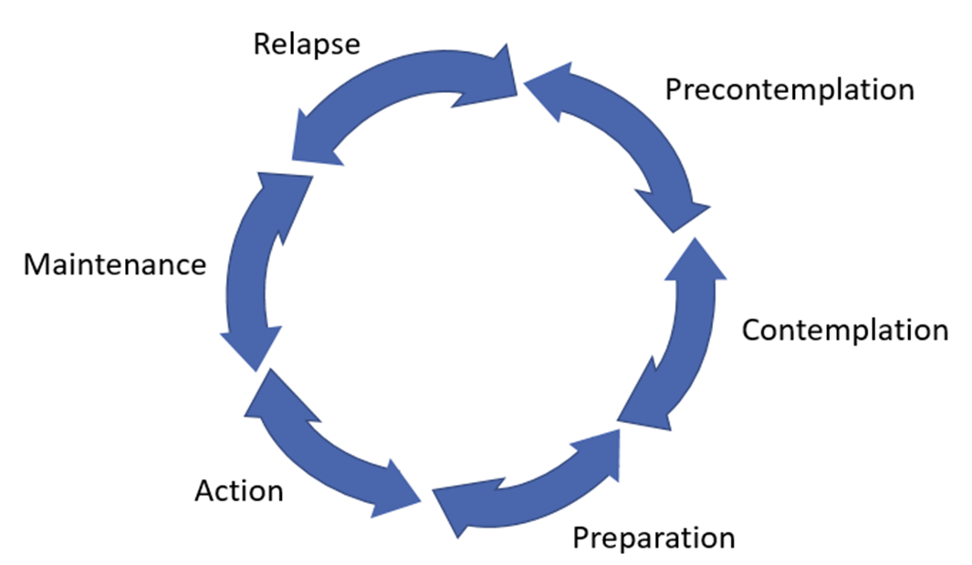
Preparation
Support self-efficacy & motivation
Discuss a plan
Committed to making a
change
Preparation
Figure 1. Adapted from Tuccero, Railey, Briggs & Hull (2016). Behavioral Health in Prevention and Chronic Illness Management, Primary Care: Clinics in Office Practice, 43, 191-102. doi: 10.1016/j.pop.2016.01.006
Notes:
We’re moving on to the preparation stage. For this stage, because someone has decided that they want to make a change, the goal is to consider a plan¹. The MI technique suggested for this stage is supporting self-efficacy¹. Self-efficacy is part of motivation, along with someone’s belief that a behavior is important⁴.

Slide 5
What is Preparation?
A patient intends to take action to change a behavior soon, usually within the next month²
They have a plan for how to make change²
Notes:
A person who is in the preparation stage intends to take action to change a behavior soon, usually defined within the next month. They are different from the contemplators because the scale has tipped in the direction of making a change and they are planning for how they can take action.

Slide 6
Recognizing Preparation
Patients in preparation may:
Be open with change talk⁴
Have taken steps to prepare⁴
Joined Weight Watchers
Bought exercise shoes
Obtained nicotine replacement therapy
Notes:
Patients in preparation will probably be easier to place in a stage of change than contemplators or precontemplators. They will tell you that they have done something to get ready for change³ such as joined weight watchers or obtained nicotine replacement therapy to quit smoking. Or, they will make other statements about the need for change or their preparation efforts where you will know they are getting ready to make a change⁴.

Slide 7
Preparation - what to do?
Support self-efficacy¹
Affirmations⁴
Help them identify a support or an accountability partner³
Help them make a plan or set a goal³
Support self-efficacy & motivation
Discuss a plan
Committed to making a
change
Preparation
Figure 1. Adapted from Tuccero, Railey, Briggs & Hull (2016). Behavioral Health in Prevention and Chronic Illness Management, Primary Care: Clinics in Office Practice, 43, 191-102. doi: 10.1016/j.pop.2016.01.006
Notes:
The primary thing to focus on in this stage is the patient’s self efficacy¹. If you remember discussing some of our MI techniques in previous conversations, affirmations are one way to support self-efficacy⁴. This is when you highlight a positive attribute about the patient⁴ such as, “By developing this plan, you’ve really shown how committed you are to lowering your blood pressure.” In addition to supporting their self-efficacy, you can consider helping them find an accountability partner to support them³. This could be a friend or family member who will help them stick with what they have planned or take action alongside them. You can also help them further develop their plan or set a specific goal³. For example, if they have made a plan to walk more, you may want to see if they are open to discussing how many days a week they think is realistic for them to do this or what time of day they think will be the easiest for them to do this.
[NOTE TO FACILITATOR: If you are completing these modules in an order other than suggested in the facilitation guide, you may need to adjust this note.]

Slide 8
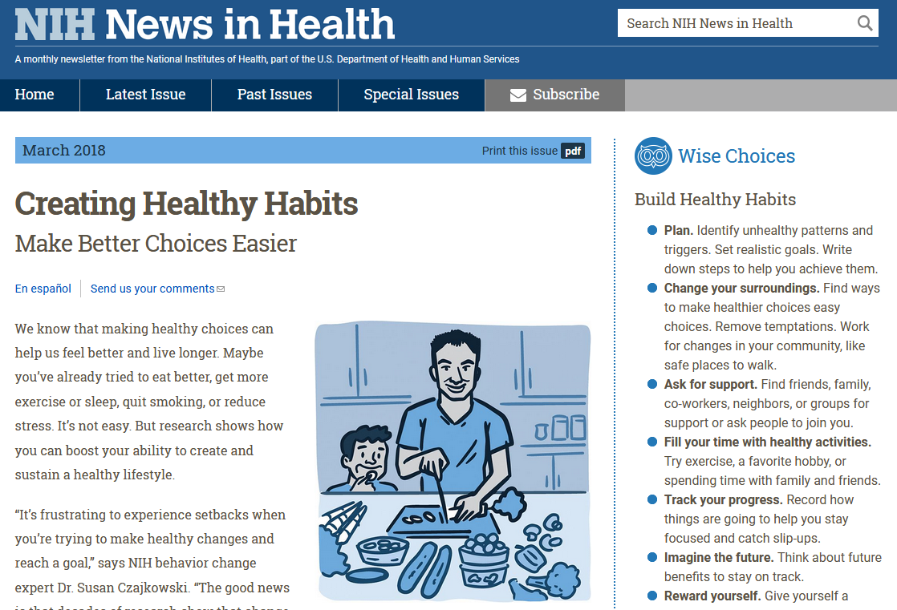
Materials to support this stage
Notes:
Here is a great tip sheet from NIH that offers suggestions for making healthy changes - this was accessed easily from MedlinePlus and would be useful for someone who is getting ready to make a behavior change. This is a great way to consider how health information ties into behavior change. Patients who are getting ready to change might be looking for information online - if they know about MedlinePlus, they may come across this type of information before they see sponsored content.

Slide 9
Take home message
Consider:
What shows you that a patient is in preparation?
Practice:
When you notice patients in preparation, what strategies discussed today work best for you?
Developed resources reported in this presentation are supported by the National Library of Medicine (NLM), National Institutes of Health (NIH) under cooperative agreement number UG4LM012342 with the University of Pittsburgh, Health Sciences Library System. The content is solely the responsibility of the authors and does not necessarily represent the official views of the National Institutes of Health.
Notes:
As we wrap up today, some things to keep in mind are: what shows you that a patient is in preparation and when you notice this, which strategies from today do you think will work the best for you when working with them?
[NOTE TO FACILITATOR: If you want to complete group discussion immediately following this module content, change the title of this slide to ‘Group Discussion’ and delete the slide with corresponding questions in the next module. If you would like to have discussion take place using your internal LMS system, you can include instructions here for how participants can participate. Then, adjust the slide with the corresponding questions in the next module as needed.]

Slide 10
References
Tuccero, Railey, Briggs & Hull (2016). Behavioral Health in Prevention and Chronic Illness Management, Primary Care: Clinics in Office Practice, 43, 191-102. doi: 10.1016/j.pop.2016.01.006
Glanz, K., Rimer, B. & Viswanath, K. (Eds.). (2015). Health Behavior: theory, research and practice. San Francisco: Jossey-Bass.
Constance, A. & Sauter, C. (2011). Inspiring and Supporting Behavior Change. United States: American Dietetic Association.
Gold, M., Kelly, T., Douihy, A. (2015). Motivational Interviewing : A Guide for Medical Trainees. New York: Oxford University Press.
McGinnis P., Davis M., Howk S., DeSordi M. & Thomas M. (2014). Integrating Primary Care Practices and Community-based Resources to Manage Obesity: A Bridge-building Toolkit for Rural Primary Care Practice Transformation. Rockville, MD: Agency for Healthcare Research and Quality: AHRQ Publication No. 14-0043-EF. Retrieved from URL to source
Stewart, E., Taylor-Post, N., Nichols L., Staton E., & Schleuning A. (2014). Community Connections: Linking Primary Care Patients to Local Resources for Better Management of Obesity. Rockville, MD: Agency for Healthcare Research and Quality; AHRQ Publication No. 14-0030-EF. Retrieved from URL to Source
Center for Substance Abuse Treatment (1999). Enhancing Motivation for Change in Substance Abuse Treatment. Treatment Improvement Protocol (TIP) Series, No. 35. HHS Publication No. (SMA) 12-4212. Rockville, MD: Substance Abuse and Mental Health Services Administration. Retrieved from URL to Source

