Slide 1
Hosting a Hackathon: Lessons Learned in Libraries
Love Data Week 2023
February 14, 2023

Slide 2
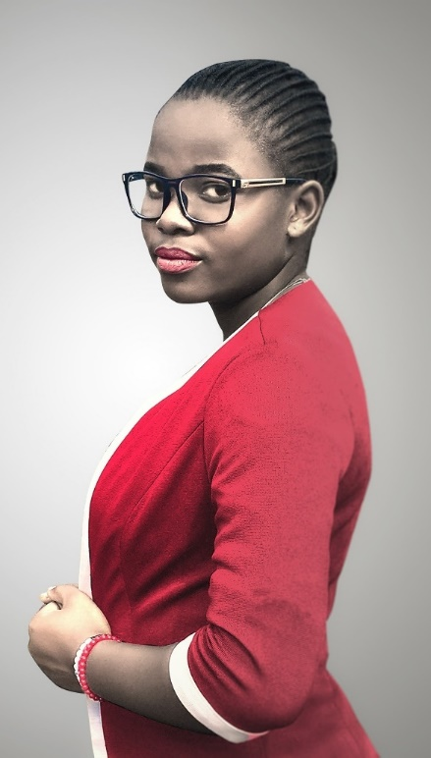
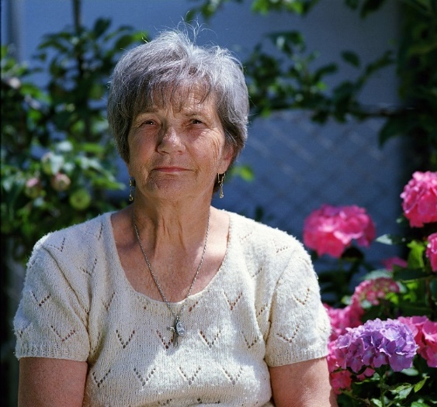
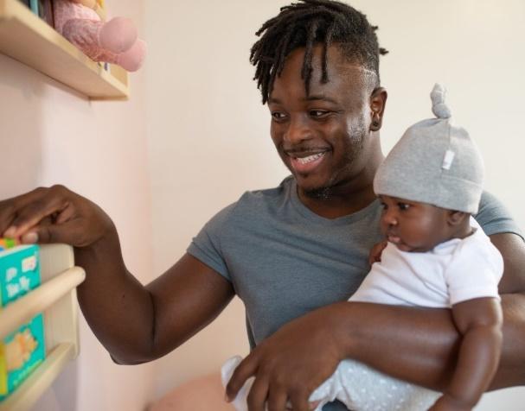
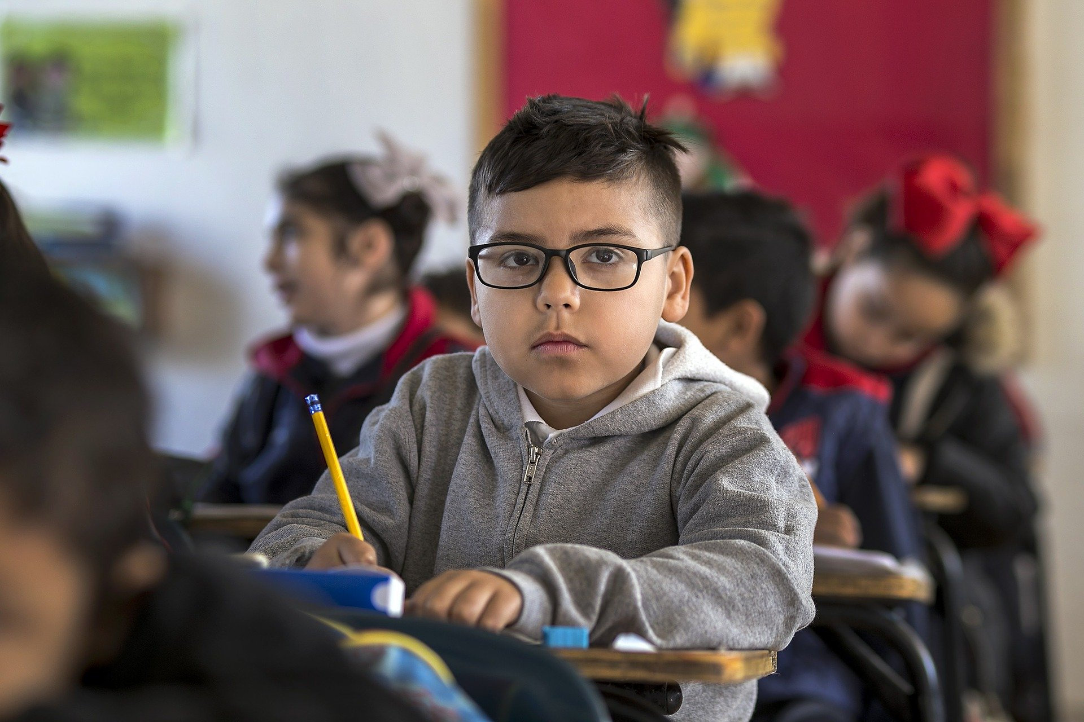
NNLM
Notes:
Some of you may be familiar with the NNLM –the Network of the National Library of Medicine, but for others this may be your first time attending one of our programs. Welcome! To give you context, I’ll briefly tell you a little bit about the NNLM and what we do.

Slide 3
Who we are
National Institutes of Health (NIH)
Nation’s leading research agency
National Library of Medicine (NLM)
World’s largest biomedical library, part of NIH
Network of the National Library of Medicine (NNLM)
Outreach program of the NLM
Regions, Offices and Centers (ROC)
7 regional medical libraries
4 national centers
4 national offices
Notes:
The Network of the National Library of Medicine is funded by the National Library of Medicine, which is the world’s largest biomedical library. The NNLM is the outreach arm of the NLM. The NLM is a part of the National Institutes of Health, which is the nation’s leading research agency.
The Network of the National Library of Medicine has what we call ROCs, or regions, offices, and centers. The NNLM is made up 7 regional medical libraries, 4 national information centers, and 3 national offices, providing training, funding, and engagement opportunities to over 9,000 NNLM member organizations.
If you’d like to learn more learn more about the NNLM, you can check out our website at nnlm.gov.

Slide 4
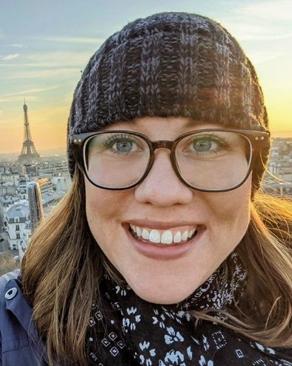
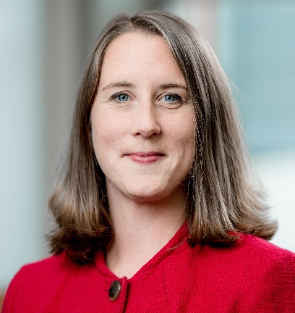
Our Panelists
Alexa Salsbury, Data Scientist/Outreach Lead at National Center for Biotechnology Information (NCBI), Bethesda, Maryland.
Ashley Rockwell, Data Literacy & Learning Specialist at Georgia State University Library, Atlanta, Georgia.
Meris Mandernach Longmeier, Associate Professor, Head of Research Services at The Ohio State University Libraries, Columbus, Ohio.
Notes:
Alexa Salsbury, Ph.D. is a Data Scientist and Outreach Lead at the National Center for Biotechnology Information. She has experience in educational event coordination, mentorship, community outreach, computational education, and computer science. Her research background includes computational chemistry, structural biology, and biophysics.
Contact codeathons@ncbi.nlm.gov for more info on code a thons from NCBI
Ashley Rockwell is the Data Literacy & Learning Specialist in the Research Data Services Department at Georgia State University Library, in Atlanta, GA. Her work focuses on building data literacy curriculum and programming for undergraduates. In 2022, she partnered with GSU’s Social Action Alliance to host their first multidisciplinary hackathon with teams of GSU undergraduates working to address Transportation and Mobility issues in partnership and mentorship with community partners. Ashley believes that expanding data literacy will not only make students more hirable, bettering their individual futures, but can empower students with the tools to understand social issues and implement social change.
Contact arockwell3@gsu.edu or @GetDataReady on Twitter and Instagram
Meris Mandernach Longmeier is the head of Research Services for Ohio State University Libraries. In this role she develops services for OSU Libraries to support the research endeavors of all faculty, staff, and students at Ohio State. Outside of her library responsibilities, she is the co-founder and co-faculty director of the OHI/O program (https://hack.osu.edu/about.html). The OHI/O Program fosters a tech culture at Ohio State and its surrounding communities, ultimately providing students the opportunity to learn and build with real technologies outside of the classroom. For the past ten years through the platform, OHI/O has connected students to real world problems and opportunities by engaging with the community and industry partners.

Slide 5
NCBI Codeathon Program
Alexa M. Salsbury, Ph.D., Data Scientist/Outreach Lead at National Center for Biotechnology Information (NCBI)

Slide 6
NCBI Codeathons 1
Collaborative events where team members with varied educational backgrounds work together on a project
They are a great opportunity for us to:
Introduce NCBI tools to researchers
Get feedback on our products
Engage with scientific communities
NCBI Codeathons website

Slide 7
NCBI Codeathons 2
Collaborative events where team members with varied educational backgrounds work together on a project
They are a great opportunity for our participants to:
Explore new technology
Learn from peers
Network

Slide 8
Planning a codeathon
Notes:
A flowchart depicting how NCBI plans a codeathon. 1:Form working group, 2: define event topic. 3. Identify target audience. 4: recruitment. 5: Assemble teams. 6: technical preparation. 7: Structure the event. 8: Deliver the event. 9: Collect feedback. 10: Publish results.

Slide 9
Learn about NCBI Resources
Join us for workshops, webinars, or codeathons!
NCBI Insights Blog
Follow us on social media:
Twitter
LinkedIn
Facebook

Slide 10
THANK YOU!
NCBI Outreach
Rana Morris, Ph.D.
Sally Chang, Ph.D.
Peter Cooper, Ph.D.
Eric Sayers, Ph.D.
Michelle Formica-Frizzi
Daniel Rice, Ph.D.
NCBI Systems
Brian Koser
Matthew Lesko
This work was supported by the Intramural Research Program of the NIH, National Library of Medicine
National Library of Medicine’s National Center for Biotechnology Information (NIH/NLM/NCBI)
NIH Science and Technology Research Infrastructure for Discovery, Experimentation, and Sustainability (STRIDES) Initiative
National Institutes of Health Office of Data Science Strategy (NIH/ODSS)

Slide 11
Hack 4 Good: A Multi-Disciplinary Community-Focused Hackathon
Ashley Rockwell, Data Literacy & Learning Specialist, Georgia State University Library, Atlanta, GA. Contact: arockwell3@gsu.edu and @GetDataReady.

Slide 12
GSU’s Hack 4 Good 2022 Theme: Transportation & Mobility in Atlanta
Day 1
Introduction to Transportation
Q&A with Community Partners
Innovation Workshop
Transportation Problem Brainstorming & Challenge Question Selection
Day 2
Teams work on their proposals/projects
Mentors & Community Partner Officer Hours
Day 3
Team Presentations
Hack 4 good website

Slide 13
Multi-Disciplinary & Community Partner Driven
Five Different Categories
Mentors, Experts, & Volunteers
Creative Arts
Consumer Products
Government& Corporate Policy
Media
Applications & Platforms
Local experts from organizations focused on transpiration and mobility University Library Research Data Services Team Members
GSU Faculty & Staff
Notes:
Ended up with 40 volunteers/mentors/experts

Slide 14
Saturday Office Hours
Converted our Study Rooms to Office Hour locations for our Community Partners & Mentors
Students could drop-in for transportation & policy expertise, data access, and data help
Students & Partners told us this was one of their favorite parts of the hackathon
Notes:
100 percent of students who filled out our survey indicated that they agreed or strongly agreed that the office hours with community members were beneficial

Slide 15
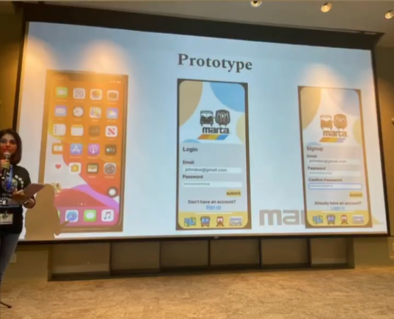
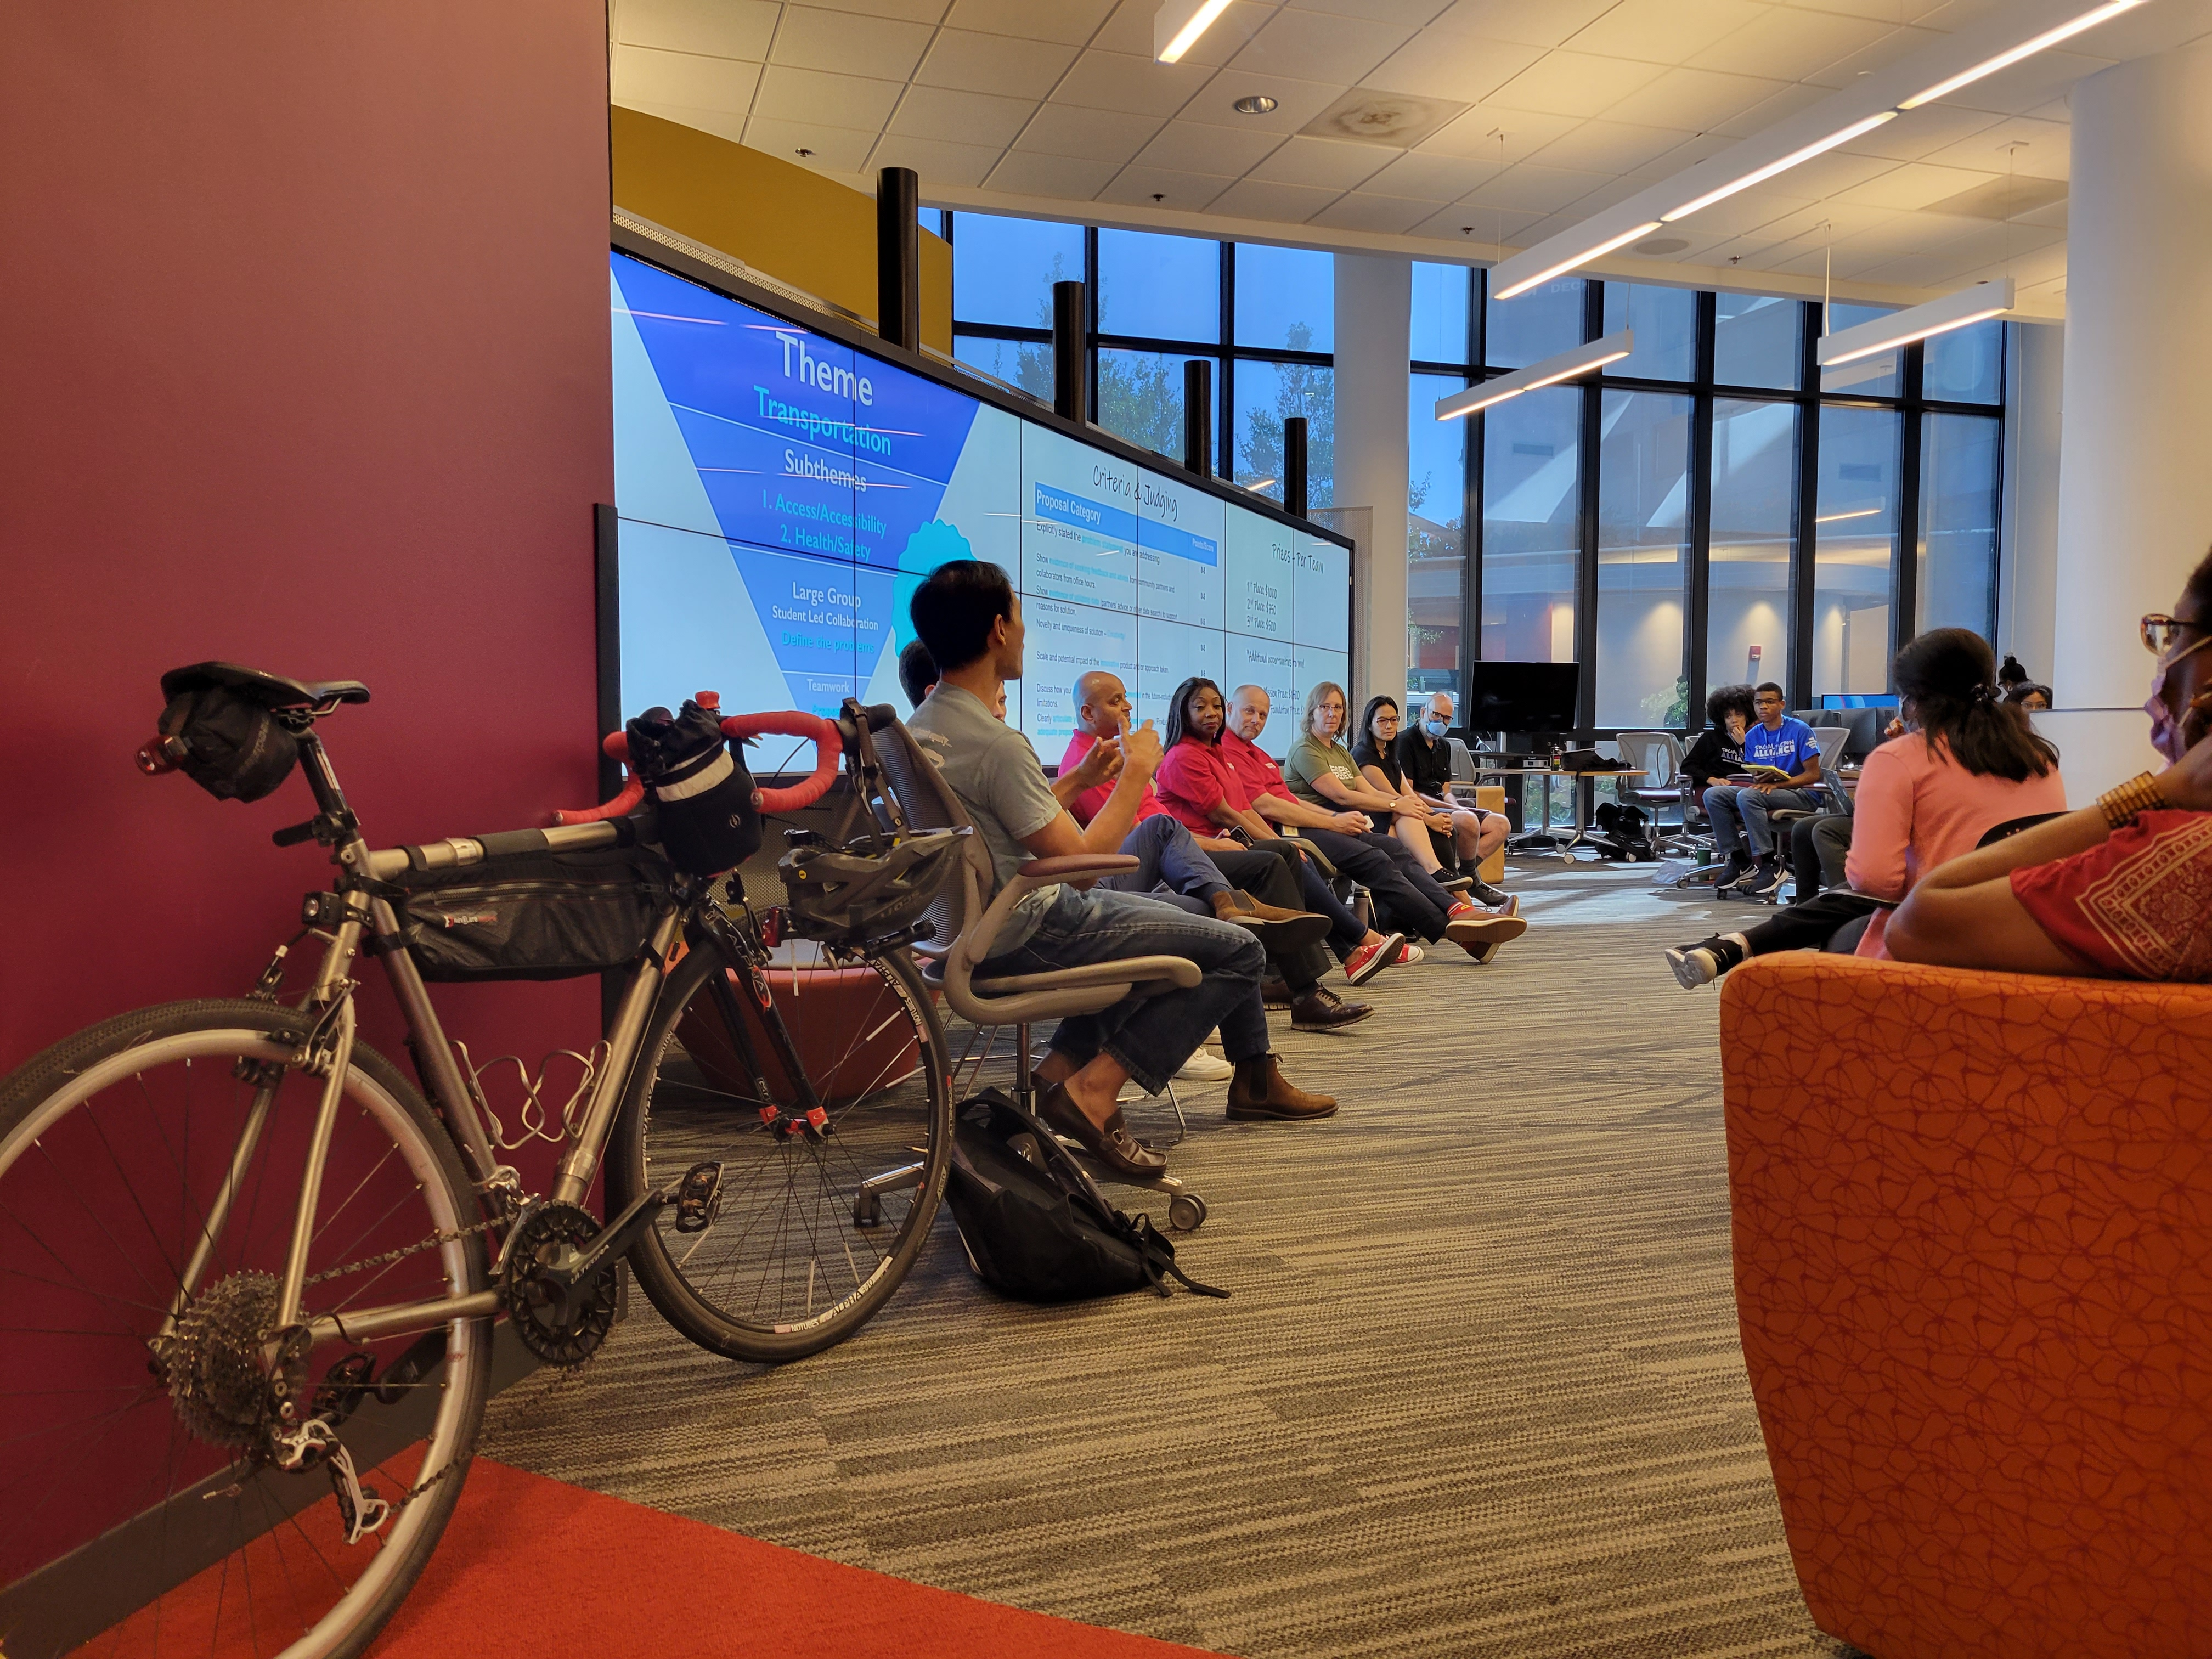
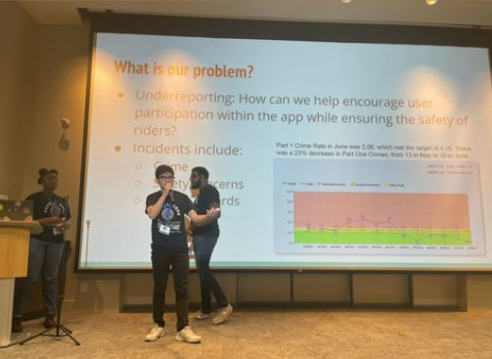
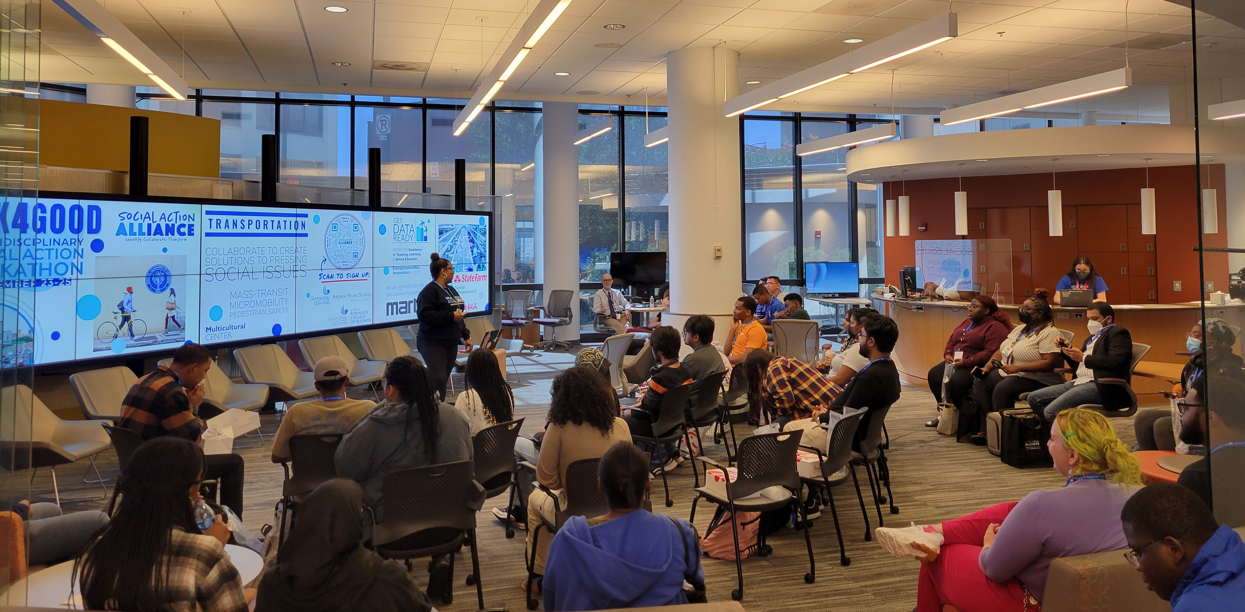
Event Photos

Slide 16
Hack 4 Good LibGuide
Visit the Hack 4 Good LibGuide at https://research.library.gsu.edu/h4g
Notes:
Visit the hack 4 Good LibGuide at https://research.library.gsu.edu/h4g

Slide 17
The Hack 4 Good gave students an opportunity to practice & gain crucial career skills
Teamwork
Time management
Consensus building
Communication & presentations
Networking
Project development
Adapting to new & changing environments
Working with multiple stakeholders
Notes:
All the student participants who responded to our Hack 4 Good Feedback Survey indicated that they either “agreed” or “strongly agreed” that the hackathon helped them practice/build their teamwork skills, problem-solving skills, communication skills, and adapting to new environments and situations. In addition, over 94% of survey participants indicated that the hackathon helped them build/practice their time management skills and networking skills.

Slide 18
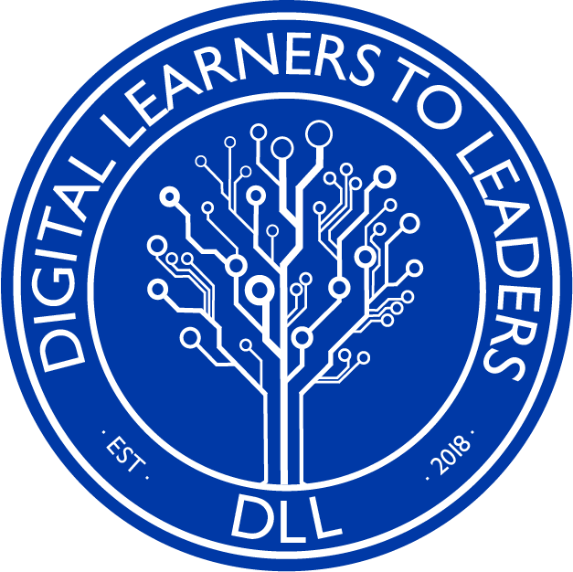
Acknowledgements
Andrew Young School of Policy Studies
J. Mack Robinson College of Business
Entrepreneurship & Innovation Institute
Center for Excellence in Teaching, Learning & Online Education

Slide 19
Additional Slides for Questions

Slide 20
Proposal & Presentation Rubric Criteria
Explicitly stated the problem statement you are addressing.
Show evidence of seeking feedback and advice from community partners and collaborators from office hours.
Show evidence of utilizing data (partners’ advice or other data search) to support reasons for solution.
Novelty and uniqueness of solution – Creativity!
Scale and potential impact of the innovative product and/or approach taken.
Discuss how your project could be feasibly implemented in the future-including limitations.
Clearly articulate your plan/project, involving all team members.
Produce an adequate proposal or content for the short time frame.

Slide 21
How Libraries Can Support Hackathons:
LibGuides
Existing datasets
Training, workshops, and other resources
Space!
Technology
Passionate people

Slide 22
Hackathons and Libraries: a perfect match
Meris Mandernach Longmeier, Associate Professor, Head of Research Services at The Ohio State University Libraries, Columbus, Ohio.
Love Data Week 2023

Slide 23
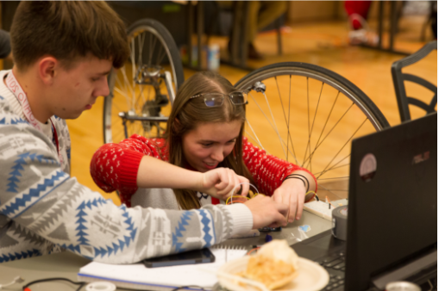
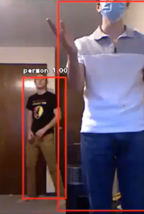
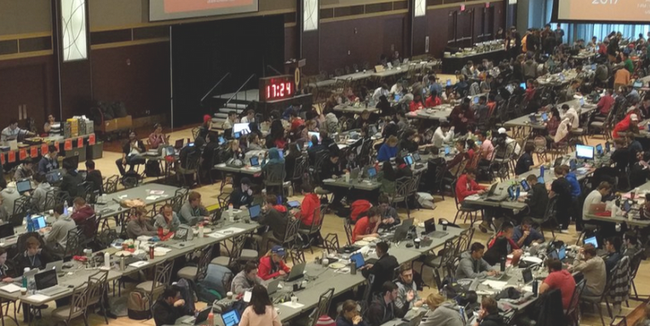
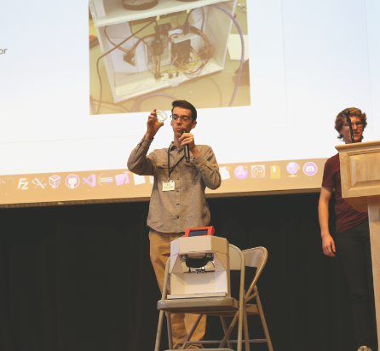
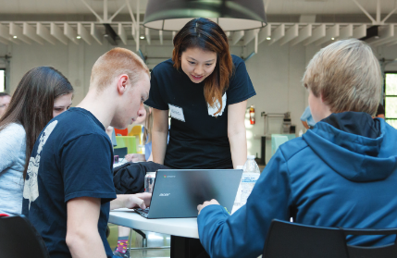
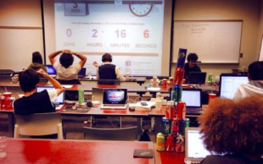
Definition of hackathons
Notes:
Hackathons are time-bound events where participants gather to build technology projects, learn from each other and experts, and create innovative solutions that are often judged for prizes. While hacking can have negative connotations when it comes to security vulnerabilities, typically for hackathon events hacking refers to modifying original lines of code or devices with the intent of creating a workable prototype or product. Here are a few pictures of the hackathons over the years, the basement of the library featured in the bottom right.
At Ohio State, the first two campus-wide hackathons were hosted in the library basement. The event grew in popularity and the event required more space. Library faculty and staff have been involved since 2013 in planning and logistics. What started as a single event has grown into a whole program of tech-related events. The libraries continue to provide judges for the main two events: hackathon and makeathon; Space for smaller events like data-thon and edit-a-thons; staff expertise and overarching program direction and guidance.

Slide 24
Timeline of OHI/O
Notes:
Timeline of OHI/O program with the hackathon in 2013, adding the makeathon in 2015, high school event and showcase event and hiring a program director in 2017, adding a grant, data and logistics event and a coding event in 2018, several additional partner events in 2019 as well as establishing an advisory board, changes due to the pandemic, and staff role changes in 2022.

Slide 25
Libraries as Place or Space
Libraries make ideal hosts for tech events
Ample parking/Hub for community
Ubiquitous wifi and outlets
May already have 24-hour spaces
Generous food policies
Outreach is a priority
Recommended Reading:
Longmeier, M.M. (2021). Hackathons and Libraries: The Evolving Landscape 2014-2020. Information Technology and Libraries, 40(4). https://doi.org/10.6017/ital.v40i4.13389
Notes:
Libraries are ideal locations for hosting large, technology-driven events given the usual amenities of ample parking, ubiquitous wifi, adequate outlets, typically generous food policies, and at times already having 24-hour spaces built into their infrastructure.
Hackathons help redefine libraries for users.

Slide 26
Scalability tips
Small steps can build over time.
You have expertise, don’t be afraid to use it.
If you have funding, that helps.
Notes:
I recognize that Ohio State has size on its side so if you can’t host a hackathon, start with an edit-a-thon.
Be a good partner and find like-minded individuals around campus.
Small steps can build over time.
You have expertise, don’t be afraid to use it.
If you have funding, that helps.
As libraries, we have a lot of assets, so it’s important to know what skill sets we possess and connections that are inherent in our spaces, services, and programs.

Slide 27
Thank you & Contact Information
Meris Mandernach Longmeier, Head of Research Services
Longmeier.10@osu.edu
https://hack.osu.edu/
Our recent article about campus tech partnerships:
https://kb.osu.edu/handle/1811/92

Slide 28
Questions & Upcoming Events
Love Data Week events through February 17
Tomorrow
Thursday
More from NNLM:
NNLM Data Viz Challenge – submissions accepted until March 31, 2023
#CiteNLM Spring 2023 Wikipedia Edit-a-thon – March 24 from 2-4pm EST

Slide 29
Evaluation and Follow Up
Evaluation link: https://www.nnlm.gov/w3CT9

Slide 30
Links shared in presentation
NCBI Codeathons: https://ncbi-codeathons.github.io (Alexa)
NCBI Outreach Events: https://ncbiinsights.ncbi.nlm.nih.gov/ncbi-outreach-events/#events (Alexa)
Hack 4 Good: https://socialaction.gsu.edu/hack-4-good/ (Ashley)
Hack 4 Good LibGuide: https://research.library.gsu.edu/h4g (Ashley)
Social Action Alliance’s Hack 4 Good - Short Testimonial Overview: https://vimeo.com/790898944 (Ashley)
OHI/O: Ohio State’s Hackathon Program: https://hack.osu.edu/about.html (Meris)
How to plan an event
https://hackathon-planning-kit.org/
https://www.carnegieuktrust.org.uk/publications/hackathons-practical-guide/
https://www.carnegieuktrust.org.uk/publications/engage-respond-innovate-the-value-of-hackathons-in-public-libraries/
Judging Examples
https://hack.osu.edu/2018/#judging-page
Links to research about hackathons and libraries
Longmeier, M.M. (2021). Hackathons and Libraries: The Evolving Landscape 2014-2020. Information Technology and Libraries, 40(4). https://doi.org/10.6017/ital.v40i4.13389

Slide 31
Contact Information
Christine Nieman, NNLM Region 1
Contact cnieman@hshsl.umaryland.edu for NNLM opportunities
Alexa Salsbury, NCBI
Contact codeathons@ncbi.nlm.gov for more info on codeathons from NCBI
Ashley Rockwell
Contact arockwell3@gsu.edu or @GetDataReady on Twitter and Instagram
Meris Mandernach Longmeier
Contact longmeier.10@osu.edu

