Slide 1
How do I search in PubMed using Clinical Queries?
Acquire

Slide 2
Discussion question
If you’re building a search with MeSH terms, what might you do if you find that one of your terms does not have an appropriate MeSH term to use?
Notes:
[NOTE TO FACILITATOR: If you skipped the optional modules 5-6 of the EBP Track you should replace this discussed question with the take home point from module 4: “What are some ways you have used PubMed to narrow search results?”]

Slide 3
Objectives
By the end of the program, participants will:
Describe the purpose of PubMed’s Topic-Specific Queries tools

Slide 4
Topic-Specific Queries
Topic-Specific (Special) Queries are a selection of pre-built search strategies that will limit your results to a certain topical area.
Notes:
PubMed offers a nice selection of what is called Topic-Specific or Special Queries. These are essentially complex pre-made search filters designed to limit your search to what you’re really looking for and reduce the number of extraneous results.

Slide 5
Time-saving tools
The Topic-Specific Queries tools in PubMed can save you a lot of time and effort in searching!
Notes:
Using the Topic-Specific Queries tools in PubMed can be a great way to save time by locating the information you need more quickly.

Slide 6
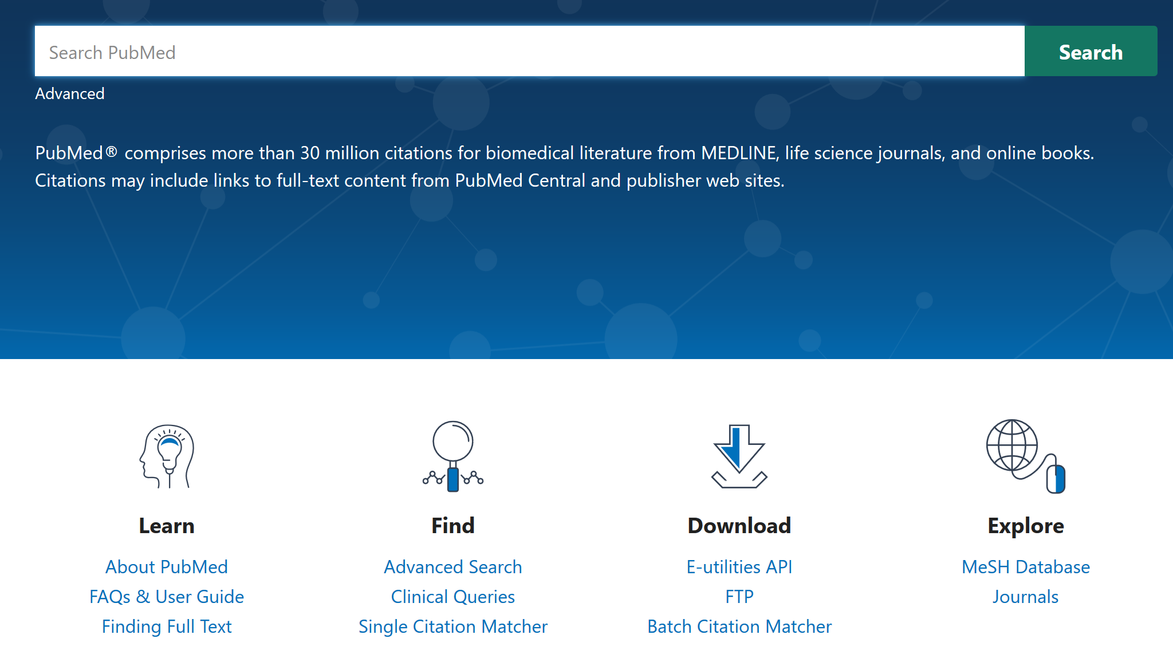
Clinical Queries (1)
Notes:
The Clinical Queries is one of these special queries that is specific to clinical care. You can find this special query on the homepage under “find”.

Slide 7
Clinical Queries (2) (URL to PubMed Clinical Queries)
Notes:
This search tool has an extremely simple interface. You can just put in the search term or terms of your choice and search.

Slide 8
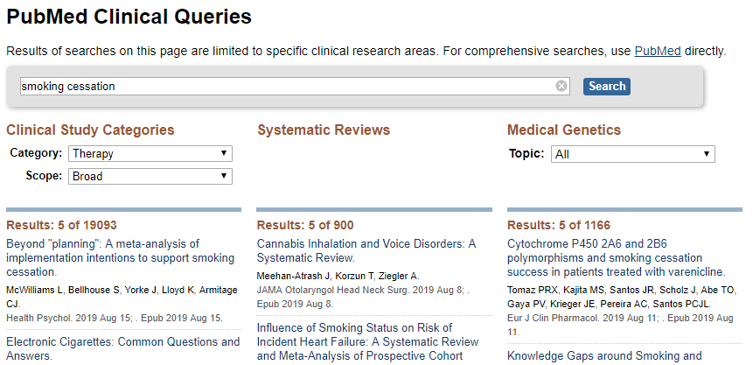
Clinical Queries (3)
Notes:
Your results page will display 3 columns:
Clinical Study Categories,
Systematic Reviews,
and Medical Genetics.
Clinical Study Categories will automatically give you literature relating to therapy for the item you searched for, but you can choose from Etiology, Diagnosis, Therapy, Prognosis, and Clinical Prediction Guides using the “Category” drop-down menu.
If you have a lot of results, you can also change the “Scope” drop-down menu to be narrow instead of broad, so your results will be more focused.
The Systematic Reviews column will return systematic review articles on the topic, which can be very useful for EBP, since systematic reviews are considered a source of high-quality evidence.
Finally, the third column will return articles relating to the medical genetics of your topic, if available. You can also narrow these results using the drop-down menu in this column.

Slide 9
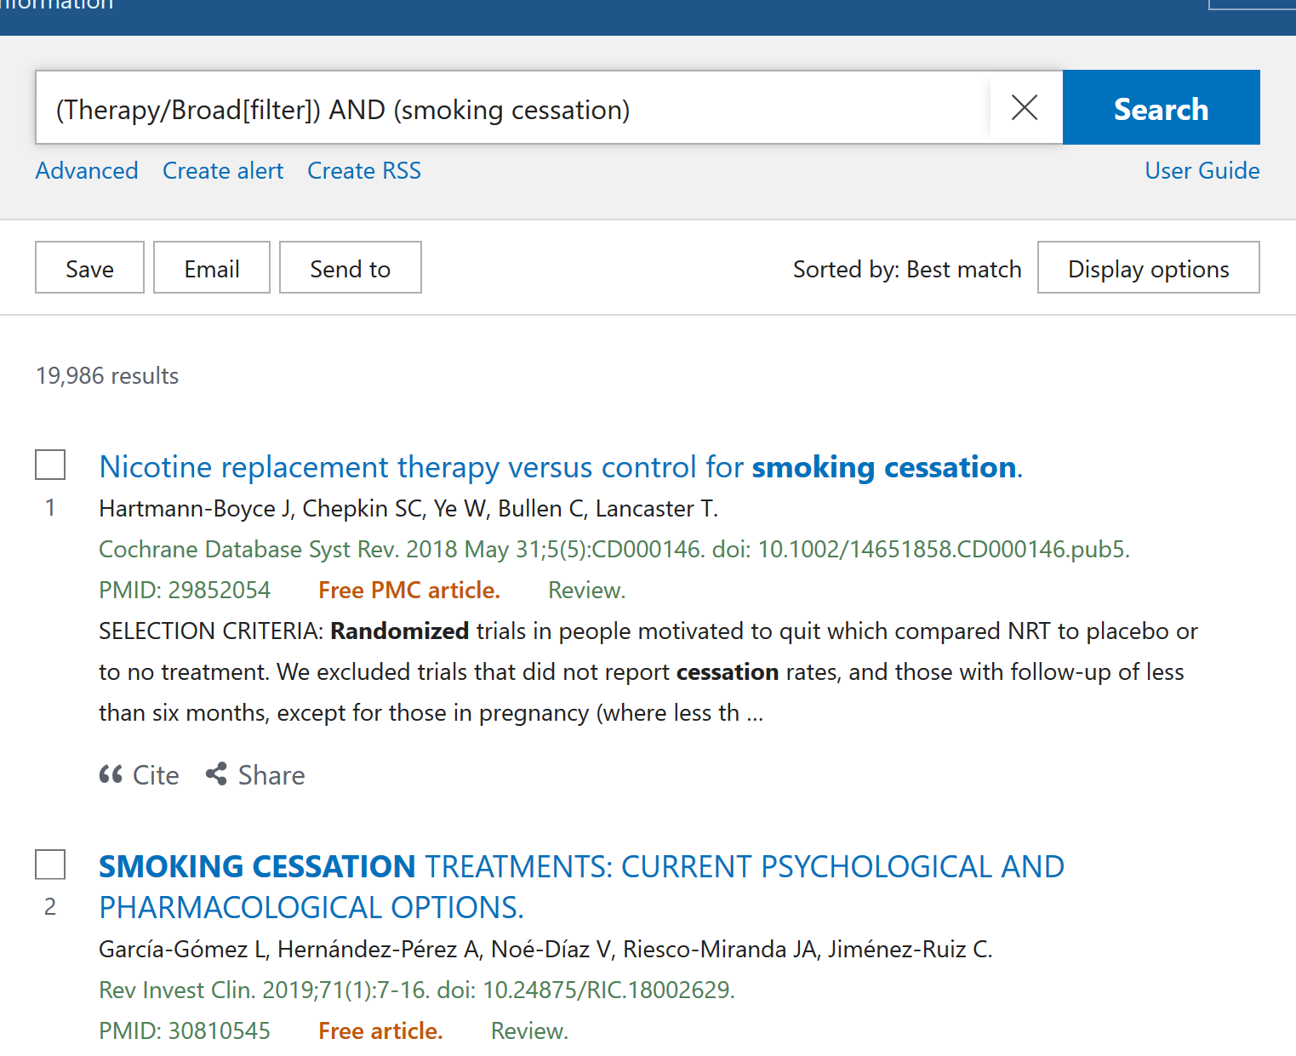
Clinical Queries (4)
Notes:
If you scroll to the bottom of the listed results for each column, you will see a link that says “See all.” Clicking on this will bring you to a more familiar-looking PubMed results page, where you can apply any filters you’d like. You’ll learn more about filtering your results in an upcoming module.

Slide 10
Take home message
Consider:
Think of some situations in which you might want to use Clinical Queries, CER Queries, and Subject Searches
Remember:
PubMed offers several types of Topic-Specific Queries including Clinical Queries, Comparative Effectiveness Research Queries, and Subject Searches
These tools help narrow down the types of results you are getting and save time
Developed resources reported in this presentation are supported by the National Library of Medicine (NLM), National Institutes of Health (NIH) under cooperative agreement number UG4LM012342 with the University of Pittsburgh, Health Sciences Library System. The content is solely the responsibility of the authors and does not necessarily represent the official views of the National Institutes of Health.
Notes:
After today’s session, take some time to think about some situations in which you might want to use Clinical Queries, CER Queries, and Subject Searches. Take some time to explore these tools.
Remember, these are all types of Topic-Specific Queries accessible via the PubMed homepage. They all, in different ways, help you narrow down the types of results you will get from a simple search, which will save you a lot of time when you’re looking for high-quality evidence but don’t have time to sift through and analyze a lot of results.
In the next module, we’ll talk more about how to know what type of resources you need to best answer your research question. The tools we just discussed will become even more useful in some situations when you’re looking for a particular type of literature.
[NOTE TO FACILITATOR: If you want to complete group discussion immediately following this module content, change the title of this slide to ‘Group Discussion’ and delete the slide with corresponding questions in the next module. If you would like to have discussion take place using your internal LMS system, you can include instructions here for how participants can participate. Then, adjust the slide with the corresponding questions in the next module as needed.]

