Slide 1
Disaster preparedness forum title slide
Notes:
Hi everyone. It’s the top of the hour, so we will get today’s session started.
Thanks so much for coming to OnTheMap for Emergency Management and My Community Explorer Data Tools.
My name is YOUR NAME, and I am the TITLE for Region # of the Network of the National Library of Medicine, and I’ll be your host for today’s session.

Slide 2
Today’s session
Use Chat to share your comments
Use Q&A to submit your questions for our speaker
Closed Caption available
Session is being recorded
Continuing Education credit available
Notes:
I have just a few informational items to cover before we get to our presentation.
Everyone has been muted to limit background noise, but we do welcome your questions and comments at any time.
Please use the Chat function to share your comments and use the Q&A function to submit any questions you have for our speaker.
Molly Knapp and Erica Lake are providing production assistance today, and they will be keeping an eye on your posts. They will queue up your questions as they come in and save them for our speaker to address at the end of his presentation.
As a reminder, by registering for this webinar, all attendees have agreed to abide by the NNLM Code of Conduct to foster a respectful and professional learning environment.
Closed Caption has been enabled and is available by clicking on the icon at the bottom of your screen with the three dots, and then selecting Closed Caption.
We are recording today’s presentation, and we will post it on NNLM’s YouTube channel in one to two weeks.
At that time, everyone who registered for this session will receive an email from us with the link for the recording, so keep an eye out for that.
This webinar is eligible for Medical Library Association and CHES Continuing Education credit which you’ll be able to claim though the evaluation link we share with you at the end of the session.
And speaking of that evaluation, your feedback really matters, and helps us improve future trainings, so please take a moment to complete it.

Slide 3
NNLM
Notes:
Since some of you might be first-time attendees to one of our webinars, I’d like to share a few words about who we are!

Slide 4
Hierarchy of NIH, NLM, and NNLM
National Institutes of Health
Nation’s leading research agency
NIH
NNLM
ROC
NLM
National Library of Medicine
World’s largest biomedical library
Network of the
National Library of Medicine
Outreach program of the NLM
Regions, Offices, and Centers
7 regional medical libraries
4 national centers
3 national offices
www.nnlm.gov
Notes:
NLM - the National Library of Medicine - is one of the 27 institutes and offices of the National Institutes of Health. It’s the world’s largest biomedical library and produces online resources like PubMed and MedlinePlus.
NNLM - the Network of the National Library of Medicine - is an outreach program of NLM, working to ensure health professionals and the public have equal access to health information.
NNLM is made up of 7 regional medical libraries, 3 national offices, and 4 national centers, all providing training, funding, and engagement opportunities to over 9k NNLM member organizations.
If you’d like to connect with your regional medical library or learn how to become a Network member, you can check out our website at nnlm.gov.

Slide 5
NNLM Virtual Disaster Preparedness Forum
NNLM Training Calendar www.nnlm.gov/training
Notes:
Today’s session is part of the NNLM Virtual Disaster Preparedness Forum, which is taking place September 12th through the 28th.
The forum features expert speakers presenting on data tools and resources, disaster planning communication, and institutional preparedness with a focus on greater inclusiveness and community resilience.
You can learn more about the forum and register for the other sessions by checking out the NNLM Training Calendar. We will drop the link for our Training Calendar into the Chat.
https://www.nnlm.gov/training

Slide 6
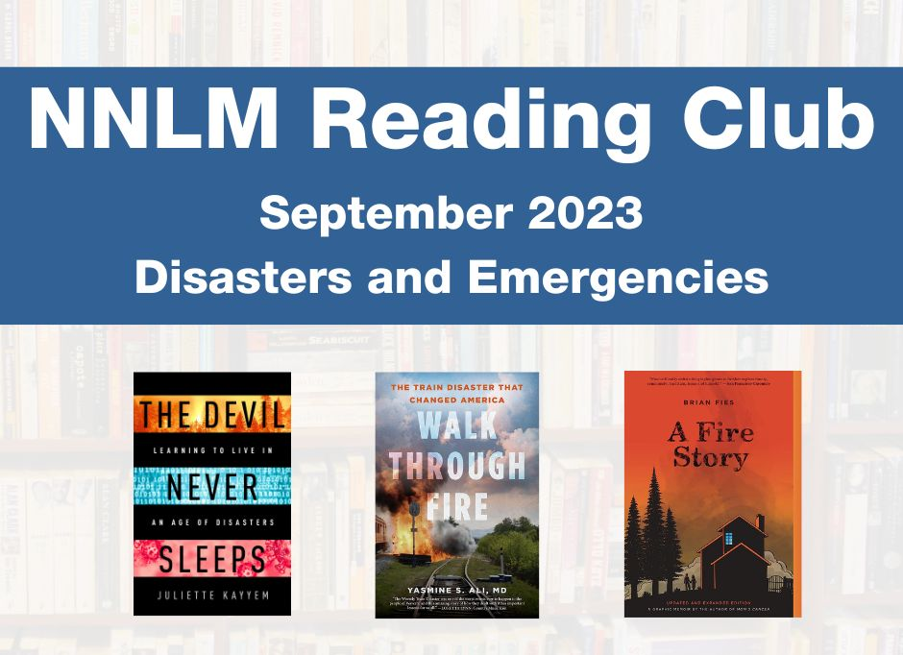
NNLM Reading Club
Notes:
We’re also excited to highlight collaboration with another NNLM program!
In observance of National Preparedness Month, the NNLM Reading Club has selected three books, and gathered information from trustworthy resources, to help you take action and stay safe.
More information is available on the NNLM Reading club website – we’ll drop that link into the Chat, too.
https://www.nnlm.gov/reading-club

Slide 7
NNLM Virtual Disaster Preparedness Forum (2)
Notes:
It’s my great pleasure to introduce our speaker for today’s session.
Tim Sarko has been employed by the U.S. Census Bureau for over 28 years. He initially served as a Supervisory Survey Statistician in 1995.
Currently, as a Data Dissemination Specialist, Tim is responsible for program planning, coordination, and implementation of data dissemination and outreach and media activities for the Census Bureau. He promotes the use of census data to anyone with an interest or a need to work with this valuable information including media, community organizations, municipal officials, chambers of commerce, librarians, students, and entrepreneurs.
Welcome, Tim!
I am now going to turn off my camera and turn the session over to you.
NOTE ATTENDEE NUMBERS

Slide 8
Community Resilience Estimates
OnTheMap for Emergency Management and
Community Resilience Estimates
September 12, 2023
Tim Sarko
Data Dissemination Specialist
U.S. Census Bureau, Data Dissemination and Training Branch

Slide 9
Outline
Outline
American Community Survey (ACS) Basics
Longitudinal Employer Household Dynamics
OnTheMap for Emergency Management
Community Resilience Estimates (CRE)
My Community Explorer
Resources for Learning More
Questions

Slide 10
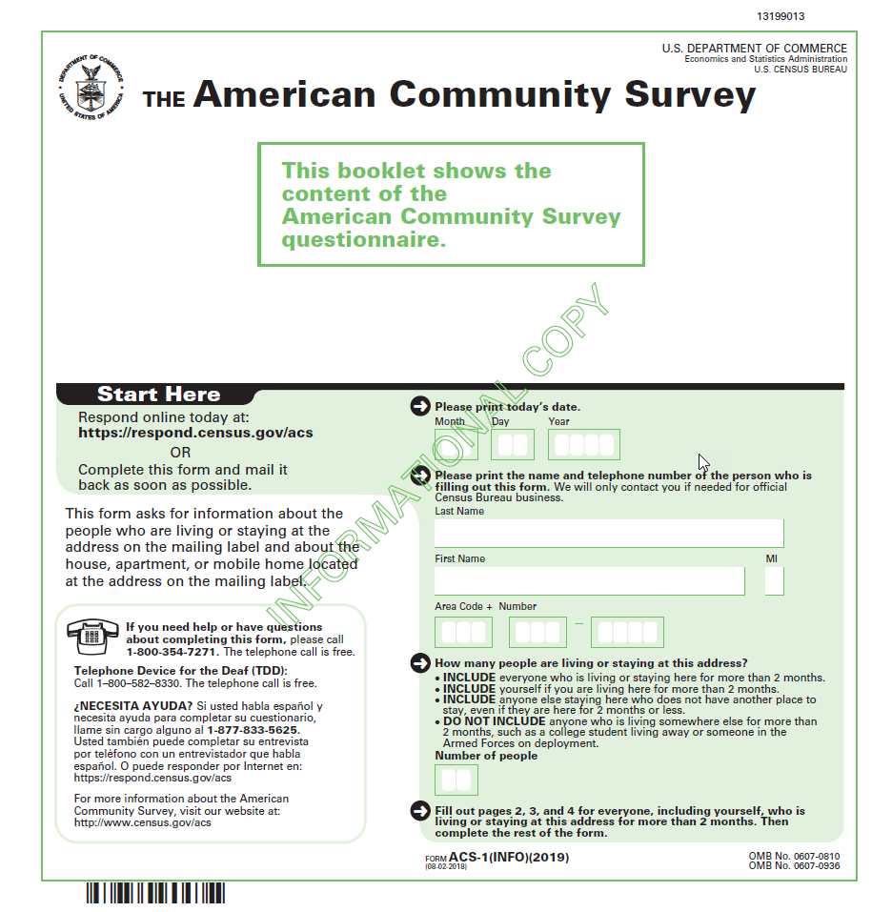
American Community Survey (ACS) Basics
American Community Survey (ACS) Basics
The American Community Survey is on the leading edge of survey design, continuous improvement, and data quality
The nation’s most current, reliable, and accessible data source for local statistics on critical planning topics such as age, children, veterans, commuting, education, income, and employment
Surveys 3.5 million addresses and informs over $675 billion of Federal government spending each year
Covers 40+ topics, supports over 300 evidence-based Federal government uses, and produces 11 billion estimates each year
Key annual data releases:
1-year Estimates (for large populations)
5-year Estimates (for very small populations)

Slide 11
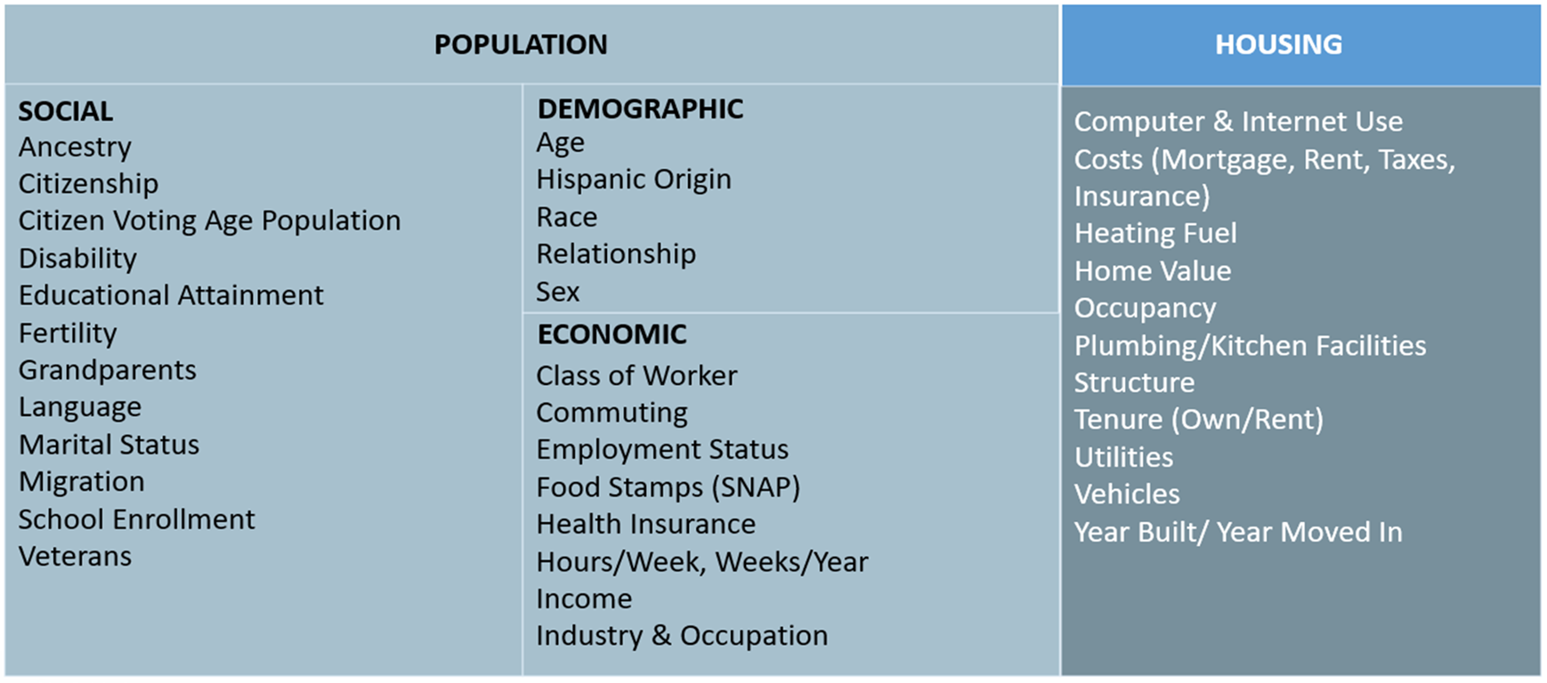
American Community Survey (ACS) Data
American Community Survey (ACS) Data

Slide 12
ACS 1-Year vs. 5-Year Estimates
ACS 1-Year vs. 5-Year Estimates
1-Year | 5-Year
12 months of collected data | 60 months of collected data
Statistics for areas with populations of 65,000+ | Statistics for all geographic areas down to the block group (sub-neighborhood) level
Smaller sample size – less reliable | Larger sample size – most reliable
More current statistics | Less current statistics
Best used when current data are more important, or for analyzing large populations | Best used when precise data are more important, or for analyzing small populations

Slide 13
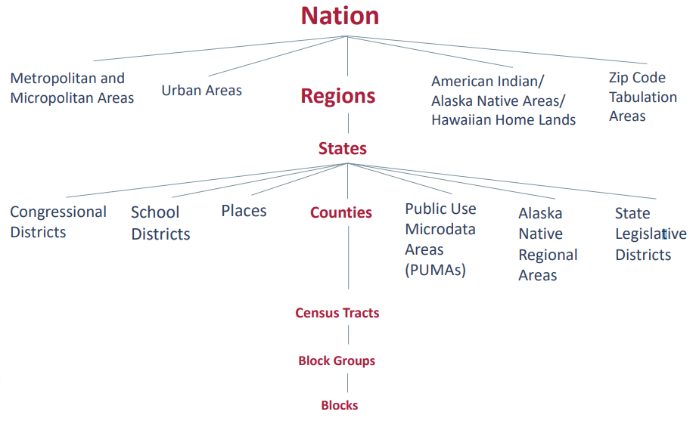
Available Geographic Areas
Available Geographic Areas
Demographic Programs • American Community Survey • Decennial Census • Decennial Census Self Response Rates • Health Insurance stats (from • The Planning Database

Slide 14
Outline (2)
Outline
American Community Survey (ACS) Basics
Longitudinal Employer Household Dynamics
OnTheMap for Emergency Management
Community Resilience Estimates (CRE)
My Community Explorer
Resources for Learning More
Questions

Slide 15
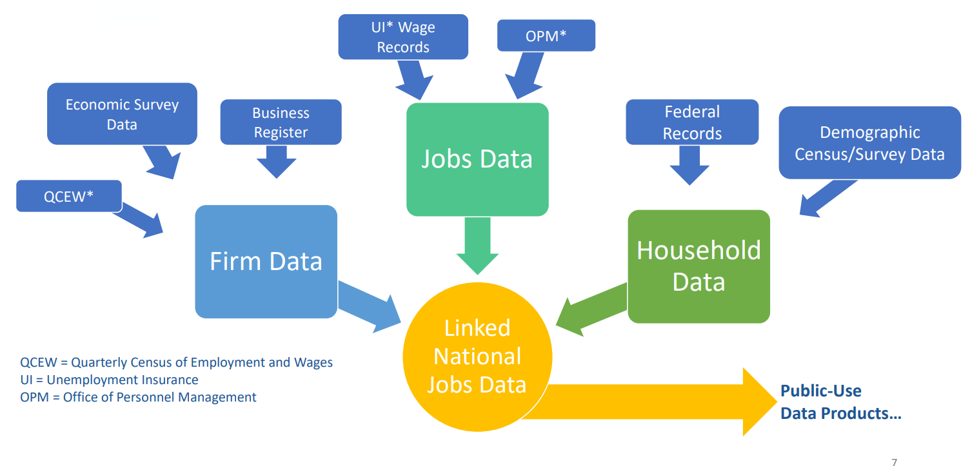
Longitudinal Employer Household Dynamics (LEHD)
Demographic Programs • American Community Survey • Decennial Census • Decennial Census Self Response Rates • Health Insurance stats (from • The Planning Database
The Longitudinal Employer-Household Dynamics (LEHD) data is a quarterly database of linked employer-employee data covering over 95% of employment in the United States.
5

Slide 16
Outline (3)
American Community Survey (ACS) Basics
Longitudinal Employer Household Dynamics
OnTheMap for Emergency Management
Community Resilience Estimates (CRE)
My Community Explorer
Resources for Learning More
Questions

Slide 17
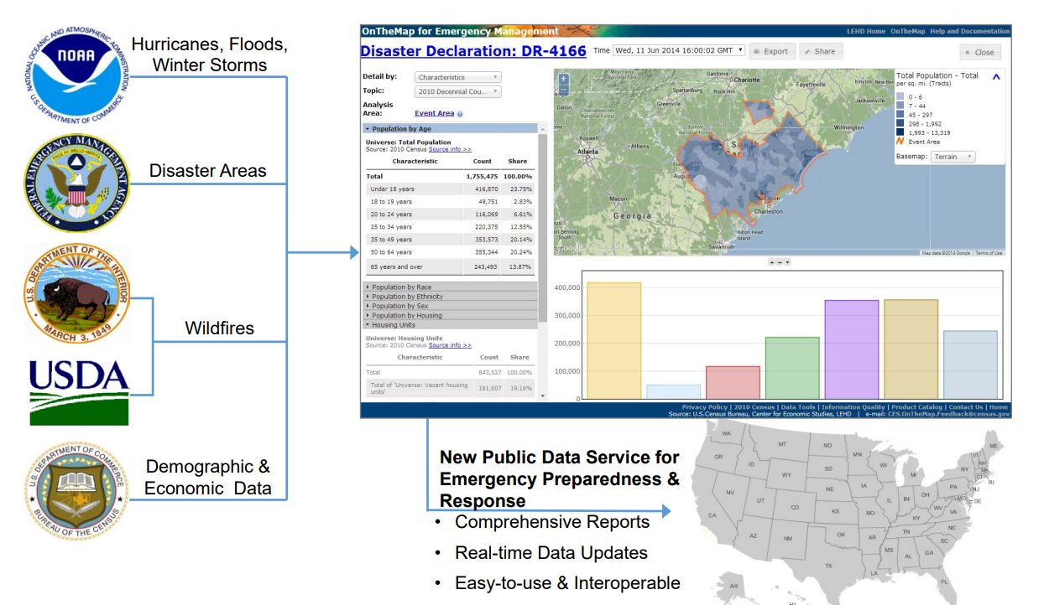
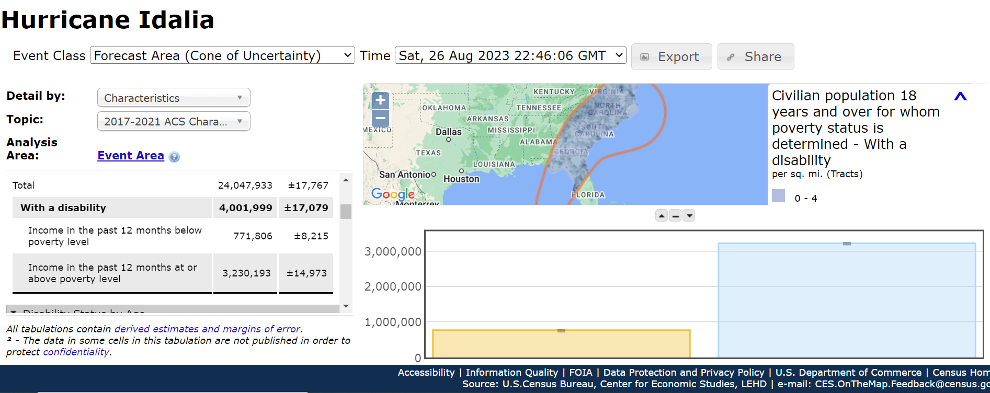
OnTheMap for Emergency Management
Demographic Programs • American Community Survey • Decennial Census • Decennial Census Self Response Rates • Health Insurance stats (from • The Planning Database
5

Slide 18
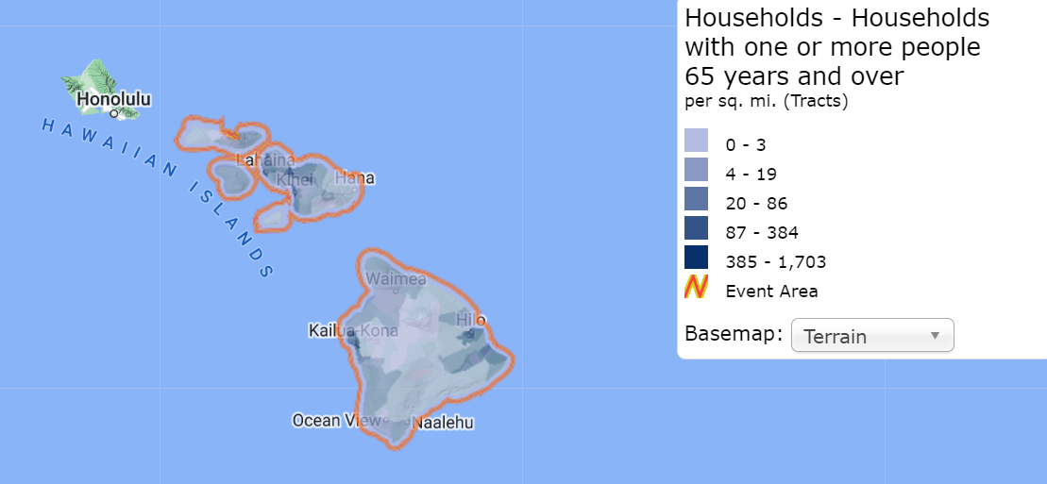
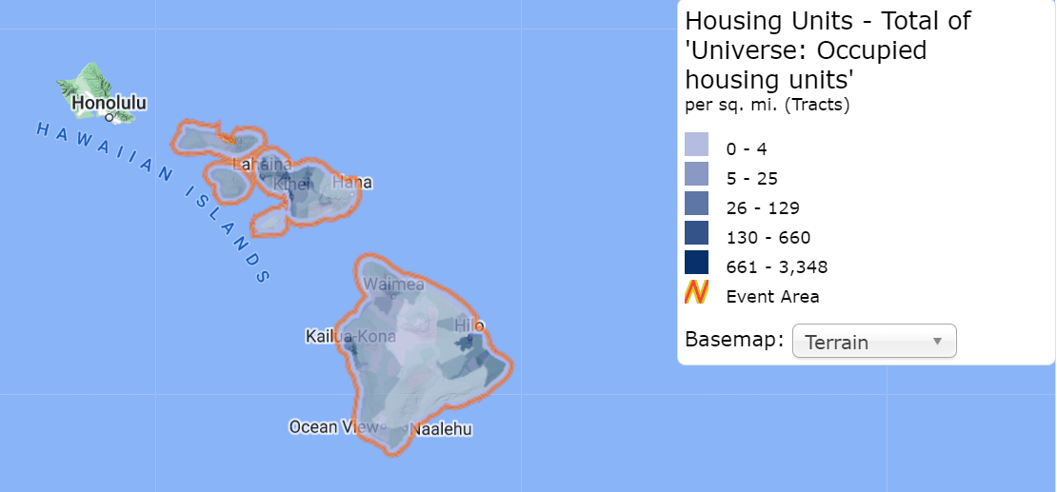
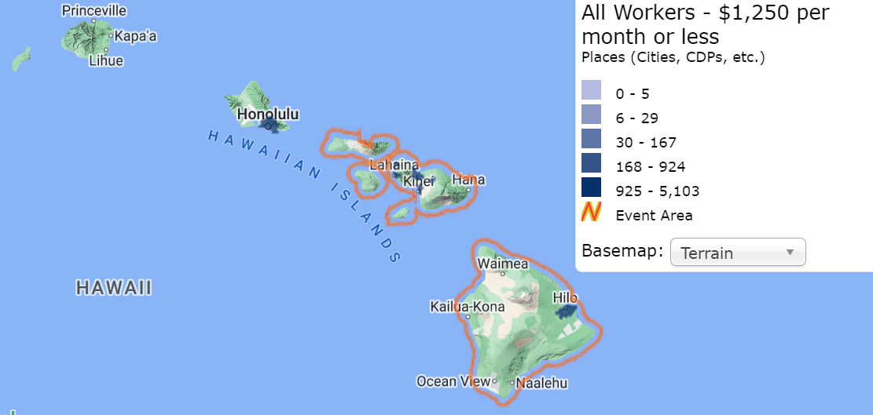
OnTheMap for Emergency Management (2)
Vulnerabilities
Physical
Decennial
Demographic Programs • American Community Survey • Decennial Census • Decennial Census Self Response Rates • Health Insurance stats (from • The Planning Database
Social
ACS
5
Economical
LODES

Slide 19
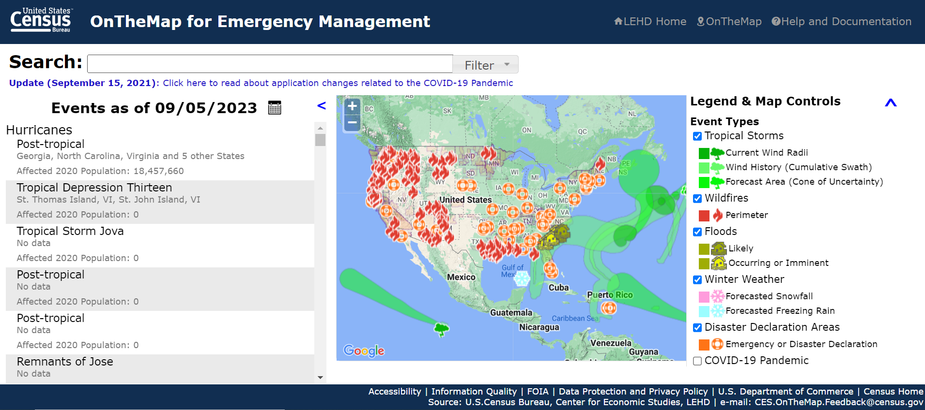
OnTheMap for Emergency Management (3)
Demographic Programs • American Community Survey • Decennial Census • Decennial Census Self Response Rates • Health Insurance stats (from • The Planning Database
https://onthemap.ces.census.gov/em/

Slide 20
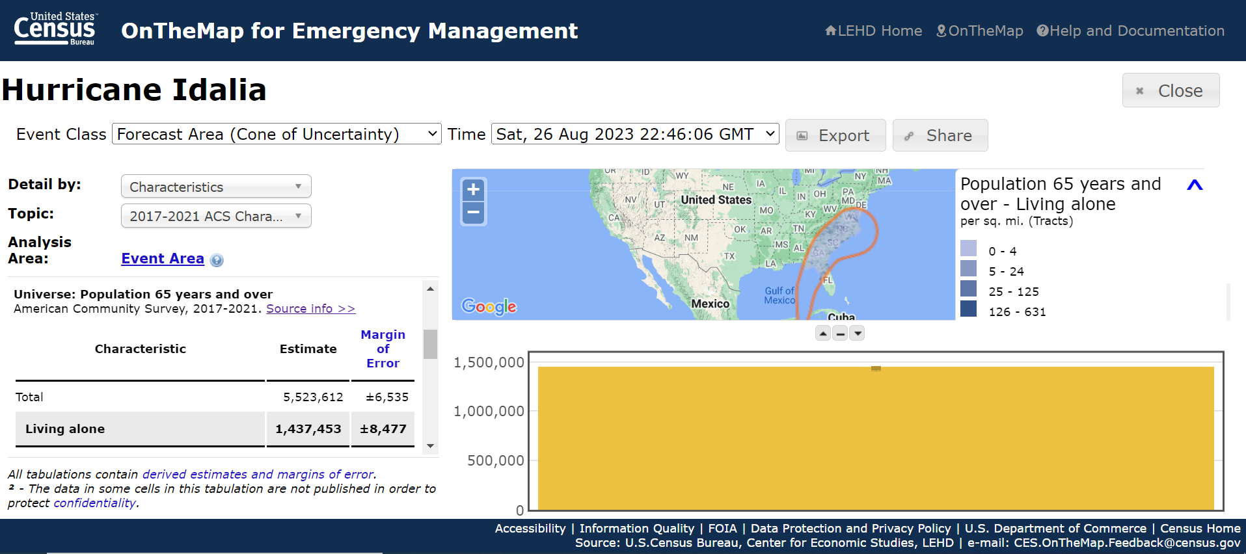
Forecast Area – Cone of Uncertainty
Demographic Programs • American Community Survey • Decennial Census • Decennial Census Self Response Rates • Health Insurance stats (from • The Planning Database
5

Slide 21
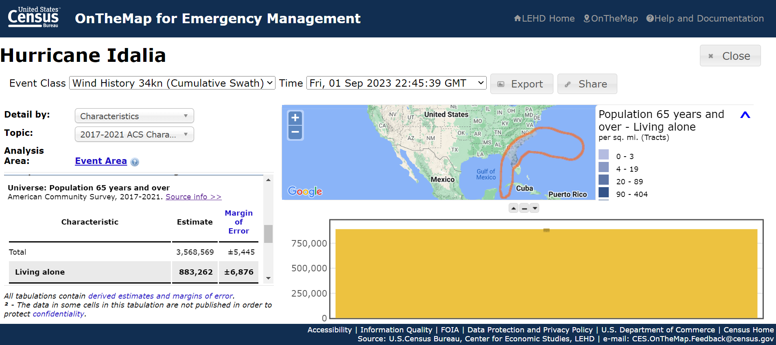
Actual Impact
Demographic Programs • American Community Survey • Decennial Census • Decennial Census Self Response Rates • Health Insurance stats (from • The Planning Database
5

Slide 22
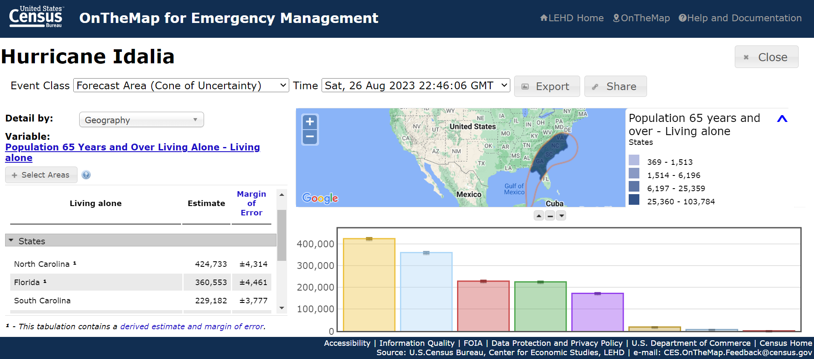
OnTheMap for Emergency Management - Geography
Demographic Programs • American Community Survey • Decennial Census • Decennial Census Self Response Rates • Health Insurance stats (from • The Planning Database
5

Slide 23
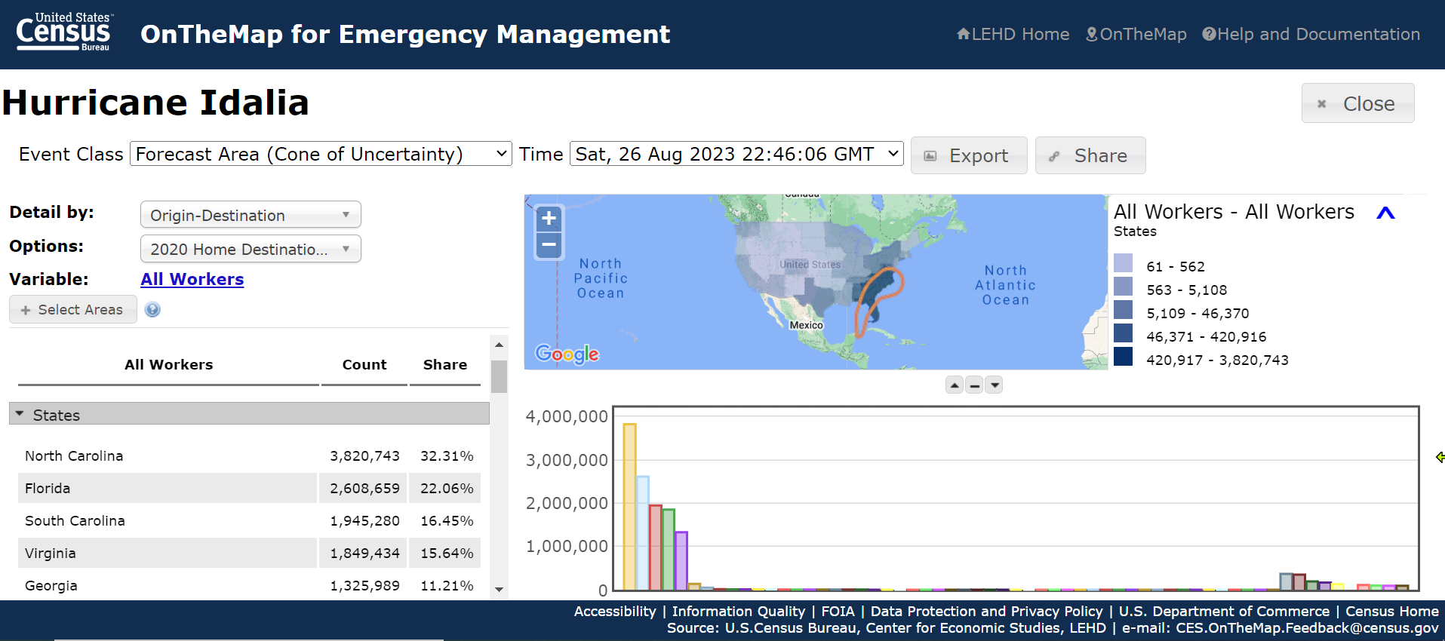
OnTheMap for Emergency Management - Workers
Demographic Programs • American Community Survey • Decennial Census • Decennial Census Self Response Rates • Health Insurance stats (from • The Planning Database
5

Slide 24
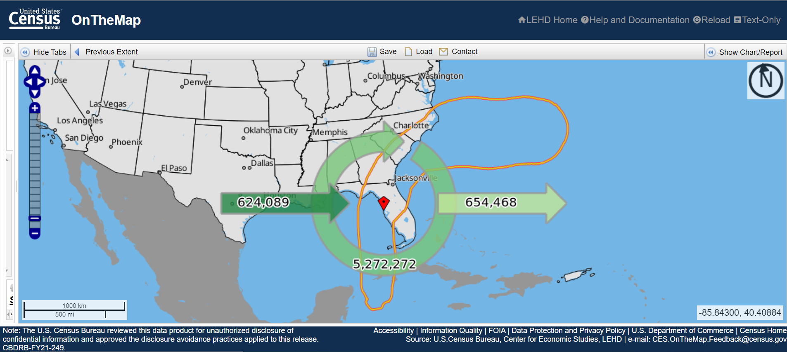
OnTheMap – Worker Inflow/Outflow Analysis
Demographic Programs • American Community Survey • Decennial Census • Decennial Census Self Response Rates • Health Insurance stats (from • The Planning Database
5
https://onthemap.ces.census.gov/em/

Slide 25
Outline (4)
American Community Survey (ACS) Basics
Longitudinal Employer Household Dynamics
OnTheMap for Emergency Management
Community Resilience Estimates (CRE)
My Community Explorer
Resources for Learning More
Questions

Slide 26
Community Resilience Estimates (CRE)
Community Resilience Estimates (CRE) are produced using information on individuals and households from the 2021 American Community Survey (ACS) and the Census Bureau’s Population Estimates Program (PEP)
Community Resilience Estimates (CRE) are produced using information on individuals and households from the 2021 American Community Survey (ACS) and the Census Bureau’s Population Estimates Program (PEP)
CRE uses 10 possible risk factors based ACS estimates

Slide 27
Outline (5)
American Community Survey (ACS) Basics
Longitudinal Employer Household Dynamics
OnTheMap for Emergency Management
Community Resilience Estimates (CRE)
My Community Explorer
Resources for Learning More
Questions

Slide 28
My Community Explorer
Demographic Programs • American Community Survey • Decennial Census • Decennial Census Self Response Rates • Health Insurance stats (from • The Planning Database
The My Community Explorer Tool includes data from:
American Community Survey (ACS)
County Business Patterns (CBP) - number of establishments, employment, and average annual payroll per employee
NonEmployer Statistics (NES) – number of self employed persons and average revenue
Active Hurricanes, Cyclones & Typhoons
Current Wildfires
3 Day Min/Max Temperature Forecast
Air Quality Monitoring Site Data

Slide 29
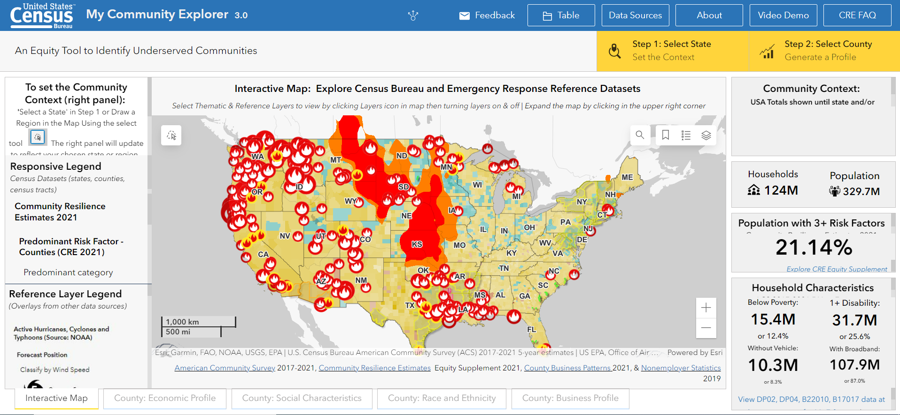
Outline (6)
Demographic Programs • American Community Survey • Decennial Census • Decennial Census Self Response Rates • Health Insurance stats (from • The Planning Database
https://experience.arcgis.com/experience/13a111e06ad242fba0fb62f25199c7dd/page/Page-1/

Slide 30
Outline (7)
American Community Survey (ACS) Basics
Longitudinal Employer Household Dynamics
OnTheMap for Emergency Management
Community Resilience Estimates (CRE)
My Community Explorer
Resources for Learning More
Questions

Slide 31
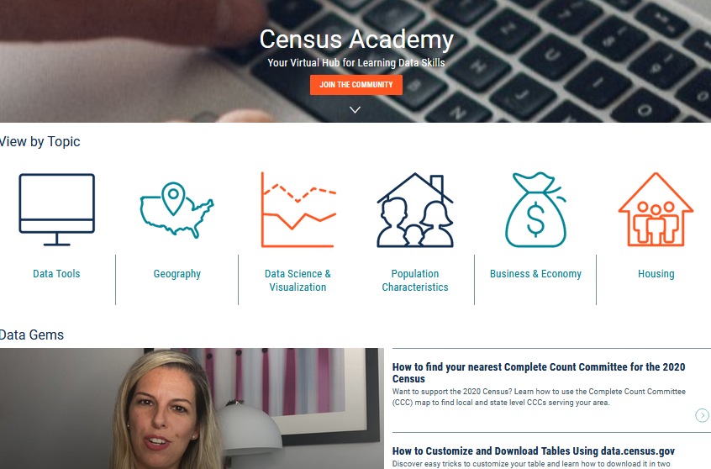
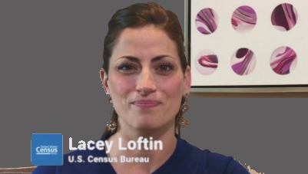
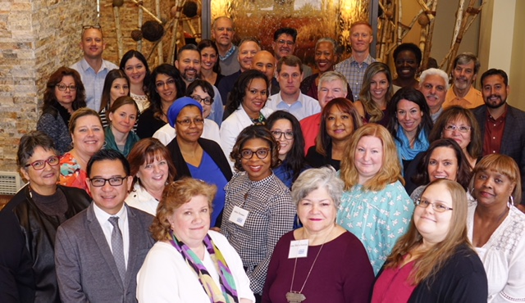
Data Dissemination and Training
Census.gov/Academy
Bring our data experts to you.
Request a free data training for your organization.
Receive our Data Gems.
These short “how-to” videos are an easy and quick way to increase your knowledge of Census data. Get them in your inbox!
Get access to our Courses.
You will learn-at-your-own-pace with these video-tutorials designed for different skill levels.
Interact with our instructors via Webinars.
Learn about our data releases and tools while attending these live virtual classes.
Contact us:
Census.askdata@census.gov
1-844-ASK-DATA
Share your ideas and feedback at census.academy@census.gov

Slide 32
Get in Touch With Us
Tim Sarko
U.S. Census Bureau
Data Dissemination and Training Branch
timothy.a.sarko@census.gov
614-600-6161
Census.askdata@census.gov
1-844-ASKDATA
@uscensusbureau
Subscribe: Census.gov/academy

Slide 33
THANK YOU

Slide 34
Thank you!
Evaluation link: https://www.nnlm.gov/BkMN7
In about a week you will receive an email with a link to the recording.
NNLM Emergency and Disaster Resources Guide
Funded by the National Library of Medicine. NLM and NNLM are service marks
of the US Department of Health and Human Services. Updated July 2022.
Notes:
Many thanks to Tim for his presentation, and thanks to all of you for attending today’s session.
The link for the class evaluation is on the slide, and we will share it in Chat.
We’ve found it works best to copy and paste it into a browser rather than directly clicking on the link.
A reminder that you will receive an email from us in about a week with a link for the recording.
And lastly, we encourage you to check out the newly updated NNLM Emergency and Disaster Resources Guide, which serves as an online collection of resources and tools relevant to disaster and emergency management.
https://www.nnlm.gov/guides/emergency-and-disaster-resources
Thanks again and enjoy the rest of your afternoon!
NOTE ATTENDEE NUMBERS

