Slide 1
NNLM Series Piecing together reviews: Part 5 Phases 5-8
Margaret Foster, MS, MPH
Evidence Synthesis & Scholarly Communication Librarian
Medical Sciences Library, Texas A&M University
October 23, 2024

Slide 2
Objectives
Describe the tasks after the review is published including preserving the report, its data and tracking its impact
Detail potential role of librarian in promoting the review and determining when to update a review
Describe how to set up a consultation service for reviews

Slide 3
3 Parts
Part 1
Part 2
Logic model
Quick recap of all sessions
Part 3
PIECES cycle
Preservation
Promotion
Impact
Update
Pitfalls & Pivots

Slide 4
Review PIE²CES² project cycle
8 phases
Each phase has potential outputs
Each phase goes through the 8 processes
Plan
Identify
Evaluate
Extract
Combine
Explain
Summarize
Share
Notes:
The PIECES Cycle is designed to:
organized model of 8 phases & 8 processes
encourages planning and testing of processes
demonstrates multiple outputs that can be produced, encouraging scholarly communication
highlights most important aspects of the phase
The cycle is not designed:
For narrative reviews that are more exploratory in nature- these projects generally do not have an a priori process
To replace the need for more detailed guides, standards, and consulting experts
The 8 phases of a review project can overlap, can have multiple outputs, which can be published or informal. And of course, some phases are optional. The phases also connect together in a cycle, for when the updating algorithm says its time to update, you then move back into the proposal phase. Now let's look at each phase separately.

Slide 5
Phases of Review:
By amount of literature sorted
Proposal: What is the scope of the review?
Only 100 articles or so to test feasibility
Protocol: What are the methods of the review? 100-200 articles; just enough to pilot methods; at least 2-3 included articles
Production: What are the preliminary findings? Some % to see trends, for poster or presentation
Paper: Writing up paper/ what is the context?
all articles processed

Slide 6
Proposal, Protocol, Production, Paper
Proposal
Protocol
Production
Paper
Preservation
Preservation, promotion and impact are all interconnected.
Need to have reports/data available in order to promote it.
Need to assess promotion efforts through tracking impact.
Timeline
Plans for the last 4 phases could all be set during the protocol stage.
Promotion
Impact tracking
Update

Slide 7
5 Preservation
Competency
Data Management Plan
Preserving the search
Search archives

Slide 8
Which of the following have you used?
Data management plans for SRs a search archive added SR data to repository
other

Slide 9
Competency for librarians
Data management competency:
Citation software
SR software: strengths, limits and uses of common resources
Data extraction tools and forms
Appropriate data and process archiving, including version tracking and PRISMA data collection

Slide 10
Data management plan for Systematic Reviews
Data Management for Systematic Reviews: Guidance is Needed
Data Management Plan Template: Systematic Reviews
Guide to DMP Assistant Template for Systematic Reviews

Slide 11
Questions on DMP Part 1
Data collection
Documentation and meta data
Storage and backup
Preservation
Sharing and reuse
Responsibilities and resources
Ethics and compliance

Slide 12
Questions on DMP Part 2
Data Collection
What types of data to be created and the file types
Consider review docs, citation files (.ris, bibtex), spreadsheets, images or figures, pdfs, any specialized files (Nvivo, others)
What conventions and procedures will be used to structure, name and version-control the files to view data organization?

Slide 13
Questions on DMP Part 3
2) Documentation and metadata
Documentation need for reading documents
What processes will used to ensure consistent documentation?
If metadata standard or tool is used, list it. Example for searches:
A suggested data structure for transparent and repeatable reporting of bibliographic searching. [Preprint].

Slide 14
Questions on DMP Part 4
3) Storage and backup
What are the anticipated storage requirements for the project, in terms of storage space (in megabytes, gigabytes, terabytes, etc.) and the length of time?
How and where will data be stored and back up during project?
3-2-1: Have 3 copies of data, store the copies of 2 different media, keep one back copy offsite
How will team access, modify, and contribute to the project?

Slide 15
Questions on DMP Part 5
4) Preservation
Where will you deposit data for long term preservation and access?
Systematic Review Data Repository
Open Science Framework
Your institutional repository
Find a repository at DataCite repository finder
Indicate how data will be preservation ready. Consider preservation-friendly file formats, file integrity, and the inclusion of supporting documentation.

Slide 16
Questions on DMP Part 6
5) Sharing and reuse
What data will you be sharing and in what form?
Raw, analyzed, final
FAIR principles: Findability, Accessibility, Interoperability, Reuse of digital assets
Type of end-user license to include with data?
Creative Commons
Open Data Commons
What steps will be taken to help the research community know that the data exists?
FAIR Guiding Principles for scientific data management and stewardship.

Slide 17
Questions on DMP Part 7
6) Responsibilities and resources
Who will be responsible for managing this project’s data during and after the project? Details tasks for each person
How will responsibilities for managing data if major personnel issues occur?
What resources will be needed to implement data management plan? What do you estimate the cost to be?

Slide 18
Questions on DMP Part 8
7) Ethics and compliance
If project includes sensitive data, how will it be securely managed, accessible only to appropriate personnel?
If applies, what strategies will be used for secondary use of sensitive data?
How will legal, ethical, and intellectual property issues be managed?

Slide 19
Why is so hard to record searches?
multi-database and individual database platforms
Diversity in search systems
Lack of awareness
Search strings are complex, errors are easy, no standard for search history
So many places to search
All of these possible places can change often
Search are reported in supplementary files
A suggested data structure for transparent and repeatable reporting of bibliographic searching

Slide 20
Data Structure
Authors
Dates
String name
Keywords
Related search records
Overview entry for this substring
Platform
Database
Search string
Search fields
Database time coverage from/to
Date limitations
Language
Settings
Quality assurance
Validation report
Description
Review question
Review type
Linked review protocol/registered report
Linked final review document
A suggested data structure for transparent and repeatable reporting of bibliographic searching
Get Credit for Your Searches: Our Experience Using searchRxiv.

Slide 21
Adding search history to a ris file
Tool: Searchrecorder
Description: This app uses a standardized search history data structure developed in consultation with a group of information specialists and librarians.
RIS files have a suite of mostly unused fields that can be "hijacked" to embed information within the RIS file. The file still functions perfectly normally in reference management software, but it carries the rich search history data as well.
searchrecorder: A tool for transparent reporting of search histories within reference files.

Slide 22
What are the issues around adding searches to archives?

Slide 23
6 promotion
Principles of Dissemination
Dissemination Guides
Stakeholders
Content
Channels and outputs

Slide 24
Principles of dissemination
Consider stakeholders interest and needs
Reasonable representation of findings
Relatability
Plain language
Structure and readability
Connecting with people
Ensure transparency and build trust
Cochrane Collaboration: Dissemination Essentials (Youtube)

Slide 25
Dissemination guides
Dissemination essentials: The checklist
Choosing images for sharing evidence: a guide

Slide 26
Steps
Select and use a dissemination framework
List stakeholders
Consider interest, needs, and other characteristics of stakeholders
Choose channel/outputs
Develop content and images
Seek
Feedback from stakeholders
advice from media and public relations experts
Getting the Word Out: New Approaches for Disseminating Public Health Science.

Slide 27
Step 1: select Dissemination frameworks
Dissemination & Implementation models in Health
Select from wide range of models
Filter by level: individuals, community, organizations
Explore D& I TMFs

Slide 28
step 2: Identify stakeholders
Patients, caretakers, general public
Health care professionals
Researchers
Policy makers,, government agencies
Hospital systems, administrators
Funders, Employers, Insurers
Note: Stakeholders could be part of the protocol and engaged throughout the policy

Slide 29
Have you worked with a team that added stakeholders during the review process?

Slide 30
Step 3: For each stakeholder, consider
Interest:
Determine the level of interest in the review topic and findings
Determine amount of time the audience will have or be willing to spend
Information resources:
List resources available to them
List sources they likely to regard as credible
Information covered:
What additional information they are likely to think is important on the review topic?
Will they expect recommendations?
Format:
Languages spoken/read
Determine level of literacy and numeracy skills
Familiarity with medical terminology
Checklist and Guidance for disseminating findings from Cochrane intervention reviews.

Slide 31
Step 4: select Channels/outputs
Getting the Word Out: New Approaches for Disseminating Public Health Science.
CDC Guidance on writing policy briefs
Plain language summary
Executive summary
News media
Social media
Policy briefs
One-on-one meetings
Workshops and seminars

Slide 32
Step 5: Content checklist items 1-10
Have you involved your target audience or sought their feedback?
Have you used plain language?
Have you used words in your title that your target audience is likely to search for, recognize and find relevant?
Have you communicated to your target audience that this product is relevant for them?
Have you structured the content so people can find key messages, then access more detail if they want?
Have you made the content easy for people to quickly scan and read?
Have you shown that the evidence involves real people?
Have you specified the population, interventions, comparisons and outcomes?
Have you stated that this information is from a systematic review?
Have you specified how up to date the review is?
Checklist and Guidance for disseminating findings from Cochrane intervention reviews.

Slide 33
Step 5: content items 11-18
11. Have you avoided misleading presentations and interpretations of the effects?
12. If you have used numbers to present the findings, have you used absolute numbers and labelled numbers clearly?
13. Have you described the certainty of the evidence?
14. Have you presented the findings in more than one way?
15. Where the topic or findings may be upsetting, controversial or disappointing, have you handled this sensitively?
16. Have you made it clear (a) that the review was prepared by Cochrane and (b) who prepared the dissemination product?
17. Is it easy for people to find information about who the review authors are, how they were funded, and any conflicts of interest?
18. Have you avoided giving recommendations?
Checklist and Guidance for disseminating findings from Cochrane intervention reviews.

Slide 34
Step 5: checklist for selecting images
Permission to use?
High-resolution
Check with stakeholder to get feedback
Inclusion and wide representation
Depict evidence accurately
Avoid images with misleading presentations or recommending a treatment
Avoid brand names
Realistic and related images for stakeholders
Consider image appropriateness across settings and cultures
Depict topic with sensitivity and appropriate context
Avoid images that stigmatize, stereotype, or dehumanize
Avoid images that trigger
Ensure image is not distorted
Images should meet accessibility standards
Credit the image source
Choosing imagers for sharing evidence: a guide

Slide 35
7 Impact
Potential attention to track
Research impact by setting/time
Research impact by use

Slide 36
Potential attention to track
Citations
Syllabi
Book chapter citation
Mentions in social media
Policies & patents
Views, downloads, other attention
Use of data
What else would you add?

Slide 37
Research impact by setting and time
Getting the Word Out: New Approaches for Disseminating Public Health Science.

Slide 38
Impact of reviews through different uses
Transparent use of (understanding): policymakers improved understanding; changes in policies, procedures
Transparent use (accessibility): policymakers accessed the information
Embedded use: no direct action is taken as a result of the evidence, but use of evidence becomes embedded in processes, systems and working culture
instrumental use: evidence is being used directly to inform a policy.
Investigating the impact of systematic reviews funded by DFID.

Slide 39
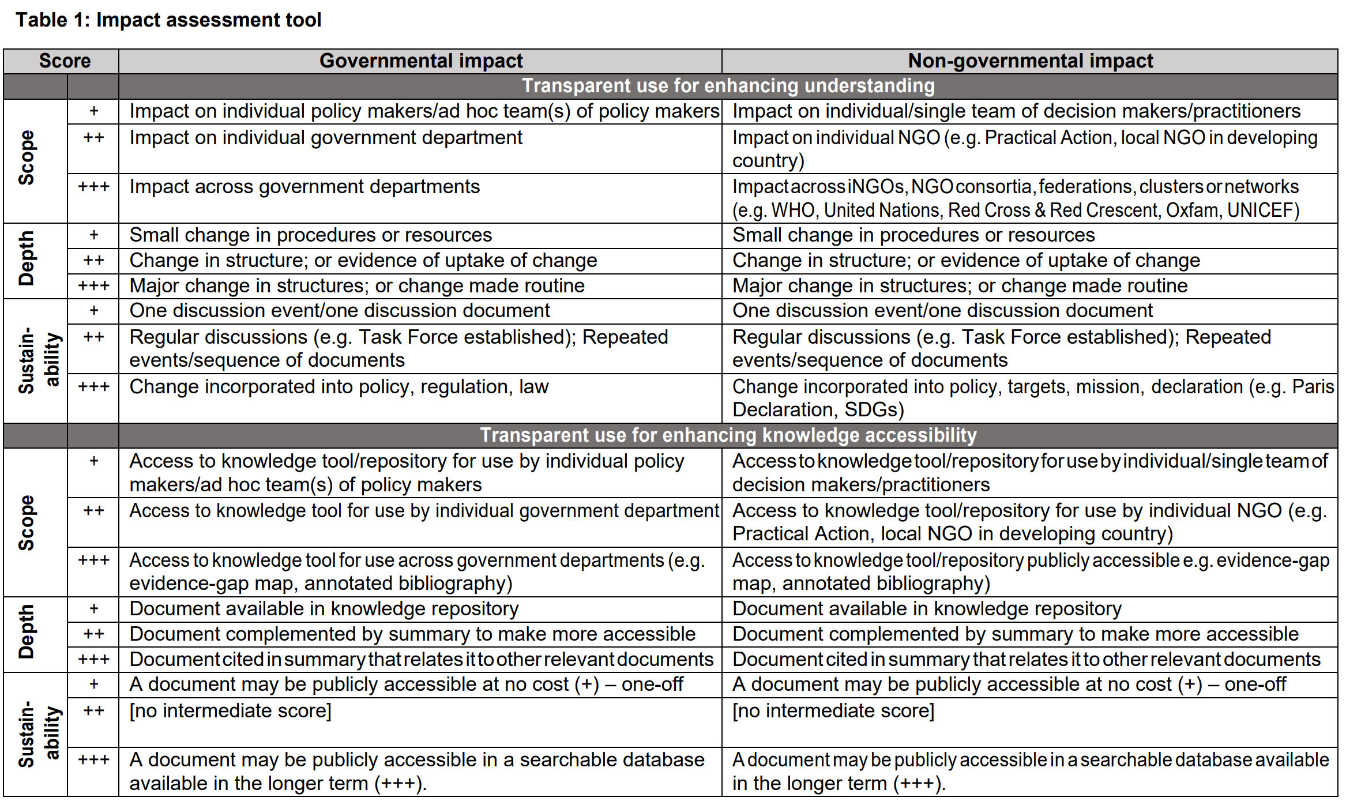
Impact of review through transparent use
Investigating the impact of systematic reviews funded by DFID.

Slide 40
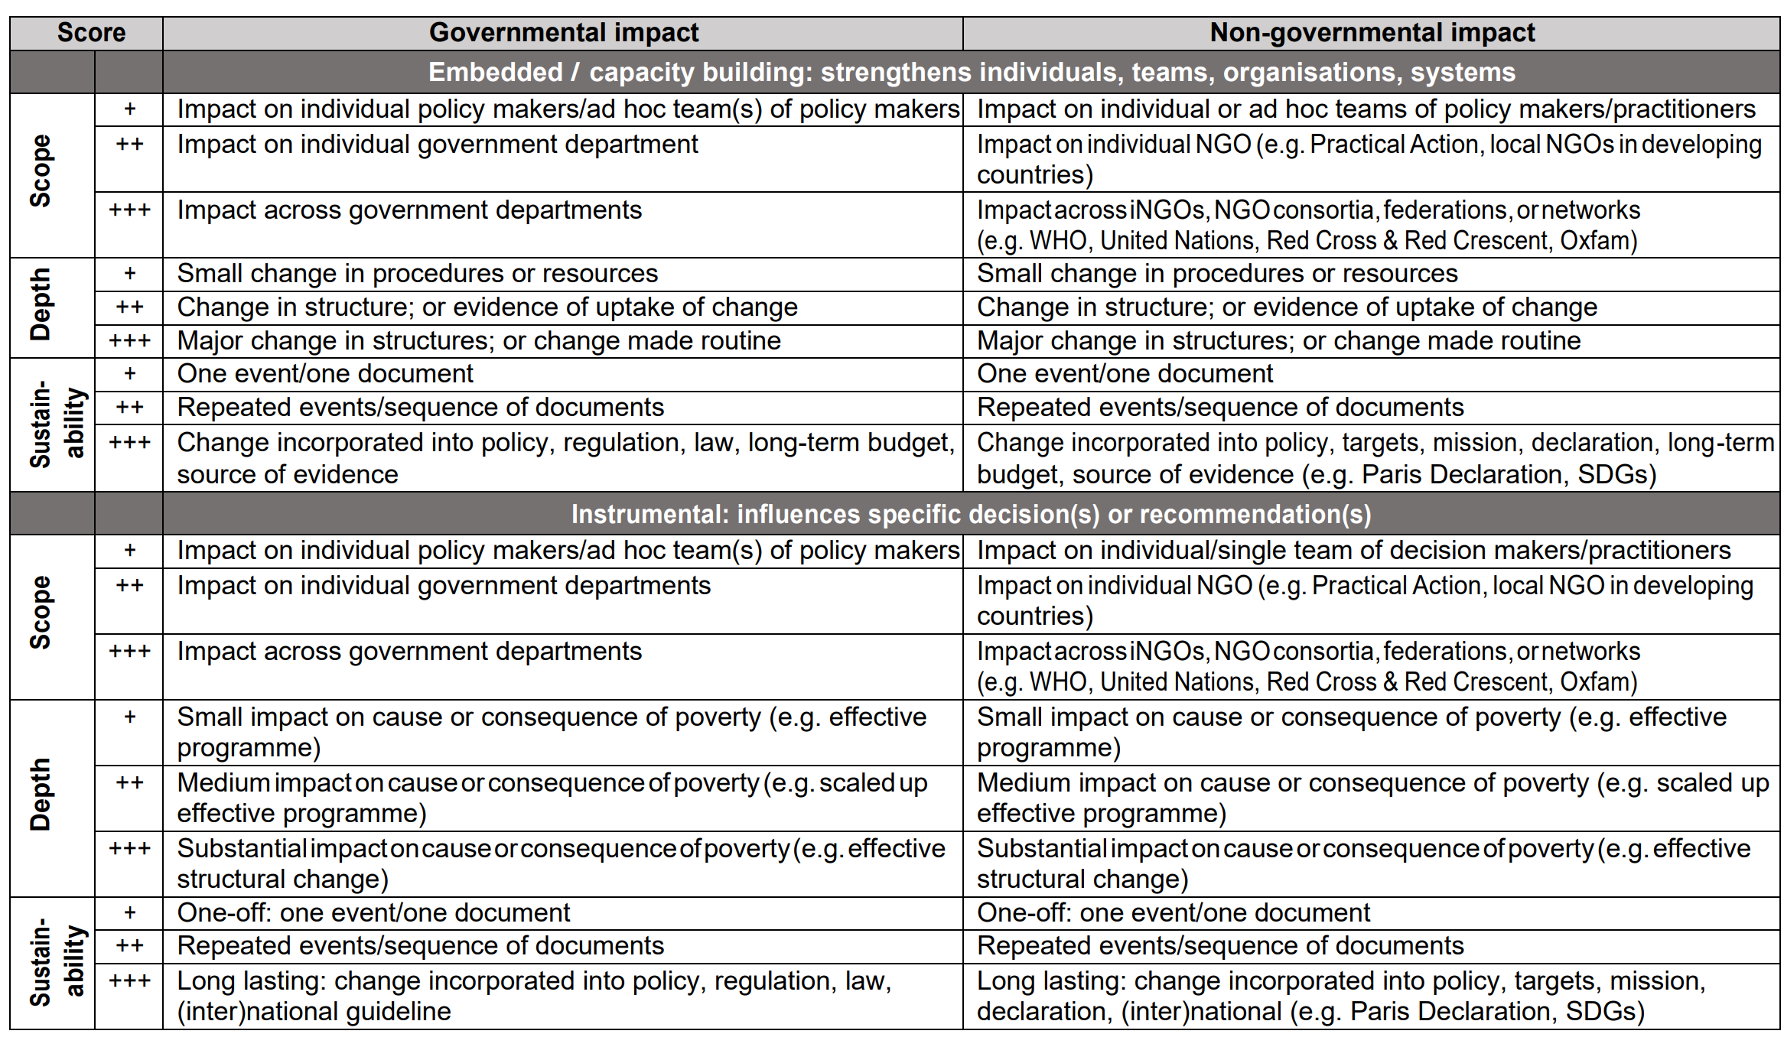
Impact of review through embedded or instrumental use
Investigating the impact of systematic reviews funded by DFID.

Slide 41
8 update
What is an update?
Why update?
Decision tree for when
Where do living reviews fit in?
MECIR Update standards
And the cycle continues . . .

Slide 42
What is an update?
So, the update address the same question as original, but not limited to original methods-
can incorporate improved methods
such as better search strategies, new analyses, or even improved question or eligibility criteria.
An update is “a new edition of a published systematic review with changes that can include:
new data,
new methods,
or new analyses
to the previous edition”
Updating systematic reviews.
When and how to update systematic reviews: consensus and checklist.

Slide 43
Why update?
New studies have been published
If agree with previous:
adding to the precision
increase application of the intervention
provide more information for sub-analysis
If studies do not agree- why? What are the issues?
Perhaps no new studies but
Better methods could be used
Other new information on the topic is now available
Looking at with different perspective

Slide 44
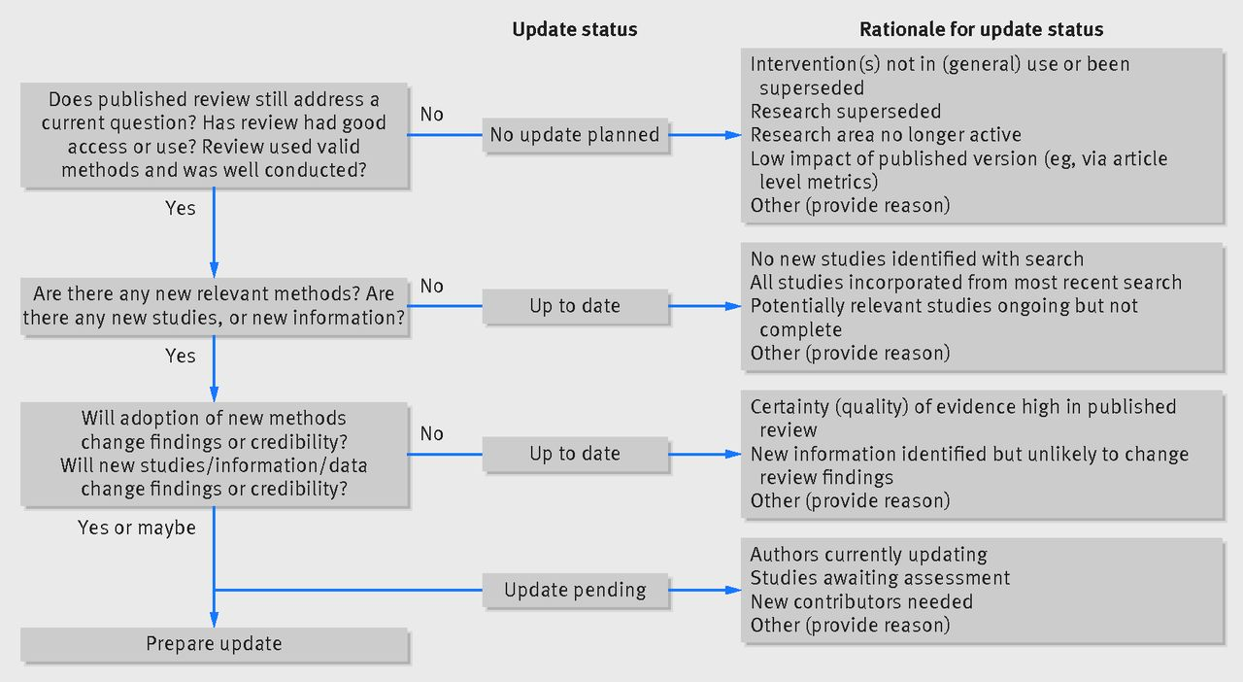
Decision tree for Updating a review
When and how to update systematic reviews: consensus and checklist.

Slide 45
Living systematic reviews
Additional tasks:
Active Monitoring: Monthly searches for new evidence.
Immediate Updates: Incorporate new important evidence as soon as identified.
Up-to-Date Communication: Regular updates on review status and new evidence.
Additional reporting:
How often new evidence is sought and screened?
When and how new evidence is added to the review?
systematic reviews that continually updated with new evidence
What is a living systematic review?

Slide 46
Options
Plan updating schedule from the start- may or may not be a living review
Set up algorithm along the way and add to final paper
Decide sometimes after publishing

Slide 47
MECIR Standards for updating: U1-U5 Planning
# | Standard
U1 | Reconsider review question
U2 | Reconsider outcomes, Prioritize those that are primary and will be assessed with GRADE
U3 | Reconsider eligibility criteria, extending or narrowing the scope?
U4 | Planning the search Changes to eligibility criteria could change search Additional resources may need to be searched, as new ones may be available or appropriate with given changes If no changes to eligibility criteria, may limit search to the end of original search. May need to edit previous search to add additional terms or remove some that were not useful
U5 | Reconsider data collection and analysis methods
May need to submit a new protocol
Standards for the planning and conduct of updates of Cochrane Intervention Reviews

Slide 48
MECIR Standards for updating: U6-U11 conducting
# | Standard
U6 | Searching within 6-12 months of anticipated publication
U7 | Identify new studies
U8 | Reconsider previously identified studies, esp. those that were ongoing (trials) are they done? Retracted? Other issues?
U9 | Assess risk of bias consistently for original included and new studies
U10 | Synthesize results, could be new methods from original as appropriate
U11 | Assess certainty of evidence- with all the studies asses the overall “risk of bias, inconsistency, indirectness, and publication bias”
Standards for the planning and conduct of updates of Cochrane Intervention Reviews

Slide 49
Review project cycle Continued
8 phases
Each phase has potential outputs
Each phase goes through the 8 processes
PIECCESS Review Cycle:
Plan
Identify
Evaluate
Extract
Combine
Explain
Summarize
Share
Piecing Together Systematic Reviews and Other Evidence Syntheses.
Notes:
The PIECES Cycle is designed to:
organized model of 8 phases & 8 processes
encourages planning and testing of processes
demonstrates multiple outputs that can be produced, encouraging scholarly communication
highlights most important aspects of the phase
The cycle is not designed:
For narrative reviews that are more exploratory in nature- these projects generally do not have an a priori process
To replace the need for more detailed guides, standards, and consulting experts
The 8 phases of a review project can overlap, can have multiple outputs, which can be published or informal. And of course, some phases are optional. The phases also connect together in a cycle, for when the updating algorithm says its time to update, you then move back into the proposal phase. Now let's look at each phase separately.

Slide 50
Questions on updating?

Slide 51
Review service
Logic model of a review service
One page summary of the service
Consider using it as a way to advocate for the service as well

Slide 52
logic model
Mission (present goals)
What does your service do and for whom?
Background
Could include specific information about your institution
Resources
People
Software and other infrastructure needs
Workflows, Templates/form
Programs/engagement
Consults and other services
Education and training
Engagement, marketing, outreach
Goals
Short term
Long term
Vision (future)
Why does this service exist? Think impact

Slide 53
Library Review Services
Library Review Services
Mission: The Review Services mission is to provide consultations, education, and engagement to the HSC faculty staff and students to meet needs related to syntheses methods.
Background | Resources | Programs | Goals
Opportunities SRs & other evidence syntheses have high potential for societal impact SRs standards call for librarians to be collaborators¹ SRs done with expert searchers more often meet standards² SRs that meet standards cited more often³ Calls for SR methods training to be part of education for masters/PhD⁴ Calls for SR projects to be more accessible⁵ Challenges Review authors tend to: use inefficient practices do not follow appropriate standards⁶ time wasted on incomplete projects that go unpublished due to lack of rigor The average SR: -takes 16 months to complete⁷ -estimated cost $140,000 per review⁷ -academic institution averages $18 mil⁷ | Staff Head of services Assistant 2 review librarians Infrastructure Ticketing system for client seeking to start a review Workflow and forms to guide communication with clients Calendar appointments Software LibAnswers for ticketing Covidence for consults Shared email for the service that allows shared accounts in Ebsco, Ovid, for saving service related searches Microfsoft Teams for communication and files | Who will be served: For health sciences faculty, staff, and students who might be: Consumers of reviews Potential authors of reviews Authors of reviews Instructors of reviews In addition, we provide support for librarians outside the review service providing consult to an affiliate. How they will be served: Presentations in courses Training for groups Consults for research teams and/or librarian Engagement: Host a monthly talk about SR methods Host a review day to share posters and research Highlighting reviews authored by HSC Advocating for open-access publishing and data sharing such as adding research to institutional repositories | Short term (easy to measure now) -increase number of consults -Increase awareness of standards and resources for reviews -Increase number of faculty submitting reviews and data to repository -Increase awareness use of SR methods Long term (how will these be measured?) -decrease the time and cost of producing reviews -increase capacity on campus to conduct reviews -increase the quality and uptake of SR methods throughout Texas A&M -increase and track their societal impact Assessments: *Surveys of clients *Evaluate data from Covidence *Track citations and other attention on all institutional reviews
Vision: The Review Services strives to increase the quality, societal impact, and capacity of evidence syntheses efforts by the HSC faculty, staff, and students and extend the land, sea, and space grant missions of TAMU through the translation of primary research into syntheses.

Slide 54
Supporting citations for logic model
Standards calling for librarians to be collaborators: National Academy of Medicine, Cochrane Collaboration, and PRISMA (Preferred Reporting Items for Systematic Reviews and Meta-Analyses)- international reporting guideline for reviews used by many biomedical journals.
Librarian co-authors correlated with higher quality reported search strategies in general internal medicine systematic reviews.
Impact of librarians on reporting of the literature searching component of pediatric systematic reviews.
Use of recommended search strategies in systematic reviews and the impact of librarian involvement: a cross-sectional survey of recent authors.
Is quality and completeness of reporting of systematic reviews and meta-analyses published in high impact radiology journals associated with citation rates?.
Meta-analysis and the science of research synthesis.
Open synthesis: On the need for evidence synthesis to embrace open science.
Systematic review search strategies are poorly reported and not reproducible: a cross-sectional metaresearch study.
The significant cost of systematic reviews and meta-analyses: A call for greater involvement of machine learning to assess the promise of clinical trials.

