Slide 1
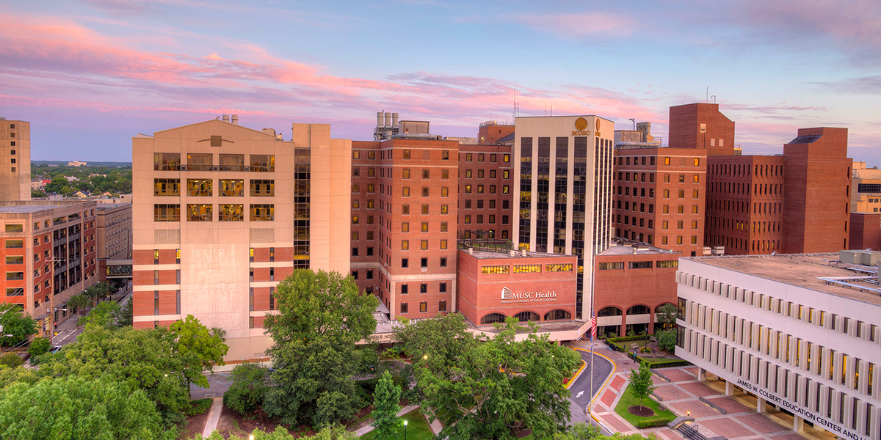
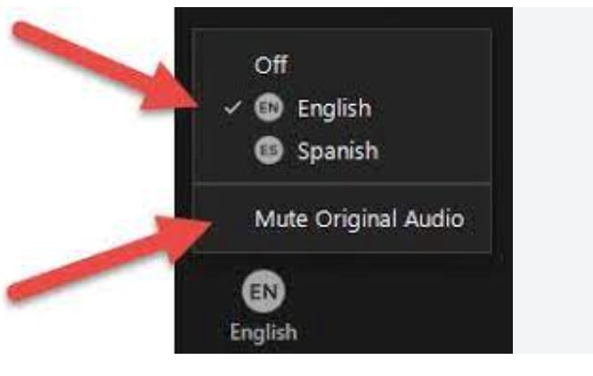
Uniendo voces: celebración del Día de la Lengua Española y promoción de la alfabetización sanitaria Uniting Voices: Celebrating Spanish Language Day and Promoting Health Literacy
Lorin Jackson (she/they) | region2@nnlm.gov
Notes:
Chef Alex
Welcome to Uniting Voices: Celebrating Spanish Language Day and Promoting Health Literacy! I am Chef Alex Askew, your host for this session. I have received funding awards from Region 2 and am also a member of the Region 2 Regional Advisory Board.
First, please take advantage of our translation services. Select the globe at the bottom of the Zoom window. Click on your language preferences. Today’s webinar is provided in English and Spanish. You must be on one of these channels to hear all the presentations today. I’ll give everyone a moment to set up their channel.

Slide 2
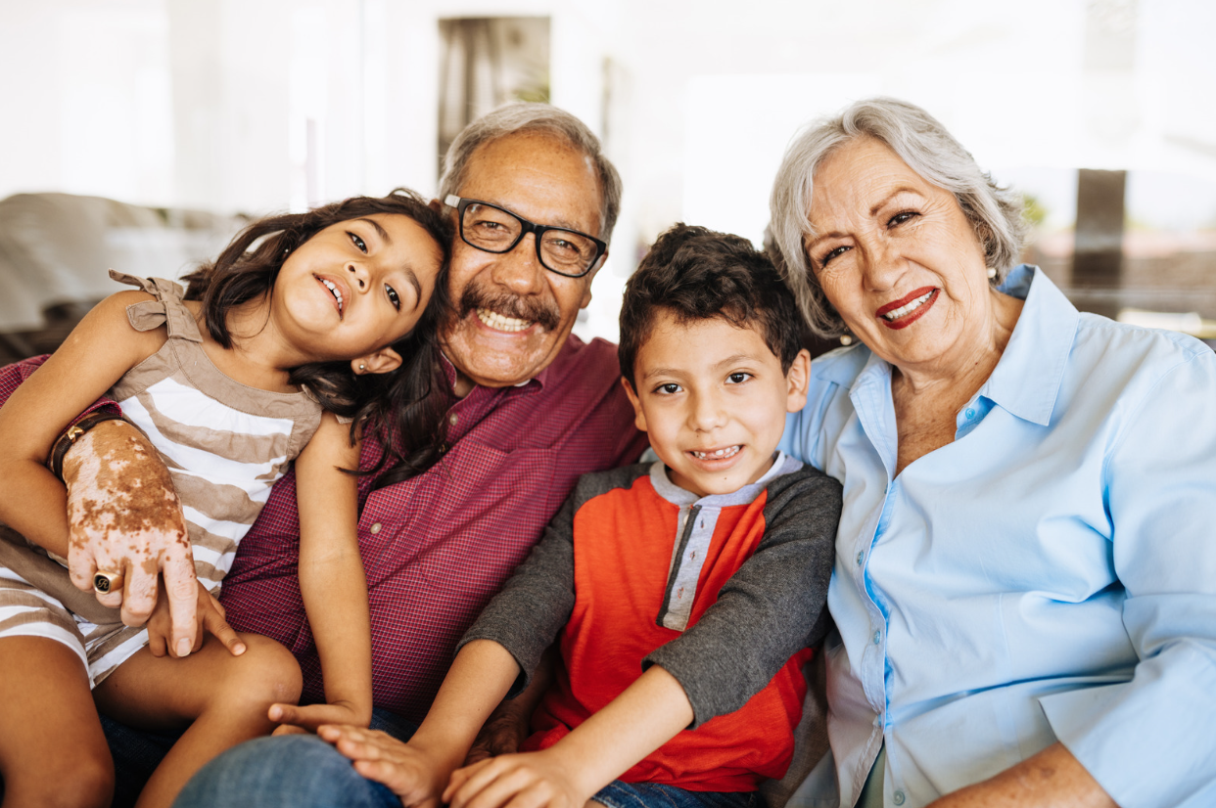
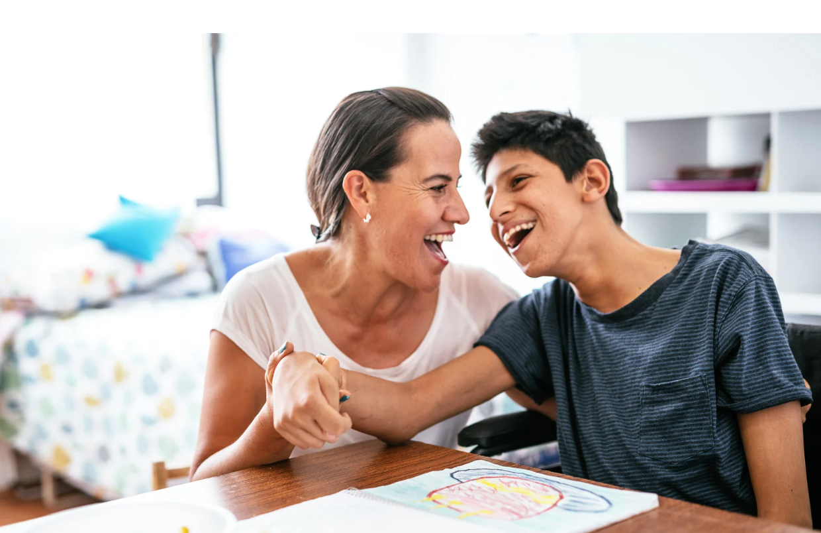
Happy Spanish Language Day!
The United Nations (UN) observes Spanish Language Day annually on 23 April.
The UN’s Department of Public Information established the event in 2010.
The UN established Spanish Language Day to “celebrate multilingualism and cultural diversity” and promote Spanish language inclusion.
R2 celebrates Spanish Language Day in support of health equity and access.
Engagement in language justice and support for Spanish-speaking members is a focus area for R2.
incrs
Notes:
Chef Alex
Happy Spanish Language Day!
The United Nations (UN) observes Spanish Language Day annually on 23 April.
The UN’s Department of Public Information established the event in 2010.
The UN established Spanish Language Day to “celebrate multilingualism and cultural diversity” and promote Spanish language inclusion.
R2 celebrates Spanish Language Day in support of health equity and access.
Engagement in language justice and support for Spanish-speaking members is a focus area for R2.

Slide 3
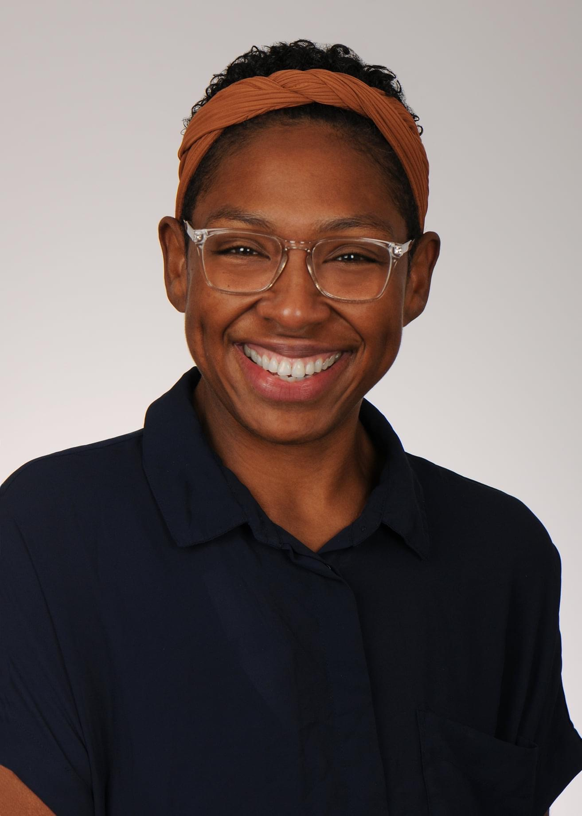
Lorin Jackson, MA, MI Executive Director, NNLM R2 Assistant Professor, MUSC Lorin Jackson leads as the Executive Director of the Region 2 Regional Medical Library (R2 RML), as part of the Network of the National Library of Medicine (NNLM), located at the Medical University of South Carolina (MUSC). Before her current position, she worked as the Research and Instruction Resident Librarian, Black Studies Librarian, and the interim Head of Access and User Services at Swarthmore College in Pennsylvania. Lorin earned a BA in Philosophy and Education from Haverford College, an MA in Philosophy and Religion from the California Institute of Integral Studies, and an MI in Library and Information Science from Rutgers University. She began her career in the non-profit and education sectors a decade ago. Since 2016, she’s worked in diverse library environments, including academic, public, special, and primary school libraries. Her research interests include trauma-informed librarianship and developing kind leadership practices in libraries.
Notes:
Chef Alex
Allow me to introduce your presenter for this session, Lorin Jackson.
Lorin Jackson leads as the Executive Director of the Region 2 Regional Medical Library (R2 RML), as part of the Network of the National Library of Medicine (NNLM), located at the Medical University of South Carolina (MUSC). Before her current position, she worked as the Research and Instruction Resident Librarian, Black Studies Librarian, and the interim Head of Access and User Services at Swarthmore College in Pennsylvania. Lorin earned a BA in Philosophy and Education from Haverford College, an MA in Philosophy and Religion from the California Institute of Integral Studies, and an MI in Library and Information Science from Rutgers University. She began her career in the non-profit and education sectors a decade ago. Since 2016, she’s worked in diverse library environments, including academic, public, special, and primary school libraries. Her research interests include trauma-informed librarianship and developing kind leadership practices in libraries.

Slide 4
Agenda Acknowledgments Welcome to the NNLM and Region 2! Today’s Events Education & Funding Opportunities with R2
Notes:
Lorin

Slide 5
Land Acknowledgement
Land acknowledgments are an honest and historically accurate way to recognize native communities. Presenting land acknowledgments recognizes histories that have been systematically erased.
The native peoples of this region include the Etiwan, Kiawah, Santee, Edisto, Nachez-Kusso, and Wassamassaw people.
The Region 2 RML recognizes the native communities of the land on which we live and work in Charleston, South Carolina. We commit to remaining mindful and to use our work to support the health and well-being of all people, including native communities.
Notes:
Lorin

Slide 6
Labor Acknowledgement
Labor acknowledgments recognize how historically, much of the substantial economic development in a geographic area or industry resulted from the unpaid labor and forced servitude of people of color, specifically people from Africa.
The R2 RML acknowledges that much of what we know of this country today was possible because of the labor of enslaved Africans, their descendants, immigrant workers, impoverished people, domestic workers, and others.
We commit to remaining mindful and to use our work to support the health and well-being of all people, including those whose labor has been historically exploited.
Notes:
Lorin

Slide 7
Community Agreements
Take care of yourself
No one knows everything/Together we know a lot
Make Space/Take Space
One mic/One voice
Understand the difference between impact and intent
Respect confidentiality
Be curious and respectful
Adapted from GLSEN Guidelines from Respectful GSA Spaces
https://www.glsen.org/activity/guidelines-respectful-gsa-spaces
Notes:
Lorin

Slide 8
National Library of Medicine
World’s largest biomedical library
National Institutes of Health
Nation’s research agency
27 institutes and offices
NIH
NLM
Network of the National
Library of Medicine
Program of the NLM comprised of 7 Regional Libraries (RMLs) and 3 offices
NNLM
Region 2
Notes:
Lorin

Slide 9
NNLM Initiatives 2021 - 2026
Confronting Health Misinformation
Bridging the Digital Divide
Environmental Determinants of Health
Notes:
Lorin

Slide 10
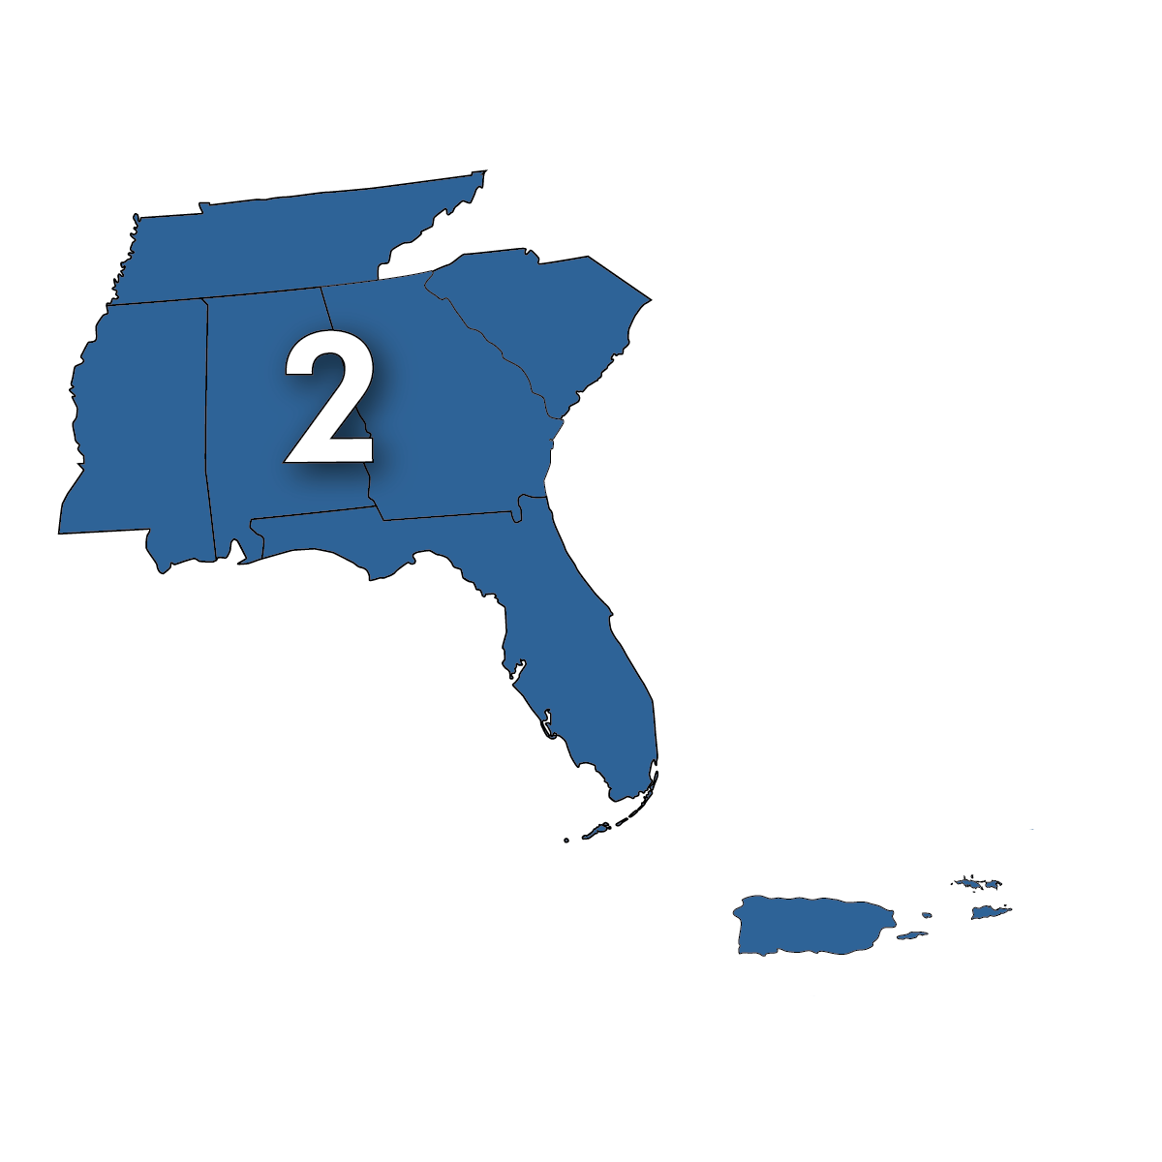
NNLM Region 2 ​
Alabama​ Florida​
Georgia​
Mississippi​
Commonwealth of Puerto Rico​
South Carolina​*
Tennessee​
US Virgin Islands
Notes:
Lorin

Slide 11
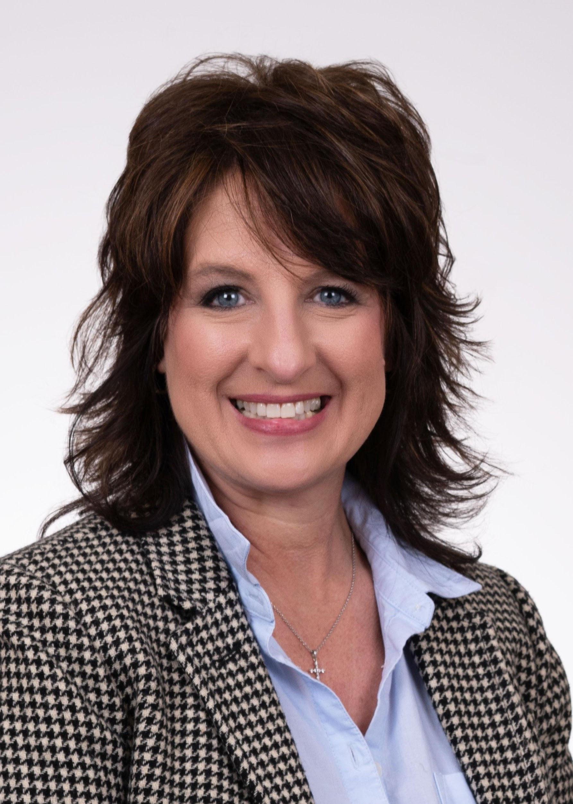
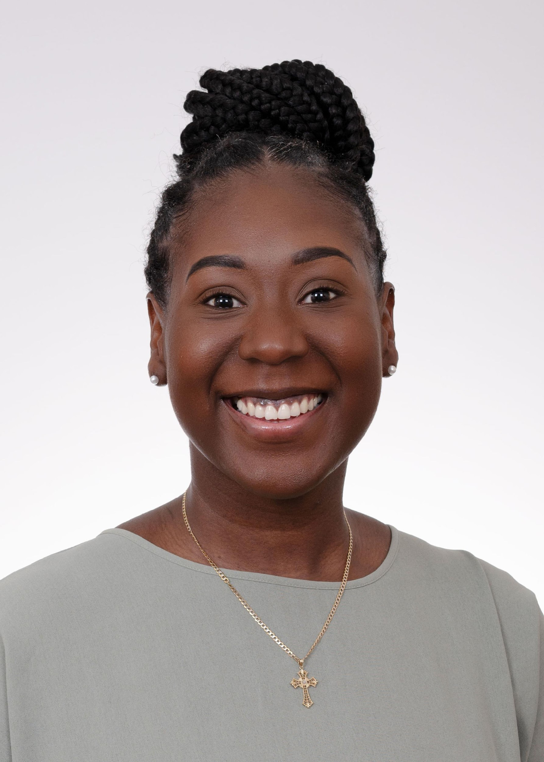
Administrative Team
Angela Hayes (she/her)
Grants Administrator II
Alabama & Mississippi
Fionia Washington, MBA (she/her)
Program Coordinator II
Tennessee
Lorin Jackson, MA, MI (she/they)
Executive Director
Commonwealth of Puerto Rico & U.S. Virgin Islands
Notes:
Lorin

Slide 12
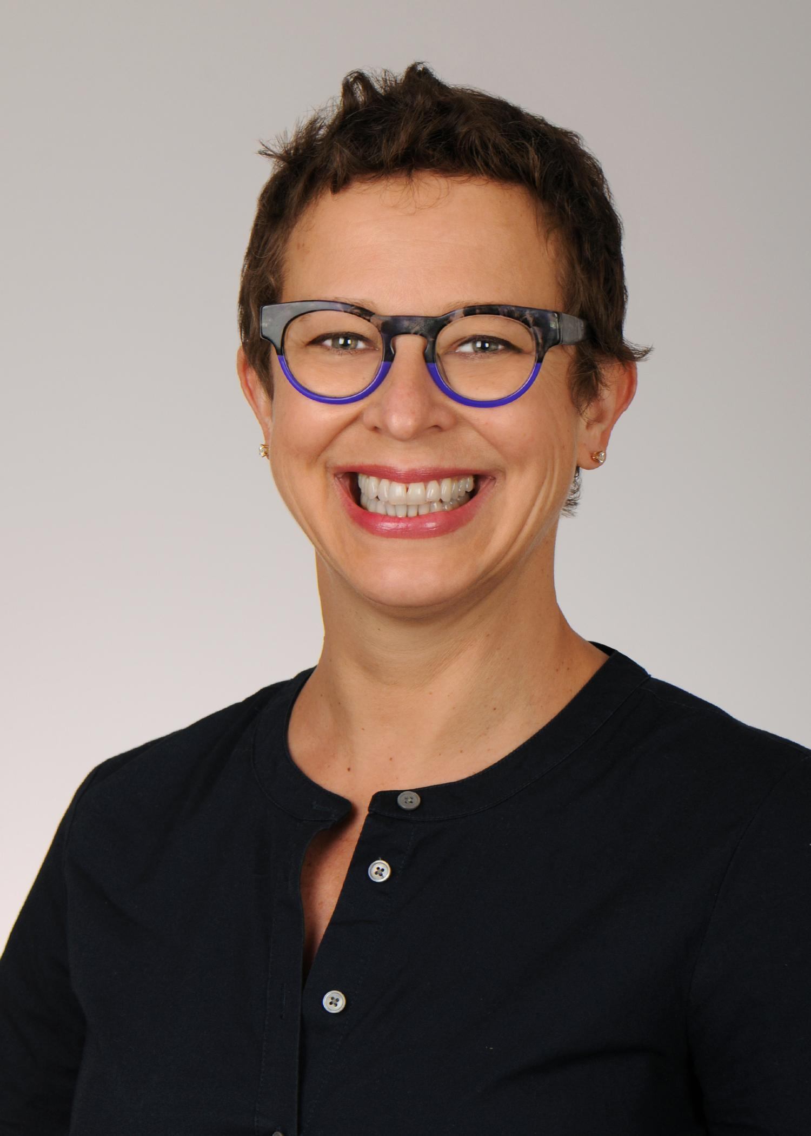
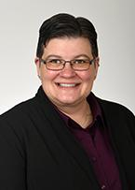
Strategist Team​
Sarah Fischer, MA (she/her)
Community Engagement and Outreach Strategist
Florida​
Debra Trogdon-Livingston, MLS (she/they)
User Experience and Education Strategist
Georgia & South Carolina
Notes:
Lorin

Slide 13
Today’s Events
Time | Session
12:00 – 12:30 PM ET | NNLM & R2 Welcome Lorin Jackson, NNLM Region 2
12:30 – 1:00 PM ET | MedlinePlus en Español Overview Javier Chavez, Health Information Program, U.S. National Library of Medicine
1:00 – 2:00 PM ET | Spanish for Library Staff: Bringing Language Access to Your Library Caroline Smith, South Carolina State Library
2:00 – 3:00 PM ET | Tatas Tales/Los Cuentos de las Tatas: The Intersection of Poetry, Transformative Writing, and Drama in Bilingual Communities Irania Patterson, The Literary Arts in Bilingual Communities, Criss Cross Mangosauce, and Beth Murray, University of North Carolina at Charlotte
3:00 – 4:00 PM ET | Evaluación en Español: consejos prácticos para elaborar planes de evaluación de proyectos Verónica Hoyo, Centro Nacional de Evaluación (NEC, por sus siglas en inglés)
Notes:
Lorin
We began planning this last fall, and we’re so glad to have so many people participating today. We have representation from different parts of our region and beyond. This project has been data-informed. We’ve heard feedback that our members want more Spanish language onput and we’ve worked together to provide live translation, thoughtful health programming, and resources to all.

Slide 14
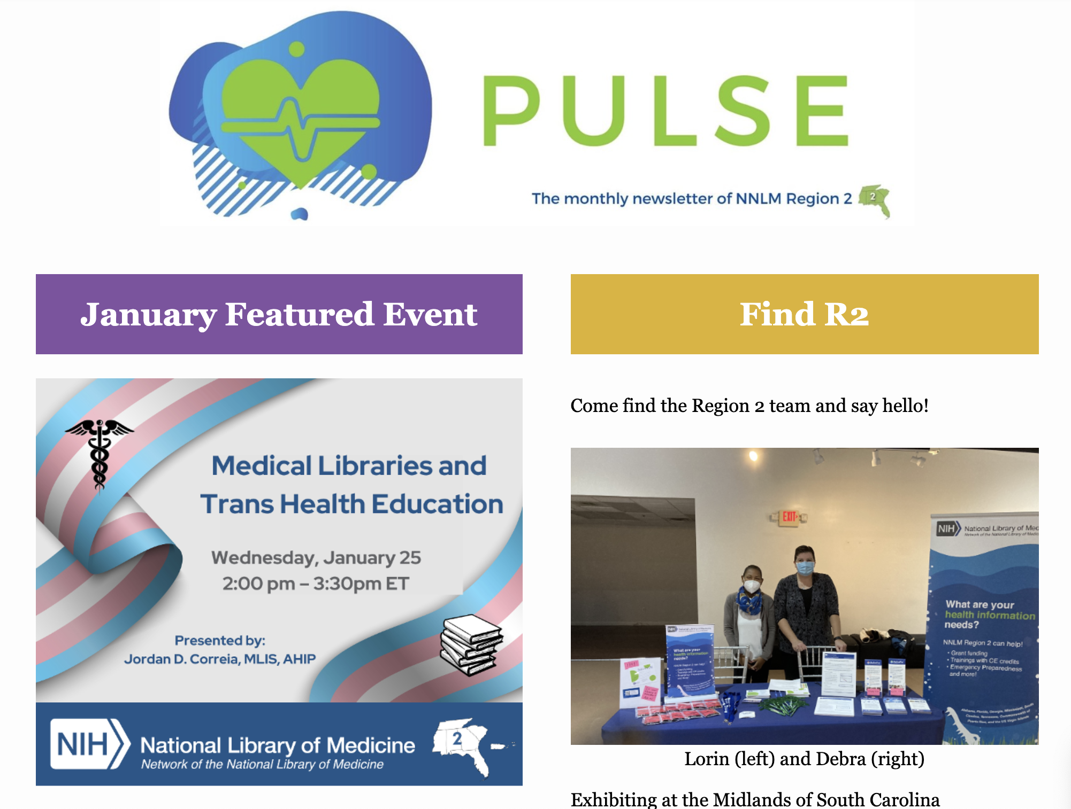
Membership Benefits
Become a member, for FREE.
https://nnlm.gov/user/join
Individual accounts & organizational membership
When becoming a member, assign yourself to an organization like work/employer institution, professional association (GHSLA)
Region 2 monthly newsletter and blog, emergency communications
Notes:
Lorin

Slide 15
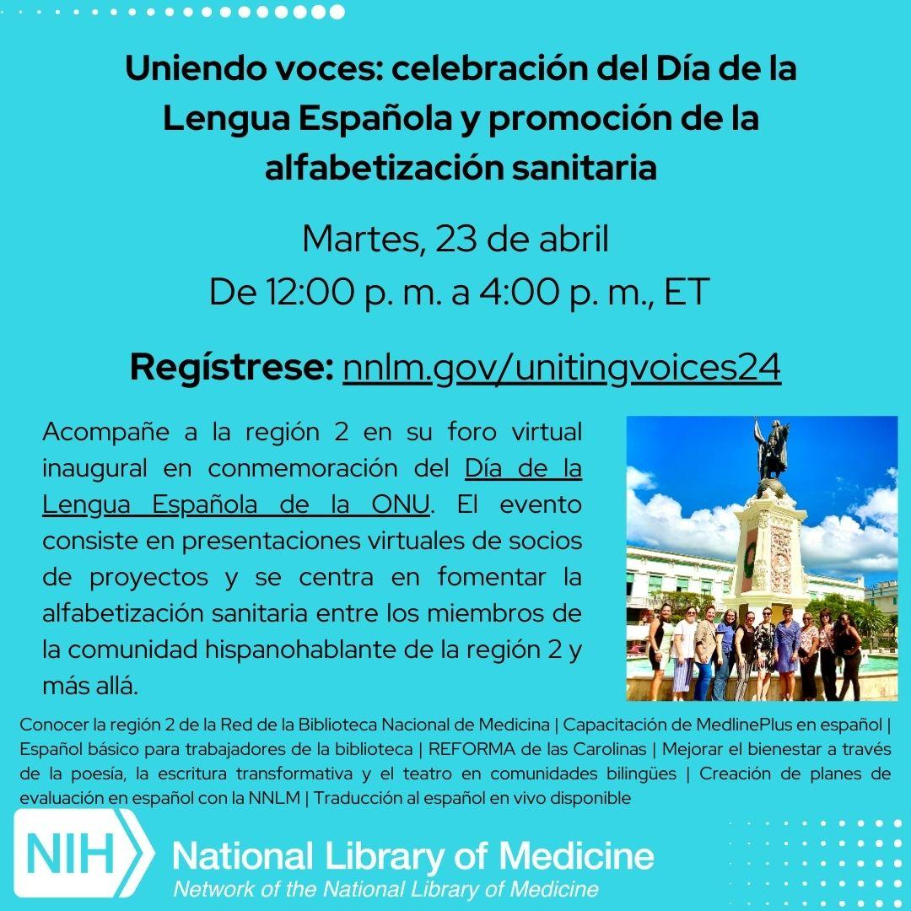
Education and Training
https://www.nnlm.gov/training
Notes:
Lorin

Slide 16
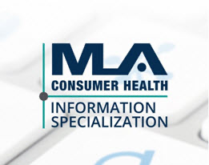
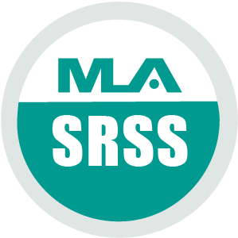
Specializations
Programs are offered by the Medical Library Association (MLA)
Class formats: live webinars, on-demand/online/recorded
NNLM sponsors the application fees
Consumer Health Information Specialization (CHIS)
Provide health information, resources, technology and services for communities
Data Services Specialization (DSS)
Quality data services, data management and support for researchers,
clinicians, students, librarians, public
Systematic Review Services Specialization (SRSS)
Provide systematic review services, serve on systematic review teams, advanced literature searching skills
https://nnlm.gov/guides/specialization
Notes:
Lorin

Slide 17
Grant Funding
Y4 Funding Cycle: May 1, 2024 – April 30, 2025
Applications are open! https://nnlm.gov/funding
Due May 17, 2024, 11:59 PM ET
Please remember you must be an NNLM member to apply (https://www.nnlm.gov/membership/join)
Award Categories
Health Information Outreach Award
Professional Development Award
Exhibit Award
Emergency Preparedness and Response Award
Innovation Impact Award
Library Student Development Award
*Proposal writing toolkit:
https://www.nnlm.gov/guides/nnlm-proposal-writing-toolkit
Notes:
Lorin
YouTube information recording: https://youtu.be/H7hoecLeAK8?si=m7_fDuWboQEgz9gA

Slide 18
Priority Populations: Language Justice
Partnership with REFORMA de Las Carolinas
Uniting Voices Webinar on April 23, 2024
Puerto Rico Outreach
Southeast Spotlight: A Love Letter to Puerto Rico https://news.nnlm.gov/region-2/2024/01/31/a-love-letter-to-puerto-rico/

Slide 19
NLM & NNLM Spanish Language Resources
MedlinePlus en Español: MedlinePlus - Información de Salud de la Biblioteca Nacional de Medicina
Resources for Public Libraries: https://www.nnlm.gov/public-libraries/resources-for-public-libraries (Health Information in multiple languages tab)
Recursos en Español (YouTube): https://www.youtube.com/playlist?list=PLUlRqrjIldD7OnJ3oCdL-k9y6iQSMKYnv

Slide 20
Let's Connect!
Find us on Facebook & LinkedIn @nnlmregion2
Region2@nnlm.gov
Notes:
Lorin

Slide 21
Thank You! 💐👏🏽
Presenters | Volunteers | Partners
Javier Chavez Caroline Smith Irania Patterson Beth Murray Verónica Hoyo | Chef Alex Askew Debra Trogdon-Livingston Gail Kouame Rossana Barrios-Llorens Pedro-Antonio Del-Valle Mary Ellen Sloane Tracy Englert Frank Fajardo NNLM Region 2 Regional Advisory Board | MasterWord NNLM Region 2
Notes:
Lorin for thank you’s on this slide.
Then, Chef Alex will close this session and introduce the next session: “Up next, we have the 30-minute MedlinePlus en Español Overview session with host Debra Trogdon-Livingston and presenter Javier Chavez.”

